Slide 1
Welcome
PLAY

Slide 2
You LOST ☹
Go Back To Level Selector

Slide 3
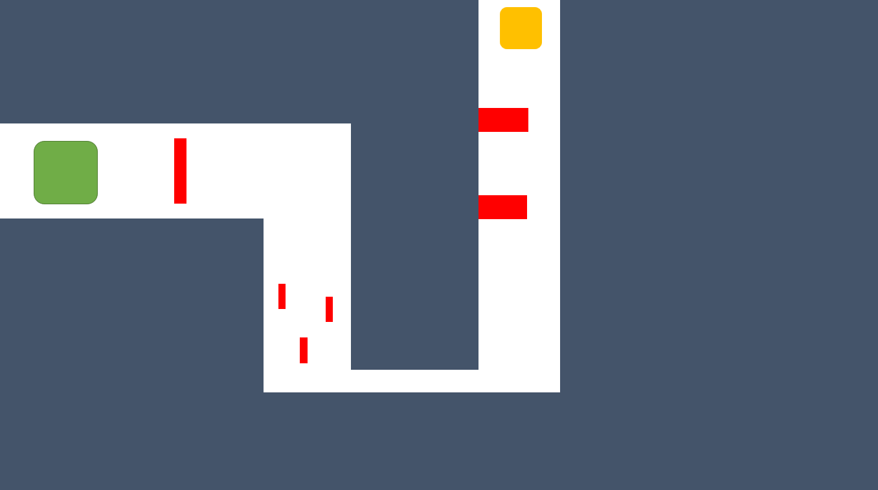
Level Selector
Level 1

Slide 6
4 maze levels
4th level unlocks break the wall where you have to break blocks to unlock the secret area to click in level 3
That area unlocks a lucky block level where you have to select the right block
Upon doing that you will gain access to a mouse accuracy game where winning will rickroll you .
You will have to find the secret path in level 2 which will take you to a puzzle like thing where you will have to search for a relic thing which you will have to place In a hidden door in level 4
Then the door will reveal a conversation of riddles which will unlock a secret area in level one
The you will have to solve an mcq quiz and then get something

