Slide 1
Customer Segmentation Using Spark ALS Algorithm A different way of segmenting customers based on customer ratings
Hackon Day Project
Sept 9, 2017
Jane Q. Zhang

Slide 2
Recommendation systems (1)
Recommendation systems have various applications. Following are some examples:
Amazon (E-commerce)
Netflix (Media, Video, DVD)
MovieLens (Movie)
Hacker News (News)

Slide 3
Recommendation systems (2)
The idea of recommendation is to help users find the product they would like or help companies advertise products.
A frequently used method is predicting ratings based on ratings which were explicitly collected from users’ previous interactions.
Different system uses different algorithm for predicting how much a user will like an item in the system and then make recommendation based on the predicted scores for the particular user.
Notes:
re

Slide 4
Customer segmentation
Customer segmentation helps companies move from massive marketing to more targeted marketing, which results in improvement of business performance [1].
This project is to explore a way of using collaborative filtering based recommendation algorithm to segment customers.
First, product is recommended to each user;
Then customers are segmented, based on predicted ratings for each user. It finds users who have top predicted ratings for a particular item.

Slide 5
Implementation(1)
One of the challenges for recommender algorithms is the computational feasibility for large dimensional matrix computation.
Principle component analysis, Matrix factorization are some of the algorithms for resolving large dimensional matrix computational problems.
Among them, ALS (Alternative Least Square) is a matrix factorization algorithm. It won a Netflix competition [3]. Spark implementation allows it to execute in parallel.

Slide 6
Implementation (2)
Data set: Amazon 5-core automotive dataset collected by Julian McAuley, UCSD
Since the rating is highly skewed toward 5, the ratings were adjusted by helpfulness and timestamp and then scaled
ALS algorithm was applied to the adjusted ratings
Rank parameter was tuned
RMSE from baseline 0.934 to 0.776 from rank tuning with 15 max-iteration. Rating adjustment didn’t adjust to expected result. Further tuning and reformulation will be necessary.

Slide 7
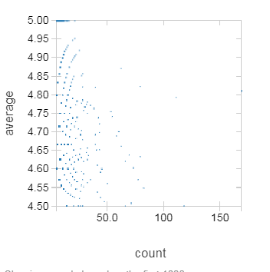
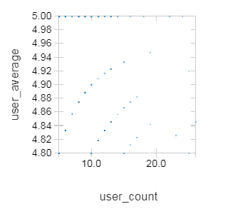
Rating diagram (average rating for product and user)

Slide 8
“helpfulness”-Adjusted Ratings
For example, a “helpfulness” score of 2/3:
2 out of 3 people found the rating and review helpful
Assumption: “helpfulness” reflects how other users feel about the rating and can indicate the reliability of a rating. In above example, not all users agree with the rating/review.
A formula was used to evaluate the effectiveness of the adjustment. Two parameters can be tuned in the formula:
- Adjustment factor
- Minimum helpful vote

Slide 9
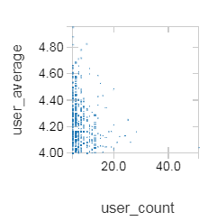
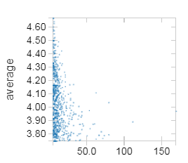
After helpful adjustment (average rating on product and user

Slide 10
Rating adjusted by timestamp
Assumption: More recent ratings more accurately reflect current product quality and user preference.
The Hacker News formula was applied here:
Score = (P-1) / (T+2)^G
where
P = points of an item (and -1 is to negate submitter’s vote)
T = time since submission (in hours)
G = Gravity, defaults to 1.8

Slide 11
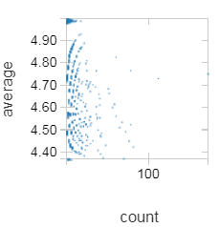
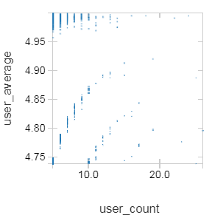
Time adjusted ratings (average ratings on product and user)
Notes:
Plot Options...

Slide 12
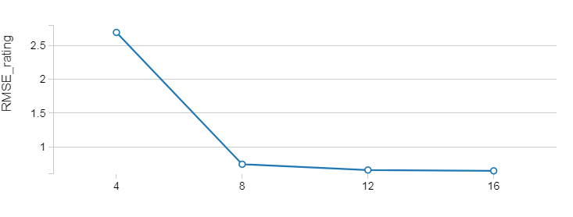
ALS rank tuning

Slide 13
Future Work
Adjust scores by length of review (assumption: longer reviews are more reliable)
Adjust based on number of reviews a user has given in the past (Assumption: more experienced users give more accurate assessments)
Other features such as review can be used

Slide 14
Reference
Customer segmentation based on a collaborative recommendation system: Application to a mass retail company
https://www.cs.umd.edu/~samir/498/Amazon-Recommendations.pdf
http://base.sjtu.edu.cn/~bjshen/2.pdf

Slide 15
Questions?

