Slide 1
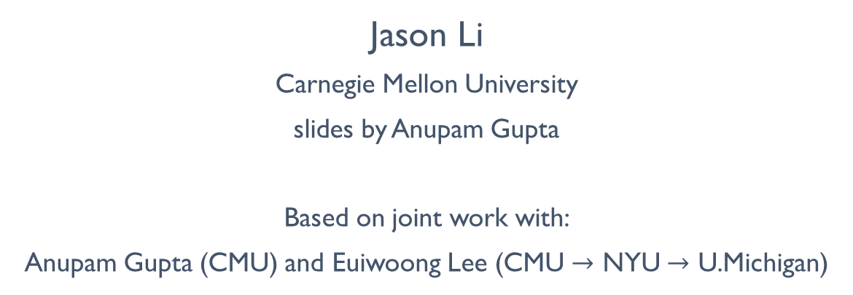
The Karger-Stein Algorithm is Optimal for k-cut
Jason Li
Carnegie Mellon University
slides by Anupam Gupta
Based on joint work with:
Anupam Gupta (CMU) and Euiwoong Lee (CMU $→$ NYU $→$ U.Michigan)

Slide 2
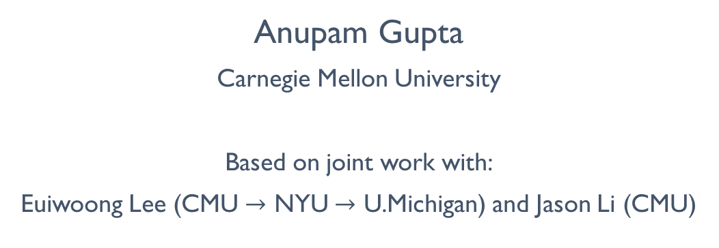
the k-cut problem: beating the Karger-Stein bound
Anupam Gupta
Carnegie Mellon University
Based on joint work with:
Euiwoong Lee (CMU $→$ NYU $→$ U.Michigan) and Jason Li (CMU)

Slide 3

the k-cut problem
Given graph G, delete minimum weight edges to cut graph into at least $k$ components.
Think of $k$ as a large constant.

Slide 4
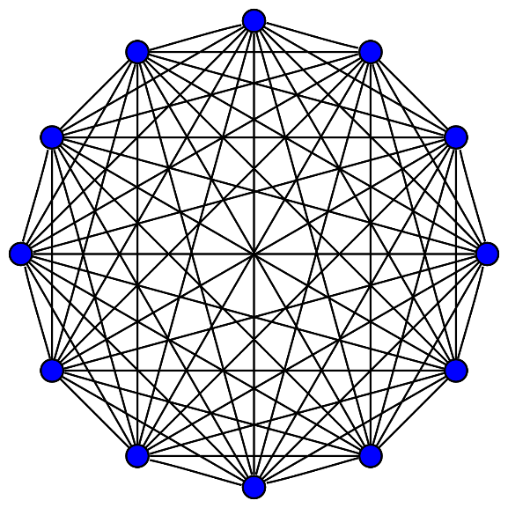

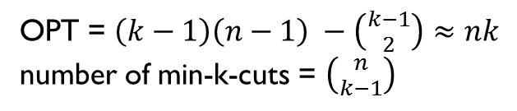
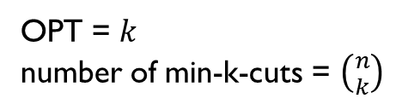
two examples
Cycle $C_{n}$
Complete graph $K_{n}$
OPT = $k$
number of min-k-cuts = $\left({n \atop k}\right)$
OPT = $\left(k−1\right)\left(n−1\right) −\left({k−1 \atop 2}\right)≈nk$
number of min-k-cuts = $\left({n \atop k−1}\right)$
Figure from Wikipedia: thanks Koko90!

Slide 5
k-cut
Given graph G, delete minimum weight edges to cut graph into at least k components.
Think of k as a large constant.
The main questions:
(computational bound) How fast can we compute k-cut?
(extremal bound) How many minimum k-cuts are there?

Slide 6
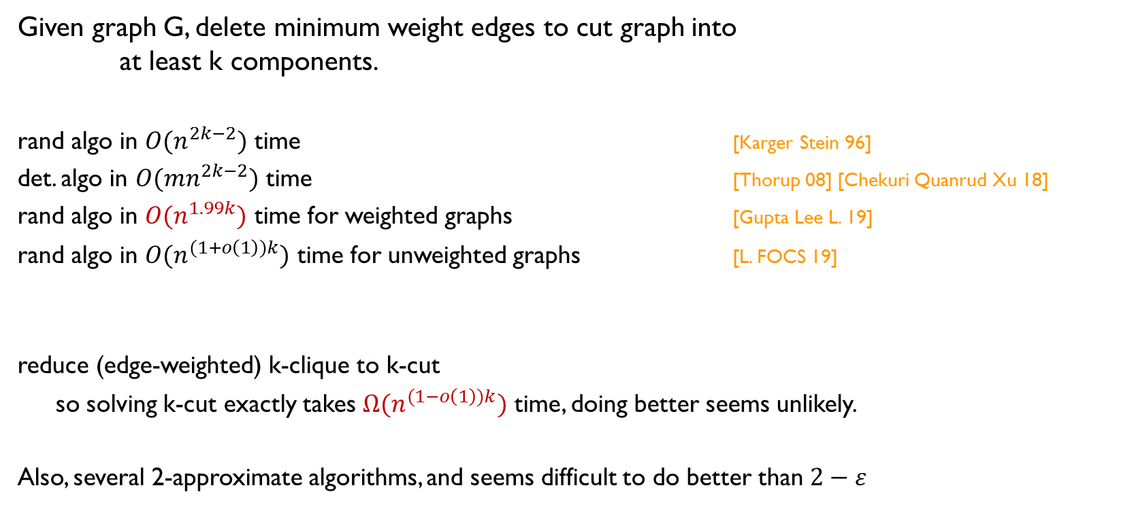
prior results
Given graph G, delete minimum weight edges to cut graph into at least k components.
rand algo in ${O(n}^{2k−2})$ time [Karger Stein 96]
det. algo in ${O(mn}^{2k−2})$ time [Thorup 08] [Chekuri Quanrud Xu 18]
rand algo in ${O(n}^{1.99k})$ time for weighted graphs [Gupta Lee L. 19]
rand algo in ${O(n}^{(1+o\left(1\right))k})$ time for unweighted graphs [L. FOCS 19]
reduce (edge-weighted) k-clique to k-cut
so solving k-cut exactly takes $Ω(n^{(1−o\left(1\right))k})$ time, doing better seems unlikely.
Also, several 2-approximate algorithms, and seems difficult to do better than $2−ε$

Slide 7
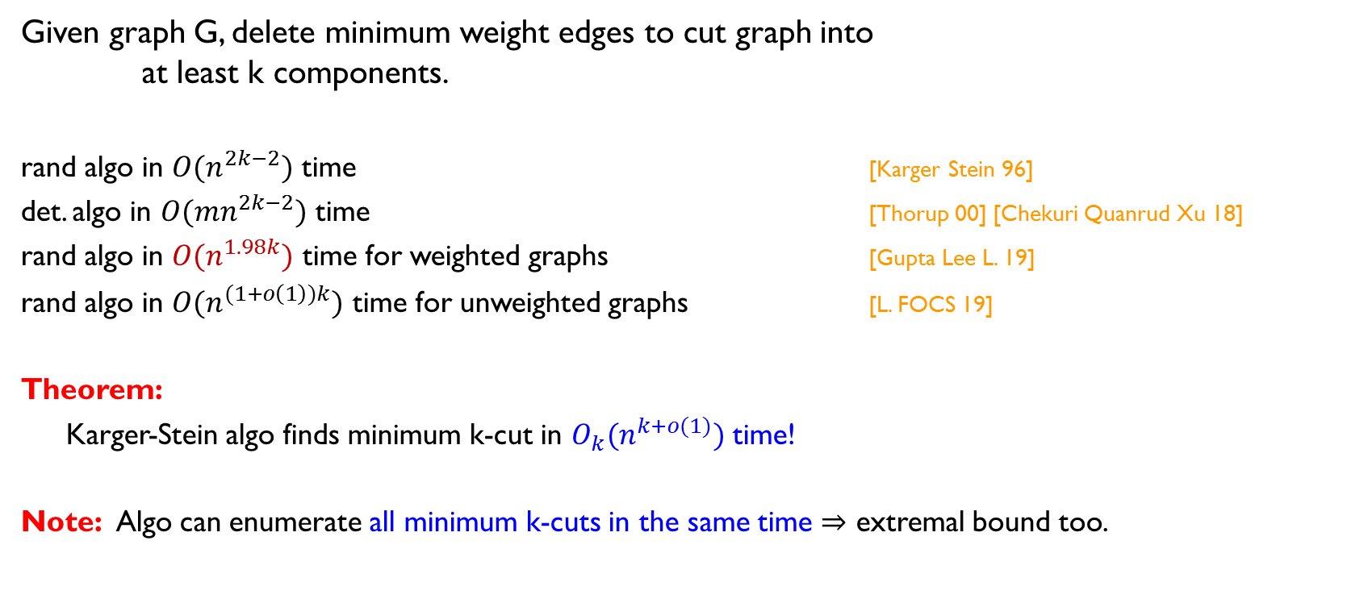
our results
Given graph G, delete minimum weight edges to cut graph into at least k components.
rand algo in ${O(n}^{2k−2})$ time [Karger Stein 96]
det. algo in ${O(mn}^{2k−2})$ time [Thorup 00] [Chekuri Quanrud Xu 18]
rand algo in ${O(n}^{1.98k})$ time for weighted graphs [Gupta Lee L. 19]
rand algo in ${O(n}^{(1+o\left(1\right))k})$ time for unweighted graphs [L. FOCS 19]
Theorem:
Karger-Stein algo finds minimum k-cut in ${O_{k}(n}^{k+o(1)})$ time!
Note: Algo can enumerate all minimum k-cuts in the same time $⇒$ extremal bound too.

Slide 8
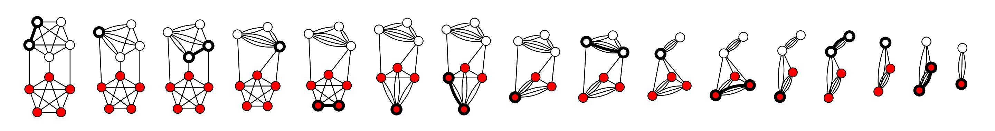

Karger’s algorithm for minimum cuts
Pick a random edge, and contract it. Stop when 2 vertices remain.
Theorem: finds the mincut w.p. at least $1/\left({n \atop 2}\right)$
Figure from Wikipedia: thanks Thore Husfeldt!

Slide 9


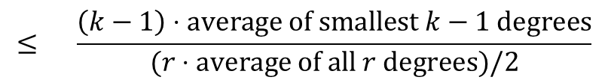

Karger-Stein algorithm for k-cuts
Pick a random edge, and contract it. Stop when $2k$ vertices remain.
Return a random partition of what remains.
Theorem: finds the mincut w.p. at least $2^{−2k}/\left({n \atop 2k}\right)$ $≈{O_{k}(n}^{−2\left(k−1\right)})$
Proof: when r vertices remain, probability to contract an edge in OPT is
Pr[OPT survives contraction] $≈ \prod{(1 −\frac{2\left(k−1\right)}{r}})≈exp⁡(−2\left(k−1\right)H_{n})$ $≈n^{−2(k−1)}$
$$\frac{OPT}{\text{\#}\text{edges}}$$
$$≤ \frac{\left(k−1\right)⋅average of smallest k−1 degrees}{(r⋅average of all r degrees)/2}$$
$$≤ \frac{2(k−1)}{r}$$

Slide 10
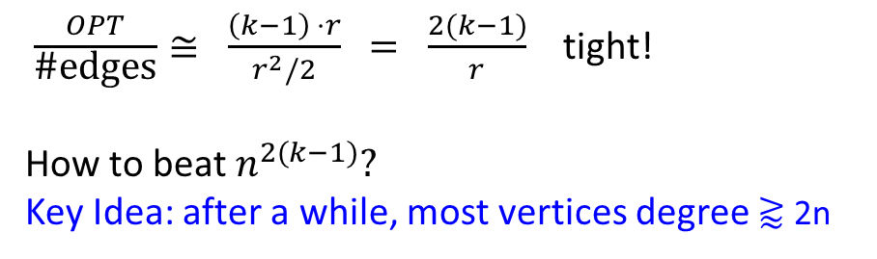


what about the two examples?
Cycle $C_{n}$
Complete graph $K_{n}$
$\frac{OPT}{\text{\#}\text{edges}}= \frac{k}{r}$ $≪ \frac{2(k−1)}{r}$ => $n^{k}$ time
$\frac{OPT}{\text{\#}\text{edges}}≅ \frac{\left(k−1\right) ⋅r}{r^{2}/2}$ $= \frac{2(k−1)}{r}$ tight!
How to beat $n^{2(k−1)}?$
Key Idea: after a while, most vertices degree ⪆ 2n

Slide 11
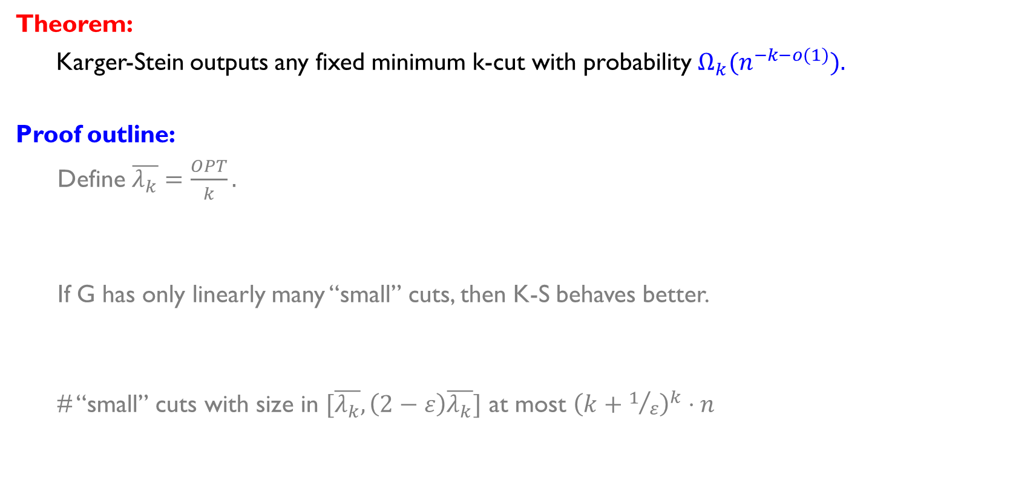
theorem and proof idea
Theorem:
Karger-Stein outputs any fixed minimum k-cut with probability ${Ω_{k}(n}^{−k−o(1)}).$
Proof outline:
Define $\overline{λ_{k}}=\frac{OPT}{k}.$
If G has only linearly many “small” cuts, then K-S behaves better.
# “small” cuts with size in $[\overline{λ_{k}}, \left(2−ε\right)\overline{λ_{k}}]$ at most ${\left(k+1/ε\right)}^{k}⋅n$
refined analysis of the Karger-Stein randomized algorithm
connection of cuts in graphs to extremal results about set systems

Slide 12

a continuous view
Imagine each edge has exponential clock with rate $1/\overline{λ_{k}}$
I.e., fires independently w.p. $δ/\overline{λ_{k}}$ in any infinitesimal interval $δ$
When an edge fires, contract it.
Claim: the edges are contracted in random order (so we’re running K-S).
But now events in each $δ$ timestep are independent
(and more than one event happens with essentially zero probability as $δ→0$).

Slide 13

a continuous view
Imagine each edge has exponential clock with rate $1/\overline{λ_{k}}$
I.e., fires independently w.p. $δ/\overline{λ_{k}}$ in any infinitesimal interval $δ$
When an edge fires, contract it.
If $r$ vertices remain at any time
have at least $r \overline{λ_{k}}/2$ edges in the graph
contract at least $δ/\overline{λ_{k}}$ $⋅$ $r \overline{λ_{k}}/2$ $= rδ/2$ edges in expectation
if $δ →0$, this is like contracting $rδ/2$ vertices (no cycles contracted)
so $r$ decreases by at least $(1−δ/2)$ factor in $δ$ time
Fact $1$: after $t$ time, expected number of vertices is at most $n{\left(1−δ/2\right)}^{t/δ}=ne^{−t/2}$

Slide 14

a continuous view
Imagine each edge has exponential clock with rate $1/\overline{λ_{k}}$
I.e., fires independently w.p. $δ/\overline{λ_{k}}$ in any infinitesimal interval $δ$
When an edge fires, contract it.
Fact $1$: after $t$ time, expected number of vertices is at most $ne^{−t/2}$.
So we stop at time at most $t^{⋆}= 2\ln{n}$.
Fact 2: a fixed min-k-cut survives for $t$ time w.p. ${\left(1−k\overline{λ_{k}}⋅δ/\overline{λ_{k}}\right)}^{t/δ}=e^{−kt}$.
This is $n^{−2k}$ at time $t^{⋆}$.
Essentially the K-S analysis: any min-cut survives w.p. $n^{−2k}$ when down to $O(k)$ vertices.

Slide 15

a continuous view
Imagine each edge has exponential clock with rate $1/\overline{λ_{k}}$
I.e., fires independently w.p. $δ/\overline{λ_{k}}$ in any infinitesimal interval $δ$
When an edge fires, contract it.
Suppose only $O(n)$ “small” cuts of size in $[\overline{λ_{k}}, \left(2−ε\right)\overline{λ_{k}}]$. (clique: small cuts = singletons)
Fact 3: Pr[cut of size at least $\overline{λ_{k}}$survives at time $t$ ] = ${\left(1−\overline{λ_{k}}⋅δ/\overline{λ_{k}}\right)}^{t/δ}=e^{−t}$.
So these linear number of small cuts die out by $t^{⋆⋆}=\ln{n}+O(1)$.
Fact 4: At most $k−1$ vertices with degrees less than $\overline{λ_{k}}$.

Slide 16

gives a weaker bound
Suppose only $O(n)$ “small” cuts of size in $[\overline{λ_{k}}, \left(2−ε\right)\overline{λ_{k}}]$.
Fact 3: these small cuts die out by $t^{⋆⋆}=\ln{n}+O(1)$.
Fact 4: At most $k−1$ vertices with degrees less than $\overline{λ_{k}}$.
Fact $1$: after $t$ time, expected number of vertices is at most $ne^{−t/2}$.
Hence, at time $t^{⋆⋆}$ most remaining vertices have degree $>\left(2−ε\right)\overline{λ_{k}}$
So shrink from $\sqrt{n}$ down to $1$at much faster rate ($≈\sqrt{n}e^{−t}$ instead of $\sqrt{n}e^{−t/2}$)
This shows we stop at $≈1.5\ln{n}$.
Hence ${e^{k(1.5\ln{n)}}=n}^{−1.5k}$ probability of the min-cut surviving.

Slide 17

to go all the way…
To get $n^{−k}$, we need two final things (we’ll skip today):
Differential equation tracking number of remaining vertices.
Concentration-of-measure to prove we stay close to this ideal trajectory.

Slide 18
remember, the approach
Theorem:
Karger-Stein outputs any fixed minimum k-cut with probability ${Ω_{k}(n}^{−k−o(1)}).$
Proof outline:
Define $\overline{λ_{k}}=\frac{OPT}{k}.$
If G has only linearly many “small” cuts, then K-S behaves better.
# “small” cuts with size in $[\overline{λ_{k}}, \left(2−ε\right)\overline{λ_{k}}]$ at most ${\left(k+1/ε\right)}^{k}⋅n$
refined analysis of the Karger-Stein randomized algorithm
connection of cuts in graphs to extremal results about set systems

Slide 19
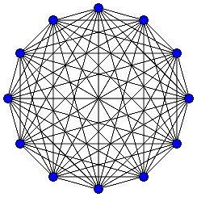

the extremal bound
Theorem:
There are at most ${O\left(\frac{1}{ε}+k\right)}^{k}n$ many cuts of size at most $\left(2−ε\right){ \overline{λ}}_{k}$.
Sanity checks:
For $C_{n}$: ${\overline{λ}}_{k}=1,$ so zero small cuts.
For $K_{n}$: ${\overline{λ}}_{k}≈n−1,$ so $n$ small cuts.

Slide 20


proof idea $1$: intersection lemmas
Idea #1: $k/2$ cuts of size $≤\left(2−ε\right){ \overline{λ}}_{k}$ intersecting must give < $k$ occupied regions,
else get k-cut of value $<{ k \overline{λ}}_{k}$ $= OPT$.

Slide 21


proof idea $2$: sunflower lemmas
[Erdos and Rado]: at least $d!r^{d}$ sets of size $d$ $⇒$ sunflower with $r$ petals
Corollary: at least $n⋅d!r^{d}$ sets of size $d$ $⇒$ sunflower w/ $r$ petals and nonempty core
core
petals (disjoint)

Slide 22

how to use the sunflowers
Assume: no cuts in the graph of size smaller than${ \overline{λ}}_{k}$
Consider sets S such that boundary of size $≤\left(2−ε\right){ \overline{λ}}_{k}$
Idea #2: cannot have sunflower with non-empty core and $2/ε$ petals
If these sets S are small (with at most $C$ vertices) $⇒n O{\left(C/ε\right)}^{C}$ bound.
But $C$ could be large!

Slide 23
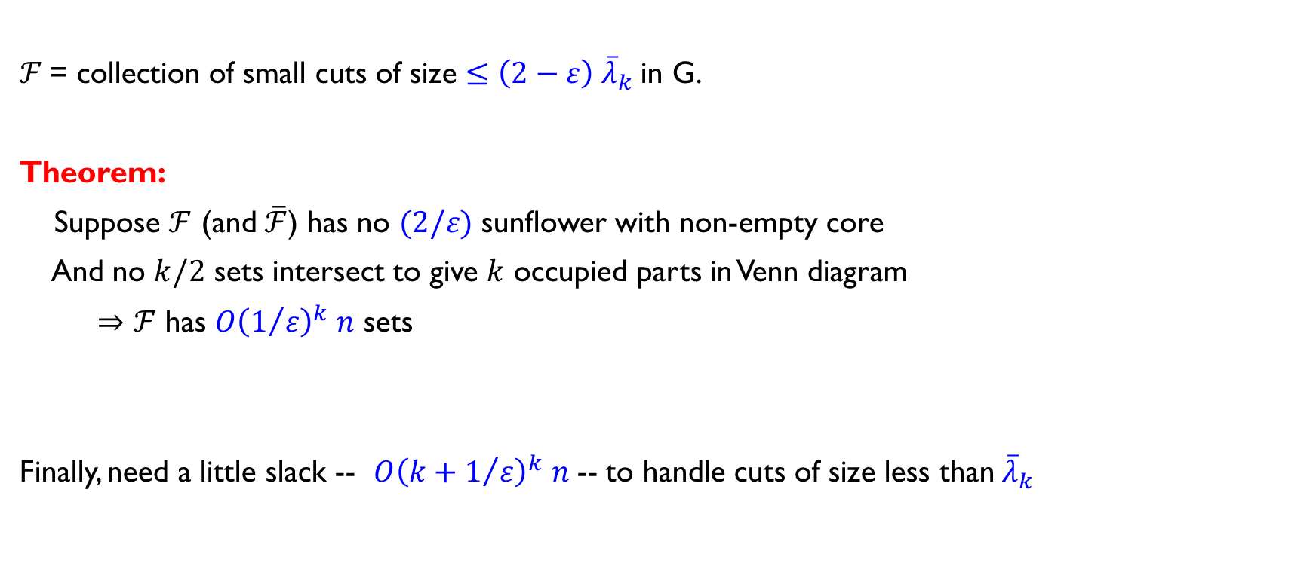
combine the two ideas
$ℱ$= collection of small cuts of size $≤\left(2−ε\right){ \overline{λ}}_{k}$in G.
Theorem:
Suppose $ℱ$ (and $\overline{ℱ}$) has no $(2/ε)$ sunflower with non-empty core
And no $k/2$ sets intersect to give $k$ occupied parts in Venn diagram
$⇒$ $ℱ$ has $O{\left(1/ε\right)}^{k} n$ sets
Finally, need a little slack -- $O{\left(k+1/ε\right)}^{k} n$ -- to handle cuts of size less than${ \overline{λ}}_{k}$

Slide 24
those were the two parts…
Theorem:
Karger-Stein outputs any fixed minimum k-cut with probability ${Ω_{k}(n}^{−k−o(1)}).$
Proof outline:
Define $\overline{λ_{k}}=\frac{OPT}{k}.$
If G has only linearly many “small” cuts, then K-S behaves better.
# “small” cuts with size in $[\overline{λ_{k}}, \left(2−ε\right)\overline{λ_{k}}]$ at most ${\left(k+1/ε\right)}^{k}⋅n$
refined analysis of the Karger-Stein randomized algorithm
connection of cuts in graphs to extremal results about set systems

Slide 25

in summary…
Theorem: Both the combinatorial and algorithmic bounds of $n^{k+o(1)}$
Open questions:
Get a tight bound of $\left({n \atop k}\right)$ on the number of min-k-cuts?
Get $1+ε$ approximation in time $f\left(k,ε\right) n^{O(1)}$?
Get a deterministic algorithm that matches this $n^{k}$ bound?

