Slide 1
Let’ Sudoku
Group Leader: Tian Tong
Member : Zhiqiang Weng

Slide 2
What is it?
Simple Sudoku game
With two level difficulties
Normal(25 hint)
Hard (20 hint)

Slide 3
Elements included
Session
Form
Timer
Function
Array
Loops

Slide 4
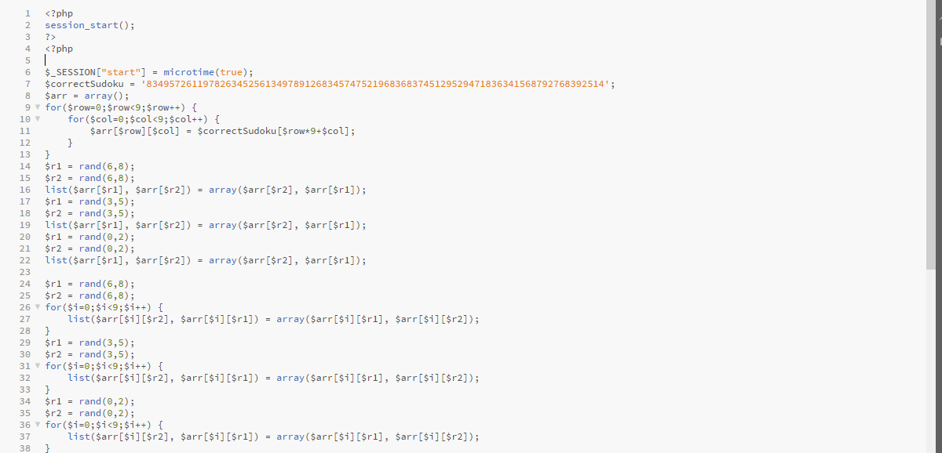

Slide 5
