Slide 1
Introduction to GPOPS
A General-Purpose MATLAB Toolbox for Solving
Optimal Control Problems Using the
Radau Pseudospectral Method

Slide 2
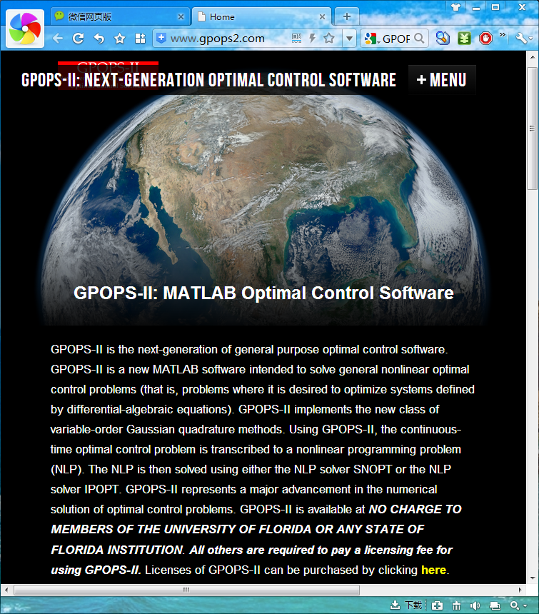

Slide 3
GPOPS-II MATLAB Optimal Control Software
GPOPS-II is a new MATLAB software intended to solve general nonlinear optimal control problems.
GPOPS-II implements the new class of variable-order Gaussian quadrature methods.
Using GPOPS-II, the continuous-time optimal control problem is transcribed to a nonlinear programming problem (NLP). The NLP is then solved using either the NLP solver SNOPT or IPOPT.
GPOPS-II represents a major advancement in the numerical solution of optimal control problems.
GPOPS-II is available at NO CHARGE TO MEMBERS OF THE UNIVERSITY OF FLORIDA OR ANY STATE OF FLORIDA INSTITUTION.
All others are required to pay a licensing fee for using GPOPS-II. Licenses of GPOPS-II can be purchased by clicking here.

Slide 4
Features of GPOPS-II
Allows for an extremely general formulation of the optimal control problem.
Allows for inclusion of integral constraints and highly general boundary conditions.
Complete first and second sparse finite-differencing of optimal control problem to compute all derivatives required by the NLP solver.
The latest advances in mesh refinement including hp-adaptive pseudospectral methods.
Gaussian quadrature integration methods for rapid convergence.
Highly accurate costate estimation.
Inclusion of the NLP solver IPOPT.
Interface for NLP solver SNOPT included (but SNOPT itself is only provided to University of Florida or State of Florida users)
No third-party products other than MATLAB are required.

Slide 5
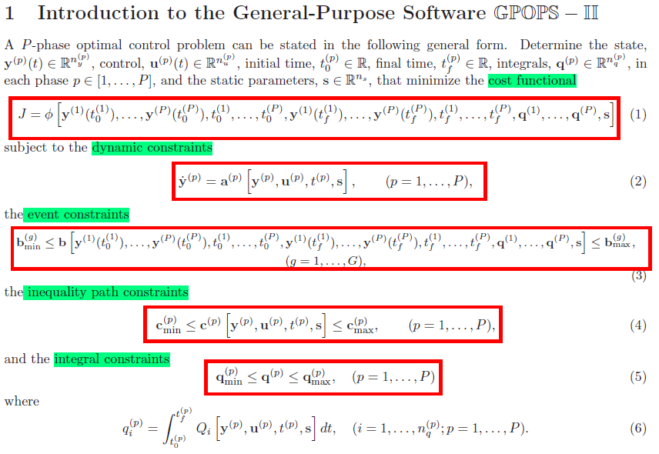
1. Introduction to GPOPS

Slide 6
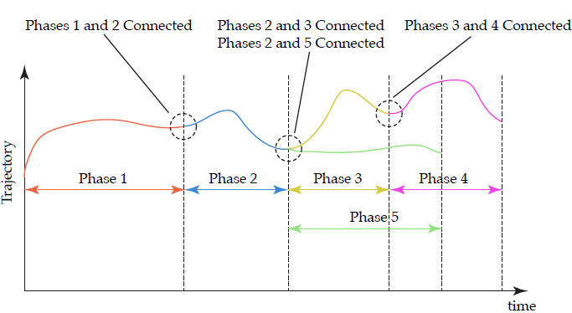

Slide 7
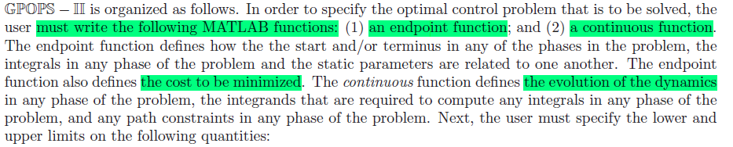
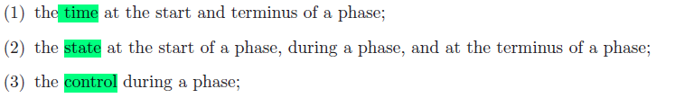
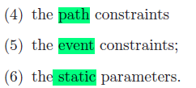
Basic Functions

Slide 8
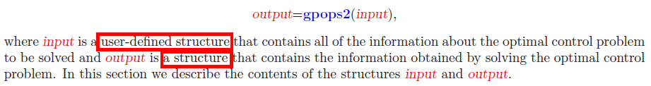
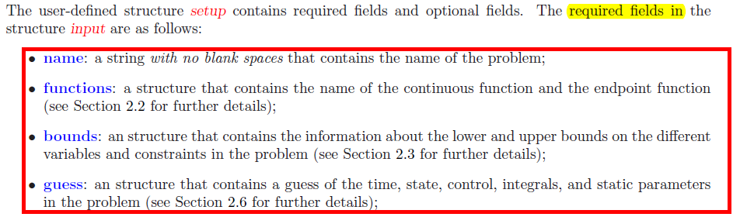
2 Constructing an Optimal Control Problem

Slide 9
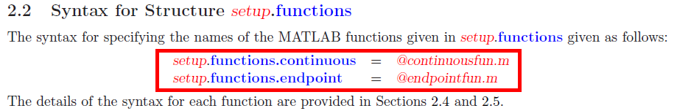







Slide 10
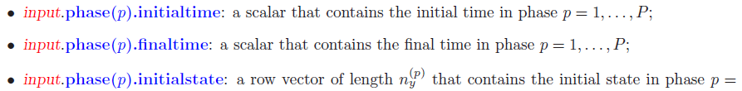

Slide 11
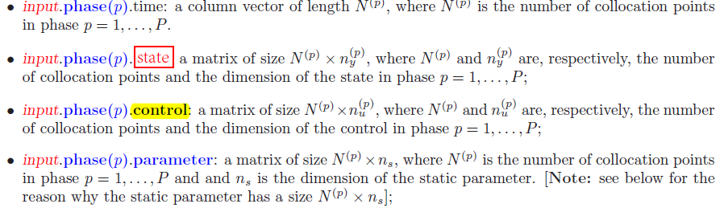
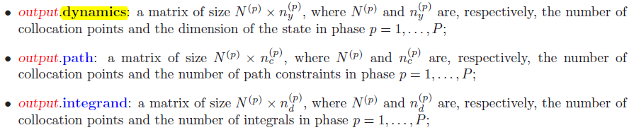

Slide 12
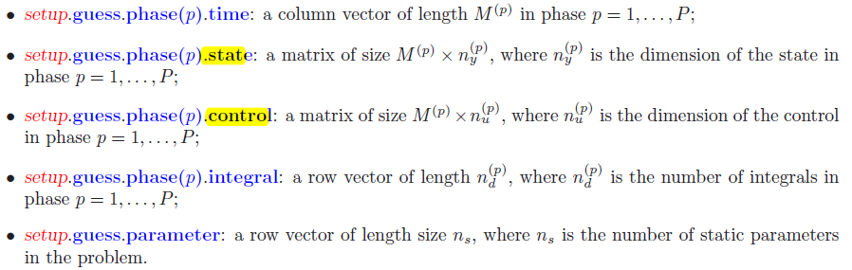

Slide 13
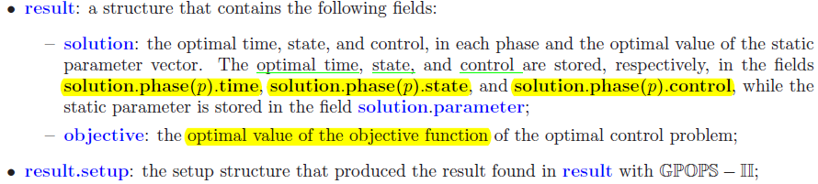
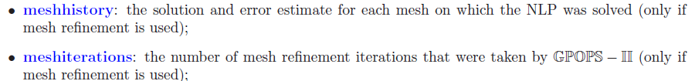
3 Output from an Execution of GPOPS

Slide 14
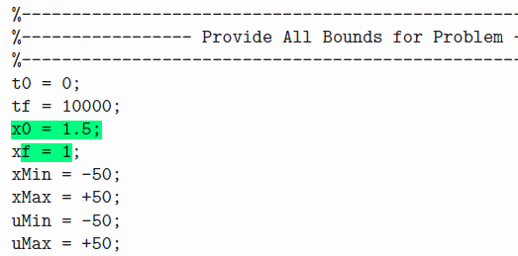
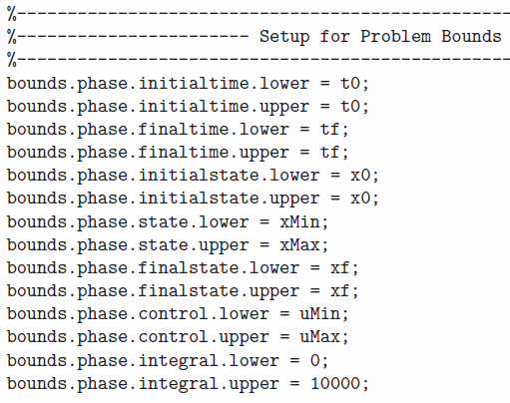

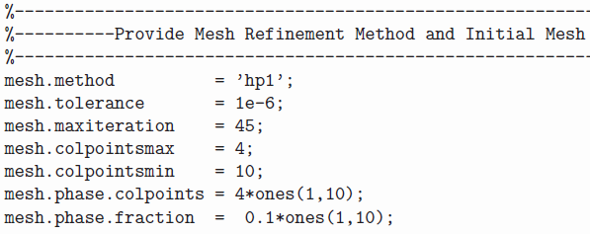


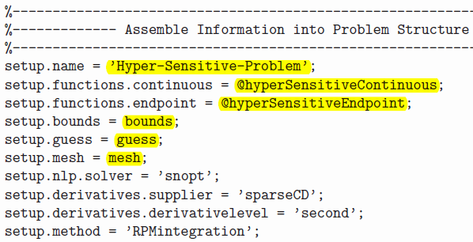

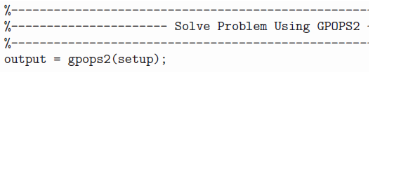
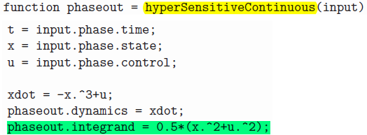


5 GPOPS Examples
Cost function
Dynamic constraint
Boundary conditions

Slide 15
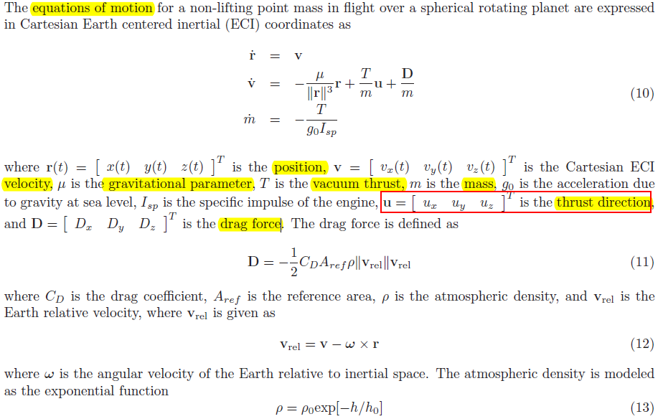
Multiple-Stage Launch Vehicle Ascent Problem

Slide 16



Multiple-Stage Launch Vehicle Ascent Problem
Initial conditions
Terminal constraints
State constraint
Path constraint
Linkage conditions
Cost function
Event function

Slide 17
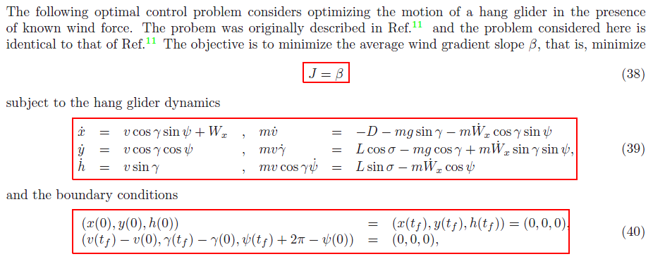
Dynamic Soaring Problem

Slide 18
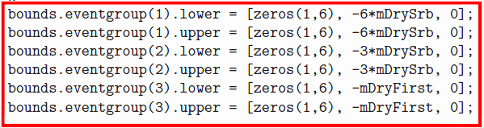

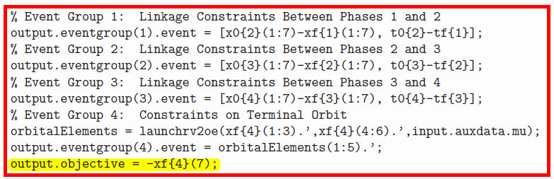
Multiple-Stage Launch Vehicle Ascent Problem

Slide 19
谢谢！

