Slide 1
Module 03: Methods
Chapter 6

Slide 2
Declaration
Please note that information in this lecture is mainly taken from:
Liang, Y. Daniel - Introduction to Java programming and data structures, comprehensive version (2019, Pearson).

Slide 3
Objectives
To understand why do we need Methods (§6.1).
To learn how to define and invoke methods (§6.2).
To understand the difference between void methods and value-returning methods (§6.3-6.4).
To learn how to pass arguments by value (§6.5).
To understand code reusability (§6.6).
To use method overloading and understand ambiguous overloading (§6.8).
To determine the scope of variables (§6.9).

Slide 4
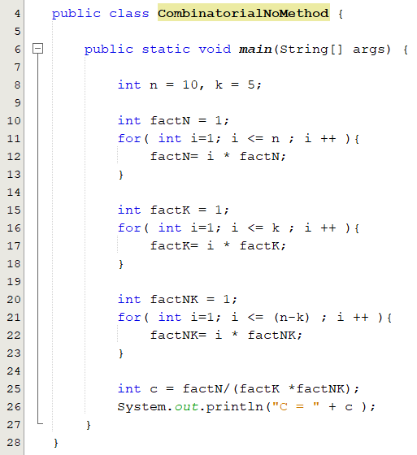
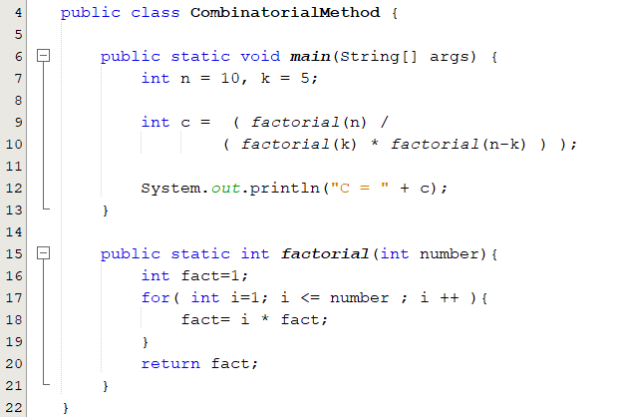
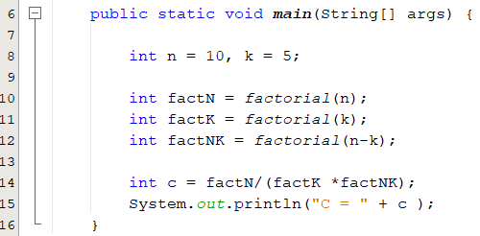
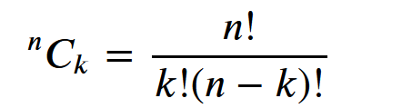
Using Methods to Reuse Code(1/2)
CombinatorialMethod.java

Slide 5
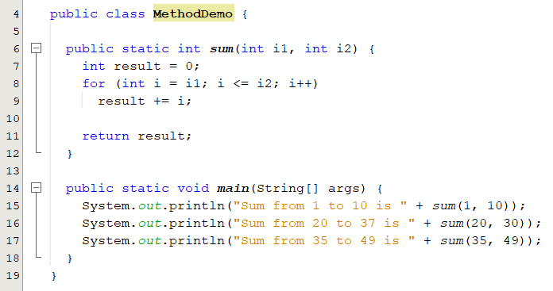
Using Methods to Reuse Code(2/2)
public static int sum(int i1, int i2) {
int sum = 0;
for (int i = i1; i <= i2; i++)
sum += i;
return sum;
}
public static void main(String[] args) {
System.out.println("Sum from 1 to 10 is " + sum(1, 10));
System.out.println("Sum from 20 to 30 is " + sum(20, 30));
System.out.println("Sum from 35 to 45 is " + sum(35, 45));
}
Sum from 1 to 10 is 55
Sum from 20 to 37 is 275
Sum from 35 to 49 is 630
output
MethodDemo.java

Slide 6
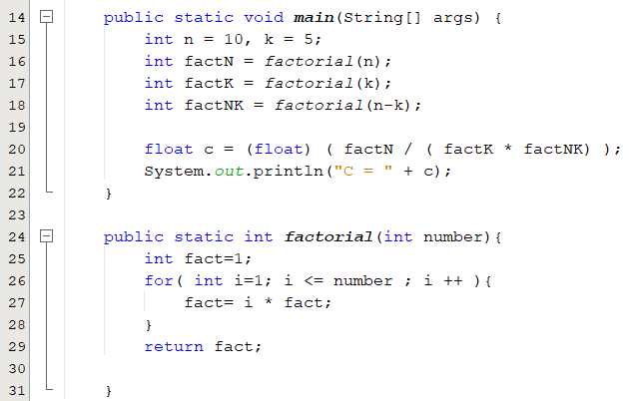
What is a Method?
A method is a collection of statements that are grouped together to perform a specific task.
To use a method, we have to:
Declare/define the method.
Call/Invoke the method.
Reuse, organize and simplify code.
Define a method
Call a method
n, k and n-k are actual parameters
number is a formal parameter

Slide 7
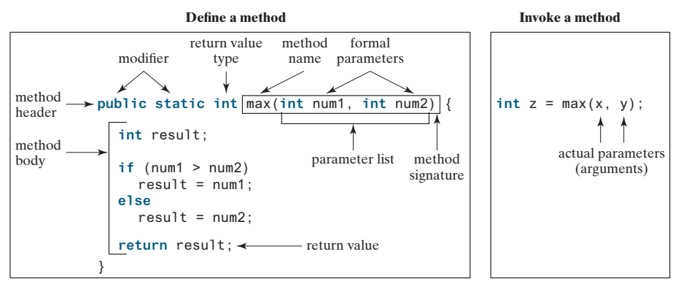
Defining a Method
A method definition consists of a header and a body.
Header:
modifier: so far, we put the public modifier.
returnValueType: can be void, byte, int, long, double, etc…
methodName: a descriptive name that reflects what a function does.
Parameters: Information can be passed to methods using parameters.
modifier returnValueType methodName( list of parameters ){
// Method body; }
In the method header, you need to declare each parameter separately. For instance,
max( int num1, int num2) is correct, but max( int num1, num2) is wrong.

Slide 8
Method Parameters
Parameters are specified after the function name, inside parentheses.
You can use as many parameters as you want, just separate them with a comma.
Parameters act as variables inside the function.
A parameter is like a placeholder: when a method is invoked, you pass a value to the parameter.
Parameters are optional; that is, a method may have no parameters.

Slide 9
Popup-Question(1): Checkpoint 6.4.6
Write method headers (not the bodies) for the following methods:
Return a sales commission, given the sales amount and the commission rate.
Display the calendar for a month, given the month and year.
Test whether a number is even and returning true if it is.
(a) public static double getCommission(double salesAmount, double commissionRate)
(b) public static void printCalendar(int month, int year)
(d) public static boolean isEven(int value)

Slide 10
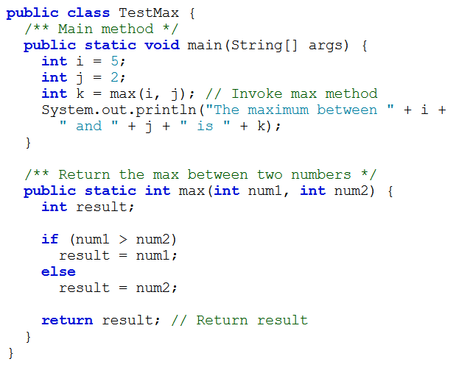
Calling a Method
In a method definition, you define what the method is to do.
To execute the method, you have to call or invoke it.
To call a method, just use method name followed by a set of parentheses that can contain arguments for the method .
When a program calls a method, program control is transferred to the called method.
When a method finishes its work, it returns control to the caller
When its return statement is executed or when its ending brace is reached.
TestMax.java

Slide 11
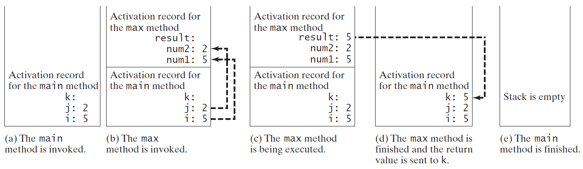
Call/Runtime Stacks
When a method is invoked,
Its parameters and variables are stored in an area of memory known as a call stack.
When a method finishes its work,
Its parameters and variables are removed from the call stack.

Slide 12
Void vs. Value-Returning Methods
A method may perform operations without returning a value.
In this case, the returned ValueType is the keyword void.
A method may return a value.
The returnValueType is the data type of the value the method returns. e.g. int, double, float.
A return statement is required for a value-returning method
public static void myMethod()
public static int factorial( int number)
public static int sign(int n) {
if (n > 0)
return 1;
else if (n == 0)
return 0;
else if (n < 0)
return –1;
}
public static int sign(int n) {
if (n > 0)
return 1;
else if (n == 0)
return 0;
else
return –1;
}
Should be
(a): compilation error the Java compiler thinks it possible that this method does not return any value
(b) To fix this problem, delete if (n < 0) in (a), so that the compiler will see a return statement to be reached regardless of how the if statement is evaluated.

Slide 13
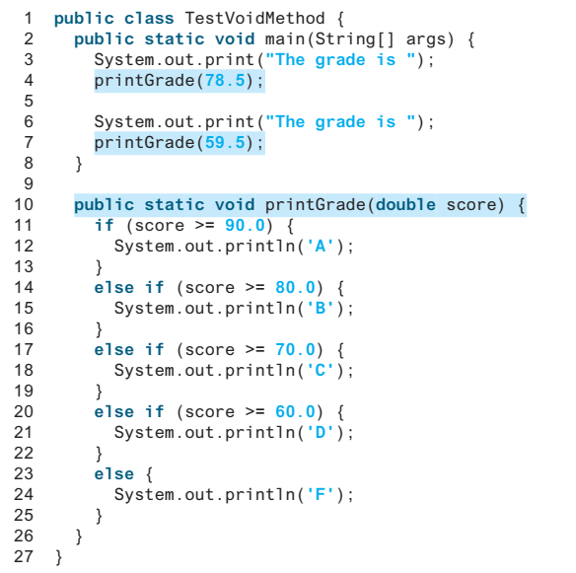


Void vs. Value-Returning Methods
Methods that do not return a value, their invocations stand alone; they are not embedded in another Java statement.
The method getGrade returns a value of type char, and so you can call it anywhere that it is valid to use a value of type char.
System.out.println(printGrade(78.5));
//compilation error
TestVoidMethod.java
TestReturnGradeMethod.java

Slide 14
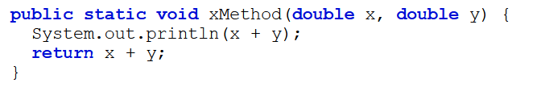
Popup-Question(2): Checkpoint 6.4.6
What would be wrong with not writing a return statement in a value-returning method?
Can you have a return statement in a void method?
Does the return statement in the following method cause syntax errors?
1. A syntax error occurs if a return statement is not used to return a value in a value-returning method.
2. A return statement is not needed for a void method, but it can be used for terminating the method and returning to the method’s caller. The syntax is simply return;
3. Yes, A syntax error occurs.

Slide 15
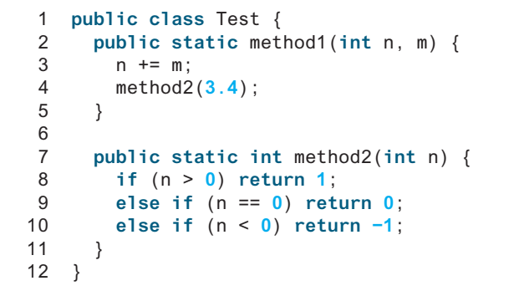
Popup-Question(3): Checkpoint 6.4.9
Identify and correct the errors in the following program
Line 2: method1 is not defined correctly. It does not have a return type or void.
Line 2: type int should be declared for parameter m.
Line 7: parameter type for n should be double to match method2(3.4).
Line 11: if (n < 0) should be removed in method, otherwise a compile error is reported.

Slide 16
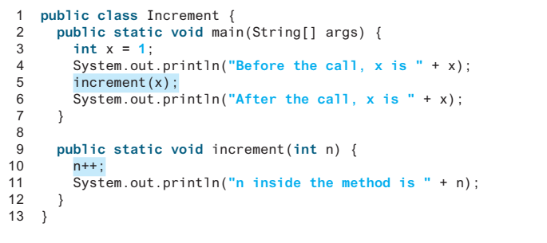
Passing Parameters by Values(1/1)
When you invoke a method with an argument,
The value of the argument is passed to the parameter. This is referred to as pass-by-value.
It makes no difference whether the parameter and the argument have the same name.
The variable is not affected, regardless of the changes made to the parameter inside the method.
The parameter is a variable in the method with its own memory space.
The arguments must match the parameters in order, number, and compatible type, as
defined in the method signature.
Increment.java
Notes:
As given in Listing 6.4, the value of x (1) is passed to the parameter n to invoke the increment method (line 5). The parameter n is incremented by 1 in the method (line 10), but x is not changed no matter what the method does.

Slide 17
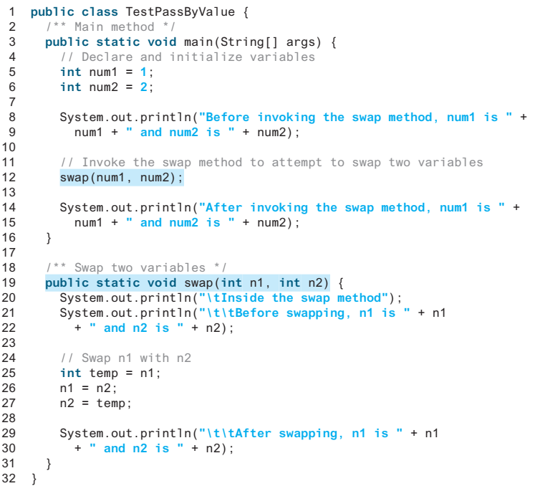
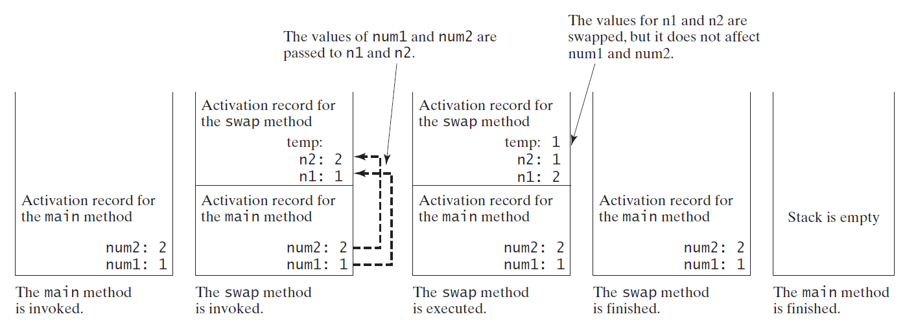
Passing Parameters by Values(2/2)
TestPassByValue.java

Slide 18
Popup-Question(4): Checkpoint 6.5.2
Identify and correct the errors in the following program:
1 public class Test {
2 public static void main(String[] args) {
3 nPrintln(5, "Welcome to Java!");
4 }
5
6 public static void nPrintln(String message, int n) {
7 int n = 1;
8 for (int i = 0; i < n; i++)
9 System.out.println(message);
10 }
11 }
The arguments are not passed in the right order.
n is a parameter but is redeclared in the nPrintln method in line 7.

Slide 19
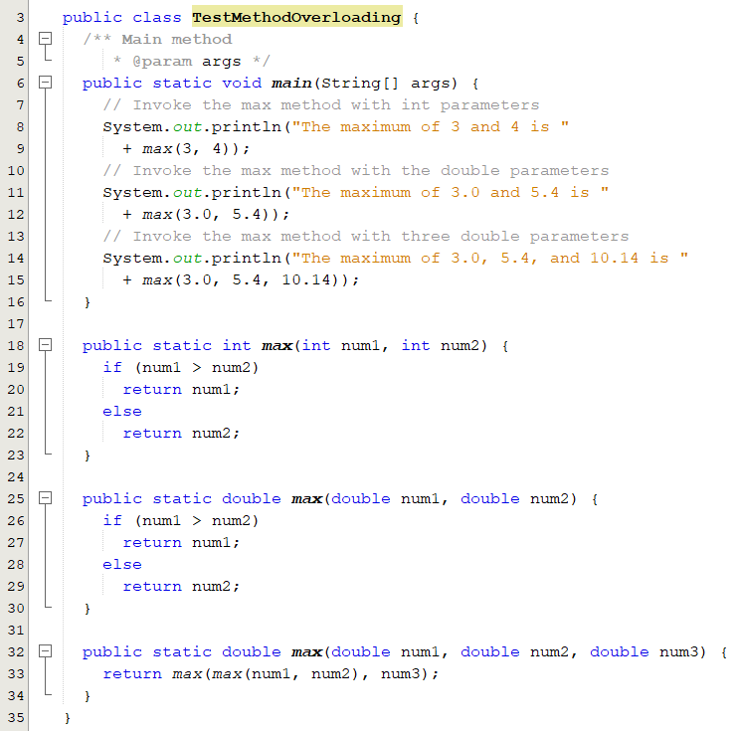
Overloading Methods
A feature that allows you to define more than one method with the same name as long as their parameter lists are different.
If you call max with int parameters,
the max method that expects int parameters will be invoked.
If you call max with double parameters,
the max method that expects double parameters will be invoked.
You cannot overload methods
based on different modifiers or return types.
Two methods or more within one class have the same name but different parameter lists.
TestMethodOverloading.java

Slide 20
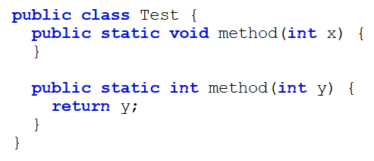
Popup-Question(5): Checkpoint 6.8.2
What is wrong in the following class?
System.out.println(x);
Two method have the same signature method(int).

Slide 21
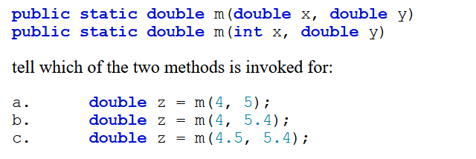
Popup-Question(6): Checkpoint 6.8.3
Given two method definitions,
invokes the second method.
invokes the second.
invokes the first method.

Slide 22
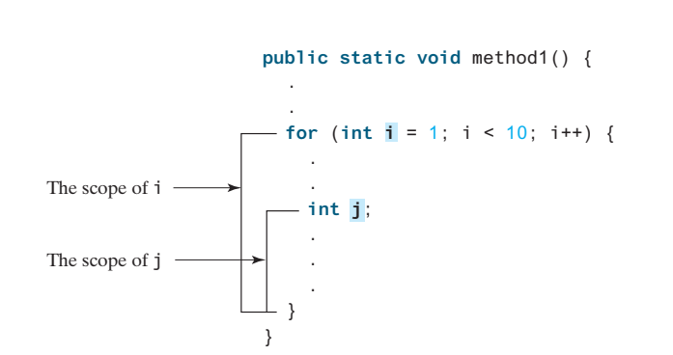
The scope of variables(1/2)
Scope: the part of the program where the variable can be referenced.
A variable defined inside a method is referred to as a local variable.
Must be declared and assigned a value before it can be used.
The scope of a local variable starts from its declaration and continues to the end of the block that contains the variable.
The scope of a method parameter covers the entire method.
A variable declared in the initial-action part of a for-loop header has its scope in the entire loop.

Slide 23
The scope of variables(2/2)
You can declare a local variable with the same name in different blocks in a method,
You cannot declare a local variable twice in the same block or in nested blocks
public static void method1() {
int x = 1;
int y = 1;
for (int i = 1; i < 10; i++) {
x += i;
}
for (int i = 1; i < 10; i++) {
y += i;
}
}
public static void method2() {
int i = 1;
int sum = 0;
for (int i = 1; i < 10; i++) {
sum += i;
}
}
It is fine to declare i in two non-nesting blocks
It is wrong to declare i in two nesting blocks
A common mistake is to declare a variable in a for loop and then attempt to use it outside the loop

Slide 24
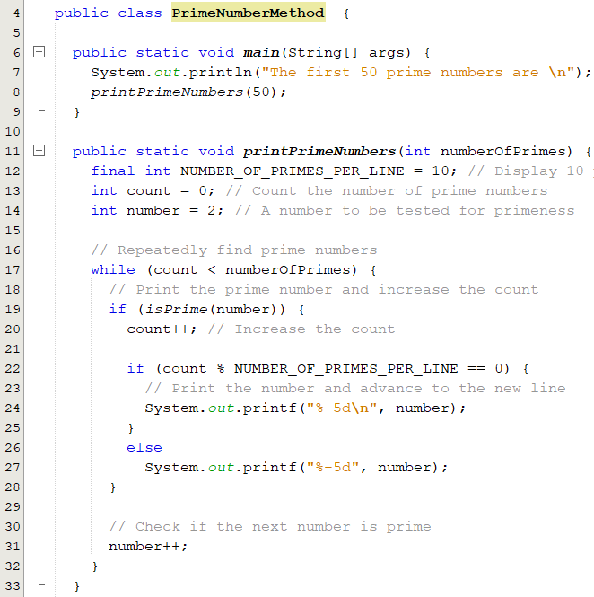
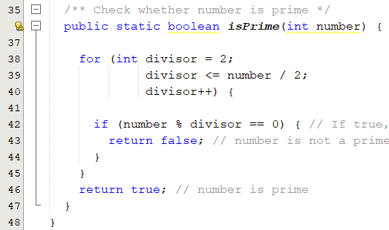
Modularizing Code
Methods can be used to reduce redundant coding and enable code reuse.
Methods can also be used to modularize code and improve the quality of the program.
PrimeNumberMethod.java

