Slide 1
Module 01: Introduction To Programming
Chapter 1

Slide 2
Declaration
Please note that information in this lecture is mainly taken from:
Liang, Y. Daniel - Introduction to Java programming and data structures, comprehensive version (2019, Pearson).

Slide 3
Objectives
To understand programming basics(§§1.2–1.4).
To explain the basic syntax of a Java program (§1.7).
To create, compile, and run Java programs (§1.8)
To use sound Java programming style. (§1.9).
To understand the differences between syntax errors, runtime errors, and logic errors (§1.10).

Slide 4
What is programming?
Computer Algorithm:
A finite, ordered, un-ambiguous, sequence of steps that solves a computer-solvable problem in a finite amount of time.
Computer program:
A sequence of instructions written to perform a specified task with a computer.
A computer algorithm translated into a program using a particular programming language.
Programming:
The translation of a computer algorithm into a program.
The act of designing and implementing computer programs is called programming.
Input: num1, num2
sum = num1 + num2
output: “Sum = ” , sum
Stop
Notes:
Computer programs, known as software, are instructions to the computer.
You tell a computer what to do through programs. Without programs, a computer is an empty machine. Computers do not understand human languages, so you

Slide 5
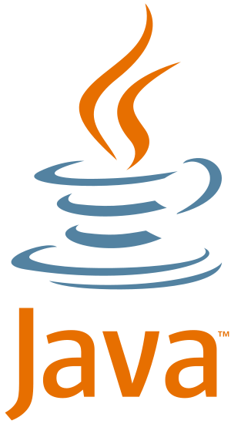
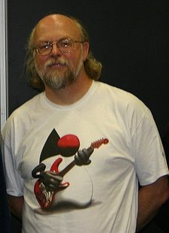
About Java
Java is an object-oriented programming language originally developed by James Gosling at Sun Microsystems.
It was first released in 1995.
The language derives much of its syntax from C and C++.
Has a simpler object model and fewer low-level facilities than C and C++.

Slide 6
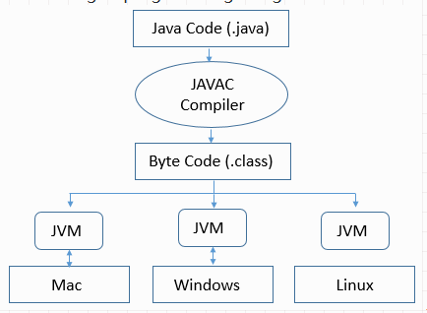
Portability of Java
Write once, run anywhere:
Can be run on any platform without being recompiled.
Notes:
Because applications written in the Java are compiled into machine-independent bytecodes, they run consistently on any Java platform.

Slide 7
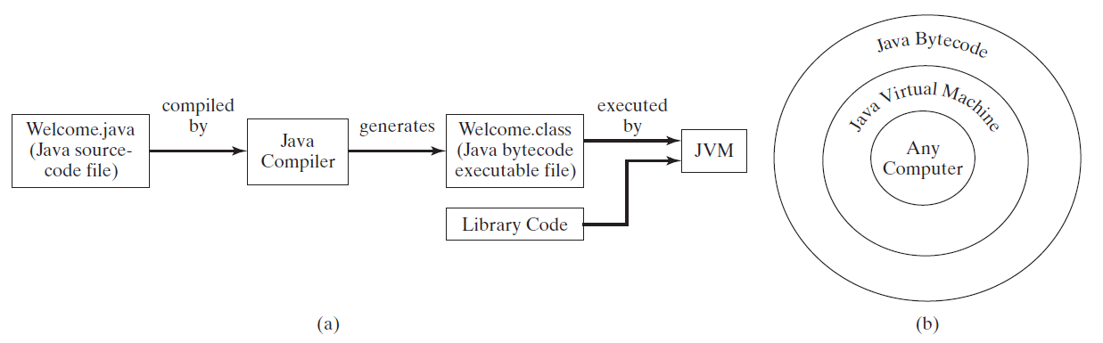
Java Compile and Run Environments: Life Cycle
Notes:
To run a Java program, first use the compiler to translate the Java program into byte-code. Then, use the JVM for your computer to translate byte-code instructions to machine language and to run the machine language instructions
A Java program is divided into smaller parts called classes, and normally each class definition is in a separate file and is compiled separately. In order to run your program, the byte-code for these various classes needs to be connected together. The connecting is done by a program known as the class loader. It is typically done automatically, so you normally need not be concerned with it. (In other programming languages, the program corresponding to the Java class loader is called a linker.)

Slide 8
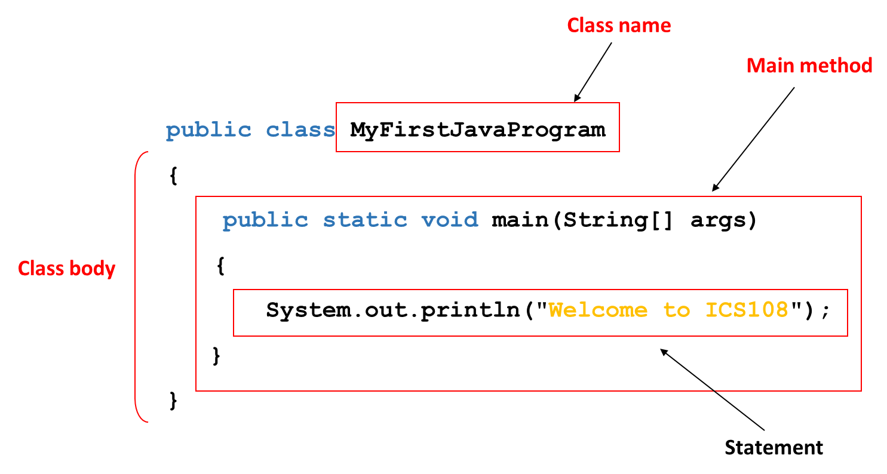
A Simple Java Program
Every Java program must have at least one class.
Each class has a name which starts with an uppercase letter. In this example, the class name is MyFirstJavaProgram.
In order to run a class, the class must contain a method named main. The program is executed from the main method.
A pair of braces in a program forms a block that groups components of a program.
Notes:
Every Java program must have at least one class. Each class has a name. By convention, class names start with an uppercase letter. In this example, the class name is MyFirstJavaProgram.
In order to run a class, the class must contain a method named main. The program is executed from the main method

Slide 9
Anatomy of a Java Program
A Java program consists of one or more classes.
Java classes reside in one or more files.
A Java class consists of some variables and one or more methods.
A Java method consists of one or more statements.
The file name of a Java program has .java extension.
A Java Program
Java
classes
Java
Methods

Slide 10


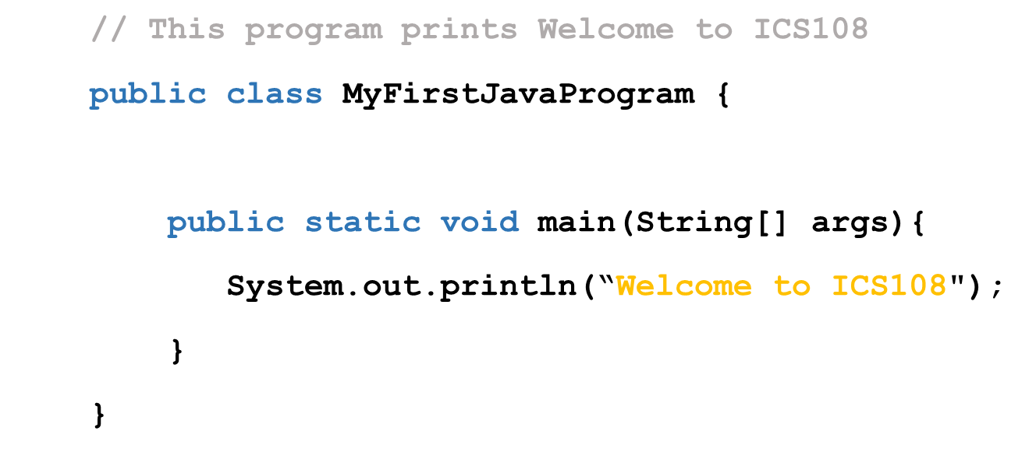
Programming Style
Proper Indentation:
Indent two spaces.
Spacing:
Use blank line to separate segments of the code
Appropriate Comments
Explain what the programs does.
line comments beginning with //
block comments beginning with /* and ends with */
Block Styles:
Use end-of-line style for braces.

Slide 11
Naming Conventions
Identifier | Naming Convention
Variables and method names | Use lowercase. If the name consists of several words, concatenate all in one, use lowercase for the first word, and capitalize the first letter of each subsequent word in the name. For example, the variables radius and area, and the method computeArea.
Class names | Capitalize the first letter of each word in the name. For example, the class name CircleArea.
Constants | Capitalize all letters in constants, and use underscores to connect words. For example, the constant PI and MAX_VALUE

Slide 12
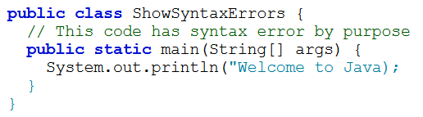
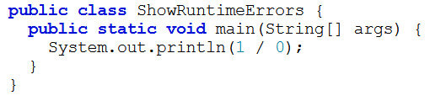
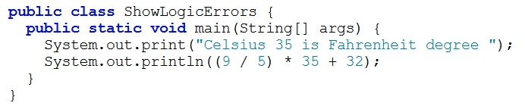
Programming Errors
Syntax errors:
Violating the rules, syntax, of the language.
Detected by the compiler: Program will not run unless it is syntax-error free.
Runtime errors:
Occur while the program is running.
Operations can not be carried out. e.g., division by zero.
Causes the program to abort.
Logical errors:
Program produces un incorrect results.

