Slide 1
Module 02: Java Basics
Chapter 2 - 5

Slide 2
Declaration
Please note that information in this lecture is mainly taken from:
Liang, Y. Daniel - Introduction to Java programming and data structures, comprehensive version (2019, Pearson).

Slide 3
Objectives
To explore Java data types (§2.9.1).
To use variables, constants and literals (§§2.5–2.7).
To write and evaluate numeric expressions
To cast the value of one type to another type (§2.15).
To avoid common errors and pitfalls in elementary programming (§2.18).
To obtain input from the console using the Scanner class (§2.3).
To write Java programs to solve mathematical problems (§4.2).
To process strings using the methods in the string object (§4.4).

Slide 4
Objectives
To use boolean variables and expressions (§3.2).
To implement selection control structure(§§3.3-3.5).
To program using selection statements (SubtractionQuiz, BMI) (§§3.7–3.9)
To implement selection control using switch statements(§3.13).
To write expressions using the conditional operator(§3.14).
To write loops using:
While statement (§5.2).
Do-while statement (§5.3).
For statement (§5.4).
To write programs using loops((§§5.5-5.11)

Slide 5
Primitive Data Types
Type Name | Kind of Value | Memory Used | Range of Values
byte | Integer | 1 byte | –2⁷ to 2⁷ – 1 (-128 to 127)
short | Integer | 2 bytes | –2¹⁵ to 2¹⁵ – 1 (-32768 to 32767)
int | Integer | 4 bytes | –2³¹ to 2³¹ – 1 (-2147483648 to 2147483647)
long | Integer | 8 bytes | –2⁶³ to 2⁶³ – 1 -9,223,372,036,854,775,808 to 9,223,372,036,854,775,807
float | Floating-point | 4 bytes | -3.4028235E+38 to -1.4E-45 1.4E-45 to 3.4028235E+38
double | Floating-point | 8 bytes | -1.7976931348623157E+308 to -4.9E-324 4.9E-324 to 1.7976931348623157E+308
char | Single character (Unicode) | 2 bytes | All Unicode values from 0 to 65,535
boolean |  |  | true or false
1.0 / 3.0 is 0.3333333333333333
The double type values are more accurate than the float type values
1.0F / 3.0F is 0.33333334
Notes:
Every data type has a range of values. The compiler allocates memory space for each variable or constant according to its data type.
The double type values are more accurate than the float type value

Slide 6
Variables
A variable is
A storage location in the computer’s memory.
It has a type, name, and value.
Used to represent information about problems.
Every variable in a Java program must be declared before it can be used.
A variable declaration tells the compiler what kind of data (type) will be stored in that variable.
Syntax
dataType variableName;
or
dataType variableName = value;
Examples:
int length, width;
double radius, area = 0.0;
char letter = ’A’;
boolean found = true;
String courseTitle = “ICS108”;
What are the required variables to write a program that computes Rectangle’s area?
Variables to represent student information:
length, width and area
name, id, major, level, etc…

Slide 7
Constants
A final variable is a variable that can be initialized only once.
To declare a variable as final, add the keyword final to the declaration.
Examples:
final double PI=3.14159;
final int HOURS_PER_DAY = 24;
final double MAX_SIZE = 70.5;
Note: If you try to change the value of a final variable you will get a compilation error: cannot assign a value to final variable.
Capitalize all letters in constants and use underscore to connect words.
Constants do not change their values;
variables can change their values
Notes:
In Java, the final keyword is used to denote constants. It can be used with variables, methods, and classes.
Once any entity (variable, method or class) is declared final, it can be assigned only once. That is,
the final variable cannot be reinitialized with another value
the final method cannot be overridden
the final class cannot be extended

Slide 8
Numeric Type Conversion
You cannot store a value of one type in a variable of another type
int value;
value = 2.99; ×
The problem is a type mismatch. The constant 2.99 is of type double, and the variable value is of type int.
Notes:
You can assign a value of type char to a variable of type int or to any of the numeric types that follow int in our list of types (but not to those that precede int). However, in most cases it is not wise to assign a character to an int variable, because the result could be confusing.

Slide 9
Type Casting
Type Casting takes a value of one type and produces a value of another type with an "equivalent" value.
There are some special cases where it is permitted to assign a value of one type to a variable of another type.
byte → short → int → long → float → double
char
Implicit casting
Explicit casting
Widening: casting a type with a small range to a type with a larger range
byte i = 100;
long k = i * 3 + 4;
double d = i * 3.1 + k / 2;
int x = ( int ) 2.9;
double d = (double) n/m;
// where n and m are of type int
Narrowing: large range to a type with a smaller range
When computing mathematical expression involving operands of different types, Java automatically converts the result to the type with larger range
Notes:
You can assign a value of type char to a variable of type int or to any of the numeric types that follow int in our list of types (but not to those that precede int). However, in most cases it is not wise to assign a character to an int variable, because the result could be confusing.

Slide 10
Arithmetic Operators
Name | Meaning | Example | Result
+ | Addition | 10 + 20 | 30
- | Subtraction | 20.0 – 5.1 | 14.9
* | Multiplication | 30 * 2.0 | 60.0
/ | Division | 34/5 34.0/5 | 6 6.8
% | Reminder | 24 % 5 | 4
++ -- | Postincrement/Postdecrement | int i=5; i++; | i = 6
++ -- | preincrement/predecrement | int i=5; --i; | i = 4
Notes:
As in most other languages, Java allows you to form expressions using variables, constants, and the arithmetic operators: + (addition), - (subtraction), * (multiplication), / (division), and % (modulo, remainder). These expressions can be used anyplace it is legal to use a value of the type produced by the expression.

Slide 11
Operator Precedence
Highest Precedence
Operator | Type | Associativity
()[] | Parentheses, Array subscript | Left to Right
multiplicative | * / % | Left to right
additive | + - | Left to right
assignment | = += -= *= /= %= etc.. | Right to left
Lowest Precedence
Notes:
The operators in the following table are listed according to precedence order. The closer to the top of the table an operator appears, the higher its precedence.
Operators with higher precedence are evaluated before operators with relatively lower precedence. Operators on the same line have equal precedence.
When operators of equal precedence appear in the same expression, a rule must govern which is evaluated first.
All binary operators except for the assignment operators are evaluated from left to right; assignment operators are evaluated right to left.

Slide 12
Common Errors and Pitfalls
Undeclared/Uninitialized Variables and Unused Variables.
Integer Overflow
Round-off Errors
Unintended Integer Division
double interestRate = 0.05;
double interest = interestrate * 45;
int value = 2147483647 + 1;
value will actually be -2147483648
System.out.println(1.0 - 0.9);
0.09999999999999998
double x = 5/2; double x = 5/2.0;

Slide 13
Console Input and Output
Console Output | Console Input
System.out refers to the standard output device | System.in refers to the standard input device
The default output device is the display monitor | The default input device is the keyboard.
println method is used to display a primitive value or a string to the console | the Scanner class is used to create an object to read input from System.in
Data is stored in output buffer before it is sent to the monitor or to an output file. | data is stored in scanner buffer before it is sent to the program
 | Whenever a user presses the Enter key, the '\n' generated is also sent to the input buffer.
keyboard
or input file
monitor
or output file
input buffer
program
output buffer
Notes:
Java uses System.out to refer to the standard output device, and System.in to the standard input device.
By default, the output device is the display monitor, and the input device is the keyboard.
To perform console output, you simply use the println method to display a primitive value or a string to the console.
To perform console input, you need to use the Scanner class to create an object to read input from System.in, as follows:
Scanner input = new Scanner(System.in)
The syntax new Scanner(System.in) creates an object of the Scanner type. The syntax Scanner input declares that input is a variable whose type is Scanner. The whole line Scanner input = new Scanner(System.in) creates a Scanner object and assigns its reference to the variable input.

Slide 14
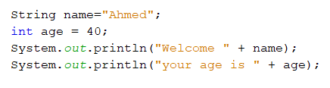
Screen Output
println: outputs one line to the screen and generates a new line after it finishes.
The items that are output can be quoted strings, variables, numbers, or almost any object you can define in Java.
To output more than one item, place a plus sign between the items.
SYNTAX System.out.println(Item_1 + Item_2 + ... + Last_Item);
Example:
The output:
Welcome Ahmed
your age is 40

Slide 15
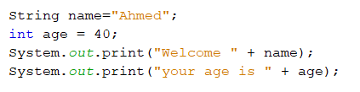

Screen Output
print: outputs one line to the screen and stays on the same line.
Example:
The output:
printf: formats output based on a format specifier, %s %d %f %c
Example
The output
Welcome Ahmedyour age is 40
$ 19.88 each
Notes:
The only difference between System.out.println and System.out.print is that with println, the next output goes on a new line, whereas with print, the next output is placed on the same line.
The print and println methods do not provide much control over the formatting
of output.
Java includes a method named printf that can be used to give output in a specific format
The printf method formats multiple arguments based on a format string.
The format string consists of a string constant embedded with format specifiers

Slide 16
Reading Input from the Console
To perform console input, you need to use the Scanner class to create an object to read input from System.in, as follows:
Scanner input = new Scanner(System.in)
An object of this class has methods for input of different types.
By default, white space characters are used to separate input data items or tokens
Notes:
The syntax new Scanner(System.in) creates an object of the Scanner type. The syntax Scanner input declares that input is a variable whose type is Scanner. The whole line Scanner input = new Scanner(System.in) creates a Scanner object and assigns its reference to the variable input.

Slide 17
Reading Input from the Console
To read | Method used | Effect
integer | input.nextInt(); | Skips leading white space in the input buffer and then consumes and returns the next token. '\n' at the end of the line is not consumed
long | input.nextLong();
double | input.nextDouble();
String (one word) | input.next();
String (complete line) | input.nextLine(); | Reads the rest of the current line and returns it as a string. The line terminator character '\n' at the end of the line is consumed
Notes:
The syntax new Scanner(System.in) creates an object of the Scanner type. The syntax Scanner input declares that input is a variable whose type is Scanner. The whole line Scanner input = new Scanner(System.in) creates a Scanner object and assigns its reference to the variable input.

Slide 18
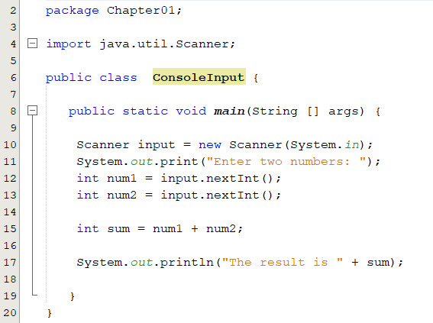
Console Input using Scanner : An Example
Import Scanner class
Create a Scanner object
Read an integer and assign it to the variable num1
Read another integer and assign it to variable num2
Sample run:
Enter two numbers: 4
12
The result is 16
Sample run:
Enter two numbers: 2 3
The result is 5

Slide 19
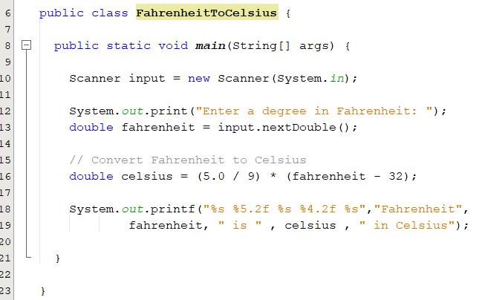
Problem: Converting Temperatures
Write a program that converts a Fahrenheit degree to Celsius using the formula:
Enter a degree in Fahrenheit: 300
Fahrenheit 300.00 is 148.89 in Celsius

Slide 20
The Math Class
Java provides many useful methods in the Math class for performing common mathematical functions.
Constants: PI and E
The Math class is in the java.lang package. Any class in the java.lang package is automatically imported. So there is no need to import it explicitly.

Slide 21
The random Method
random(): returns a random double value in the range [0.0, 1.0).

Slide 22
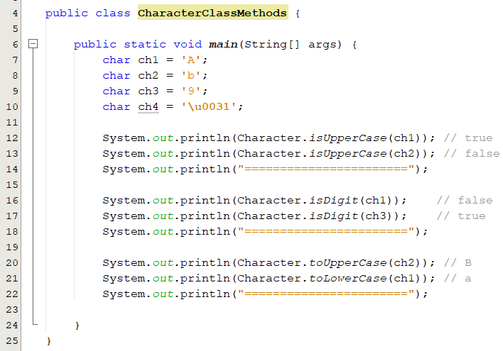
The Character class
Java provides the following methods in the Character class for testing characters
Method | Description
isDigit(ch) | Returns true if the specified character is a digit.
isLetter(ch) | Returns true if the specified character is a letter.
isLetterOrDigit(ch) | Returns true if the specified character is a letter or digit
isLowerCase(ch) | Returns true if the specified character is a lowercase letter.
isUpperCase(ch) | Returns true if the specified character is an uppercase letter
toLowerCase(ch) | Returns the lowercase of the specified character.
toUpperCase(ch) | Returns the uppercase of the specified character.

Slide 23
The Class String
Objects of type String are sequence of characters that are written within double quotes.
"KFUPM" "ICS018 "
The class String is a predefined class that is made available to you when you are programming in Java.
String declaration:
String courseTitle = “ICS108”;
String objects are immutable, which means that once created, their values cannot be changed; however, references to String objects may be changed.
Notes:
You can obtain a string literal simply by enclosing a sequence of characters in double quotation marks.
A String object can be constructed by either:
directly assigning a string literal’s starting address to a String reference variable.
By assigning a String object’s starting address to a String reference variable via the new operator and a constructor

Slide 24
The Class String
String word1, word2;
word1 = "Java";
word2 = word1;
Memory is allocated for word1 and word2 but with no values
A String object with value “Java” is created and word1 refers to it
The address in word1 is assigned to word2 so both refer to the same String object
word1
6000
6000
Memory
Java
word2
6000

Slide 25
String concatenation
Concatenation: Using the + operator on two (or more) strings in order to connect them to form one longer string.
When a string is combined with almost any other type of item, the result is a string.
Strings may also be concatenated by using the String concat method:
String courseID = “ICS108";
String courseTitle = " OOP:Java";
String course = courseID + courseTitle;
ICS018OOP:Java
int no = 108;
String s = "ICS";
System.out.println(s + no);
String courseTitle = "ICS ".concat("108 ");

Slide 26
Comparing Strings Methods
Assume str1=“ICS108 Course” and str2 = “ICS108 course”
Method | Description | Result
str1.equals(str2) | Returns true if the contents of the String objects referenced by str1 and str2 are equal; otherwise it returns false. | false
str1.compareTo(str2) | Compares a String to another String and returns an int less than zero, zero, or greater than zero, indicating, respectively, whether this String (the String referenced by str1) is smaller, equal to or larger than the other String. For example: str1.compareTo(str2) | Negative number
boolean contains(String str) | Returns true if and only if this string contains the string str. | str1.contains("CS"); // true
int length() | Returns how many characters in a string | str1.length() //returns 13
StringMethods.java

Slide 27
Methods for Obtaining Substrings
Assume str1=“ICS108 Course”
Method | Description | Example
String substring(int beginIndex) | Returns a new string that is a substring of this string, starting from beginIndex to the end of this string. (Error if beginIndex is not valid) | String str2 = str1.substring(3); // str2 = “108 Course"
String substring(int beginIndex, int endIndex) | Returns a new string that is a substring of this string starting from beginIndex to endIndex - 1. (Error if any of the index is not valid) | String str2 = str1.substring(2,5); // str2 = "S10"
char charAt(int index) | Returns the char value at the specified index. (Error if index is not valid) | char ch = str1.charAt(1); // ch = ‘C'
str1. substring(3,6) is 108
str1. substring(7) is Course
0 | 1 | 2 | 3 | 4 | 5 | 6 | 7 | 8 | 9 | 10 | 11 | 12
I | C | S | 1 | 0 | 8 |  | C | o | u | r | s | e
str1.charAt(1)

Slide 28
Conversion between Strings and Numbers
int i = Integer.parseInt("200");
double a = Double.parseDouble("200.5");
String s3 = Integer.toString(99);
String s5 = Double.toString(99.5);
String s = number + ""; // number + String → String
Character, Integer and Double are wrapper classes.

Slide 29
Comparison & Logical Operators
Math Notation | Name | Java Notation | Examples
= | Equal to | == | balance == 0 answer == 'y'
≠ | Not equal to | != | income != tax
> | Greater than | > | expenses > income
≥ | Greater than or equal to | >= | points >= 60
< | Less than | < | pressure < max
≤ | Less than or equal to | <= | expenses <= income
A boolean expression is an expression that evaluates to either true or false
A | B | A && B | A || B | !(A) | A ^ B
true | true | true | true | false | false
true | false | false | true | false | true
false | true | false | true | true | true
false | false | false | false | true | false
boolean b = (1 > 2);
b is a boolean variable
(x > 0) && ( x < 10)
Notes:
Often in a program you need to compare two values, such as whether i is greater than j. Java provides six comparison operators

Slide 30
Decision/Selection Structure
This structure lets us execute a block of code under a certain condition.
Finding the square root of a given number, ( x > 0).
Withdrawing money from your account (as long as you have enough balance).
Calculating students letter grade( A+, A, B+, B, etc…).
The if and switch statements are used to implement the decision/selection in Java.
Notes:
The selection control structure allows one set of statements to be executed if a condition is true and another set of actions to be executed if a condition is false.
Every decision a computer program makes involves evaluating a Boolean expression

Slide 31
Equivalent Expressions
if (even = true) {
System.out.println("It is even");
}
even = true;
if (even) {
System.out.println("It is even");
}

Slide 32
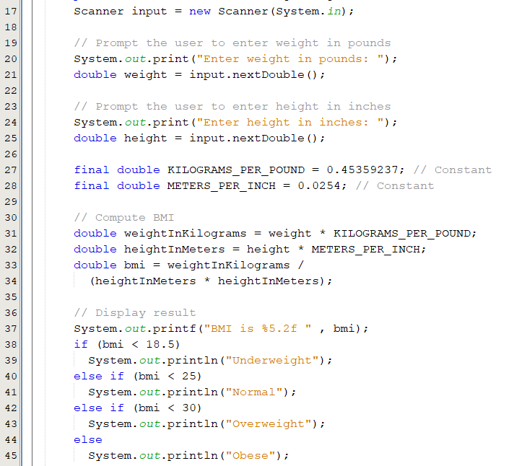
Example: Body Mass Index
Body Mass Index (BMI) is a measure of health on weight. It can be calculated by taking your weight in kilograms and dividing by the square of your height in meters. The interpretation of BMI for people 16 years or older is as follows
BMI Interpretation
-------------------------------------------------
BMI < 18.5 Underweight
18.5 <= BMI < 25.0 Normal
25.0 <= BMI < 30.0 Overweight
30.0 <= BMI Obese
BMICalculation.java

Slide 33
Switch Statement
When a multiway if-else statement has many possible outcomes, it can be hard to read.
If the choice is based on the value of an integer or a character expression, the switch statement can make your code easier to understand
The value1, ..., and valueN must have the same data type as the value of the switch-expression.
switch (switch-expression) {
case value1->
statement(s)1;
case value2 ->
statement(s)2;
…
case valueN ->
statement(s)N;
default:
statement(s)-for-default;
}
Notes:
The body of the statement is always enclosed in a pair of braces. Listing 3.5 shows a sample switch statement, whose controlling expression is the variable numberOfBabies.
Within the braces is a list of cases, each case consisting of the keyword case followed by a constant—called a case label—then a colon, and then a list of statements, which are the actions for that case:

Slide 34
How Switch Statement executes?
The controlling expression is evaluated.
The value of the expression is compared with the value of each case.
If there is a match, the associated block of code is executed.
The statements for this case are executed
import java.util.Scanner; public class Days { public static void main(String[] args) { int dayNumber; Scanner input = new Scanner(System.in); System.out.print("Enter number between 1 and 7 > "); dayNumber = input.nextInt(); input.close(); switch (dayNumber) { case 1-> System.out.println("Sunday"); case 2-> System.out.println("Monday"); case 3-> System.out.println("Tuesday"); case 4-> System.out.println("Wednesday"); case 5-> System.out.println("Thursday"); case 6-> System.out.println("Friday"); case 7-> System.out.println("Saturday"); default-> System.out.println("Error"); } } }
Days.java
Notes:
When the switch statement is executed, the controlling expression— dayNumber in this example is evaluated.
The list of alternatives is then searched until a case label that matches the value of the controlling expression is found, and the action associated with that label is executed.
You cannot have duplicate case labels, since that would produce an ambiguous situation. Notice that the action for each case in Listing 3.5 ends with a brea
Case doesn’t always need to have order 1, 2, 3 and so on. It can have any integer value after case keyword. Also, case doesn’t need to be in an ascending order always, you can specify them in any order based on the requirement.
2) You can also use characters in switch case. for example

Slide 35
Conditional Operators
A conditional operator evaluates an expression based on a condition.
Syntax
boolean-expression ? exp1 : exp2
Example
if (n1 > n2)
max = n1;
else
max = n2;
can be expressed as follows:
max = (n1 > n2) ? n1 : n2;

Slide 36
Popup Question(2)
What is the output of the following code?
A
int i = 1, j = 2, k = 3;
if (i > j)
if (i > k)
System.out.println("A");
else
System.out.println("B");
int i = 1, j = 2, k = 3;
if (i > j)
if (i > k)
System.out.println("A");
else
System.out.println("B");
B
The else clause matches the most recent if clause in the same block
C
int i = 1, j = 2, k = 3;
if (i > j){
if (i > k)
System.out.println("A");
}
else
System.out.println("B");
To force the else clause to match the first if clause, you must add a pair of braces:

Slide 37
Loop Statements
Java has three types of loop statements:
while statement
do-while statement
for statement
A loop consists of:
Body: The code that is repeatedly executed inside the loop.
Condition (boolean expression): as long as it is true, the body executes.
Each repetition of the loop body is called an iteration.
loop
condition
false
true
Statements
Loop body
Notes:
A Loop condition that controls the execution of the body. It is evaluated each time to determine if the loop body is executed.

Slide 38
While Statement: Example
A while statement is used to execute statements while the condition is true.
As long as loop-condition is true, the loop body executes.
The loop-condition is re-tested after each iteration.
The loop terminates when the condition becomes false.
while (loop-condition) {
// loop-body;
Statement(s);
}
int n= 100;
int count = 1;
while (count <= n) {
System.out.println("Welcome to ICS108!");
count++;
}
n = 100; count = 1;
false
count<=n?
true
System.out.println("Welcome to ICS108!");
count++;
How many times the loop executes if we replace the statement count++ with count = count + 2
Notes:
Using a loop statement, you can simply tell the computer to display a string a hundred times without having to code the print statement a hundred times, as follows:

Slide 39
Do-While Statement
A do-while statement is used to execute a block of statements one or more times.
Syntax
do {
// Loop body;
Statement(s);
} while (loop-condition);
Statements
loop body
loop
condition
int n = 100, count = 1;
do {
System.out.println("Welcome to ICS108!");
count++;
} while(count <= n);
true
false
int n= 100, count = 1;
while (count <= n) {
System.out.println("Welcome to ICS108!");
count++;
}

Slide 40
For Statement
A for loop allows you to efficiently write a loop that needs to execute a specific number of time.
Syntax
for (counter-initialization; loop-condition; counter-update) {
// loop body;
Statement(s);
}
counter-initialization
loop
condition
false
for (int i=1; i<=100; i++) {
System.out.println("Welcome to ICS108!");
}
true
Statements
Loop body
int i = 1;
while (i <= 100) {
System.out.println("Welcome to ICS108!");
i++;
}
counter-update

Slide 41
Loop Statements:
int n = 100, i =1;
while (i <= n) {
System.out.println(i);
i++;
}
int n =100;
for (int i = 1; i <= n ; i++) {
System.out.println(i);
}
int n = 100; i = 1;
do {
System.out.println(i);
i++;
} while (i<=n);

Slide 42
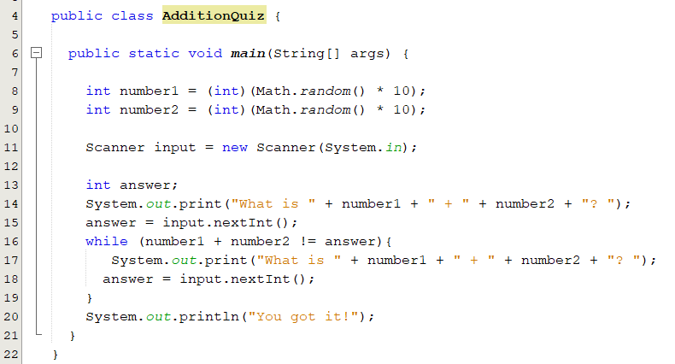
Example : AdditionQuiz
Write a program that prompts the user to enter an answer for a question on addition of two single digits. Let the user enter a new answer until it is correct.
Using while loop
AdditionQuiz.java

