Slide 1
Module 04: Arrays and Array Lists
Chapter 7,8,11

Slide 2
Declaration
Please note that information in this lecture is mainly taken from:
Liang, Y. Daniel - Introduction to Java programming and data structures, comprehensive version (2019, Pearson).

Slide 3
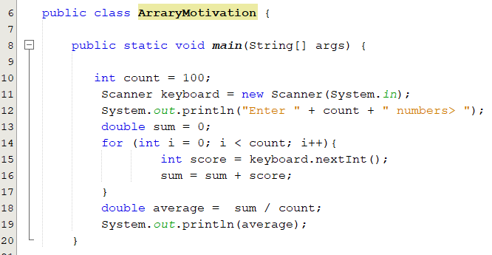
Motivation: Why do we need arrays?
What does the following program do?
Suppose we want to compute the average score of 100 students and find out how many students are above the average.
To be able to count how many students above the average, we must remember the 100 scores and then compare them to the average.
How can we do this? Use 100 variables. What do you think? Is it practical solution?

Slide 4
Motivation: Why do we need arrays?
In many programs, you need to manipulate collections of related values.
It would be impractical to use a sequence of variables such as value1, value2, value3, . . . , and so on.
The array construct provides a better way of storing a collection of values.
Notes:
An array is a data structure used to process a collection of data that is all of the same
type, such as a list of numbers of type double or a list of strings. In this chapter, we
introduce you to the basics of defining and using arrays in Java

Slide 5
Objectives
Declare, create and initialize 1D-array (§§7.2.1–7.2.2).
Access array elements using indexes (§7.2.4).
Process 1D-array:(§7.2.6).
Printing and reading.
Randomly initializing arrays.
Summing array elements.
Finding minimum, maximum and their positions.
Random shuffling.
Shifting arrays.
To copy contents from one array to another (§7.5).
Arrays and methods (passing and returning array) values (§§7.6–7.9).
To use the methods in the java.util.Arrays class (§7.12).
Declare/Create/Initialize and process 2D Array (§8.1-8.8).

Slide 6
Introducing Arrays
An array is a sequence of values of the same type.
The values that are stored in the array are called its “elements”
myArray
myArray[0]
myArray[1]
myArray[2]
myArray[3]
myArray[4]
myArray[5]
myArray[6]
myArray[7]
myArray[8]
myArray[9]
4.5
12.1
5.6
2.1
7.3
4.2
5.5
12.0
9.3
45.0
Array reference variable
Element at index 7
8th element
Element value

Slide 7
Declaring 1D-array
To declare an array, define the variable type with square brackets:
dataType[] arrayRefVar ;
Example: double[] myArray;
datatype arrayRefVar[]; // This style is allowed, but not preferred
Example: double myArray[];
No space allocated in the memory for the array.
A space is allocated only for the reference to an array.
Its value is null.
You cannot assign elements to an array unless it has already been created.
Address | value
myArray | null
Notes:
the declaration of an array variable does not allocate any space in memory for the array.
It creates only a storage location for the reference to an array. If a variable does not contain a reference to an array, the value of the variable is null. You cannot assign elements to an array unless it has already been created. After an array variable is declared, you can create an array by using the new operator and assign its reference to the variable with the following syntax: arrayRefVar = new elementType[arraySize];
arrayName = new dataType [6] does two things:
(1) it creates an array using new elementType[6] and (2) it assigns the reference of the newly created array to the variable arrayName

Slide 8
Creating 1D-array
The new operator is used to create an array and assign its reference to the variable with the following syntax:
arrayRefVar = new dataType [arraySize];
e.g. myArray = new double [4];
Address | value
myArray
Address | value
 | 0.0
 | 0.0
 | 0.0
 | 0.0
Declaring and creating an array can be combined in one statement.
double[] myArray = new double [4];
When creating an array:
Its size must be given. It cannot be changed after the array is created.
Size can be obtained using arrayName.length. myArray.length is 4.
Its elements are assigned the default value of 0 for the numeric primitive data types, \u0000 for char types, false for boolean types, and null for objects.
Notes:
Unlike declarations for primitive data type variables, the declaration of an array variable does not allocate any space in memory for the array.
It creates only a storage location for the reference to an array. If a variable does not contain a reference to an array, the value of the variable is null. You cannot assign elements to an array unless it has already been created. After an array variable is declared, you can create an array by using the new operator and assign its reference to the variable with the following syntax: arrayRefVar = new elementType[arraySize];
arrayName = new dataType [6] does two things:
(1) it creates an array using new elementType[6] and (2) it assigns the reference of the newly created array to the variable arrayName

Slide 9
Initializing 1D-array
Initializing 1D-array: Using the Shorthand Notation
dataType[] arrayRefVar = {value₀, value₁, ..., value_{n}};
Examples:
double[] myArray = {3.5, 5.3, 2.7, 5.6};
This is equivalent to
double [] myArray = new double[4];
myArray[0] = 3.5;
myArray[1] = 5.3;
myArray[2] = 2.7;
myArray[3] = 5.6;
Using the shorthand notation, you have to declare, create, and initialize the array all in one statement. Splitting it would cause a syntax error.
double[] myArray;
myArray = {3.5, 5.3, 2.7, 5.6};
Notes:
Java has a shorthand notation, known as the array initializer, which combines the declaration, creation, and initialization of an array in one statement using the following syntax:
elementType[] arrayRefVar = {value0, value1, ..., valuek};
For example, the statement
double[] myArray = {1.9, 2.9, 3.4, 3.5};

Slide 10
Accessing Array Elements
The array elements are accessed through the index.
Array elements are indexed from 0 to array length - 1.
Bounds checking of indices is done by Java.
Each element in the array is represented using the following syntax, known as an indexed variable:
arrayRefVar[index] where 0 <= index < arrayName.length
Example:
double[] myArray = {3.4, 5.3, 2.7, 5.6};
System.out.println(myArray[0]); → 3.4
myArray[2] = 4.5; →
myArray[1] = myArray[0] + myArray[2]; →
0 | 1 | 2 | 3
3.4 | 5.3 | 2.7 | 5.6
0 | 1 | 2 | 3
3.4 | 5.3 | 4.5 | 5.6
0 | 1 | 2 | 3
3.4 | 7.9 | 4.5 | 5.6
Notes:
Array elements are indexed from 0 to array size -1

Slide 11
Trace Program with Arrays
What is the contents of the array after executing the following code?
After line 3
0
1
2
3
4
0
0
0
0
0
1 public class Test {
2 public static void main(String[] args) {
3 int[] values = new int[5];
4 for (int i = 1; i < 5; i++) {
5 values[i] = i + values[i-1];
6 }
7 values[0] = values[1] + values[4];
8 }
9 }
After line 7
0
1
2
3
4
11
1
3
6
10

Slide 12
Popup-Question(1): Checkpoint: 7.2.8
Write statements to do the following:
Create an array to hold 10 double values.
Randomly generate an index and display the element of this index in the array.
Use an array initializer to create an array with the initial values 3.5, 5.5, 4.52, and 5.6.
double[] arr = new double[10];
idx = (int) (Math.random() * arr.length);
System.out.println(arr[idx]);
double[] arr = {3.5, 5.5, 4.52, 5.6};

Slide 13
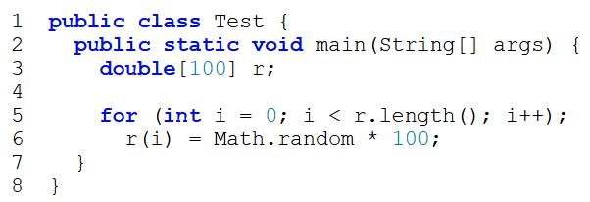
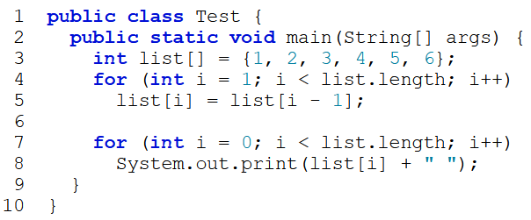
Popup-Question(2)
Checkpoint: 7.2.10: Identify and fix the errors in the following code?
Checkpoint: 7.2.11: What is the output of the following code?
Line 3: the array declaration is wrong. It should be double[]. The array needs to be created before it's been used. e.g., new double[10]
Line 5: The semicolon (;) at the end of the for-loop heading should be removed.
Line 5: r.length() should be r.length.
Line 6: random should be random()
Line 6: r(i) should be r[i].
Index | 0 | 1 | 2 | 3 | 4 | 5
Value | 1 | 2 | 3 | 4 | 5 | 6
New Value
New Value | 1 | 1 | 1 | 1 | 1 | 1

Slide 14
Processing Array
To process arrays, we often use a loop.
Printing array
System.out.println(Arrays.toString(values));
int[] array = {90, 60, 70, 85, 75};
for( int i = 0; i<array.length; i++){
System.out.println("[" + i + "] = " + array[i]);
}
for (int e: array) {
System.out.print(e + " ");
}
Reading array elements
for (elementType value: arrayRefVar){
// Process the value
}
Scanner input = new Scanner(System.in);
int[] array = new int[5];
System.out.print("Enter " + array.length + " values: ");
for (int i = 0; i < array.length; i++)
array[i] = input.nextInt();
Initializing arrays with random values
int[] array = new int[5];
for (int i = 0; i < array.length; i++)
array[i] = (int) ( Math.random() * 100 );
ArrayWithMethod.java

Slide 15
Processing Array
Summing array elements
int sum = 0;
for (int i = 0; i < array.length; i++)
sum = sum + array[i];
Finding the largest element
int maxNumber = Integer.MIN_VALUE;
for (int i = 0; i < array.length; i++)
if (array[i]> maxNumber )
maxNumber = array[i];
System.out.println("Maximum = " + maxNumber);
Find the smallest index of the largest element?
Random shuffling
int[] array = {90, 60, 70, 85, 75};
for (int i = 0; i < array.length; i++){
int j = ( int ) ( Math.random() * array.length);
int temp = array[i];
array[i] = array[j];
array[j] = temp;
}

Slide 16
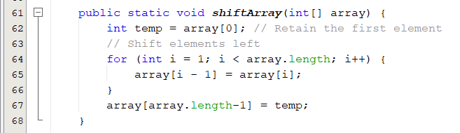
Shifting arrays
Shift array elements to left
0 | 1 | 2 | 3 | 4 | 5 | 6 | 7 | 8 | 9
50 | 90 | 65 | 80 | 60 | 75 | 95 | 78 | 64 | 81
0 | 1 | 2 | 3 | 4 | 5 | 6 | 7 | 8 | 9
90 | 65 | 80 | 60 | 75 | 95 | 78 | 64 | 81 | 50
Shift array elements to right?
ArrayShift.java

Slide 17
Array Assignment (1/2)
Array contents are stored together in one section of memory.
The location of the entire array contents can be specified by one memory address, the memory address of the array.
Using = operator
Does not copy the contents of the array referenced by array1 to array2.
Copies the reference value from array1 to array2
Before the assignment
array2 = array1;
After the assignment
array2 = array1;
array1
Elements of array1
array1
Elements of array1
array2
Elements of array2
array2
Elements of array2
Notes:
This statement does not copy the contents of the array referenced by array1 to array2, but instead merely copies the reference value from array1 to array2

Slide 18

Array Assignment (2/2)
Before statement 3
Address | value
 | 10
 | 20
 | 30
 | 0
 | 0
 | 0
Address | value
a
b
int[] a = {10, 20, 30 }
int[] b = new int[3];
b = a;
a[1]++;
print( a[1], b[1] )
after statement 3
Address | value
a
b
Address | value
 | 10
 | 21
 | 30
after statement 4
When we change the value of a[1]
we are also changing the value of b[1]
Address | value
a
b

Slide 19
Copying Arrays
Using a loop:
Using the arraycopy utility
Using clone method
targetArray = sourceArray.clone()
int[] sourceArray = {2, 3, 1, 5, 10};
int[] targetArray = new int[sourceArray.length];
for (int i = 0; i < sourceArray.length; i++)
targetArray[i] = sourceArray[i];
int[] sourceArray = {2, 3, 1, 5, 10};
int[] targetArray = new int[sourceArray.length];
System.arraycopy( sourceArray, 0, targetArray, 0, sourceArray.length);
The syntax for arraycopy is:
arraycopy( sourceArray, srcPos, targetArray, tarPos, length);
ArrayCopy.java
Notes:
You can write a loop to copy every element from the source array to the corresponding element in the target array. The following code, for instance, copies sourceArray to targetArray using a for loop:
Another approach is to use the arraycopy method in the java.lang.System class to copy arrays instead of using a loop. The syntax for arraycopy is:arraycopy(sourceArray, srcPos, targetArray, tarPos, length);

Slide 20
Arrays and Methods
You can use both array indexed variables and entire arrays as arguments to methods.
Passing an indexed variable:
Can be an argument to a method in exactly the same way that any variable of the array base type can be an argument.
Suppose we have the following declaration,
int[] myArray = {3, 5, 2, 5};
Suppose that myMethod is a method that takes one argument of type int, so the following is legal
myMethod (myArray[myIndex]) ,where 0<=myIndex<4
Passing an array:
The reference ( name ) of the array is passed to the method.
public static void printArray(int[] a) // printArray is a method that takes argument of type array (int[]).
To call this method, use: printArray( myArray );

Slide 21
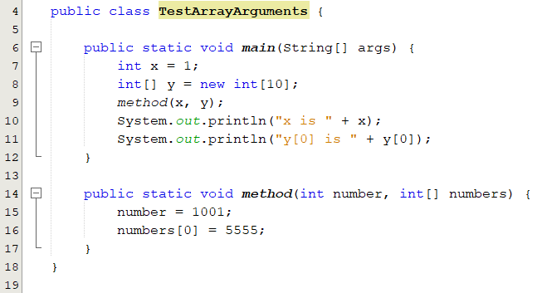
Passing Arrays to Methods
When passing an array to a method, the reference of the array is passed to the method.
Anonymous Array
method(x, new int[]{3, 1, 2, 6, 4, 2});
No explicit reference variable for the array.
TestArrayArguments.java

Slide 22
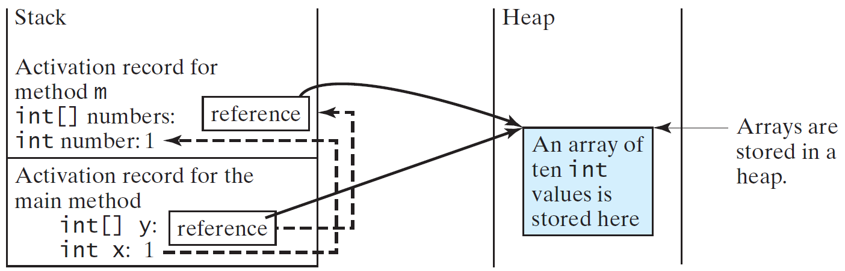
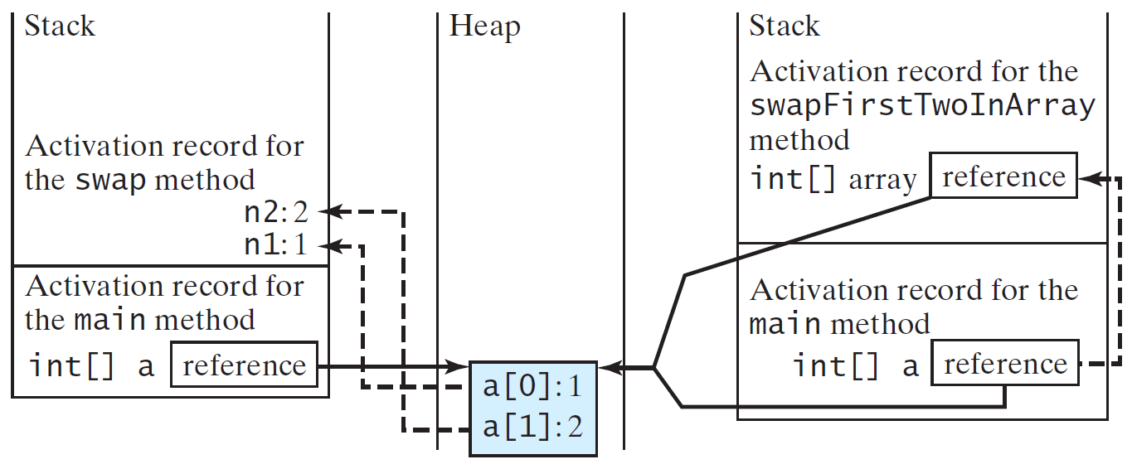
Call Stack
The JVM stores the array in an area of memory, called heap, which is used for dynamic memory.

Slide 23
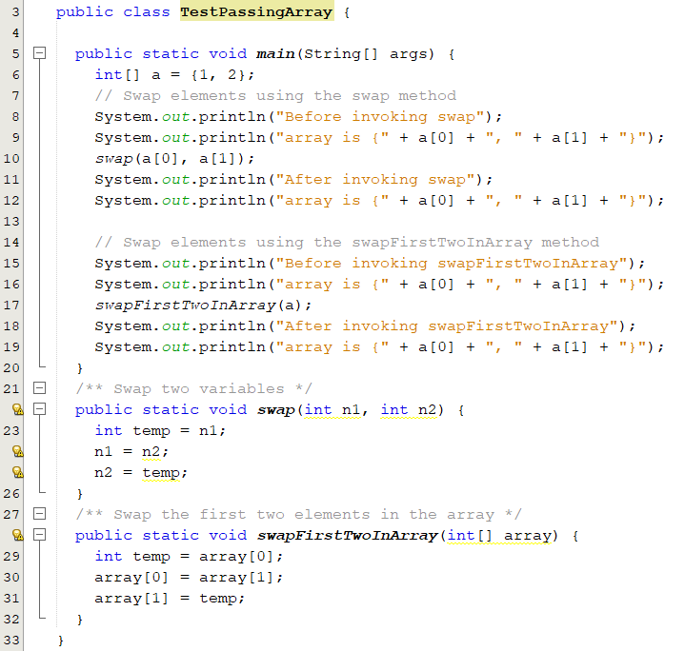
Popup-Question(3)
What is the output of the following code?
Before invoking swap
array is {1, 2}
After invoking swap
array is {1, 2}
Before invoking swapFirstTwoInArray
array is {1, 2}
After invoking swapFirstTwoInArray
array is {2, 1}
TestPassingArray.java

Slide 24
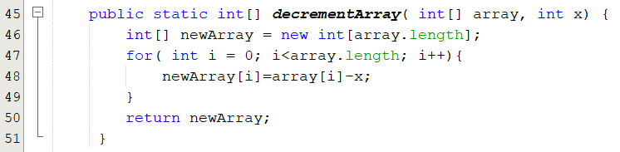
Methods That Return an Array
In Java, a method may return an array.
You specify the return type for a method that returns an array in the same way that you specify a type for an array parameter.
Syntax:
public static dataType[] methodName(Parameter_List)
The following is an example of a method that returns an array:

Slide 25
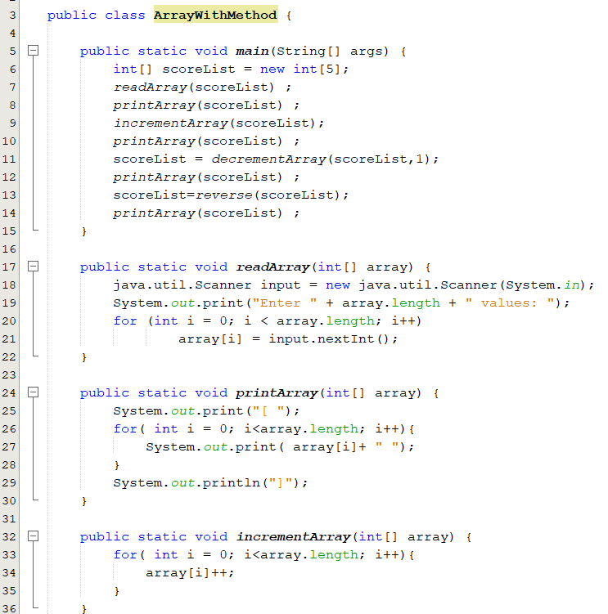
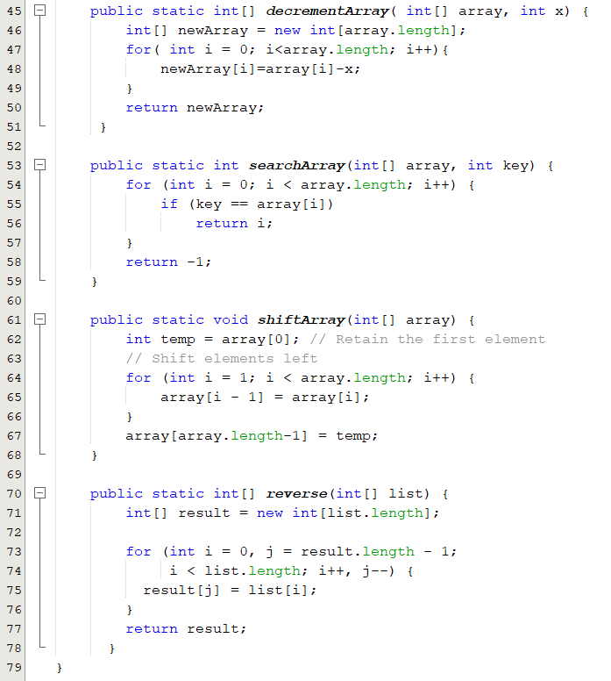
Arrays and Methods: Example
ArrayWithMethod.java

Slide 26
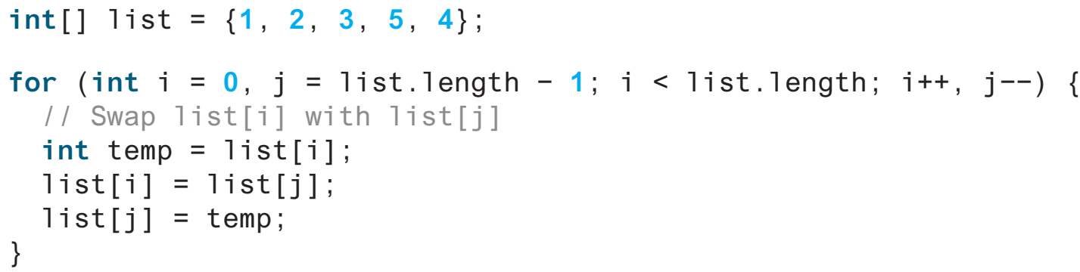
Popup-Question(4): Checkpoint: 7.7.1
Suppose the following code is written to reverse the contents in an array, explain why it is wrong. How do you fix it?
It swaps the elements twice. For example, the first element is swapped with the last element once and then the last element is swapped with the first element another time. In effect, the elements are not swapped. Here is the fix:
i < list.length / 2;

Slide 27
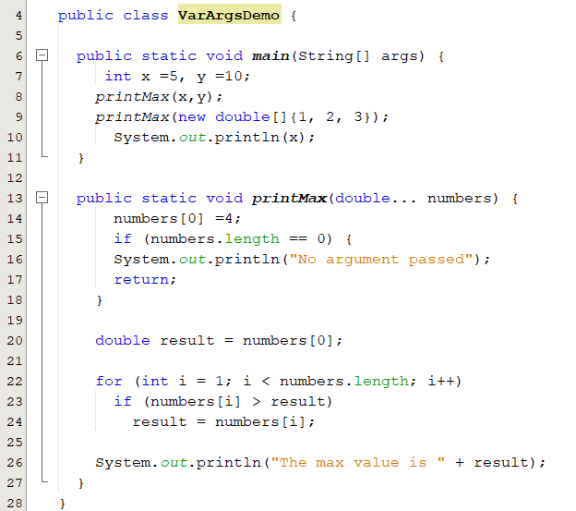
Variable-Length Arguments
You can pass a variable number of arguments of the same type to a method.
Only one variable-length parameter may be specified in a method, and this parameter must be the last parameter.
The method return type cannot be a variable-length parameter
The max value is 10.0
The max value is 4.0
5
VarArgsDemo.java

Slide 28
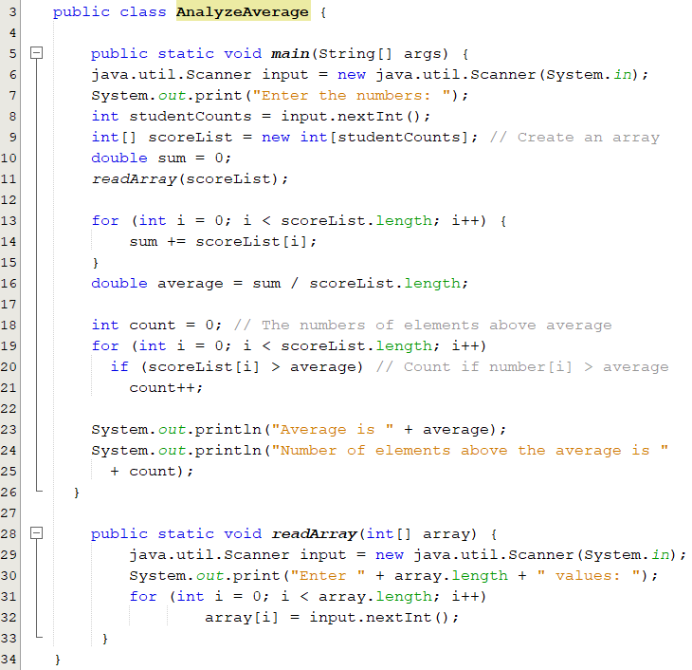
Motivation: Solution
Find the average score of n students and find out how many students are above the average
AnalyzeAverage.java

Slide 29
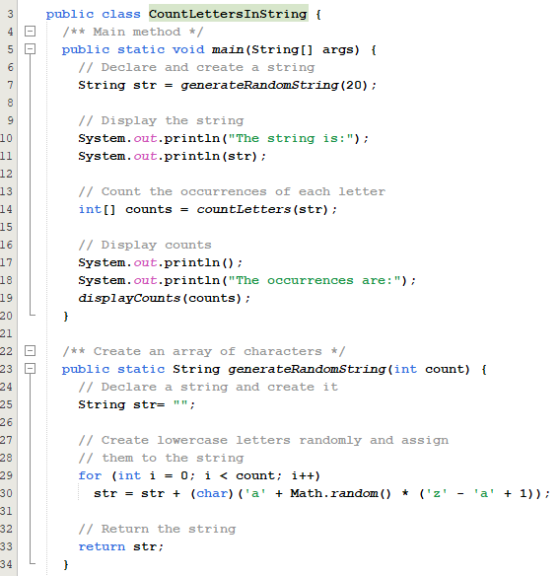
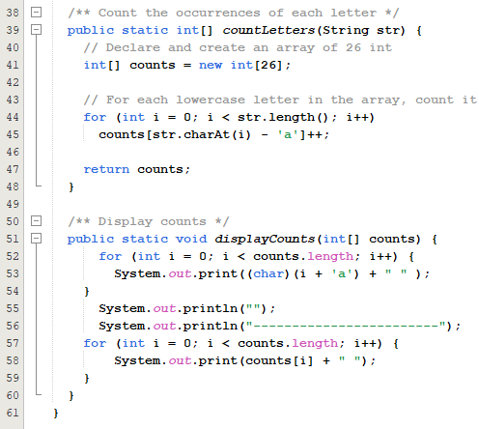
Problem: Counting Occurrence of Each Letter
Generate 100 lowercase letters randomly and count the occurrence of each letter in the string.
CountLettersInString.java
Notes:
package Chapter07_8;
public class CountLettersInString {
/** Main method */
public static void main(String[] args) {
// Declare and create a string
String str = generateRandomString(20);
// Display the string
System.out.println("The string is:");
System.out.println(str);
// Count the occurrences of each letter
int[] counts = countLetters(str);
// Display counts
System.out.println();
System.out.println("The occurrences are:");
displayCounts(counts);
}
/** Create an array of characters */
public static String generateRandomString(int count) {
// Declare a string and create it
String str= "";
// Create lowercase letters randomly and assign
// them to the string
for (int i = 0; i < count; i++)
str = str + (char)('a' + Math.random() * ('z' - 'a' + 1));
// Return the string
return str;
}
/** Count the occurrences of each letter */
public static int[] countLetters(String str) {
// Declare and create an array of 26 int
int[] counts = new int[26];
// For each lowercase letter in the array, count it
for (int i = 0; i < str.length(); i++)
counts[str.charAt(i) - 'a']++;
return counts;
}
/** Display counts */
public static void displayCounts(int[] counts) {
for (int i = 0; i < counts.length; i++) {
System.out.print((char)(i + 'a') + " " );
}
System.out.println("");
System.out.println("------------------------");
for (int i = 0; i < counts.length; i++) {
System.out.print(counts[i] + " ");
}
}
}

Slide 30
The Arrays Class
The java.util.Arrays class contains various static methods for
Sorting and searching arrays
Arrays.sort(array);
Arrays.binarySearch(array,15);
Comparing arrays
Arrays.equals(array1, array2);
Filling array elements
Arrays.fill(array, 1);
Returning a string representation of the array.
Arrays.toString(array);
These methods are overloaded for all primitive types.

Slide 31
2D Arrays
Why 2D arrays
Declare/Create/Initialize 2D Arrays
Processing 2D arrays
Reading
Printing
Summing all elements
Summing elements by row
Random shuffling
Passing 2D array to Methods
Ragged Array
Examples:
Finding two points nearest to each other
Grading MCQ test

Slide 32
Declaring 2D-Arrays
Declaring 2D-array
dataType[ ][ ] arrayName;
int[ ][ ] studentScores;
Creating 2D-array
arrayName = new datatype[rows ][cols ];
studentScores = new int[ 5][ 6];
Declaring and Creating 2D-array
dataType[ ][ ] arrayName = new datatype[ ][ ]
int [ ][ ] studentScores = new int[5][6];
Initializing 2D-array
int [ ][ ] studentScores = { {10, 20, 30}, {11, 22, 33},
{7, 9, 8}, {21, 31, 41},
}
Accessing array elements
array[0][0] = 1
 | 0 | 1 | 2 | 3 | 4 | 5
0 | 0 | 0 | 0 | 0 | 0 | 0
1 | 0 | 0 | 0 | 0 | 0 | 0
2 | 0 | 0 | 0 | 0 | 0 | 0
3 | 0 | 0 | 0 | 0 | 0 | 0
4 | 0 | 0 | 0 | 0 | 0 | 0
2D arrays use two indices
 | 0 | 1 | 2
0 | 10 | 20 | 30
1 | 11 | 22 | 33
2 | 7 | 9 | 8
3 | 21 | 31 | 41
Notes:
Note that this syntax is almost identical to the syntax we used for the one dimensional case. The only difference is that we added a second pair of square brackets in two places, and we gave a number specifying the size of the second dimension, that is, the number of columns

Slide 33
Representation of 2D-Arrays
A two-dimensional array is actually an array of arrays.
int [ ][ ] studentScores = { {10, 20, 30}, {11, 22, 33},
{7, 9, 8}, {21, 31, 41},
}
studentScores[0]
studentScores[1]
studentScores[2]
studentScores[3]
10 | 20 | 30
11 | 22 | 33
7 | 9 | 8
21 | 31 | 41
act as if the array is actually an array with two indices
studentScores.length is 4
studentScores[0].length is 3
studentScores[3][1]
Notes:
The Java compiler represents a multidimensional array as several one dimensional array

Slide 34
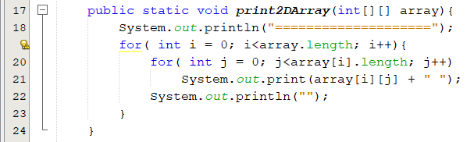
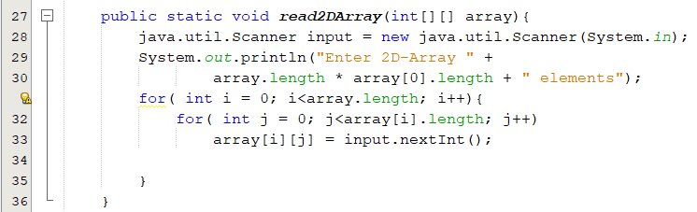
Processing 2D-Array
Printing a 2D-array
Reading a 2D-array
TwoDArray.java

Slide 35
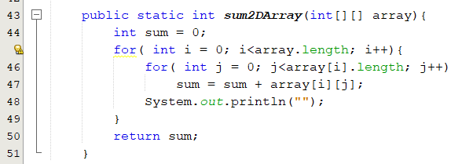
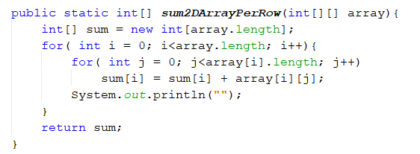
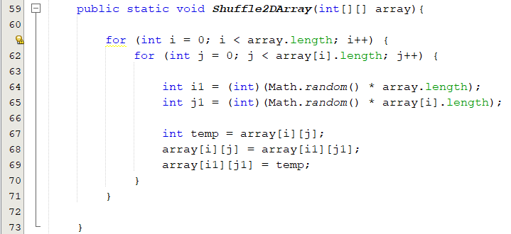
Processing 2D-Array
Summing a 2D-array elements
Random shuffling

Slide 36
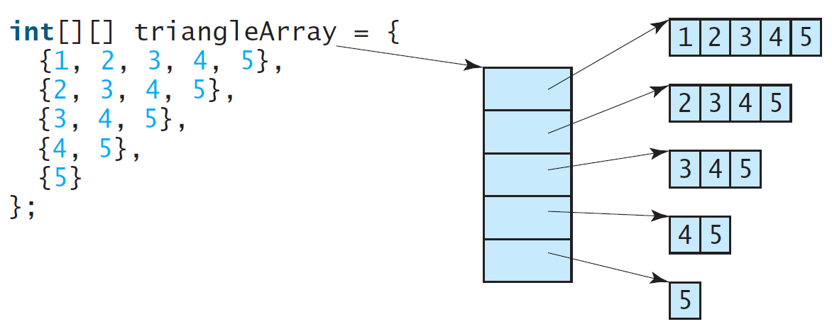
Ragged Arrays
Rows can have different lengths
matrix.length is 5
matrix[0].length is 5
matrix[1].length is 4
matrix[2].length is 3
matrix[3].length is 2
matrix[4].length is 1

Slide 37
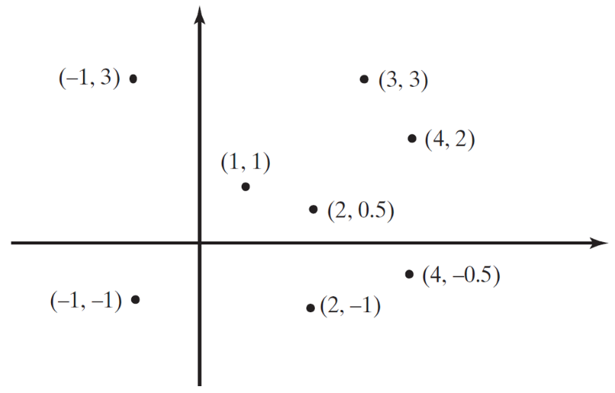
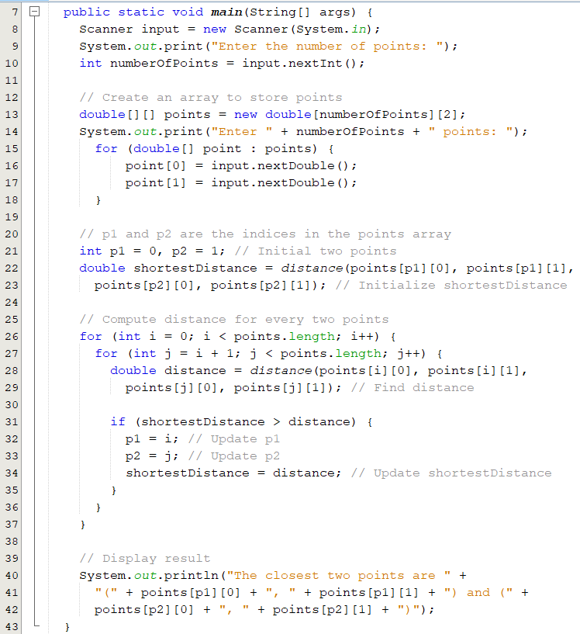

Problem: Finding Two Points Nearest to Each Other
FindNearestPoints.java

Slide 38
The ArrayList Class
You can create an array to store objects. But the array’s size is fixed once the array is created. Java provides the ArrayList class that can be used to store an unlimited number of objects.

Slide 39
Generic Type
ArrayList is known as a generic class with a generic type E.
You can specify a concrete type to replace E when creating an ArrayList.
For example, the following statement creates an ArrayList and assigns its reference to variable cities.
This ArrayList object can be used to store strings.
ArrayList<String> cities = new ArrayList<String>();
ArrayList<String> cities = new ArrayList<>();

Slide 40
Arrays vs Array Lists

Slide 41
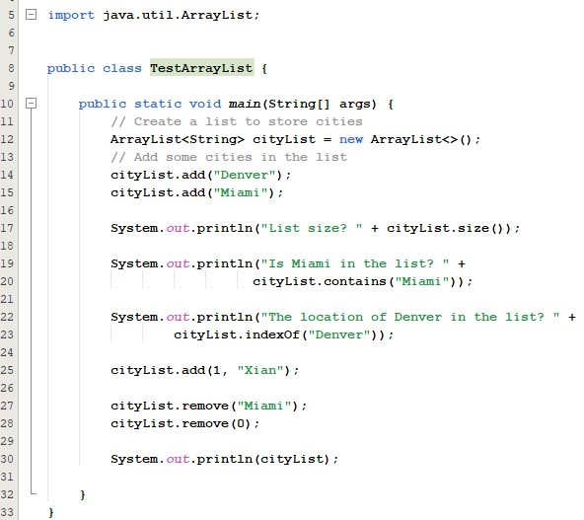
Example
Notes:
import java.util.ArrayList;
public class TestArrayList {
public static void main(String[] args) {
// Create a list to store cities
ArrayList<String> cityList = new ArrayList<>();
// Add some cities in the list
cityList.add("Denver");
cityList.add("Miami");
System.out.println("List size? " + cityList.size());
System.out.println("Is Miami in the list? " +
cityList.contains("Miami"));
System.out.println("The location of Denver in the list? " +
cityList.indexOf("Denver"));
cityList.add(1, "Xian");
cityList.remove("Miami");
cityList.remove(0);
System.out.println(cityList);
}
}

Slide 42
Array Lists from/to Arrays
Creating an ArrayList from an array:
String[] array = {"red", "green", "blue"};
ArrayList<String> list = new ArrayList<>(Arrays.asList(array));
Creating an array from an ArrayList:
String[] array1 = new String[list.size()];
list.toArray(array1);

