Slide 1
Module 08: Exception Handling & Text I/O

Slide 2
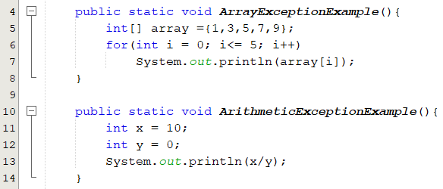

Motivation
What would happen?
The program terminates abnormally.
How can you handle the runtime error so that the program can continue to run or terminate gracefully?

Slide 3
Objectives
To get an overview of exceptions (§12.1).
To explore exception handling and its advantages (§12.2).
To understand the exception class hierarchy (§12.3).
To distinguish exception types:
Error (fatal) vs. Exception (nonfatal).
checked vs. unchecked.
To declare/ throw/ catch exceptions(§12.4) - (§12.7).
To use finally block(§12.5).
To create user-defined exceptions (§12.9).

Slide 4
Exceptions: Runtime Errors
When a program runs into a runtime error, the program terminates abnormally.
An exception is an object that represents an error or a condition that prevents execution from proceeding normally.
Exception Causes:
Operating system: Memory violation, disk full, stack overflow.
Language: Type conversion, Bound violation, class not found.
Input/output errors: EOF, file doesn’t exist, socket connection closed, URL doesn’t exits.
How can you handle runtime errors so that the program can continue to run or terminate gracefully?
Exception handling enables a program to deal with runtime errors and continue its normal execution.
Notes:
Runtime errors occur while a program is running if the JVM detects an operation that is impossible to carry out. For example, if you access an array using an index that is out of bounds, you will get a runtime error with an ArrayIndexOutOfBoundsException.
If you enter a double value when your program expects an integer, you will get a runtime error with an InputMismatchException.
If the exception is not handled, the program will terminate abnormally.
How can you handle the exception so the program can continue to run or else terminate gracefully?
This chapter introduces this subject
An exception is an unwanted or unexpected event, which occurs during the execution of a program i.e at run time, that disrupts the normal flow of the program’s instructions.

Slide 5
Some Exceptions(1/2):
ArithmeticException:
Java does not allow division by zero in integer arithmetic.
Java does allow division by zero with floating-point values
System.out.println(1.0/0); // Infinity or -Infinity
System.out.println(0.0/0); // NaN
NullPointerException
Thrown when an application invoke a method or accessing or modifying the field of a null object.
ArrayIndexOutOfBoundsException
StringIndexOutOfBoundsException
ClassCastException:
Indicate that the code has attempted to cast an object to a subclass of which it is not an instance.
SimpleCircle circle; circle.getArea();
int[] list = {2, 4, 6, 8};
System.out.println(list[4]);
String s = “ICS108";
System.out.println(s.charAt(6));
Object x = new Integer(0);
System.out.println((String) x );

Slide 6
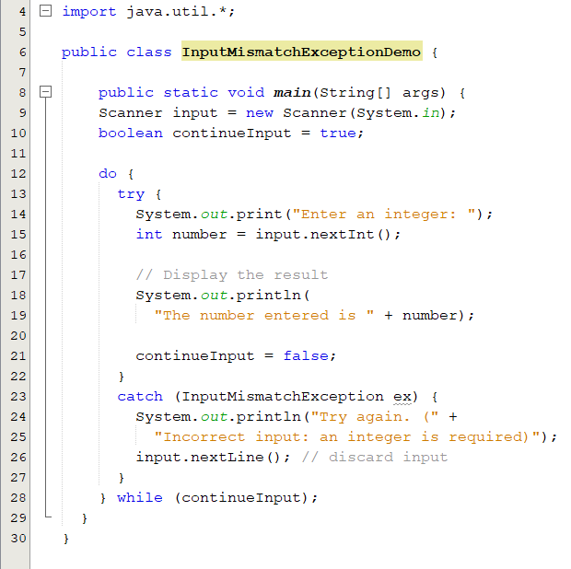
Some Exceptions(2/2):
InputMismatchException
thrown by a Scanner to indicate that the token retrieved does not match the pattern for the expected type.
NumberFormatException
Indicates that the application has attempted to convert a string to one of the numeric types, but that the string does not have the appropriate form
String str="1.2r";
Double.parseDouble(str);
What would happen:
If the user enters 5
If the user enters java

Slide 7
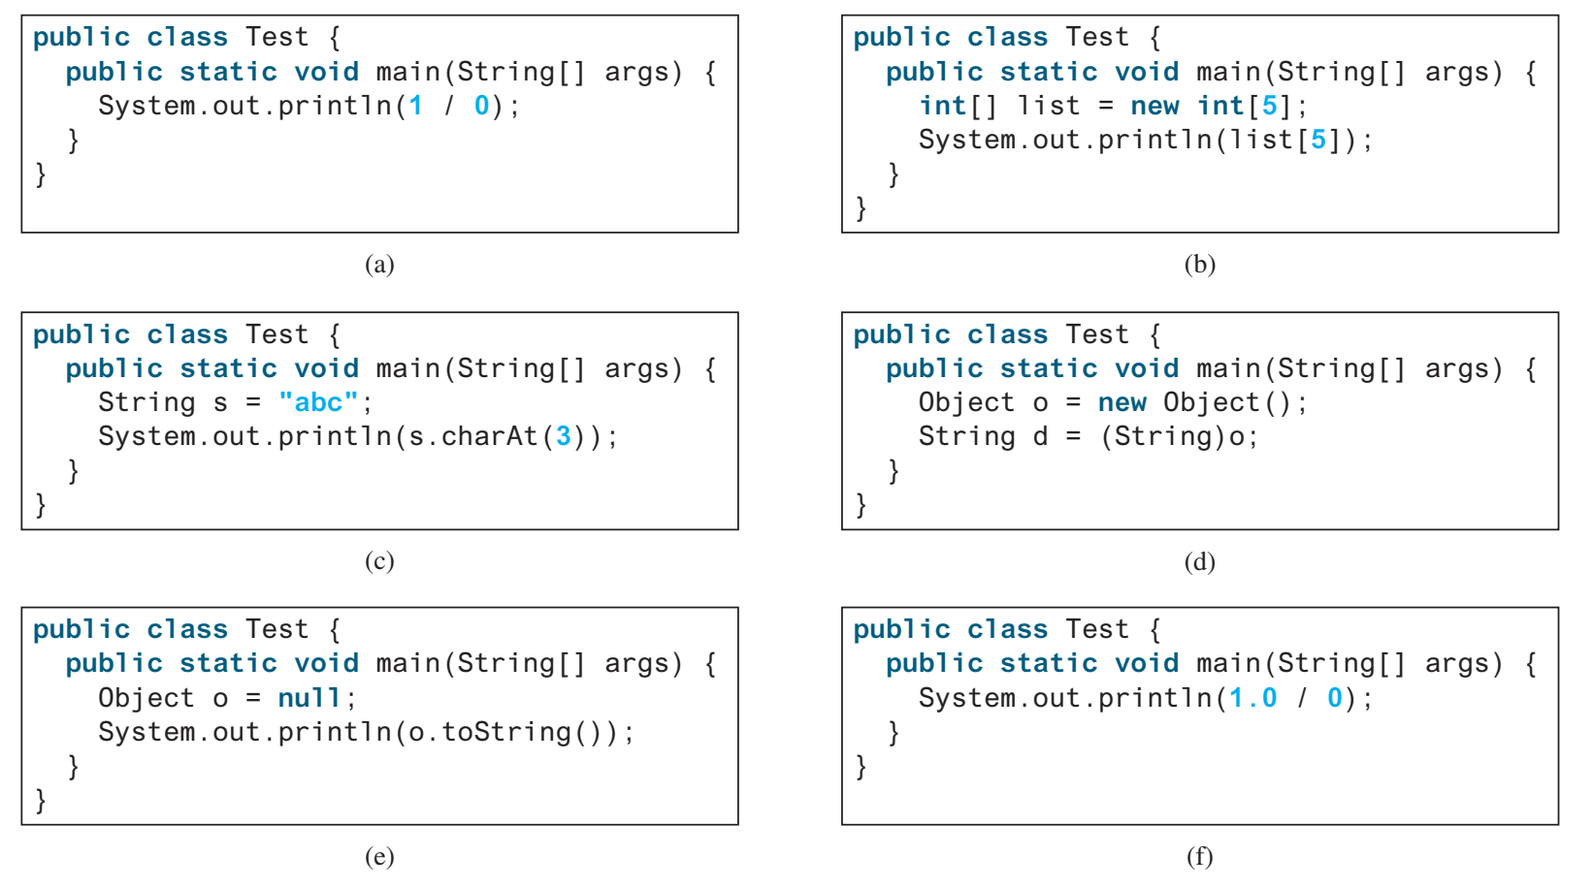
Popup-Question(1)
12.3.2 What RuntimeException will the following programs throw, if any?
a. ArithmeticException b.ArrayIndexOutOfBoundsException
c. StringIndexOutOfBoundsException d. ClassCastException
e. NullPointerException f. No exception

Slide 8
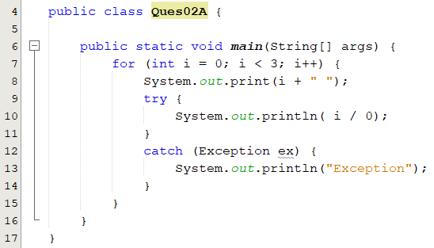
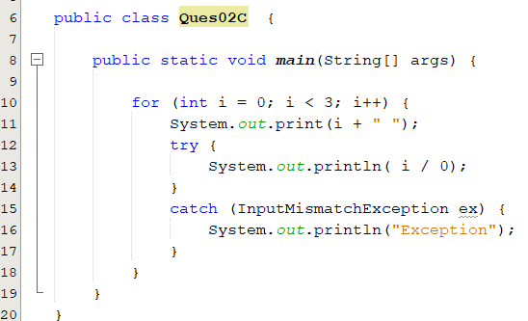
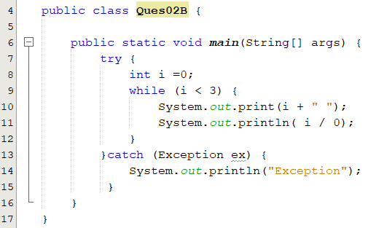
Popup-Question(2)
What is the output of the following code segments?
ArithmeticException: / by zero
0 Exception
1 Exception
2 Exception
0 Exception

Slide 9
Exception Types: System Errors
Represented in the Error class.
Thrown by JVM.
Describes internal system errors, infrequent errors.
Example: VirtualMachineError.
Run out of memory.
If one does, there is little you can do beyond notifying the user and trying to terminate the program gracefully.
1
Notes:
StackOverflowError
https://blog.fastthread.io/2018/09/24/stackoverflowerror/

Slide 10
Exception Types: Exceptions
Represented in the Exception class.
Thrown by Java program and external circumstances.
Can be caught and handled by Java programs.
2

Slide 11
Exception Types: Runtime Exceptions
Represented in the RuntimeException class.
Can be caught and handled by your program.
Programming errors, such as bad casting and numeric errors.
3

Slide 12
Checked Exceptions vs. Unchecked Exceptions
The compiler forces the programmer to check and deal with them in a try-catch block or declare it in the method header.
Checked exceptions
unchecked exceptions
Notes:
In most cases, unchecked exceptions reflect programming logic errors that are not recoverable.
For example, a NullPointerException is thrown if you access an object through a reference variable before an object is assigned to it; an IndexOutOfBoundsException is thrown if you access an element in an array outside the bounds of the array. These are the logic errors that should be corrected in the program. Unchecked exceptions can occur anywhere in the program. To avoid cumbersome overuse of try-catch blocks, Java does not mandate you to write code to catch unchecked exceptions.

Slide 13
Catching Exceptions(1/2)
When an exception is thrown, it can be caught and handled in a try-catch block.
try block encloses code that might throw an exception.
Begins with the keyword try followed by a block of code.
catch block
Allows you to define a block of code to be executed, if an error occurs in the try block.
try {
// statements that may cause an exception
} catch (ExceptionType1 object1) {
//handler for exception2
}
…
…
catch (ExceptionTypeN objectN) {
//handler for exceptionN
}
try {
// statements that may cause an exception
} catch (ExceptionType1 | ExceptionType2 object) {
//error handling code
}
Notes:
If the bodies of several catch blocks are identical, you can use the multi-catch feature (introduced in Java SE 7) to catch those exception types in a single catch handler and perform the same task
Each exception type is separated from the next with a vertical bar (|).
The preceding line of code indicates that any of the types (or their subclasses) can be caught in the exception handler

Slide 14
Catching Exceptions(2/2)
The process of finding a handler for an exception.
If no exceptions are thrown in a try block
The try block executes.
The catch blocks are skipped.
Statement after the try-catch block executes.
If an exception occurs in a try block
The try block terminates immediately.
Program control transfers to the first matching catch block.
When a try or catch block terminates, local variables declared in that block go out of scope.
The local variables of a try or catch block are not accessible in the corresponding catch blocks.
Try block
Catch block
Catch block
Catch block
Next block
Try block
Catch block
Catch block
Catch block
Next block
Notes:
The try block executes.
The catch blocks are skipped.
Control continues with the first statement after the catch block

Slide 15
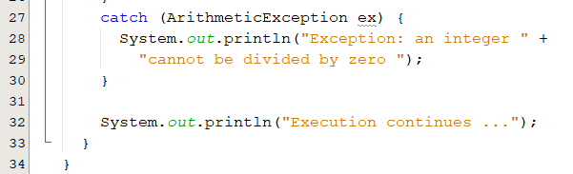
try-catch Statement(1/3)
catch block
Also called a catch clause or exception handler.
Begins with the keyword catch followed by exception parameters in parentheses and a block of code enclosed in curly braces.
Exception parameter identifies the exception type the handler can process.
The mentioned exception type (or its subclasses) can be caught in the exception handler.
Exception type
catch–block parameter
Handle related exceptions polymorphically
What do we call this feature?

Slide 16
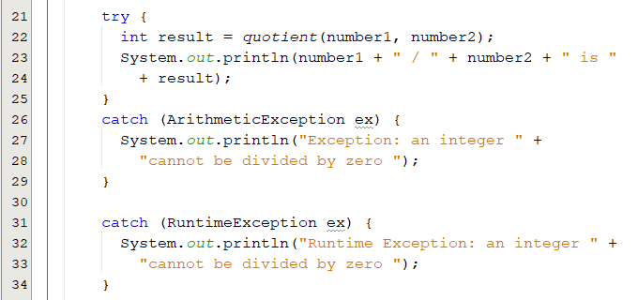
try-catch Statement(2/3)
When an exception occurs in a try block, the catch block that executes is the first one whose type matches the type of the exception that occurred.
Any remaining catch blocks in the try-catch statement are ignored.
When a catch block terminates,
Execution resumes at the first line of code after the t-catch block.
At least one catch block or a finally must immediately follow the try block.
Which catch block would be execute if we replace ArithmaticException with IOException ?

Slide 17
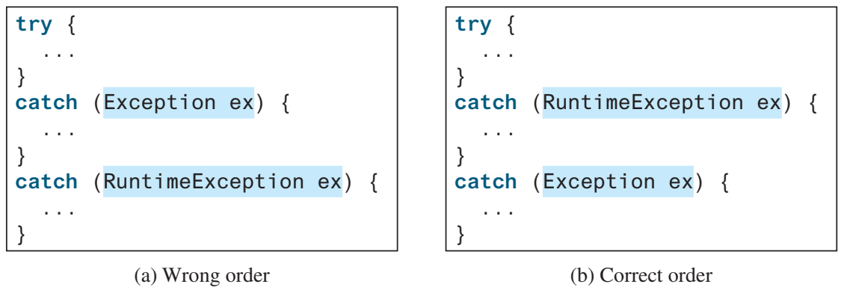
try-catch Statement(3/3)
The order in which exceptions are specified in catch blocks is important.
A compile error will result if a catch block for a superclass type appears before a catch block for a subclass type.
A superclass type appears before a subclass type.
A subclass type appears before a superclass type.
×
√

Slide 18
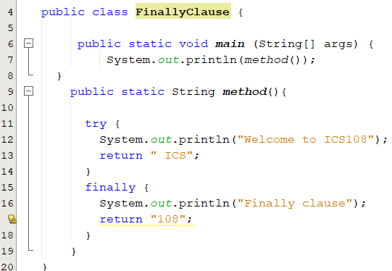
The finally Clause(1/2)
Always executed regardless of whether an exception occurred or not.
Executes if a try-catch block exits by using a return statement.
Overrides the values returned by try-catch clause.
try {
statements;
}
catch(ExceptionType ex) {
handling ex;
}
finally {
finalStatements;
}
try {
statements;
}
finally {
finalStatements;
}
Welcome to ICS108
Finally clause
108
Notes:
Occasionally, you may want some code to be executed regardless of whether an exception occurs or is caught.
The code in the finally block is executed under all circumstances, regardless of whether an exception occurs in the try block or is caught .

Slide 19
The finally Clause(2/2)
No exceptions →
statement1
statement2
finalStatement
lastStatement
try {
statement1;
statement2;
}
catch(ExceptionType1 ex1) {
handling ex1;
}
catch(ExceptionType2 ex2) {
handling ex2;
throw ex;
}
finally {
finalStatement;
}
lastStatement;
Exception of type ExceptionType1 is thrown by statement1 →
statement1
handling ex1
finalStatement
lastStatement
Exception of type ExceptionType2 is thrown by statement1 →
statement1
handling ex2;
finalStatement
throw ex;
Exception of type neither ExceptionType1 nor ExceptionType2 is thrown by statement1 →
statement1
finalStatement
and then terminates because of an unhandled exception
Notes:
Occasionally, you may want some code to be executed regardless of whether an exception occurs or is caught.
The code in the finally block is executed under all circumstances, regardless of whether an exception occurs in the try block or is caught .

Slide 20
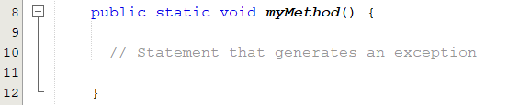
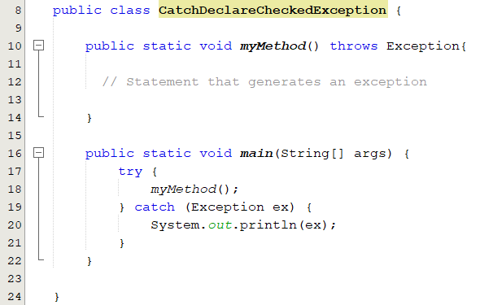
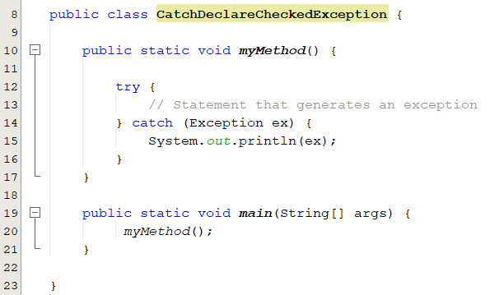
Catch or Declare Checked Exceptions
Compiler enforces a catch-or-declare requirement for checked exceptions.
Either we will handle it within method.
Or we can pass it to the caller method to be handled there.
An error is thrown by the compiler
Solution 2
Solution 1

Slide 21
Declaring and Throwing Exceptions
The throws keyword in the method header is used to declare an exception in a method.
throws clause:
Specifies the exceptions a method might throw if problems occur.
Must appear after the method’s parameters and before the body.
May contains a list of exceptions separated by comma.
public void myMethod() throws IOException{}
Indicates myMethod might throw an IOException
public void myMethod() throws IOException, OtherException{}
If a method does not declare exceptions in the superclass, you cannot override it to declare exceptions in a subclass.

Slide 22
Throwing Exceptions
When program detects an error.
Can create an instance of an appropriate exception type.
Throw that exception.
ArithmeticException ex = new ArithmeticException(“Divisionby zero”);
throw ex;
throw new ArithmeticException(“Divisionby zero”);
/** Set a new radius */
public void setRadius(double newRadius) throws IllegalArgumentException {
if (newRadius >= 0)
radius = newRadius;
else
throw new IllegalArgumentException("Radius cannot be negative");
}

Slide 23
Popup-Question(3)
What is legal and illegal in the following code?
public static void main(String[] args) {
try {
int[] list = new int[5];
System.out.println("list[5] is " + list[5]);
}
catch (ArithmeticException ex) {
System.out.println("ArithmeticException");
}
catch (Exception ex) {
System.out.println("Exception");
}
catch (Runtime Exception ex) {
System.out.println("Runtime Exception");
}
}

Slide 24
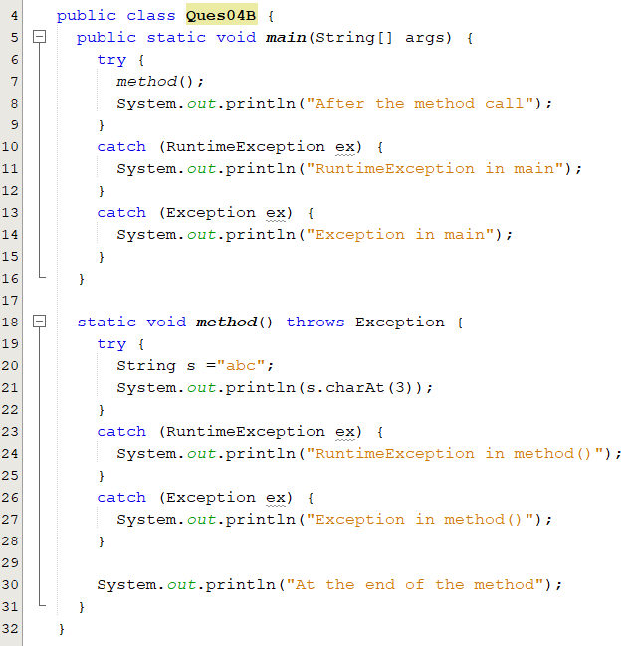
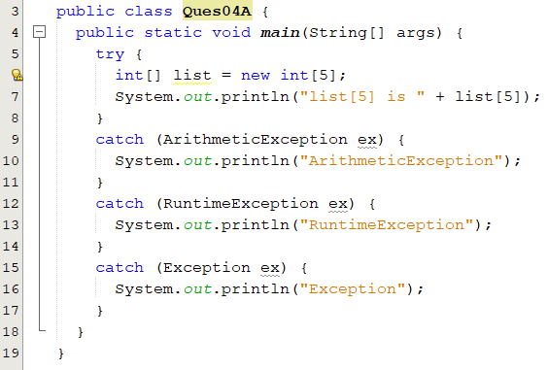
Popup-Question(4)
What is displayed when running the following programs?

Slide 25
Defining Custom Exception Class
Use Java predefined exception classes whenever possible.
You can create your own exception classes.
How two define custom exception:
Derive it from Exception or from a subclass of Exception.
Define two constructors, a default constructor and one that has a single String parameter.
Start each constructor definition with a call to the constructor of the base class, using super.
It is legal to define other methods, most time you do not need that.
You should not declare an exception that extends Error class.
When an exception of Error type occurs, your program would terminate.
Notes:
You can define your own exception classes, but they must be derived classes of some already defined exception class.
An exception class can be a derived class of any predefined exception class or of any exception class that you have already successfully defined.
Use the class Exception as the base, if you have no compelling reason to use any other class as the base class.

Slide 26
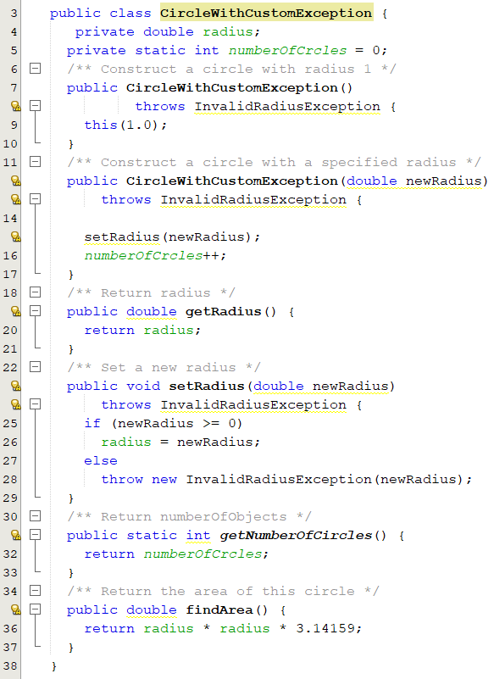
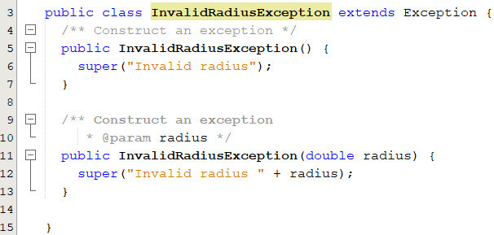
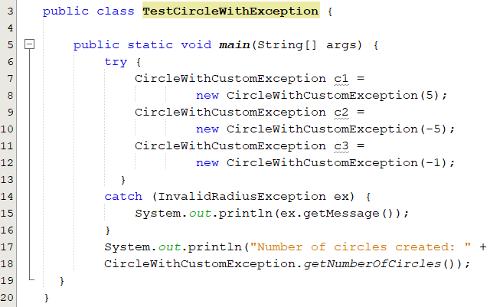
Custom Exception: Example

Slide 27
Text I/O

Slide 28
Motivation
The input and output operation that we have performed so far were done through screen and keyboard only.
Once we compile and run the program, we have to enter the input and the output is printed on the screen.
This output is not stored in the form of information anywhere in the system.
If you terminate the program, the output will be lost.
If we want to get the output of the program, it becomes a tedious task to run the same program multiple times.
What do we have to do if we want to store the output produced for future references?
Notes:
The keyboard input and screen output we have used so far deal with temporary data. When the program ends, the data typed at the keyboard and left on the screen go away. Files provide you with a way to store data permanently. The contents of a file remain until a person or program changes the file. An input file can be used over and over again by different programs, without the need to type the data again for each program. Files also provide you with a convenient way to deal with large quantities of data. When your program takes its input from a large input file, it receives a lot of data without user effort.
The input and output operation that we have performed so far were done through screen and keyboard only.
After the termination of program all the entered data is lost because primary memory is volatile .
If the data has to be used later ,then it becomes necessary to keep it in permanent storage device. so the Java language provide the concept of file through which data can be stored on the disk or secondary storage device.
The stored data can be read whenever required.
This is where file handling comes into play.

Slide 29
Motivation
Java language provides the concept of file through which data can be stored on the disk or secondary storage devices.
The stored data can be read/written whenever required.
A computer file is used to store data in digital format.
Plain text, image data, or any other content.
Computer files can be organized inside different directories.
Files are used to keep digital data, whereas directories are used to keep files.

Slide 30
Objectives
To use the File class to discover file/directory properties, to delete and rename files/directories, and to create directories (§12.10).
To write data to a file using the PrintWriter class (§12.11.1-2).
To read data from a file using the Scanner class. (§12.11.3-4).
To develop programs that manipulate text files. (§12.11.5).
To read data from the Web (§12.12) and (§12.13) .

Slide 31
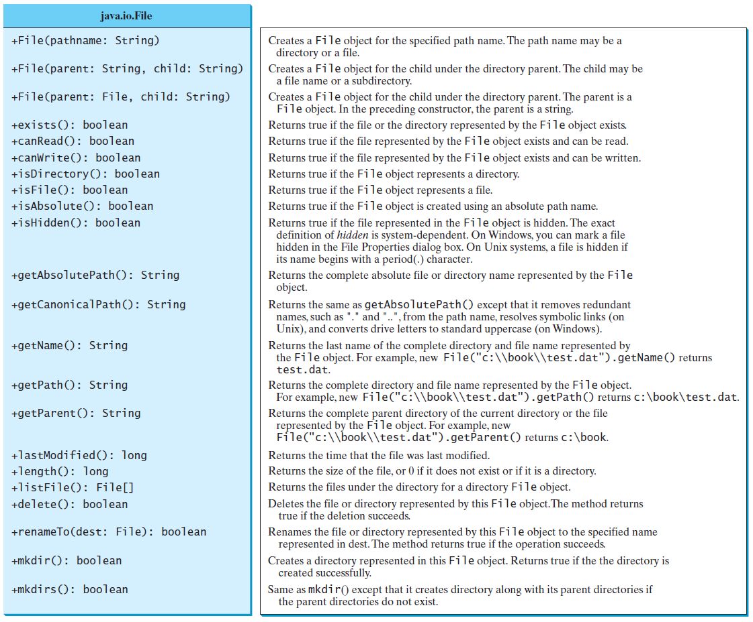
The File Class
The File class from the java.io package, allows us to work with files.
https://docs.oracle.com/javase/9/docs/api/java/io/File.html
It provides an abstraction that deals with files in a machine-independent fashion.
It has methods that operate on files and directories.
Creating, renaming and deleting files and directories.
It is a wrapper class for the file name and its directory path.

Slide 32
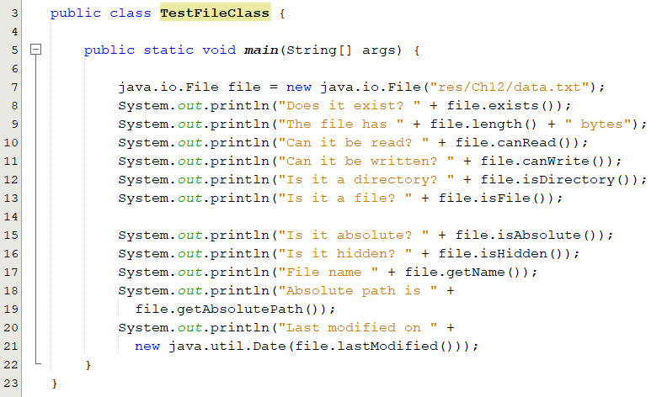
Files Properties: Example
Create a file object.
Creating a File object does not create a file/directory on the disk.
File name is a string.
Absolute file name:
A file name with its complete path and drive letter.
It is machine dependent.
Examples: c:\\book\\Welcome.java or home/book/Welcome.java.
Relative name:
Is in relation to the current working directory.
Example: Welcome.java
Output:
Does it exist? true
The file has 66 bytes
Can it be read? true
Can it be written? true
Is it a directory? false
Is it a file? true
Is it absolute? false
Is it hidden? false
File name data.txt
Absolute path is C:\Users\othmanr\Documents\NetBeansProjects\ICS108\res\Ch12\data.txt
Last modified on Fri Nov 05 19:44:15 AST 2021

Slide 33
How Is Text I/O Handled in Java?
File object encapsulates the properties of a file.
Does not have methods for reading/writing data from/to a file.
To perform I/O, you need to create objects using appropriate Java I/O classes.
Use their methods for reading/writing data from/to a file.
There are many I/O classes for various purposes.
Input Classes
Contain methods to read data. e.g. Scanner
Output Classes
Contain methods to write data. e.g. PrintWriter

Slide 34
Input and Output Classes
Scanner input = new Scanner(new File("temp.txt"));
System.out.println( input.nextLine() );
Input stream
An object reads a stream of data from a file.
PrintWriter output = new PrintWriter("temp.txt");
output.println("Java 101");
output.close();
Output stream
An object writes a stream of data to a file
Notes:
f temp.txt contains the text Java 101, input.nextLine() returns the string "Java 101". Figure 17.1 illustrates Java I/O programming. An input object reads a stream of data from a file, and an output object writes a stream of data to a file. An input object is also called an input stream and an output object an output stream

Slide 35
Steams
Java performs I/O operation through streams
Java defines two types of streams Byte Stream and Character stream.
Byte streams provide a convenient means for handling input and output of bytes. Byte streams are used when reading or writing binary data.
Character streams provide a convenient means for handling input and output of characters. They use Unicode and, therefore, can be internationalized.
At the lowest level, all I/O are byte oriented. Java implements streams within class hierarchies defined in the java.io package.

Slide 36
PrintWriter Class
The java.io.PrintWriter class can be used to create a file and write data to a text file.
PrintWriter
+PrintWriter(filename: String) +PrintWriter(file: File) +print(s: String): void +print(c: char): void +print(cArray: char[]): void +print(i: int): void +print(l: long): void +print(f: float): void +print(d: double): void +print(b: boolean): void Also contains the overloaded println methods. Also contains the overloaded printf methods.
Creates a PrintWriter for the specified file name. Creates a PrintWriter for the specified file. Writes a string. Writes a character. Writes an array of character. Writes an int value. Writes a long value. Writes a float value. Writes a double value. Writes a boolean value. A println method acts like a print method; additionally, it prints a line separator. The line separator string is defined by the system. It is \r\n on Windows and \n on Unix. The printf method was introduced in §4.6, “Formatting Console Output and Strings.”
https://docs.oracle.com/en/java/javase/19/docs/api/java.base/java/io/PrintWriter.html

Slide 37
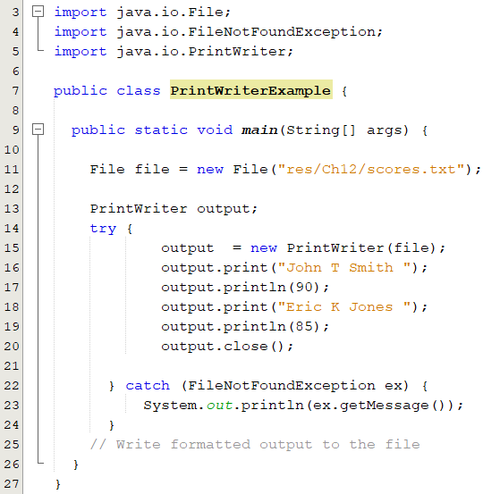
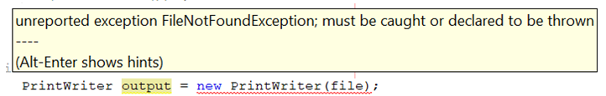
Writing Data Using PrintWriter
Create a PrintWriter object for a text file
PrintWriter output = new PrintWriter(filename);
Invoke the print, println and printf methods on the PrintWriter.
scores.txt
John T Smith 90
Eric K Jones 85
Notes:
Lines 4–7 check whether the file scores.txt exists. If so, exit the program (line 6). Invoking the constructor of PrintWriter will create a new file if the file does not exist. If the file already exists, the current content in the file will be discarded without verifying with the user. Invoking the constructor of PrintWriter may throw an I/O exception. Java forces you to write the code to deal with this type of exception. For simplicity, we declare throws IOException in the main method header (line 2).

Slide 38
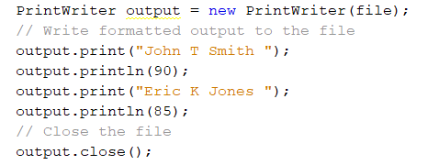
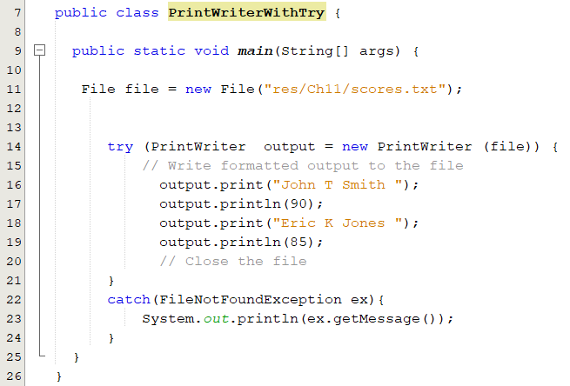
Using try-with-resources
Used to automatically close files.
declare/create a resource →
use the resource →
The printerWriter close() method is automatically invoked to close the resource
→
Closing a stream ensures that:
Data will be written to the file.
Resource acquired by the stream object are releases.
Two ways to close a stream:
Invoking the close() method.
Using the try-catch-resource to automatically close the stream.
Notes:
Programmers often forget to close the file. JDK 7 provides the followings new try-withresources syntax that automatically closes the files.
A resource is declared and created followed by the keyword try. Note the resources are enclosed in the parentheses.
he statements in the block (lines 12–18) immediately following the resource declaration use the resource. After the block is finished, the resource’s close()method is automatically invoked to close the resource

Slide 39
Reading Data Using Scanner
Used to read string and primitive values from the console.
Scanner input = new Scanner (System.in);
To read from a file, create a Scanner for a file.
Scanner input = new Scanner( new File (filename) );
It breaks its input into tokens delimited by whitespace characters.
If the token does not match the expected type, a runtime exception java.util.InputMismatchException will be thrown.
You can use the useDelimiter(String regex) method to set a new pattern for delimiters.

Slide 40
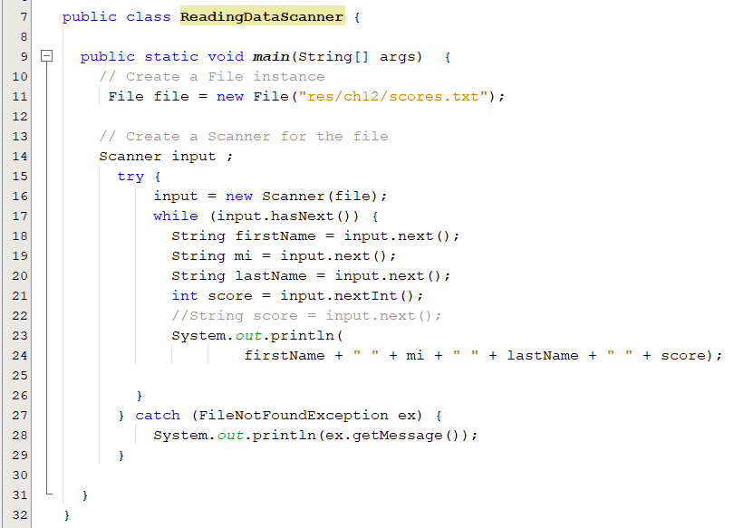
Reading Data Using Scanner
Create a Scanner for the file
Create a file object
May throw an I/O exception
John T Smith 90
Eric K Jones 85
Notes:
o create an instance of the File using the constructor new File(filename) (line 6) and use new Scanner(File) to create a Scanner for the file

Slide 41
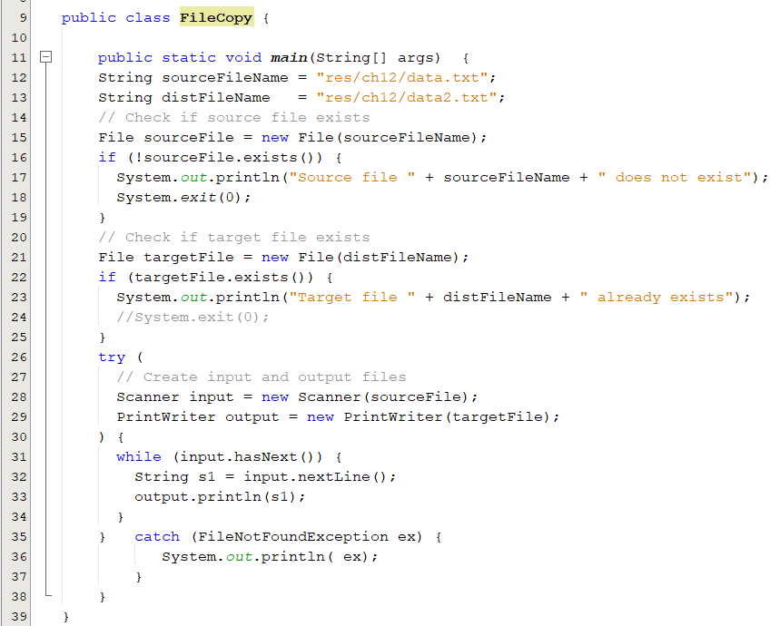
Case Study: File Copy
Case Study: Replacing Text
s1 = s1.replaceAll(oldString, nesString);

Slide 42
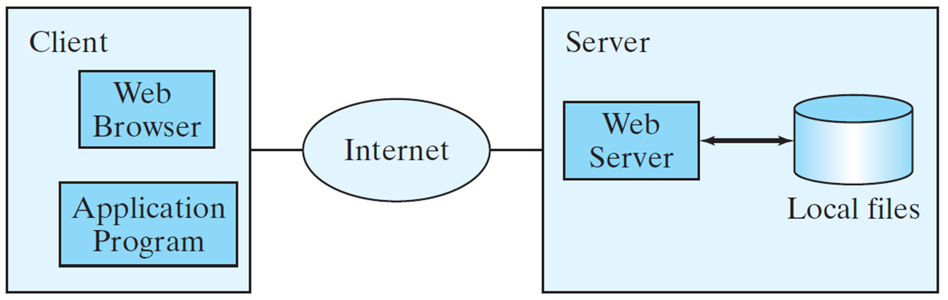
Reading Data from the Web
Java programs can read data from a file that is on the Web .
Create a URL object using the java.net.URL class:
URL(String spec) throws MalformedURLException
Use the openStream() method defined in the URL class to open an input stream.
Use this stream to create a Scanner
Read data from the input stream just like from a local file.
try {
URL url = new URL("http://www.google.com/index.html");
} catch (MalformedURLException ex) {
ex.printStackTrace();
}
Scanner input = new Scanner(url.openStream());
Notes:
In addition to reading data from a local file on a computer or file server, you can also access data from a file that is on the Web if you know the file’s URL

Slide 43
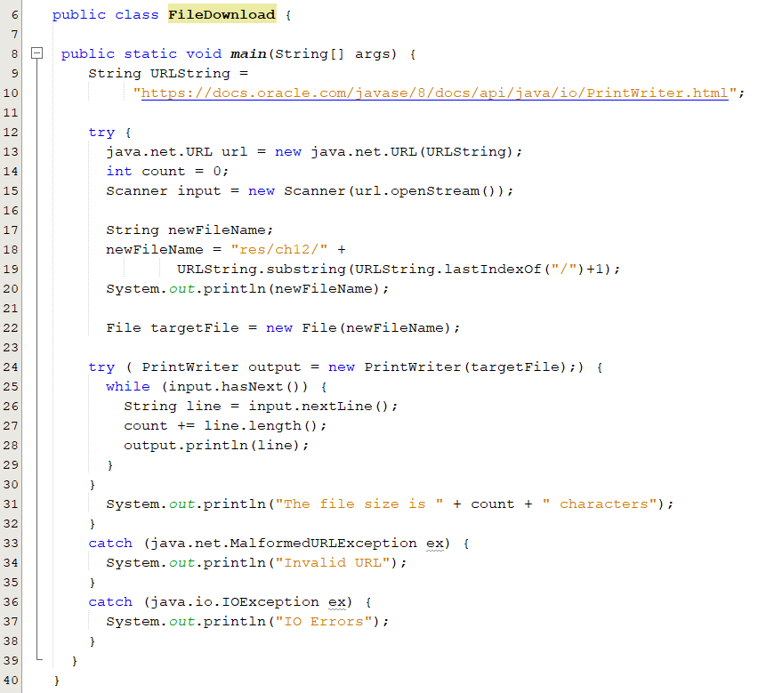
File Download
Create a URL object using the java.net.URL class.
Use the openStream() method defined in the URL class to open an input stream.
3. Read data from the input stream just like from a local file.

Slide 44
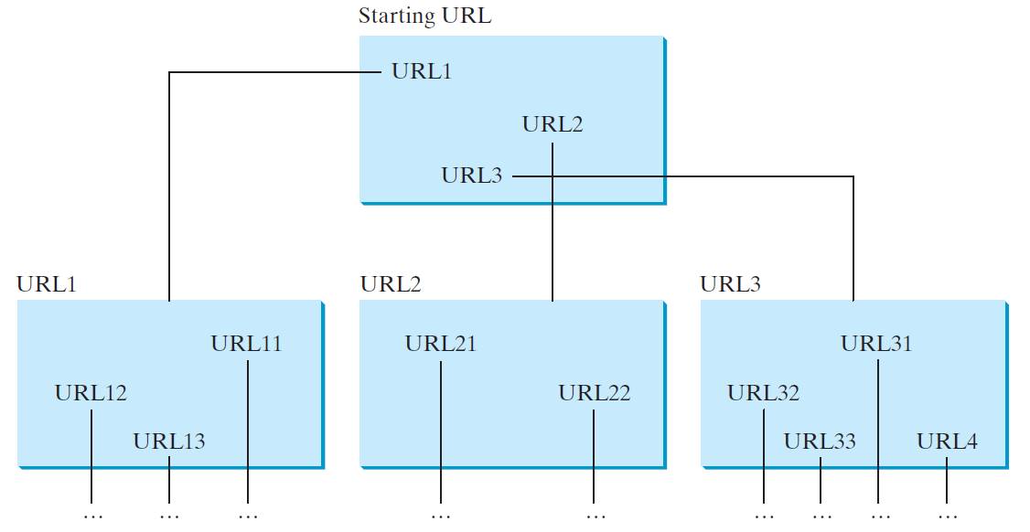
Case Study: Web Crawler
This case study develops a program that travels the Web by following hyperlinks.

