Slide 1
Module 12: Searching and Sorting
Chapter 7, 18

Slide 2
Declaration
Please note that information in this lecture is mainly taken from:
Liang, Y. Daniel - Introduction to Java programming and data structures, comprehensive version (2019, Pearson).

Slide 3
Objectives
To search elements using the linear or binary search algorithm (§7.10).
To sort an array using different approaches (§7.11).
To use the methods in the java.util.Arrays class (§7.12).

Slide 4
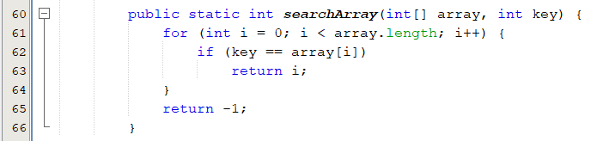
Searching Arrays: The Linear Search Approach
The process of looking for a specific element in an array.
discovering whether a certain value is included in a array.
The Linear Search Approach:
Compares the key sequentially with each element in the array.
It continues to do so until the key matches an element in the array, or the array is exhausted without a match being found.
If a match is made, the linear search returns the index of the element in the array that matches the key.
If no match is found, the search returns -1.

Slide 5
Searching Arrays: The Linear Search Approach
3
6 | 4 | 1 | 9 | 7 | 3 | 2 | 8
Key
array
3
6 | 4 | 1 | 9 | 7 | 3 | 2 | 8
3
6 | 4 | 1 | 9 | 7 | 3 | 2 | 8
3
6 | 4 | 1 | 9 | 7 | 3 | 2 | 8
3
6 | 4 | 1 | 9 | 7 | 3 | 2 | 8
3
6 | 4 | 1 | 9 | 7 | 3 | 2 | 8
Live example
3
6 | 4 | 1 | 9 | 7 | 3 | 2 | 8

Slide 6
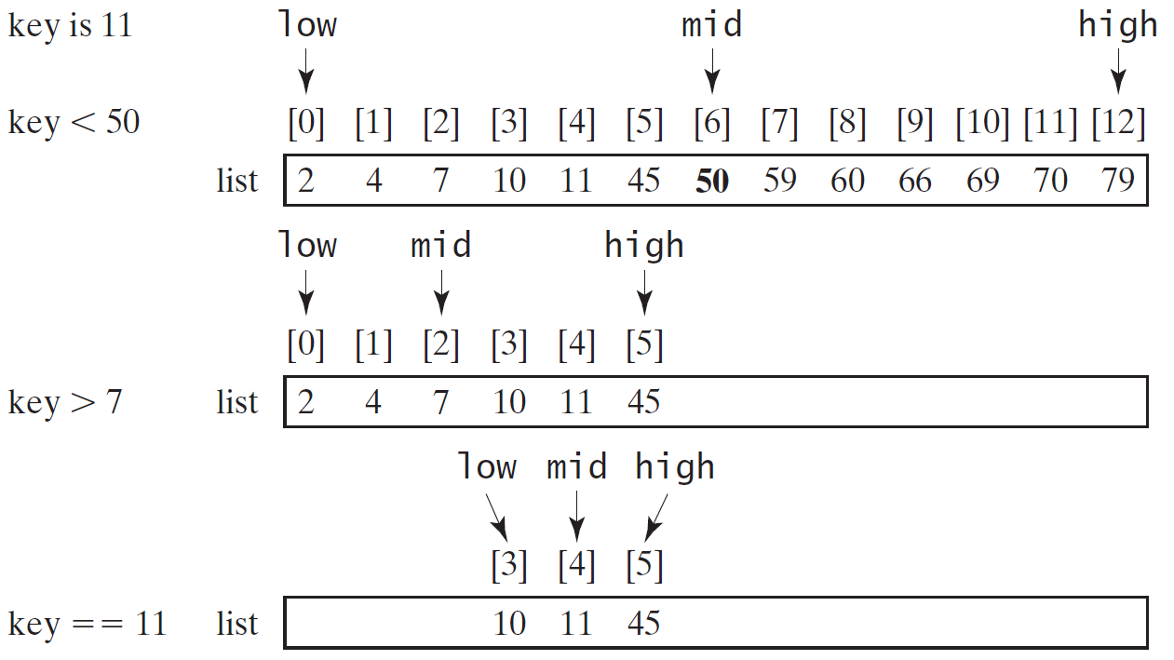
The Binary Search Approach(1/4)
For binary search to work, the elements in the array must already be ordered.
Live example

Slide 7
The Binary Search Approach(2/4)

Slide 8
The Binary Search Approach(3/4)
Elements in the array must already be ordered.
2 4 7 10 11 45 50 59 60 66 69 70 79
The binary search first compares the key with the element in the middle of the array.
If the key is equal to the middle element, the search ends with a match.
If the key is less than the middle element, you only need to search the key in the first half of the array.
If the key is greater than the middle element, you only need to search the key in the second half of the array

Slide 9
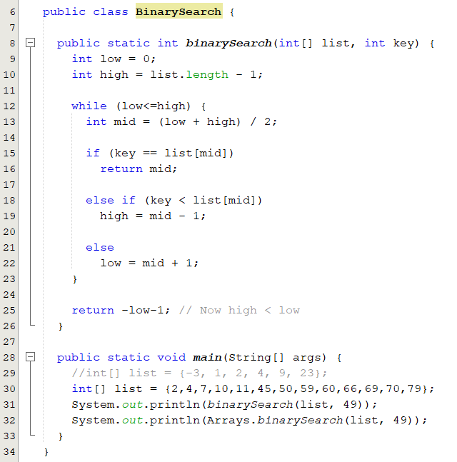
The Binary Search Approach(4/4)
The binarySearch method returns the index of the element in the list that matches the search key if it is contained in the list.
Otherwise, it returns
-insertion point - 1.
The insertion point is the point at which the key would be inserted into the list.
BinarySearch.java

Slide 10
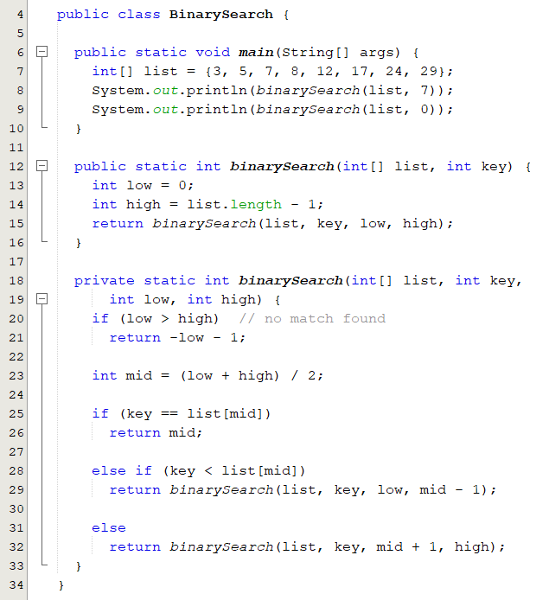
Recursive Binary Search
Case 1: If the key is equal to the middle element, the search ends with a match.
Case 2: If the key is less than the middle element, recursively search the key in the first half of the array.
Case 3: If the key is greater than the middle element, recursively search the key in the second half of the array.

Slide 11
Sorting
Sorting is a common task in computer programming.
There are three reasons for studying sorting algorithms.
They illustrate many creative approaches to problem solving.
Can be applied to solve other problems.
A good for practicing fundamental programming techniques using selection statements, loops, methods, and arrays.
Excellent examples to demonstrate algorithm performance.
The data to be sorted might be integers, doubles, characters, or objects.
Data are stored in an array.
Data are sorted in ascending order.

Slide 12
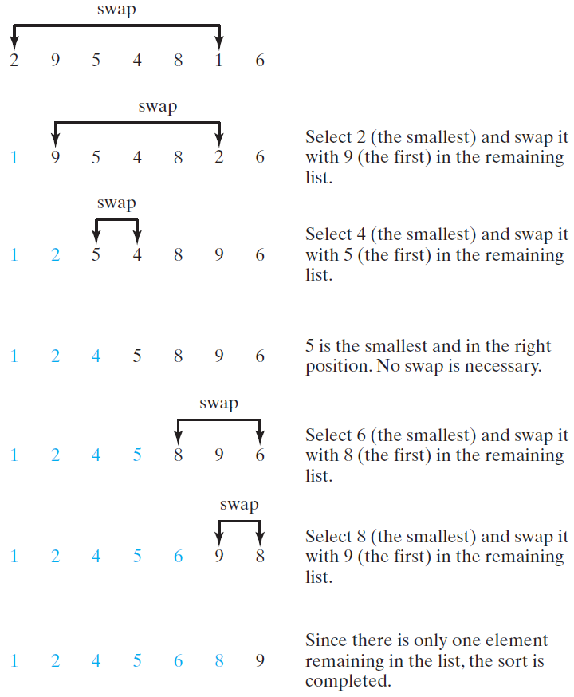
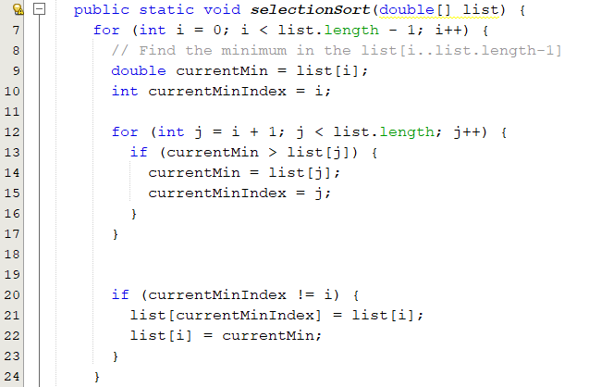
Selection Sort
Finds the smallest number in the list and places it first.
It then finds the smallest number remaining and places it second, and so on until the list contains only a single number.
SelectionSort.java

Slide 13
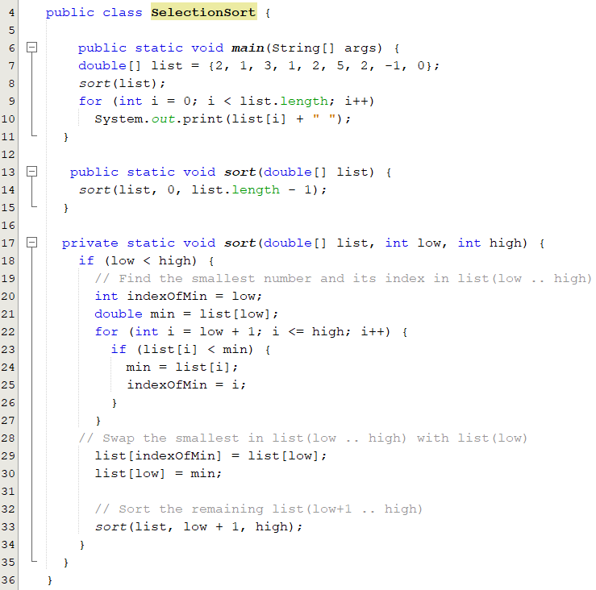
Recursive Selection Sort
Recall that selection sort finds the smallest element in the list and swaps it with the first element.
It then finds the smallest element remaining and swaps it with the first element in the remaining list and so on until the remaining list contains only a single element.

Slide 14
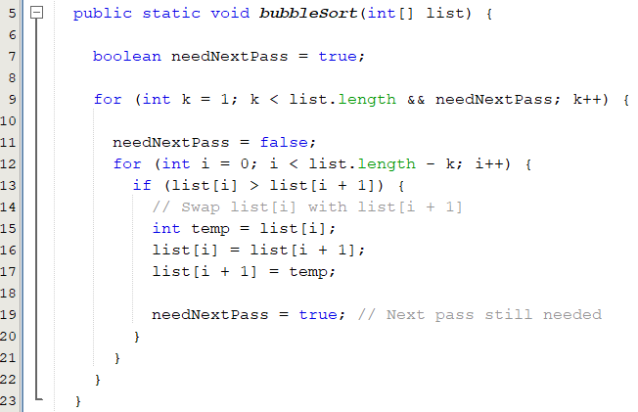
Bubble Sort
A bubble sort sorts the array in multiple passes.
Each pass successively swaps the neighboring elements if the elements are not in order
BubbleSort.java

