Slide 1


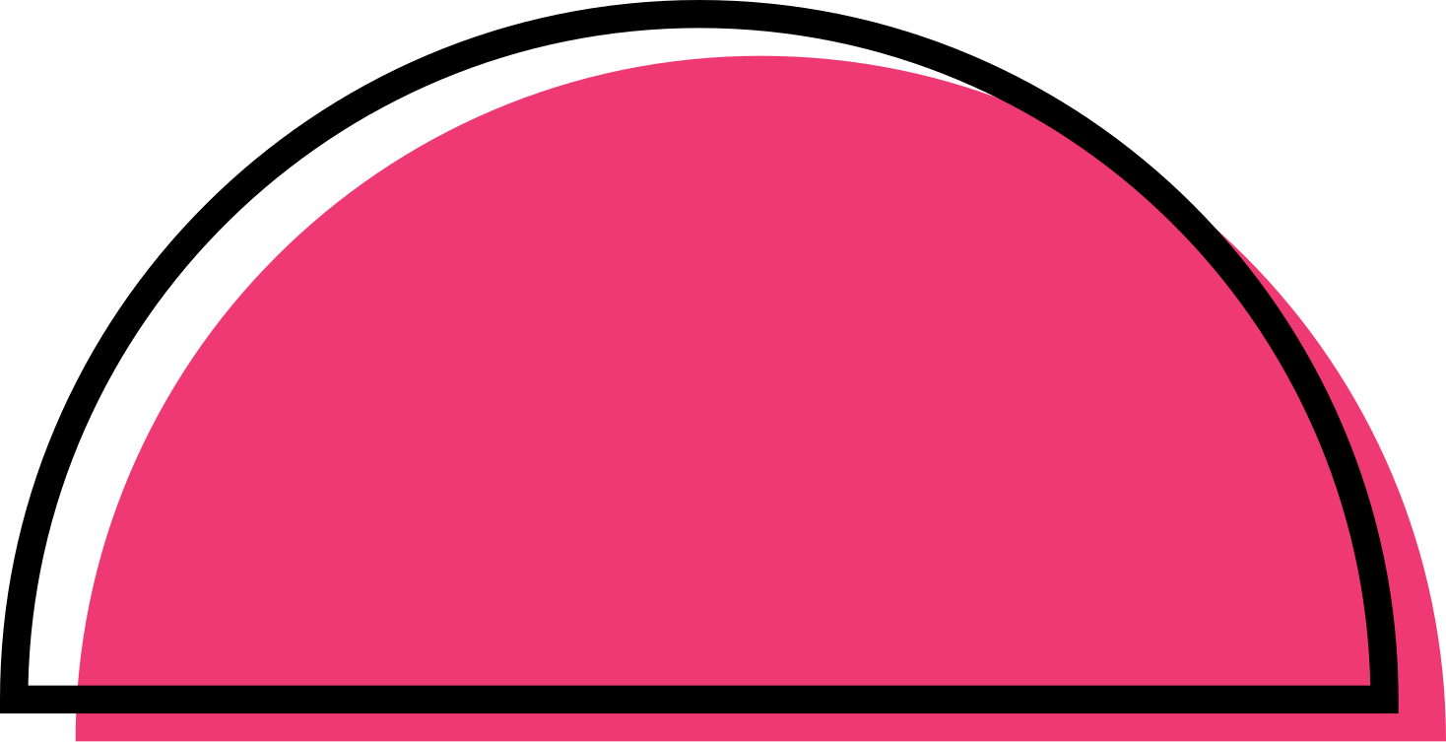

p22
June jam
submission
adaptation

Slide 2


What is the game’s concept?
The game aims to help beginners learn Python basics in a fun and interactive way.

Slide 3
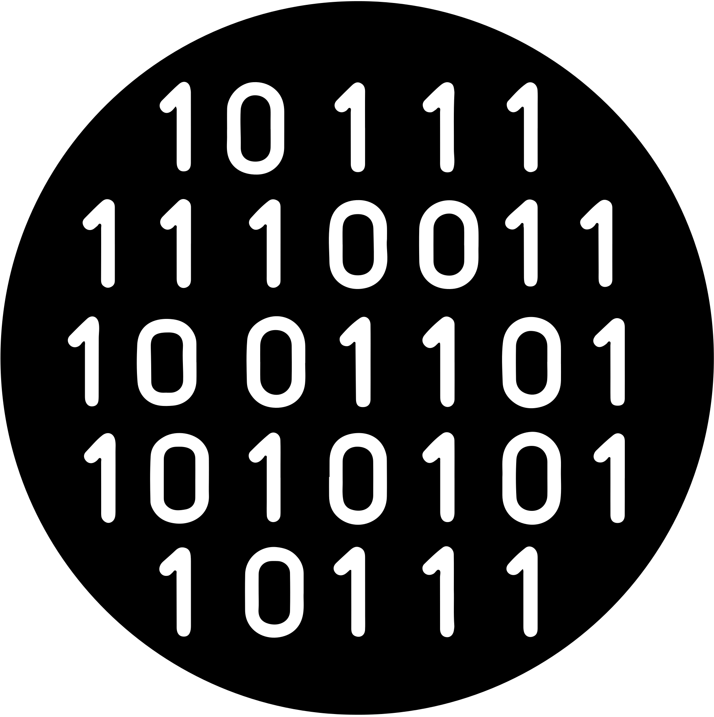

Introduction
The game works by only letting you upgrade when you answer Python questions correctly, and when you upgrade your stats, you are able to defeat stronger enemies and do more damage. This leads to a fun, interactive way to learn Python in a gamified manner.

Slide 4
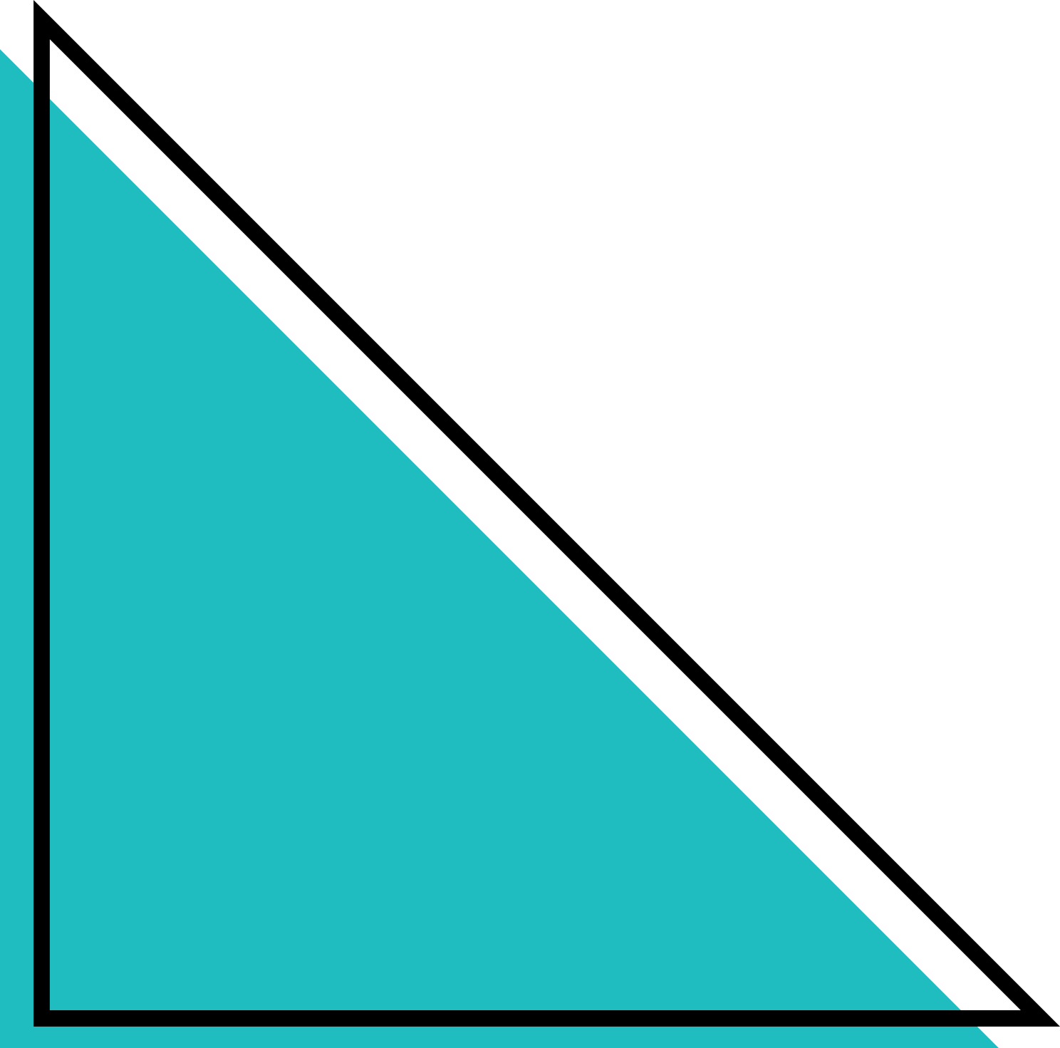
who is our target audience?
The game aims to appeal to people with little to no knowledge of Python and/or any programming language, as it starts at a low difficulty and slowly increases as the player progresses.

Slide 5
enjoy a short live demonstration of the game!

Slide 6
how did we build our game?
At first, we made the logics of the game using just the basic functions of pygame -e.g.(mob AI, raids, etc) We had to do a lot of bug testing which took 2 and a half out of the 3 days we spent building the game. After that, we had no time to make custom textures for our sprites and level, so we found a library -numpy- which allowed us to make our game much more polished in terms of art. However, because of the time constraints, we did not have the time to learn how to use this library to it’s fullest extend, therefore, we had to use AI for most of the draw functions using this library. However, the logic and bug testing of the code was done mostly no AI and the times they were used were only for syntax correction.

Slide 7
Q and a time!!!

