Slide 1


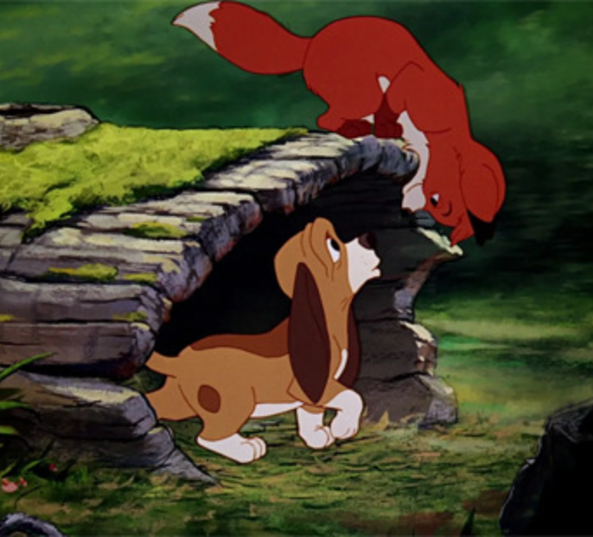


CS 4795
Artificial Intelligence -Project
Fox & Hounds Game
Presented By: Chanchal Preet Kaur, Fatima Asif, Medha Madhub
Let’s Get Started

Slide 2
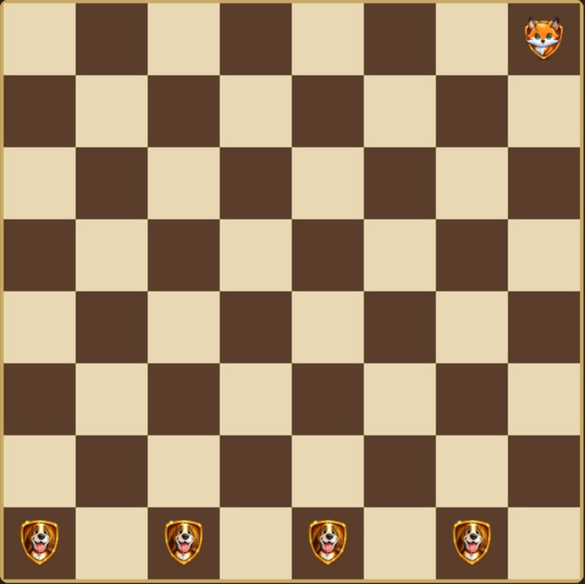
CS 4795
Artificial Intelligence - project
How to play
Fox and Hounds is a strategy game played on an 8×8 checkerboard between one fox and four hounds.
There are two modes in the game. A player can choose to play either as the fox or as the hounds, while the other player controls the remaining side.
At the start, the four hounds are placed on one side of the board and the fox on the opposite side. In this version, the game can start on either the dark or light brown squares.
All pieces move diagonally one square at a time. The hounds can only move forward, while the fox can move forward and backward.
The fox wins by reaching the opposite side of the board, while the hounds win by trapping the fox so it cannot move

Slide 3
CS 4795
Artificial Intelligence - Project
Project Goal
To build an AI agent that can intelligently play Fox and Hounds using adversarial search.
01
02
03
Heuristic evaluation function
Minimax
Alpha-Beta pruning

Slide 4
CS 4795
Artificial Intelligence - project
State Of The Art VS Our Approach
State-of-the-art AI uses:
deep search
advanced heuristics
learning-based methods
Our implementation:
Minimax with Alpha-Beta pruning
heuristic evaluation function
Focus was on balancing:
Speed
decision quality

Slide 5
CS 4795
Artificial Intelligence - project
Game Implementation
Built using Python + Pygame for an interactive experience
Built an interactive GUI-based board system
Designed a dynamic menu and control interface
Developed:
rule-based legal move generation system
turn management logic
win condition detection
Integrated smooth animations for improved user experience

Slide 6
CS 4795
Artificial Intelligence - project
Evaluation Function
Evaluation Function
A heuristic function used to evaluate non-terminal states
Guides the Minimax algorithm at limited search depth
Features used:
Fox progress toward winning
Mobility of the fox
Strategic positioning of hounds
Distance-based pressure on the fox
Trap detection for near-winning states

Slide 7
CS 4795
Artificial Intelligence - project
Why we chose this approach
Fox and Hounds is a strategic adversarial game
Suitable for:
Minimax algorithm
Alpha-Beta pruning
Allows exploration of:
decision-making under limited depth
heuristic design
Helps understand how AI evaluates game states

Slide 8
CS 4795
Artificial Intelligence - project
Most Interesting Idea
Even without deep search, the AI behaves intelligently just because of the evaluation function.
Even with limited search depth:
a good heuristic can guide better decisions
Small changes in evaluation logic:
significantly change AI behavior
Shows how AI “thinks” about the game

Slide 9
CS 4795
Artificial Intelligence - project
Implementation VS Idea
Idea:
AI explores all possible moves deeply
always finds optimal strategy
Implementation:
limited depth due to performance constraints
relies on heuristic evaluation
Trade-off:
accuracy vs speed

Slide 10
CS 4795
Artificial Intelligence - project
Most Striking Success
AI made more strategic moves after improving evaluation function
Hounds were better at trapping the fox
Fox mobility was effectively reduced
Alpha-Beta pruning improved performance
Game became more realistic and competitive

Slide 11
CS 4795
Artificial Intelligence - project
Most Striking Failure
AI still makes suboptimal decisions at low depth
Cannot always predict long-term strategies
Sometimes misses better moves due to heuristic limitations
Performance decreases with higher depth

Slide 12
CS 4795
Artificial Intelligence - project
Suggested Improvements
Enhance the evaluation function by considering:
open escape paths for the fox
blocking strategies for hounds
Fine-tune heuristic weights to balance mobility, positioning, and trapping
Increase minimax depth while maintaining performance using optimizations
Reduce randomness in move selection to improve consistency
Implement AI vs AI simulations to evaluate long-term performance
Explore learning-based approaches (e.g., reinforcement learning) for adaptive AI

Slide 13
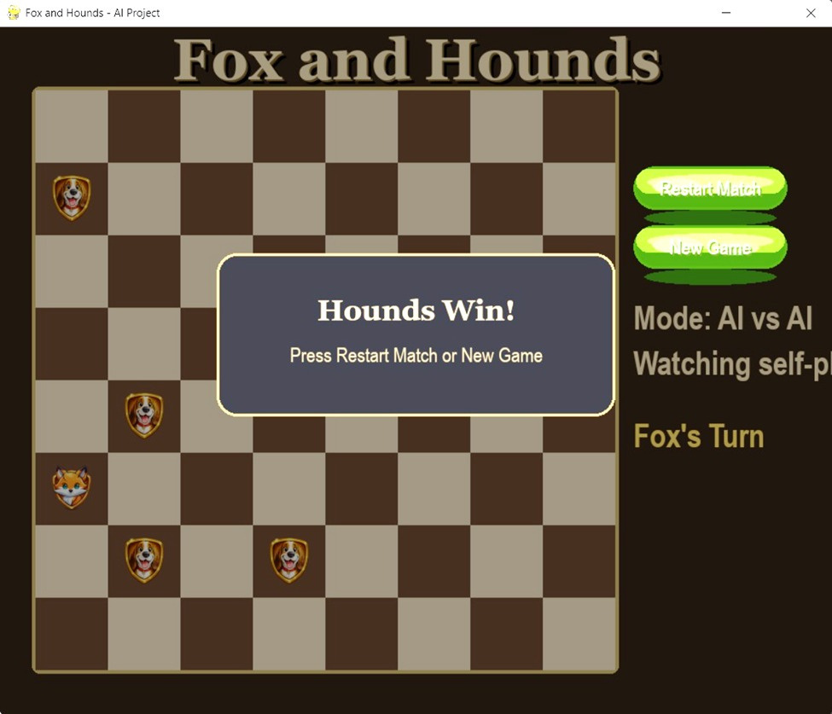
CS 4795
Artificial Intelligence - project
Problems we faced (Before)
Fox was losing every time in the same scenario.

Slide 14
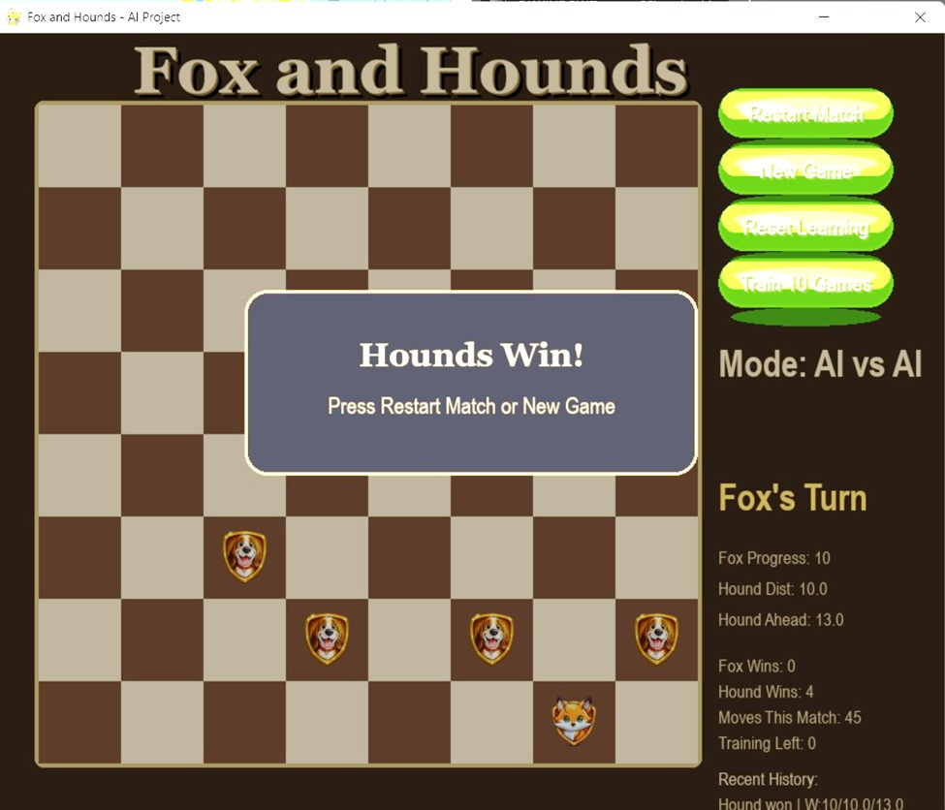
CS 4795
Artificial Intelligence - project
Problems we faced (After)
Improved the code so they are not ending up in same scenario.

Slide 15
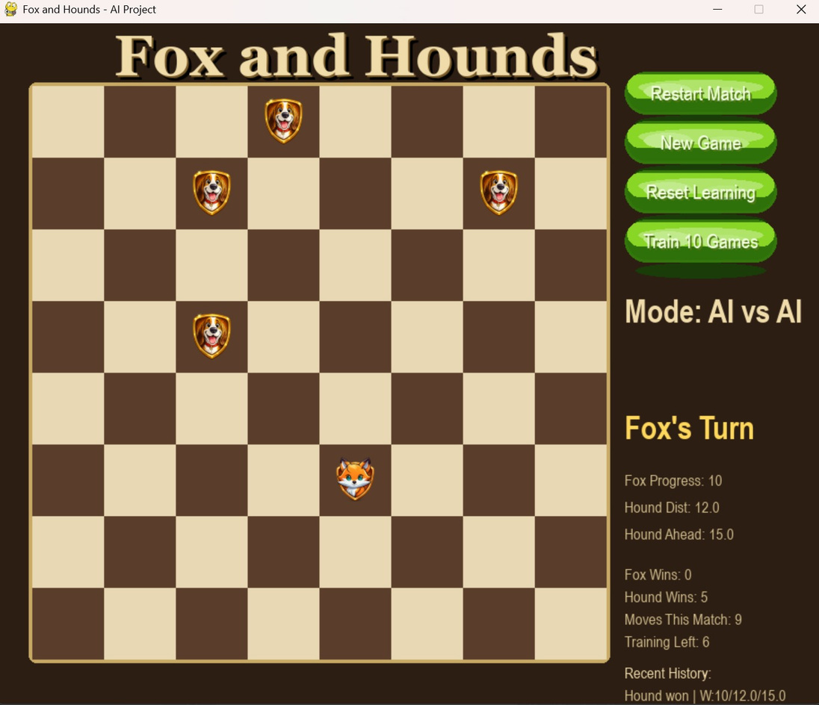
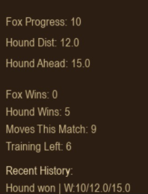
CS 4795
Artificial Intelligence - project
Training First 5 Games
Shows variation and learning behavior

Slide 16
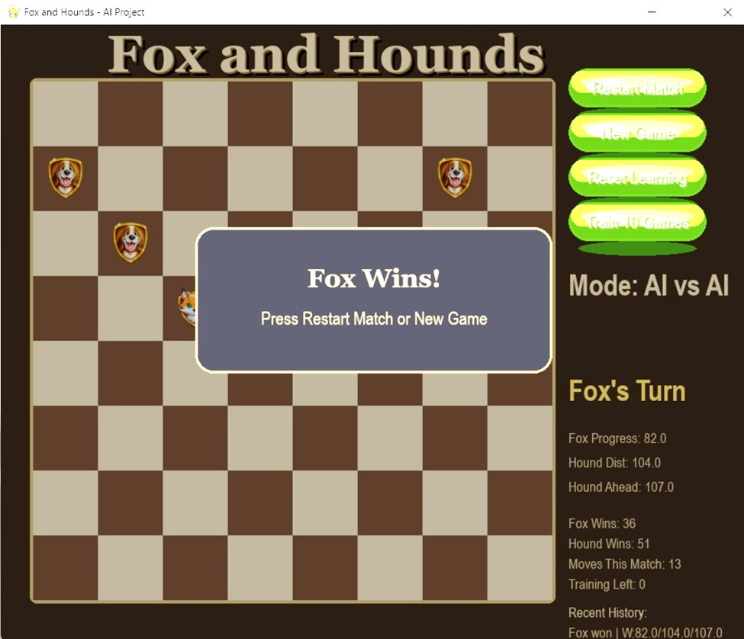
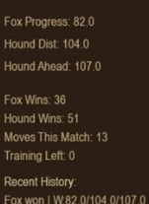
CS 4795
Artificial Intelligence - project
Training 80+ Games
Fox win rate increased from 10% to 45%

Slide 17
Conclusion
AI makes decisions using search and heuristics
Evaluation function and logic strongly impact performance
Small improvements can lead to better results

Slide 18
Thank You!

