Slide 1




Fox and Hounds
CS 4795 – Artificial Intelligence Project

Slide 2

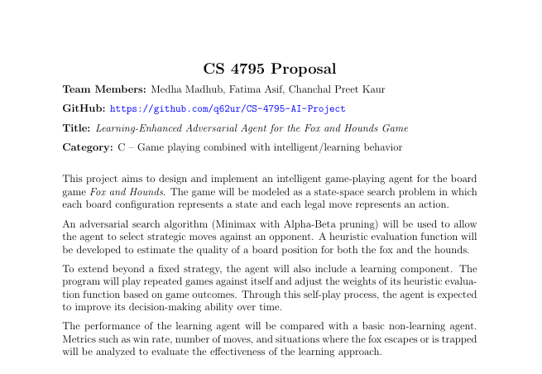

Slide 3
References
Preliminary Bibliography Academic paper on Fox and Hounds strategy and analysis
https://scholarworks.calstate.edu/downloads/1v53k187p
Fox andHoundsRulesandDiscussion. Reddit. https://www.reddit.com/r/Ruleshorror/ comments/1gn9iw0/fox_and_hounds/
Fox andHoundsGameDescription andMathematical Discussion. https://mathwithbaddrawings. com/wp-content/uploads/2020/11/Game-33-Fox-and-Hounds.pdf
Fox and Hounds Strategy and Analysis. Gilith Blog. https://gilith.wordpress.com/ 2018/11/26/fox-hounds/
Fox and Hounds– GameExplanation. YouTube video. https://www.youtube.com/watch? v=6VjNwmGAyzo
Fox and Geese (Fox and Hounds) Mobile Game Application. Google Play Store. https: //play.google.com/store/apps/details?id=com.donkeycat.foxandgeese&hl=en_CA

Slide 4
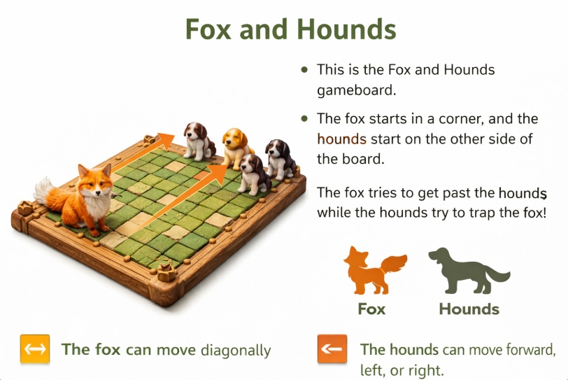

Slide 5
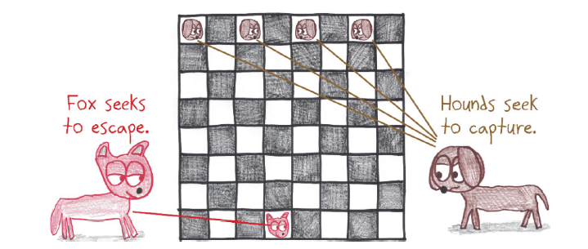

Slide 6
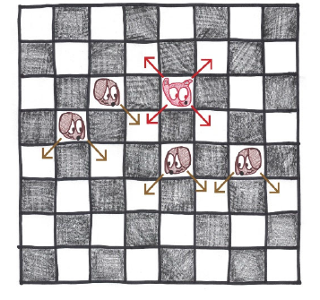

Slide 7
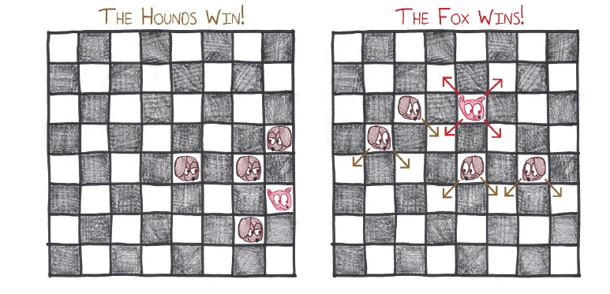

Slide 8
Idea vs Implementation
Idea
• Build an AI agent that can intelligently play the Fox and Hounds game. • Use adversarial search to allow the AI to plan moves against an opponent.
Implementation
• Represent the board as game states and the possible moves as actions. • Use the Minimax algorithm with Alpha-Beta pruning to choose the best move efficiently. • Use a heuristic evaluation function to estimate how good a board position is for the fox or the hounds. • Compare a basic AI agent with a learning version to see if performance improves.

Slide 9
Failures
1.Performance issue
Minimax without pruning was slow because it checked too many moves. We improved it by using alpha-beta pruning to skip unnecessary branches.
2. Heuristic issue
At first our evaluation function was not very accurate, so the algorithm sometimes chose weaker moves. We improved it by adjusting the evaluation function.
3. Search depth issue
At first we used a small search depth, so the algorithm missed better moves. We improved it by increasing the depth.

Slide 10
Thank You

