Slide 1
Pet Adoption Management System
Chanchalpreet Kaur
CS1103
Java + SQLite + JDBC

Slide 2
Introduction
Console-based system for managing pet adoption
Integrates Java application with SQLite database
Demonstrates real-world database usage

Slide 3
Problem Statement
Manual tracking is inefficient and error-prone
Difficult to manage multiple records
Need for structured database system

Slide 4
Objectives
Store and manage pet & adopter data
Enable adoption workflow
Maintain relationships between entities
Update data dynamically

Slide 5
System Architecture
Frontend: Java (logic)
Database: SQLite
Connection: JDBC
Console-based user interface

Slide 6

Database Design
Core Tables:
Pet, Adopter
Process Tables: AdoptionApplication, AdoptionRecord
Supporting Table: Shelter

Slide 7
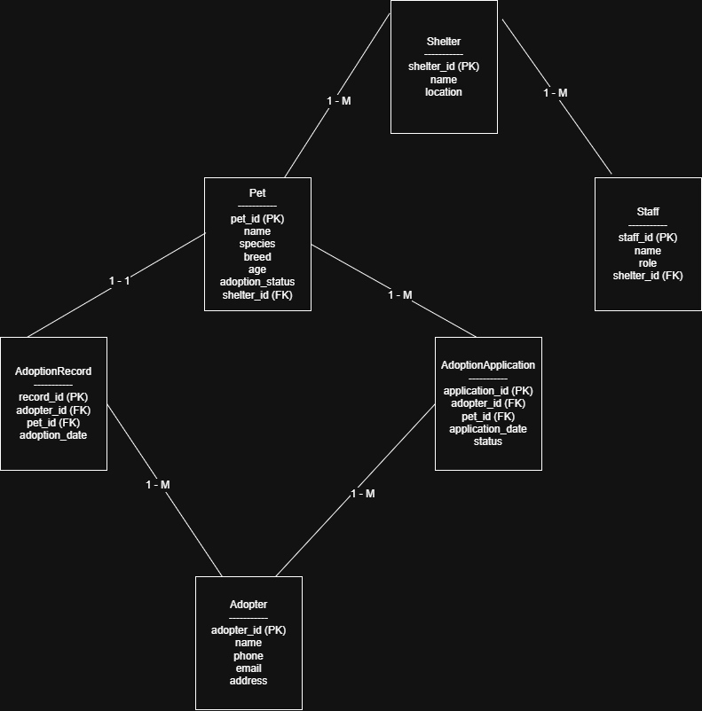
Entity Relationship Diagram

Slide 8

SQL Usage (DDL & DML)
DDL: CREATE TABLE for structure
DML: INSERT, SELECT, UPDATE
JOIN used to combine tables
Ensures efficient data handling

Slide 9

Key Features
View available pets
View adopters
Submit adoption application
View adopted pets
Reset system & view shelters

Slide 10

System Workflow
User views pets
Selects adopter & pet
Application is stored
Pet status updated to Adopted
Changes reflected instantly

Slide 11
JDBC & Error Handling
Tables created using JDBC
Database connection handled safely
Try-catch used for error handling
Ensures stability during execution

Slide 12

Transactions & Data Handling
Database instance created at runtime
Operations ensure data consistency
Status updates handled correctly
Prevents invalid adoptions

Slide 13
Functions & Logic
Validation for pet availability
Dynamic ID generation
Reset functionality for reuse
Handles individual records effectively

Slide 14

Challenges & Limitations
JDBC setup issues
Menu synchronization errors
Console-based limitations
No advanced validation

Slide 15
Improvements & Enhancements
Added reset feature
Improved UI formatting
Added adopter & shelter views
Handled empty cases properly

Slide 16
Conclusion
System demonstrates SQL + Java integration
Efficient database design and operations
Real-time updates implemented successfully
Ready for further improvements

