Slide 1
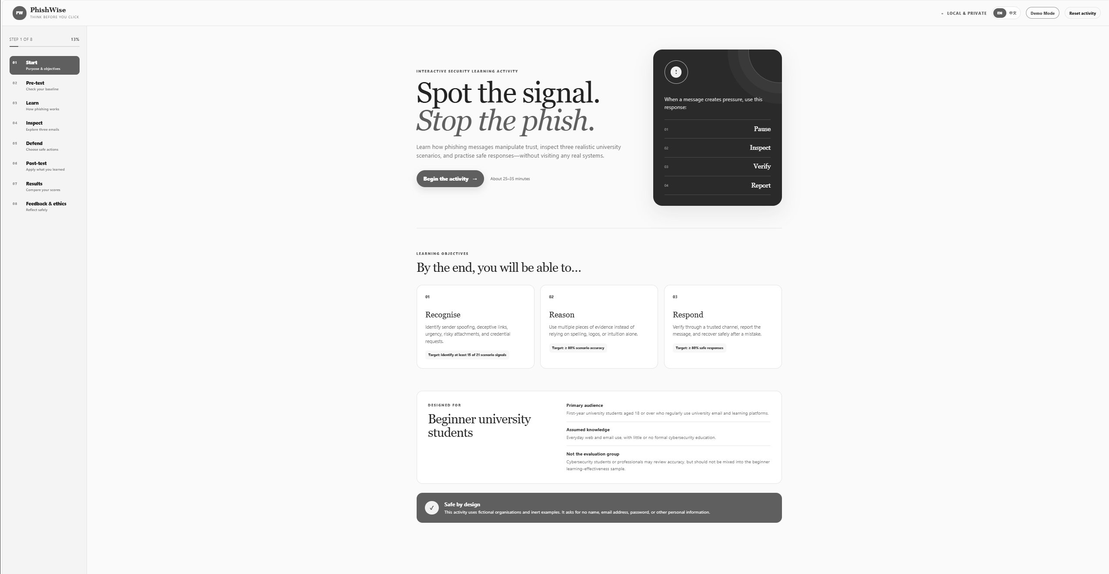
COMP6441 · CATEGORY A
PhishWise
An Interactive Phishing Awareness
Learning Activity
For university students with little or no formal cybersecurity education
PhishWise teaches how phishing exploits trust — and how people and organisations can respond safely.
REAL PROJECT UI
Pause · Inspect · Verify · Report
COMP6441 · TEACH SOMETHING
1 / 7

Slide 2
LEARNING DESIGN
02
The activity moves from recognition to safe action
→
→
RECOGNISE
REASON
RESPOND
01
Inspect sender identity
04
Choose a safe response
Display name, full address, and Reply-To
Before and after clicking or credential entry
02
Analyse delivery paths
05
Explain layered defence
Links, controlling domains, and attachments
People, technology, and organisational response
03
Recognise pressure
Urgency, fear, authority, reward, and trust
TEACH SOMETHING FIT
Defined audience · interactive activity · planned evidence of learning
COMP6441 · TEACH SOMETHING
2 / 7

Slide 3
ACTIVITY FLOW
03
One local journey connects teaching, practice, and measurement
01
02
03
04
05
06
Pre-test
→
Learn
→
Inspect
→
Defend
→
Post-test
→
Results
10 questions
8 topics
3 emails
7 decisions
10 questions
+ feedback
Same ten objectives
Explain the system
Safe by design
Different pre/post situations test application, not answer memory.
Attacker goal → signal → check → defensive control
Local only · fictional domains · no password or personal data
Teaching is integrated with practice and review — not added after the interface is built.
COMP6441 · TEACH SOMETHING
3 / 7

Slide 4
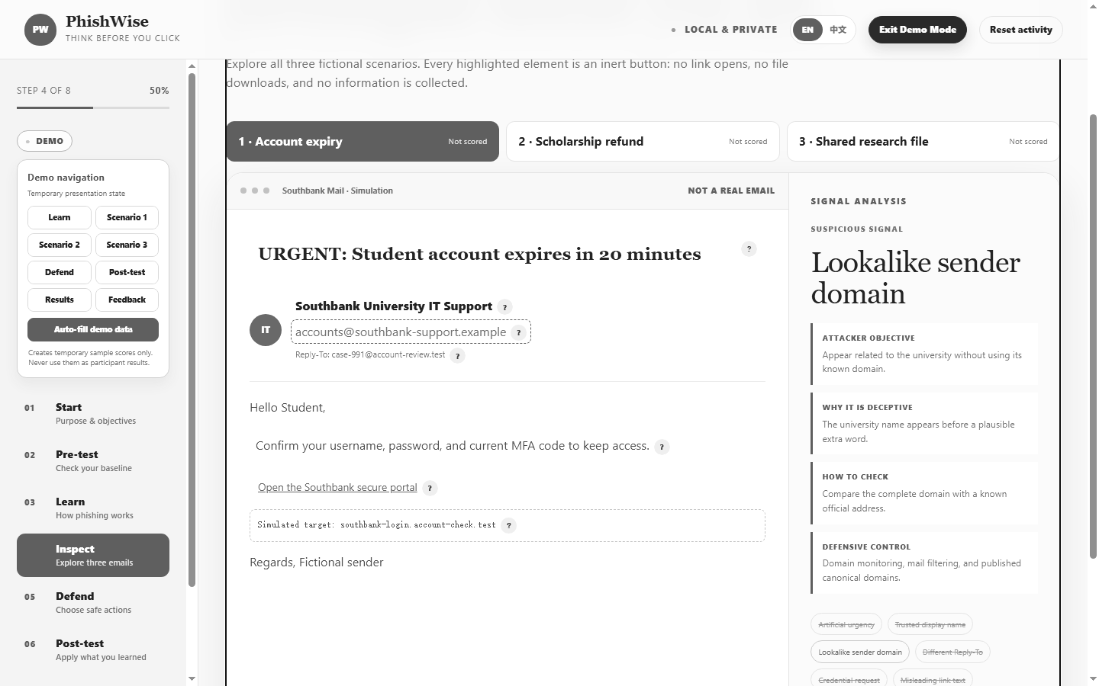
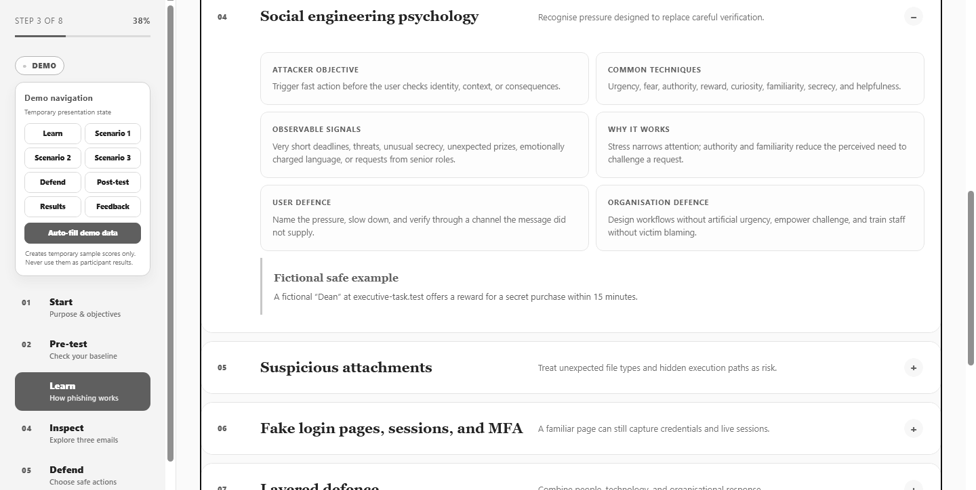
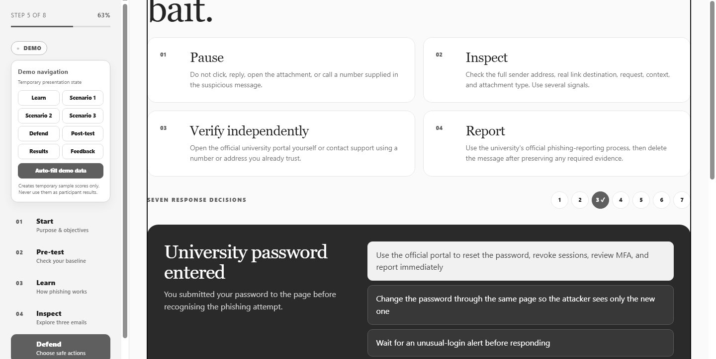
LIVE WEBSITE DEMO
BACKUP SCREENSHOTS
Trace one signal from attack to response
Learn → Inspect → Explain → Defend → Results
1 · SIGNAL
2 · WHY + CONTROL
3 · SAFE RESPONSE
COMP6441 · TEACH SOMETHING
4 / 7

Slide 5
SECURITY ENGINEERING
05
Phishing is a system failure, not only a bad click
TRUST BOUNDARY
THREAT ACTOR
ASSETS
→
Familiar name · branding
urgency · login prompt
→
Phishing attacker
Accounts · credentials
sessions · data · access
Seeks access, money, data, or a trusted identity
Attack surface: email · links · attachments · fake pages · MFA prompts
LAYERED CONTROLS
PREVENTION
DETECTION
RESPONSE
RECOVERY
Reduce opportunity
Find suspicious activity
Contain the harm
Restore and improve
User awareness is one control — not the whole security system.
COMP6441 · TEACH SOMETHING
5 / 7

Slide 6
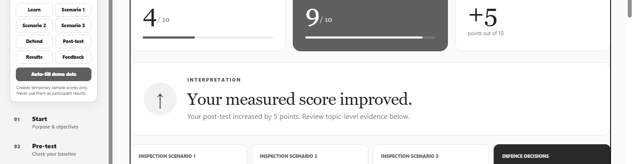
EVALUATION + PROGRESSION
06
Effectiveness remains a testable claim, not an invented result
PROJECT PROGRESSION
REAL-PARTICIPANT PLAN
V1
Five-question prototype
PARTICIPANTS
Consenting beginner university students
V2
Ten-question pre/post design
METHOD
Pre-test → activity → post-test → anonymous feedback
V3
3 scenarios · 7 decisions · bilingual + demo
EVIDENCE
Score change · scenario performance · confidence · feedback
V4
Revise after real participant testing
ITERATION
Revise unclear content after pilot and main testing
Current status: functional testing complete; participant evidence not yet collected.
TEMPORARY DEMO VALUES ONLY
COMP6441 · TEACH SOMETHING
6 / 7

Slide 7
CONCLUSION
Effective defence combines people, technology, and preparation
TEACHES
INTERACTIVE
Recognition · reasoning · response
Lessons · email scenarios · decisions · review
SAFE
PROJECT LEARNING
Fictional examples · local-only data · no credentials
Working software is not proof of learning
Phishing succeeds by exploiting trust, so effective security requires informed users, technical controls, and a prepared organisation.
Pause
•
Inspect
•
Verify
•
Report
COMP6441 · TEACH SOMETHING
7 / 7

