Slide 1
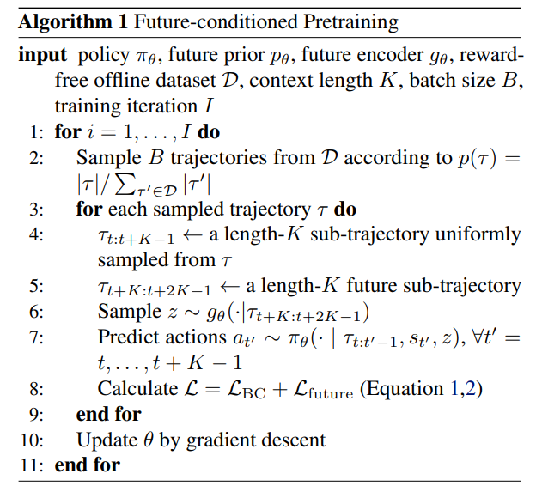
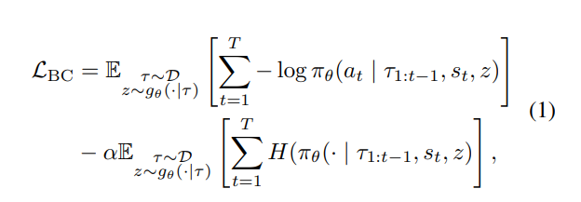


行为克隆损失函数
未来条件预训练（PDT）模型的损失函数
E（egularization term）+E（prior model term）
PDT not only shows good initial performance by learning to act based on the future, but also quickly adapts to the target task under the supervision of task rewards.

Slide 2


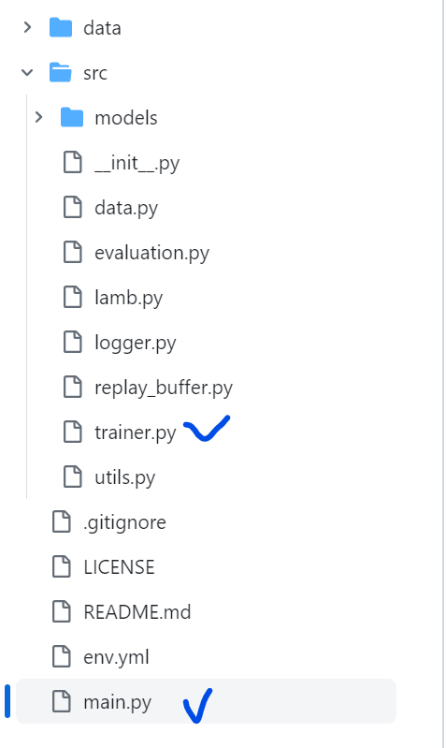
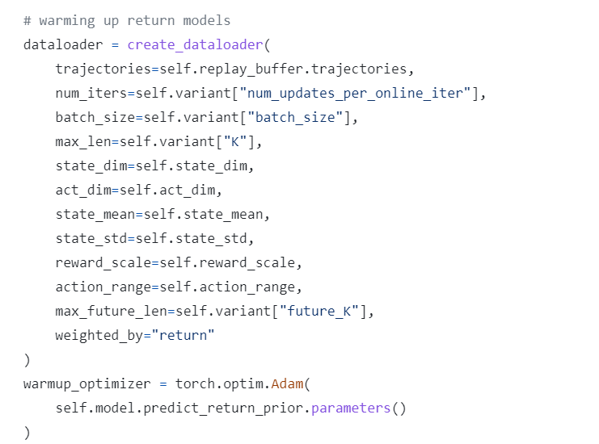
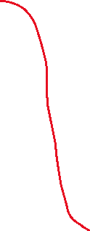


def online_tuning(self, online_envs, eval_envs):

Slide 3
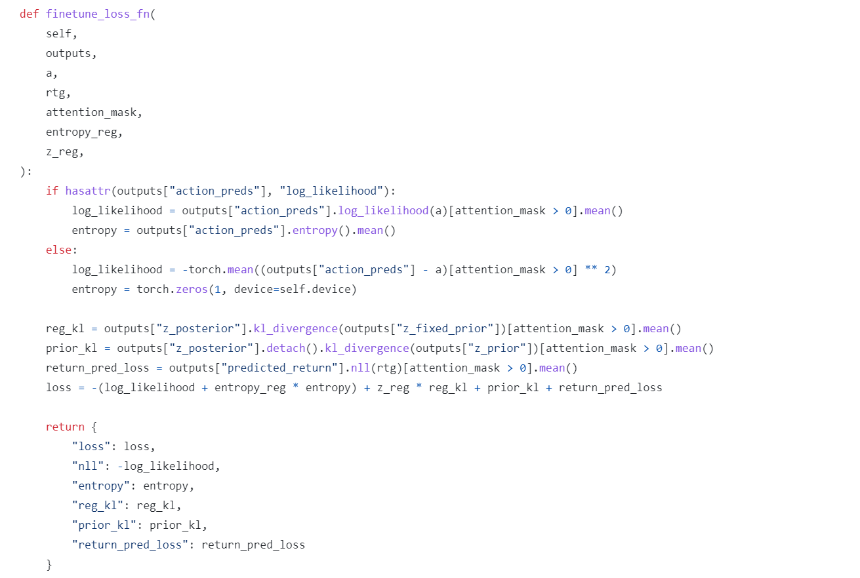


trainer.py

Slide 4
trainer.py

