Slide 1
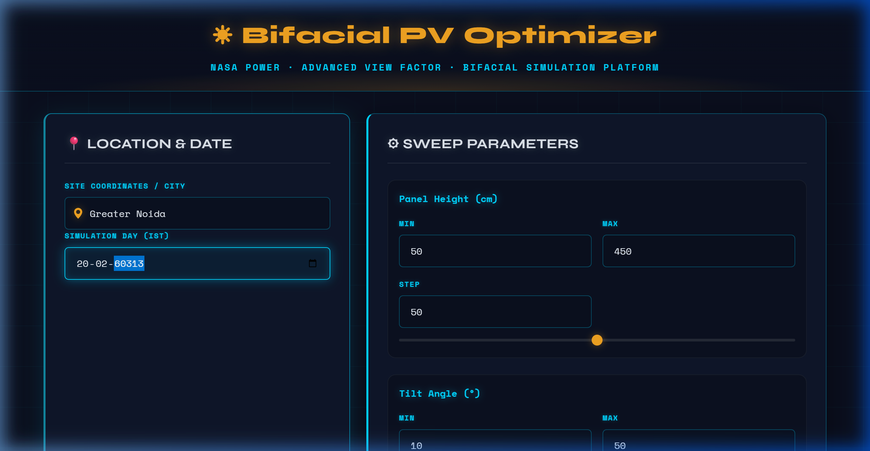
Bifacial PV Optimizer — Platform Overview
Platform Features
• Location-based solar data via NASA POWER API
• Configurable sweep parameters: Height, Tilt, Step sizes
• Interactive city search with geocoding support
• Date-specific hourly analysis with IST timezone handling
• Dark-themed professional UI with real-time validation
Bifacial PV Optimizer | NSUT, New Delhi | EndSem 2026

Slide 2
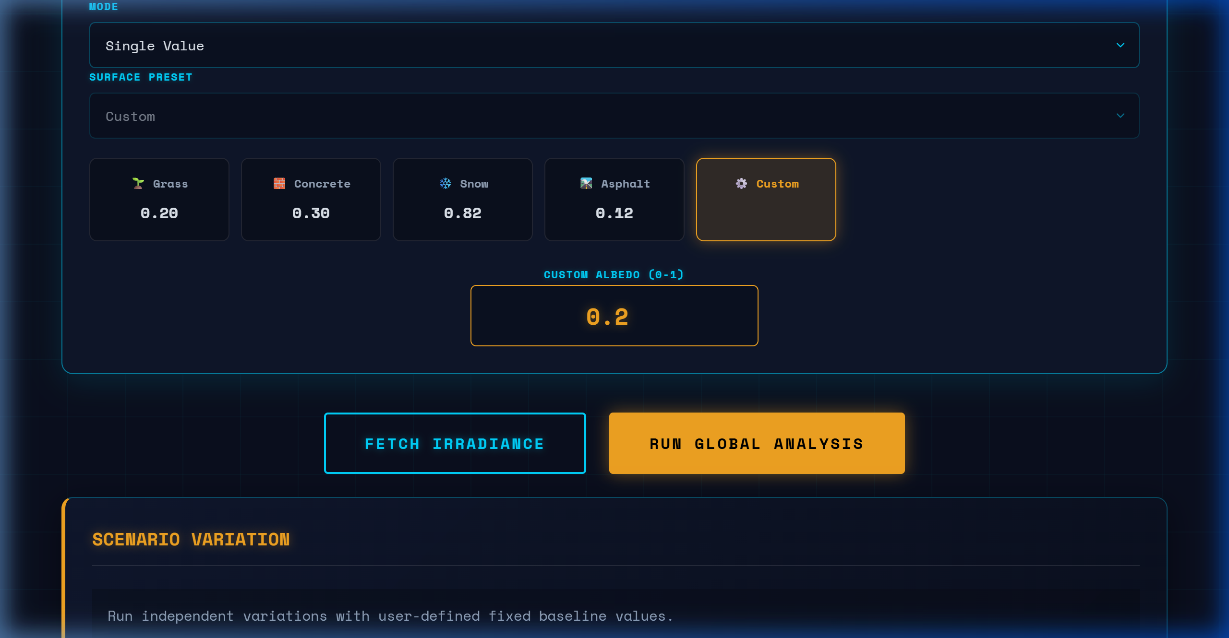
Input Configuration — Albedo & Surface Selection
Surface Albedo Presets
• 5 preset surfaces: Grass (0.20), Concrete (0.30), Snow (0.82), Asphalt (0.12), Custom (user-defined)
• Custom albedo range: 0–1
• "Fetch Irradiance" retrieves hourly GHI from NASA POWER
• "Run Global Analysis" triggers full parametric sweep engine
• Array azimuth configurable (default 180° for South-facing)
Bifacial PV Optimizer | NSUT, New Delhi | EndSem 2026

Slide 3
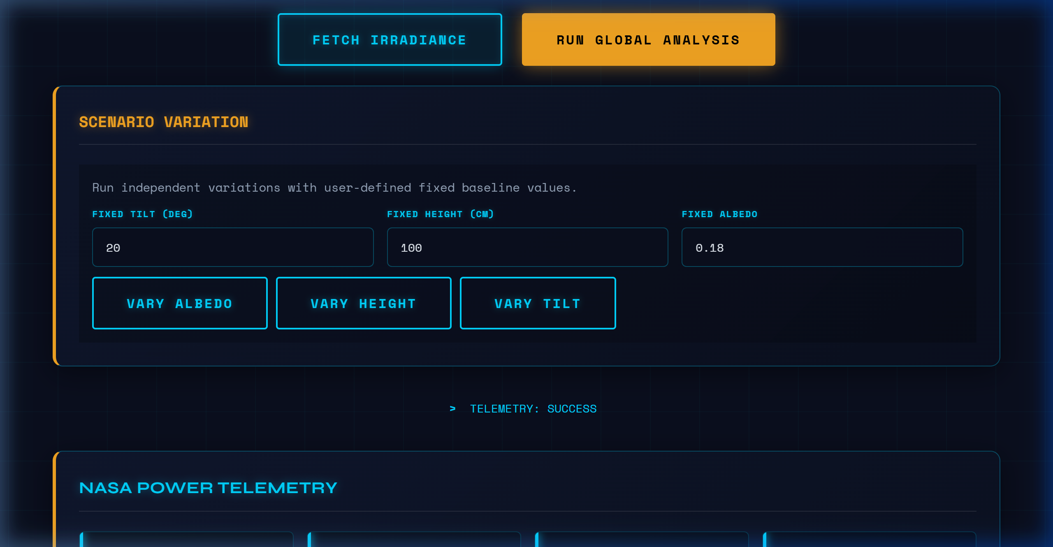
NASA POWER Telemetry — Solar Irradiance Data
Data Retrieved
• Source: NASA POWER API (Hourly, 0.5° resolution)
• Parameters: ALLSKY_SFC_SW_DWN (Global Horizontal Irradiance)
• Erbs clearness-index model decomposes GHI → DNI + DHI
• Total GHI: ~5.43 kWh/m²/day for Greater Noida
• Hourly temperature data for NOCT thermal derating
Bifacial PV Optimizer | NSUT, New Delhi | EndSem 2026

Slide 4
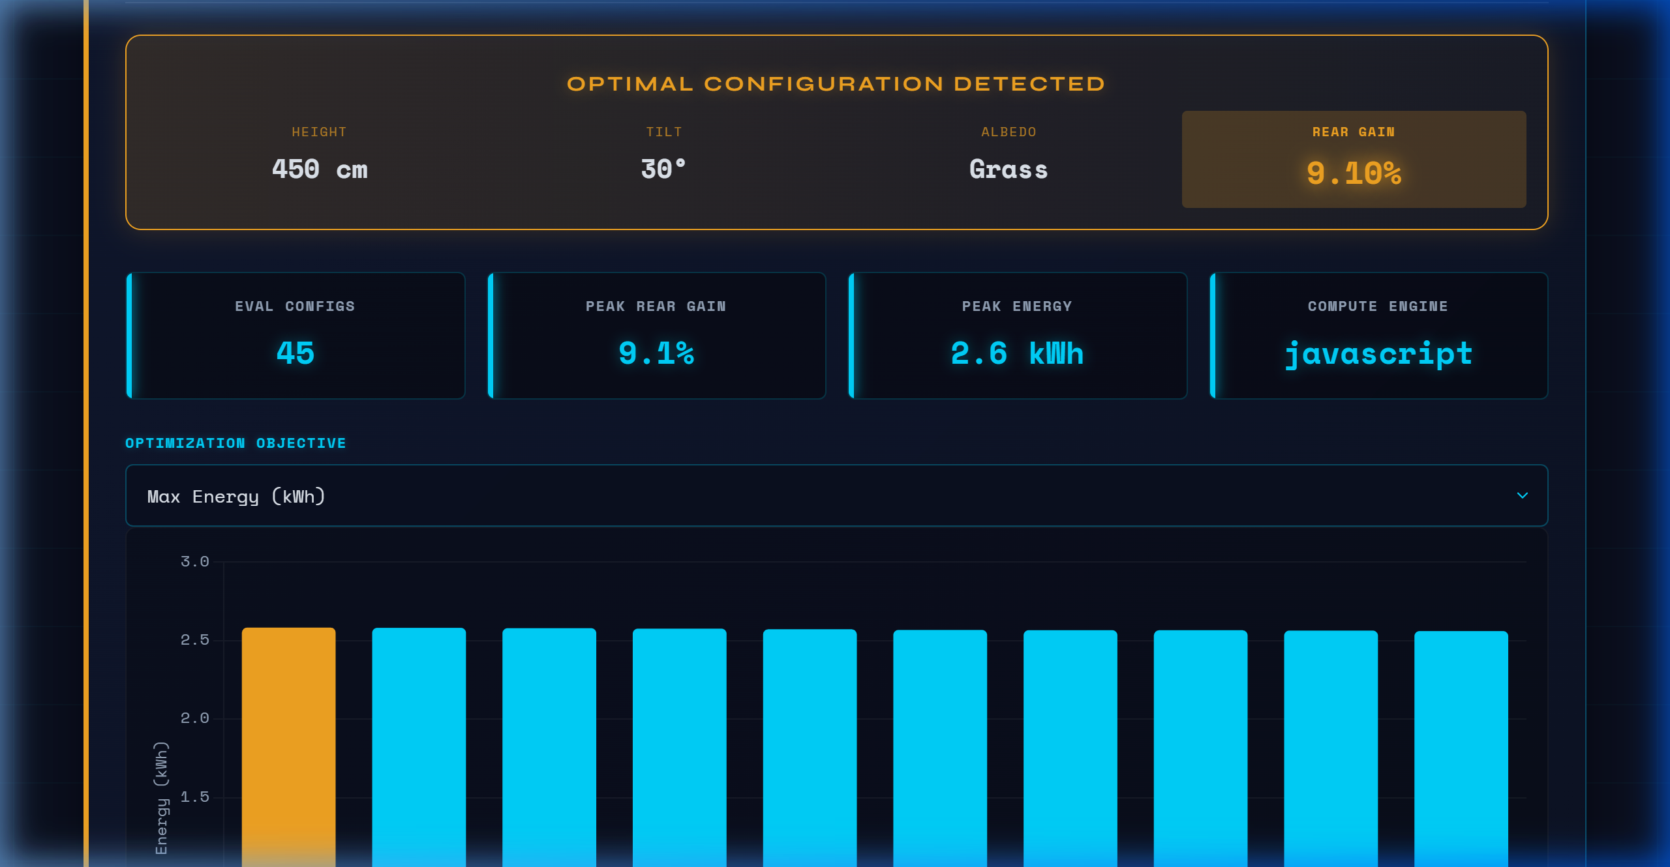
Optimization Engine — Results Dashboard
↑ Optimal configuration identified: Height 450cm, Tilt 30° → Max Energy; Height 450cm, Tilt 10° → Max Rear Gain
Bifacial PV Optimizer | NSUT, New Delhi | EndSem 2026

Slide 5
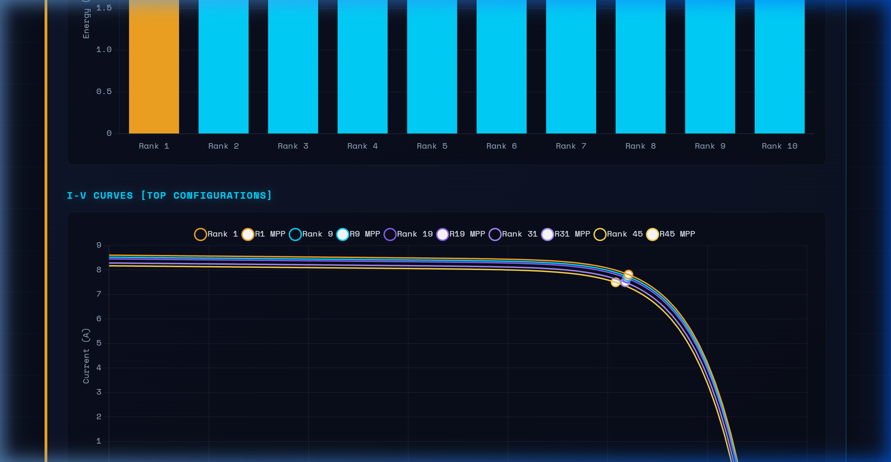
Energy Yield Comparison — Top Configurations
↑ Bar chart comparing total energy (kWh) across top-ranked configurations with optimal highlighted
Bifacial PV Optimizer | NSUT, New Delhi | EndSem 2026

Slide 6
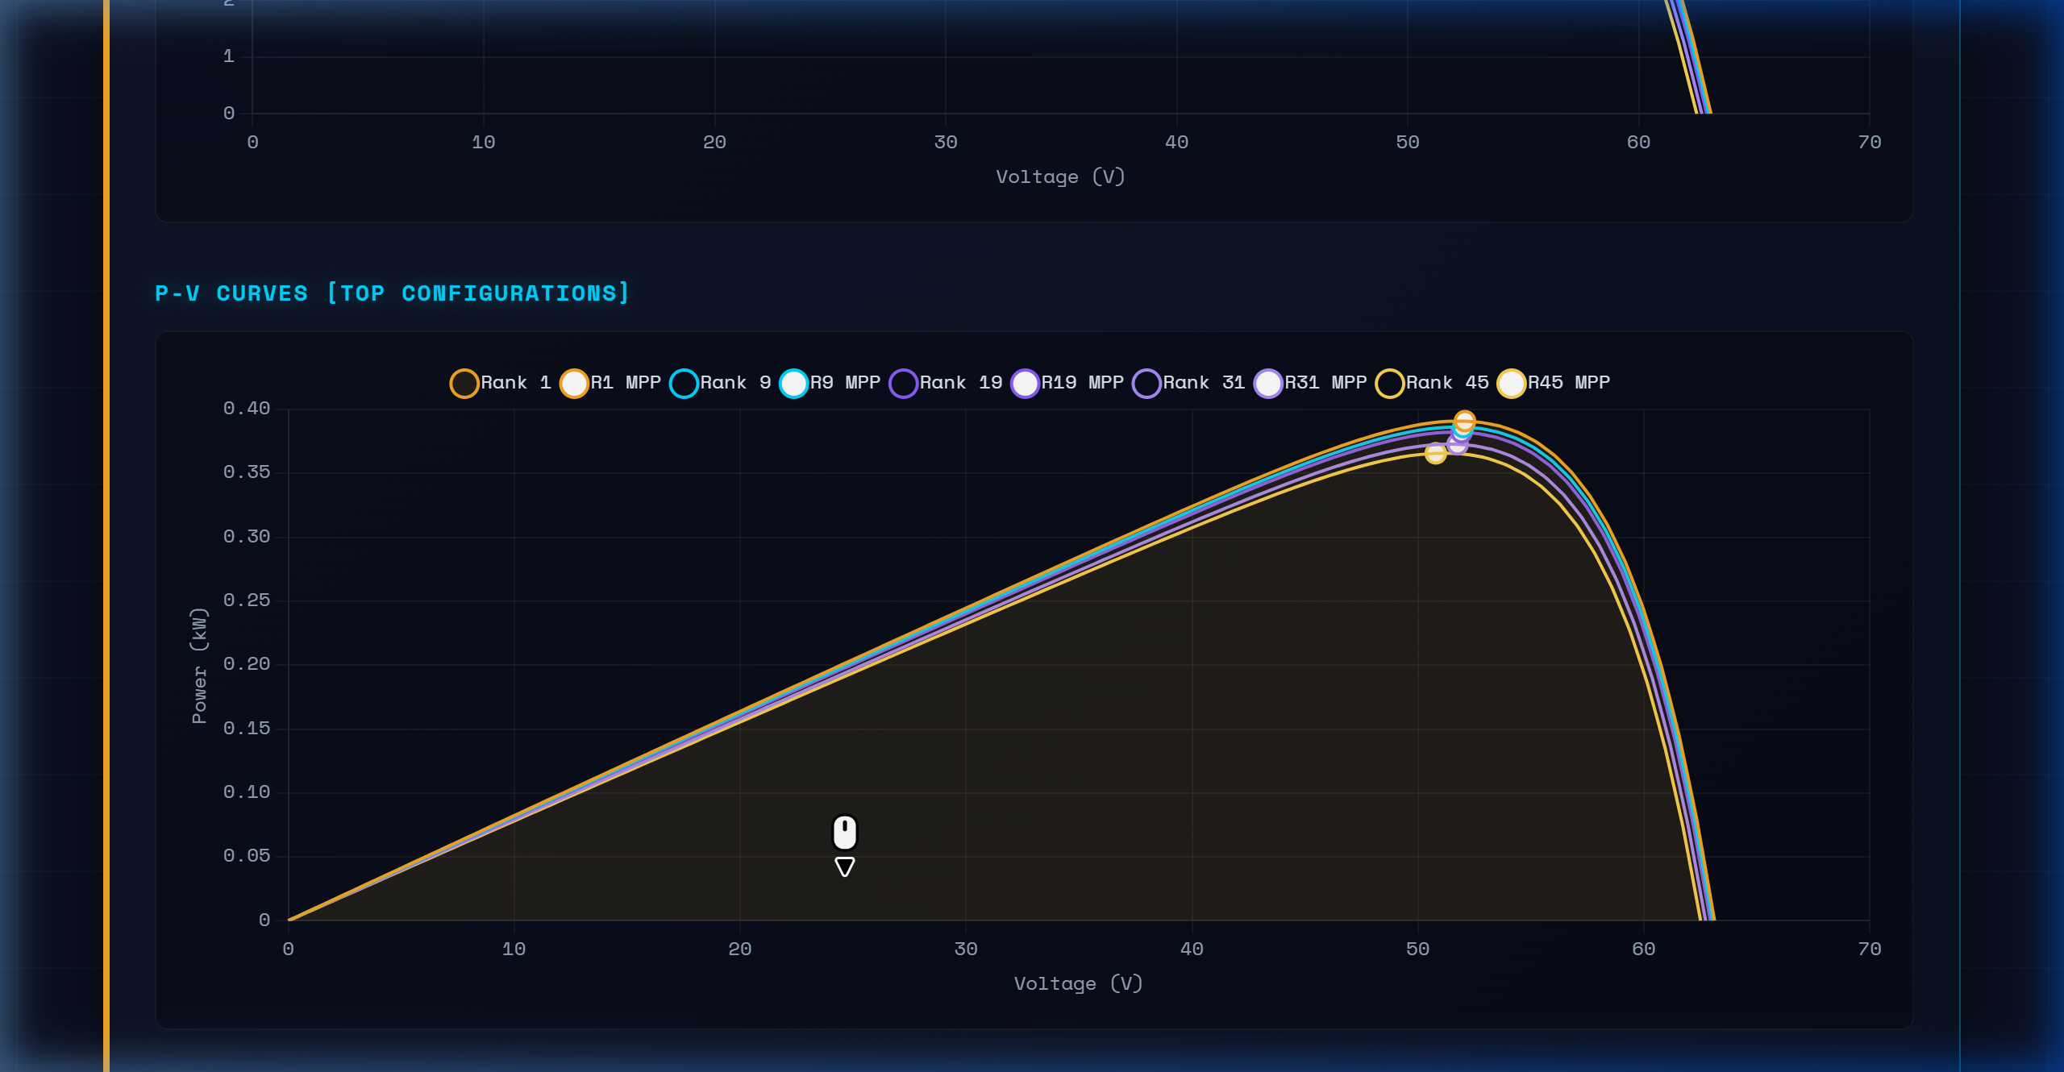

Electrical Characteristics — I-V & P-V Curves
• I-V curves show current vs. voltage for top configurations with both front and rear irradiance
• P-V curves identify Maximum Power Point (MPP) for each configuration
• Higher effective irradiance → higher Isc and peak power; Voc remains relatively stable
Bifacial PV Optimizer | NSUT, New Delhi | EndSem 2026

Slide 7
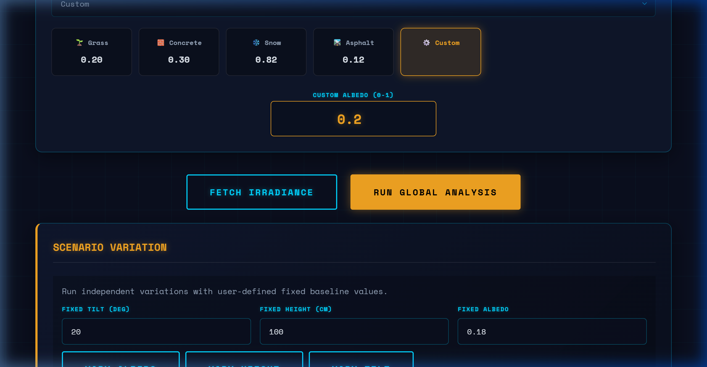
Scenario Variation — Individual Parameter Analysis
• Vary Albedo: Rear gain ranges from <5% (asphalt) to >24% (aluminum) — most influential parameter
• Vary Height: Logarithmic dependence; diminishing returns above 200-300cm
• Vary Tilt: Max rear gain at low tilt (10°); front irradiance peaks near latitude tilt (28°)
Bifacial PV Optimizer | NSUT, New Delhi | EndSem 2026

Slide 8
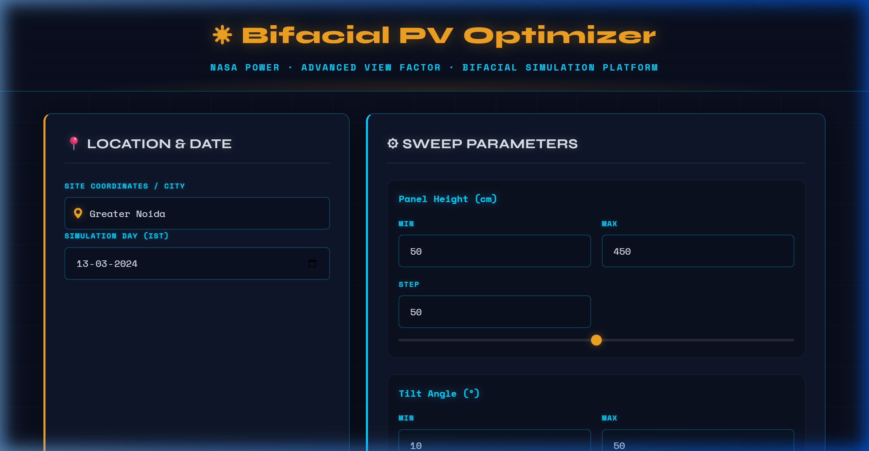
Complete Application — Full Stack Architecture
Technology Stack
▶ Frontend: HTML5, CSS3, JavaScript Chart.js for visualization
▶ Backend: Node.js + Express.js RESTful API design
▶ Data Source: NASA POWER API Hourly GHI & Temperature
▶ Simulation: MATLAB/Simulink engine calculate_irradiance.m
▶ Analysis: JS-based fallback engine Parametric sweep + I-V/P-V
Bifacial PV Optimizer | NSUT, New Delhi | EndSem 2026

