Slide 1
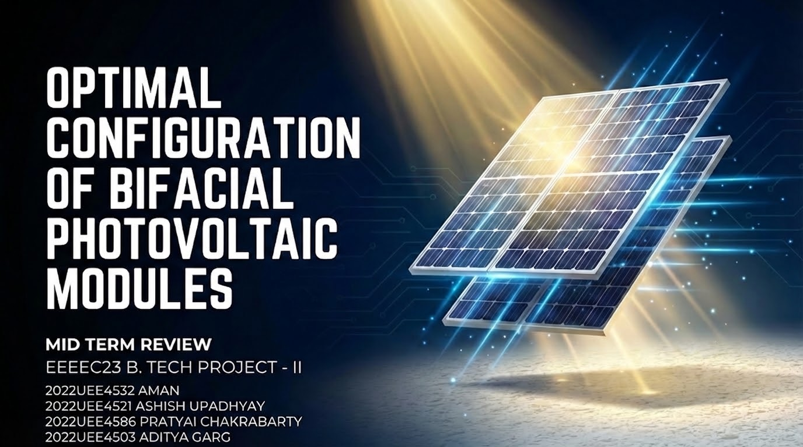
OPTIMAL CONFIGURATION OF BIFACIAL PHOTOVOLTAIC MODULES USING PARAMETRIC ANALYSIS
End-Semester Presentation | B.Tech. Project
Ashish Upadhyay (2022UEE4521) | Pratyai Chakrabarty (2022UEE4586) Aman (2022UEE4532) | Aditya Garg (2022UEE4503)
Under the supervision of Dr. Astitva Kumar
Department of Electrical Engineering Netaji Subhas University of Technology, New Delhi

Slide 2
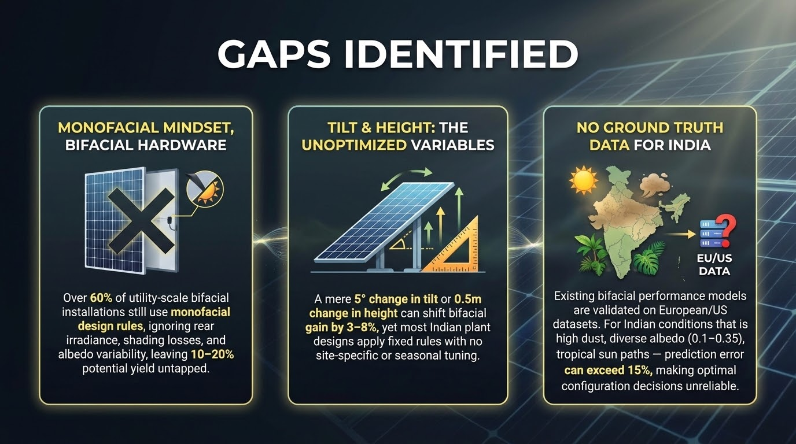

Presentation Outline
1. Introduction & Motivation
2. Literature Survey & Gaps
3. Problem Statement & Objectives
4. Mathematical Formulation (Equations 1-11)
5. Simulink Model & Frontend Platform
6. Case Study: Greater Noida
7. Results & Analysis
8. Comparison with Literature
9. Conclusion & Key Findings
10. Future Scope
11. Publication & References

Slide 3
Introduction & Motivation
• Solar PV is the fastest-growing electricity source — global capacity exceeded 1,500 GW by end of 2024
• India targets 500 GW non-fossil fuel capacity by 2030 under the National Solar Mission
• Bifacial PV modules capture irradiance from both front and rear surfaces, achieving 5–30% higher energy yield
• However, rear-side contribution is highly sensitive to tilt angle, ground albedo, and mounting height
• Need for systematic, location-specific optimization tools to realize the full potential of bifacial technology
• First industrial bifacial panels: 1984 — predicted to capture ~35% of global PV market by 2027

Slide 4
Literature Survey
Guerrero-Lemus et al. [7]: Comprehensive bifacial PV technology review; need for standardized testing
Yusufoglu et al. [2]: Annual performance analysis; up to 30% gain at 2m height; log-height dependence
Dincer & Ozer [3]: Parametric analysis — albedo, tilt, height, mounting; 21.2% rear gain for aluminum
Sun et al. [10]: Global optimization perspective; location-specific analysis essential
Ganesan et al. [4]: n-type PERT bifacial under diverse albedo; 21.4% avg gain with aluminum
Pelaez et al. [5]: Comparison of 5 bifacial irradiance models; ~20% bifacial gain validated

Slide 5
Gaps Identified
Limited Combined Analysis: Most studies evaluate tilt, albedo, height independently — not their combined interaction effect
Location-Specific Gap: Many studies limited to European/American climates; India-specific validation lacking
Accessibility Barrier: Current tools require specialized software (PVsyst, SAM) or commercial licenses
Single Optimization Objective: Few studies consider dual objectives: max energy vs. max rear gain trade-off
No User-Friendly Platform: No web-based tool exists for real-time location-specific bifacial PV optimization

Slide 6
Problem Statement
"How can the rear-side energy contribution and overall performance of bifacial PV systems be maximized by optimally selecting tilt angle, ground albedo, and mounting height for a given geographical location?"
Research Objectives:
1. Develop comprehensive mathematical model for bifacial PV (front + rear irradiance)
2. Implement in MATLAB/Simulink for I-V / P-V characteristic simulation
3. Build user-oriented frontend platform with NASA POWER API integration
4. Perform parametric sweep for optimal configuration identification
5. Validate through case study and literature comparison

Slide 7
Mathematical Formulation — Front Irradiance
Eq. 1: G_tot = G_front + G_rear → Total effective irradiance on bifacial module
Eq. 2: beam_tilted = DNI × max(0, cos θᵢ) → Direct beam on tilted surface
Eq. 3: sky_vf = (1 + cos β) / 2 → Sky view factor for tilted plane
Eq. 4: gnd_vf = (1 − cos β) / 2 → Ground view factor for tilted plane
Eq. 5: G_front = beam + DHI·sky_vf + GHI·ρ·gnd_vf → Liu-Jordan isotropic model [1]

Slide 8
Mathematical Formulation — Rear Irradiance & Shadow
Eq. 6: γ_profile = arctan(tan α_sun / cos(γ_sun − γ_panel)) → Solar profile angle
Eq. 7: shadow_lower = h / tan(γ_profile) → Lower shadow edge on ground
Eq. 8: shadow_upper = (h + W·sinβ) / tan(γ_profile) → Upper shadow edge
Eq. 9: F_V = ∫ cosθ₁·cosθ₂ / (2r) dx → Shadow view factor [2]
Eq. 10: G_r0 = ρ·DHI·rear_vf + ρ·(GHI−DHI)·(rear_vf−F_V) → Rear irradiance with shadow correction
Eq. 11: G_rear = G_r0 × φ_bifaciality → Scaled by bifaciality factor (0.7)

Slide 9
Simulink Model & Implementation
• calculate_irradiance MATLAB function block implements Eqs. 1–11
• PV Array block: single-diode model 550 Wp bifacial module
• V_ramp sweep: 0V to Voc for complete I-V / P-V curves
• NOCT thermal model: cell temp derating
• Simpson's rule numerical integration for shadow view factor F_V (200 pts)
[Insert Simulink Model Screenshot Here]

Slide 10
Frontend Platform Architecture
▶ User Interface: City selection, date range, sweep parameters, albedo surface type, optimization objective
▶ Backend (Node.js/Express): API routing, input validation, NASA POWER data retrieval, parametric sweep coordination
▶ NASA POWER API: Hourly GHI, DHI, DNI, temperature data for any global location (0.5° resolution)
▶ Analysis Engine: Erbs decomposition, Liu-Jordan transposition, view factor computation, I-V/P-V generation
▶ Results Dashboard: Optimal config tables, I-V/P-V charts, individual parameter variation graphs

Slide 11
Case Study: Greater Noida, India
• Location: 28.47°N, 77.50°E
• Date: 13 March 2026
• Height sweep: 50–450 cm (step 50)
• Tilt sweep: 10°–50° (step 10°)
• Albedo: 0.3 (Concrete)
• Azimuth: 180° (South-facing)
• Bifaciality: 0.7
• Total GHI: 6.08 kWh/m²
• Peak GHI: 866.53 W/m²
• 45 evaluation points (9×5)
[Insert Frontend Screenshot]

Slide 12
Results: Maximum Energy Configuration
Optimization Objective: Maximize Total Energy Output
Rank | Height (cm) | Tilt (°) | Surface | Energy (kWh) | Rear Gain (%)
1 | 450 | 30 | Concrete | 3.16843 | 16.55
2 | 450 | 40 | Concrete | 3.16570 | 15.61
3 | 400 | 30 | Concrete | 3.16521 | 16.39
4 | 400 | 40 | Concrete | 3.16258 | 15.45
5 | 350 | 30 | Concrete | 3.16113 | 16.19
✓ Optimal: 30° tilt, 450cm height → matches latitude (28.47°N)
✓ Top 5 configs differ by < 0.25% in energy → robust near optimum
✓ Rear gain of 16.55% demonstrates significant bifacial advantage

Slide 13
Results: Maximum Rear Gain Configuration
Optimization Objective: Maximize Rear-Side Contribution
Rank | Height (cm) | Tilt (°) | Surface | Energy (kWh) | Rear Gain (%)
1 | 450 | 10 | Concrete | 2.99422 | 17.90
2 | 400 | 10 | Concrete | 2.99130 | 17.76
3 | 350 | 10 | Concrete | 2.98755 | 17.57
4 | 300 | 10 | Concrete | 2.98258 | 17.33
5 | 450 | 20 | Concrete | 3.11109 | 17.33
✓ Max rear gain (17.90%) at 10° tilt — low tilt → larger ground view factor
✓ Energy trade-off: 5.5% lower total energy vs max-energy config
✓ Dual optimization enables informed design decisions

Slide 14
I-V and P-V Characteristics
[Insert I-V Curve Plot]
[Insert P-V Curve Plot]
• Higher effective irradiance → higher Isc and peak power • MPP shifts with installation configuration • Voc relatively stable across configs (logarithmic irradiance dependence)

Slide 15
Individual Parameter Variation Analysis
Albedo Effect
Height Effect
Tilt Effect
Fixed: tilt=20°, h=100cm • Aluminum (0.85): 24.72% rear gain • Concrete (0.30): ~12% • Asphalt (0.12): < 5% • Near-linear relationship • Most influential parameter
Fixed: tilt=20°, albedo=0.18 • Rear gain increases with height • 6.61% at h=100cm • Diminishing returns (log) • 200-300cm practical sweet spot
Fixed: h=100cm, albedo=0.18 • Max rear gain 7.24% at 10° • Decreases with higher tilt • Trade-off: front vs rear • Combined optimization needed

Slide 16
Comparison with Published Literature
Study | Scenario | Reported | This Study
Dincer & Ozer [3] | Aluminum, tilt 20° | 21.2% | 24.72%
Dincer & Ozer [3] | Height 40-100cm | 4.1-4.5% | 5.2-6.6%
Yusufoglu et al. [2] | Albedo=0.2, 2m, Cairo | ~13.8% | 16.55%
Ganesan et al. [4] | Aluminum surface | 21.4% | 24.72%
Pelaez et al. [5] | High albedo config | ~20% | 17.9-24.7%
✓ Consistent trends and magnitudes validate the proposed framework ✓ Slight differences due to geographic location, irradiance conditions, and modeling methodology ✓ Albedo sensitivity, height dependency, and tilt optimization all show good agreement

Slide 17
Conclusion & Key Findings
✓ Developed comprehensive bifacial PV optimization framework with validated math model (Eqs. 1-11)
✓ Optimal config for Greater Noida: 30° tilt, 450cm height → 16.55% rear gain, 3.168 kWh
✓ Albedo is the dominant parameter: 5× variation in rear gain across surface types
✓ Height shows logarithmic benefit; 200-300cm is the practical sweet spot
✓ Dual optimization (max energy vs max rear gain) reveals clear, quantifiable trade-offs
✓ Web-based platform makes bifacial optimization accessible without specialized software
✓ Results validated against Dincer & Ozer, Yusufoglu et al., Ganesan et al., Pelaez et al.

Slide 18
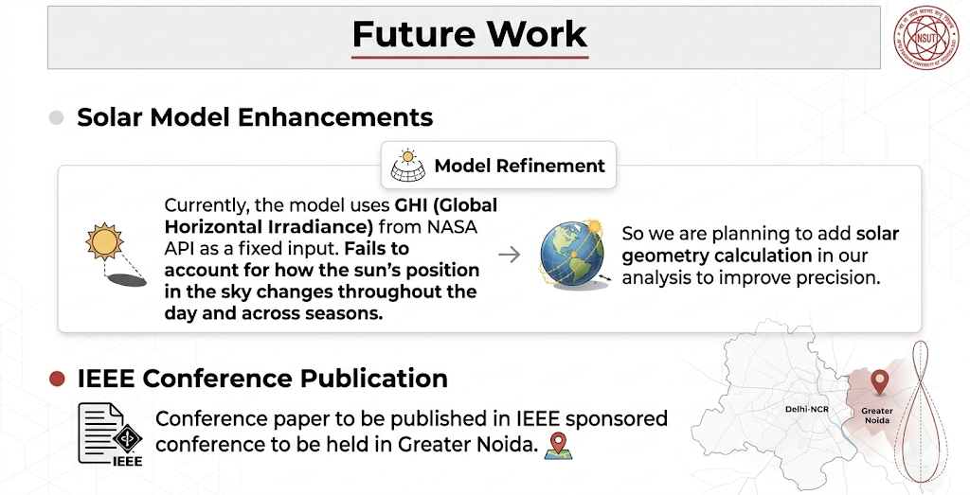
Future Scope
1. Annual energy yield simulation (365-day analysis)
2. Multi-row array modeling with inter-row shading
3. Machine learning-based rapid optimization
4. Techno-economic analysis (LCOE integration)
5. Real-time IoT monitoring & adaptive optimization
6. GIS integration for regional deployment planning
7. Single/dual-axis tracking system comparison
8. Anisotropic sky models (Perez/Hay-Davies)

Slide 19
References
[1] B.Y.H. Liu, R.C. Jordan, Solar Energy, vol. 4, 1960
[2] U.A. Yusufoglu et al., IEEE J. Photovolt., vol. 5, 2015
[3] F. Dincer, E. Ozer, Energies, vol. 18, 2025
[4] K. Ganesan et al., Solar Energy, vol. 252, 2023
[5] S.A. Pelaez et al., IEEE J. Photovolt., vol. 9, 2019
[6] N. Riedel-Lyngskjaer et al., Solar Energy, vol. 231, 2022
[7] R. Guerrero-Lemus et al., RSER, vol. 60, 2016
[8] M. Alam et al., SETA, vol. 57, 2023
[9] C. Deline et al., NREL Tech. Rep., 2019
[10] X. Sun et al., Appl. Energy, vol. 212, 2018
[11] A. Basak et al., Appl. Energy, vol. 345, 2025
[12] U. Peter, M. Novak, J. Sustain. Energy Syst., 2025
[13] M.H. Aksoy, H.A. Ceylan, RERJ, vol. 13, 2023
[14] N. Baghel et al., Solar Energy, vol. 250, 2023
[15] I.N. Atalay et al., Solar Energy, vol. 246, 2023
[16] D.S. Braga et al., REES, vol. 8, 2023
[17] A.F. Almarshoud et al., Energies, vol. 17, 2024
[18] M.T. Patel et al., IEEE J. Photovolt., vol. 11, 2021
[19] J.A. Duffie, W.A. Beckman, Wiley, 2013
[20] B. Marion et al., IEEE PVSC, 2017
[21] P.K. Sahu et al., Solar Energy, vol. 262, 2023
[22] C. Ghenai et al., Solar Energy, vol. 223, 2021

Slide 20
Thank You!
Questions & Discussion
Publication: "Performance Analysis of Bifacial PV System Based on Different Albedos" Accepted at IC2PCT 2026
Dr. Astitva Kumar (Supervisor) | Dept. of Electrical Engineering, NSUT

