Slide 1
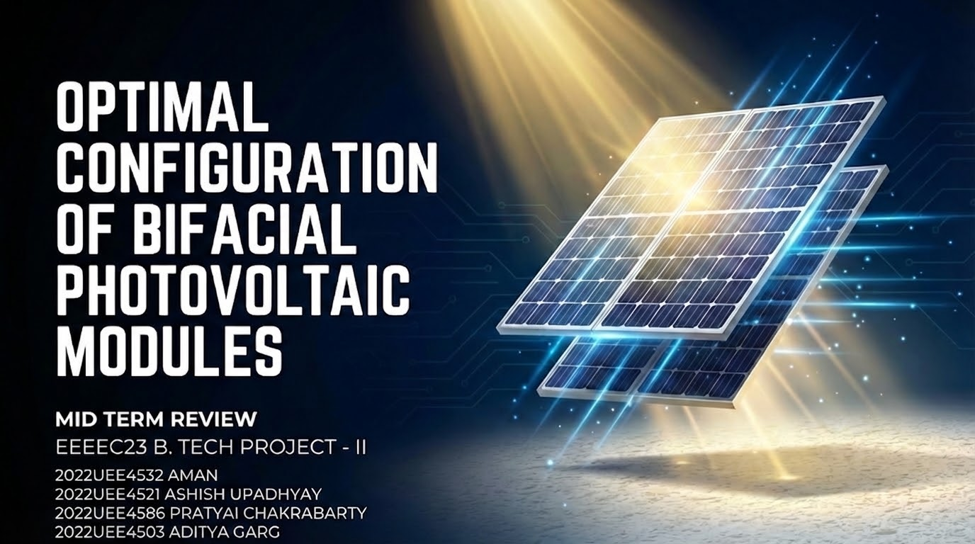

Slide 2

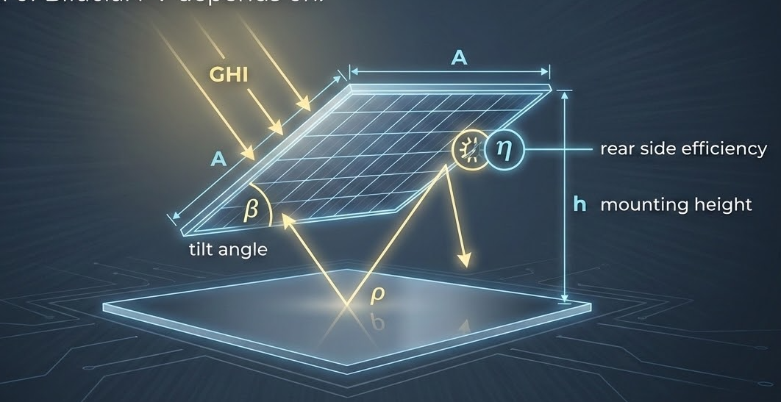
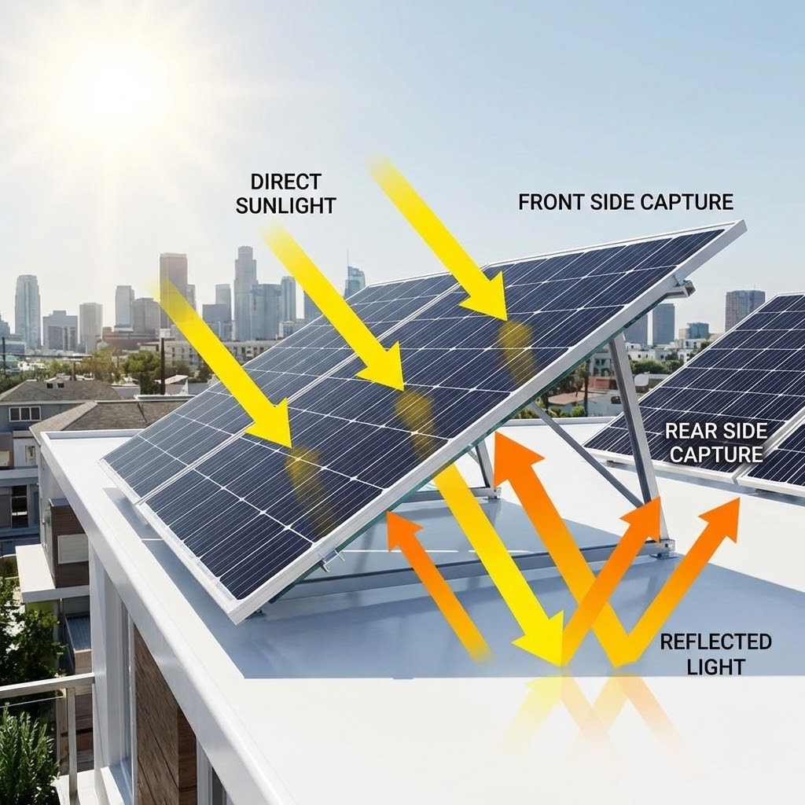
Introduction
India's Clean Energy Imperative 500 GW non-fossil capacity + 50% renewable electricity by 2030 — solar is the fastest path there.
Bifacial Modules: Double the Surface, Higher the Yield Unlike conventional panels, bifacial modules harvest energy from both sides capturing reflected ground light for significantly greater output.
Configuration is Everything Tilt, spacing, and albedo directly determine rear-side gain. Getting the setup right is what separates good performance from optimal performance.

Slide 3
Literature Survey
S.No. | Paper | Area of Focus | Findings
1 | Furkan Dincer & Emre Ozer — "Optimization of Rear-Side Energy Contribution in Bifacial PV Panels: A Parametric Analysis..." (Energies, 2025) | Systematic investigation of how four key parameters (albedo, tilt angle, panel height, and mounting configuration) affect rear-side energy generation and overall bifacial panel efficiency. | Technical findings: * High-albedo surfaces like aluminum (21.2%) maximize rear yield. * Increasing tilt up to 50° and higher panel elevation enhance back-side generation. * Horizontal mounting yields slightly more (4.5%) than vertical (4.1%) due to increased exposure to ground-reflected radiation Gaps/Findings relevant to our work: * While it isolates single variables successfully, finding the true "optimal configuration" .
2 | Hanna Langels & Fredrik Gannedahl — “BiFacial PV Systems: technological & practical rooftop comparison” (Uppsala University (Master's Thesis), 2018) | On-site comparison of bifacial and standard modules on a rooftop installation — emphasis on how installation choices (tilt, elevation, roof surface reflectivity) and module construction affect measured system output; used system power logs and simulation tools for sensitivity interpretation. | Technical findings: *Measured rear-gain ≈ +7.8%(energy) vs monofacial PV; up to +16.2% with higher albedo. *Rear irradiance strongly controlled by ground albedo, module elevation, tilt and shading. Gaps/Findings relevant to our work: *Façade installations typically have lower rear irradiance and constrained elevation/tilt which leads to substantially smaller bifacial gains than rooftop cases.
3 | A.A.F. Husain, W.Z.W. Hasan, Suhaidi Shafie, Mohd N. Hamidon, Shyam S. Pandey — A review of transparent solar photovoltaic technologies.(Renewable and Sustainable Energy Reviews, 2018) | This paper focuses on transparent solar photovoltaic (TPV) technologies, reviewing their materials, designs, and performance trade-offs. It examines how different approaches balance optical transparency with power conversion efficiency, stability, and cost. | Technical findings: *Transparent PVs achieve 20–70% visible light transmission while harvesting UV/IR for power. *Organic, dye-sensitized, and perovskite cells show promising efficiencies but face transparency–performance trade-offs. Gaps/Findings relevant to our work: *No clear solution for balancing efficiency and transparency. Scalability and cost-effective large-area modules remain unproven.

Slide 4
aa
S.No. | Paper | Area of Focus | Findings
4 | Lunt, Richard & Bulovic, Vladimir. (2011). Transparent, near-infrared organic photovoltaic solar cells for window and energy-scavenging applications.(Applied Physics Letters, 2011) | This paper focuses on transparent near-infrared organic photovoltaic (NIR-OPV) solar cells designed for use in windows and energy-scavenging applications. By selectively harvesting NIR light while transmitting visible light, the devices enable high transparency (>65% AVT) with modest efficiencies. The research explores material design, electrode engineering, and optical coatings to balance transparency, efficiency, and integration potential. | Technical findings: *Transparent NIR-OPVs achieved >65% average visible transmission with ~1.3% efficiency. *Using a NIR distributed-Bragg-reflector (DBR) mirror + antireflection coatings raised efficiency to ~1.7% while keeping AVT >55%. *Opaque reference cells reached ~2.4% efficiency, showing trade-off between transparency and performance. Gaps/Findings relevant to our work: Efficiency remains low compared to opaque OPVs, with significant transparency–performance trade-offs.
5 | Hassan Gholami, Harald Nils Røstvik, Daniela Müller-Eie (2019), Holistic economic analysis of building integrated photovoltaics (BIPV) system.(Energy and Buildings, 2019) | Economic feasibility of BIPV systems using Lifecycle Cost Analysis (LCCA), Net Present Value (NPV), and Discounted Payback Period (DPP). Four case studies analyzed: Brazil, Italy, China, and Bahrain. The study introduced an innovative LCCA framework that incorporates societal and environmental benefits (carbon cost, transmission loss, delivery cost, equivalent building material cost) into economic analysis. | No cost data on manufacturing/transport/disposal of BIPV panels considered. No analysis of financial risk/uncertainty (e.g., tariff fluctuations, policy changes) as payback and feasibility are strongly tied to. Assumes fixed O&M (1%/yr) and inverter replacement cycles, which may differ in real practice.
6 | Shirazi, A. M., Zomorodian, Z. S., & Tahsildoost, M. (2019). Techno-economic BIPV evaluation method in urban areas(Renewable Energy, 2019) | Techno-economic tool that combines 3D urban models with solar simulations to identify optimal BIPV placement and tilt, while evaluating feasibility through NPV, IRR, LCOE, and payback periods. | Carbon reduction: Rooftops gave the highest CO₂ savings (~160 kg/panel), while façades still offered useful reductions despite lower efficiency. Lifecycle costs missing: Inverter replacement, disposal, and salvage value are not considered, making cost estimates less realistic. CO₂ savings are calculated per PV strategy, but carbon reductions are not given any economic value.

Slide 5
aa
S.No. | Paper | Area of Focus | Findings
7 | Wenbo Gu, Tao Ma, Salman Ahmed, Yijie Zhang, Jinqing Peng — A comprehensive review and outlook of bifacial photovoltaic (bPV) technology.(Energy Conversion and Management, 2020) | This paper focuses on bifacial photovoltaic (bPV) technology, reviewing its principles, performance benefits, and influencing factors compared to monofacial PV. It examines modeling approaches, experimental field results, optical/electrical/thermal loss mechanisms, and design parameters such as albedo, tilt, and module elevation. The study emphasizes performance prediction, optimization, and future development needs for widespread bPV adoption | Technical findings: *Modeling approaches (ray-tracing, view factor, and empirical) predict bifacial gains with <2% error under controlled setups. *Rear irradiance nonuniformity and mismatch losses are significant in large arrays. *Optical, electrical, and thermal losses (reflection, resistance, shading) influence actual field performance. Gaps/Findings relevant to our work: Field data across diverse climates and real installation geometries are still limited. Rear-side mismatch and nonuniform shading effects lack robust mitigation strategies.
8 | K. Lee, J.-H. Park, Y. Cho, et al. — The Development of Transparent Photovoltaics(Cell Reports Physical Science, 2020) | This review paper surveys recent developments in transparent photovoltaics (TPVs), with emphasis on methods that impart transparency to conventional solar cells. It covers material innovations, device architectures, optical management strategies, and performance metrics, aiming to chart the path from laboratory prototypes toward viable, large-area transparent solar modules for windows, façades, and integrated surfaces. | Technical findings: *Various transparent PV technologies (organic, perovskite, dye-sensitized, QD-based) demonstrate power conversion efficiencies ranging from ~2% to 12% while maintaining visible light transmittance of 20–70%. *Trade-off exists between optical transparency and electrical efficiency, requiring careful optimization of materials and device architectures. Gaps/Findings relevant to our work: Long-term stability and large-scale manufacturability of transparent PV remain underdeveloped. Economic analysis and lifecycle assessment are limited, making ROI and practical adoption uncertain.
9 | A. Al-Waeli, K. Sopian, M.Y. Sulaiman, H.A. Kazem, M.T. Chaichan — Photovoltaic solar thermal (PV/T) systems: Status and future prospects.(Renewable and Sustainable Energy Reviews, 2017) | This paper reviews the current status and future prospects of photovoltaic/thermal (PV/T) systems, which simultaneously generate electricity and utilize thermal energy. It explores system designs, performance parameters, cooling techniques, and hybrid configurations. The review emphasizes improving overall efficiency, reducing operating temperature, and addressing practical challenges for integrating PV/T into renewable energy applications. | Technical findings: *PV/T systems improve overall efficiency by combining electricity and heat generation. *Water and nanofluid cooling enhance electrical performance more than air cooling. Gaps/Findings relevant to our work: Long-term durability of advanced cooling methods is unproven. Limited economic and lifecycle assessments hinder large-scale adoption. Scaling and maintenance in building applications remain challenging.

Slide 6
aa
S.No. | Paper | Area of Focus | Findings
10 | Yakubu et al. (2024). A systematic literature review of the bifacial photovoltaic module and its applications . (The Journal of Engineering, 2024) | The study focuses on experimentally validating an energy-yield prediction model for bifacial photovoltaic modules deployed in a Canadian cold-climate environment. It investigates how rear-side gains respond to seasonal irradiance variability, snow-induced albedo changes, and hemispherical light distribution. | Ground-measured irradiance inputs reduced normalized RMSE values relative to satellite data, indicating higher modelling fidelity. Winter deviations were dominated by snow-driven albedo spikes and shading, but integrating snow-coverage detection reduced prediction error by ~50%.
11 | Jang et al. (2021), Performance Analysis of Bifacial PV Modules with Transparent Mesh Backsheet .(Energies, 2021) | The study investigates the performance enhancement potential of bifacial photovoltaic (PV) modules equipped with a transparent mesh backsheet, designed to improve rear-side irradiance capture without compromising structural protection. It assesses optical, electrical, and thermal impacts of mesh-based encapsulation under realistic operating conditions, comparing output characteristics against conventional bifacial designs with opaque backsheets. | Transparent mesh backsheets increased rear-side irradiance coupling, yielding higher bifacial gain relative to solid backsheets, particularly under elevated albedo or ground-reflective conditions. Electrical output improvements were observed, but performance was sensitive to mesh density and optical transmittance, requiring careful balance between durability and transparency.
12 | Ghafiri, S., Darnon, M., Davigny, A., Trovão, J. P. F. & Abbes, D. (2024). A comprehensive performance evaluation of bifacial photovoltaic modules.(EPJ Photovoltaics, 2024) | The paper focuses on developing and experimentally validating a bifacial photovoltaic (PV) performance model using year-long outdoor measurements in a Canadian cold-climate environment. It evaluates how irradiance sources ground-measured versus satellite-derived affect the accuracy of energy-yield prediction, while accounting for snow-induced albedo variability and rear-side light collection. | Local irradiance data significantly improved model accuracy compared to satellite-based inputs, lowering seasonal NRMSE values across spring, summer, and fall. Winter prediction errors rose due to snow-driven albedo fluctuations and shading effects, but integrating snow-detection logic reduced error by roughly 50%.

Slide 7
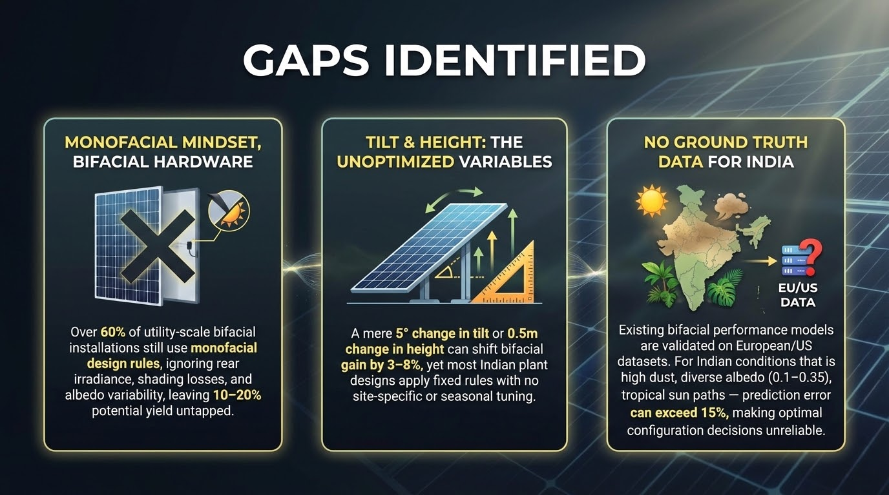
Gaps Identified
Monofacial Mindset, Bifacial Hardware Over 60% of utility-scale bifacial installations still use monofacial design rules , ignoring rear irradiance, shading losses, and albedo variability, leaving 10–20% potential yield untapped.
Tilt & Height: The Unoptimized Variables A mere 5° change in tilt or 0.5m change in height can shift bifacial gain by 3–8% , yet most Indian plant designs apply fixed rules with no site-specific or seasonal tuning.
No Ground Truth Data for India Existing bifacial performance models are validated on European/US datasets. For Indian conditions that is high dust, diverse albedo (0.1–0.35), and tropical sun paths — prediction error can exceed 15%, making optimal configuration decisions unreliable.

Slide 8
Problem Statement
How can the rear side energy contribution and overall performance of Bifacial PV systems be maximized by optimally selecting surface albedo, panel tilt angle and mounting height?

Slide 9
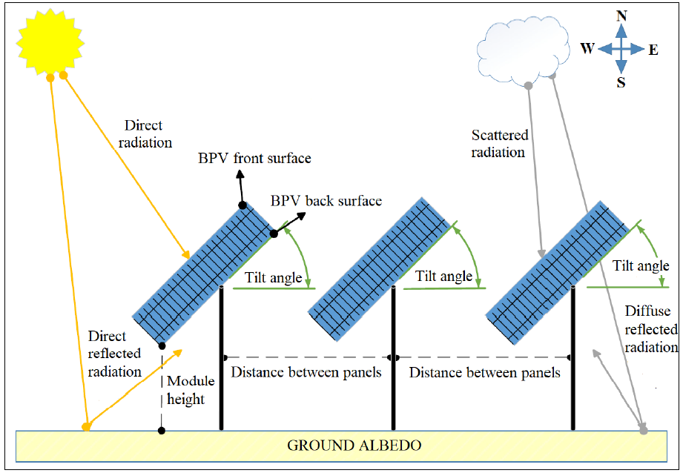

Rear Power from Bifacial PV
Rear gain of Bifacial PV depends on :
i) surface albedo (ρ)
ii) tilt angle (β)
iii) mounting height (h)
iv) solar irradiance (GHI)
v) rear side efficiency (η)
vi) panel area (A)

Slide 10
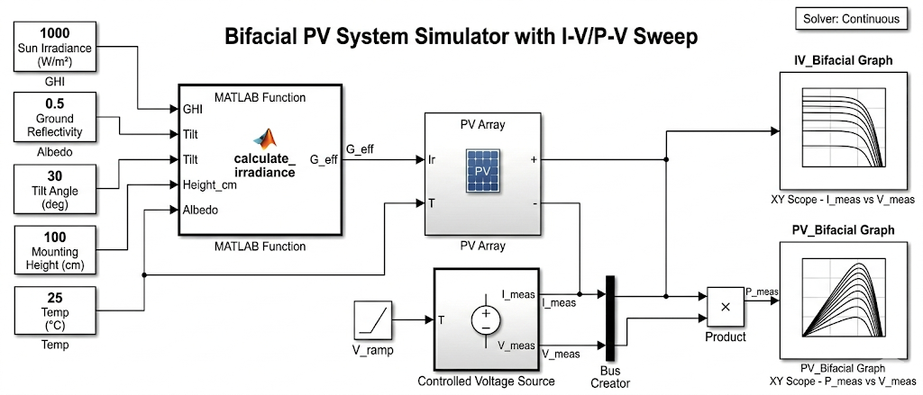
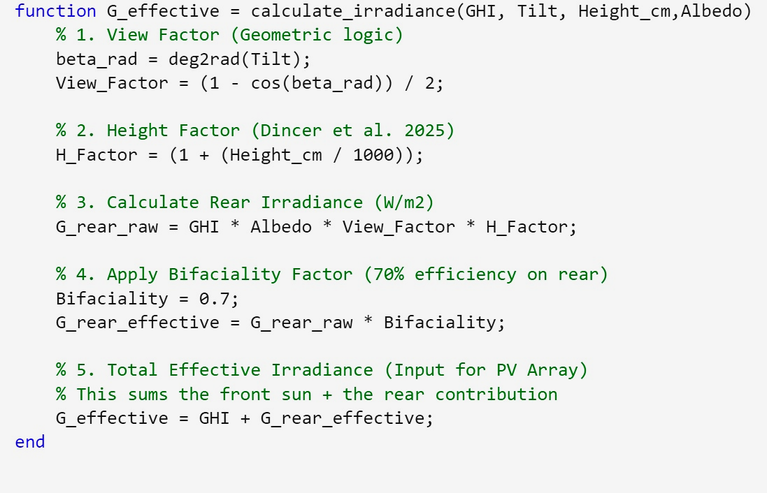
Modelling and Script
Simulink model integrates 5 physical inputs (Irradiance, Temp, Tilt, Height, Albedo) to simulate real-world bifacial PV behaviour
Parallel IV & PV curve outputs generated for monofacial vs bifacial — enabling direct performance comparison

Slide 11
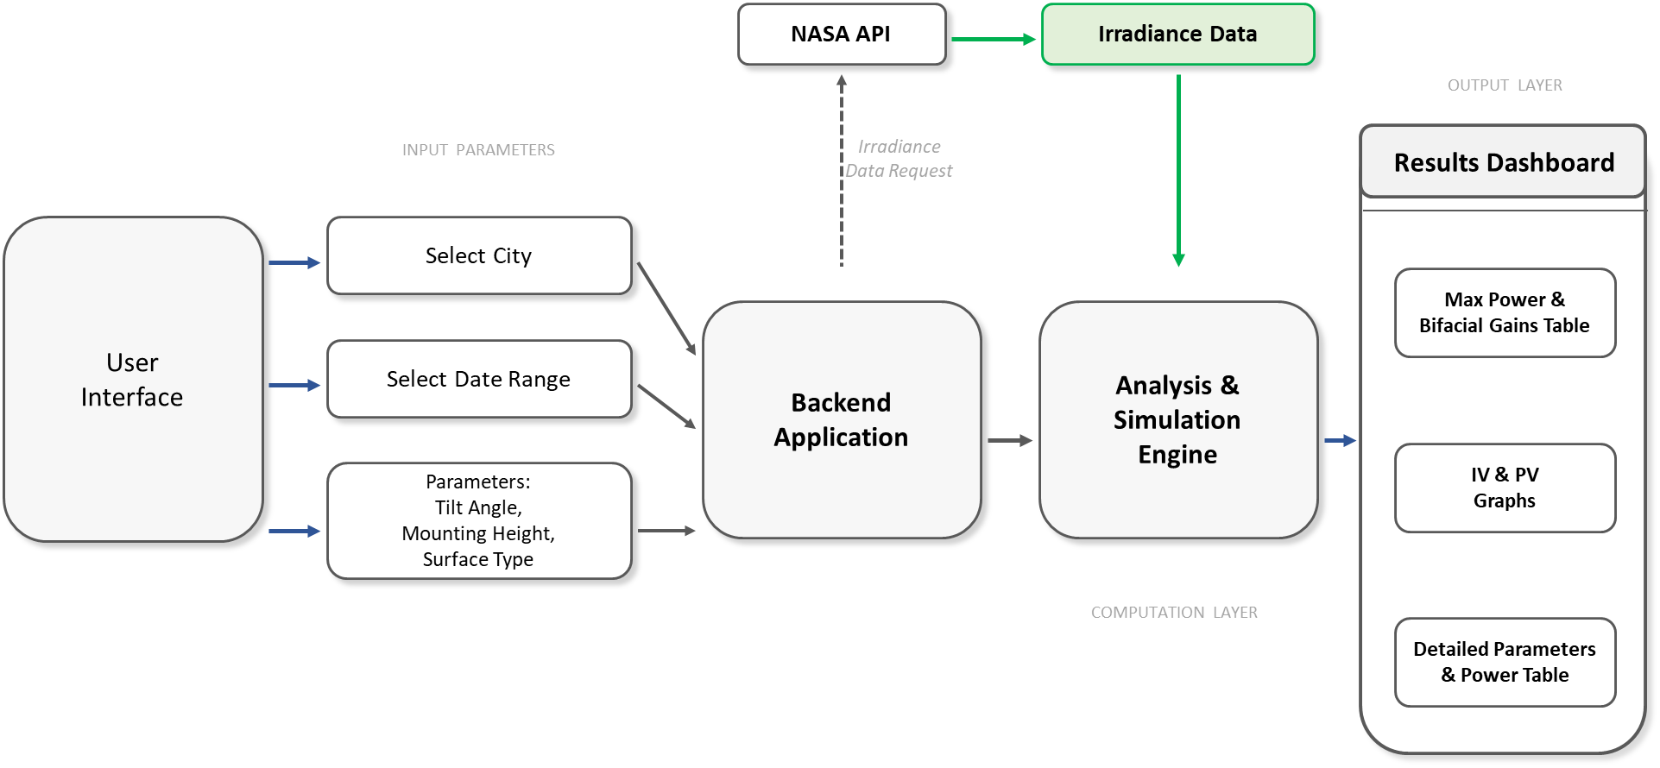
Methodology Proposed
Why this framework?
Manually re-running the Simulink model for every city, date, and parameter combination is time-consuming and error-prone.
A web-based interface replaces the need for MATLAB expertise, making bifacial PV analysis accessible and reproducible across any location.
The underlying computational model is scaled to evaluate a standard 5kW bifacial PV system across all selected locations and configurations.

Slide 12
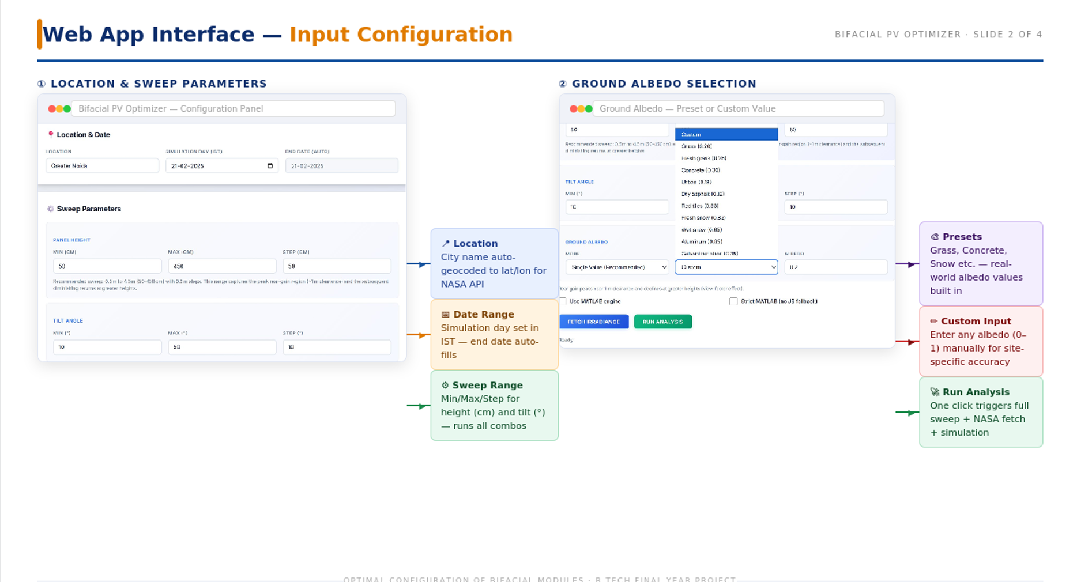

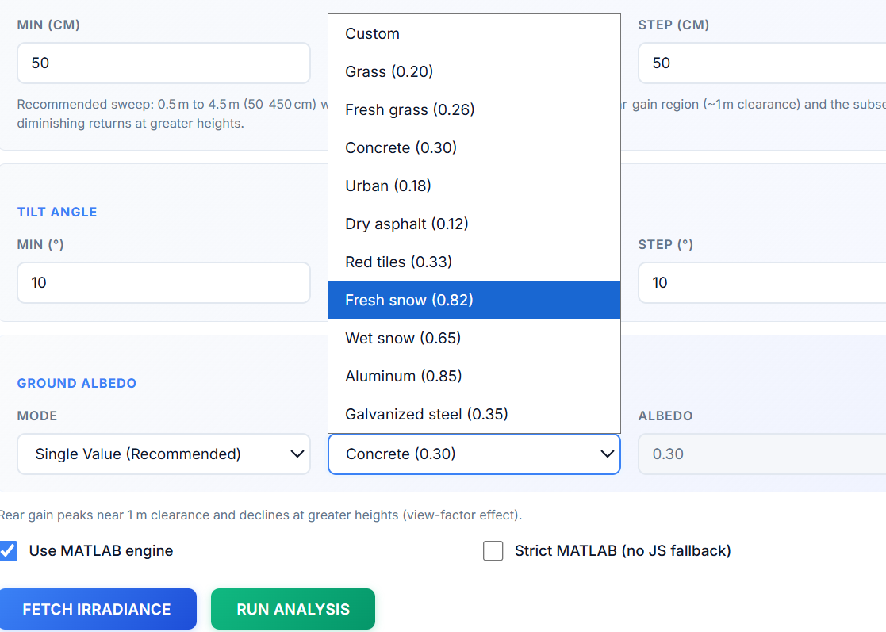
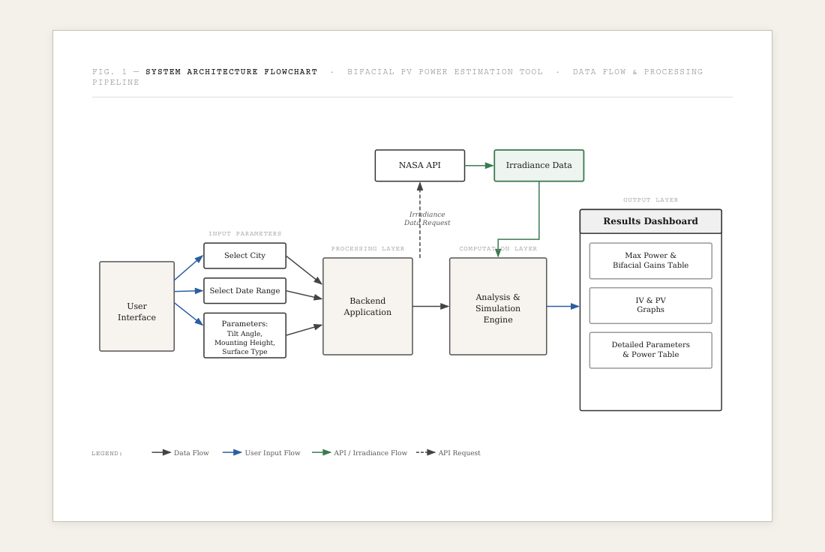
Bifacial PV Optimizer
Why this framework?
Manually re-running the Simulink model for every city, date, and parameter combination is time-consuming and error-prone
The proposed framework automates this pipeline — from user inputs to NASA irradiance fetch to simulation — eliminating repetitive manual effort
A web-based interface replaces the need for MATLAB expertise, making bifacial PV analysis accessible, scalable, and reproducible across any location or configuration

Slide 13
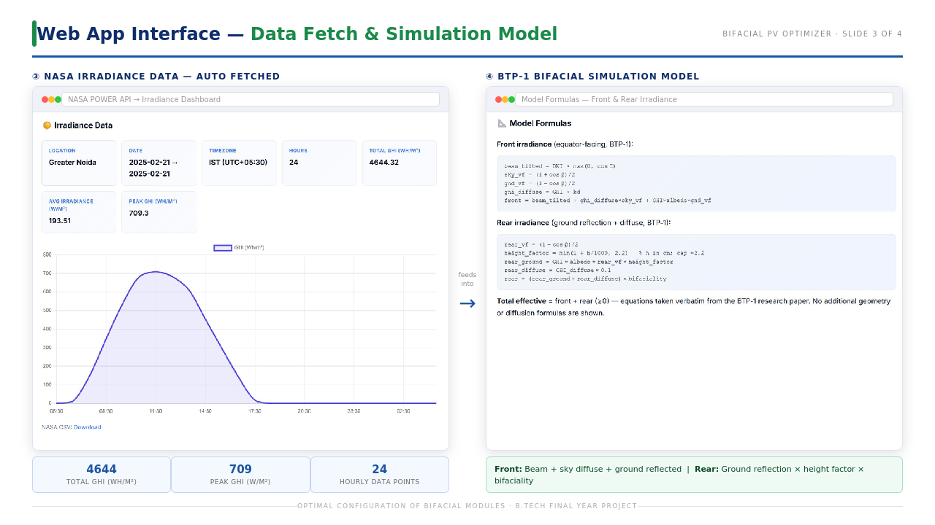
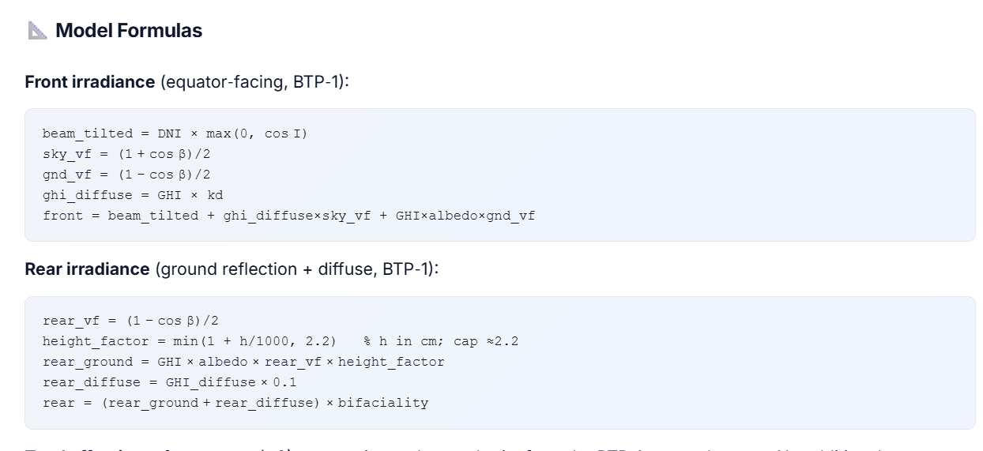

Slide 14
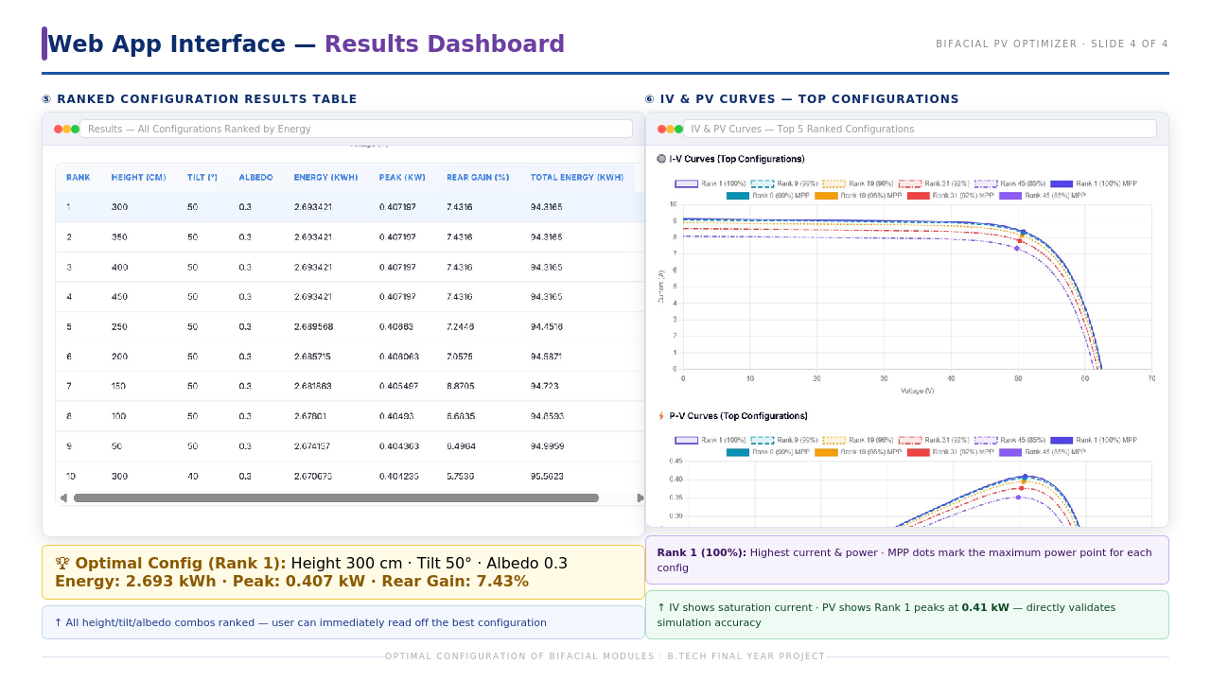
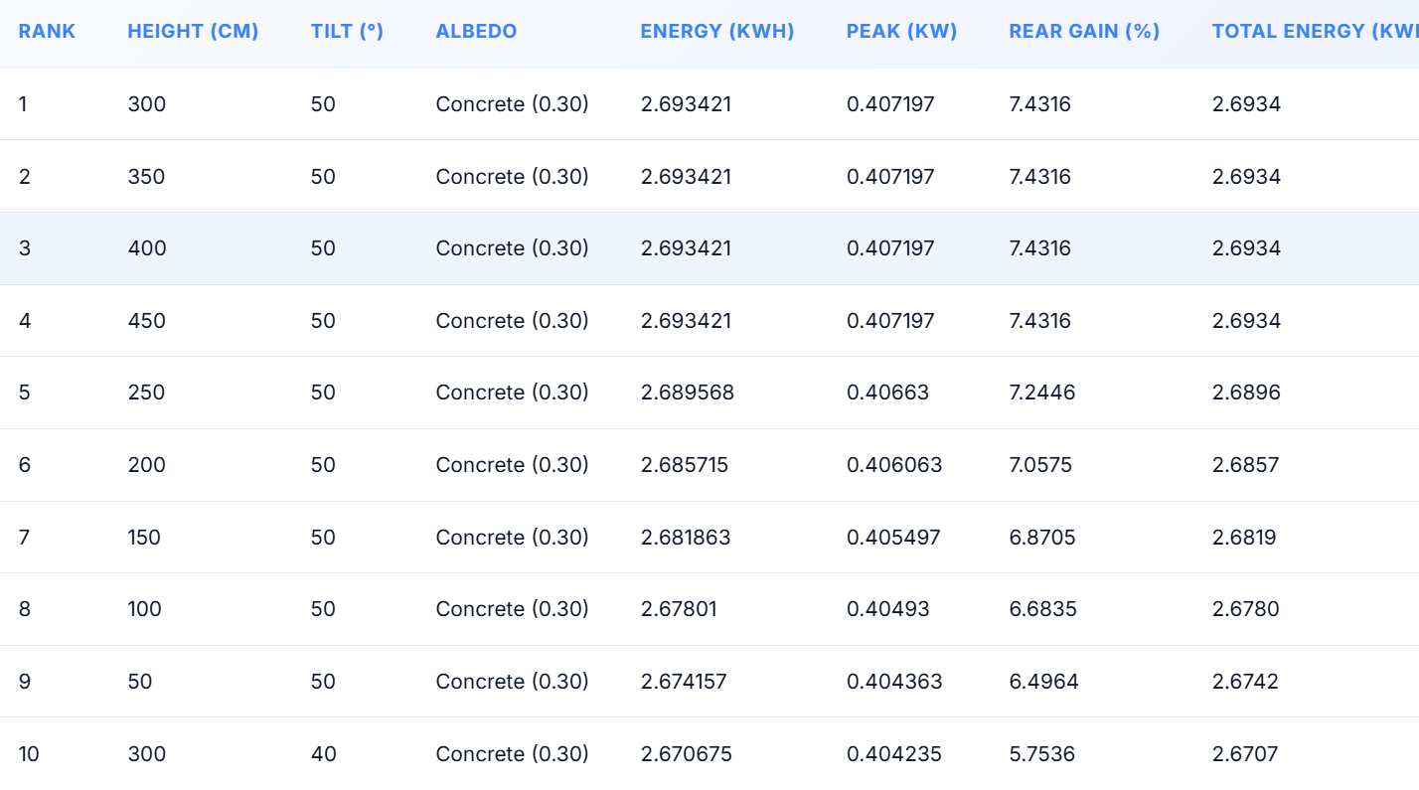
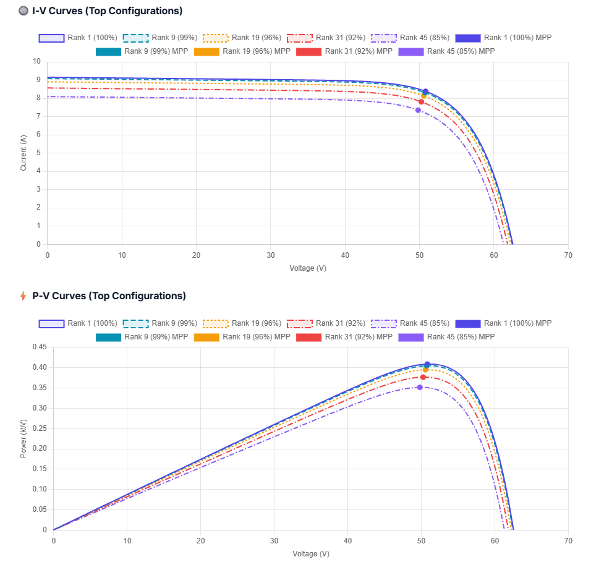

Slide 15
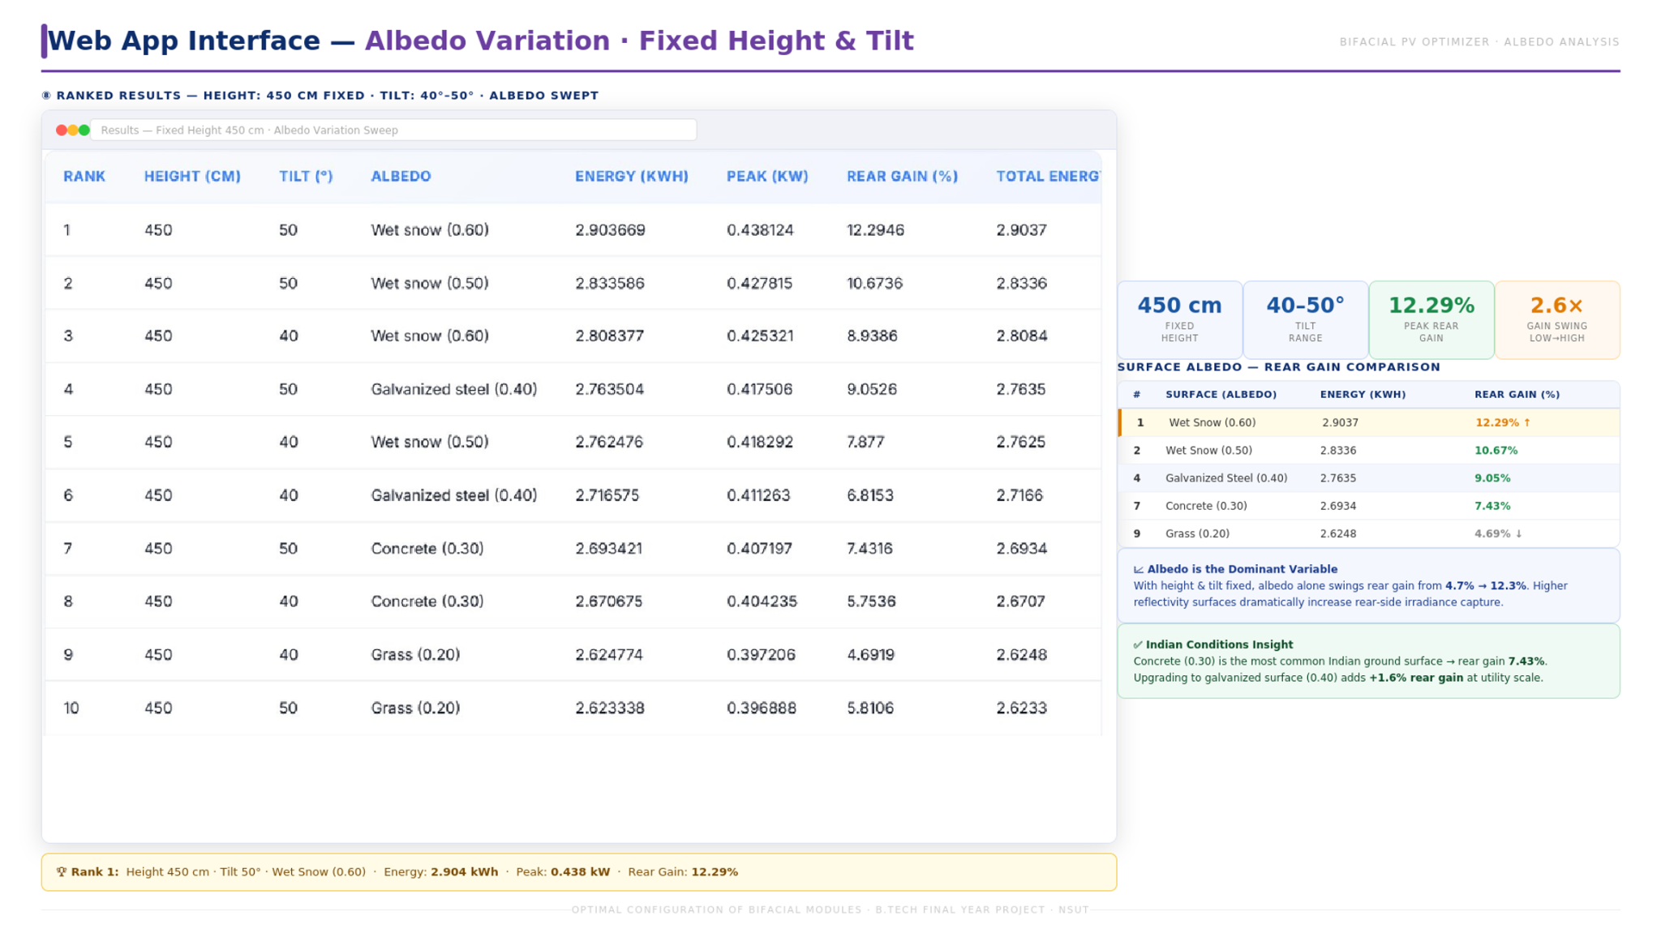

Slide 16
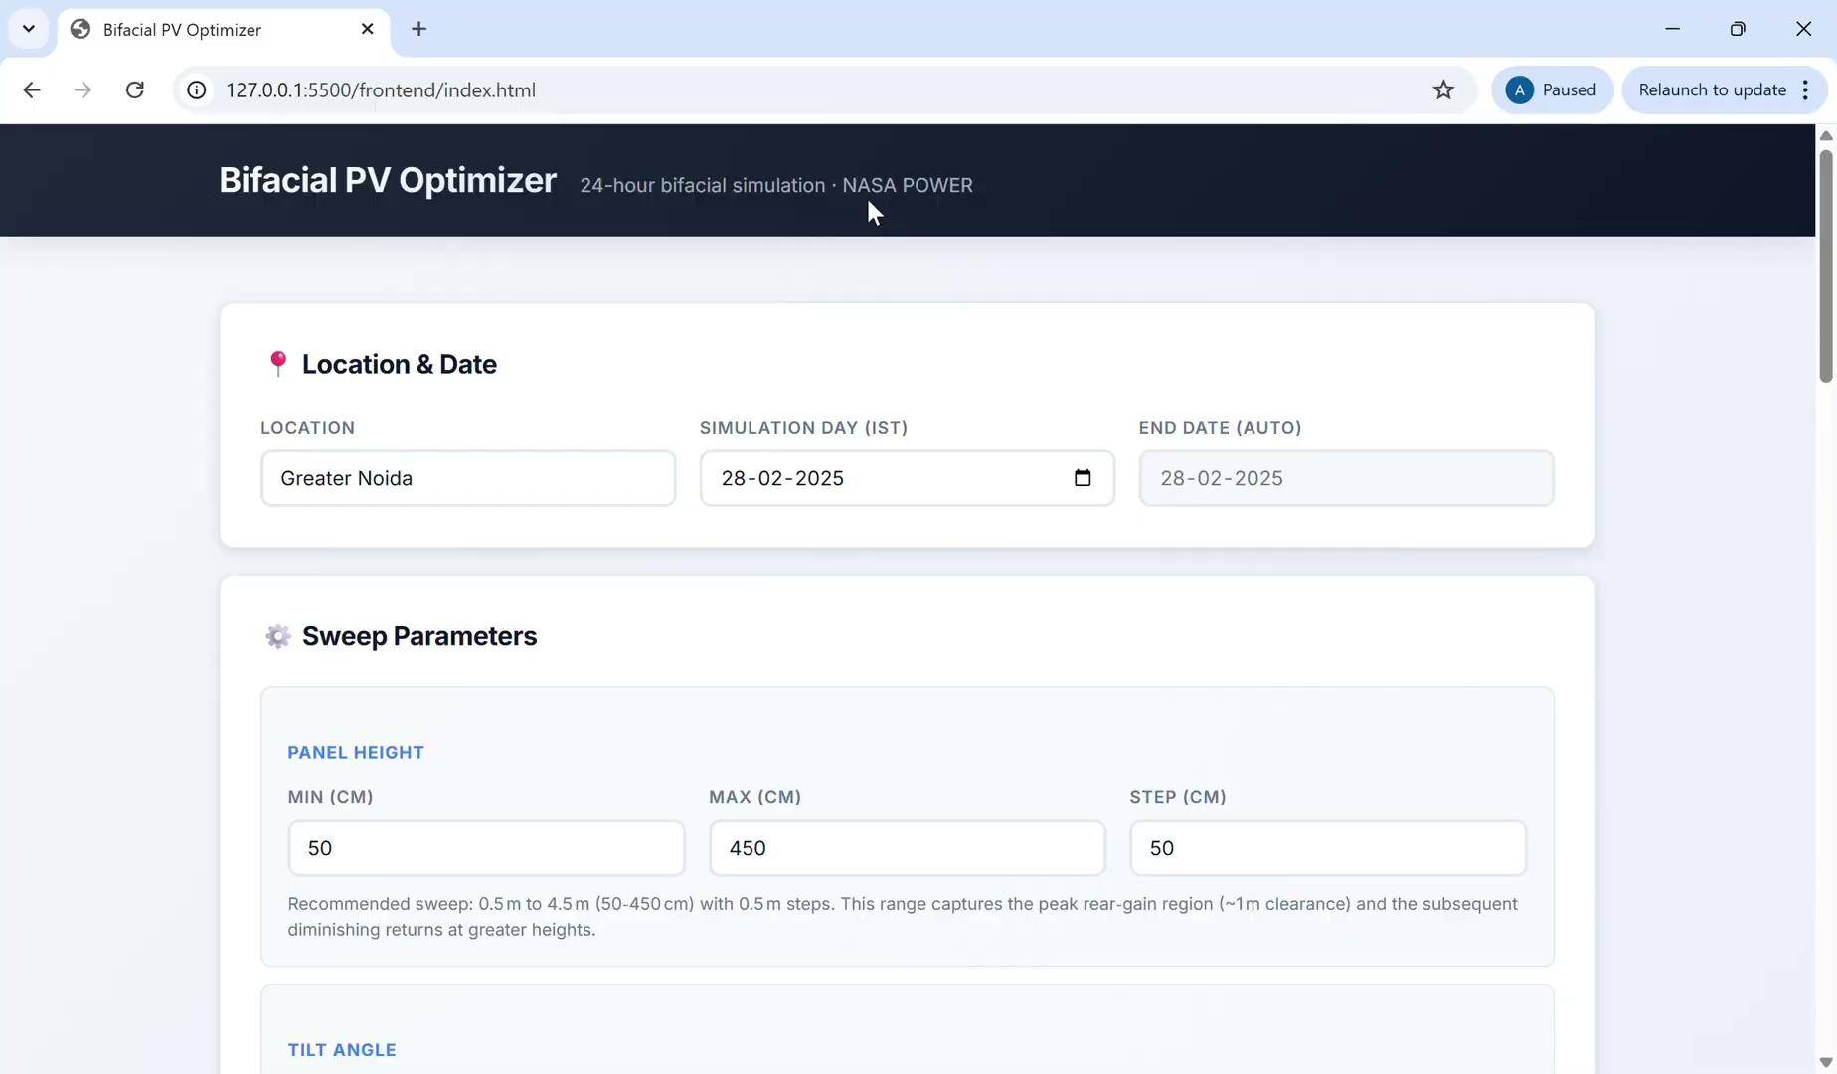
Demo Video

Slide 17
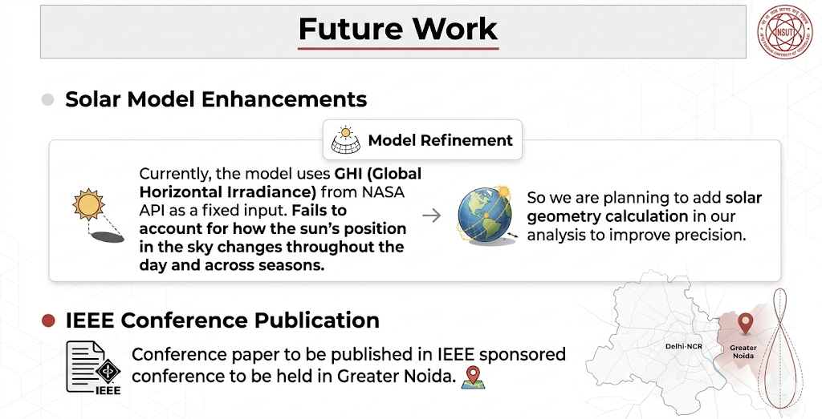
Future Work
Currently, the model uses GHI (Global Horizontal Irradiance) directly from NASA API as a fixed input — it does not account for how the sun's position in the sky changes throughout the day and across seasons.
So we are planning to add solar geometry as well in our analysis.
Conference paper to be published in IEEE sponsored conference to be held in Greater Noida.

Slide 18
References
[1] F. Dincer and E. Ozer, "Optimization of Rear-Side Energy Contribution in Bifacial PV Panels: A Parametric Analysis on Albedo, Tilt, Height, and Mounting Configuration," Energies, vol. 18, p. 4443, 2025.
[2] A. A. F. Husain, W. Z. W. Hasan, S. Shafie, M. N. Hamidon, and S. S. Pandey, “A review of transparent solar photovoltaic technologies,” Renewable and Sustainable Energy Reviews, vol. 94, pp. 779–791, 2018
[3] R. R. Lunt and V. Bulović, “Transparent, near-infrared organic photovoltaic solar cells for window and energy-scavenging applications,” Appl. Phys. Lett., vol. 98, no. 11, p. 113305, Mar. 2011
[4] H. Gholami, H. N. Røstvik, and D. Müller-Eie, “Holistic economic analysis of building integrated photovoltaics (BIPV) system: Case studies evaluation,” Energy and Buildings, vol. 203, art. 109461, Oct. 2019
[5] A. M. Shirazi, Z. S. Zomorodian, and M. Tahsildoost, “Techno-economic BIPV evaluation method in urban areas,” Renewable Energy, vol. 143, pp. 1235–1246, Dec. 2019
[6] W. Gu, T. Ma, S. Ahmed, Y. Zhang, and J. Peng, “A comprehensive review and outlook of bifacial photovoltaic (bPV) technology,” Energy Conversion and Management, vol. 223, art. 113283, Nov. 2020
[7] K. Lee, H.-D. Um, D. Choi, J. Park, N. Kim, H. Kim, and K. Seo, “The Development of Transparent Photovoltaics,” Cell Reports Physical Science, vol. 1, no. 8, art. 100143, Aug. 2020
[8] B. Yu, D. Song, Z. Sun, K. Liu, Y. Zhang, D. Rong, and L. Liu, “A study on electrical performance of N-type bifacial PV modules,” Solar Energy, vol. 137, pp. 129–133, Nov. 2016

Slide 19
References
[9] A. Desai, I. Mukhopadhyay, and A. Ray, “Feasibility Assessment of Bifacial Rooftop Photovoltaic Systems in the State of Gujarat in India,” Frontiers in Energy Research, vol. 10, art. 869890, 28 Jun. 2022
[10] A. H. A. Al-Waeli, K. Sopian, H. A. Kazem, and M. T. Chaichan, “Photovoltaic/Thermal (PV/T) systems: Status and future prospects,” Renewable and Sustainable Energy Reviews, vol. 77, pp. 109–130, Sep. 2017
[11] S. Ghafiri, M. Darnon, A. Davigny, J. P. F. Trovão, and D. Abbes, “A comprehensive performance evaluation of bifacial photovoltaic modules: insights from a year-long experimental study conducted in the Canadian climate” EPJ Photovoltaics, vol. 15, p. 28, Jan. 2024
[12] J. Jang, A. Pfreundt, M. Mittag, and K. Lee, “Performance analysis of bifacial PV modules with transparent mesh backsheet” Energies, vol. 14, no. 5, Art. no. 1399, Mar. 2021
[13] R. O. Yakubu, L. D. Mensah, D. A. Quansah, and M. S. Adaramola, “A systematic literature review of the bifacial photovoltaic module and its applications” The Journal of Engineering, vol. 2024, no. 8, Aug. 2024

Slide 20
Thank You.
2022UEE4532 | AMAN
2022UEE4521 | ASHISH UPADHYAY
2022UEE4586 | PRATYAI CHAKRABARTY
2022UEE4503 | ADITYA GARG
Mid Term Review
EEEEC23 B. Tech Project - II

