Slide 1
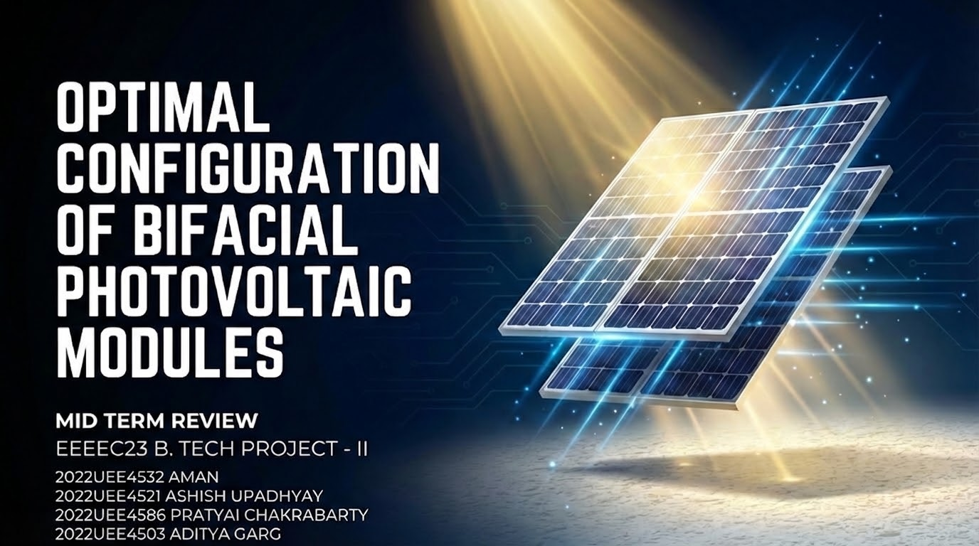
OPTIMAL CONFIGURATION OF BIFACIAL PHOTOVOLTAIC MODULES USING PARAMETRIC ANALYSIS
End-Semester Presentation | B.Tech. Project
Ashish Upadhyay (2022UEE4521) | Pratyai Chakrabarty (2022UEE4586) Aman (2022UEE4532) | Aditya Garg (2022UEE4503)
Under the supervision of Dr. Astitva Kumar
Department of Electrical Engineering Netaji Subhas University of Technology, New Delhi

Slide 2
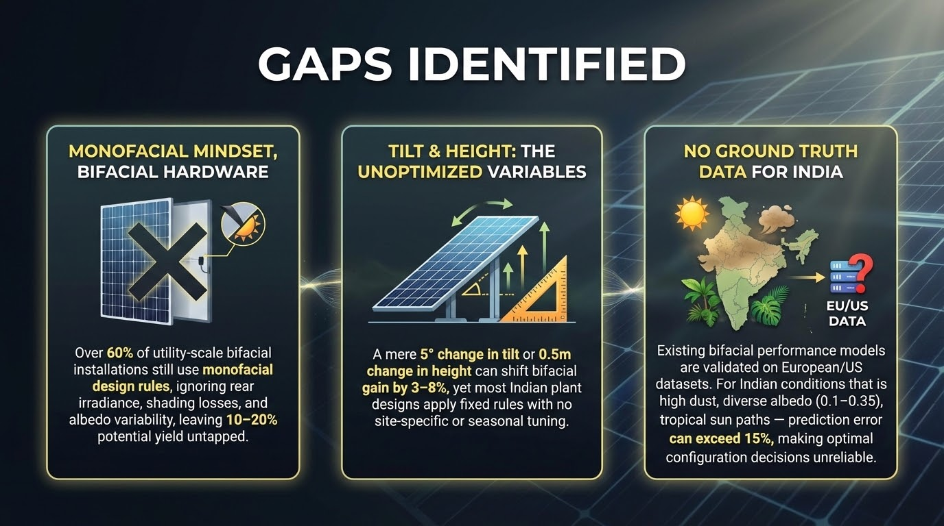

Presentation Outline
1. Introduction & Motivation
2. Literature Survey & Gaps
3. Problem Statement & Objectives
4. Mathematical Formulation (Equations 1-11)
5. Simulink Model & Frontend Platform
6. Case Study: Greater Noida
7. Results & Analysis
8. Comparison with Literature
9. Conclusion & Key Findings
10. Future Scope
11. Publication & References

Slide 3
Introduction & Motivation
• Solar PV is the fastest-growing electricity source — global capacity exceeded 1,500 GW by end of 2024
• India targets 500 GW non-fossil fuel capacity by 2030 under the National Solar Mission
• Bifacial PV modules capture irradiance from both front and rear surfaces, achieving 5–30% higher energy yield
• However, rear-side contribution is highly sensitive to tilt angle, ground albedo, and mounting height
• Need for systematic, location-specific optimization tools to realize the full potential of bifacial technology
• First industrial bifacial panels: 1984 — predicted to capture ~35% of global PV market by 2027

Slide 4
Literature Survey
Guerrero-Lemus et al. [7]: Comprehensive bifacial PV technology review; need for standardized testing
Yusufoglu et al. [2]: Annual performance analysis; up to 30% gain at 2m height; log-height dependence
Dincer & Ozer [3]: Parametric analysis — albedo, tilt, height, mounting; 21.2% rear gain for aluminum
Sun et al. [10]: Global optimization perspective; location-specific analysis essential
Ganesan et al. [4]: n-type PERT bifacial under diverse albedo; 21.4% avg gain with aluminum
Pelaez et al. [5]: Comparison of 5 bifacial irradiance models; ~20% bifacial gain validated

Slide 5
Gaps Identified
Limited Combined Analysis: Most studies evaluate tilt, albedo, height independently — not their combined interaction effect
Location-Specific Gap: Many studies limited to European/American climates; India-specific validation lacking
Accessibility Barrier: Current tools require specialized software (PVsyst, SAM) or commercial licenses
Single Optimization Objective: Few studies consider dual objectives: max energy vs. max rear gain trade-off
No User-Friendly Platform: No web-based tool exists for real-time location-specific bifacial PV optimization

Slide 6
Problem Statement
"How can the rear-side energy contribution and overall performance of bifacial PV systems be maximized by optimally selecting tilt angle, ground albedo, and mounting height for a given geographical location?"
Research Objectives:
1. Develop comprehensive mathematical model for bifacial PV (front + rear irradiance)
2. Implement in MATLAB/Simulink for I-V / P-V characteristic simulation
3. Build user-oriented frontend platform with NASA POWER API integration
4. Perform parametric sweep for optimal configuration identification
5. Validate through case study and literature comparison

Slide 7
Mathematical Formulation — Front Irradiance
Eq. 1: G_tot = G_front + G_rear → Total effective irradiance on bifacial module
Eq. 2: beam_tilted = DNI × max(0, cos θᵢ) → Direct beam on tilted surface
Eq. 3: sky_vf = (1 + cos β) / 2 → Sky view factor for tilted plane
Eq. 4: gnd_vf = (1 − cos β) / 2 → Ground view factor for tilted plane
Eq. 5: G_front = beam + DHI·sky_vf + GHI·ρ·gnd_vf → Liu-Jordan isotropic model [1]

Slide 8
Mathematical Formulation — Rear Irradiance & Shadow
Eq. 6: γ_profile = arctan(tan α_sun / cos(γ_sun − γ_panel)) → Solar profile angle
Eq. 7: shadow_lower = h / tan(γ_profile) → Lower shadow edge on ground
Eq. 8: shadow_upper = (h + W·sinβ) / tan(γ_profile) → Upper shadow edge
Eq. 9: F_V = ∫ cosθ₁·cosθ₂ / (2r) dx → Shadow view factor [2]
Eq. 10: G_r0 = ρ·DHI·rear_vf + ρ·(GHI−DHI)·(rear_vf−F_V) → Rear irradiance with shadow correction
Eq. 11: G_rear = G_r0 × φ_bifaciality → Scaled by bifaciality factor (0.7)

Slide 9
Simulink Model & Implementation
• calculate_irradiance MATLAB function block implements Eqs. 1–11
• PV Array block: single-diode model 550 Wp bifacial module
• V_ramp sweep: 0V to Voc for complete I-V / P-V curves
• NOCT thermal model: cell temp derating
• Simpson's rule numerical integration for shadow view factor F_V (200 pts)
[Insert Simulink Model Screenshot Here]

Slide 10
Frontend Platform Architecture
▶ User Interface: City selection, date range, sweep parameters, albedo surface type, optimization objective
▶ Backend (Node.js/Express): API routing, input validation, NASA POWER data retrieval, parametric sweep coordination
▶ NASA POWER API: Hourly GHI, DHI, DNI, temperature data for any global location (0.5° resolution)
▶ Analysis Engine: Erbs decomposition, Liu-Jordan transposition, view factor computation, I-V/P-V generation
▶ Results Dashboard: Optimal config tables, I-V/P-V charts, individual parameter variation graphs

