Slide 1
MAASLIN3 ANALYSIS

Slide 2
Initialization and setup of Maaslin3 for analysis
R script used to preprocess microbiome data and run a Maaslin3 supervised model with tempo as the main fixed effect and sex, bmi, and age as confounders. The code imports the phyloseq RDS object, extracts OTU, taxonomy, and metadata tables, merges taxonomic identifiers, formats categorical variables, and constructs the final model formula including a random intercept for id_original. The script then executes Maaslin3 using TSS normalization and log transformation, generating summary plots and significant associations in the specified output directory.

Slide 3
Creation of abundance and prevalence matrices stratified by tempo and statistical significance
R script used to generate four result matrices derived from Maaslin3 outputs. The code filters the full results table by the metadata variable tempo and separates features according to the statistical model applied (abundance or prevalence).
Each model is further split into two significance-based subsets: taxa significant at pval < 0.05 and taxa significant at qval < 0.1. This results in four final matrices: abundance–pval, abundance–qval, prevalence–pval, and prevalence–qval, which are used for downstream comparative analyses.

Slide 4
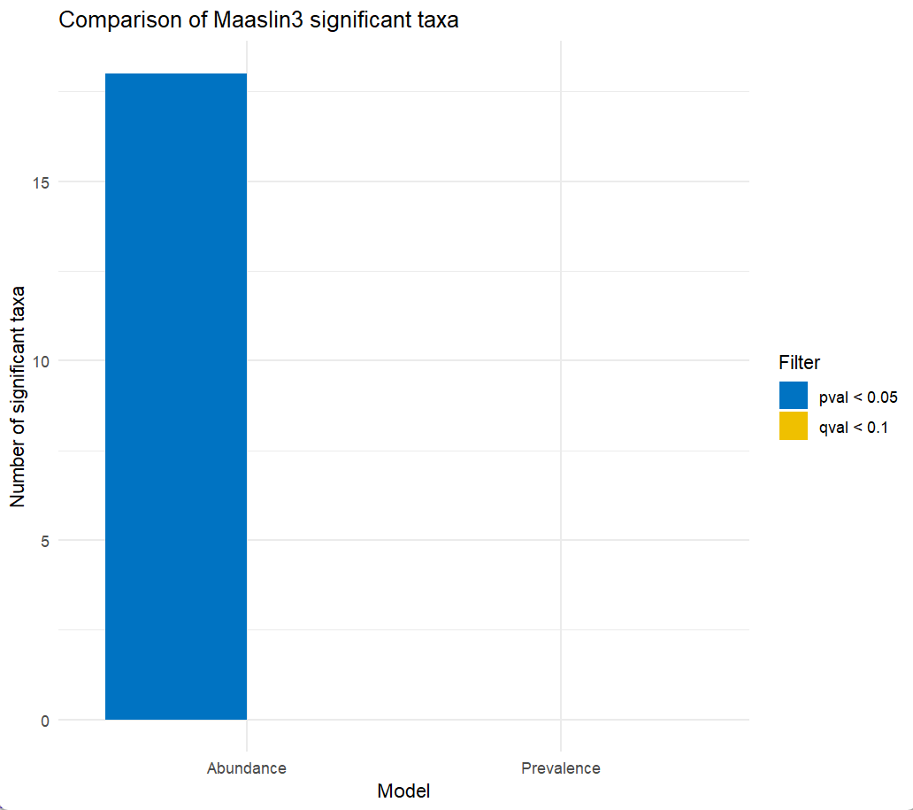
Comparison of Maaslin3 significant taxa
Bar chart showing the comparison between Maaslin3 models based on abundance and prevalence. The plot illustrates the number of significant taxa identified in each model, considering two statistical significance thresholds: pval < 0.05 (blue) and qval < 0.1 (yellow). Only the abundance model detected significant taxa, indicating greater sensitivity compared to the prevalence model.
ggplot(counts, aes(x = Model, y = Count, fill = Filter)) + geom_bar(stat = "identity", position = position_dodge()) + labs(title = "Comparison of Maaslin3 significant taxa", x = "Model", y = "Number of significant taxa") + theme_minimal() + scale_fill_manual(values = c("#0073C2FF", "#EFC000FF"))

Slide 5
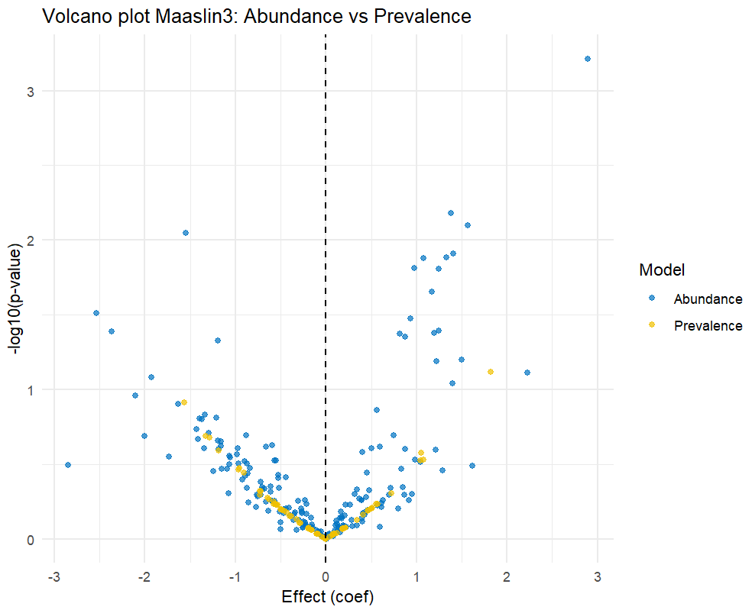
Comparative volcano plot illustrating effect size versus statistical significance
Comparative volcano plot generated from Maaslin3 results, illustrating the relationship between effect size (coefficient) and statistical significance (−log10 p-value) for taxa analyzed under the abundance and prevalence models. Each point represents a taxon, with blue dots corresponding to the abundance model and yellow dots to the prevalence model. The results show that no taxa are significant for q-value in either model, and the prevalence model does not yield any significant taxa even for p-value. Therefore, the only significant findings are observed in the abundance model (p-value < 0.05), making it the sole dataset containing statistically significant results.

Slide 6
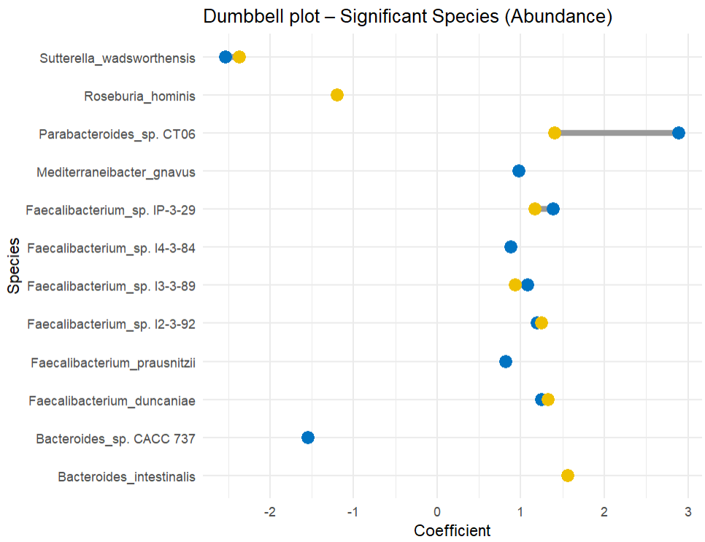
Dumbbell plot comparing T1 vs T12 coefficients for each significant species
Dumbbell plot showing the coefficients for timepoints T1 (blue) and T12 (yellow) for each significant bacterial species identified in the abundance model. Each line connects the two coefficients for the same species, illustrating the direction and magnitude of change between timepoints.
Parabacteroides sp. CT06 shows the largest difference between T1 and T12, highlighting its strong temporal variation in abundance.

Slide 7
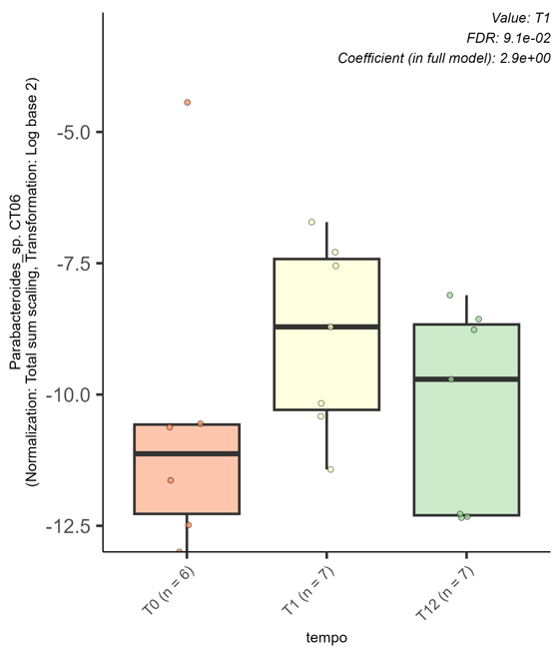
Boxplot showing the normalized and log-transformed abundance (Total Sum Scaling, log base 2) of Parabacteroides sp. CT06 across three timepoints (T0, T1, T12). Each box represents the interquartile range, with the median indicated by the thick horizontal line and individual samples shown as dots. The results highlight a marked increase in abundance at T1 compared to T0, followed by a slight decrease at T12. Maaslin3 automatically generated this plot in the Figures → Association Plots section, reporting an FDR of 0.091 and a coefficient of 2.9 in the full model, confirming the significant association for T1.

Slide 8
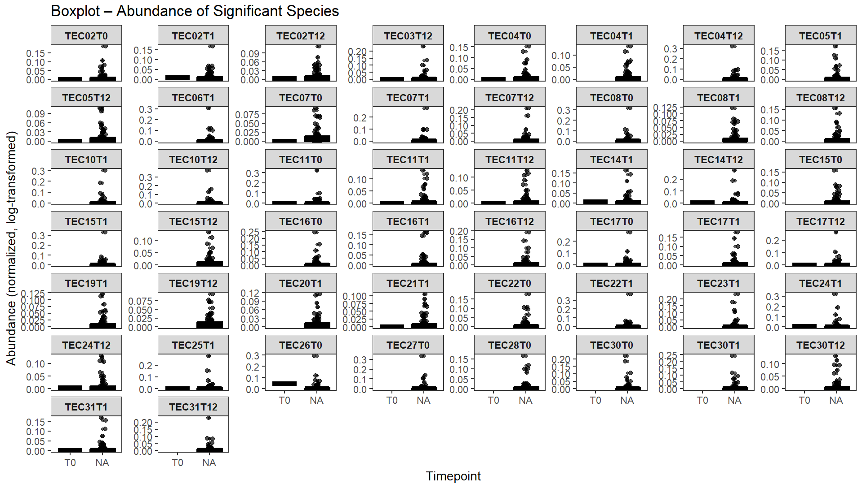
Boxplot per vedere l’abbondanza delle specie significative

