Slide 1
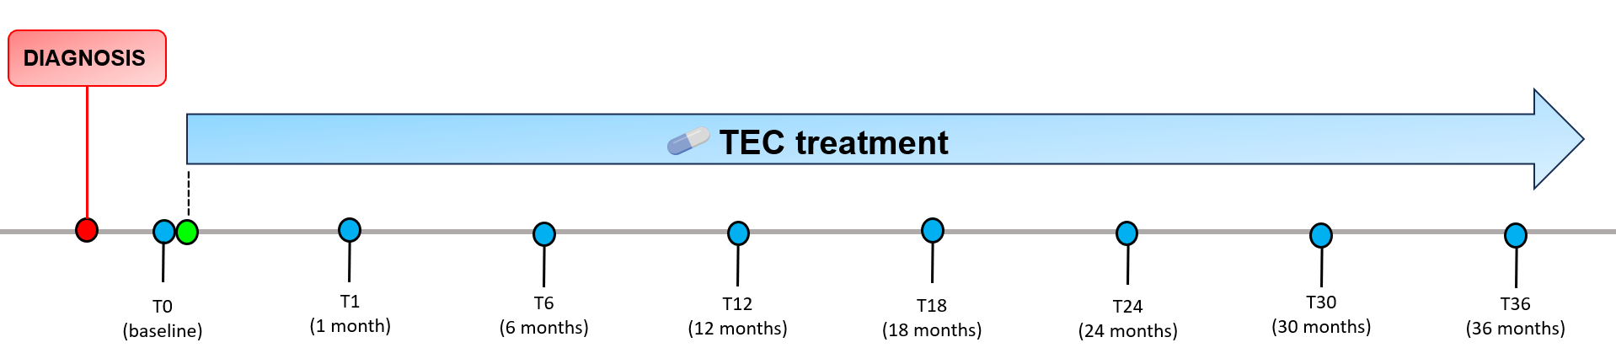




Study design and sampling schedule during TEC treatment
Diagnosis pre-treatment
TEC treatment initiation
Follow-up timepoint
TEC (daily administration from T0 to T36)
Clinical visit
Faecal sample collection

Slide 2

Study design and sampling schedule during TEC treatment
Diagnosis pre-treatment
TEC treatment initiation
Follow-up timepoint
TEC (daily administration from T0 to T36)
Clinical visit
Faecal sample collection

