Slide 1



TEC therapy and sample collection timeline
Daily TEC administration
Follow-up visit
Faecal sample collection
DIAGNOSIS
T0
T1
T6
T12
T18
T24
T30
T36

Slide 2

Study design and sampling schedule during TEC treatment
DIAGNOSIS
TEC treatment
-----
T0
(baseline)
T1
(1 month)
T6
(6 months)
T12
(12 months)
T18
(18 months)
T24
(24 months)
T30
(30 months)
T36
(36 months)

Slide 3
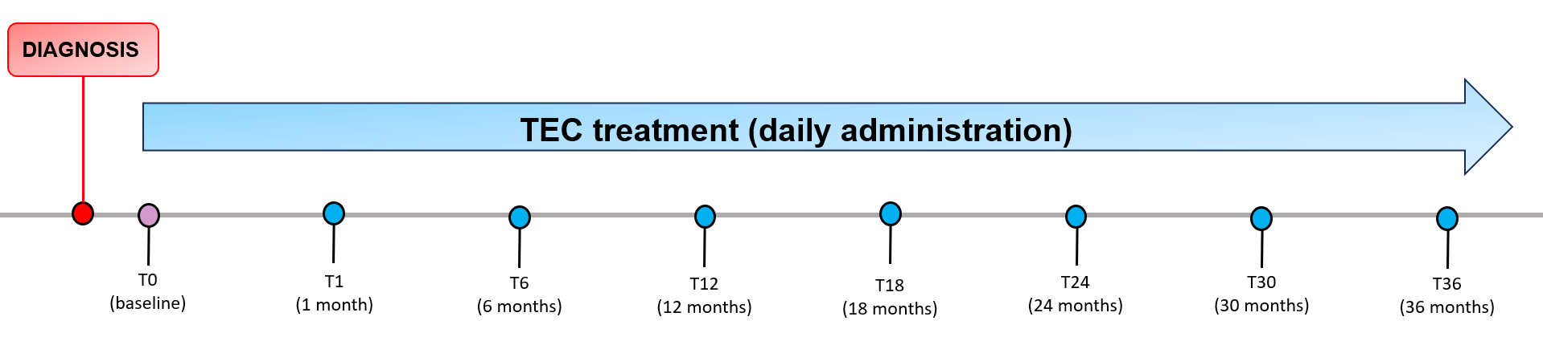


Study design and sampling schedule during TEC treatment
 | ✔ | ✔ | ✔ | ✔ | ✔ | ✔ | ✔ | ✔
 | ✔ | ✔ |  | ✔

Slide 4
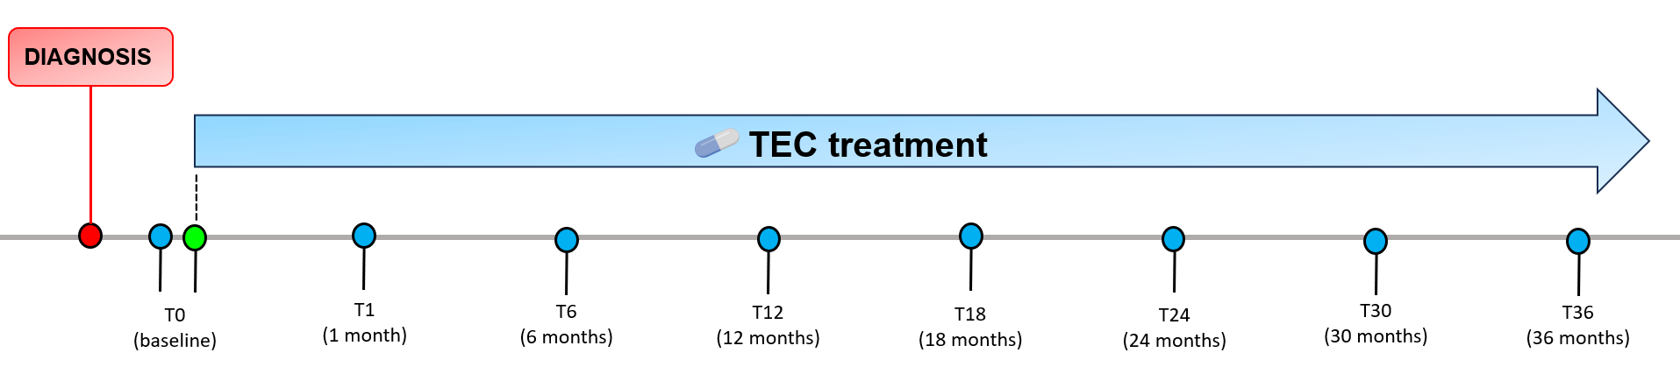

Study design and sampling schedule during TEC treatment
Diagnosis pre-treatment
Start of TEC treatment
Follow-up timepoint
TEC (daily administration from T0 to T36)
Clinical visit
Faecal sample collection

Slide 5

Study design and sampling schedule during TEC treatment
Diagnosis pre-treatment
Start of TEC treatment
Follow-up timepoint
TEC (daily administration from T0 to T36)
Clinical visit
Faecal sample collection

Slide 6
