Slide 1
TEC_Aurelia

Slide 2
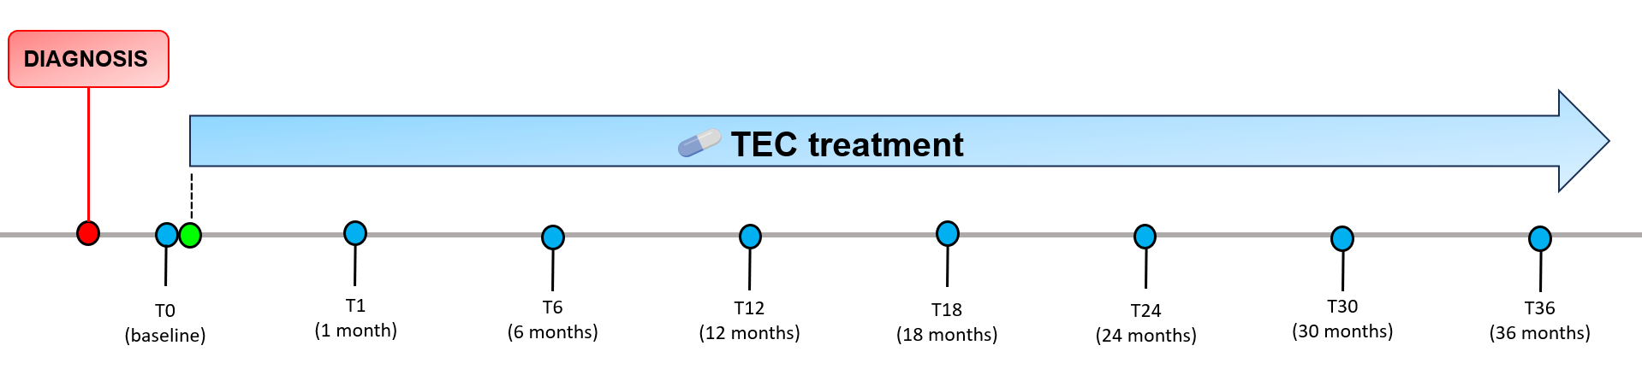




Study design and sampling schedule during TEC treatment
Diagnosis pre-treatment
TEC treatment initiation
Follow-up timepoint
TEC (daily administration from T0 to T36)
Clinical visit
Faecal sample collection

Slide 3

Study design and sampling schedule during TEC treatment
Diagnosis pre-treatment
TEC treatment initiation
Follow-up timepoint
TEC (daily administration from T0 to T36)
Clinical visit
Faecal sample collection

Slide 4
MAV_Elisa

Slide 5
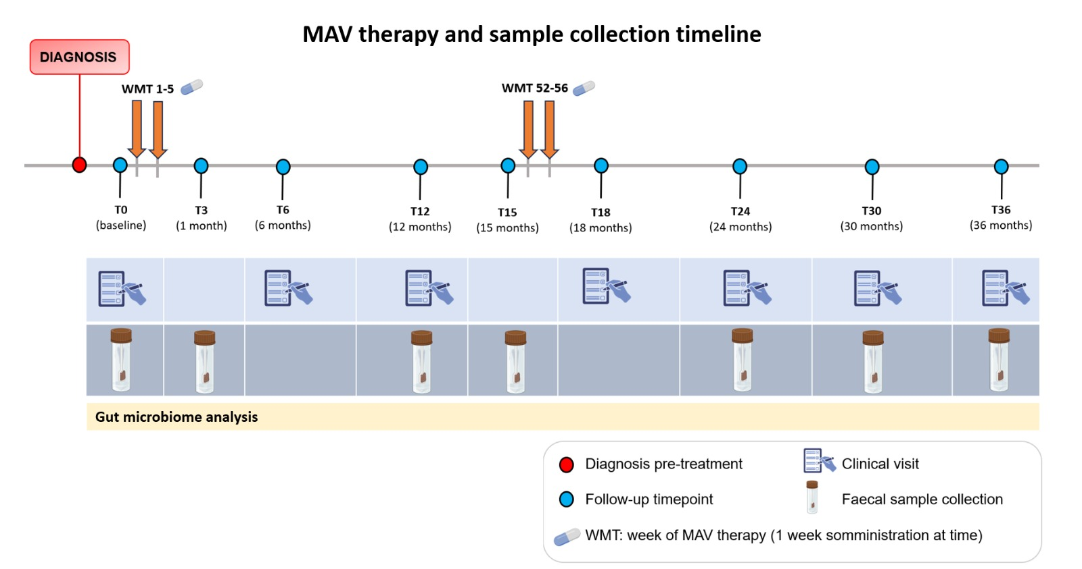

Slide 6
TEC+MAV_Cecilia

Slide 7
