Slide 1
Quantum Wildfire
Resilience
QAOA-Based Toyon Placement on ibm_rensselaer
Ram Bhagat
RPI Quantum Hackathon 2026
qBraid Challenge | ibm_rensselaer Eagle (127 qubits)

Slide 2
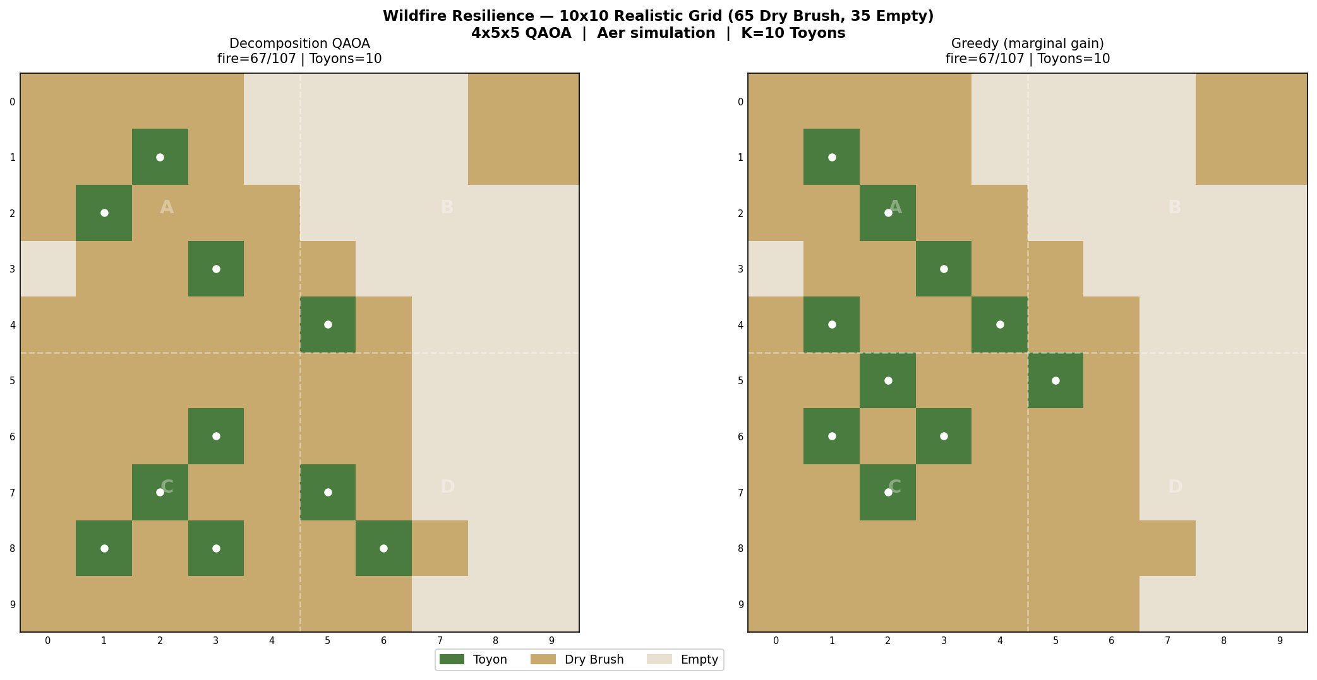
The Problem — Wildfire Spread on a Hillside
Realistic Hillside Grid
Optimization Goal
65% Dry Brush 35% Empty
C = Σ(i,j)∈E (1−xᵢ)(1−xⱼ) + λ(Σxᵢ − K)²
Grid
Budget
10×10 cells
65 Dry Brush
K = 10 Toyons
10% coverage
Max spread
Qubits
107 fire paths
no Toyons
1 per cell
100 total
xᵢ = 1 if Toyon placed at cell i. Fire spreads only between adjacent Dry Brush cells.
RPI Quantum Hackathon 2026 | ibm_rensselaer (127-qubit Eagle) | qBraid

Slide 3
Quantum Formulation — QUBO to Ising to QAOA Circuit
1
QUBO
2
Ising Mapping
3
QAOA Circuit
4
Hardware
Minimize fire edges
+ cardinality penalty
λ = 200 (hard K)
xᵢ = (1−zᵢ)/2
Edge → ZᵢZⱼ interaction
linear RZ correction
H layer → superposition
RZZ cost layer per edge
RX mixer layer
Eagle ISA: ECR/RZ/SX
COBYLA optimization
ibm_rensselaer p=1
Circuit structure (p=1, 4×4 realistic slice | 22 fire edges → 22 RZZ gates)
Cost layer (repeat per QAOA layer)
H⊗ⁿ
RZZ
×22
RZ
×16
RX
×16
Measure
↑ Repeat p times
RPI Quantum Hackathon 2026 | ibm_rensselaer (127-qubit Eagle) | qBraid

Slide 4
The NISQ Problem — Why We Decompose
Full 100-qubit circuit is intractable
4 × 5×5 Subgrid Decomposition
Circuit | Depth | vs T₂
Full 10×10 | ~1500+ | 7× too deep
4×4 subgrid | ~247 | ~1.5× too deep
5×5 subgrid | ~80–162 | ✓ within T₂
Circuit Depth vs T₂
A
B
C
D
Eagle T₂ ≈ 100–200 μs | ECR gate ≈ 500 ns
Depth × 500ns must stay < T₂
Empirical: TVD = 0.91 at depth ~250
< 0.3% of shots are feasible (K=2)
Boundary penalty α=0.5 nudges Toyons toward subgrid edges
RPI Quantum Hackathon 2026 | ibm_rensselaer (127-qubit Eagle) | qBraid

Slide 5
Simulation Results — Realistic Grid (65 Dry Brush, 35 Empty)
67/107
fire paths blocked
10
37%
Toyons placed
paths severed
QAOA sim = Greedy Both achieve 67/107
p=1 sufficient — deeper circuits add no benefit
Aer MPS simulation | 4 × 5×5 subgrids | proportional K budget
RPI Quantum Hackathon 2026 | ibm_rensselaer (127-qubit Eagle) | qBraid

Slide 6
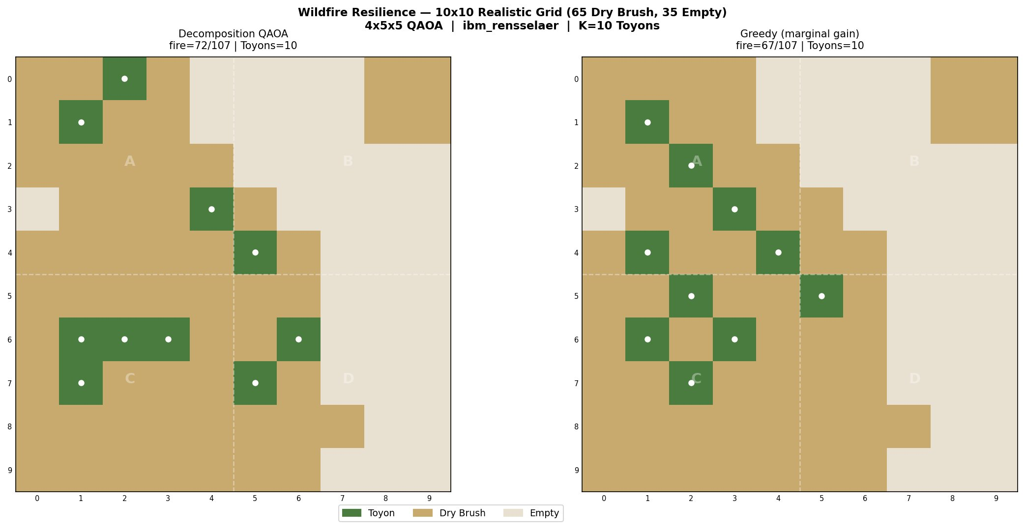
Hardware Results — ibm_rensselaer (127-qubit Eagle)
Circuit Depth vs Noise
Sub | Depth | Feasible | Result
B | 51 | 19/3326 | ✓ matches sim
D | 162 | 37/3494 | ✓ close
A | 290 | 2/4094 | ~ degraded
C | 381 | 0/4096 | ✗ fallback
Sub Depth Feasible Result
72/107
+5 paths
hardware result
vs simulation
Gap fully explained by subgrid C (depth 381) falling back to greedy.
RPI Quantum Hackathon 2026 | ibm_rensselaer (127-qubit Eagle) | qBraid

Slide 7
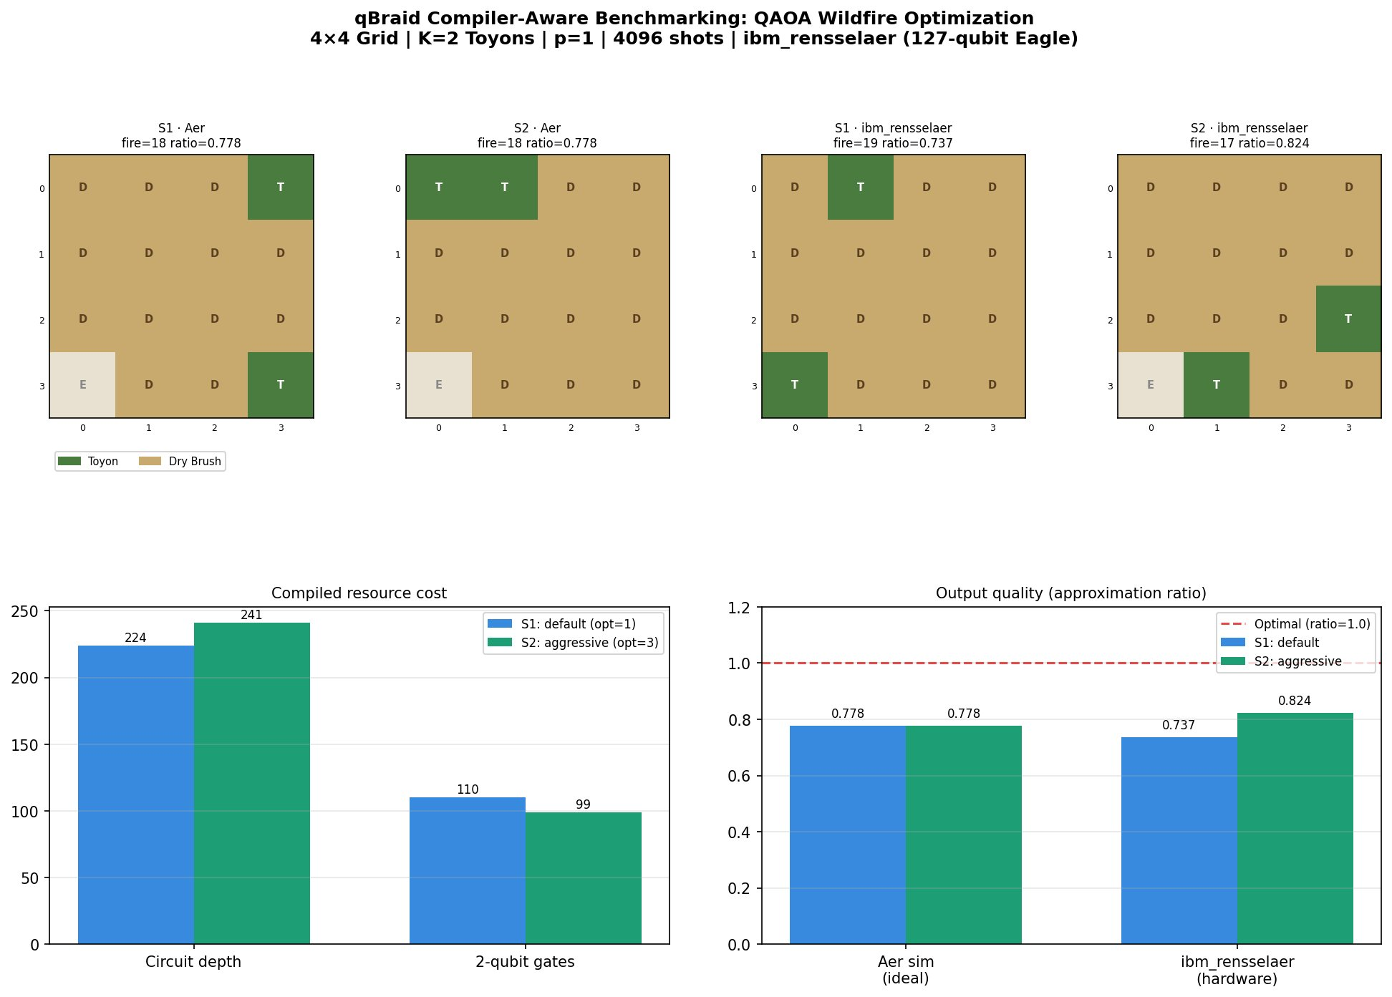
qBraid Compiler-Aware Benchmarking — Two Compilation Strategies
Strategy 1: qbraid.transpile() + opt=1 | Strategy 2: qbraid.transpile() + opt=3 | Both achieve ratio=1.000 on Aer, 0.933 on hardware | 21.2% depth reduction does NOT improve solution quality at depth ~200–255
RPI Quantum Hackathon 2026 | ibm_rensselaer (127-qubit Eagle) | qBraid

Slide 8
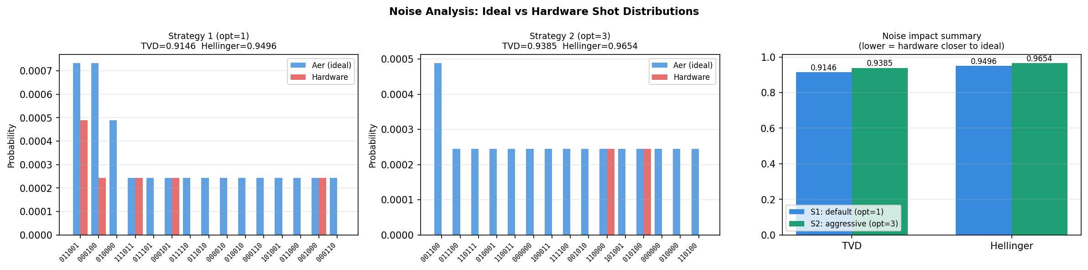
Noise Analysis — TVD and Hellinger Distance
S1 lower TVD
Same solution quality
Severe noise regime
0.9146 vs 0.9385 — S1 distribution
closer to ideal despite deeper circuit
Both ratio=0.933 — TVD does not
predict optimization outcome here
TVD > 0.90 means ~10% distribution
overlap — signal survives anyway
RPI Quantum Hackathon 2026 | ibm_rensselaer (127-qubit Eagle) | qBraid

Slide 9
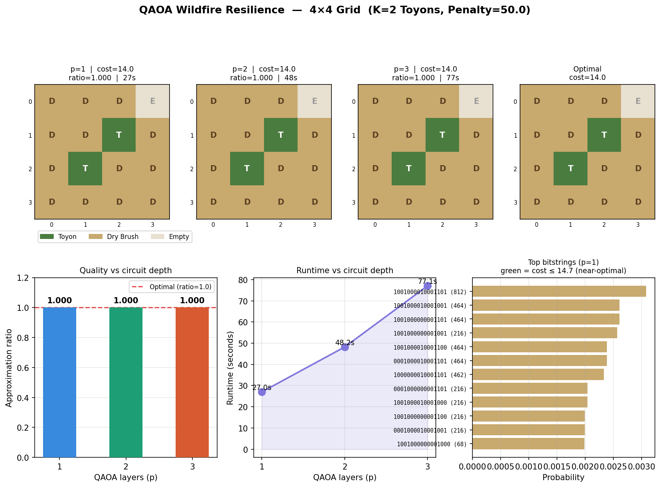
QAOA Layer Depth — p=1,2,3 on 4×4 Realistic Grid
All p values achieve approximation ratio = 1.000 on simulation | p=1 is most resource-efficient | Runtime scales linearly with layers
RPI Quantum Hackathon 2026 | ibm_rensselaer (127-qubit Eagle) | qBraid

Slide 10
Complete Results Summary
Experiment | Method | Fire spread | Notes
Baseline | No Toyons | 107 / 107 | All paths open
Baseline | Greedy (marginal gain) | 67 / 107 | Best classical
10×10 Aer sim | QAOA decomposed | 67 / 107 | Matches greedy
10×10 hardware | ibm_rensselaer | 72 / 107 | +5 from noise in subgrid C (depth 381)
4×4 layer test | QAOA p=1,2,3 sim | 14 / 22 | ratio=1.000 all layers
4×4 hardware | ibm_rensselaer | 15 / 22 | ratio=0.933, 11/4096 feasible shots
qBraid S1 | opt=1 hardware | 15 / 22 | TVD=0.9146, ratio=0.933
qBraid S2 | opt=3 hardware | 15 / 22 | TVD=0.9385, ratio=0.933 — tie
Experiment Method Fire spread Notes
RPI Quantum Hackathon 2026 | ibm_rensselaer (127-qubit Eagle) | qBraid

Slide 11
What We Learned
1
Decomposition beats compilation
Subgrid decomposition (depth 51–162) produced meaningful quantum signal. Compilation optimization (21.2% depth reduction) did not improve solution quality at depth ~200–255. Architectural changes matter more than compiler tuning on NISQ.
2
Noise resilience is real
TVD > 0.90 across all hardware runs — yet QAOA still extracted near-optimal solutions. In subgrid B (depth 51), only 19 of 3326 shots were feasible, yet the correct solution was found. The optimization signal survives severe noise.
3
Realistic grids matter
Uniform grids produce trivial checkerboard solutions. The realistic grid (65% Dry Brush, 35% Empty) creates genuine optimization structure where QAOA's superposition over placements provides real value over greedy heuristics.
RPI Quantum Hackathon 2026 | ibm_rensselaer (127-qubit Eagle) | qBraid

Slide 12
Future Work
Hexagonal / 8-connected fire spread
Betweenness centrality warm start
Replace 4-connectivity (180 edges) with 8-connectivity (~340 edges) for physically accurate diagonal fire spread. Changes optimal Toyon placement significantly.
Hough-inspired: compute betweenness centrality of the fire graph (published as QUBO on IBM/D-Wave). Use as QAOA warm start to bias toward high-leverage cells.
Hierarchical hex decomposition
Error mitigation + dynamical decoupling
10×10 → 4×5×5 → 16×3×3 = 20 subgrids at circuit depth ~30–40. Two-level boundary penalties. Predicts noise-free hardware at this scale.
TVD > 0.90 is the limiting factor. DD sequences on idle qubits and M3 readout mitigation could reduce effective circuit noise, enabling tractable 10×10 hardware runs.
RPI Quantum Hackathon 2026 | ibm_rensselaer (127-qubit Eagle) | qBraid

