Slide 1
RPI QUANTUM HACKATHON 2026
MarketMind-Q
Finance data
CML vs QML
11 sector ETFs vs SPY
walk-forward benchmark
A compiler-aware benchmark for finance QML
We benchmark quantum kernels against strong classical ML, then use qBraid to test whether the quantum workload survives compilation across representations and execution environments.
qBraid
compile + preserve
Rows evaluated
qBraid success
Best CML ROC-AUC
480
64/64
0.665
Research demo only. Not investment advice.

Slide 2
PROBLEM
Finance is a hostile benchmark for QML
The labels are short-horizon, low-signal, and regime-dependent. A useful quantum claim needs strong baselines and time-respecting evaluation.
No random split
No live API dependency
Noisy labels
Five trading days is enough for market noise to dominate simple signals.
Low data regime
Quantum methods are most plausible where classical models have fewer samples.
Regime drift
Signal is small
High-volatility and low-volatility slices behave differently.
The benchmark asks whether a quantum feature map can recover useful structure without future leakage.
MarketMind-Q | 2

Slide 3
DATASET
One frozen market dataset, one target, one timeline
Sector ETF rows from 2018-01-01 through 2026-03-31. SPY is only the market benchmark.
XLB
XLC
XLE
XLF
XLI
XLK
XLP
XLRE
XLU
XLV
XLY
Walk-forward cutoffs start in 2023
Target
2018
2019
2020
2021
2022
2023
2024
2025
2026
1 if sector ETF beats SPY by more than 0.25% over the next five trading days
Rows
Cutoffs
Train sizes
Features
22,390
12
40-320
Past-only returns, volatility, volume ratios, relative strength, SPY volatility, weekday/month seasonality
MarketMind-Q | 3

Slide 4
FAIRNESS
Classical baselines are deliberately strong
If QML looks useful here, it is not because the classical panel was weak.
Best observed ROC-AUC
Logistic regression
linear signal check
RBF SVM
0.665
RBF SVM
nonlinear classical kernel
Quantum kernel
0.639
Random forest
bagged tree baseline
XGBoost
Same rows. Same splits. Same metrics.
boosted tree baseline
No random train/test split appears anywhere in the benchmark.
MarketMind-Q | 4

Slide 5
QUANTUM MODEL
The QML workload is a quantum-kernel SVM
The core quantum subroutine estimates kernel-entry probabilities from compute-uncompute circuits.
Financial row
ZZ feature map
Kernel matrix
SVM classifier
past-only features
Qiskit circuit
p(|00...0>)
precomputed kernel
Exact
Shots
Noisy
statevector fidelity
1024-shot finite sampling
depolarizing + readout proxy
Manual precomputed-kernel path keeps the project robust if high-level Qiskit ML APIs shift.
MarketMind-Q | 5

Slide 6
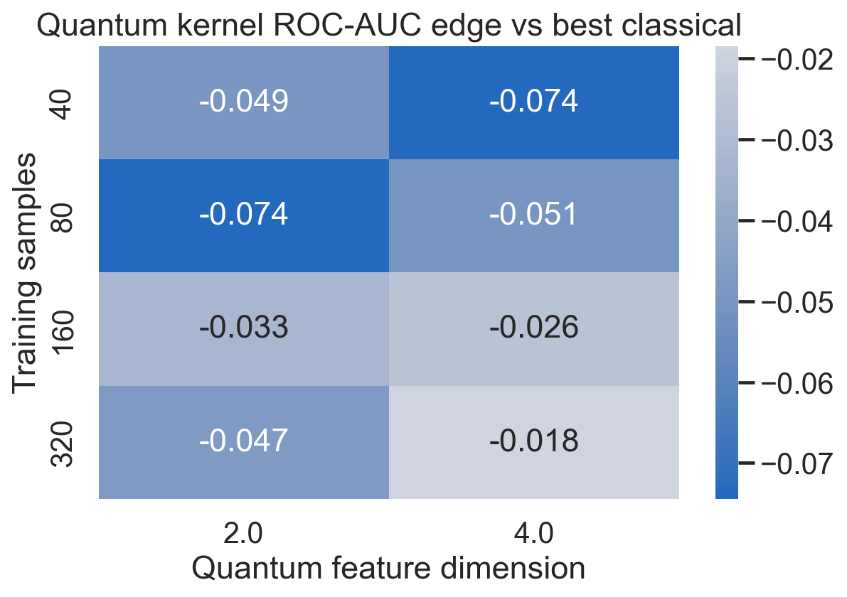
BOUNDARY RESULT
QML is not a universal winner; it has slices
The important artifact is a map: where the quantum kernel is useful, competitive, or impractical.
Best positive slice
train=160, d=2, cutoff=2023-01-03
QML edge
QSVM exact
Best CML
+0.152
0.577
0.425
The average map is hard on QML; the slice-level edge shows why boundary analysis is more honest than a single leaderboard.
MarketMind-Q | 6

Slide 7
QBRAID LAYER
The quantum workload is tested for compiler survival
qBraid is central to the second question: does the kernel-estimation circuit preserve output quality after conversion?
QASM2 roundtrip
qBraid transpile to QASM2,
then back to Qiskit
Qiskit source
Output quality
Resource cost
QuantumCircuit
compute-uncompute kernel
source p(0) vs compiled p(0)
Hellinger distance
depth, 2Q gates,
serialized size, runtime
Cirq direct
qBraid transpile to Cirq
simulation path
Strategies
Environments
Rows
Success
2
4
64
64/64
MarketMind-Q | 7

Slide 8
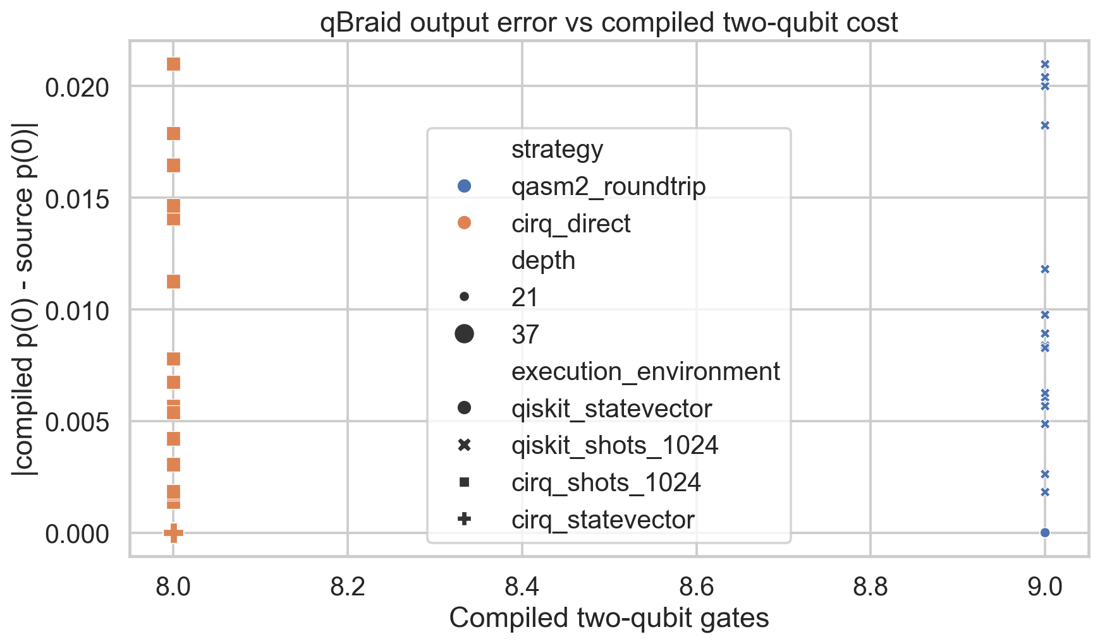
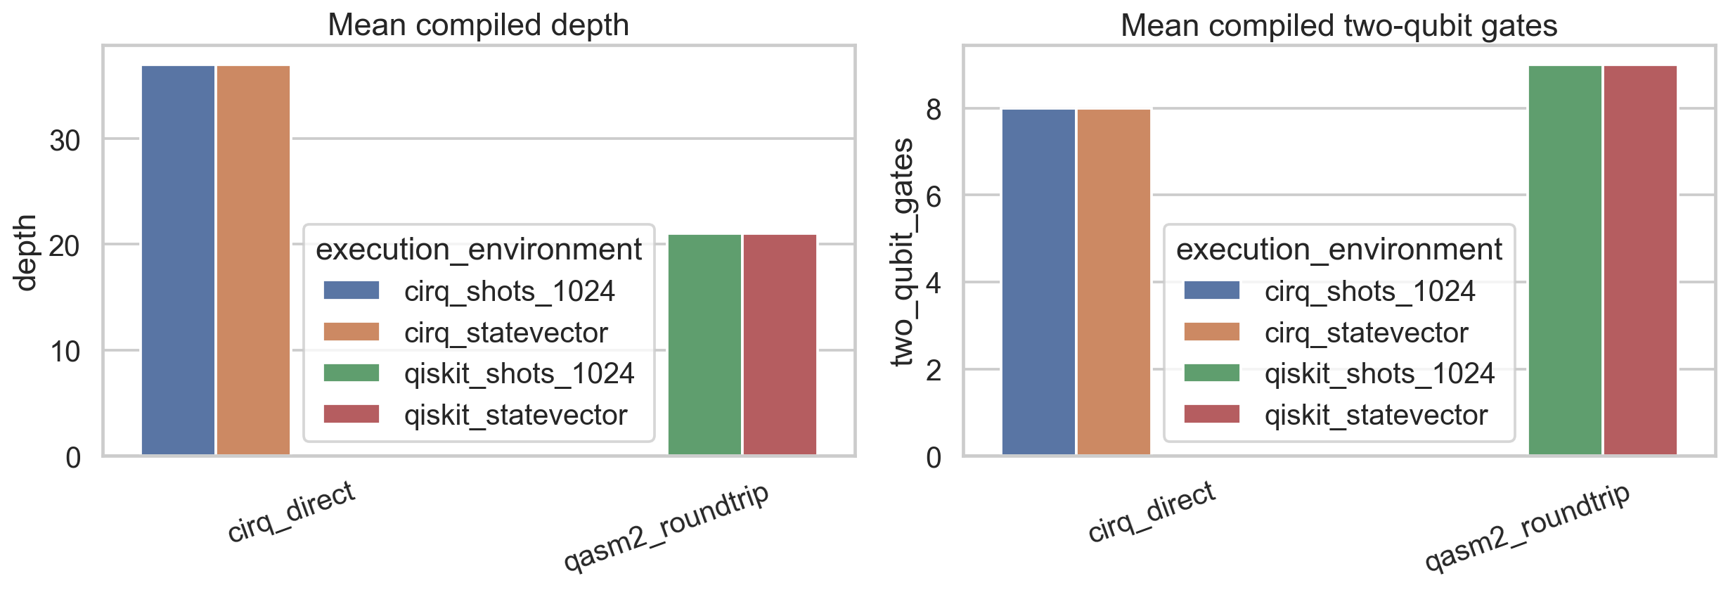
COMPILER-AWARE RESULT
qBraid preserves the kernel workload, with measurable cost
Exact paths preserve probability; shot paths reveal the practical sampling floor.
qiskit statevector
cirq statevector
The result is not just that qBraid converts circuits; it quantifies whether conversion preserves the classifier’s kernel probabilities.
0.0000
7.0e-8
MarketMind-Q | 8

Slide 9
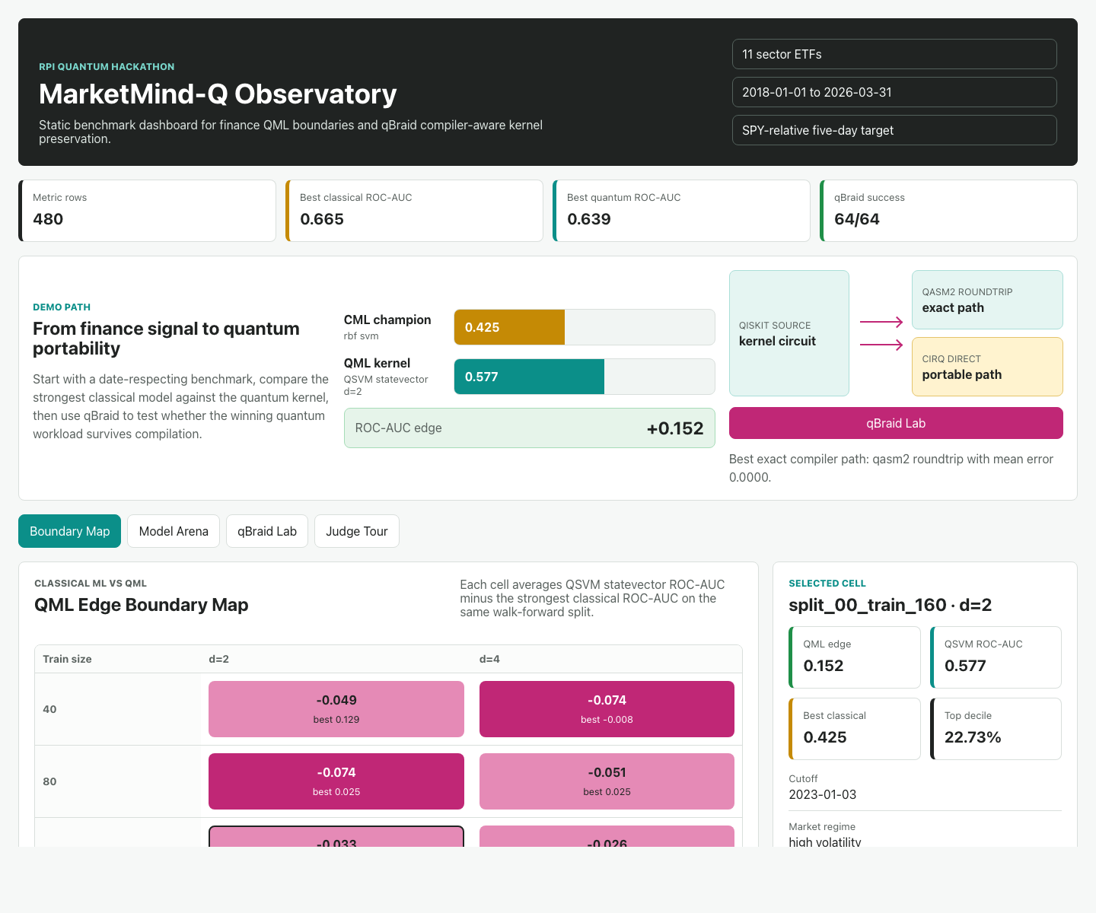
DEMO
The web app turns CSV evidence into a judge-ready story
The dashboard starts with the usable benchmark view and links CML vs QML to the qBraid compiler lab.
Boundary Map
QML edge by train size and feature dimension
Model Arena
same split, same metrics, all baselines
qBraid Lab
strategy quality vs compiled-resource cost
Judge Tour
90-second narrative path
MarketMind-Q | 9

Slide 10
Final claim
MarketMind-Q is a boundary map, not a hype claim.
CML still wins often
QML can be competitive in slices
qBraid makes portability measurable
That is why the comparison is credible.
Low-data, regime-sensitive contexts are the interesting frontier.
Compilation paths are judged by output quality and circuit cost.
Best demo path: Boundary Map -> Model Arena -> qBraid Lab -> one-sentence conclusion.
Research and education only. Not investment advice.

