Slide 1






qBraid features we used
QBRAID AWARD · GRID GUARDIANS · SECURE THE GRID
We built an eavesdropper alarm for a power-grid control link, using the BB84 quantum key protocol.
Quantum hardware
Simulators
qBraid Lab
IonQ, IQM, Rigetti, Quantinuum
GPU state vector, tensor network
Notebooks, environments
IQM Garnet and IonQ Forte 1: 2 jobs each, clean link vs. eavesdropper
GPU state vector: tuned the alarm line on 30 qubits before touching hardware
One shared notebook for the team, with a Launch on qBraid button
Encouraged
qBraid AI
Transpiler
Jobs and results
AI Chat, Agent mode, MCP server
Qiskit, Cirq, Braket, OpenQASM
Jobs page, job IDs, plots
An agent drafted our batched circuit, and AI Chat compared device prices
Wrote it once in Qiskit, and qBraid converted it for each device
Pulled job IDs from the Jobs page and plotted all three backends together
Notes:
Example. The team kept the six tiles for features they really used and deleted the other two.

Slide 2
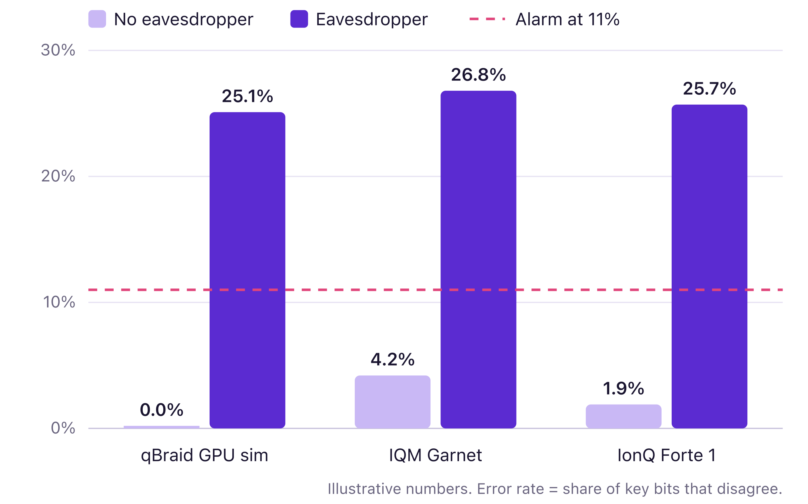



Our alarm works on real quantum hardware
QBRAID AWARD · GRID GUARDIANS
What it shows
Noise alone stays under our 11% alarm line. An eavesdropper pushes every backend past 25%.
Where AI helped
An agent drafted the batched circuit in minutes. It mixed up which bits to keep, and we caught it on the simulator.
What surprised us
IQM Garnet ran noisier than IonQ, but still left a wide margin under 11%.
Notes:
Example. One chart, a plain-English takeaway, and an honest note on where AI helped and where the team stepped in.

Slide 3



Check it
QBRAID AWARD · GRID GUARDIANS · OPTIONAL
Proof
Links
Credits and next
IQM Garnet: <ID 1>, <ID 2>
IonQ Forte 1: <ID 3>, <ID 4>
Job IDs copied from the Jobs page in our qBraid account
Screen recording (1:45): <link>
qBraid notebook: <link>
Repo with a Launch on qBraid button: <link>
About 6,000 credits (about $60): 4 hardware jobs plus GPU simulator time
Two kinds of hardware, to see how real noise moves the alarm line
Next: run the alarm on Quantinuum
Use your credits: hardware, GPUs and qBraid AI all count when they serve your project.
Notes:
Example. This slide is optional, but it makes it easy for judges to confirm the work ran on qBraid.

