Slide 1
It’s not that simple…
presenting

Slide 2
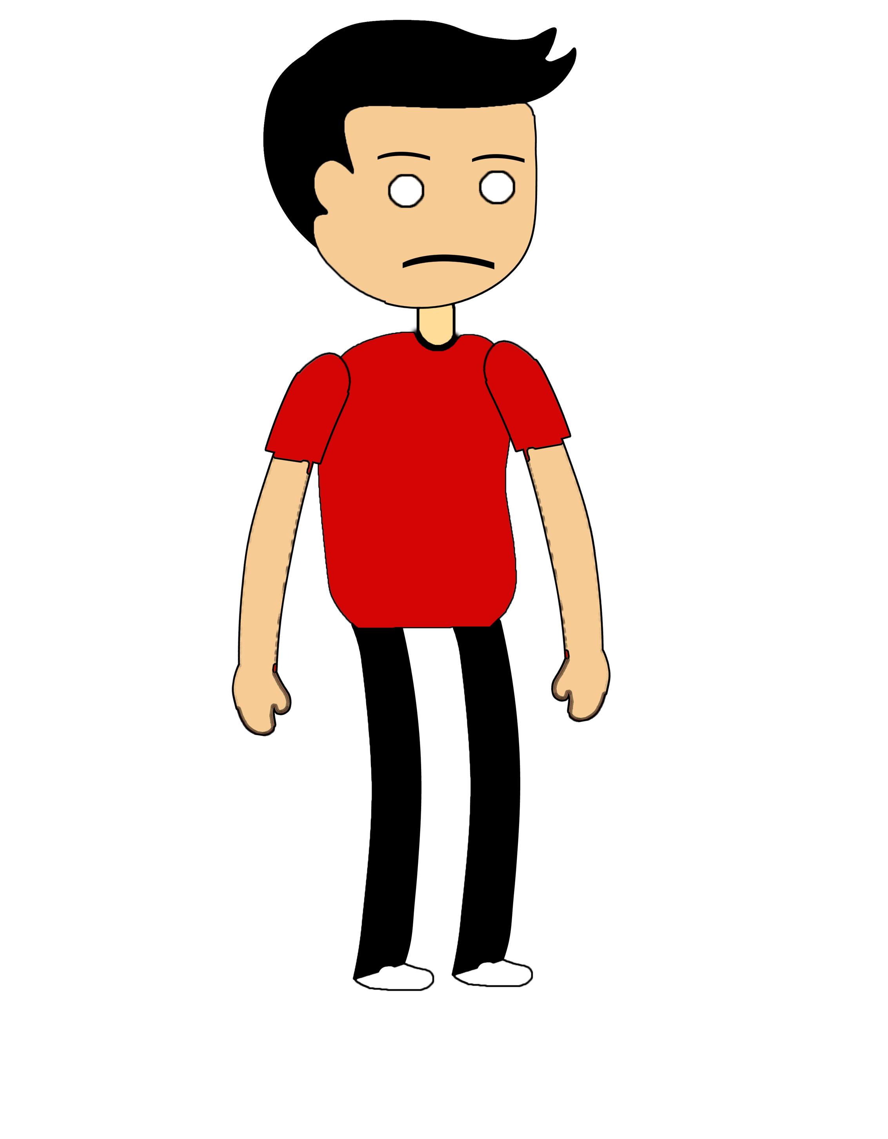
Healthy Henry
A web based role-playing game where the player will have control over the decisions of the main protagonist.

Slide 3
Main objectives:
Let the player influence Henry’s budget, health and task allocation.
Highlight the different factors that impact an individual’s health.
Make the player realise that he has no control on certain aspects of the game which can heavily influence his health (initial budget, nearest supermarket, laws…).
Give general information on some popular misconceptions regarding certain specific foods.

