Slide 1


Mini Project One
Animation
LANGXUAN(HARRY) HE

Slide 2
Content
Goal
Techniques
CCD IK
Transpose Jacobian
Result Compares
Discussion

Slide 3
Goal
Implement two procedural animation techniques (CCD and Transpose Jacobian)
Compare results between two methods

Slide 4
Technique - CCD
Cyclic Coordinate Descent Inverse Kinematics
Main idea: align one joint with the end effector and the target at a time, so that the last bone of the chain iteratively gets closer to the target.
Algorithm:
Target T (x_t,y_t);
End Effecter E (x_e,y_e);
Joint J(x_j,y_j)
dis(T,E)
WHILE(dis(T,E) is not close enough)
DO
Vector3 normalized(JT);
VEctor3 normalized(JE);
Quat q = Compute rotation quaternion from JE -> JT;
apply quaternion rotation to current joint J;
Update new dis(T,E);
IF current J is root joint
DO
reset to first joint;
ELSE
change current J to upper joint;
END IF
END WHILE

Slide 5
Technique - CCD
https://drive.google.com/file/d/1cXJuW23p0SBLWSxeaMUhmf_lWb7PyK7U/view?usp=share_link

Slide 6
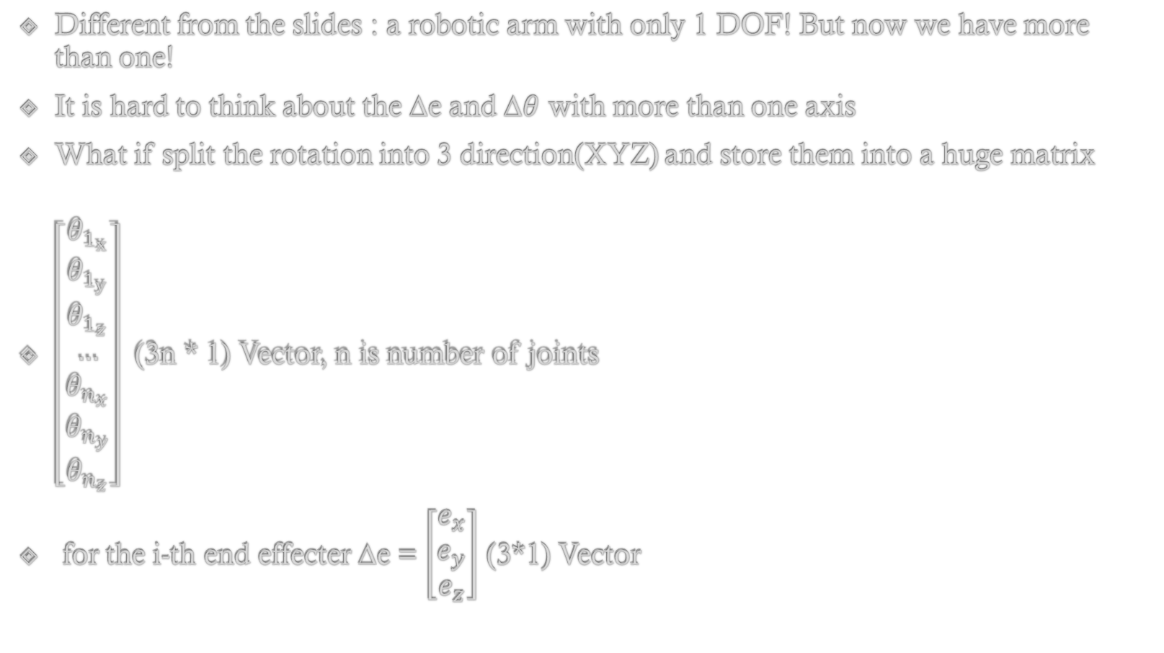
Technique – Jacobian Transpose IK(3DOF) (Numerical Approach)
Different from the slides : a robotic arm with only 1 DOF! But now we have more than one!
It is hard to think about the ∆e and ∆$θ$ with more than one axis
What if split the rotation into 3 direction(XYZ) and store them into a huge matrix
$\left[\begin{matrix}θ_{1_{x}} \\ θ_{1_{y}} \\ θ_{1_{z}} \\ … \\ θ_{n_{x}} \\ θ_{n_{y}} \\ θ_{n_{z}}\end{matrix}\right]$ (3n * 1) Vector, n is number of joints
for the i-th end effecter ∆e = $\left[\begin{matrix}e_{x} \\ e_{y} \\ e_{z}\end{matrix}\right]$ (3*1) Vector

Slide 7
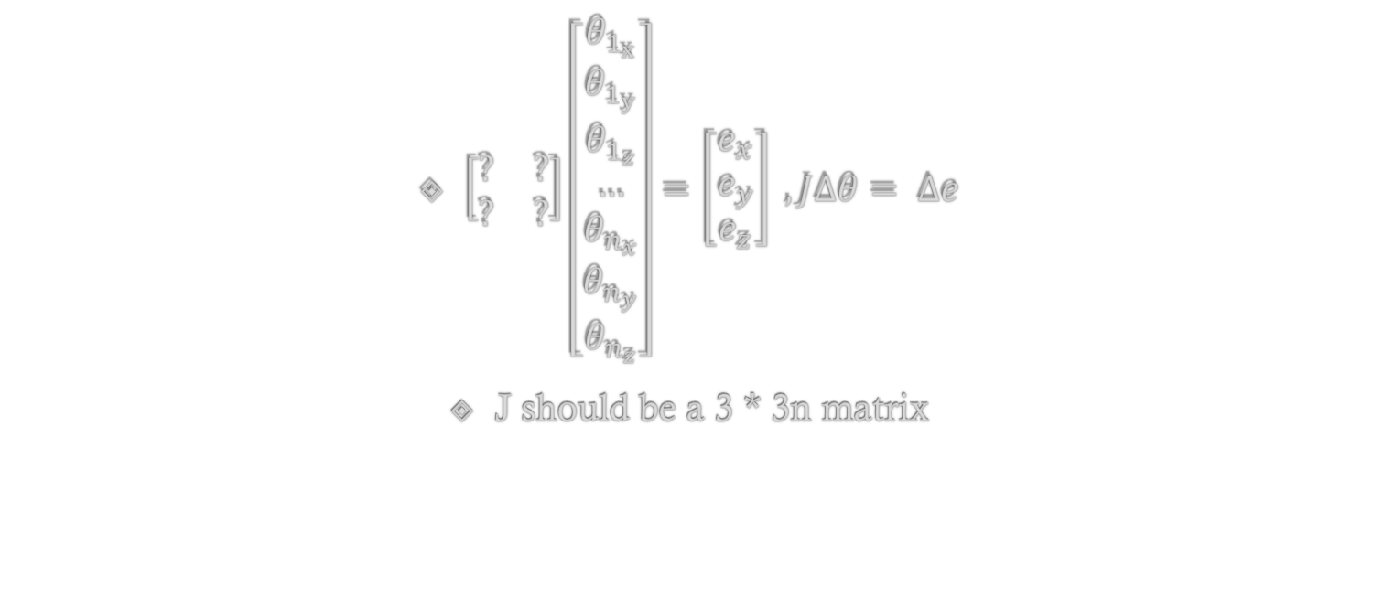
Technique – Jacobian Transpose IK (Numerical Approach)
$\left[\begin{matrix}? & ? \\ ? & ?\end{matrix}\right]\left[\begin{matrix}θ_{1_{x}} \\ θ_{1_{y}} \\ θ_{1_{z}} \\ … \\ θ_{n_{x}} \\ θ_{n_{y}} \\ θ_{n_{z}}\end{matrix}\right]=\left[\begin{matrix}e_{x} \\ e_{y} \\ e_{z}\end{matrix}\right] , J∆θ= ∆e$
J should be a 3 * 3n matrix

Slide 8
Technique – Jacobian Transpose IK (Numerical Approach)
Algorithm:
distance = dis(target,current_end effecter);
Matrix jacobian[3][3*num_of_joint];
FOR int j = 0 ;j < num_of_joint ;j++
DO
FOR int axis = 0; axis < 3; axis ++
DO
quat step = compute a step rotation quaternion based on axis;
Character::tmp_pose;
copy current arm rotation into tmp_pose;
apply rotation to tmp_pose;
Vector 3f delta_e_step = tmp_pose_joint[joint_idx] – current_pose[joint_idx];
float delta = delta_e_step / step;
jacobian[0][j*3 + axis] = delta.x;
jacobian[1][j*3 + axis] = delta.y;
jacobian[2][j*3 + axis] = delta.z;
END FOR
END FOR

Slide 9
Technique – Jacobian Transpose IK (Numerical Approach)
Algorithm(CONTINUE):
Compute Jacobian Transpose jacobian_T[3*n][3];
Compute new delta_theta;
Apply rotation to current pose by new delta_theta = j_t * delta_e;

Slide 10
Technique – Jacobian Transpose IK (Numerical Approach)
Converge α
Simply by calculate the error between two previous and current
If previous error is larger then magnify α
Else half α

Slide 11
Technique - Jacobian Transpose IK (Numerical Approach)
https://drive.google.com/file/d/1k4lqpEn8rAxm63b32C83LchFFtexe3E6/view?usp=share_link

Slide 12
Result Compare
CCD method moves faster than Jacobian IK
Jacobian IK is smoother than CCD
CCD will take more time to converge to best approximation

Slide 13
Discussion
My version of Jacobian IK don’t seriously think of picking a good scalar value α
My Jacobian IK treats all joint with 3DOF
Thinking of trying more Jacobian option (like pseudo-Jacobian, Damped least squares)
Analytical Jacobian Method is hard to think when facing more than 1 DOF robotic arm

