Slide 1

React
The future of web development

Slide 2
React is a popular JavaScript library for building user interfaces, particularly single-page applications. It is maintained by Facebook and a community of individual developers and companies.

Slide 3
Key Features

Slide 4
History
React was created by Jordan Walke, a software engineer at Facebook, who released an early prototype of React called "FaxJS".
He was influenced by XHP, an HTML component library for PHP.
It was first deployed on Facebook's News Feed in 2011 and later on Instagram in 2012.
It was open-sourced at JSConf US in May 2013.

Slide 5
Component-Based Architecture
React applications are built using components, which are reusable and independent pieces of code. Each component encapsulates its own structure, behavior, and style.
Components can be functional or class-based, though functional components with hooks are more common in modern React development.

Slide 6
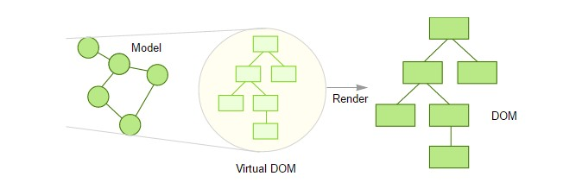
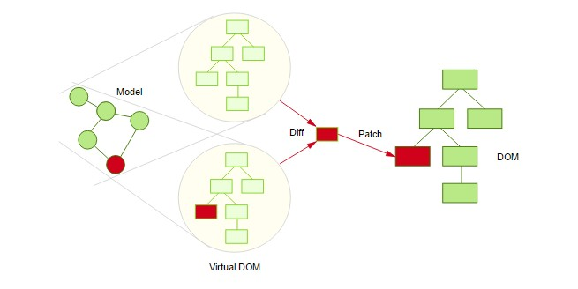
Virtual DOM
React uses a virtual DOM to optimize rendering. The virtual DOM is a lightweight copy of the actual DOM.
When the state of a component changes, React updates the virtual DOM and then efficiently updates the actual DOM, minimizing the number of manipulations and improving performance.
Only diff changes from the two V-DOMs are applied to real DOM

Slide 7
JSX (JavaScript XML)
React uses JSX, a syntax extension that allows writing HTML-like code within JavaScript.
JSX makes the code easier to understand and maintain by combining HTML structure and JavaScript logic in a single file.

Slide 8
Hooks
Introduced in React 16.8, hooks allow functional components to use state and other React features without writing a class.
Common hooks include useState, useEffect, useContext, useMemo, useCallback, and useRef.

Slide 9
State Management
React manages the state at the component level, but for more complex applications, state management libraries like Redux, MobX, or the Context API can be used.
The state and props system in React ensures that data flows in a predictable manner, making applications easier to debug and reason about.

Slide 10
Ecosystem and Tools
React has a rich ecosystem with numerous libraries and tools to enhance development, such as React Router for routing, Redux for state management, and Next.js for server-side rendering.
Tools like Create React App or Vite provide a zero-configuration setup to start new React projects quickly.

Slide 11
Ecosystem and Tools
React has a rich ecosystem with numerous libraries and tools to enhance development, such as React Router for routing, Redux for state management, and Next.js for server-side rendering.
Tools like Create React App or Vite provide a zero-configuration setup to start new React projects quickly.

Slide 12
Performance Optimization
React offers several built-in mechanisms to optimize performance, such as Pure Components, React.memo, and lazy loading with React.lazy and Suspense.
These features help to reduce unnecessary renders and load parts of the application on demand

Slide 13
Advantages
Declarative:
React's declarative nature makes it easier to understand and debug the code. Developers describe what the UI should look like for a given state, and React handles the rendering.
Reusable Components:
Components can be reused across different parts of an application or even across different projects, reducing code duplication and improving maintainability.
Strong Community Support:
React has a vast community of developers, which means abundant resources, tutorials, and third-party libraries are available.
Backward Compatibility:
React places a strong emphasis on backward compatibility, ensuring that updates and new versions do not break existing applications.

Slide 14
Popular Use Cases
Single-Page Applications (SPAs):
React is ideal for building SPAs where the UI needs to be dynamic and responsive without requiring full page reloads.
Interactive User Interfaces:
React is used to create highly interactive and complex user interfaces, such as dashboards, forms, and data visualization tools.
Mobile Applications:
React Native, a framework based on React, allows developers to build mobile applications for iOS and Android using the same principles and codebase.

Slide 15
Conclusion
React has revolutionized the way developers build web applications by introducing a component-based architecture, efficient rendering with the virtual DOM, and a rich ecosystem of tools and libraries. Its flexibility, performance, and strong community support make it a preferred choice for building modern, scalable, and maintainable user interfaces.

Slide 16
The shift begins with you
Trainer name
Trainer
Assistant name
Assistant
trainer@mail.com assistant@mail.com

