Slide 1

Context API

Slide 2
Manage State Efficiently in React Applications with Context API

Slide 3
Introduction to Context API. What is Context API?
A way to pass data through the component tree without having to pass props down manually at every level.
Useful for sharing data like themes, user information, and settings.

Slide 4
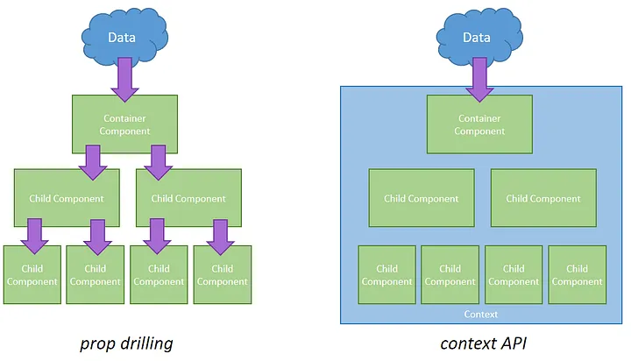
Context API is used to fix prop drilling

Slide 5
When to Use Context API
Ideal Use Cases
Theming
User authentication
Locale settings
Avoiding prop drilling for deeply nested components
When Not to Use
Small applications where prop drilling is minimal
Situations requiring frequent updates (performance concerns)

Slide 6
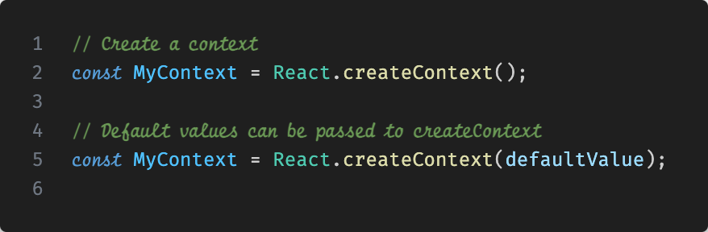
Creating Context

Slide 7
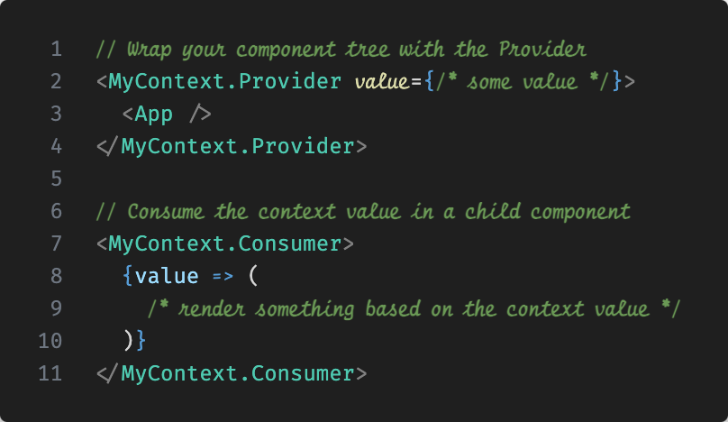
Provider and Consumer

Slide 8
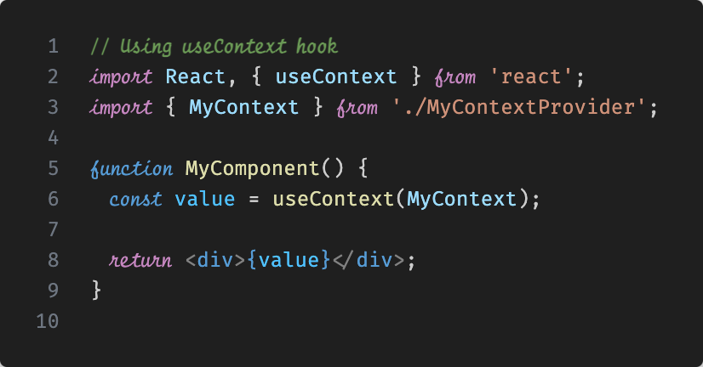
Using Context in Functional Components

Slide 9
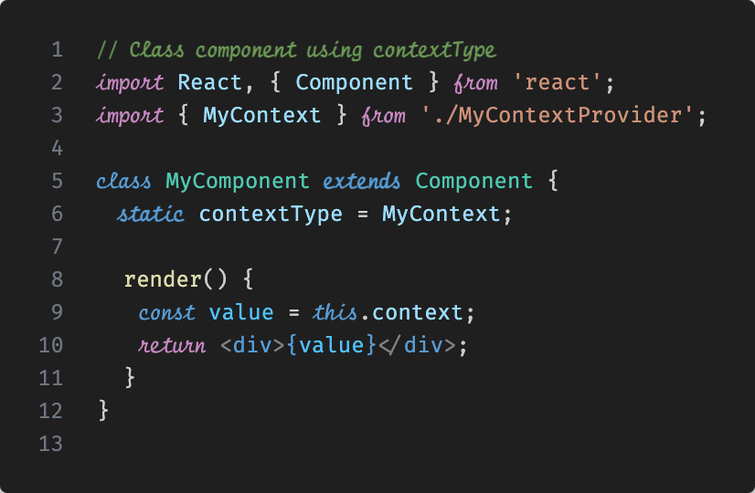
Using Context in Class Components

Slide 10
Best Practices
Avoid Overusing Context
Only use it for state that needs to be shared globally.
Separate Contexts
Create separate contexts for unrelated state to avoid unnecessary re-renders.
Default Values
Utilize default values to make context easier to use and test.
Performance
Be mindful of performance. Updates to context value can trigger re-renders in all consuming components.

Slide 11
The shift begins with you
Trainer name
Trainer
Assistant name
Assistant
trainer@mail.com assistant@mail.com

