Slide 1

Understanding React Lifecycle Hooks

Slide 2
A Deep Dive into Class Components and Functional Components with Hooks

Slide 3
Props vs State
Features | props | state
Can get initial value from parent Component? | Yes | Yes
Can be changed by parent Component? | Yes | No
Can set default values inside Component? | Yes | Yes
Can change inside Component? | No | Yes
Can set initial value for child Components? | Yes | Yes
Can change in child Components? | Yes | No

Slide 4
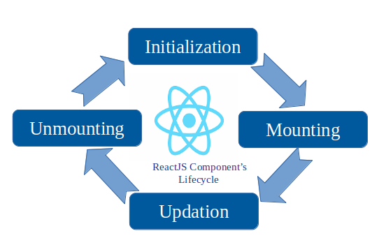
Component lifecycle

Slide 5
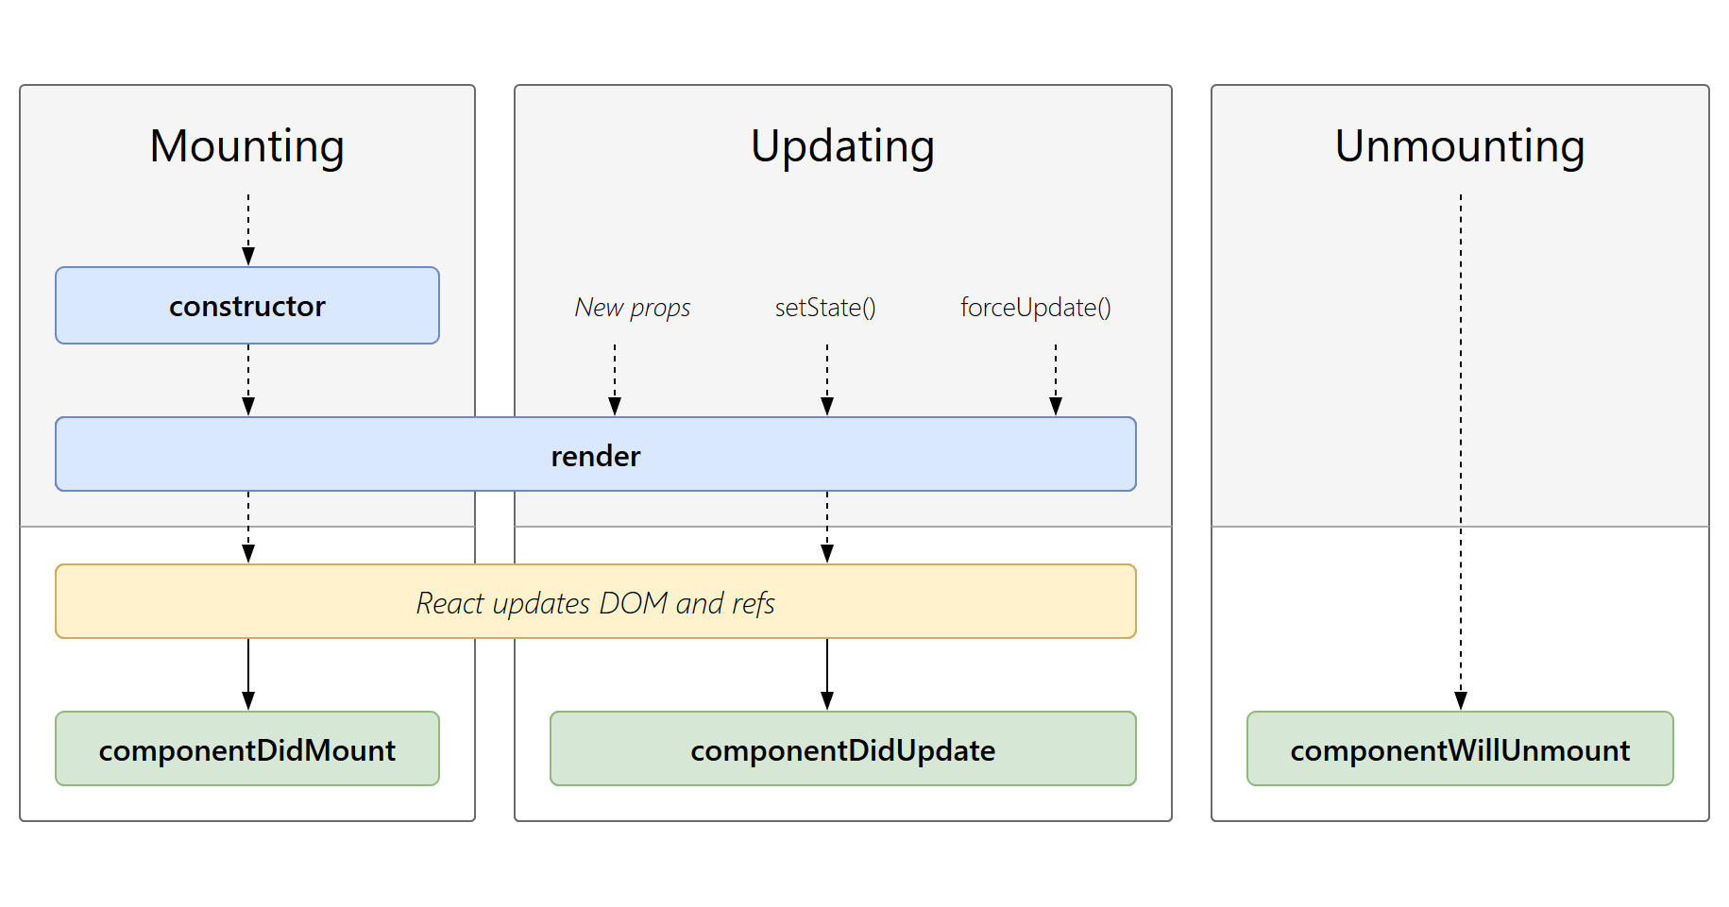
Component lifecycle

Slide 6
Introduction to React Lifecycle
What are Lifecycle Hooks?
Lifecycle hooks are methods that get called at different stages of a component's existence.
These hooks provide opportunities to execute code at key moments in the component's lifecycle.
Lifecycle Stages:
Mounting: When the component is being created and inserted into the DOM.
Updating: When the component is being re-rendered due to changes in props or state.
Unmounting: When the component is being removed from the DOM.

Slide 7
Class Component Lifecycle Hooks
Mounting:
constructor(): Initializes the component's state and binds methods.
static getDerivedStateFromProps(): Updates the state based on initial props.
render(): Returns the JSX to be rendered in the DOM.
componentDidMount(): Invoked immediately after the component is mounted.
Updating:
static getDerivedStateFromProps(): Also called when props change.
shouldComponentUpdate(): Determines whether the component should re-render.
render(): Called again to update the DOM.
getSnapshotBeforeUpdate(): Captures information before the DOM updates.
componentDidUpdate(): Invoked immediately after the component updates.
Unmounting:
componentWillUnmount(): Called just before the component is removed from the DOM.

Slide 8
Functional Components with Hooks
Introduction to Hooks:
Hooks are functions that let you "hook into" React state and lifecycle features from function components.
Commonly used hooks: useState, useEffect, useCallback, useMemo, useRef.
useEffect Hook:
Combines the lifecycle methods: componentDidMount, componentDidUpdate, and componentWillUnmount.
useEffect(callback, dependencies): The callback is run after the render and can optionally clean up.

Slide 9
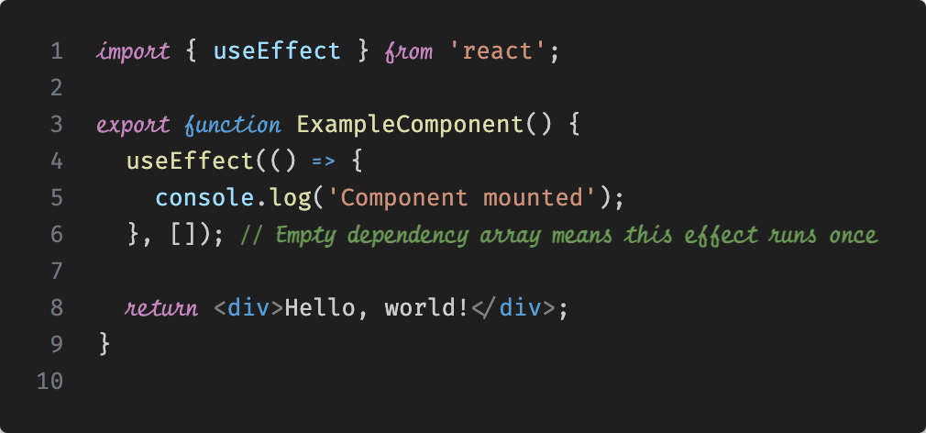
Examples of Functional Components with Hooks
Mounting with useEffect:

Slide 10
Examples of Functional Components with Hooks
Updating with useEffect:

Slide 11
Examples of Functional Components with Hooks
Unmounting with useEffect:

Slide 12
Comparing Class and Functional Components
Class Components:
Verbose and often require multiple lifecycle methods.
Suitable for scenarios where fine-grained control of lifecycle stages is needed.
Functional Components:
Simpler and more concise.
Hooks provide a powerful way to manage state and side effects.
Promotes the use of functional programming principles.

Slide 13
Best Practices with Lifecycle Hooks
Class Components:
Minimize stateful logic in constructors.
Avoid unnecessary re-renders with shouldComponentUpdate.
Clean up resources in componentWillUnmount.
Functional Components:
Use the dependency array in useEffect to control when the effect runs.
Clean up subscriptions or timers in the cleanup function of useEffect.
Combine multiple useEffect calls for different lifecycle events.

Slide 14
Conclusion
Lifecycle hooks are essential for managing side effects and state in React.
Class components offer detailed control with explicit lifecycle methods.
Functional components with hooks provide a modern, concise way to manage state and effects.

Slide 15
References
React Documentation: https://reactjs.org/docs/getting-started.html
React Lifecycle Methods Diagram: https://projects.wojtekmaj.pl/react-lifecycle-methods-diagram/
Medium Article on Functional Component Lifecycle: https://medium.com/@addyosmani/a-beginners-guide-to-react-component-lifecycle-5708a33fe45e

Slide 16
The shift begins with you
Trainer name
Trainer
Assistant name
Assistant
trainer@mail.com assistant@mail.com

