Slide 1

Managing State in React Functional Components

Slide 2
A Comprehensive Guide to State Management with Hooks

Slide 3
Introduction to State Management in React
What is State?
State is a built-in object that holds data or information about the component.
It can change over time and affects how the component renders and behaves.
Why is State Important?
Enables dynamic and interactive UIs.
Keeps track of user inputs, API responses, and other dynamic data.

Slide 4
useState Hook
Introduction to useState:
useState is a hook that lets you add state to functional components.
It returns an array with two elements: the current state and a function to update it.
Syntax:
const [state, setState] = useState(initialState);

Slide 5
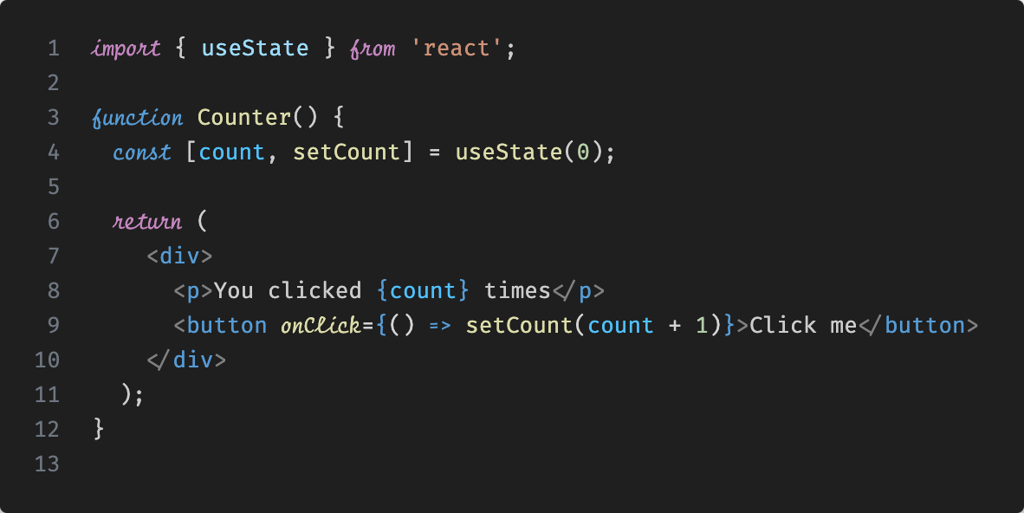
Example of useState Hook

Slide 6
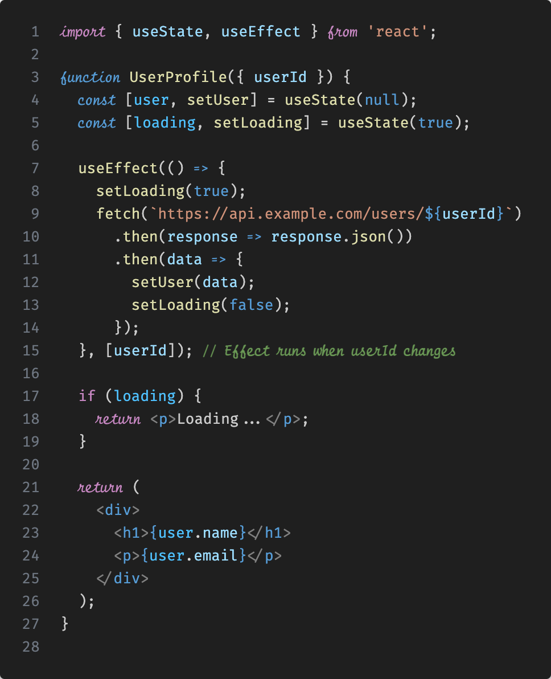
Combining Multiple Hooks

Slide 7
Best Practices with Hooks
Separation of Concerns:
Use multiple useEffect calls to separate unrelated logic.
Keep state management clean and predictable.
Optimizing Performance:
Use useMemo and useCallback to optimize performance by memoizing expensive calculations and callbacks.
Use useRef for accessing DOM elements directly without triggering re-renders.

Slide 8
Conclusion
Functional components with hooks offer a powerful way to manage state and side effects.
Hooks like useState and useEffect simplify complex state logic.
Best practices help maintain clean, performant, and testable code.

Slide 9
References
React Documentation: https://reactjs.org/docs/hooks-intro.html
useEffect Hook: https://reactjs.org/docs/hooks-effect.html
Advanced State Management: https://kentcdodds.com/blog/state-management

Slide 10
The shift begins with you
Trainer name
Trainer
Assistant name
Assistant
trainer@mail.com assistant@mail.com

