Slide 1

Routing

Slide 2
Efficient Navigation in Single Page Applications

Slide 3
Introduction to React Router. What is React Router?
Library for routing in React applications
Enables Single Page Applications (SPAs) to navigate without refreshing the browser.

Slide 4
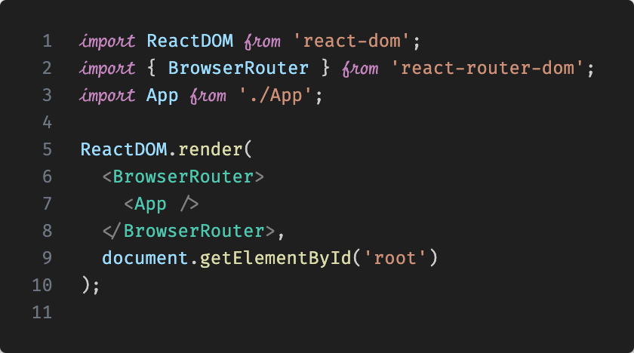
Setting Up React Router
# Install React Router using npm
npm install react-router-dom

Slide 5
Basic Concepts
Router Components: BrowserRouter, HashRouter
Route: Associates URL paths with components
Link: Navigation links that change the URL

Slide 6
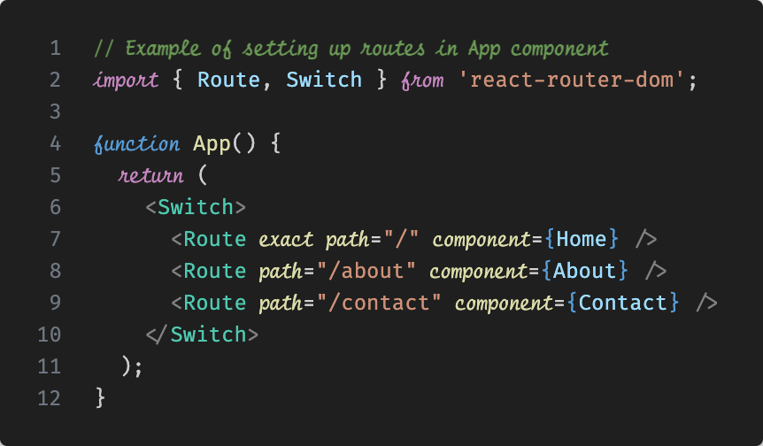
Basic Route Configuration
Router Components: BrowserRouter, HashRouter
Route: Associates URL paths with components
Link: Navigation links that change the URL

Slide 7
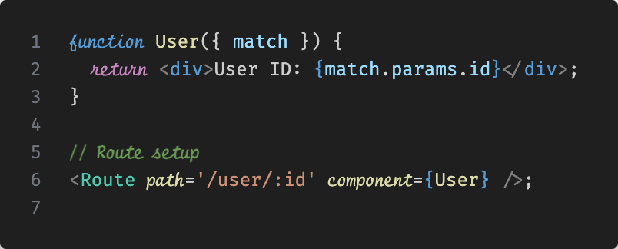
Dynamic Routing
Dynamic Parameters

Slide 8
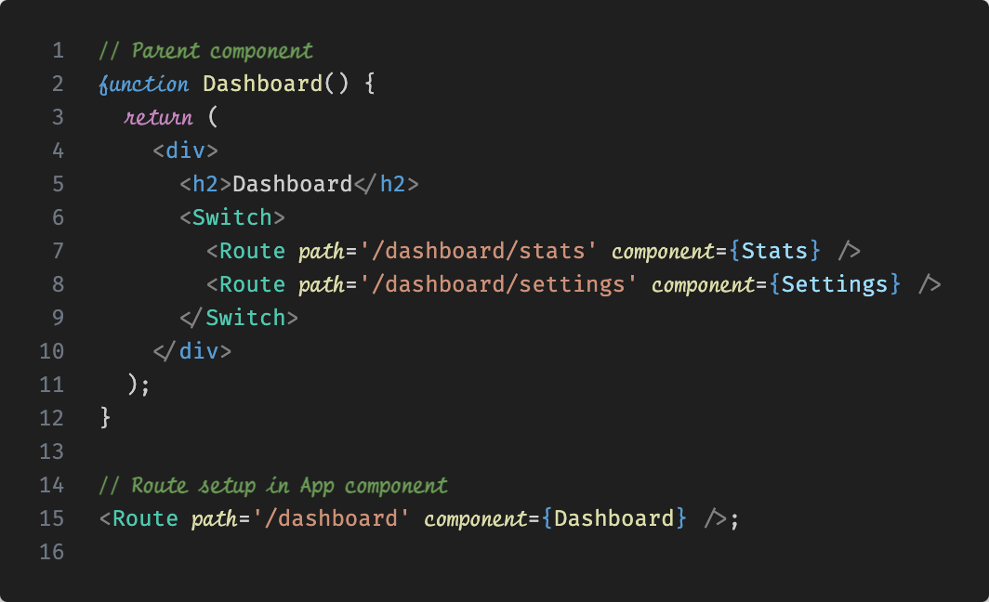
Nested Routes

Slide 9
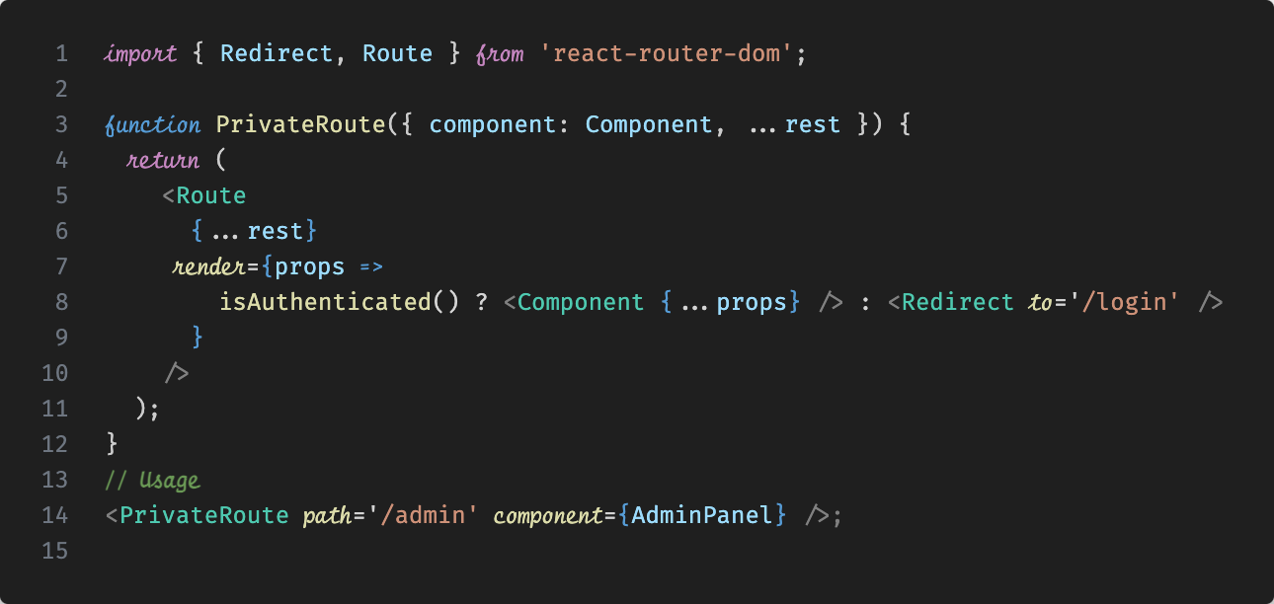
Route Guards
Protecting Routes
Use Redirect component for guarding

Slide 10
The shift begins with you
Trainer name
Trainer
Assistant name
Assistant
trainer@mail.com assistant@mail.com

