Slide 1


Testing Report
Manual QA · Login · Search · My Info · Admin
71
58
13
13
Test Cases
Passed
Failed
Bugs Found
Tested by: Piyush Bhagchandani | May 2026 | OrangeHRM OS 5.8

Slide 2
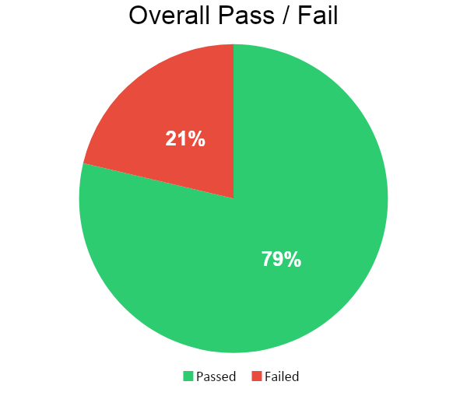
Test Execution Summary
Total Test Cases
71
Passed
58
Failed
13
Bugs Reported
13
Pass Rate: 78.7%

Slide 3
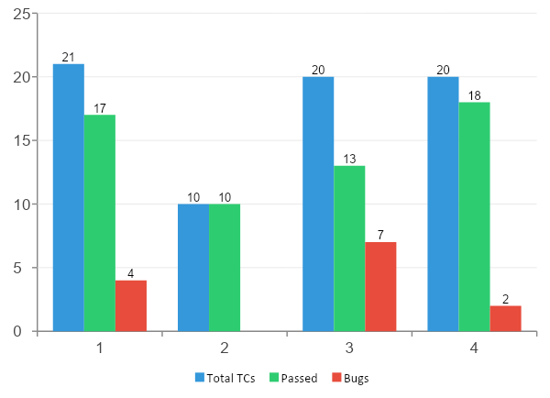
Module-wise Breakdown
Login
21 TCs | 4 Bugs
Search
10 TCs | 0 Bugs
My Info
20 TCs | 7 Bugs
Admin
20 TCs | 2 Bugs

Slide 4
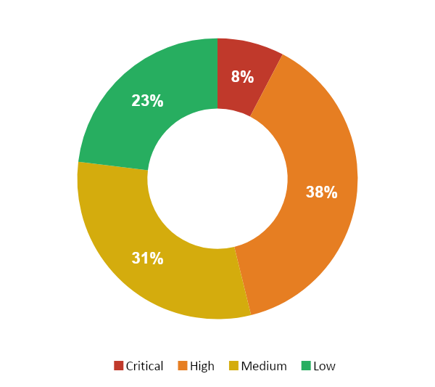
Bug Severity Breakdown
Critical — 1 Bug
Auth bypass via special chars in username
High — 5 Bugs
Case sensitivity, Employee ID editable, Partial search
Medium — 4 Bugs
License date, DOB, Name validation, Driver's license
Low — 3 Bugs
Gender options, minor UI / misunderstanding

Slide 5
Login Module — Bugs Found
4 Bugs | 1 Critical · 3 High
Bug_001
High
Login with invalid Credentials
Lowercase username 'admin' logs in successfully — case sensitivity not enforced
Bug_002
High
Username all lowercase
Username 'admin' bypasses authentication — no case validation
Bug_003
Critical
Special chars in username
Username with special chars (Admin!@#$%) still logs in successfully
Bug_004
High
Username all uppercase
'ADMIN' uppercase logs in — no case validation on username field

Slide 6
My Info Module — Bugs Found
7 Bugs | 2 High · 3 Medium · 1 Low
Bug_005
Medium
Bug_009
Medium
Name with numbers
Future date of birth
First name accepts numeric input '123456' and saves without error
Future DOB accepted — no age logic or date validation
Bug_006
High
Bug_010
Low
Name with special characters
Gender options incomplete
First name accepts '@#$' — no format validation on name fields
Only Male/Female present — no Other/Non-binary option
Bug_007
High
Bug_011
Medium
Employee ID read-only check
Driver's License invalid input
Employee ID is editable — should be read-only (unique identifier)
Random string 'fadfada' accepted as valid license number
Bug_008
Medium
License expiry in the past
Past license expiry date accepted with no warning or validation

Slide 7
Admin Module — Bugs Found
Bug_012
High
Partial username search fails
Searching 'Ahmed' returns 'No records found' — partial match broken
Recommendation: Implement partial/contains match in username filter
Bug_013
Low
Add new employee field confusion
Employee name field in Add User does not create new employee
Recommendation: Implement partial/contains match in username filter

Slide 8
Bug Summary Table
Bug ID | Module | Severity | Scenario | Status
Bug_001 | Login | High | Login with invalid Credentials | Open
Bug_002 | Login | High | Username all lowercase | Open
Bug_003 | Login | Critical | Special chars in username | Open
Bug_004 | Login | High | Username all uppercase | Open
Bug_005 | My Info | Medium | Name with numbers | Open
Bug_006 | My Info | High | Name with special characters | Open
Bug_007 | My Info | High | Employee ID read-only check | Open
Bug_008 | My Info | Medium | License expiry in the past | Open
Bug_009 | My Info | Medium | Future date of birth | Open
Bug_010 | My Info | Low | Gender options incomplete | Open
Bug_011 | My Info | Medium | Driver's License invalid input | Open
Bug_012 | Admin | High | Partial username search fails | Open
Bug_013 | Admin | Low | Add new employee field confusion | Open

Slide 9
Key Findings & Recommendations
Authentication is not secure
🔴
Username case sensitivity absent — 'admin', 'ADMIN', 'Admin' all login. Critical auth flaw that must be fixed before production.
Employee ID must be read-only
🟠
Any user can edit their own Employee ID (unique system identifier). This can cause data corruption and audit failure.
No data validation on key fields
🟡
Driver's license, name fields, and DOB accept any input. Business data quality is compromised — garbage in, garbage out.
Admin search — partial match broken
🔵
Searching 'Ahmed' returns no records instead of matching AhmedAli1/2/3. Core HR function is non-functional.

Slide 10
Testing Complete
OrangeHRM Manual QA Report
71 test cases executed across 4 modules
13 bugs identified and documented with Defect IDs
1 Critical · 5 High · 4 Medium · 3 Low severity bugs
Pass rate: 78.7% — recommend fixes before production release
Tested by: Piyush Bhagchandani | May 2026

