Slide 1
Web Technologies in Java EE
JAX-RS, JSON-P, WebSocket, Angular 5
Jiří Kremser

Slide 2
Agenda
Client-Side vs. Server Side Web
JAX-RS 2.0 – RESTFul Services
- Origins + News in 2.0
JSON-P – Java API for JSON Processing
Java API for WebSocket
Angular 5 – client side JavaScript framework

Slide 3
Client-Side
vs
Server-Side
Web Architecture

Slide 4
{Client vs. Server}-Side Web
Server-Side Web (Thin Client)
- well-established approach
- 90's, 00's
Client-Side Web (Thick Client)
- modern approach
- SPA (Single Page Applications)
- Leverages enhancements in web standards & protocols
- 10's

Slide 5
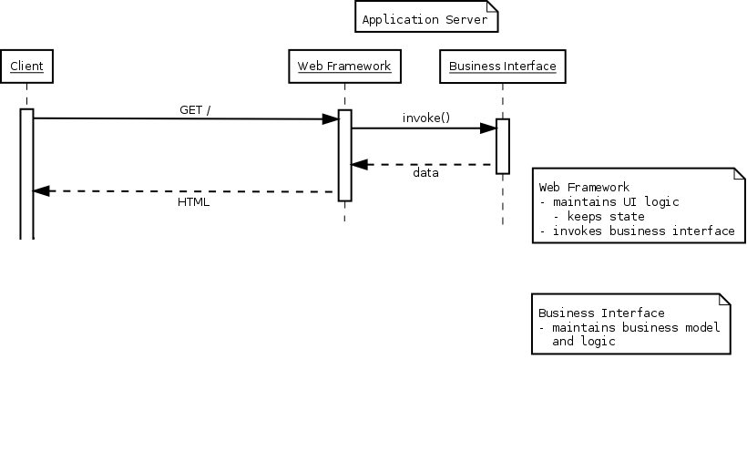
Server-Side

Slide 6
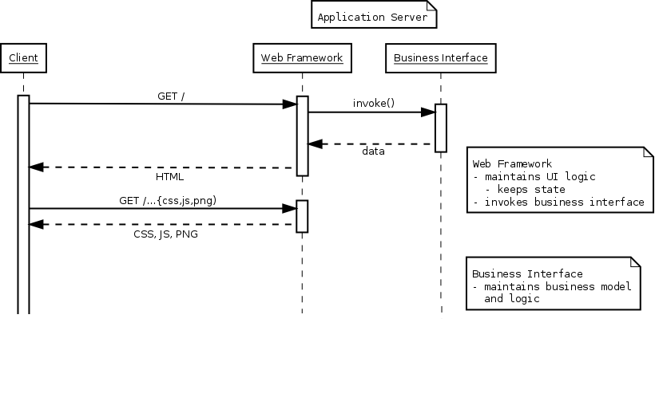
Server-Side

Slide 7
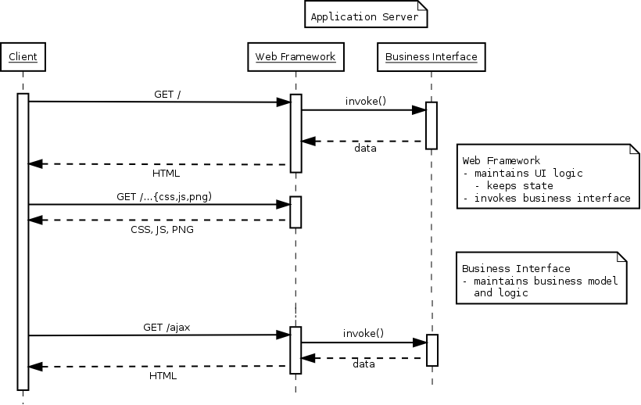
Server-Side

Slide 8
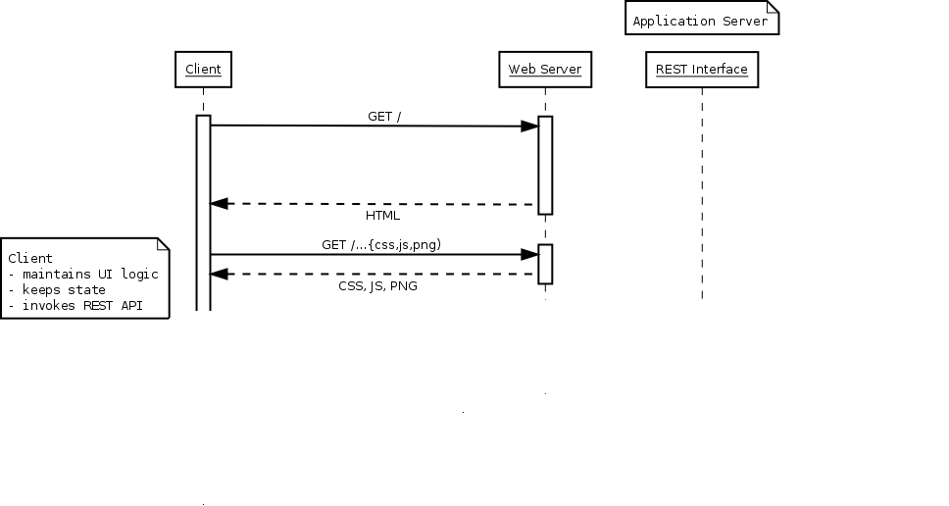
Client-Side

Slide 9
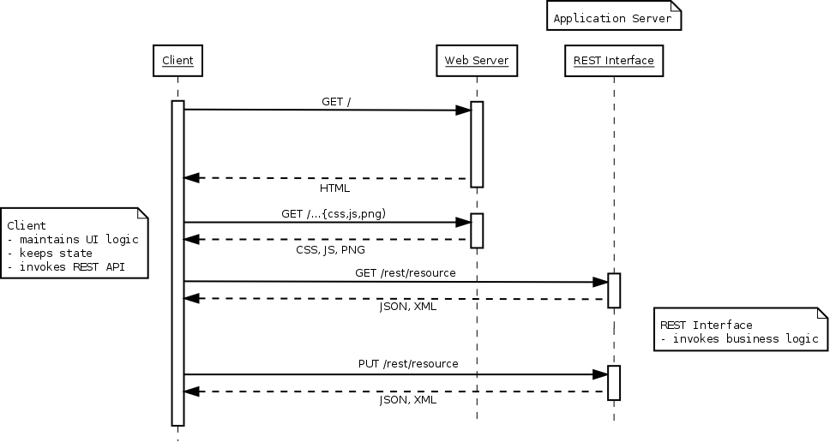
Client-Side

Slide 10
Client-Side Web Approach
Off-loading server
- Stateless, Scalable, More battery demands
Client-Side Frameworks
- Angular, React, Ember, Backbone, ..........
Standards improvements
- HTML5 + Protocols
REST interfaces
- Data-oriented, presentation independent

Slide 11
Server-Side Advantages
Well-Known
No need for another layer of abstraction
Full granularity and control over the content

Slide 12
Java API for RESTful
Services
JAX-RS 2.0

Slide 13
JAX-RS Origins
RESTful Principles
- Assign everything an ID
- Link things together
- Use common methods (GET, POST, …)
- Stateless communication

Slide 14
JAX-RS 1.0 Goals
POJO-Based API
HTTP Centric
Format Independence

Slide 15
JAX-RS API
Application Resources
- @ApplicationPath (or web.xml)
- @Path
HTTP methods
- @GET / @POST / @PUT / @DELETE /..
Parameters
- @PathParam / @QueryParam / ...
Media-Type
- @Consumes / @Produces

Slide 16
Demo JAX-RS Endpoint
https://github.com/javaee-samples/javaee7-samples
From root of samples (i.e javaee7-samples directory):
mvn -DskipTests=true clean install
From javaee7-samples/ {path to sample} directory:
mvn test
Start and deploy to server
<server> ./bin/standalone.sh <sample> mvn wildfly:deploy

Slide 17
HTTP Method Purpose
Method | Meaning
@GET | Read, possibly cached
@POST | Modify or create with a known ID (modify/update)
@PUT | Modify or create without a known ID (create/modify)
@DELETE | Remove
@HEAD | GET with no response
(@PATCH) | json-patch
http://stackoverflow.com/questions/630453/put-vs-post-in-rest
http://stackoverflow.com/questions/25253899/how-to-implement-patch-requests-in-resteasy

Slide 18
Parameter Injection
Annotation | Example
@PathParam(“id”) | @Path(“/consumer/{id}”)
@QueryParam(“query”) | GET /consumer/search?query=???
@CookieParam(“username”) | Cookie: ...
@HeaderParam(“Authorization”) | Header: Authorization: ...
@FormParam(“inputName”) | @Consumes("multipart/form-data")
@MatrixParam(“query”) | GET /consumer;name=???/orders
http://stackoverflow.com/questions/630453/put-vs-post-in-rest
http://stackoverflow.com/questions/25253899/how-to-implement-patch-requests-in-resteasy

Slide 19
New in JAX-RS 2.x
New Features
- Client API
- Filters and Interceptors
- Asynchronous API
- Hypermedia
Improvements
- Content-Type Negotiation
- Validation Alignments

Slide 20
Demo
JAX-RS – Client API

Slide 21
Asynchronous
Let “borrowed” threads run free!
- Suspend and resume connections
    Suspend while waiting for an event (@Suspended AsyncResponse)
    Resume when event arrives
Client API support
- Future<T>, InvocationCallback<T>

Slide 22
Demo
JAX-RS – Asynchronous

Slide 23
Demo
JAX-RS – Bean validation

Slide 24
Hypermedia
extension to Hypertext concept
enables you to send the client links (in http header or as response payload)
javax.ws.rs.core.Link
hypermedia content is represented by link – indicating other options
HATEOAS (“hypermedia as the engine of application state”)
javax.ws.rs.core.UriBuilder
javax.ws.rs.core.UriInfo
  provides access to application URI information

Slide 25
Java API for JSON Processing
JSON-P
(JSR 374)

Slide 26
Motivation: JSON
JavaScript Object Notation
  The format of the Web
    Comes from JavaScript object syntax
    Human readable
  Language independent
    Standard parsers in many languages
  Key-value Pair Format
{ “firstName”: “John”, “lastName”: “Smith” }

Slide 27
Motivation: Java API for JSON
Lot of vendor-dependent APIs
  Need for standardization
Standard API for JSON processing
  generate, parse

Slide 28
JSON-P APIs
Streaming API
  Similar to StAX
Object Model APIs
  Similar to XML DOM

Slide 29
Java API for WebSocket

Slide 30
Motivation
HTTP is half-duplex
HTTP is inefficient
HTTP hacked to achieve Push

Slide 31
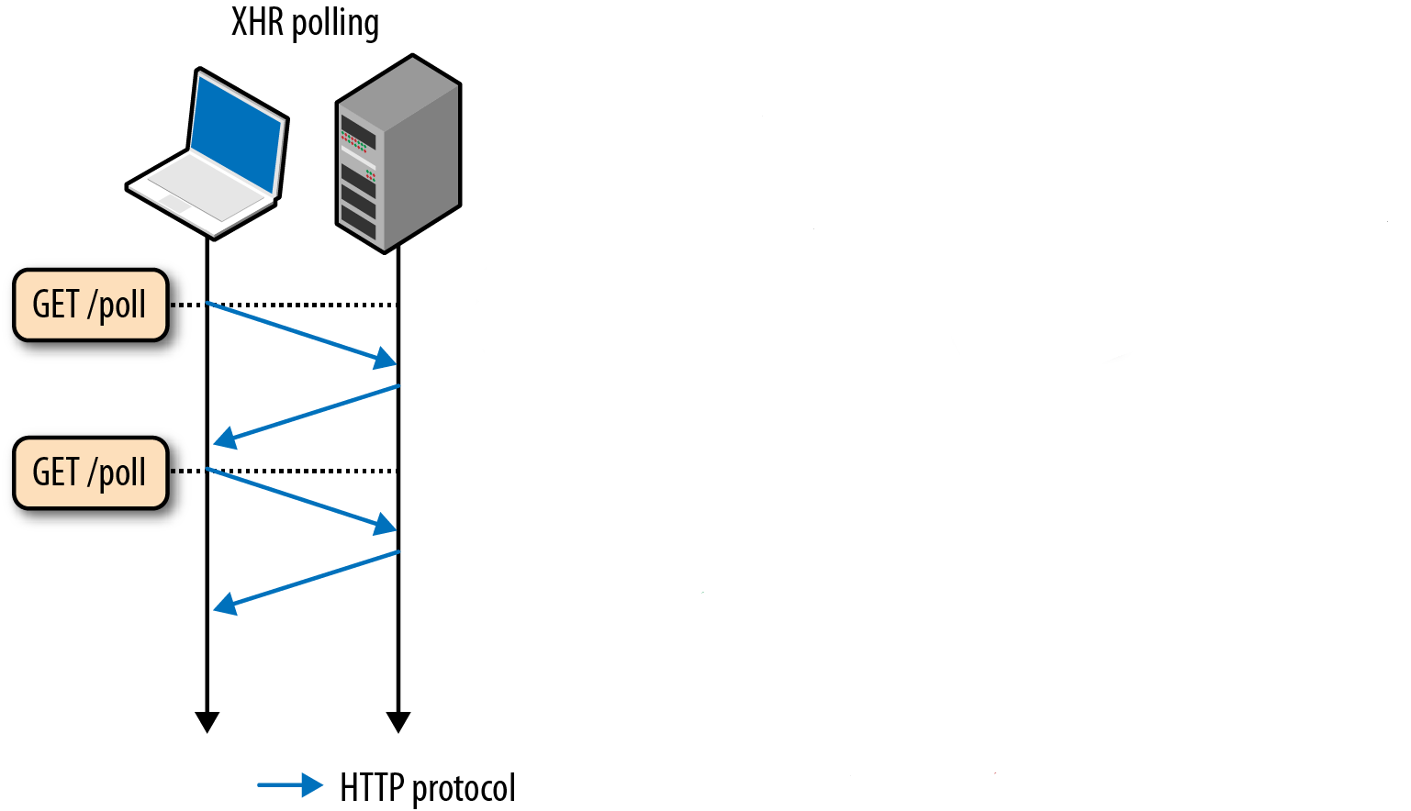
Server Push - Polling

Slide 32
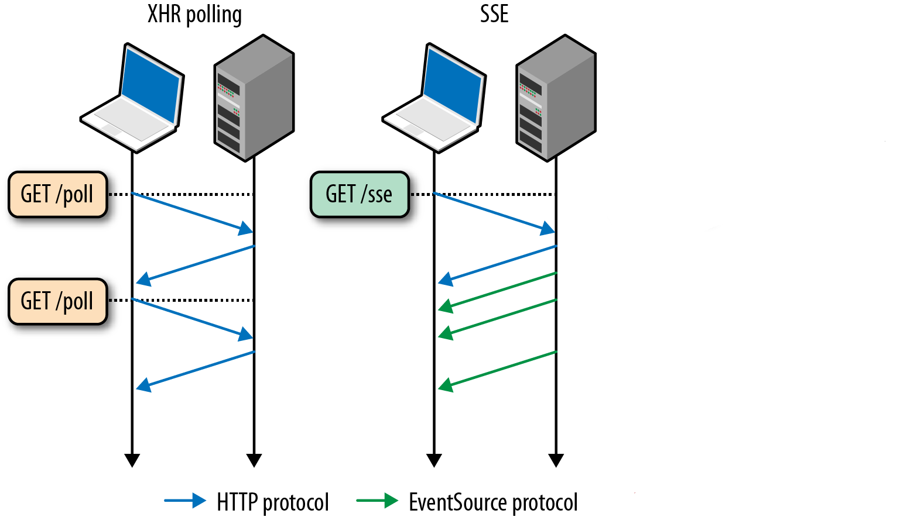
Server Push - Polling

Slide 33
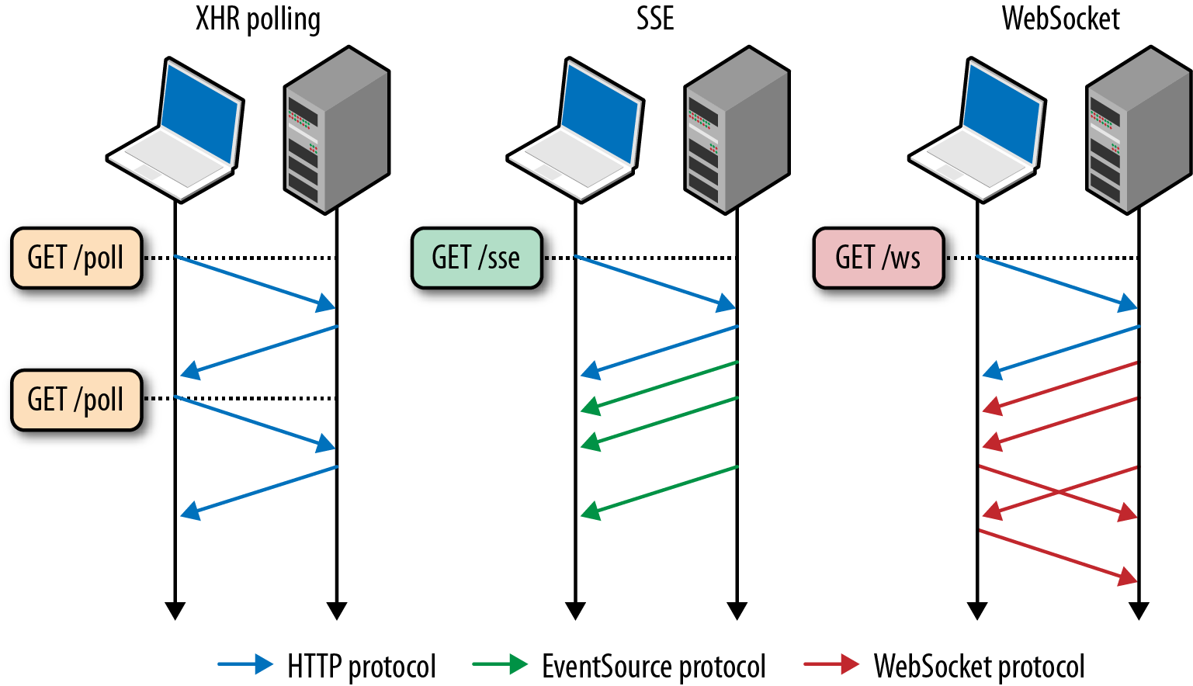
Server Push - Polling

Slide 34
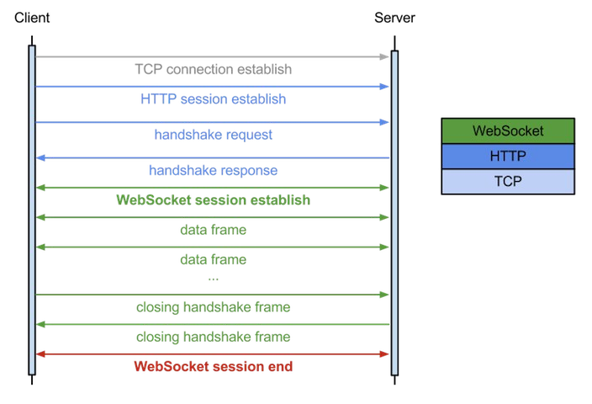
Handshake

Slide 35
WebSocket
Full duplex & efficient communication
A component of HTML5
  JavaScript API under W3C
  Protocol under IETF (Internet Engineering Task Force)
Wide support for browsers
  http://caniuse.com/#feat=websockets

Slide 36
WebSocket: Limitations
Use of existing infrastructure
  Proxies doesn't have to handle connection upgrade
Fallback mechanisms
  Atmosphere

Slide 37
WebSocket: Trade-offs
WebSocket
  Low efforts to maintain TCP connection
  Limited by number of available ports
  Highly interactive applications
HTTP
  Resource-consuming protocol
  Fairly interactive applications

Slide 38
WebSocket: Use Cases
Realtime, truly low latency
  Chat applications
  Live sports ticker
  Realtime updating social streams
  Multiplayer online games
Requires architecture shift to
  Non-blocking IO
  Event queues

Slide 39
Java API for WebSocket
Programmatic
Annotation based
  Our focus

Slide 40
WebSocket Annotations
@ServerEndpoint
  @OnOpen
  @OnMessage
  @OnClose

Slide 41
Demo
WebSocket Whiteboard

Slide 42
Method Parameters
Session
Implicitly supported types
  String, byte[]
  JsonArray, JsonObject
More types supported by Encoders

Slide 43
Integration to Java EE 7
Relation to Servlet 3.1
  HttpServletRequest.upgrade(ProtocolHandler)
Dependency Injection
  CDI beans
  EJB beans
Security
  ws://... vs. wss://…
  web.xml: <security-constraint>

Slide 44
Angular

Slide 45
Angular
Client side JavaScript Framework for adding interactivity to HTML
MVC-like
Adding behaviour to HTML through web components

Slide 46
TypeScript
Created by Microsoft
ECMAScript super-set
Types are optional
Types for JSON (weaker than json schema though)

Slide 47
Demo
TypeScript
http://www.typescriptlang.org/play/

Slide 48
Web components
Goal is reusable encapsulated HTML tag
Set of APIs
Shadow DOM
www.webcomponents.org

Slide 49
Webpack
Bundling the assets
environments
SASS
Rich plugin system
<script src="bundle.js">

Slide 50
RxJS
Asynchronous programming model
Observables ~ stream of events
Combine operators
Much more powerful than Promises
Functional reactive programming
http://rxmarbles.com/

Slide 51
Angular-cli
Bootstraps the application
Creates:
  TypeScript configuration
  e2e tests
  Asset pipeline
  .angular-cli.json
Generators
ng eject

