Slide 1
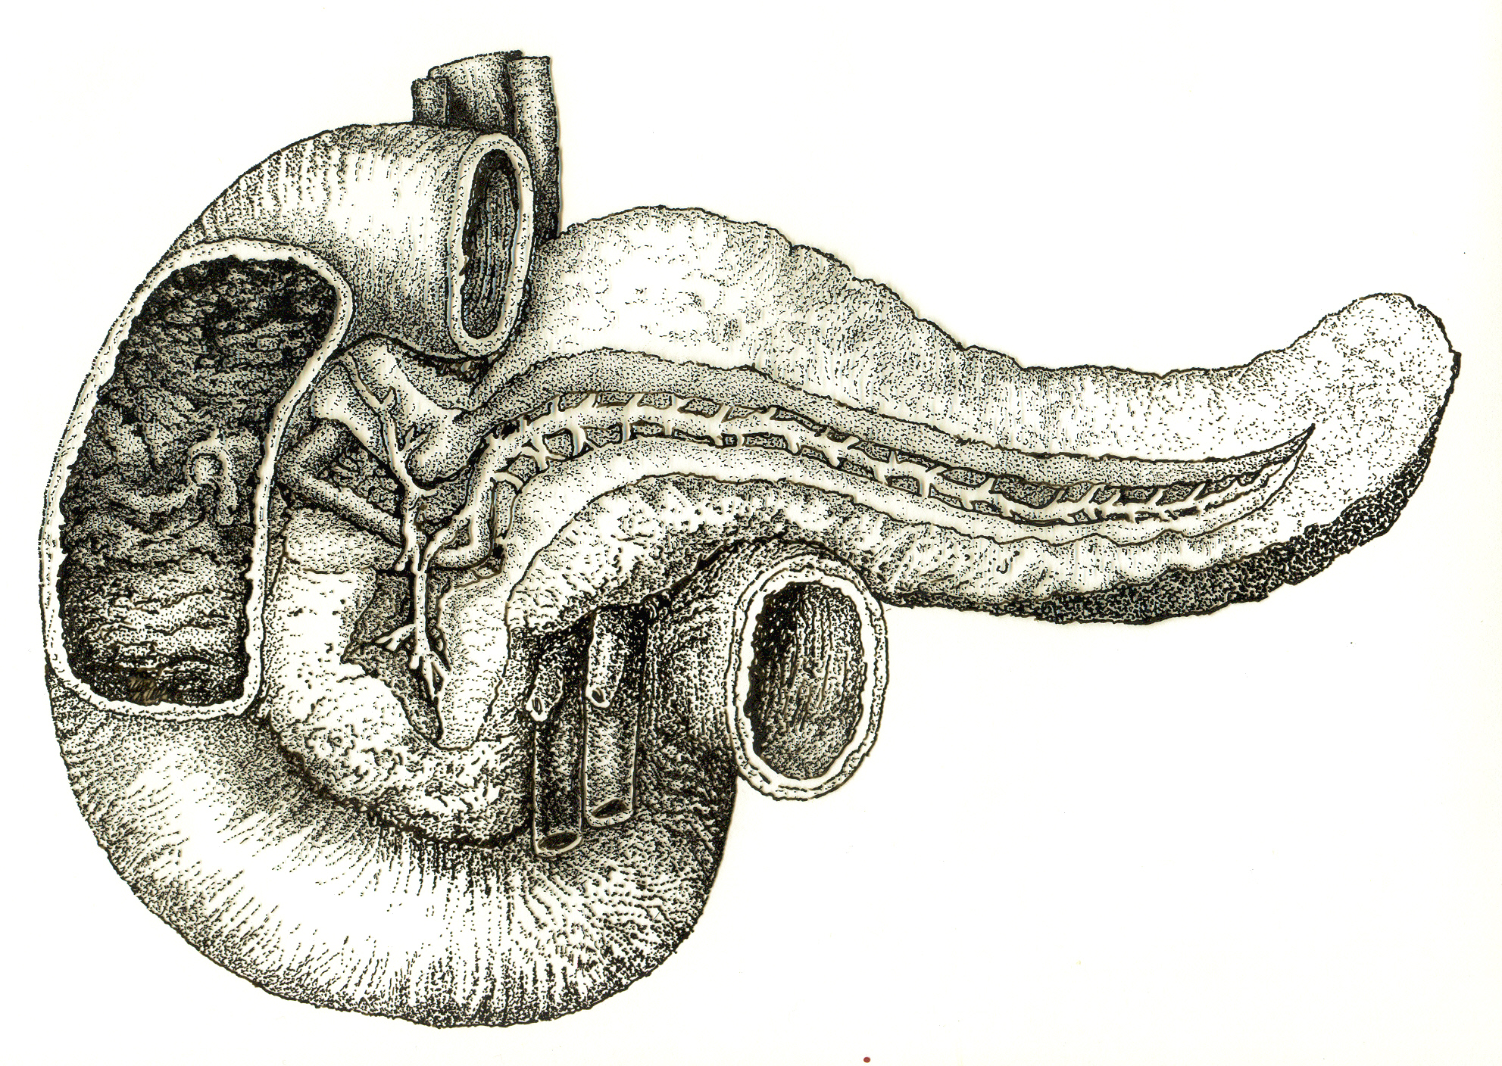
Acute Pancreatitis
Mohammad Almeqdadi
GI Fellow

Slide 2
Case Presentation

Slide 3
Case Presentation
History of presenting illness: the patient is a 19-year-old lady with history of alcohol misuse disorder and recurrent pancreatitis, who presented to the ED with nausea, vomiting, and epigastric abdominal pain. The patient developed the symptoms soon after an episode of binge drinking during her birthday 2 days prior to admission.
Vitals: BP 119/72 HR 78 Resp 18 Temp 37˚C
Physical exam: Patient was lying comfortably in bed. Was not in acute distress. She was complaining of epigastric abdominal pain. Anicteric sclerae. Abdomen was soft, mild tenderness in the epigastric region, no RUQ tenderness, negative murphy, no organomegaly, normoactive bowel sounds.

Slide 4
Case Presentation
Laboratory investigations:
WBC 8.9
Hct 39.3%, Hb 13.7
BUN 7, Creatinine 0.61
Tbili 1.0, AST 18, ALT 13, Alk 47
Lipase 1932

Slide 5
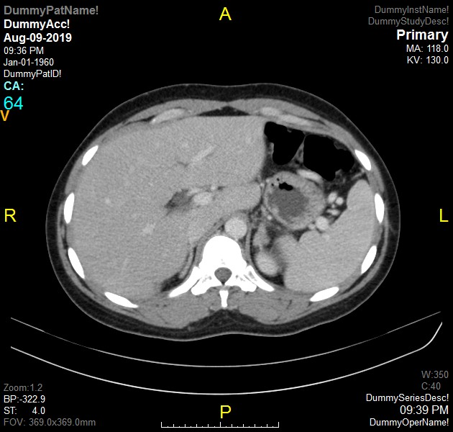
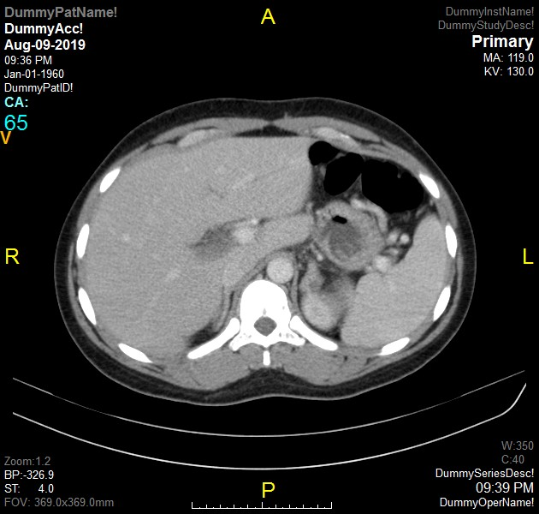


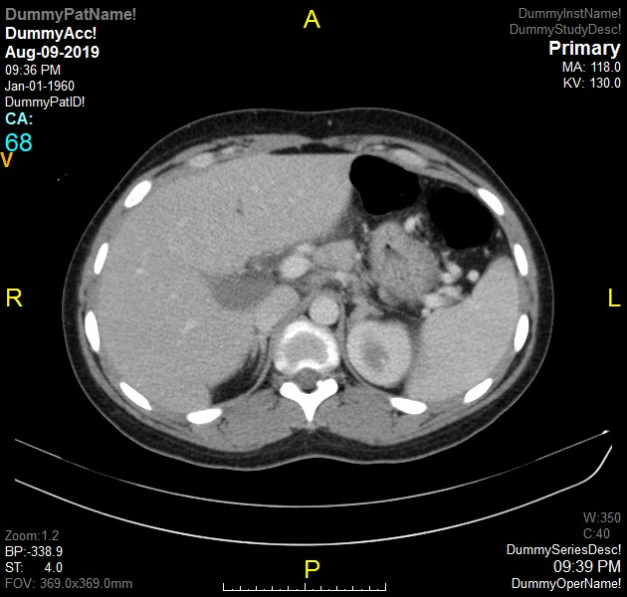
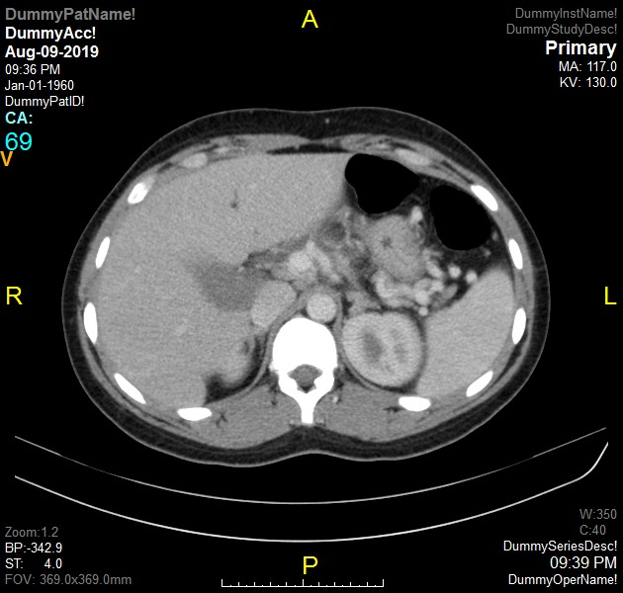
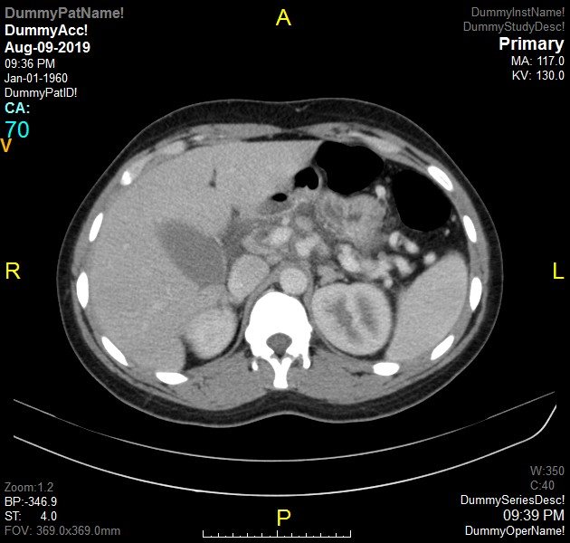
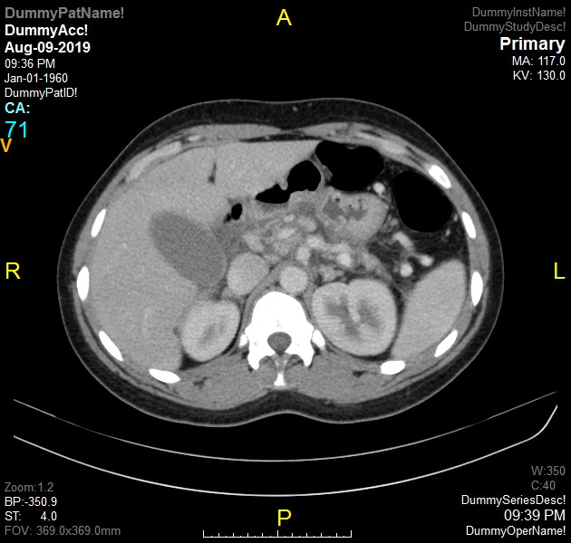
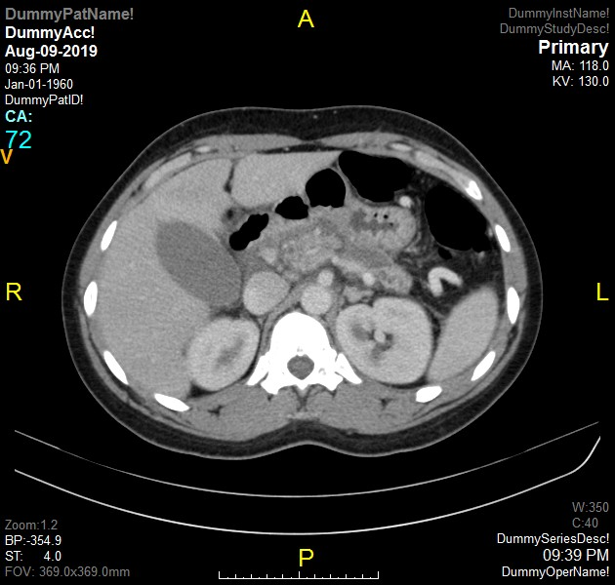
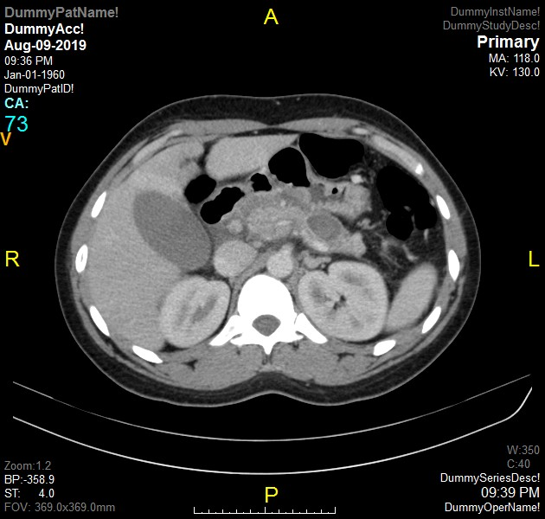
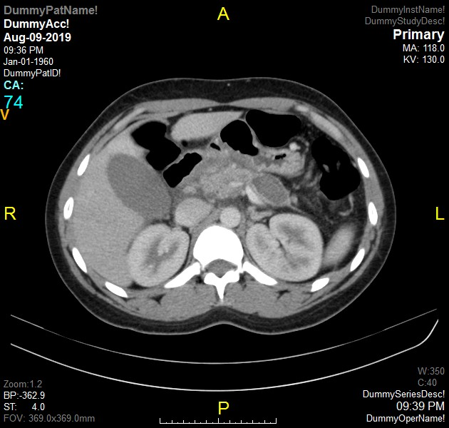
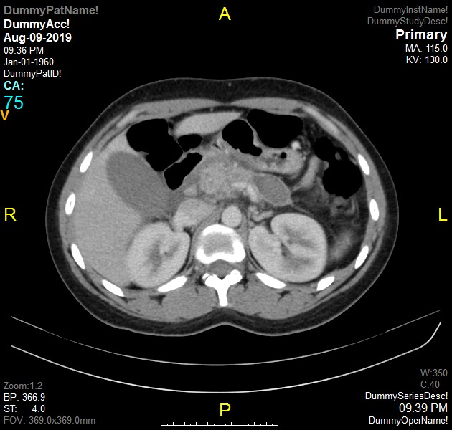
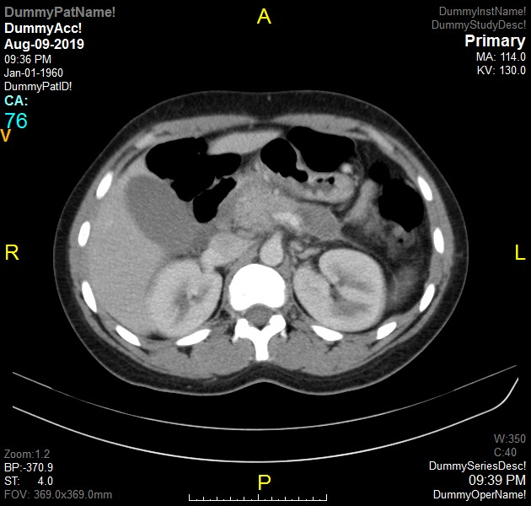
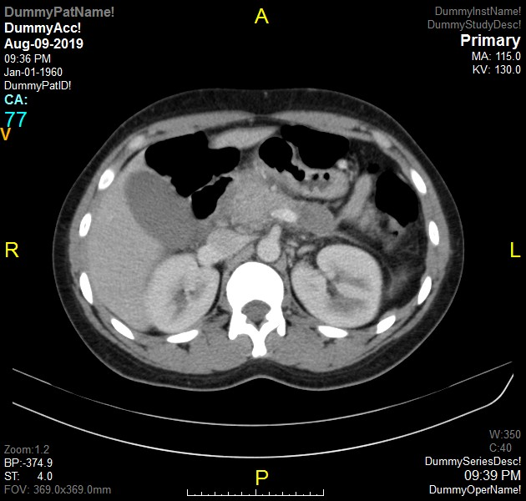
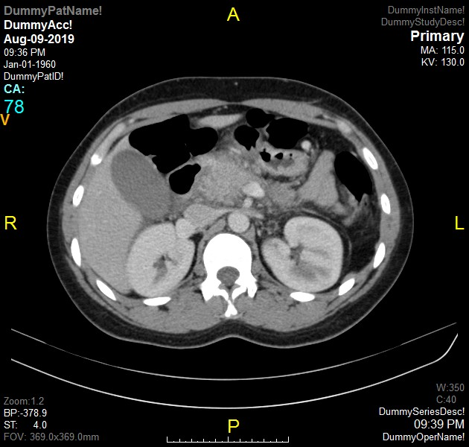
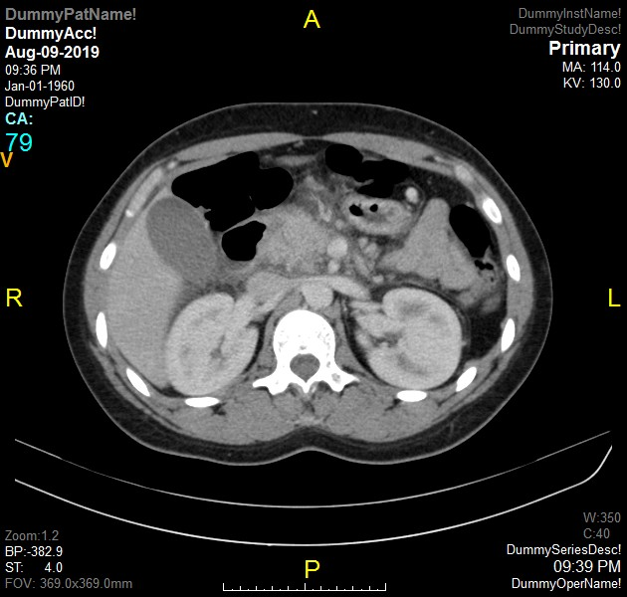
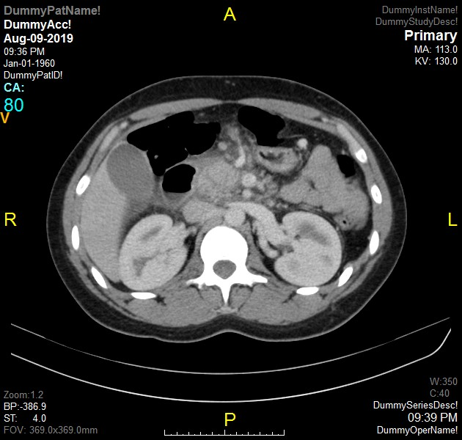
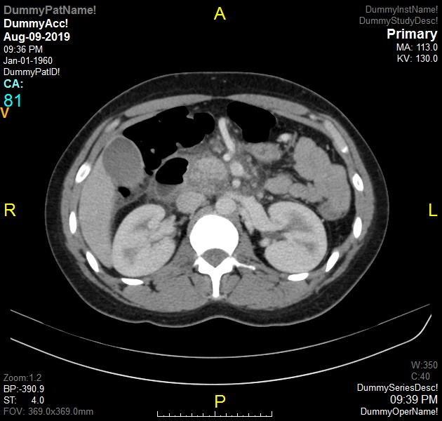
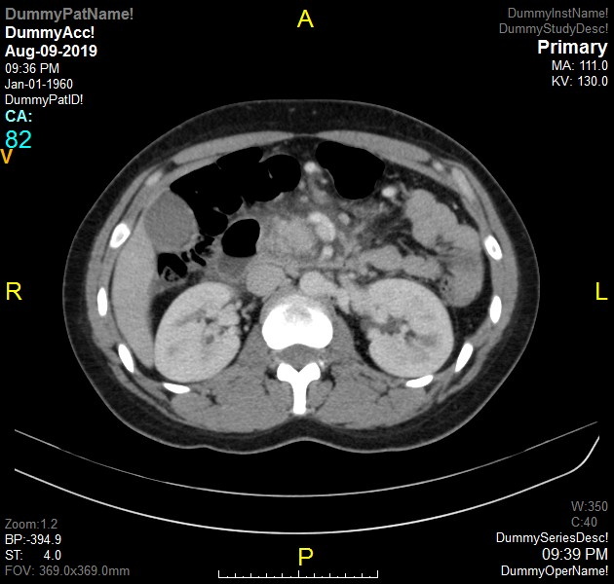
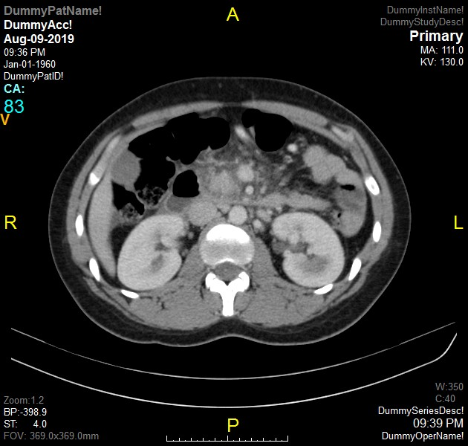
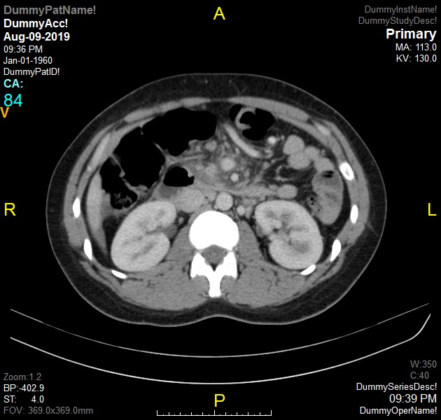
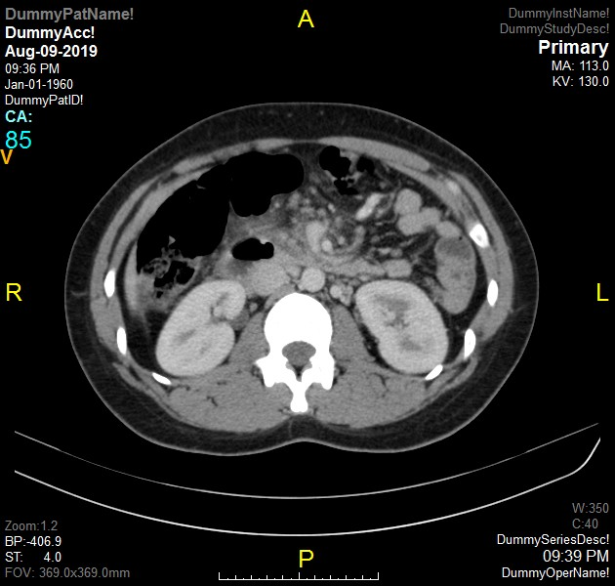
CT A/P

Slide 6
What’s the appropriate management?

Slide 7
History

Slide 8
Historic Background
Pancreas
“pan-”: all “-kreas”: flesh.
First coined by Ruphos Ephesus in the year 100, as this organ did not contain any bone, muscle, or cartilage.
First description of acute pancreatitis was made by Nicholaes Tulp in 1652.

Slide 10
Pathophysiology of Acute Pancreatitis

Slide 11
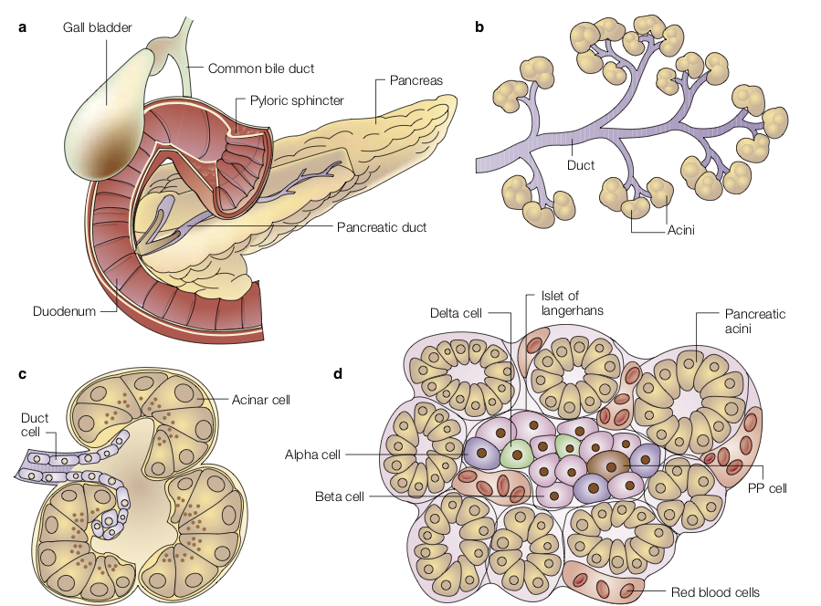
Anatomy of the Pancreas
Nature Reviews Cancer; volume 2, pages897–909 (2002)

Slide 12
A Paradigm Shift

Slide 13
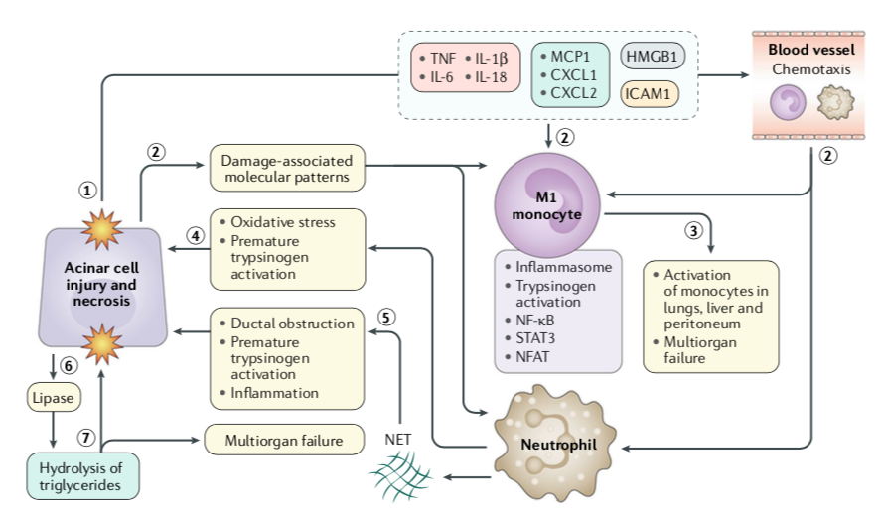
The Immune Response
Lee, P. and Papachristou, G. (2019). New insights into acute pancreatitis. Nature Reviews Gastroenterology & Hepatology, 16(8), pp.479-496.

Slide 14
Robbins, S., Cotran, R., Kumar, V., Abbas, A. and Aster, J. (2015). Pathologic basis of disease. Philadelphia, PA: Saunders Elsevier.

Slide 15
Diagnosis

Slide 16
Diagnosis
Two out of three criteria
Typical history and physical exam
Amylase and/or lipase elevation (3 times ULN)
Imaging supporting inflammatory changes (CT, ultrasonography, etc.)

Slide 17
Etiologies of Acute Pancreatitis

Slide 18
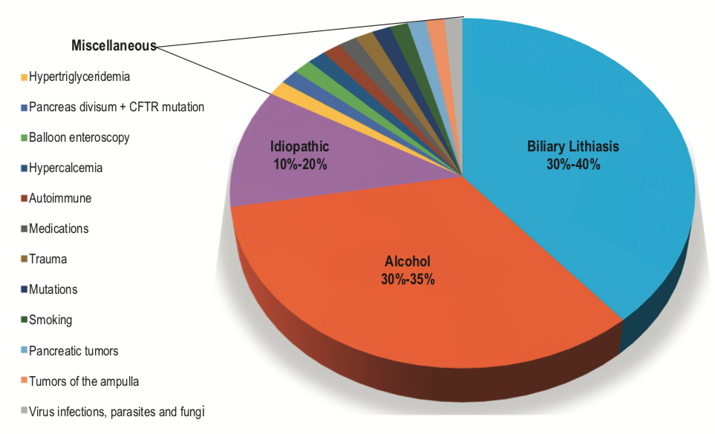
Etiologies of Acute Pancreatitis
Díaz et al. (2015) Revista Colombiana de Gastroenterologia, 30(4), 479-484.

Slide 19
Management of Acute Pancreatitis

Slide 20
Summary of Management
Severity assessment
Fluid resuscitation
Pain control
Nutritional support
Antibiotics
Specific management in different etiologies
Complications and their management

Slide 21
Which of the following is the most reliable lab in predicting the severity/mortality in acute pancreatitis?
Hematocrit
Blood urea nitrogen
Serum creatinine
Lipase levels
C-reactive protein

Slide 22
Which of the following is the most reliable lab in predicting the severity/mortality in acute pancreatitis?
Hematocrit
Blood urea nitrogen
Serum creatinine
Lipase levels
C-reactive protein

Slide 23
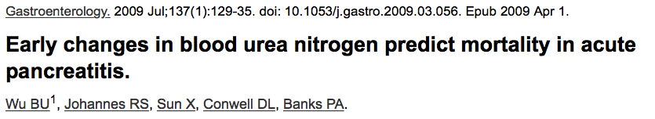
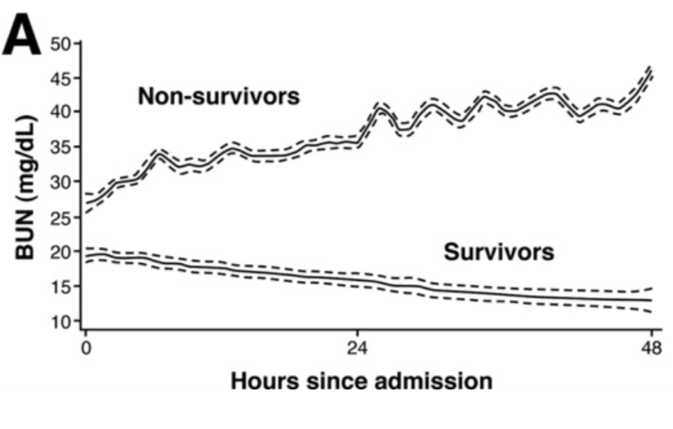
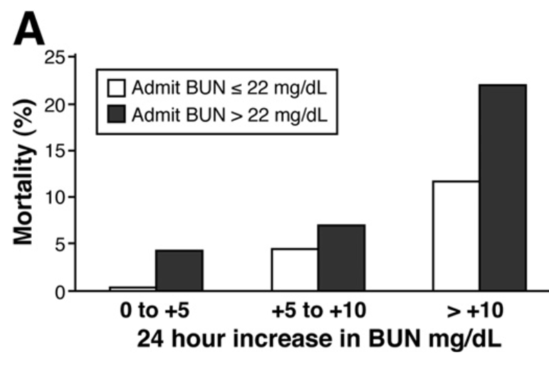
n = 13,384

Slide 24
Assessment of Severity

Slide 25
Assessment of Severity
Multiple scoring systems have been developed trying to assess the severity of acute pancreatitis
None have been proven to be perfect

Slide 26
Assessment of Severity

Slide 27
Assessment of Severity
Ranson’s Criteria

Slide 28
Assessment of Severity
APACHE II

Slide 29
Assessment of Severity
APACHE II
SIRS

Slide 30
Assessment of Severity
APACHE II
SIRS
BISAP

Slide 31
Assessment of Severity
APACHE II
SIRS
HAPS
BISAP

Slide 32
Assessment of Severity
What does the AGA recommend?

Slide 33
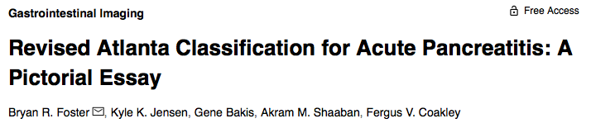
Assessment of Severity
What does the AGA recommend?

Slide 34
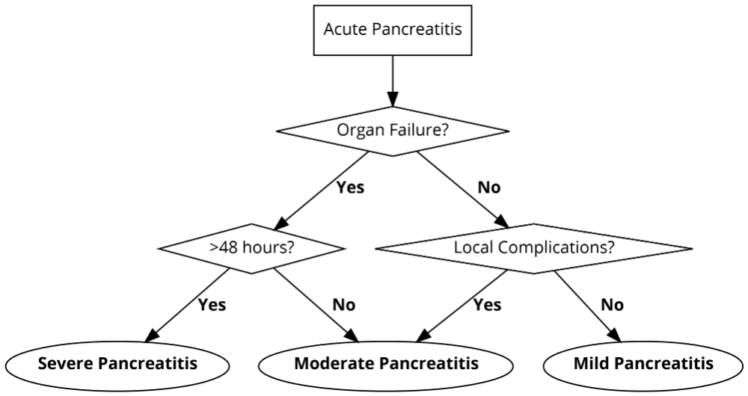
Assessment of Severity

Slide 35
How to determine “Organ Failure”?

Slide 36
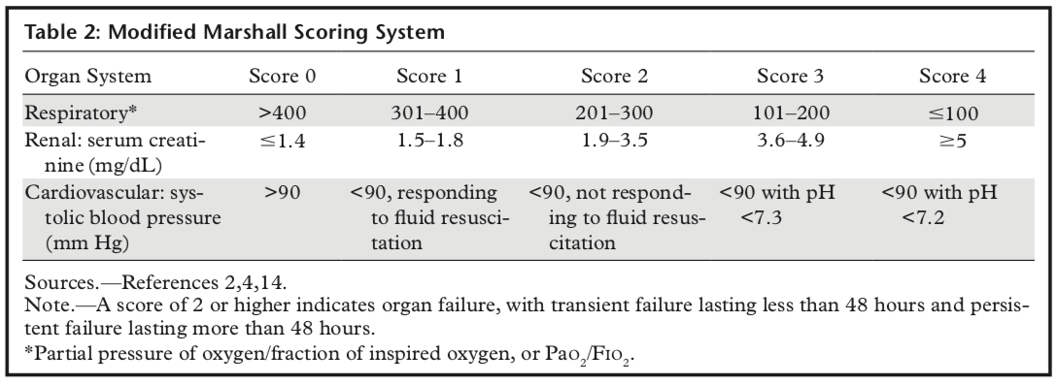

Slide 37
Fluid Resuscitation

Slide 38
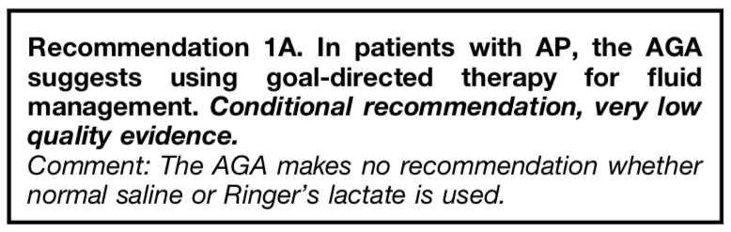
Fluid Resuscitation

Slide 39
Fluid Resuscitation

Slide 40
Normal Saline vs. Lactated Ringer’s?

Slide 41
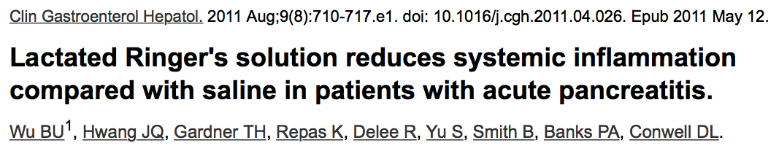
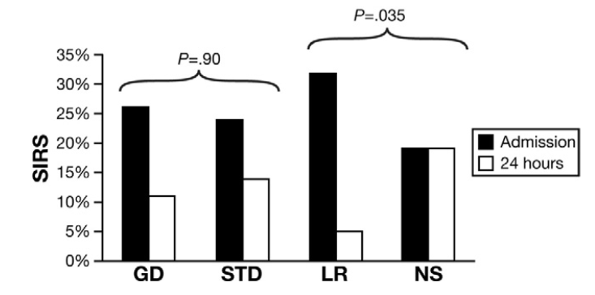
Normal Saline vs. Lactated Ringer’s
Pitfalls
Total of 40 patients, double-blind multi-center RCT.
Used SIRS and CRP as end points

Slide 42
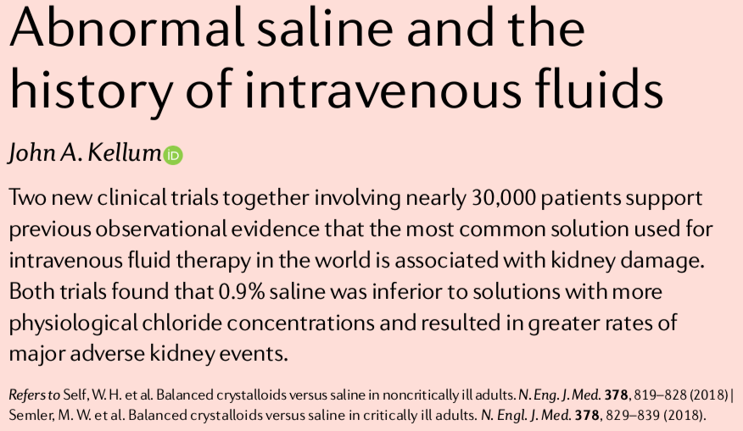

Slide 43
Pain Control

Slide 44
Pain Control
What’s the agent of choice for pain control?

Slide 45
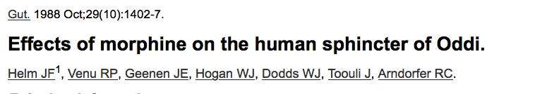
Pain Control
Usually resort to opioids for adequate analgesia
Morphine was found to cause transient spasms of sphincter of Oddi
  No proven cases of worsening pancreatitis
  No proven cases of cholecystitis
Agents of choice are hydromorphone or fentanyl given intravenously

Slide 46
Nutritional Support

Slide 47
Nutritional Support
When to start feeding?

Slide 48
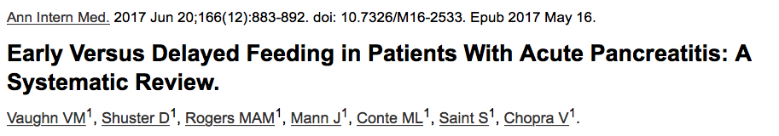
Nutritional Support
Although the data is limited, early feeding (within 24h) of patients with acute pancreatitis does not increase adverse events.
In patients with mild-to-moderate pancreatitis, it could reduce length of hospital stay.

Slide 49
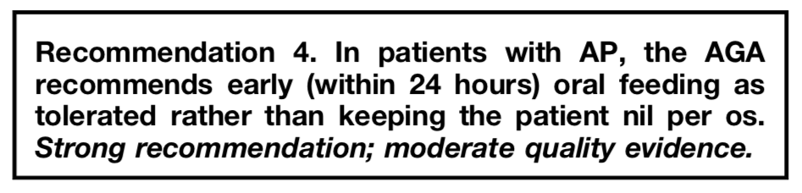
Nutritional Support

Slide 50
Enteral feeding
Nasogastric vs. Nasojejunal?

Slide 51
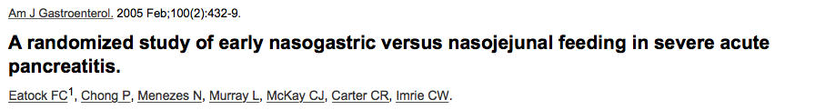
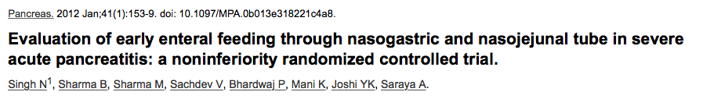
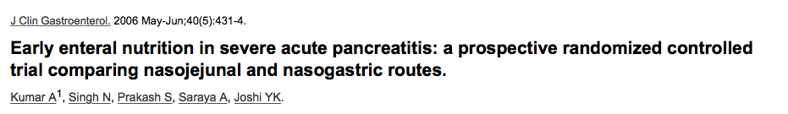
Nasogastric vs. Nasojejunal Feeding

Slide 52
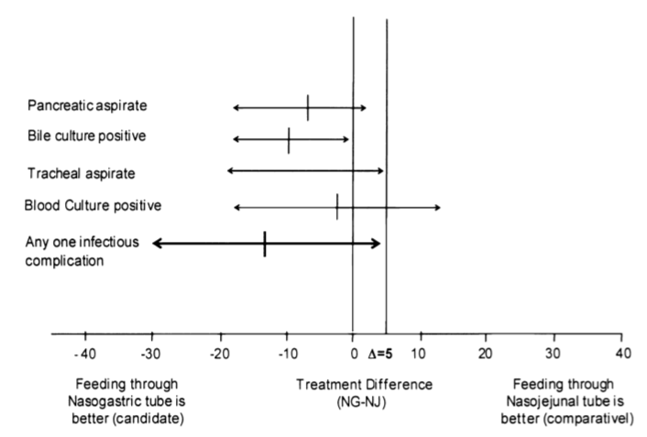
Nasogastric vs. Nasojejunal Feeding

Slide 53
Parenteral Nutrition
Should be only used for patients who do not tolerate enteral nutrition within 48-72 hours

Slide 54
Parenteral Nutrition
Should be only used for patients who do not tolerate enteral nutrition within 48-72 hours
Can you use parenteral nutrition in adjunct to enteral nutrition?

Slide 55
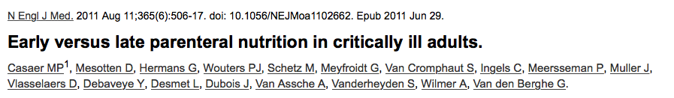
Parenteral Nutrition
Should be only used for patients who do not tolerate enteral nutrition within 48-72 hours
Can you use parenteral nutrition in adjunct to enteral nutrition?
“Late initiation of parenteral nutrition was associated with faster recovery and fewer complications, as compared with early initiation.”

Slide 56
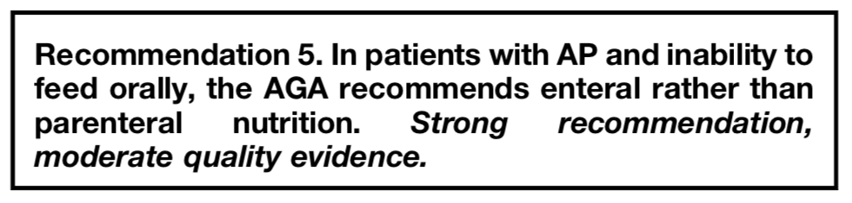
Parenteral Nutrition

Slide 57
Prophylactic Antibiotics

Slide 58
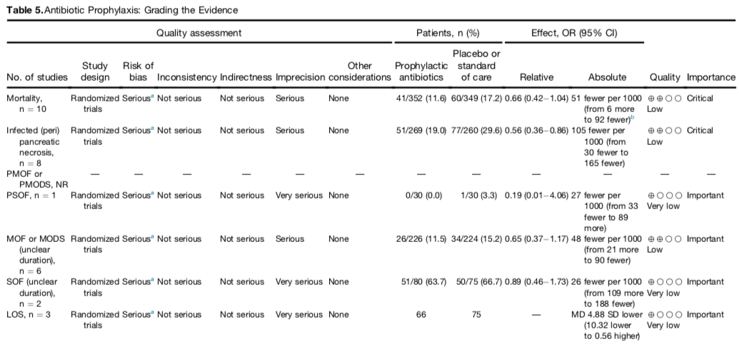
Prophylactic Antibiotics
Vege et al.. (2018). Initial Medical Treatment of Acute Pancreatitis: American Gastroenterological Association Institute Technical Review. Gastroenterology, 154(4), 1103–1139.

Slide 59
Prophylactic Antibiotics
Vege et al.. (2018). Initial Medical Treatment of Acute Pancreatitis: American Gastroenterological Association Institute Technical Review. Gastroenterology, 154(4), 1103–1139.

Slide 60
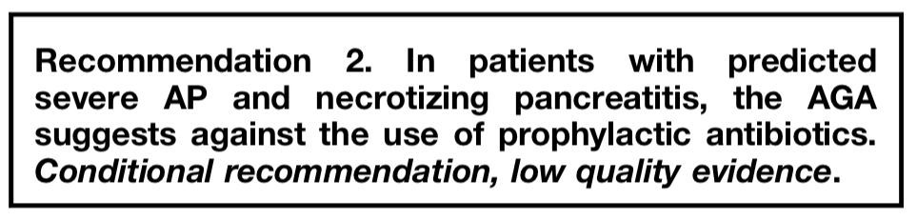
Antibiotics

Slide 61
When do you repeat a CT scan?

Slide 62
When do you repeat a CT scan?
Only indicated if the pancreatitis is severe, lasts longer than 48 hours, or complications are suspected.

Slide 63
When do you trend lipase/amylase?

Slide 64
When do you trend lipase/amylase?
Never.

Slide 65
Investigating the Etiology

Slide 66
Investigating the Etiology
Every patient with acute pancreatitis should get those investigations:
Med reconciliation
Alcohol levels
Triglycerides level
RUQ ultrasound
IgG4/IgG-levels (if recurrent, other association, or imaging findings)
Calcium levels (BMP)

Slide 67
Specific Management

Slide 68
Specific Management
Acute Biliary Pancreatitis

Slide 69
Acute Biliary Pancreatitis
Patients with acute pancreatitis who are found to have gallstones are presumed to have acute biliary pancreatitis
Recommendation is to perform a cholecystectomy for all comers with acute biliary pancreatitis

Slide 70
Acute Biliary Pancreatitis
Patients with acute pancreatitis who are found to have gallstones are presumed to have acute biliary pancreatitis
Recommendation is to perform a cholecystectomy for all comers with acute biliary pancreatitis
What is the ideal timing for cholecystectomy?

Slide 71

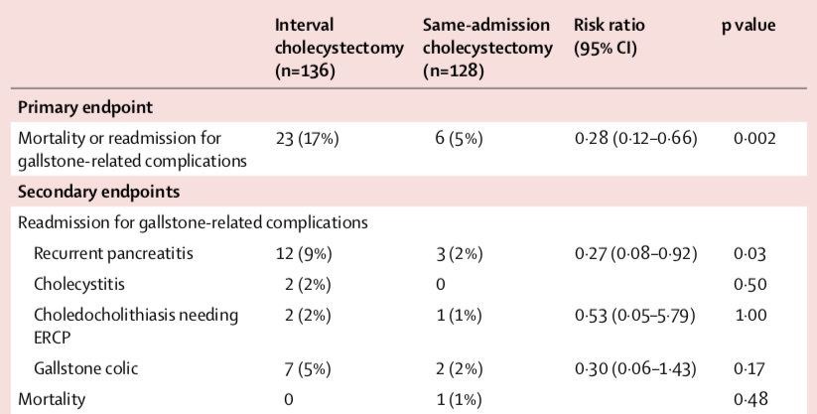
Acute Biliary Pancreatitis

Slide 72
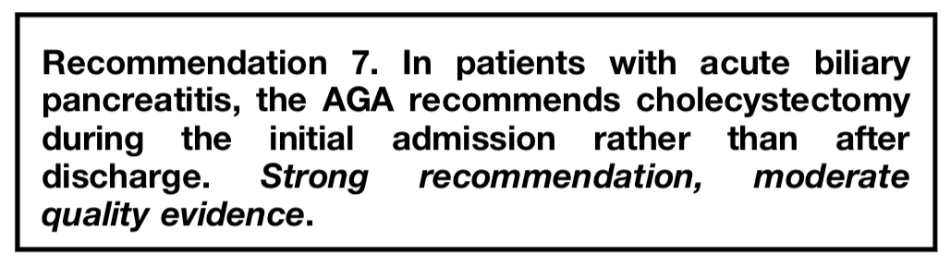
Acute Biliary Pancreatitis

Slide 73
What about ERCP?

Slide 74
What about ERCP?
8 RCTs were done investigating the role of urgent ERCP in acute biliary pancreatitis
In the absence of cholangitis and/or choledocholithiasis, it was found that there is no difference in the primary and secondary outcomes of people with acute biliary pancreatitis
Vege, S. S., DiMagno, M. J., Forsmark, C. E., Martel, M., & Barkun, A. N. (2018). Initial Medical Treatment of Acute Pancreatitis: American Gastroenterological Association Institute Technical Review. Gastroenterology, 154(4), 1103–1139. https://doi.org/10.1053/j.gastro.2018.01.031

Slide 75
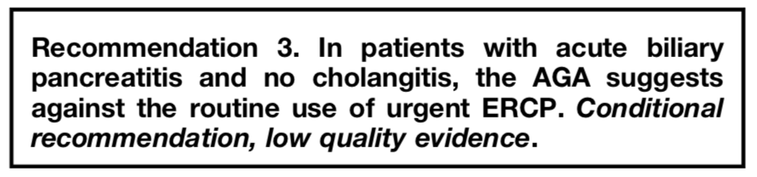
What about ERCP?
8 RCTs were done investigating the role of urgent ERCP in acute biliary pancreatitis
In the absence of cholangitis and/or choledocholithiasis, it was found that there is no difference in the primary and secondary outcomes of people with acute biliary pancreatitis
Vege, S. S., DiMagno, M. J., Forsmark, C. E., Martel, M., & Barkun, A. N. (2018). Initial Medical Treatment of Acute Pancreatitis: American Gastroenterological Association Institute Technical Review. Gastroenterology, 154(4), 1103–1139. https://doi.org/10.1053/j.gastro.2018.01.031

Slide 76
Specific Management
Acute Hypertriglyceridemic Pancreatitis

Slide 77
Acute Hypertriglyceridemic Pancreatitis
Serum triglycerides level of > 1000 mg /dL
Apheresis vs. Insulin infusion, depending on severity and availability
Target triglycerides level is < 500 mg /dL
Initiate fibrate therapy

Slide 78
Specific Management
Acute Autoimmune Pancreatitis

Slide 79
Acute Autoimmune Pancreatitis
Sausage-like swelling of pancreas with loss of pancreatic clefts and thin, symmetric capsule-like rim of low attenuation surrounding pancreas
Can be misdiagnosed as pancreatic cancer
IgG4 levels (don’t forget total IgG levels)
Treatment is glucocorticoids

Slide 80
Local Complications of Acute Pancreatitis

Slide 81
Subgrouping of Acute Pancreatitis
In the revised Atlanta classifications, acute pancreatitis can be divided into two categories
Interstitial edematous pancreatitis (IEP)
Necrotizing pancreatitis

Slide 82
Subgrouping of Acute Pancreatitis
Interstitial edematous pancreatitis (IEP) | Necrotizing pancreatitis
Non-necrotizing inflammation of the pancreas The entire pancreas will enhance at contrast-enhanced CT or MR imaging, with no unenhanced (necrotic) areas There should be no surrounding peri- pancreatic necrotic collections | Necrosis may involve either the pancreatic parenchyma or the peripancreatic tissues Can involve pancreas, peripancreatic tissue or both which is most common
When imaging is performed within the first few days of disease onset, necrosis may not be detected

Slide 83
Local Complications Nomenclature

Slide 84
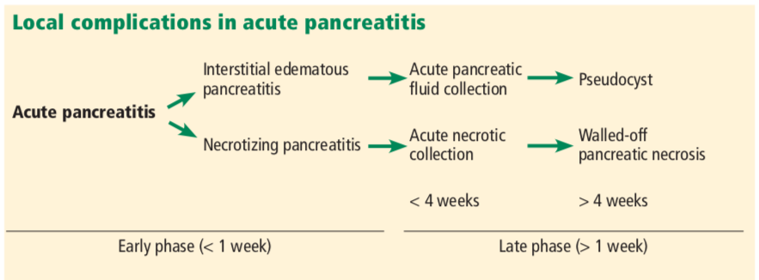
CHUA, T. Y., WALSH, R. M., BAKER, M. E., & STEVENS, T. (2017). Necrotizing pancreatitis: Diagnose, treat, consult. Cleveland Clinic Journal of Medicine, 84(8), 639–648

Slide 85
Local Complications
No Necrosis |  | Yes Necrosis
Interstitial edematous pancreatitis (IEP) |  | Necrotizing pancreatitis
APFC | Pseudocyst | ANC | WON
Acute (< 4wk) | Chronic (>4wk) | Acute (<4wk) | Chronic (>4wk)
Resolve spontaneously, drainage should not be performed CT in 2 weeks can differentiate it from ANC | Develops after APFC matures Can be connected to the ductal system Only drain if rapidly increasing in size, or causing local complications | Presence of heterogenous non-liquefied debris | Develops after ANC matures MR imaging outperforms CT imaging
 |  | Can be complicated by infection causing infected pancreatic necrosis

Slide 86
When do you drain a pancreatic necrotic collection (ANC/WON)?

Slide 87
When do you drain a pancreatic necrotic collection (ANC/WON)?
Infected necrotic collection
  Should use antibiotics to cover intraabdominal flora (carbapenem)
Symptomatic collection
  Gastric outlet obstruction
  Failure to thrive
  Biliary obstruction
  Intractable pain
Lee, P. and Papachristou, G. (2019). New insights into acute pancreatitis. Nature Reviews Gastroenterology & Hepatology, 16(8), pp.479-496.

Slide 88
When do you drain a pancreatic necrotic collection (ANC/WON)?
Infected necrotic collection
  Should use antibiotics to cover intraabdominal flora (carbapenem)
Symptomatic collection
  Gastric outlet obstruction
  Failure to thrive
  Biliary obstruction
  Intractable pain
Avoid in patients with sterile necrosis without symptoms, regardless of the size of the collection
Lee, P. and Papachristou, G. (2019). New insights into acute pancreatitis. Nature Reviews Gastroenterology & Hepatology, 16(8), pp.479-496.

Slide 89
Vascular Complications

Slide 90
Vascular Complications
Venous and/or arterial thrombosis of the splanchnic vessels
  Mostly benign course, do not require intervention
Splenic vein thrombosis -> local portal hypertension -> gastric varices
SMV thrombosis -> ascites
  Anticoagulation
If pseudoaneurysm occurs -> IR embolization as soon as possible
  Do not drain a pseudocyst if a pseudoaneurysm is suspected!

Slide 91
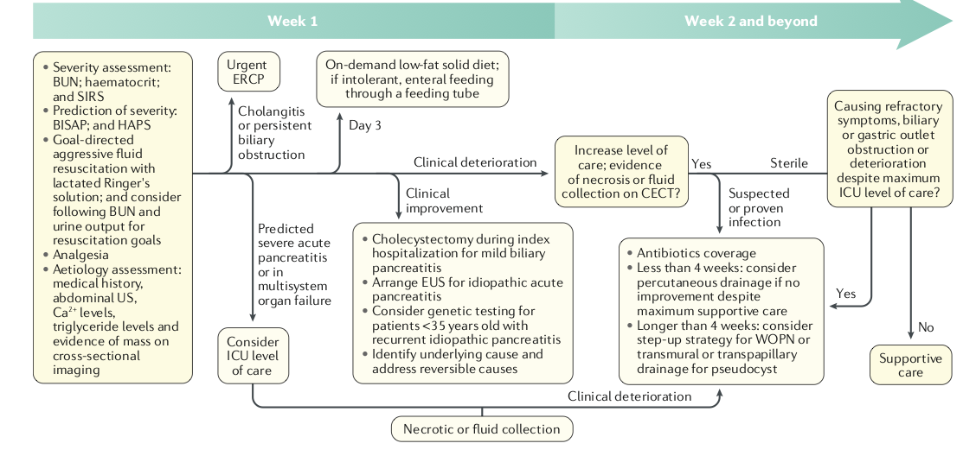
Suggested Algorithm for Management
Lee, P. and Papachristou, G. (2019). New insights into acute pancreatitis. Nature Reviews Gastroenterology & Hepatology, 16(8), pp.479-496.

Slide 92
Long-term Complications of Pancreatitis

Slide 93
Long-term Complications of Pancreatitis
Recurrent pancreatitis in 18%
Endocrine insufficiency and diabetes in about 33%
Exocrine insufficiency in 24-40%
Quality of life is reduced, and 53% of patients become registered as disabled at one year following discharge
Lee, P. and Papachristou, G. (2019). New insights into acute pancreatitis. Nature Reviews Gastroenterology & Hepatology, 16(8), pp.479-496.

Slide 94
Future Directions

Slide 95

Potential Therapeutic Targets in Acute Pancreatitis
Lee, P. and Papachristou, G. (2019). New insights into acute pancreatitis. Nature Reviews Gastroenterology & Hepatology, 16(8), pp.479-496.

Slide 96
Potential Therapeutic Targets in Acute Pancreatitis
Lee, P. and Papachristou, G. (2019). New insights into acute pancreatitis. Nature Reviews Gastroenterology & Hepatology, 16(8), pp.479-496.

Slide 97
MKSAP Question

Slide 98
A 35-year-old man is evaluated in the emergency department for a 6-hour history of epigastric abdominal pain that radiates to the back. He also has nausea and occasional bilious vomiting. He has consumed between six and twelve beers daily for 10 to 15 years.
On physical examination, temperature is 37.2 °C (99.0 °F), blood pressure is 110/65 mm Hg, pulse rate is 105/min, and respiration rate is 22/min. Abdominal examination discloses epigastric tenderness without guarding or rebound. Bowel sounds are present but hypoactive, and there is mild abdominal distention. No jaundice is noted.
Laboratory studies reveal a leukocyte count of 14,000/μL (14 × 10⁹/L), a blood urea nitrogen level of 25 mg/dL (8.9 mmol/L), and a serum lipase level of 952 U/L.
Abdominal ultrasound shows a normal-appearing gallbladder and no biliary dilation. The patient is admitted to the hospital. Over the next 48 hours, he has ongoing abdominal pain, nausea, and poor appetite despite supportive therapy consisting of pain medication and aggressive intravenous fluid replacement. Subsequent contrast-enhanced CT of the abdomen shows nonenhancing areas of the head and body of the pancreas (consistent with necrosis) and several peripancreatic fluid collections.
Which of the following is the most appropriate management?
Drainage of the fluid collections
Endoscopic retrograde cholangiopancreatography
Enteral nutrition by nasogastric tube
Total parenteral nutrition

Slide 99
A 35-year-old man is evaluated in the emergency department for a 6-hour history of epigastric abdominal pain that radiates to the back. He also has nausea and occasional bilious vomiting. He has consumed between six and twelve beers daily for 10 to 15 years.
On physical examination, temperature is 37.2 °C (99.0 °F), blood pressure is 110/65 mm Hg, pulse rate is 105/min, and respiration rate is 22/min. Abdominal examination discloses epigastric tenderness without guarding or rebound. Bowel sounds are present but hypoactive, and there is mild abdominal distention. No jaundice is noted.
Laboratory studies reveal a leukocyte count of 14,000/μL (14 × 10⁹/L), a blood urea nitrogen level of 25 mg/dL (8.9 mmol/L), and a serum lipase level of 952 U/L.
Abdominal ultrasound shows a normal-appearing gallbladder and no biliary dilation. The patient is admitted to the hospital. Over the next 48 hours, he has ongoing abdominal pain, nausea, and poor appetite despite supportive therapy consisting of pain medication and aggressive intravenous fluid replacement. Subsequent contrast-enhanced CT of the abdomen shows nonenhancing areas of the head and body of the pancreas (consistent with necrosis) and several peripancreatic fluid collections.
Which of the following is the most appropriate management?
Drainage of the fluid collections
Endoscopic retrograde cholangiopancreatography
Enteral nutrition by nasogastric tube
Total parenteral nutrition

Slide 100
CT A/P
What’s the appropriate management?

Slide 101
Take-home Points
Assessing patients clinically is more accurate than fancy scoring systems
Triage appropriately (ICU vs Floors)
Fluids fluids fluids! -> Lactated Ringer’s
No role for prophylactic antibiotics
Escalate as appropriate
  Cholangitis -> ERCP
  Necrosis -> Step-up therapy
  Infected necrosis -> Antibiotics
Prevention is likely to be the focus in the next decade

Slide 102

Summary of The AGA Recommendations
Questions?

