Slide 1
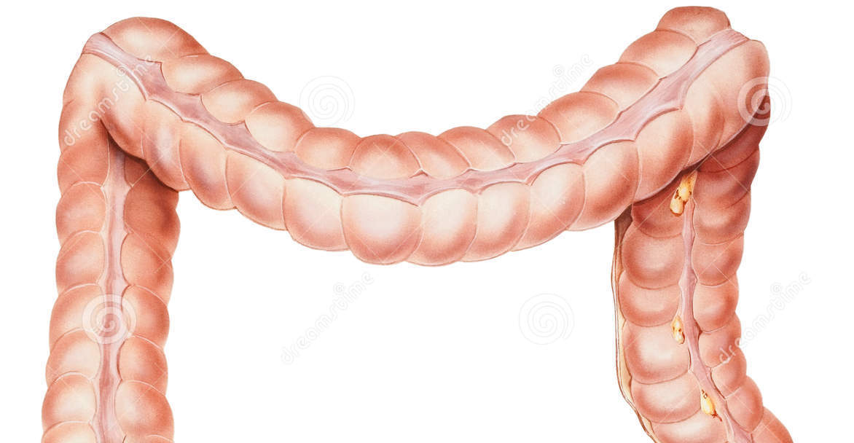
Mesenteric Ischemia and Ischemic colitis
Mohammad Almeqdadi
GI Fellow

Slide 2
Case presentation
The patient is a 67-year-old lady who presented with abdominal pain and altered mental status.
She had been having intermittent infra-umbilical abdominal pain, sharp and crampy in nature, without radiation. The pain was associated with mild nausea without vomiting. The pain started few days prior to admission. She had constipation, but no blood in stool, or melena.
Patient was noted to be more altered the day prior to presentation by her family, and due to increasing confusion, she was brought to the ED.
She had no fevers, chills, rigors, chest pain or shortness of breath.

Slide 3
Case presentation
Past medical history:
Cerebrovascular accidents with residual aphasia and right sided weakness
Carotid artery stenosis, status post stenting
Multiple GI bleeds secondary to arteriovenous malformations
  History of multiple clipping and cauterization
Hypertension
Hyperlipidemia
Chronic obstructive pulmonary disease

Slide 4
Case presentation
Home medications:
Aspirin 81 mg daily
Atorvastatin 80 mg daily
Lisinopril 5 mg daily
Pantoprazole 40 mg BID
Alprazolam 0.5 mg TID as needed
Citalopram 20 mg daily
Loratadine 10 mg daily
Albuterol inhaler 2 puffs as needed

Slide 5
Case presentation
Family history: Her mother had diabetes, and cancer of unknown type. Father had heart disease.
Social history: Former smoker, 40 pack-year history. No alcohol or illicit drug use.

Slide 6
Physical exam
Vitals: 36.6C, HR 94 bpm, RR 19, BP 95/62 mmHg, O2sat 95
General: Septic appearing patient examined while lying in bed
HEENT: Atraumatic, normocephalic, sclera clear nonicteric membranes moist neck supple
Cardiovascular: S1-S2 regular rate and rhythm, tachycardic
Pulmonary: Scattered rhonchi, tachypneic
Gastrointestinal: Abdomen firm, left lower quadrant tenderness bowel sounds absent
GU: No CVA tenderness
Peripheral vascular: Radial, posterior tibialis and dorsalis pedis pulses present bilaterally, no edema noted
Musculoskeletal: Patient moves all extremities on the bed
Neuro: Unable to participate in cranial nerve exam due to somnolence

Slide 7
What’s your next step?

Slide 8
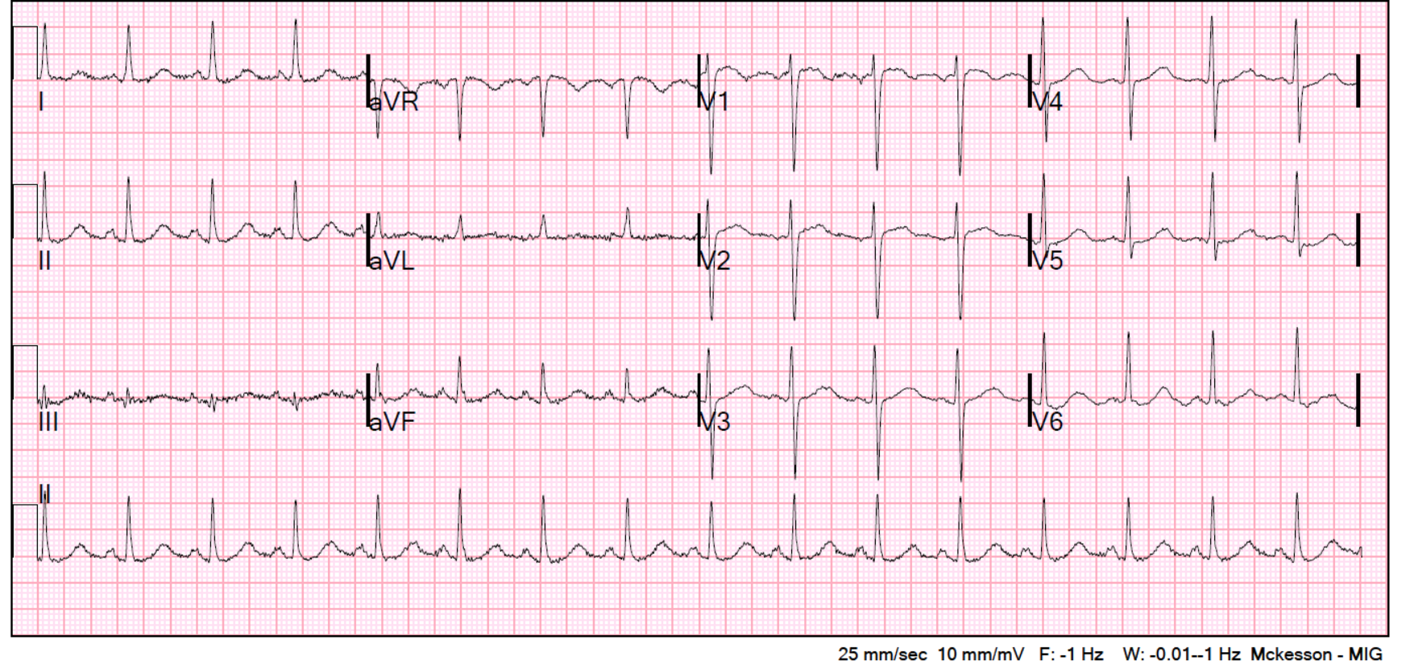

Slide 9
CT Abdomen/Pelvis without IV contrast

Slide 10
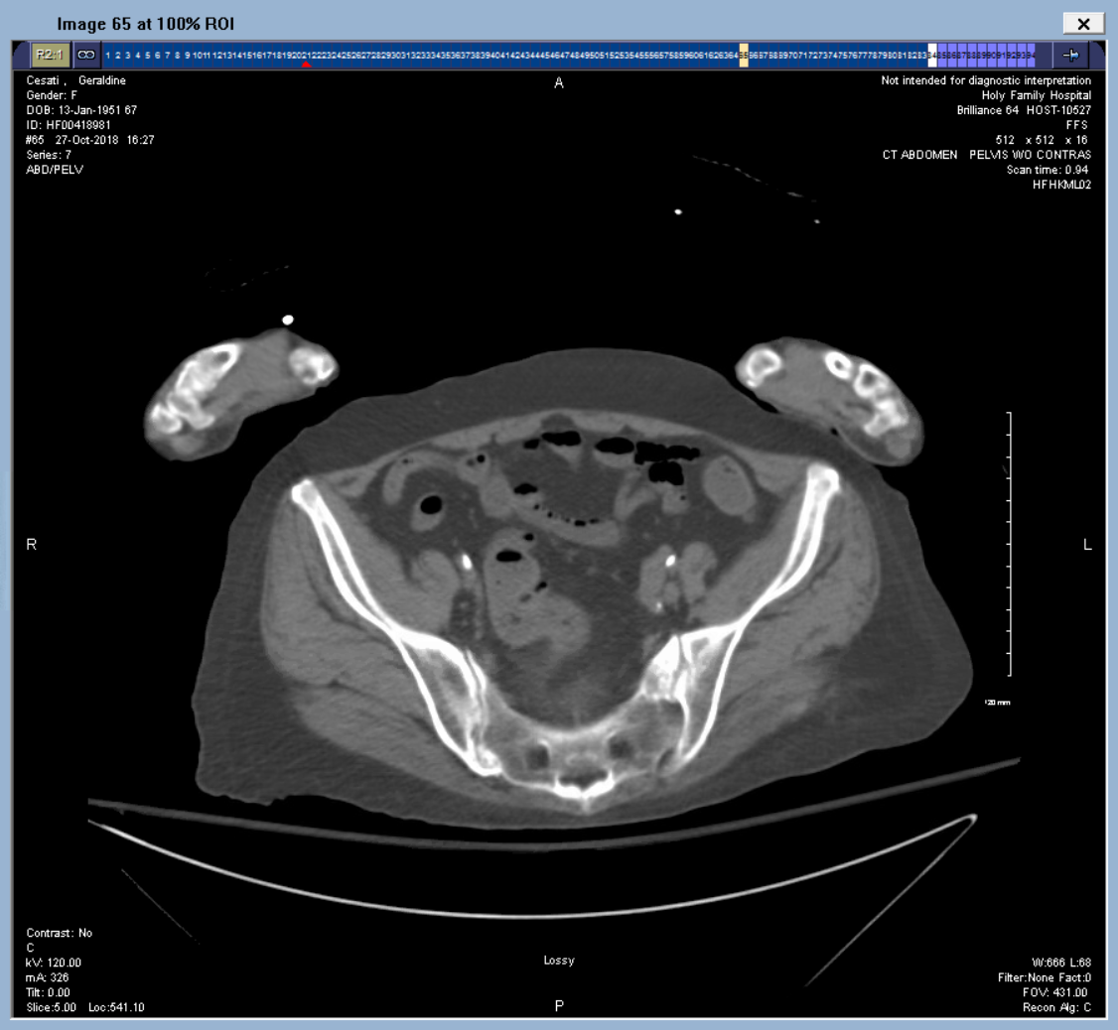
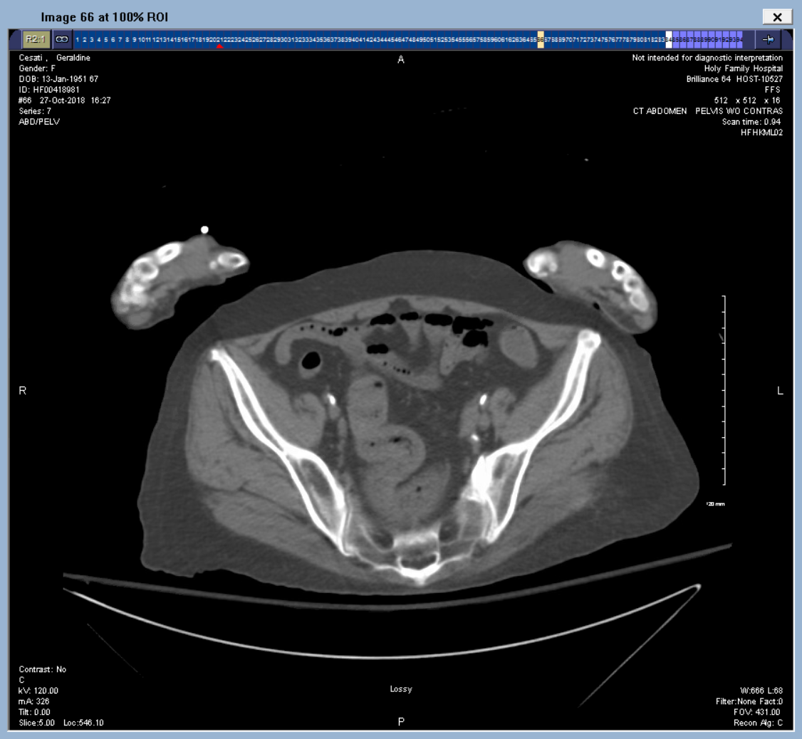
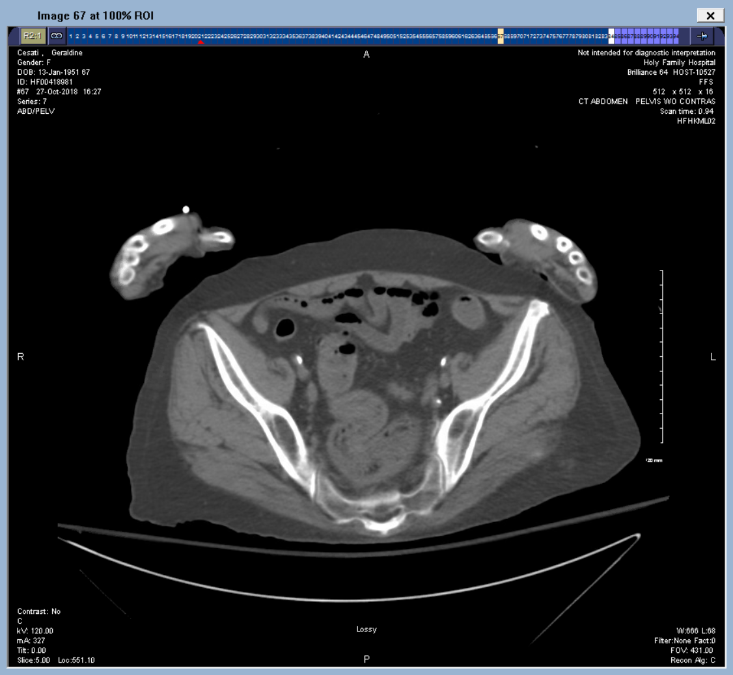
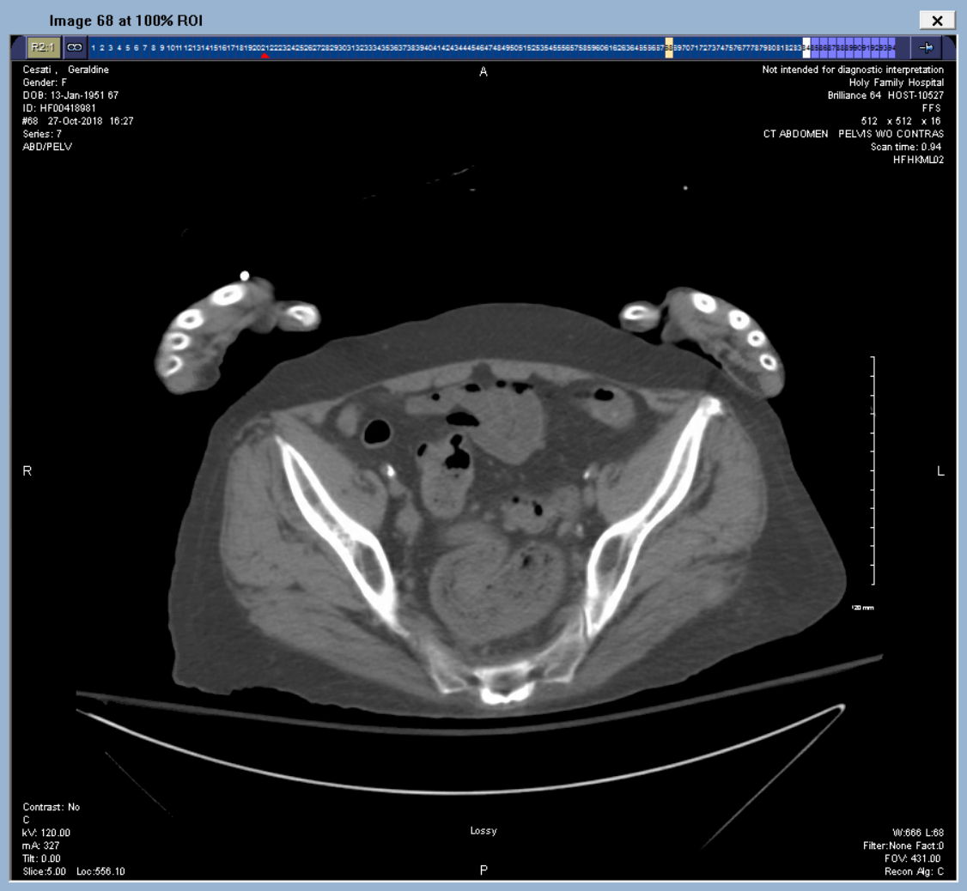
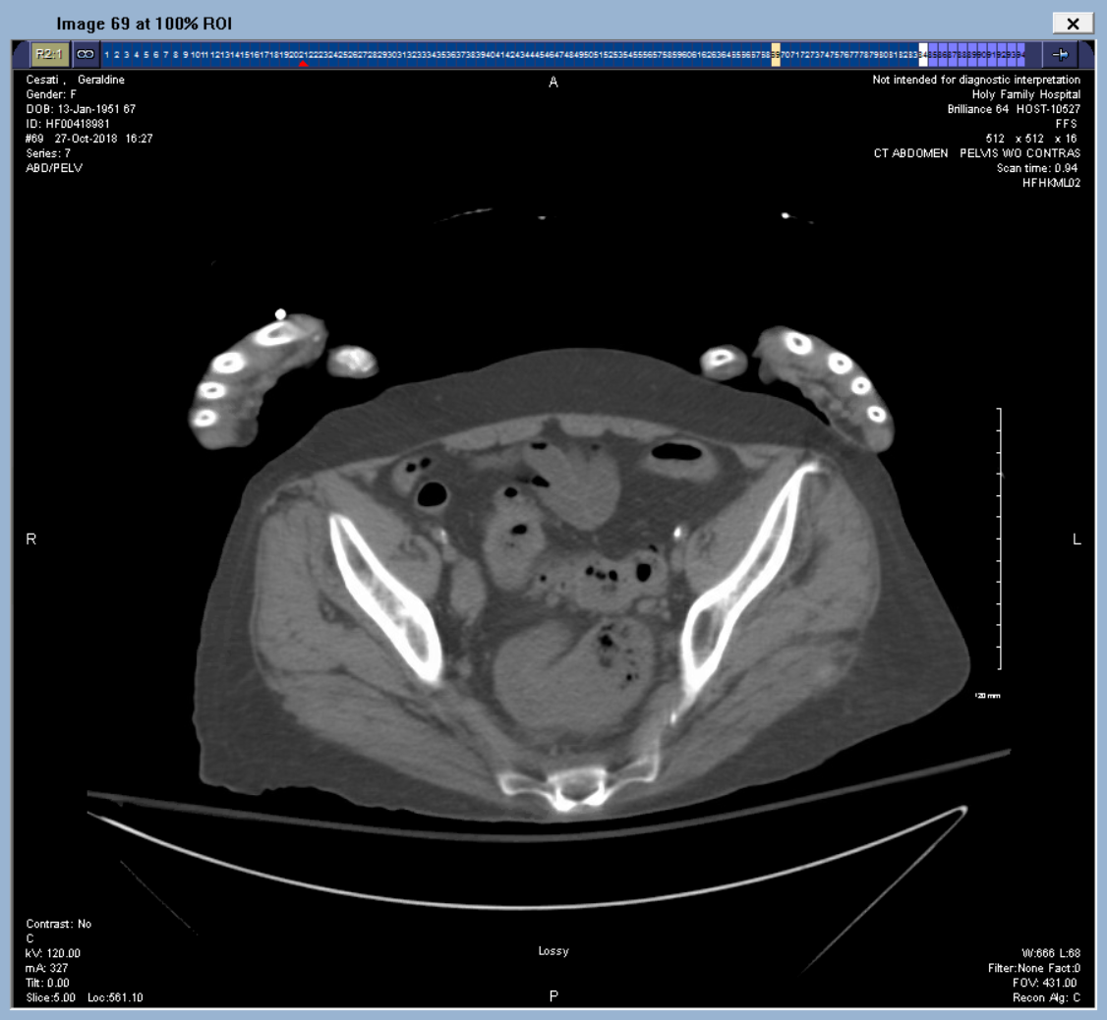
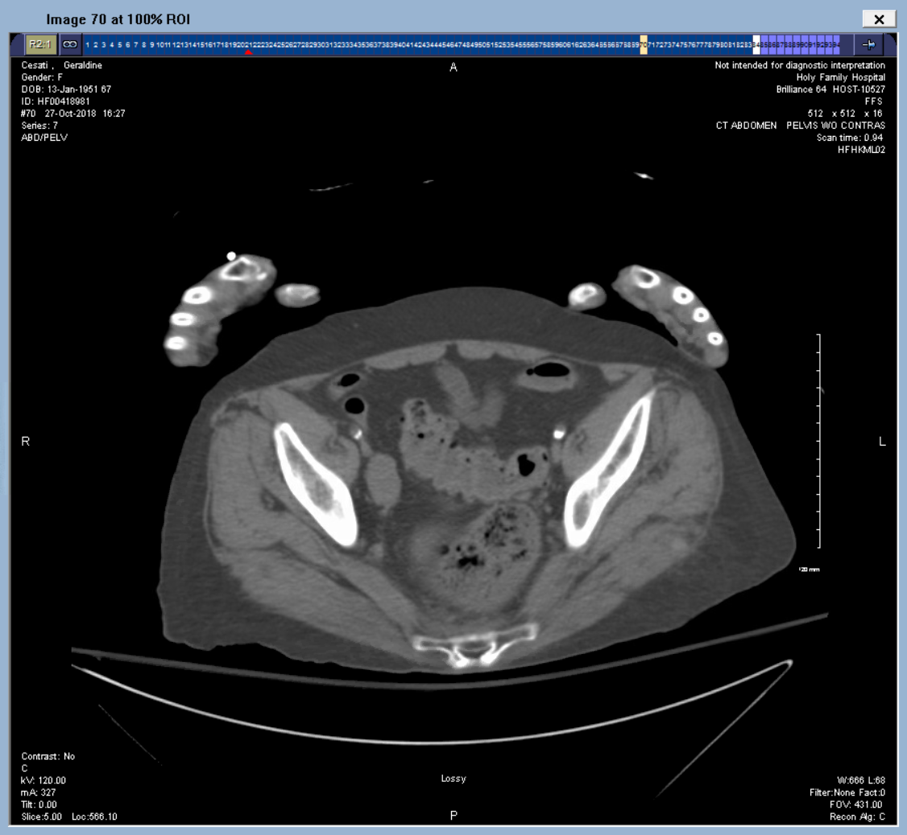
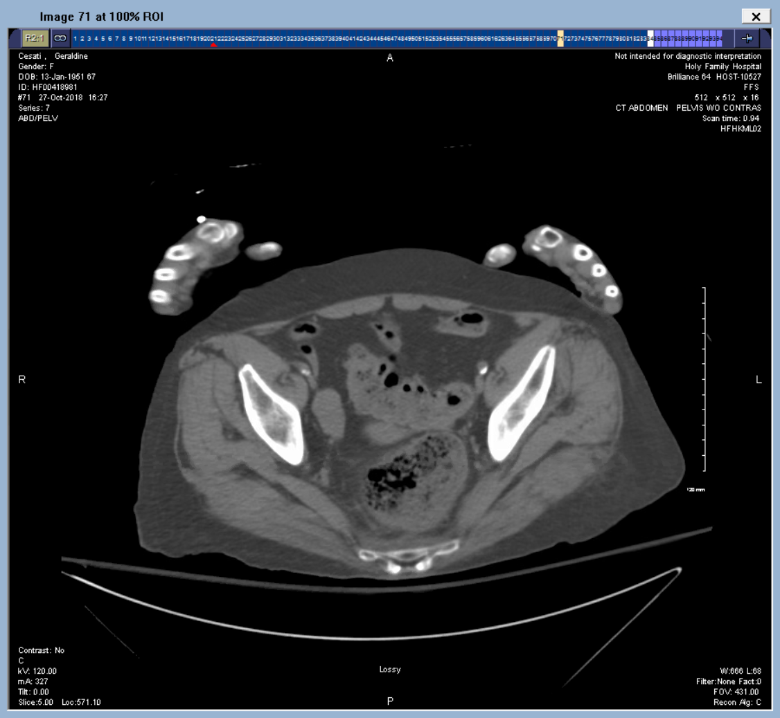
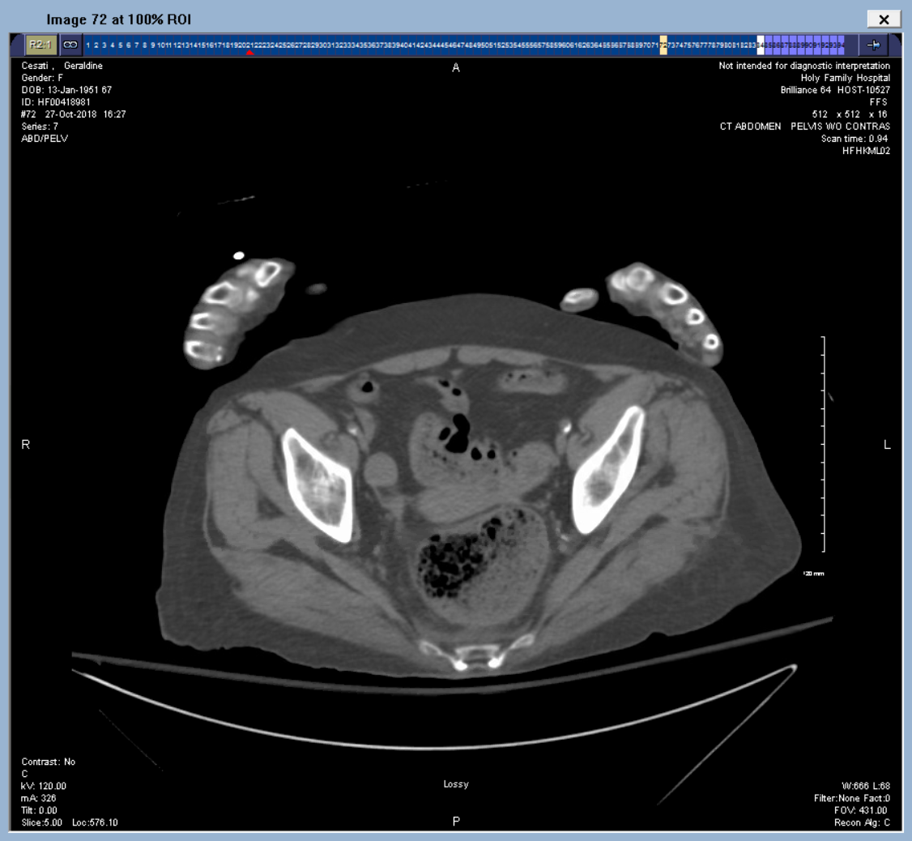
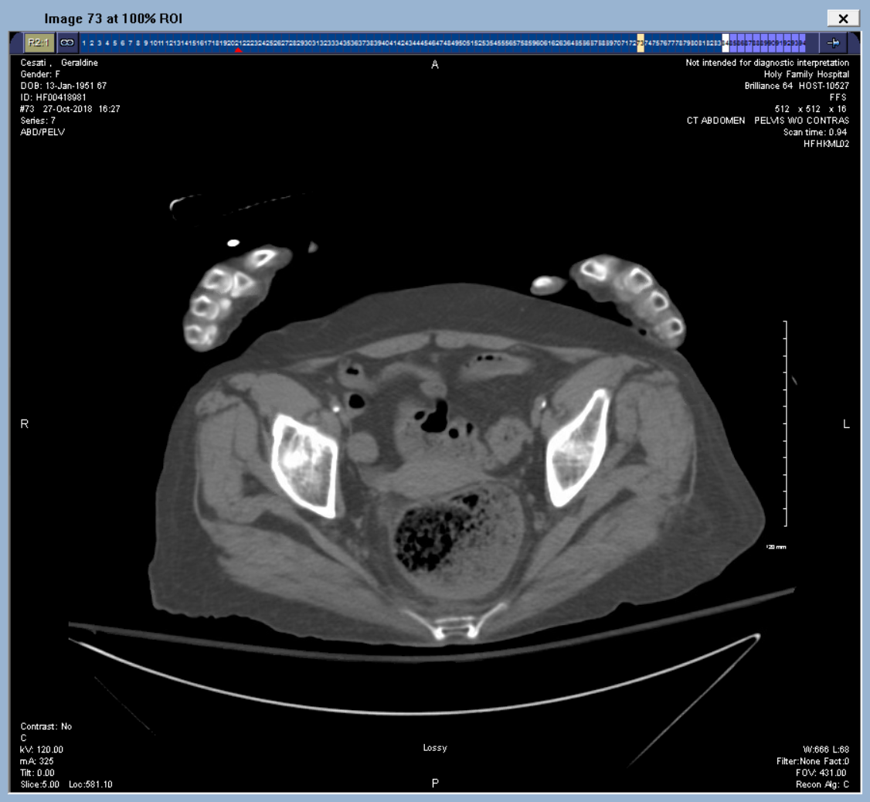
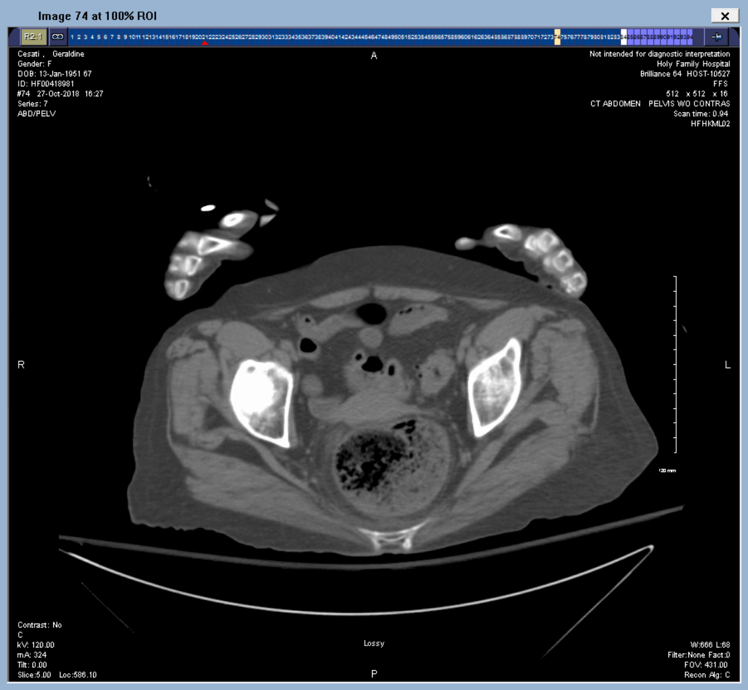
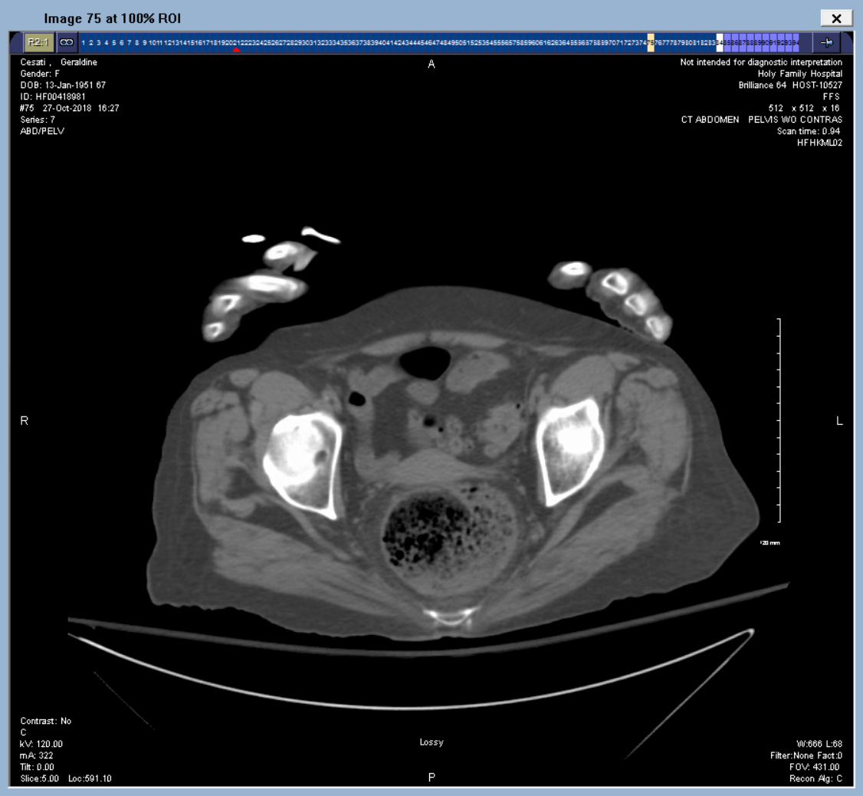

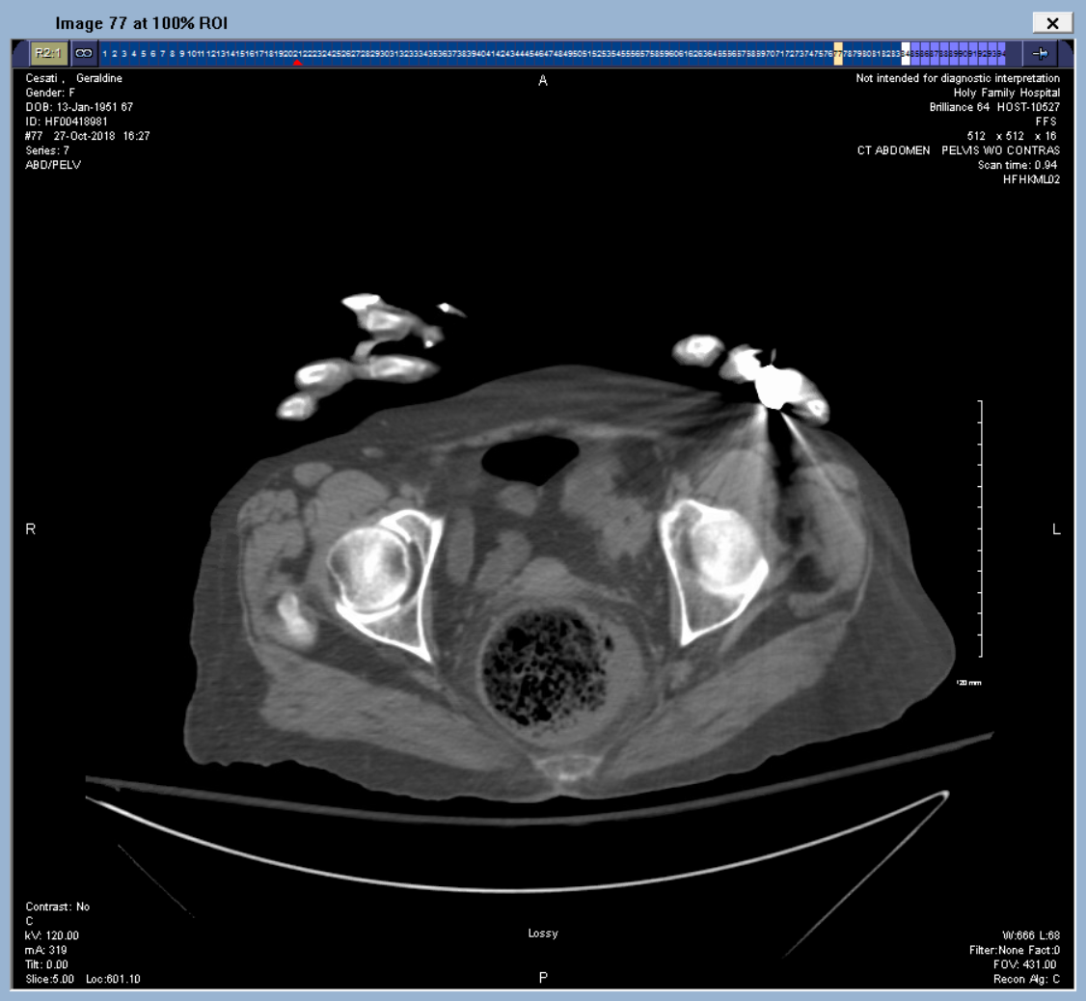
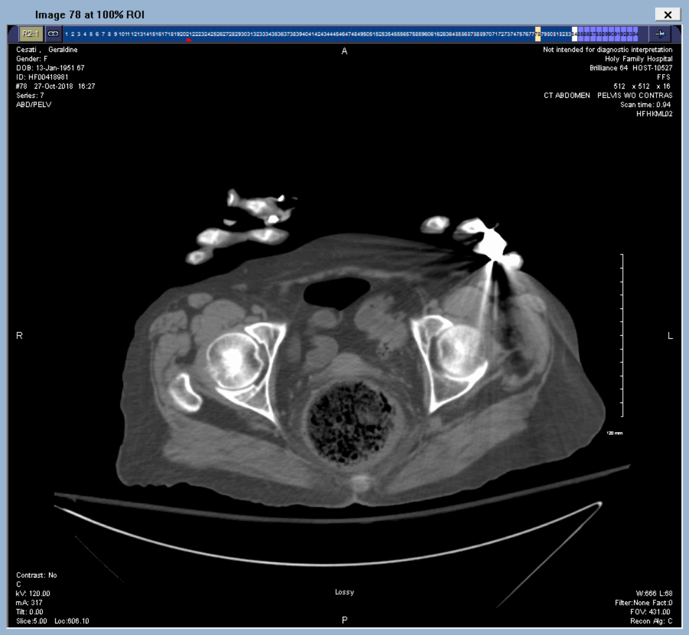
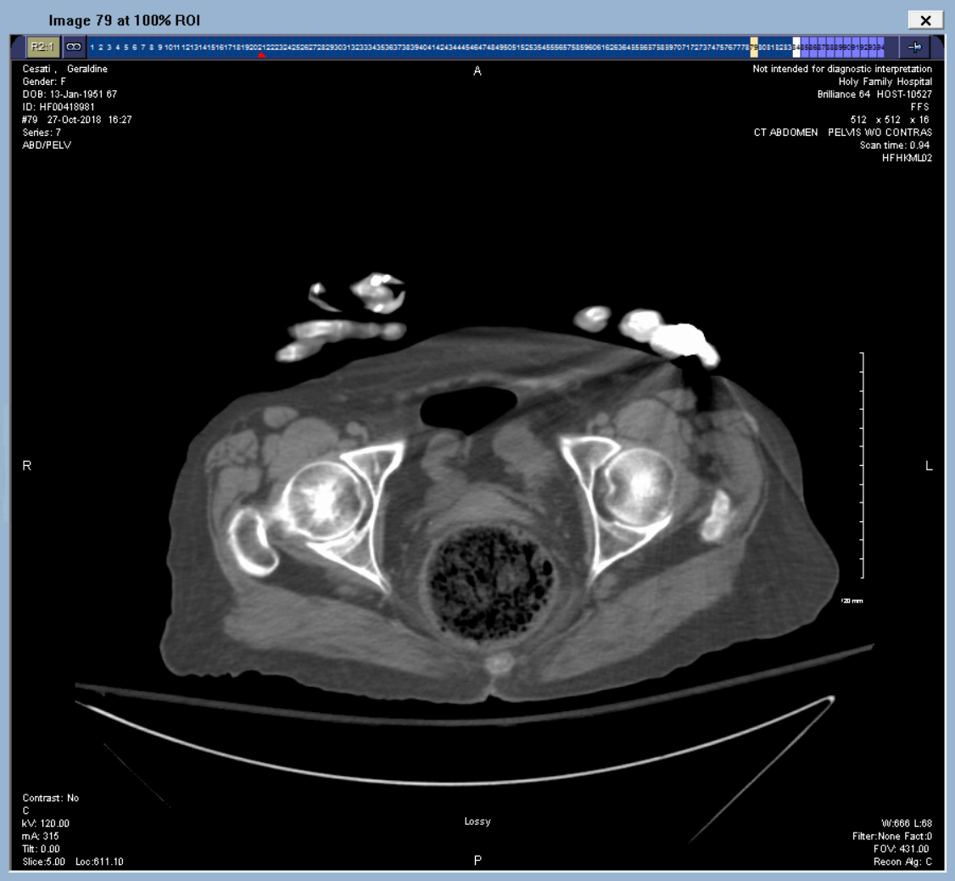
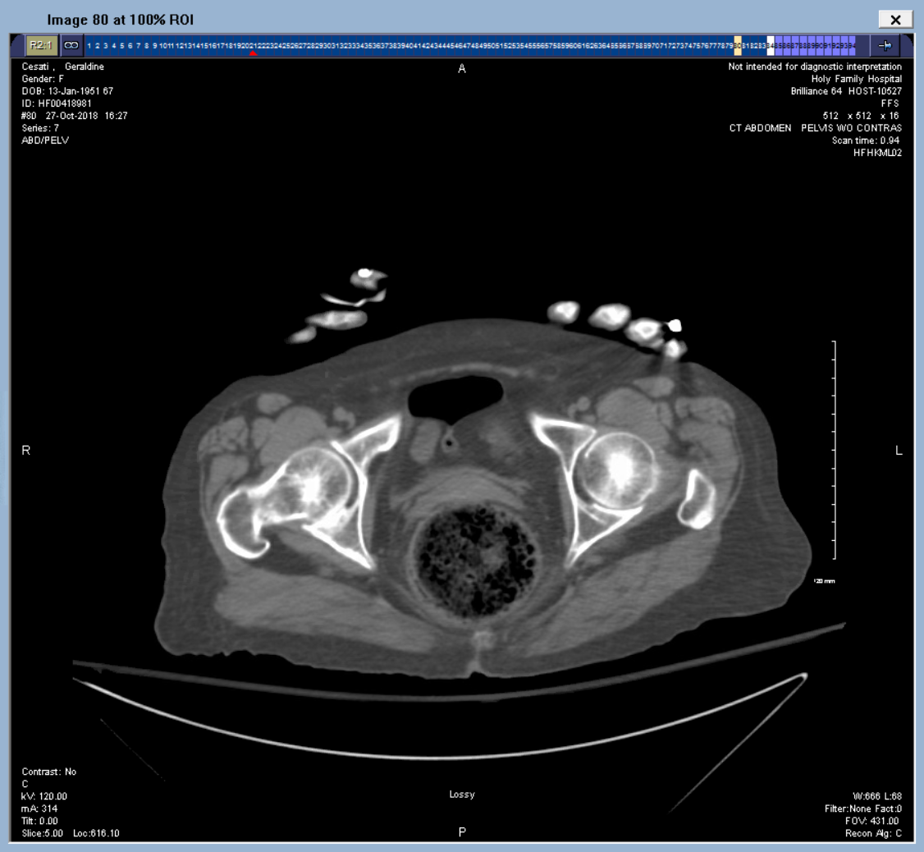
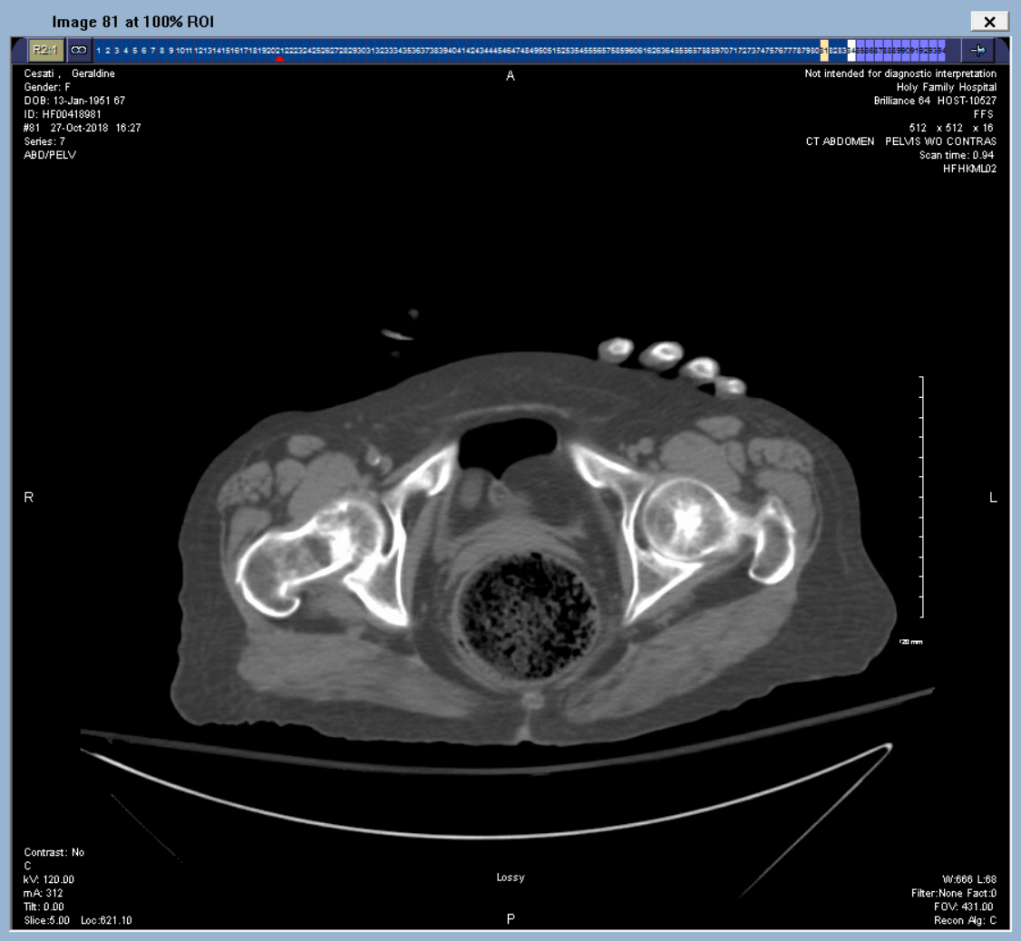
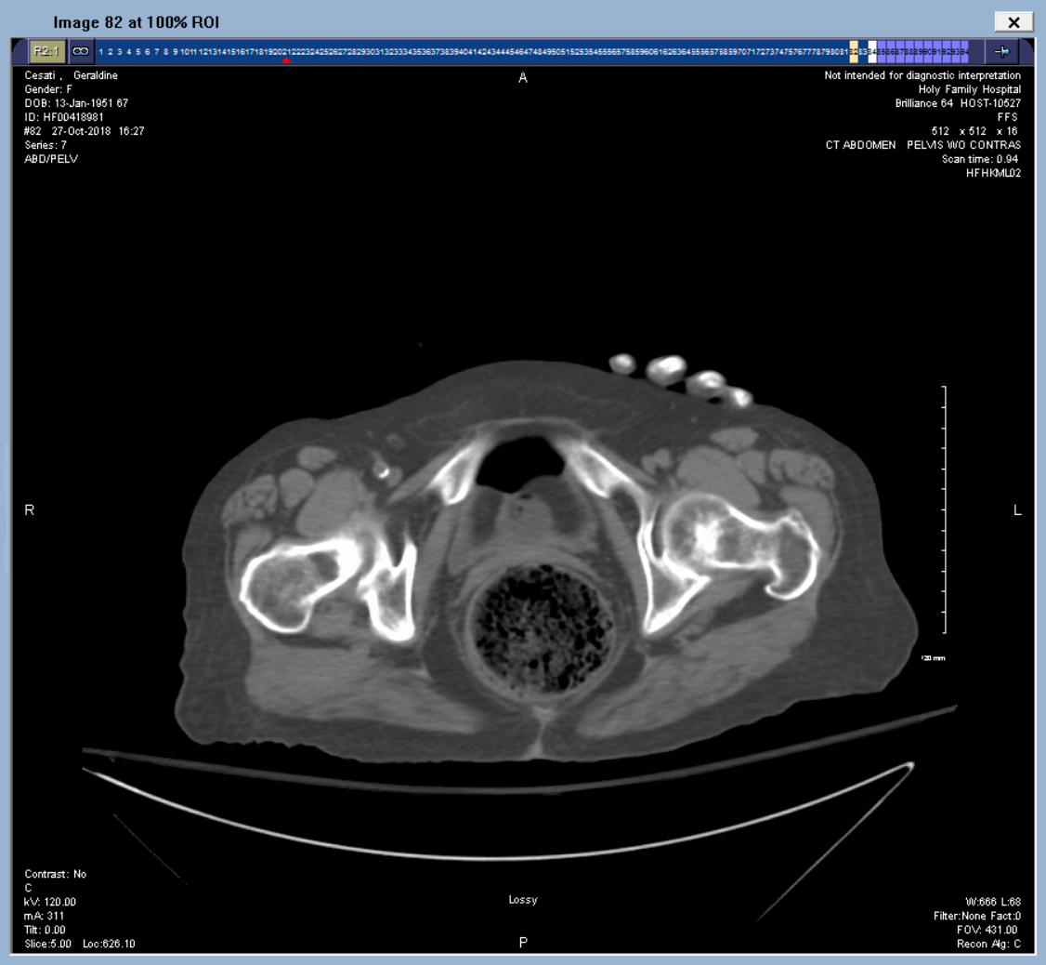
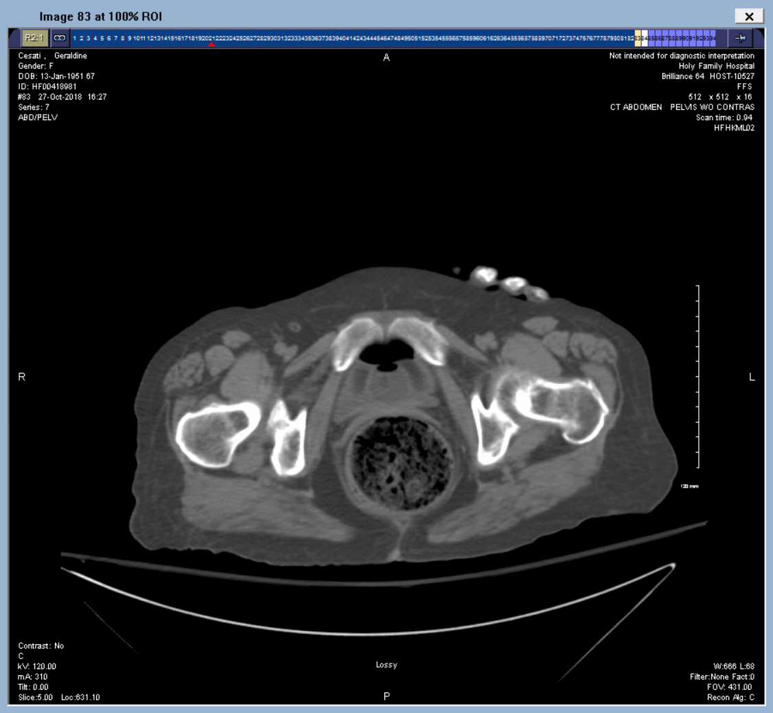
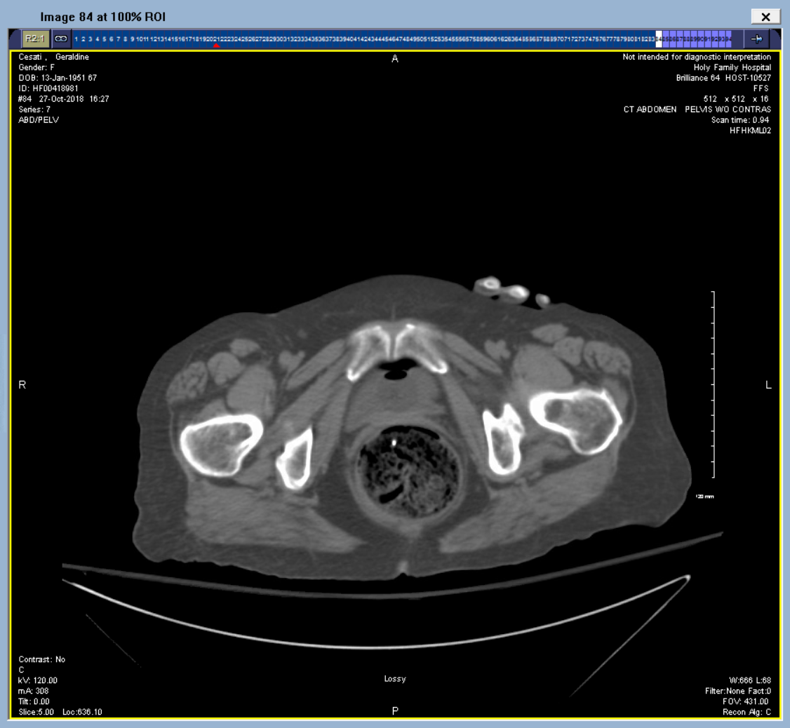
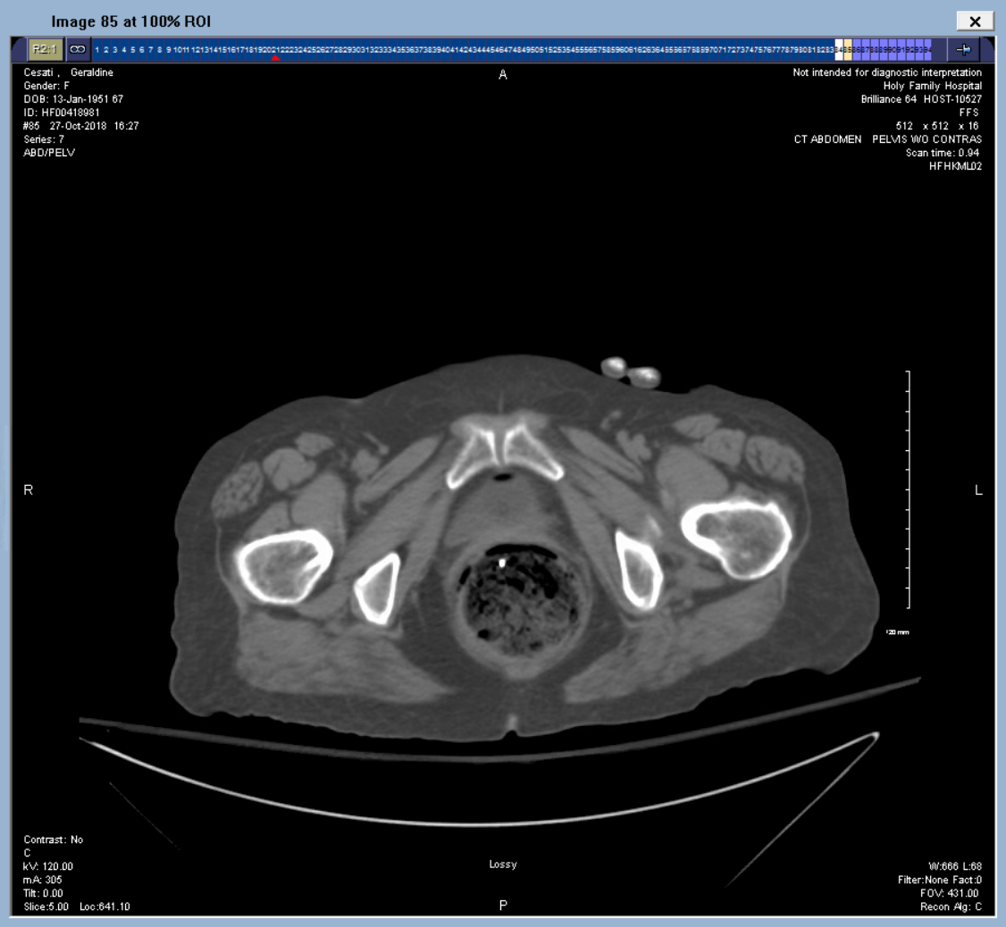
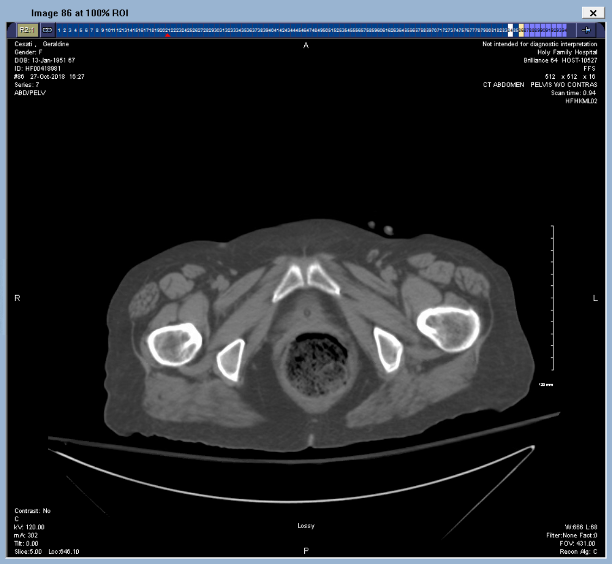

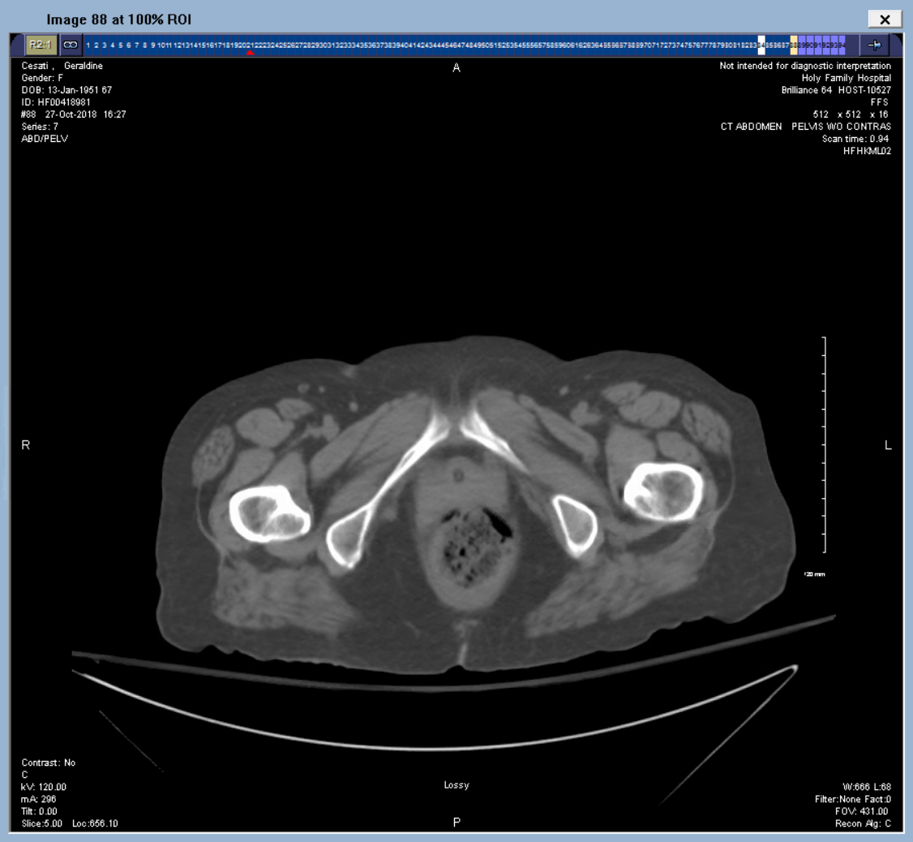
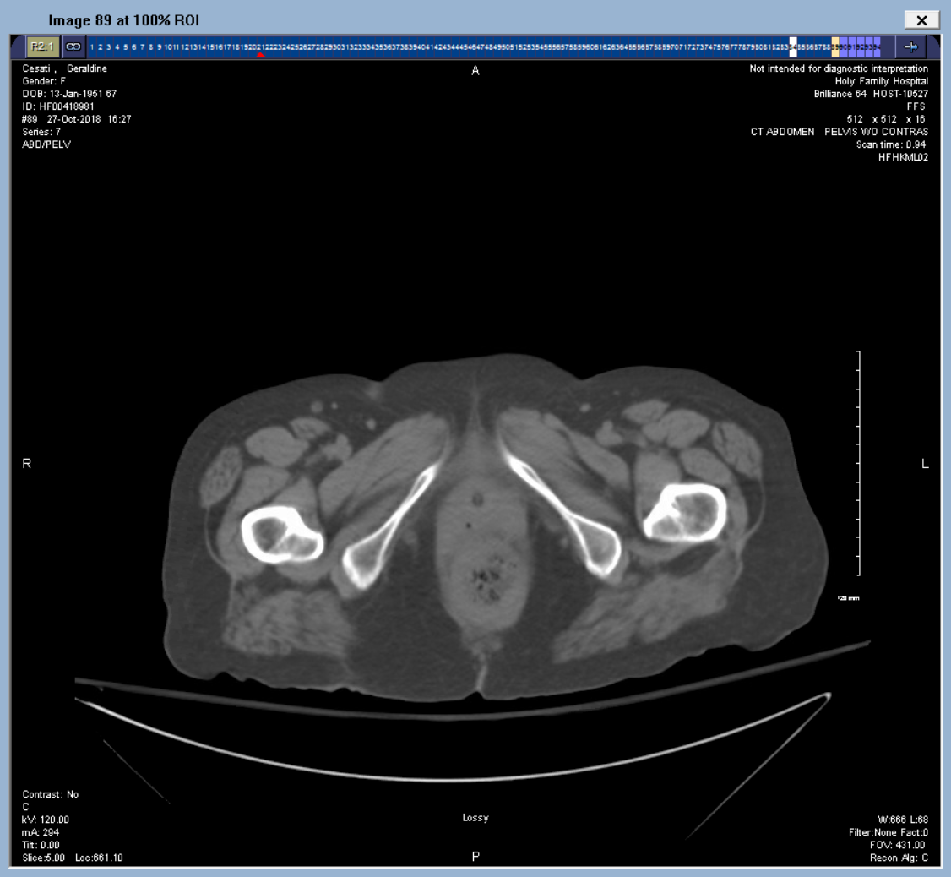

Slide 11
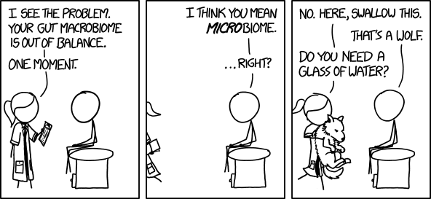
Laboratory investigations

Slide 12
Laboratory investigations
WBC: 12.1K
Hb 11.3
Platetlets 373K
Na 138
K 3.0
Cl 102
HCO3 19
Creatinine 2.1
(Anion gap 18)
Total bilirubin 0.5
AST 40
ALT 19
ALP 95
Albumin 3.6
Trop T < 0.01
Lipase 33

Slide 13
Laboratory investigations
WBC: 12.1K
Hb 11.3
Platetlets 373K
Na 138
K 3.0
Cl 102
HCO3 19
Creatinine 2.1
(Anion gap 18)
Total bilirubin 0.5
AST 40
ALT 19
ALP 95
Albumin 3.6
Trop T < 0.01
Lipase 33
What’s your next lab to order?

Slide 14
Laboratory investigations
WBC: 12.1K
Hb 11.3
Platetlets 373K
Na 138
K 3.0
Cl 102
HCO3 19
Creatinine 2.1
(Anion gap 18)
Total bilirubin 0.5
AST 40
ALT 19
ALP 95
Albumin 3.6
Trop T < 0.01
Lipase 33
Lactic acid 6.7

Slide 15
What are your differential diagnoses?

Slide 16

Colitis

Slide 17
Definition
Colitis refers to inflammation of the colon, that can be associated with concurrent inflammation of the small bowel (enterocolitis) or rectum (proctocolitis), or both.
Many different causes and etiologies.

Slide 18
Definition
Colitis refers to inflammation of the colon, that can be associated with concurrent inflammation of the small bowel (enterocolitis) or rectum (proctocolitis), or both.
Many different causes and etiologies.
What are some?

Slide 19
Etiologies of Colitis

Slide 20
Colitis
Infectious
Ischemic colitis
Allergic colitis
Inflammatory bowel disease
Viral colitis
Parasitic colitis
Bacterial colitis
Pseudomembranous colitis
Ulcerative colitis (proctocolitis)
Crohn’s colitis (enterocolitis)
Indeterminate colitis
Stercoral colitis
Non-infectious

Slide 21
Colitis
Infectious
Ischemic colitis
Allergic colitis
Inflammatory bowel disease
Viral colitis
Parasitic colitis
Bacterial colitis
Pseudomembranous colitis
Ulcerative colitis (proctocolitis)
Crohn’s colitis (enterocolitis)
Indeterminate colitis
Stercoral colitis
Non-infectious

Slide 22
Ischemic colitis vs mesenteric ischemia

Slide 23
Ischemic colitis vs mesenteric ischemia
The colon is particularly sensitive to ischemia – True or False?

Slide 24
Ischemic colitis vs mesenteric ischemia
The colon is particularly sensitive to ischemia – False

Slide 25
Ischemic colitis vs mesenteric ischemia
The colon is not particularly sensitive to ischemia
Ischemic colitis is usually preceded by a period of global hypoperfusion – True or False?

Slide 26
Ischemic colitis vs mesenteric ischemia
The colon is not particularly sensitive to ischemia
Ischemic colitis is usually preceded by a period of global hypoperfusion – False

Slide 27
Ischemic colitis vs mesenteric ischemia
The colon is not particularly sensitive to ischemia
Ischemic colitis is rarely preceded by a period of global hypoperfusion
The "watershed areas" are not disproportionately affected – True or False?

Slide 28
Ischemic colitis vs mesenteric ischemia
The colon is not particularly sensitive to ischemia
Ischemic colitis is rarely preceded by a period of global hypoperfusion
The "watershed areas" are not disproportionately affected – True

Slide 29
Ischemic colitis vs mesenteric ischemia
The colon is not particularly sensitive to ischemia
Ischemic colitis is rarely preceded by a period of global hypoperfusion
The "watershed areas" are not disproportionately affected
Colonoscopy with biopsy is specific for the disease. - True or False?

Slide 30
Ischemic colitis vs mesenteric ischemia
The colon is not particularly sensitive to ischemia
Ischemic colitis is rarely preceded by a period of global hypoperfusion
The "watershed areas" are not disproportionately affected
Colonoscopy with biopsy is specific for the disease. - False

Slide 31
Ischemic colitis vs mesenteric ischemia
The colon is not particularly sensitive to ischemia
Ischemic colitis is rarely preceded by a period of global hypoperfusion
The "watershed areas" are not disproportionately affected
Colonoscopy with biopsy is not specific for the disease.
The cause of "ischemic" colitis is unknown. Therefore it is, until proven otherwise, "acute idiopathic colitis."
Carlson RM, Madoff RD. Is "ischemic" colitis ischemic?. Dis Colon Rectum. 2011;54(3):370-3.

Slide 32
Nostalgic anatomy

Slide 33
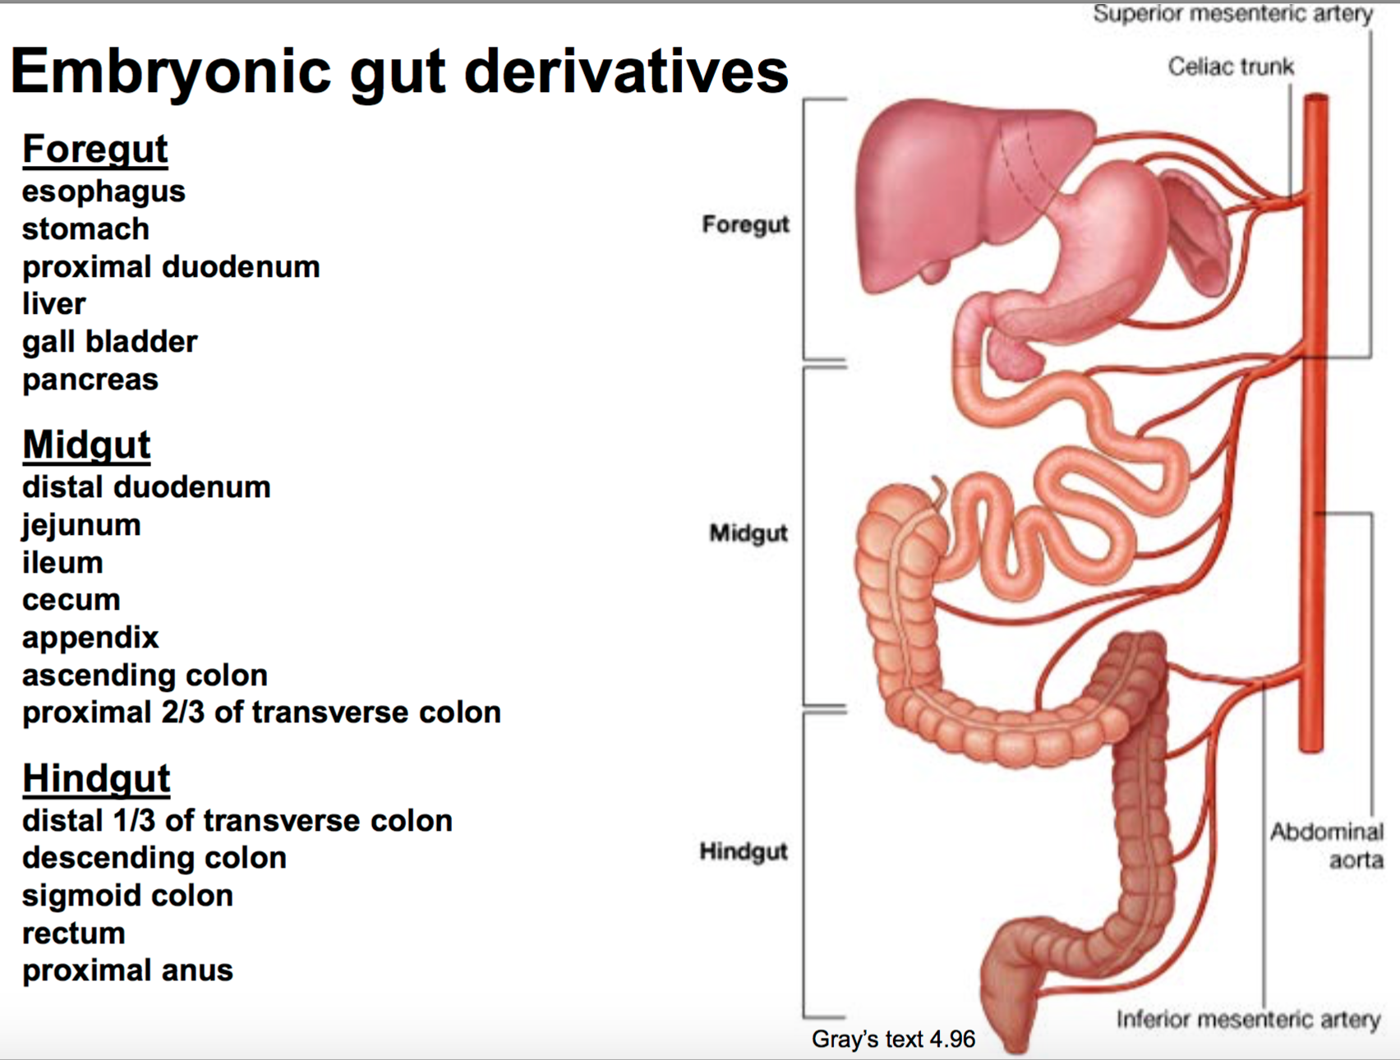

Slide 34
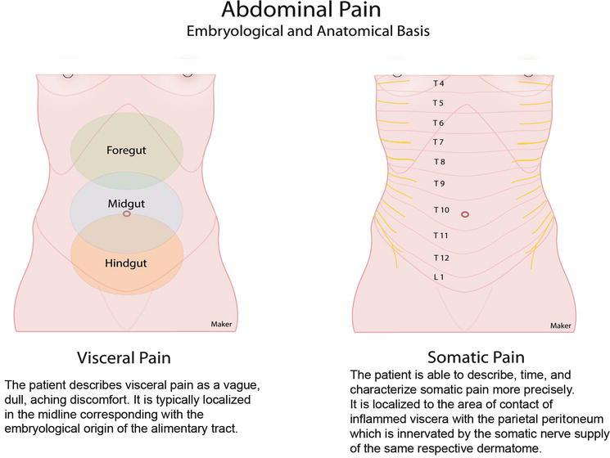

Slide 35
Types of mesenteric ischemia
1. Acute mesenteric ischemia
2. Chronic mesenteric ischemia

Slide 36
Types of mesenteric ischemia
1. Acute mesenteric ischemia
2. Chronic mesenteric ischemia

Slide 37
Nonocclusive mesenteric ischemia
Occlusive mesenteric ischemia
Mesenteric arterial embolism
Acute mesenteric arterial thrombosis
Mesenteric venous thrombosis
Venous
Arterial
Acute mesenteric ischemia

Slide 38
Nonocclusive mesenteric ischemia
Occlusive mesenteric ischemia
Mesenteric arterial embolism
Acute mesenteric arterial thrombosis
Mesenteric venous thrombosis
Venous
Arterial
Acute mesenteric ischemia

Slide 39
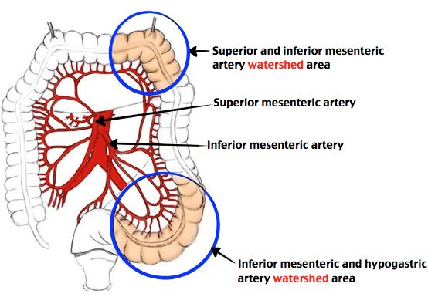
Nonocclusive mesenteric ischemia
Precipitated by reduction in mesenteric perfusion
Etiologies include:
  Shock (cardiac, septic, hypovolemic, etc.)
  Potent vasopressors
  Arterial spasms (think cocaine)
  Celiac artery compression syndrome (i.e. median arcuate ligament)
Can end up in ischemic colitis
Resolves with supportive measures

Slide 40
What common cardiac medication can result in acute nonocclusive mesenteric ischemia and ischemic colitis?

Slide 41
What common cardiac medication can result in acute nonocclusive mesenteric ischemia and ischemic colitis?
Digoxin

Slide 42
Nonocclusive mesenteric ischemia
Occlusive mesenteric ischemia
Mesenteric arterial embolism
Acute mesenteric arterial thrombosis
Mesenteric venous thrombosis
Venous
Arterial
Acute mesenteric ischemia

Slide 43
Acute mesenteric arterial embolism
Usually arises from cardiac emboli (i.e. a fib, or ventricular thrombosis post MI), proximal aortic embolus from a ruptured plaque, or post aortic catheterization (iatrogenic embolization)
Most likely to lodge in the SMA, and end up in distal branches causing limited bowel ischemia
Presentation is the most abrupt, with severe abdominal pain

Slide 44
Nonocclusive mesenteric ischemia
Occlusive mesenteric ischemia
Mesenteric arterial embolism
Acute mesenteric arterial thrombosis
Mesenteric venous thrombosis
Venous
Arterial
Acute mesenteric ischemia

Slide 45
Acute mesenteric arterial thrombosis
Most likely is the result of atherosclerotic vascular disease
  But other causes include: aortic aneurysm, aortic dissection, arteritis (vasculitis), severe dehydration
This occurs typically in the vessel’s origin (SMA, or celiac trunk) causing extensive bowel involvement

Slide 46
Nonocclusive mesenteric ischemia
Occlusive mesenteric ischemia
Mesenteric arterial embolism
Acute mesenteric arterial thrombosis
Mesenteric venous thrombosis
Venous
Arterial
Acute mesenteric ischemia

Slide 47
Acute mesenteric venous thrombosis
About 80 percent of patients have predisposing factors
  Hypercoagulability
  Venous congestion (i.e. cirrhosis)
  Cancer
  Intra-abdominal infections
  Pancreatitis
  Iatrogenic (post intra-abdominal surgery)

Slide 48
When to suspect mesenteric ischemia? i.e. what is the most pathognomonic clinical finding?

Slide 49
When to suspect mesenteric ischemia? i.e. what is the most pathognomonic clinical finding?
“pain that is disproportionate to physical exam findings”

Slide 50
How to differentiate?

Slide 51
 | Arterial |  |  | Venous
 | Occlusive |  | Nonocclusive
 | Acute mesenteric arterial embolism | Acute mesenteric arterial thrombosis | Acute nonocclusive mesenteric ischemia | Acute mesenteric venous thrombosis
Shared signs | “pain that is disproportionate to physical exam” Pain usually follows embryologic distribution Nausea, vomiting and abdominal distension GI bleeding only in 25 percent of cases
Characteristic signs | Most abrupt and most painful “bowel attack” | Postprandial pain starting after 30 minutes lasting up to 2-3 hours (abdominal angina) More gradual onset, with sudden acute episode | Elderly patients, commonly in the ICU setting Usually patient sin shock with multiple vasopressors | Younger individuals Insidious onset, less painful History of hypercoagulability (i.e. OCP use)

Slide 52
Even with all those symptoms and signs, what would be your differential diagnosis for a patient with all of the above?

Slide 53
Abdominal Abscess Abdominal Angina Abdominal Aortic Aneurysm Acute Abdomen and Pregnancy Acute Cholecystitis and Biliary Colic Acute Intermittent Porphyria Acute Pancreatitis Acute Pyelonephritis Aortic Dissection Appendicitis Bacterial Pneumonia Bacterial Sepsis Biliary Disease Biliary Obstruction Boerhaave Syndrome Cholangitis Cholecystitis Diverticulitis Ectopic Pregnancy Esophageal Rupture Gallstones (Cholelithiasis) Gastric Volvulus Helicobacter Pylori Infection Hypovolemic Shock Postoperative Ileus Intestinal Perforation Lactic Acidosis Large-Bowel Obstruction Multiple Organ Dysfunction Syndrome in Sepsis Myocardial Infarction Nephrolithiasis Pneumothorax Imaging Septic Shock Small-Bowel Obstruction Testicular Torsion Imaging

Slide 54
Abdominal Abscess Abdominal Angina Abdominal Aortic Aneurysm Acute Abdomen and Pregnancy Acute Cholecystitis and Biliary Colic Acute Intermittent Porphyria Acute Pancreatitis Acute Pyelonephritis Aortic Dissection Appendicitis Bacterial Pneumonia Bacterial Sepsis Biliary Disease Biliary Obstruction Boerhaave Syndrome Cholangitis Cholecystitis Diverticulitis Ectopic Pregnancy Esophageal Rupture Gallstones (Cholelithiasis) Gastric Volvulus Helicobacter Pylori Infection Hypovolemic Shock Postoperative Ileus Intestinal Perforation Lactic Acidosis Large-Bowel Obstruction Multiple Organ Dysfunction Syndrome in Sepsis Myocardial Infarction Nephrolithiasis Pneumothorax Imaging Septic Shock Small-Bowel Obstruction Testicular Torsion Imaging
Just to name a couple.

Slide 55
Work-up and diagnostic modalities

Slide 56
Laboratory studies
Unlike myocardial ischemia, there is no “troponin” and “CK-MB” test for mesenteric ischemia
Leukocytosis and left-shift in <50 percent of all cases
Lactic acid is elevated late in the course
  However, if lactic acid remains within normal limits, can rule out the diagnosis
Several studies found a role for D-dimer as an early marker
  “again with the D-dimer”…

Slide 57
Imaging studies

Slide 58
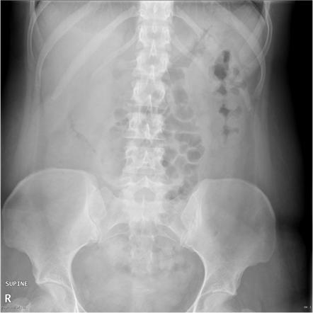
The good ol’ plain abdominal film (“KUB”)

Slide 59

The good ol’ plain abdominal film (“KUB”)

Slide 60
The good ol’ plain abdominal film (“KUB”)

Slide 61
The good ol’ plain abdominal film (“KUB”)
“Thumbprinting” sign

Slide 62
Abdominal plain x-rays
Often normal in acute (and chronic) mesenteric ischemia
Can be helpful in detecting air under the diaphragm (perforation)
“Thumbprinting” can be seen with or without the use of barium enemas
Pneumatosis intestinalis can be seen in < 30 percent of patients
Other signs include portal venous gas

Slide 63
CTA of the abdomen and pelvis

Slide 64
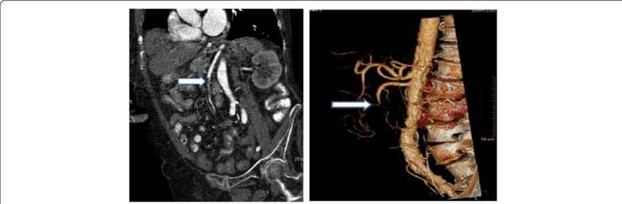
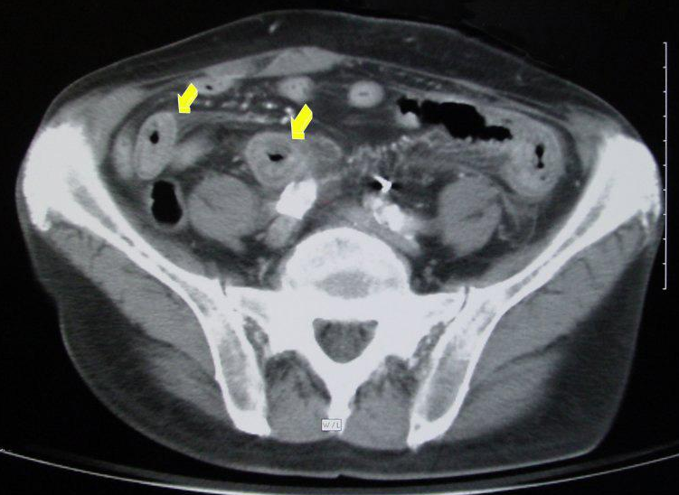
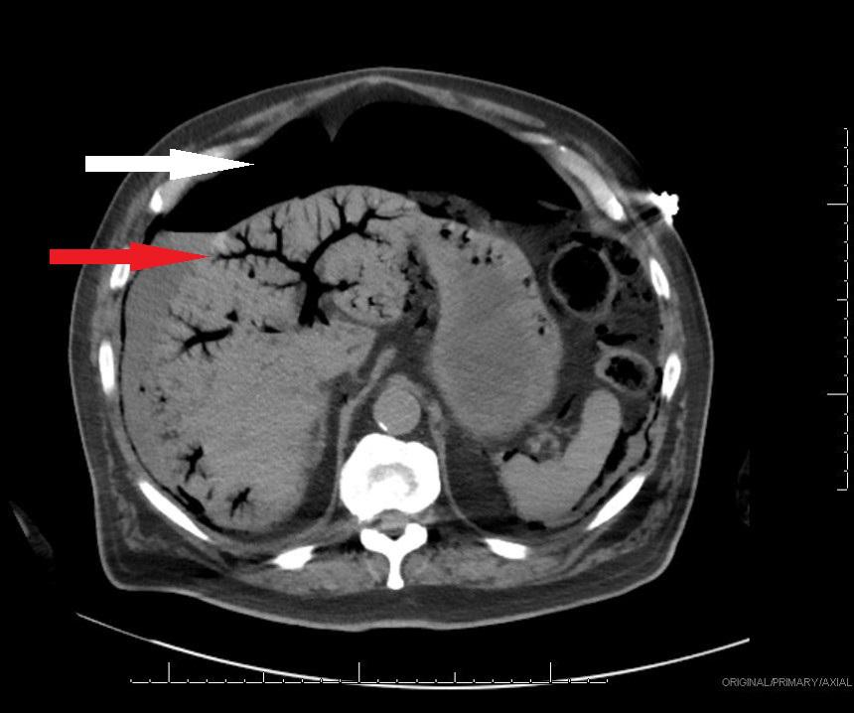
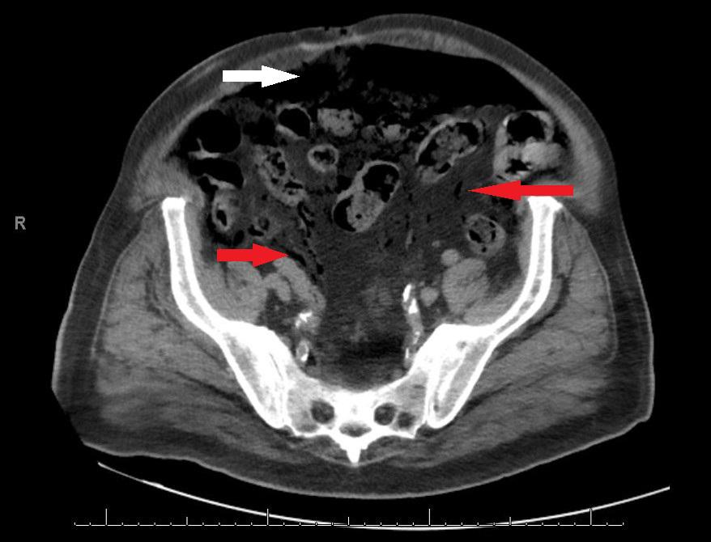

Slide 65
Classic “arrow” signs on CTA

Slide 70
CTA of the abdomen and pelvis
Sensitivity is 96-100 percent, and specificity is 89-94 percent for mesenteric ischemia (all types)
Bowel-wall edema is the most common finding
Could visualize the arterial or venous thromboembolism

Slide 71
Other imaging modalities
Magnetic resonance imaging
  Sensitivity of 100 percent and specificity of 91 percent
  High cost (time and money)
  Not typically used
Ultrasonography with duplex study
  Sensitivity of 70-90 percent and specificity of 92-100 percent
  Considered as second-line if CTA is not available
Conventional angiography
  Sensitivity of 74-100 percent and specificity of 100 percent
  Can be used therapeutically
  However, highly invasive, and can precipitate acute mesenteric ischemia

Slide 72
I know what you’re thinking…

Slide 73
I know what you’re thinking…
“How about colonoscopy?”

Slide 74
I know what you’re thinking…
“How about colonoscopy?”
This is a GI conference, after all…

Slide 75
Role of colonoscopy in ischemic colitis
Can be used to increase pre-test probability for ischemic colitis induced by mesenteric ischemia, however is only limited to the colon and terminal ileum
Ischemia rather than inflammatory bowel disease is suggested by segmental distribution, abrupt transition between injured and noninjured mucosa, and rectal sparing
A single linear ulcer running along the longitudinal axis of the colon (the "single-stripe sign") may also favor an ischemic cause of colitis

Slide 76
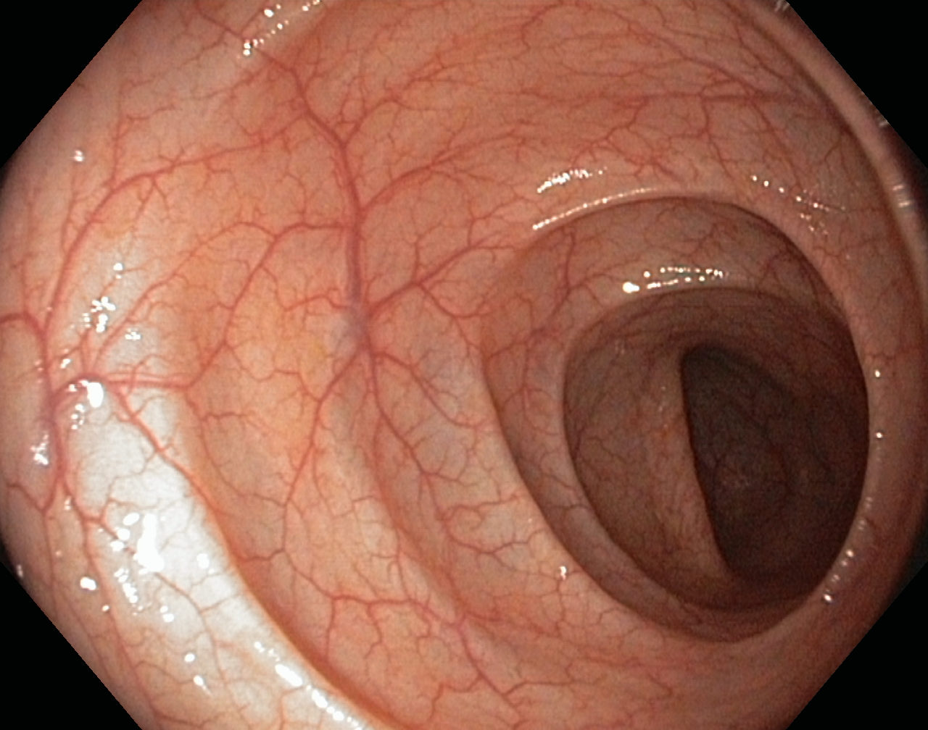

Slide 77
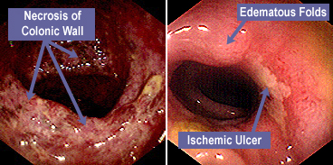

Slide 78
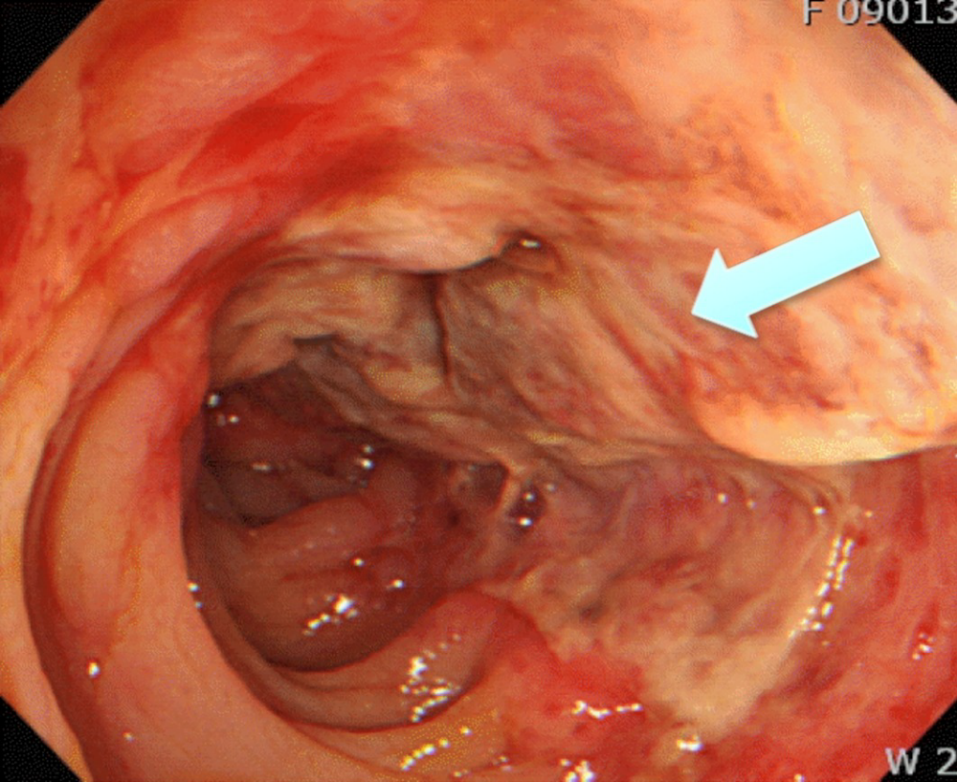

Slide 79
Treatment

Slide 80
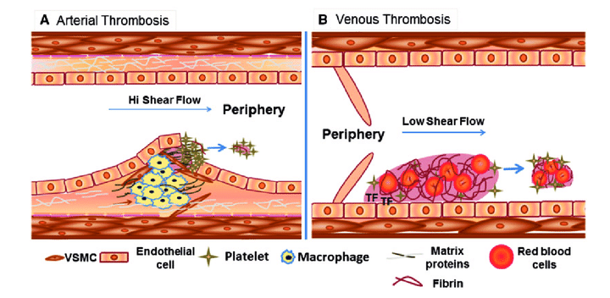

Slide 81
Antiplatelets
Anticoagulants
Thrombolytics
Thrombolytics

Slide 82
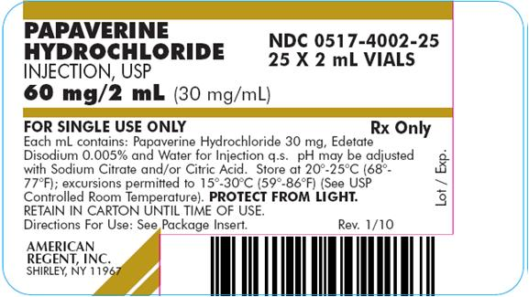

Slide 83
Potent smooth muscle spasmolytic and thus vasodilator, used specifically for mesenteric ischemia

Slide 84
In Summary
Acute mesenteric arterial embolism - Papaverine infusion, surgical embolectomy, and intra-arterial thrombolysis
Acute mesenteric arterial thrombosis - Papaverine infusion and arterial reconstruction, either through aorto-superior mesenteric arterial bypass grafting or through reimplantation of the superior mesenteric artery into the aorta
Nonocclusive mesenteric ischemia - Papaverine infusion, supportive care
Mesenteric venous thrombosis - Anticoagulation with heparin or warfarin, either alone or in combination with surgery; immediate heparinization should be started even when surgical intervention is indicated

Slide 85
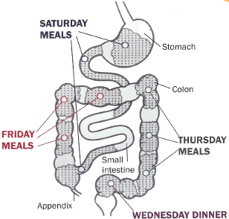
“Time equal brain”

Slide 86
“Time equal brain”
“Time equal muscle”

Slide 87
“Time equal brain”
“Time equal muscle”
“Time equal bowel”

Slide 88
AGA statements regarding acute mesenteric ischemia (updated in 2000)
There are no laboratory studies that are sufficiently accurate to identify the presence or absence of ischemic or necrotic bowel, although elevated l-lactate and D-dimer may assist. (Recommendation 1B)
Computed tomography angiography (CTA) should be performed as soon as possible for any patient with suspicion for AMI. (Recommendation 1A)
When the diagnosis of AMI is made, fluid resuscitation should commence immediately to enhance visceral perfusion. Electrolyte abnormalities should be corrected, and nasogastric decompression initiated. (Recommendation 1B)
Broad-spectrum antibiotics should be administered immediately. Unless contraindicated, patients should be anticoagulated with intravenous unfractionated heparin. (Recommendation 1B)
Prompt laparotomy should be done for patients with overt peritonitis. (Recommendation 1A)
Endovascular revascularization procedures may have a role with partial arterial occlusion. (Recommendation 1C)
Mesenteric venous thrombosis can often be successfully treated with a continuous infusion of unfractionated heparin. (Recommendation 1B)
When nonocclusive mesenteric ischemia is suspected, the treatment focus should be to correct the underlying cause and to restore mesenteric perfusion. Infarcted bowel should be resected promptly. (Recommendation 1B)
American Gastroenterological Association Medical Position Statement: guidelines on intestinal ischemia. Gastroenterology. 2000;118(5):951-3.

Slide 89
Review Questions

Slide 90
Question 1
A 58-year-old woman is evaluated in the emergency department for a 1-day history of nausea and pain in the left lower abdomen, which was followed by the onset of several episodes of dark-red rectal bleeding. Her bowel habits were previously normal, and she has not had tenesmus, fecal urgency, constipation, diarrhea, weight change, or previous abdominal pain. She has no history of gastrointestinal bleeding, alcoholism, chronic liver disease, bleeding disorders, or cancer. Other medical problems are hypertension, hyperlipidemia, and peripheral vascular disease. Her medications are chlorthalidone, ramipril, and simvastatin. She continues to smoke 1 pack of cigarettes daily.
On physical examination, temperature is 37.0 °C (98.6 °F), blood pressure is 125/68 mm Hg, pulse rate is 87/min, and respiration rate is 14/min; BMI is 27. Abdominal examination reveals pain in the left lower abdomen with no guarding or rebound. No abdominal masses are noted, and the liver and spleen are not enlarged. Bowel sounds are diminished in frequency, and abdominal distention is noted. Rectal examination identifies a small amount of fresh blood and clots; no external hemorrhoids or anal fissure are noted. Femoral, popliteal, and dorsalis pedis pulses are diminished bilaterally.
Laboratory studies reveal a hemoglobin level of 10 g/dL (100 g/L), a leukocyte count of 14,000/µL (14 × 109/L), and a platelet count of 215,000/µL (215 × 109/L).
Which of the following is the most likely diagnosis?
Angiodysplasia
Colon cancer
Diverticular Bleeding
Ischemic colitis
Ulcerative colitis

Slide 91
Question 1
A 58-year-old woman is evaluated in the emergency department for a 1-day history of nausea and pain in the left lower abdomen, which was followed by the onset of several episodes of dark-red rectal bleeding. Her bowel habits were previously normal, and she has not had tenesmus, fecal urgency, constipation, diarrhea, weight change, or previous abdominal pain. She has no history of gastrointestinal bleeding, alcoholism, chronic liver disease, bleeding disorders, or cancer. Other medical problems are hypertension, hyperlipidemia, and peripheral vascular disease. Her medications are chlorthalidone, ramipril, and simvastatin. She continues to smoke 1 pack of cigarettes daily.
On physical examination, temperature is 37.0 °C (98.6 °F), blood pressure is 125/68 mm Hg, pulse rate is 87/min, and respiration rate is 14/min; BMI is 27. Abdominal examination reveals pain in the left lower abdomen with no guarding or rebound. No abdominal masses are noted, and the liver and spleen are not enlarged. Bowel sounds are diminished in frequency, and abdominal distention is noted. Rectal examination identifies a small amount of fresh blood and clots; no external hemorrhoids or anal fissure are noted. Femoral, popliteal, and dorsalis pedis pulses are diminished bilaterally.
Laboratory studies reveal a hemoglobin level of 10 g/dL (100 g/L), a leukocyte count of 14,000/µL (14 × 109/L), and a platelet count of 215,000/µL (215 × 109/L).
Which of the following is the most likely diagnosis?
Angiodysplasia
Colon cancer
Diverticular Bleeding
Ischemic colitis
Ulcerative colitis

Slide 92
Question 2
A 48-year-old woman is evaluated for a 3-month history of anorexia associated with a 9.1-kg (20.0-lb) weight loss. Six months ago she began having nausea, vomiting, meal-related abdominal pain and bloating, and diarrhea. Other medical problems include dyslipidemia and hypertension treated with simvastatin, chlorthalidone, and lisinopril. She has a 25-pack-year history of smoking.
On physical examination, blood pressure is 140/85 mm Hg and pulse rate is 88/min; BMI is 17. A bruit is audible in the upper abdomen and over both femoral arteries. Dorsalis pedis and posterior tibial pulses are diminished bilaterally.
Upper endoscopy findings are normal. CT scan of the abdomen and pelvis demonstrates a dilated and debris-filled stomach and diffuse dilation of the small bowel.
Which of the following diagnostic tests should be done next?
Abdominal ultrasonography
Capsule endoscopy
CT angiography
Splanchnic angiography

Slide 93
Question 2
A 48-year-old woman is evaluated for a 3-month history of anorexia associated with a 9.1-kg (20.0-lb) weight loss. Six months ago she began having nausea, vomiting, meal-related abdominal pain and bloating, and diarrhea. Other medical problems include dyslipidemia and hypertension treated with simvastatin, chlorthalidone, and lisinopril. She has a 25-pack-year history of smoking.
On physical examination, blood pressure is 140/85 mm Hg and pulse rate is 88/min; BMI is 17. A bruit is audible in the upper abdomen and over both femoral arteries. Dorsalis pedis and posterior tibial pulses are diminished bilaterally.
Upper endoscopy findings are normal. CT scan of the abdomen and pelvis demonstrates a dilated and debris-filled stomach and diffuse dilation of the small bowel.
Which of the following diagnostic tests should be done next?
Abdominal ultrasonography
Capsule endoscopy
CT angiography
Splanchnic angiography

Slide 94
Thank you.
Questions?

