Slide 1
Design and Analysis of Algorithms
Lecture 02

Slide 2
Linear Search
A linear search scans one item at a time, without jumping to any item
The worst case complexity is O(n), sometimes known an O(n) search
Time taken to search elements keep increasing as the number of elements are increased.

Slide 3
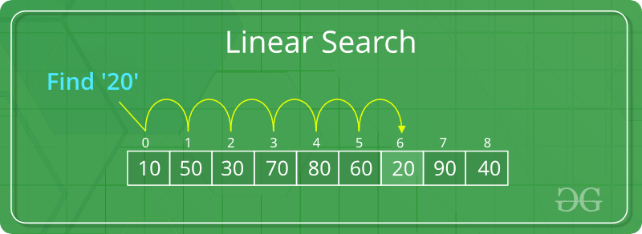

Slide 4
Start from the leftmost element of arr[] and one by one compare x with each element of arr[]
If x matches with an element, return the index.
If x doesn’t match with any of elements, return -1.

Slide 5
Binary Search
A binary search however, cut down your search to half as soon as you find middle of a sorted list.
The middle element is looked to check if it is greater than or less than the value to be searched.
Accordingly, search is done to either half of the given list

Slide 6
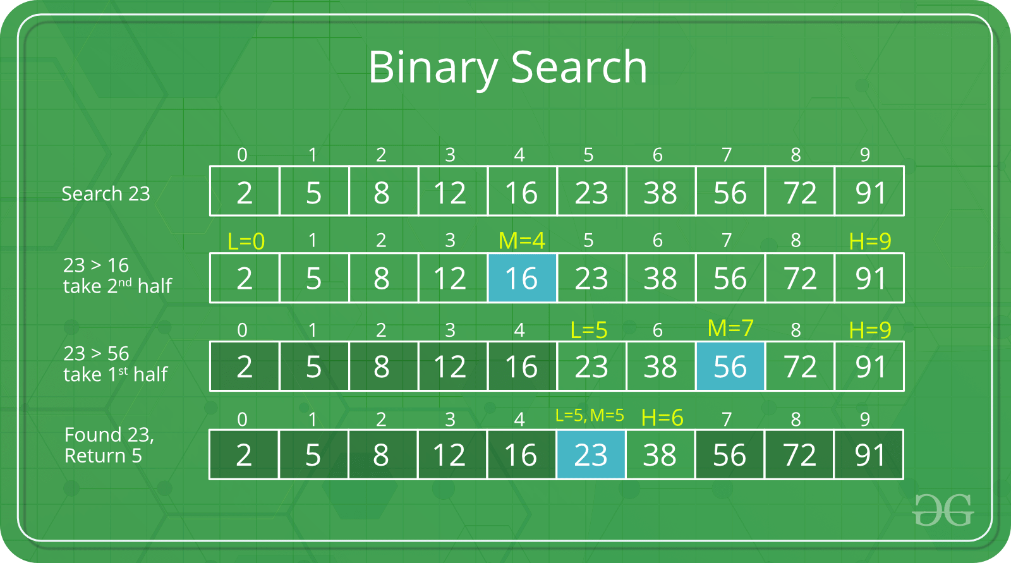
Complexity Analysis of Binary Search

Slide 7
Calculating Time complexity:
At each iteration, the array is divided by half.
So let’s say the length of array at any iteration is n
At Iteration 1,Length of array = n
At Iteration 2,Length of array = ^{n}⁄₂
At Iteration 3,Length of array = ^{(n⁄}₂⁾⁄₂ = ^{n}⁄₂²
Therefore, after Iteration k, Length of array = ^{n}⁄₂^{k}

Slide 8
After k divisions, the length of array becomes 1
Therefore :
Length of array = ^{n}⁄₂^{k} = 1
=> n = 2^{k}
Applying log function on both sides:
=> log₂ (n) = log₂ (2^{k})
=> log₂ (n) = k log₂ (2)
As (log_{a} (a) = 1) Therefore,=> k = log₂ (n)

Slide 9
Hence, the time complexity of Binary Search is
log₂ (n)

Slide 10
Important Differences
Input data needs to be sorted in Binary Search and not in Linear Search
Linear search does the sequential access whereas Binary search access data randomly.
Time complexity of linear search -O(n) , Binary search has time complexity O(log n).
Linear search performs equality comparisons and Binary search performs ordering comparisons

Slide 11
Sortin
SORTING ALGORITHM | TIME COMPLEXITY |  |  | SPACE COMPLEXITY
 | BEST CASE | AVERAGE CASE | WORST CASE | WORST CASE
Bubble Sort | Ω(N) | Θ(N2) | O(N2) | O(1)
Selection Sort | Ω(N2) | Θ(N2) | O(N2) | O(1)
Insertion Sort | Ω(N) | Θ(N2) | O(N2) | O(1)
Merge Sort | Ω(N log N) | Θ(N log N) | O(N log N) | O(N)
Heap Sort | Ω(N log N) | Θ(N log N) | O(N log N) | O(1)
Quick Sort | Ω(N log N) | Θ(N log N) | O(N2) | O(N log N)
Radix Sort | Ω(N k) | Θ(N k) | O(N k) | O(N + k)
Count Sort | Ω(N + k) | Θ(N + k) | O(N + k) | O(k)
Bucket Sort | Ω(N + k) | Θ(N + k) | O(N2) | O(N)

Slide 12
Difference between Posteriori and Priori analysis
Algorithm is a combination or sequence of finite-state to solve a given problem. If the problem is having more than one solution or algorithm then the best one is dicided by the analysis based on two factors.
CPU Time (Time Complexity)
Main memory space (Space Complexity)
Time complexity of an algorithm can be calculated by using two methods:
Posteriori Analysis
Priori Analysis

Slide 13
A POSTERIORI ANALYSIS | A PRIORI ANALYSIS
Posteriori analysis is a relative analysis. | Piori analysis is an absolute analysis.
It is dependent on language of compiler and type of hardware. | It is independent of language of compiler and types of hardware.
It will give exact answer. | It will give approximate answer.
It doesn’t use asymptotic notations to represent the time complexity of an algorithm. | It uses the asymptotic notations to represent how much time the algorithm will take in order to complete its execution.
The time complexity of an algorithm using a posteriori analysis differ from system to system. | The time complexity of an algorithm using a priori analysis is same for every system.
If the time taken by the algorithm is less, then the credit will go to compiler and hardware. | If the program running faster, credit goes to the programmer.

Slide 14
int a = 0, i = N;
while (i > 0) {
a += i;
i /= 2;
}
Complexity is ?

Slide 15
for (int i = 1; i <=n; i *= c) {
// some O(1) expressions
}
for (int i = n; i > 0; i /= c) {
// some O(1) expressions
}
The loop variables is divided / multiplied by a constant amount.

Slide 16
The algorithms can be classified as follows from the best-to-worst performance (Running Time Complexity):
A logarithmic algorithm – O(logn)
Runtime grows logarithmically in proportion to n.
▪ A linear algorithm – O(n)
Runtime grows directly in proportion to n.
▪ A superlinear algorithm – O(nlogn)
Runtime grows in proportion to n.
▪ A polynomial algorithm – O(nc)
Runtime grows quicker than previous all based on n.
▪ A exponential algorithm – O(cn)
Runtime grows even faster than polynomial algorithm based on n.
▪ A factorial algorithm – O(n!)
Runtime grows the fastest and becomes quickly unusable for even
small values of n.

Slide 17
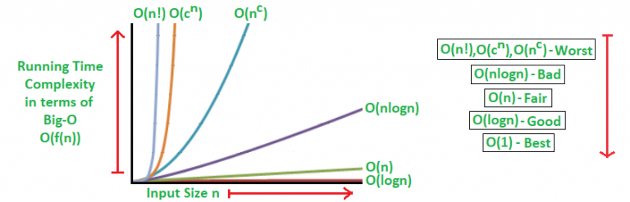

Slide 18
Algorithmic Examples of Runtime Analysis:
Some of the examples of all those types of algorithms (in worst-case scenarios) are mentioned below:
Logarithmic algorithm – O(logn) – Binary Search. Linear algorithm – O(n) – Linear Search. Superlinear algorithm – O(nlogn) – Heap Sort, Merge Sort. Polynomial algorithm – O(n^c) – Strassen’s Matrix Multiplication, Bubble Sort, Selection Sort, Insertion Sort, Bucket Sort. Exponential algorithm – O(c^n) – Tower of Hanoi. Factorial algorithm – O(n!) – Determinant Expansion by Minors, Brute force Search algorithm for Traveling Salesman Problem.

Slide 19
Ideal algorithm - O(1) - Linear Search, Binary Search,
Bubble Sort, Selection Sort, Insertion Sort, Heap Sort, Shell Sort.
▪ Logarithmic algorithm - O(log n) - Merge Sort.
▪ Linear algorithm - O(n) - Quick Sort.
▪ Sub-linear algorithm - O(n+k) - Radix Sort.

Slide 20
Table of common time complexities These are the most common time complexities expressed using the Big-O notation:

Slide 21
╔══════════════════╦═════════════════╗ ║ Name ║ Time Complexity ║ ╠══════════════════╬═════════════════╣ ║ Constant Time ║ O(1) ║ ╠══════════════════╬═════════════════╣ ║ Logarithmic Time ║ O(log n) ║ ╠══════════════════╬═════════════════╣ ║ Linear Time ║ O(n) ║ ╠══════════════════╬═════════════════╣ ║ Quasilinear Time ║ O(n log n) ║ ╠══════════════════╬═════════════════╣ ║ Quadratic Time ║ O(n^2) ║ ╠══════════════════╬═════════════════╣ ║ Exponential Time ║ O(2^n) ║ ╠══════════════════╬═════════════════╣ ║ Factorial Time ║ O(n!) ║ ╚══════════════════╩═════════════════╝

Slide 22
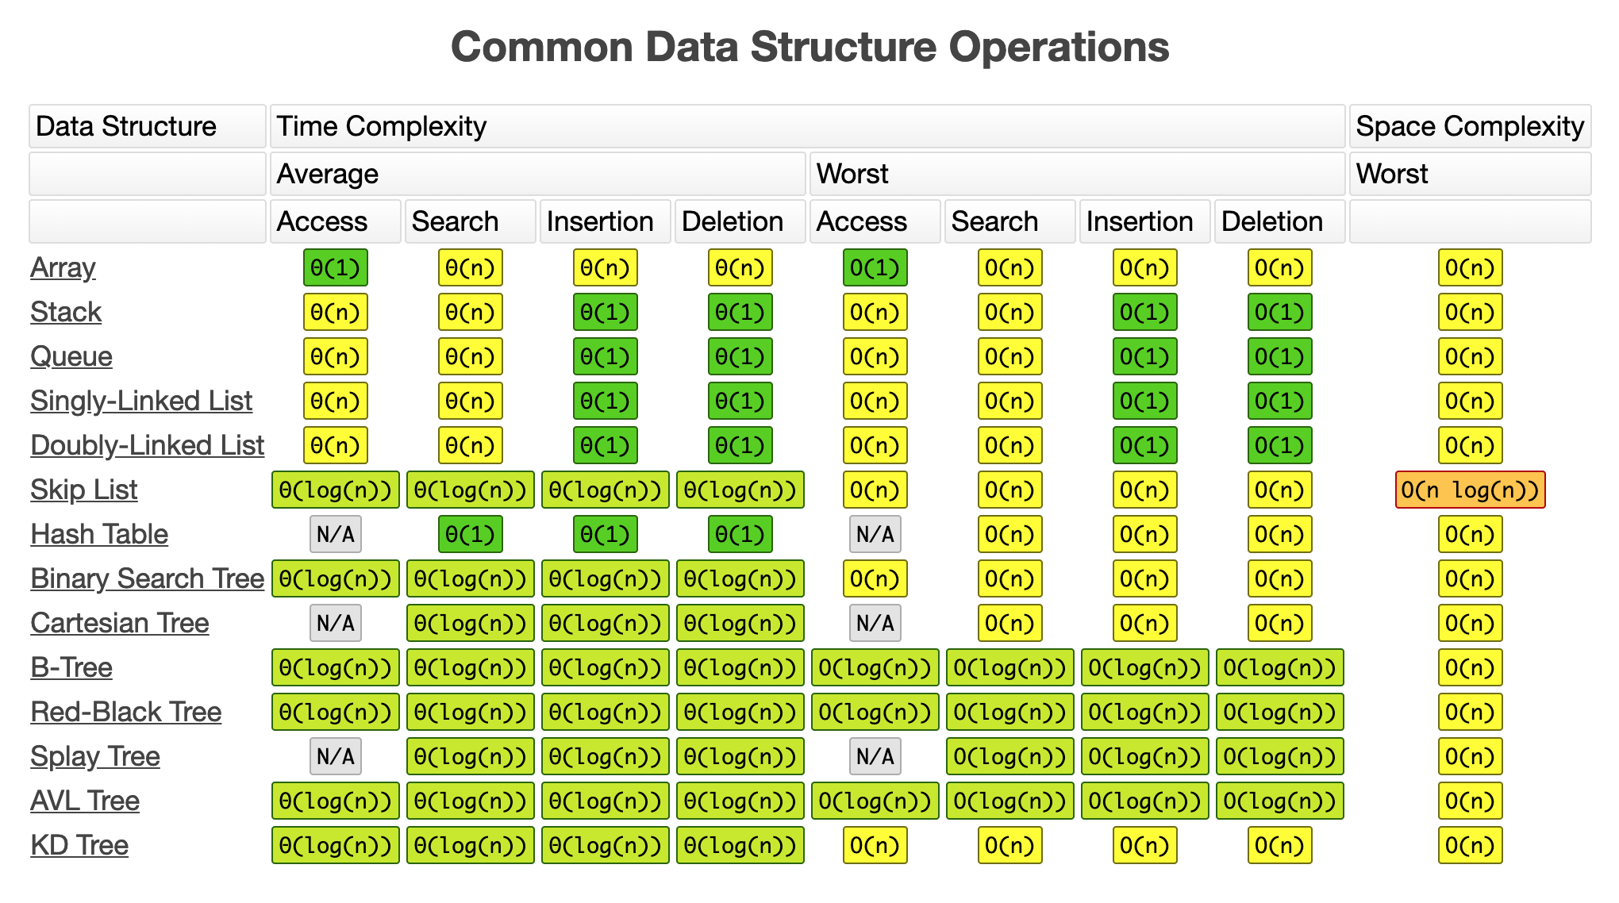

Slide 23
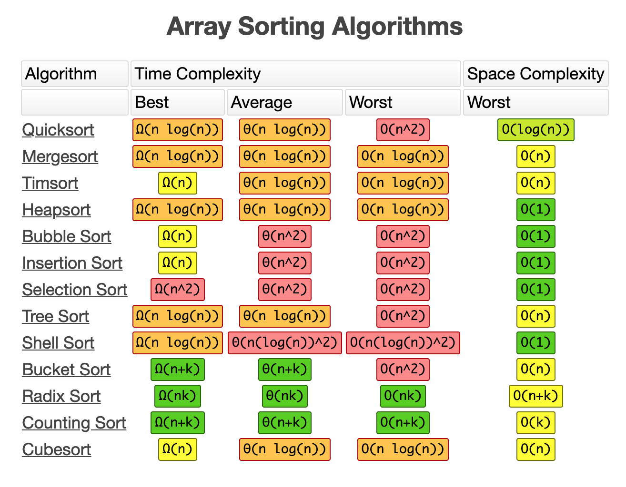

Slide 24
