Slide 1
DOA
Understanding Time Complexity with Simple Examples

Slide 2
Real Life Example
Imagine a classroom of 100 students in which you gave your pen to one person. Now, you want that pen. Here are some ways to find the pen and what the O order is.

Slide 3
Answer
O(n2): You go and ask the first person of the class, if he has the pen. Also, you ask this person about other 99 people in the classroom if they have that pen and so on, This is what we call O(n2).
O(n): Going and asking each student individually is O(N).

Slide 4
O(log n): Now I divide the class into two groups, then ask: “Is it on the left side, or the right side of the classroom?” Then I take that group and divide it into two and ask again, and so on. Repeat the process till you are left with one student who has your pen. This is what you mean by O(log n).

Slide 5
I might need to do the O(n2) search if only one student knows on which student the pen is hidden. I’d use the O(n) if one student had the pen and only they knew it. I’d use the O(log n) search if all the students knew, but would only tell me if I guessed the right side.

Slide 6
#include <stdio.h>
int main()
{
printf("Hello World");
}
In above code “Hello World!!!” print only once on a screen. So, time complexity is constant: O(1)

Slide 7
Now consider another code:
#include <stdio.h>
void main()
{
int i, n = 8;
for (i = 1; i <= n; i++) {
printf("Hello Word !!!");
}
}

Slide 8
Output:
Hello Word !!!Hello Word !!!Hello Word !!!Hello Word !!!
Hello Word !!!Hello Word !!!Hello Word !!!Hello Word !!!
In above code “Hello World!!!” will print N times. So, time complexity of above code is O(N).

Slide 9
Complexity is expressed using big-O notation. The complexity is written as O(<some function>), meaning that the number of operations is proportional to the given function multiplied by some constant factor. For example, if an algorithm takes 2*(n**2) operations, the complexity is written as O(n**2), dropping the constant multiplier of 2.

Slide 10
Some of the most commonly seen complexities are:
O(1) is constant-time complexity. The number of operations for the algorithm doesn’t actually change as the problem size increases.
O(n) time complexity means that an algorithm is linear; doubling the problem size also doubles the number of operations required.

Slide 11
O(log n) is logarithmic complexity. The base used to take the logarithm makes no difference, since it just multiplies the operation count by a constant factor. The most common base is base 2, written as log_2 or lg.

Slide 12
O(n**2) is quadratic complexity. Doubling the problem size multiplies the operation count by four. A problem 10 times larger takes 100 times more work.

Slide 13
O(n**3), O(n**4), O(n**5), etc. are polynomial complexity.
O(2**n) is exponential complexity. Increasing the problem size by 1 unit doubles the work. Doubling the problem size squares the work. The work increases so quickly that only the very smallest problem sizes are feasible.

Slide 14
time, space complexity
int a = 0, b = 0;
for (i = 0; i < N; i++) {
a = a + rand();
}
for (j = 0; j < M; j++) {
b = b + rand();
}

Slide 15
O(N + M) time, O(1) space
The first loop is O(N) and the second loop is O(M). Since we don’t know which is bigger, we say this is O(N + M). This can also be written as O(max(N, M)).
Since there is no additional space being utilized, the space complexity is constant / O(1)

Slide 16
int a = 0;
for (i = 0; i < N; i++) {
for (j = N; j > i; j--) {
a = a + i + j;
}
}

Slide 17
time complexity
O(N*N)
The above code runs total no of times
= N + (N – 1) + (N – 2) + … 1 + 0
= N * (N + 1) / 2
= 1/2 * N^2 + 1/2 * N
O(N^2) times.

Slide 18
time complexity
int i, j, k = 0;
for (i = n / 2; i <= n; i++) {
for (j = 2; j <= n; j = j * 2) {
k = k + n / 2;
}
}

Slide 19
O(nLogn)
If you notice, j keeps doubling till it is less than or equal to n. Number of times, we can double a number till it is less than n would be log(n).
Let’s take the examples here.
for n = 16, j = 2, 4, 8, 16
for n = 32, j = 2, 4, 8, 16, 32
So, j would run for O(log n) steps.
i runs for n/2 steps.
So, total steps = O(n/ 2 * log (n)) = O(n*logn)

Slide 20
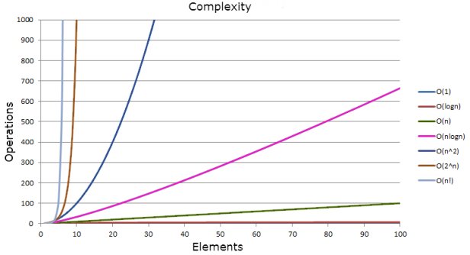
The following graph compares the growth rates of various time complexities

Slide 21
When writing down big-O notation, we can keep only the fastest-growing term and drop slower-growing terms.
For example, instead of writing O(n**2 + 10n + 5), we drop the lower terms and write only O(n**2).

Slide 22
Big-O notation is an upper bound, expressing the worst-case time required to run an algorithm on various inputs.

Slide 23
What is the time, space complexity of following code:
int a = 0, b = 0;
for (i = 0; i < N; i++) {
a = a + rand();
}
for (j = 0; j < M; j++) {
b = b + rand();
}

Slide 24
int a = 0;
for (i = 0; i < N; i++) {
for (j = N; j > i; j--) {
a = a + i + j;
}
}

Slide 25
What is the time complexity of following code:
int i, j, k = 0;
for (i = n / 2; i <= n; i++) {
for (j = 2; j <= n; j = j * 2) {
k = k + n / 2;
}
}

