Slide 1
Design and Analysis of Algorithms
Lecture 02
Searching and Sorting

Slide 2
Searching Algorithms
Search Problem: Locating an element in an
(ordered) list.
Linear search
Binary search (ordered list)

Slide 3
Linear Search
A linear search scans one item at a time, without jumping to any item
The worst case complexity is O(n), sometimes known an O(n) search
Time taken to search elements keep increasing as the number of elements are increased.

Slide 4
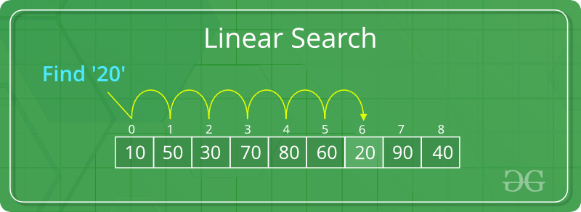

Slide 5
Start from the leftmost element of arr[] and one by one compare x with each element of arr[]
If x matches with an element, return the index.
If x doesn’t match with any of elements, return -1.

Slide 6
Binary Search
A binary search however, cut down your search to half as soon as you find middle of a sorted list.
The middle element is looked to check if it is greater than or less than the value to be searched.
Accordingly, search is done to either half of the given list

Slide 7
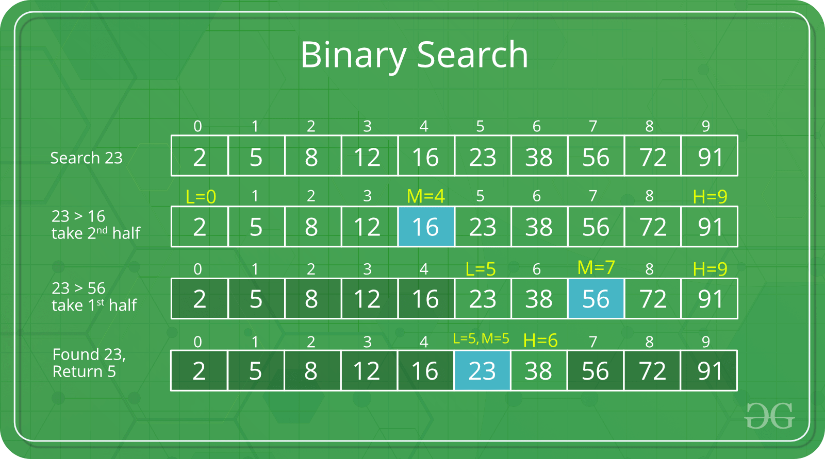
Complexity Analysis of Binary Search

Slide 8
Calculating Time complexity:
At each iteration, the array is divided by half.
So let’s say the length of array at any iteration is n
At Iteration 1,Length of array = n
At Iteration 2,Length of array = ^{n}⁄₂
At Iteration 3,Length of array = ^{(n⁄}₂⁾⁄₂ = ^{n}⁄₂²
Therefore, after Iteration k, Length of array = ^{n}⁄₂^{k}

Slide 9
After k divisions, the length of array becomes 1
Therefore :
Length of array = ^{n}⁄₂^{k} = 1
=> n = 2^{k}
Applying log function on both sides:
=> log₂ (n) = log₂ (2^{k})
=> log₂ (n) = k log₂ (2)
As (log_{a} (a) = 1) Therefore,=> k = log₂ (n)

Slide 10
Hence, the time complexity of Binary Search is
log₂ (n)

Slide 11
Important Differences
Input data needs to be sorted in Binary Search and not in Linear Search
Linear search does the sequential access whereas Binary search access data randomly.
Time complexity of linear search -O(n) , Binary search has time complexity O(log n).
Linear search performs equality comparisons and Binary search performs ordering comparisons

Slide 12
Selection Sort
Selection sort orders a list of values by repetitively putting a particular value into its final position
More specifically:
find the smallest value in the list
switch it with the value in the first position
find the next smallest value in the list
switch it with the value in the second position
repeat until all values are in their proper places

Slide 13
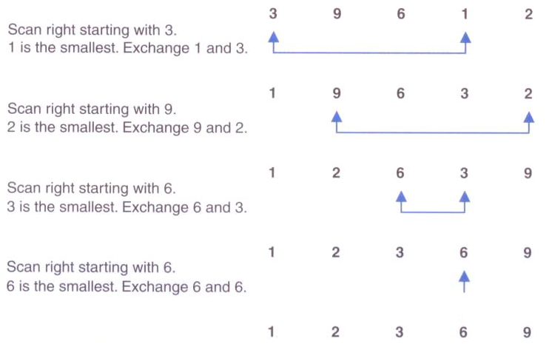
Selection Sort

Slide 14
Insertion Sort
Insertion sort orders a values by repetitively inserting a particular value into a sorted subset of the list
More specifically:
consider the first item to be a sorted sublist of length 1
insert the second item into the sorted sublist, shifting the first item if needed
insert the third item into the sorted sublist, shifting the other items as needed
repeat until all values have been inserted into their proper positions

Slide 15
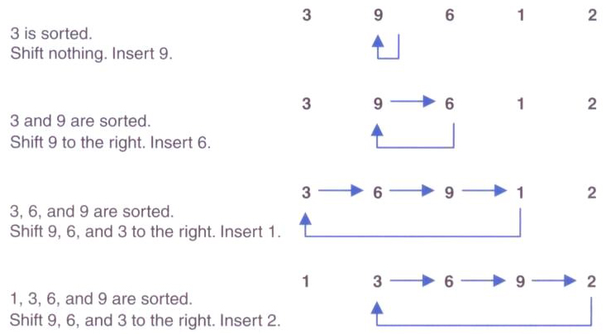
Insertion Sort

Slide 16
Bubble Sort
Bubble sort orders a list of values by repetitively comparing neighboring elements and swapping their positions if necessary
More specifically:
scan the list, exchanging adjacent elements if they are not in relative order; this bubbles the highest value to the top
scan the list again, bubbling up the second highest value
repeat until all elements have been placed in their proper order

Slide 17
Quick Sort
Quick sort orders values by partitioning the list around one element, then sorting each partition
More specifically:
choose one element in the list to be the partition element
organize the elements so that all elements less than the partition element are to the left and all greater are to the right
apply the quick sort algorithm (recursively) to both partitions

Slide 18
Merge Sort
Merge sort orders values by recursively dividing the list in half until each sub-list has one element, then recombining
More specifically:
divide the list into two roughly equal parts
recursively divide each part in half, continuing until a part contains only one element
merge the two parts into one sorted list
continue to merge parts as the recursion unfolds

Slide 19
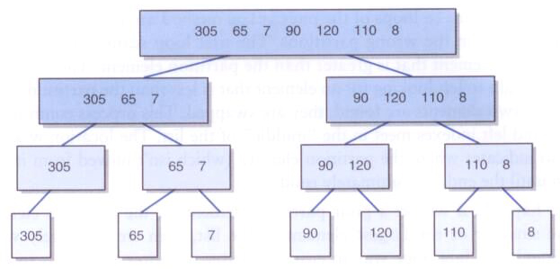
Merge Sort
Dividing lists in half repeatedly:

Slide 20
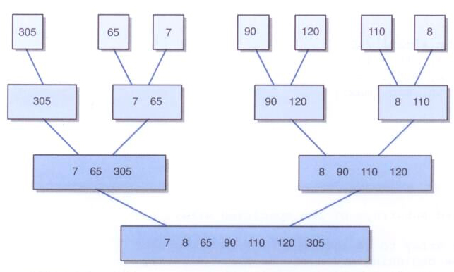
Merge Sort
Merging sorted elements

Slide 23
Difference between Posteriori and Priori analysis
Algorithm is a combination or sequence of finite-state to solve a given problem. If the problem is having more than one solution or algorithm then the best one is decided by the analysis based on two factors.
CPU Time (Time Complexity)
Main memory space (Space Complexity)
Time complexity of an algorithm can be calculated by using two methods:
Posteriori Analysis
Priori Analysis

Slide 24
A POSTERIORI ANALYSIS | A PRIORI ANALYSIS
Posteriori analysis is a relative analysis. | Piori analysis is an absolute analysis.
It is dependent on language of compiler and type of hardware. | It is independent of language of compiler and types of hardware.
It will give exact answer. | It will give approximate answer.
It doesn’t use asymptotic notations to represent the time complexity of an algorithm. | It uses the asymptotic notations to represent how much time the algorithm will take in order to complete its execution.
The time complexity of an algorithm using a posteriori analysis differ from system to system. | The time complexity of an algorithm using a priori analysis is same for every system.
If the time taken by the algorithm is less, then the credit will go to compiler and hardware. | If the program running faster, credit goes to the programmer.

Slide 25
The algorithms can be classified as follows from the best-to-worst performance (Running Time Complexity):
A logarithmic algorithm – O(logn)
Runtime grows logarithmically in proportion to n.
▪ A linear algorithm – O(n)
Runtime grows directly in proportion to n.
▪ A superlinear algorithm – O(nlogn)
Runtime grows in proportion to n.
▪ A polynomial algorithm – O(nc)
Runtime grows quicker than previous all based on n.
▪ A exponential algorithm – O(cn)
Runtime grows even faster than polynomial algorithm based on n.
▪ A factorial algorithm – O(n!)
Runtime grows the fastest and becomes quickly unusable for even
small values of n.

Slide 26
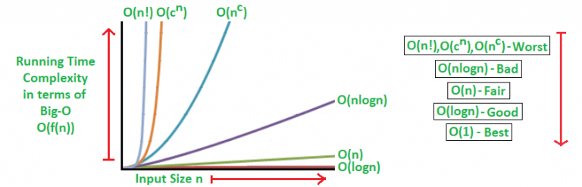

Slide 27
Algorithmic Examples of Runtime Analysis:
Some of the examples of all those types of algorithms (in worst-case scenarios) are mentioned below:
Logarithmic algorithm – O(logn) – Binary Search. Linear algorithm – O(n) – Linear Search. Superlinear algorithm – O(nlogn) – Heap Sort, Merge Sort. Polynomial algorithm – O(n^c) –Bubble Sort, Selection Sort, Insertion Sort
Exponential algorithm – O(c^n) – Tower of Hanoi. Factorial algorithm – O(n!) –Brute force Search algorithm for Traveling Salesman Problem.

