Slide 1
Design and Analysis of Algorithms
Lecture 04
Optimization Problem: Greedy Method

Slide 2
Feasible Soltution
A solution (set of values for the decision variables) for which all of the constraints in the given problem are satisfied is called a feasible solution.

Slide 3
Optimal Solution
An optimal solution is a feasible solution where the objective function reaches its maximum (or minimum) value – for example, the most profit or the least cost.
There can only be one Optimal solution.

Slide 4
Optimization Problems
An optimization problem is one in which you want to find, not just a solution, but the best solution from all feasible solutions ( either minimum result or maximum result)

Slide 5
Strategies for solving Optimization Problelm
Greedy Method
Dynamic Programming
Branch and Bound

Slide 6
for i =1 to n do
{
x= select(a);
feasible (x) then
solution = solution +x;
}

Slide 7
Greedy Algorithm
In greedy algorithm approach, decisions are made from the given solution domain. As being greedy, the closest solution that seems to provide an optimum solution is chosen.
Greedy algorithms try to find a localized optimum solution, which may eventually lead to globally optimized solutions. However, generally greedy algorithms do not provide globally optimized solutions.
Notes:
Definition: An algorithm that always takes the best immediate, or local, solution while finding an answer. Greedy algorithms find the overall, or globally, optimal solution for some optimization problems, but may find less-than-optimal solutions for some instances of other problems

Slide 8
Examples
Most networking algorithms use the greedy approach. Here is a list of few of them
Knapsack Problem
Job Scheduling Problem
Prim's Minimal Spanning Tree Algorithm
Kruskal's Minimal Spanning Tree Algorithm
Travelling Salesman Problem
Dijkstra's Minimal Spanning Tree Algorithm
Graph - Map Coloring
Graph - Vertex Cover

Slide 9
Greedy Technique
Constructs a solution to an optimization problem piece by piece through a sequence of choices that are:
feasible, i.e. satisfying the constraints.
locally optimal (with respect to some neighborhood definition).
greedy (in terms of some measure).

Slide 10
Knapsack problem
Given some items, pack the knapsack to get the maximum total value. Each item has some weight and some value. Total weight that we can carry is no more than some fixed number W.
So we must consider weights of items as well as their values.

Slide 11
Knapsack problem
There are two versions of the problem:
0-1 knapsack problem
Items are indivisible; you either take an item or not. Some special instances can be solved with dynamic programming
No greedy algorithm exists.
Fractional knapsack problem
Items are divisible: you can take any fraction of an item. Solved by greedy algorithm.
Object can be 0 <= x. <= 1

Slide 12
The optimal Fractional Knapsack Algorithm
This algorithm is for time complexity O(n logn))
Sort the n objects from large to small based on the ratios vi/wi. We assume the arrays w[1..n] and v[1..n] store the respective weights and values after sorting.
initialize array x[1..n] to zeros.
weight = 0; i = 1
while (i <= n and weight < W) do
If weight + w[i] <= W then x[i]=1
else x[i] = (W – weight) / w[i]
weight = weight + x[i] * w[i]
i++

Slide 13
Knapsack Problem
Let us consider that the capacity of the knapsack W = 60 and the list of provided items are shown in the following table −
Ratio: Value /
Item | A | B | C | D
Value | 280 | 100 | 120 | 120
Weight | 40 | 10 | 30 | 24
Ratio | 7 | 10 | 6 | 5

Slide 14
As the provided items are not sorted. After sorting, the items are as shown in the following table.
B A C D
1 1. 10 /20 0
Weight : 1* 10 + 1*40 + 10/20* 20 +0* 24
Now calculate the profit: 1*100+ 1* 280 +10/20* 120 +0 * 120
100+280+60+0= 440
Item | B | A | C | D
Value | 100 | 280 | 120 | 120
Weight | 10 | 40 | 20 | 24
Ratio | 10 | 7 | 6 | 5

Slide 15
Solution
After sorting all the items, First all of B is chosen as weight of B is less than the capacity of the knapsack.
Next, item A is chosen, as the available capacity of the knapsack is greater than the weight of A.
Now, C is chosen as the next item. However, the whole item cannot be chosen as the remaining capacity of the knapsack is less than the weight of C.
Hence, fraction of C (i.e. (60 − 50)/20) is chosen.

Slide 16
Now, the capacity of the Knapsack is equal to the selected items. Hence, no more item can be selected.
The total weight of the selected items is
10 + 40 + 20 * (10/20) = 60
And the total profit is
100 + 280 + 120 * (10/20) = 380 + 60 = 440
This is the optimal solution. We cannot gain more profit selecting any different combination of items.
Item | A | B | C | D
Selected | 1 | 1 | 0.5 | 0

Slide 17
Job Sequencing Problem
The objective is to find a sequence of jobs, which is completed within their deadlines with maximum profit
Because we are using two loops one within another, the complexity of this algorithm is O(n2)

Slide 18
Algorithm Job_seq (d, 1, n)
{
d [0] = 0; 1
JS [1] = 1; 1
i = 1; 1
for j= 2 to n do;{ n k = i; 1 while ((d[JS[k] > d[j]]) and (d[JS[k]] != k)) 2*n
do k = k -1; 2 if ((d[JS[k] < d[j]]) and (d[j] > k)) then
{ 2*n
For m= i to (k+1) step-1 do n*n
JS [m+1] = JS [m]; 1*n*n
JS [K+1] = j; 1*n*n
i = i+1; 2*n*n
} }
Return i;
}
Time complexity = O(n2)

Slide 19
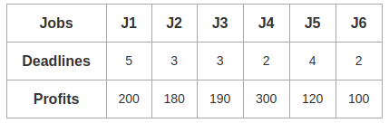
Example
Value of maximum deadline = 5

Slide 20
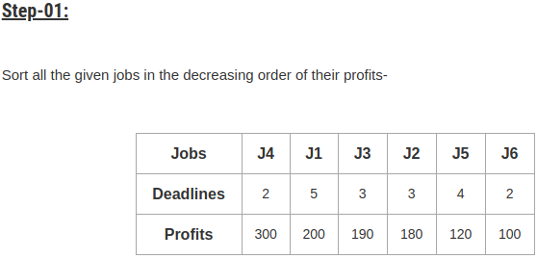
Value of maximum deadline = 5
1 | 2 | 3 | 4 | 5
J1 | J4 | J3 | J5

Slide 21
0-1. 1-2. 2-3 3-4 4-5

Slide 22
1 | 2 | 3 | 4 | 5
J2 | J4 | J3 | J5 | J1
Profit = 180 + 300 + 190 + 120 + 200 = 990

Slide 23
Huffman Coding
Greedy Method

Slide 24
Example:
Message: BCCABBDDAECCBBAEDDCC length: 20 letters
Total size of the message is 8 * 20= 160 bits

Slide 25
Message send in the form of ASCII code
ASCII represented as bits. 8 bits codes for each Character
Lets suppose
A is represented as 65 01000001
B is represented as 66 01000010 and so on

Slide 26
Huffman Coding
A technique to compress data effectively • Usually between 20%-90% compression
Lossless compression • No information is lost • When decompress, you get the original file

Slide 27
Huffman Coding: Applications
Saving space
Store compressed files instead of original files
Transmitting files or data
Send compressed data to save transmission time and power
Encryption and decryption
Cannot read the compressed file without knowing the “key”

Slide 28
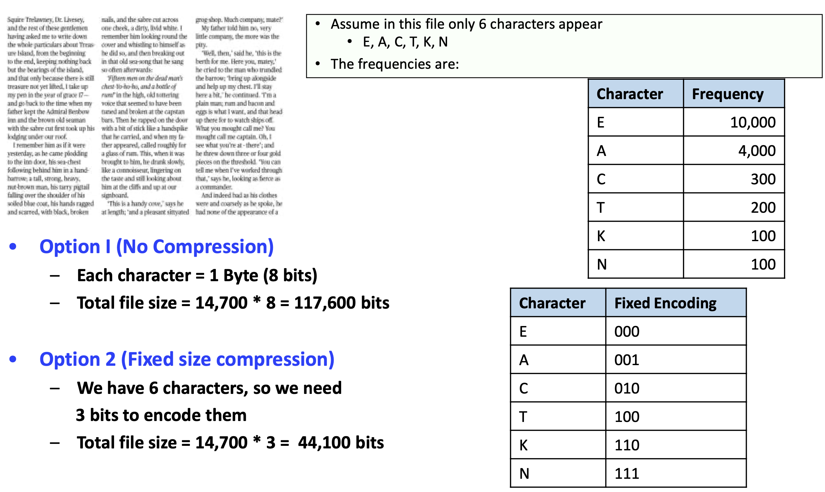
Main Idea: Frequency-Based Encoding

Slide 29
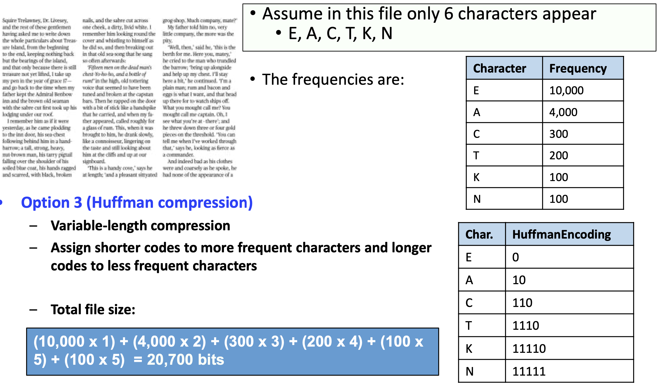

Slide 30
Huffman Coding
A variable-length coding for characters
More frequent characters➔shorter codes
Less frequent characters➔longer codes
It is not like ASCII coding where all characters have the same coding length (8 bits)
Two main questions
How to assign codes (Encoding process)?
How to decode (from the compressed file, generate the original file) (Decoding process)?

Slide 31
How to encode the Fixed Length BCCABBDDAECCBBAEDDCC
Character | Count / Frequency | Code
A | 3 | 000
B | 5 | 001
C | 6 | 010
D | 4 | 011
E | 2 | 100
Length: 20 Size: 20*3 = 60 bits

Slide 32
Decoding for fixed-length codes is much easier
We need ASCII bits to decode the message
5* 8
A | 000
B | 001
C | 010
D | 011
E | 100
5* 8 =40 bits | 5*3= 15 bits
55 bits

Slide 33
Message with decoding table
Size of Message = 60 bits
Decode Table= 55 bits
Total size= 115 bits
This way 35-40% reduction in size

Slide 34
Huffman Algorithm
Step 1: Get Frequencies • Scan the file to be compressed and count the occurrence of each character • Sort the characters based on their frequency
Step 2: Build Tree & Assign Codes • Build a Huffman-code tree (binary tree) • Traverse the tree to assign codes
Step 3: Encode (Compress) • Scan the file again and replace each character by its code
Step 4: Decode (Decompress) • Huffman tree is the key to decompress the file

Slide 35
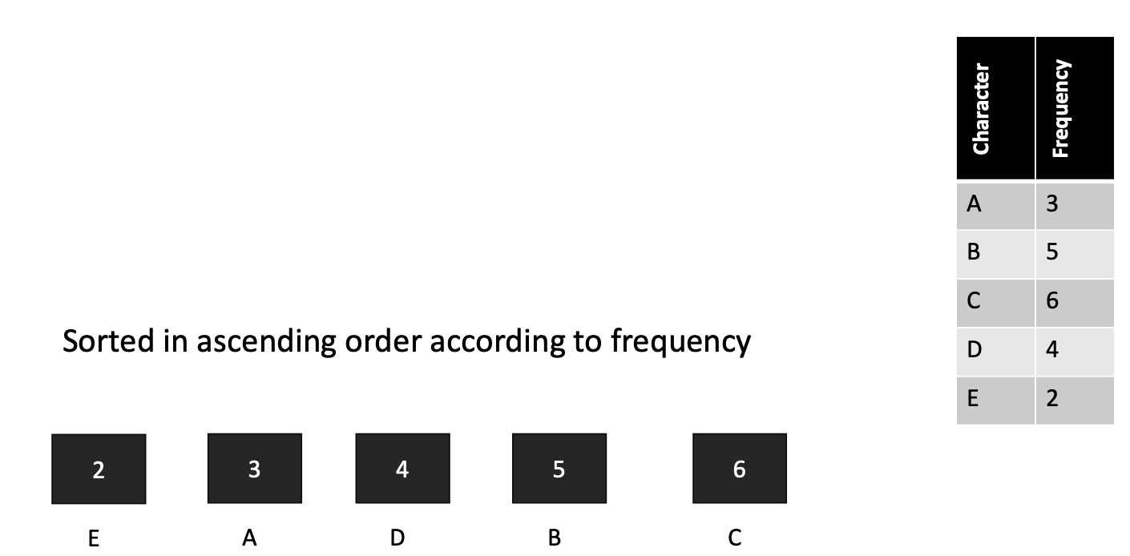
Message: BCCABBDDAECCBBAEDDCC
Step 1: Get Frequencies

Slide 36
Step 2: Build Huffman Tree & Assign Codes
It is a binary tree in which each character is a leaf node • Initially each node is a separate root
At each step • Select two roots with smallest frequency and connect them to a new parent (Break ties arbitrary) [The greedy choice]
• The parent will get the sum of frequencies of the two child nodes
Repeat until you have one root

Slide 37
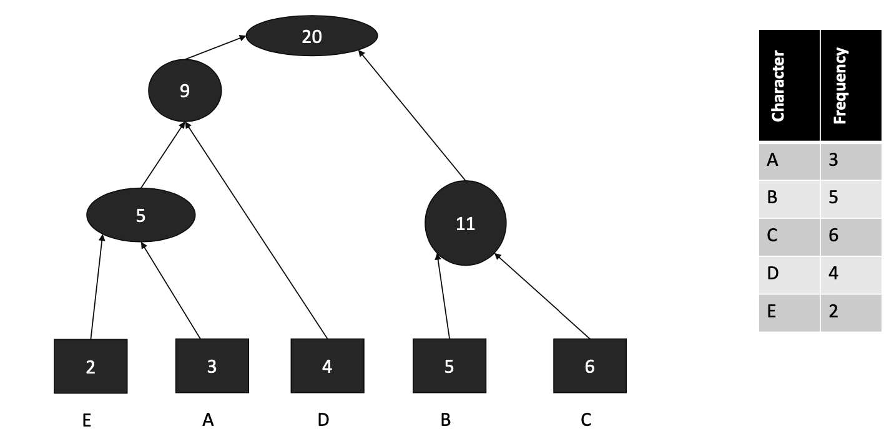
Now we have a single root...This is the Huffman Tree

Slide 38
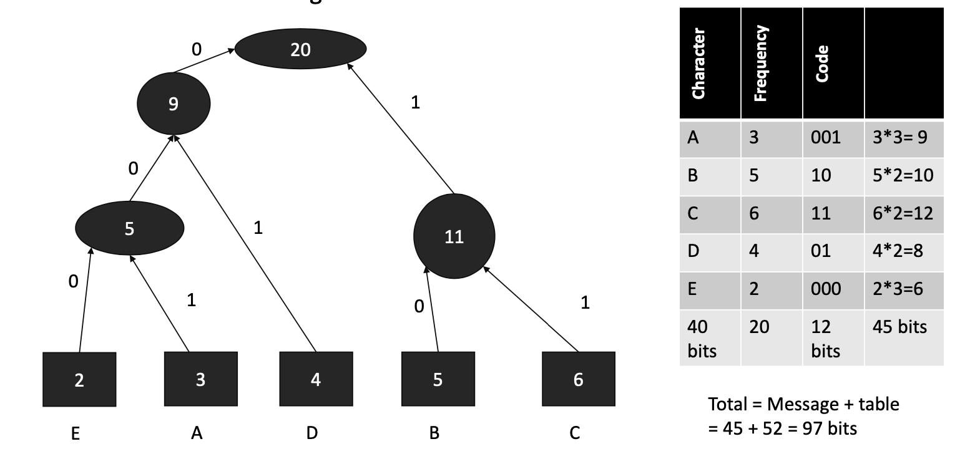
Traverse the tree • Any left edge➔add label 0 •
As right edge➔add label 1
Lets Assign Codes

Slide 39
Time Complexity
An appropriate data structure is a binary min-heap
Rebuilding the heap is lgn and n-1 extractions are made, so the complexity is O( nlgn)

