Slide 1
Design and Analysis of Algorithms
Lecture 05
Optimization Problem: Greedy Method

Slide 2
Spanning Tree
Given a connected, undirected graph, a spanning tree of that graph is a subgraph which is a tree and connects all the vertices together.
A single graph can have many different spanning trees.

Slide 4
Minimum Spanning Tree
A minimum spanning tree is then a spanning tree with weight less than or equal to the weight of every other spanning tree.
In order to find a spanning tree, we must make sure that every node (vertex) is some how connected to the rest of the nodes by arcs (edges)
Use the fewest number of edges possible.
If a loop can be found, then one of the edges is not necessary

Slide 5

MST by Prim’s Algorithm

Slide 6
PSEUDO-CODE FOR PRIM'S ALGORITHM
Designate one node as the start node. ( Select a minimum cost edge) Add the start node to the priority queue of open nodes. WHILE (there are still nodes to be added to the closed list)
{
Remove a node from priority queue of open nodes, designate it as current node.
IF (the current node is not already in the closed list)
{
IF the node is not the first node removed from the priority queue, add the minimal edge connecting it with a closed node to the minimal spanning tree.
Add the current node to the closed list. FOR each successor of current node
IF (the successor is not already in the closed list OR the successor is now connected to a closed node by an edge of lesser weight than before)
Add that successor to the priority queue of open nodes;
}
}

Slide 7
4
c
b
4
1
a
2
e
4
d
1
7
j
2
6
f
5
6
3
5
g
4
h
i
2
3

Slide 8
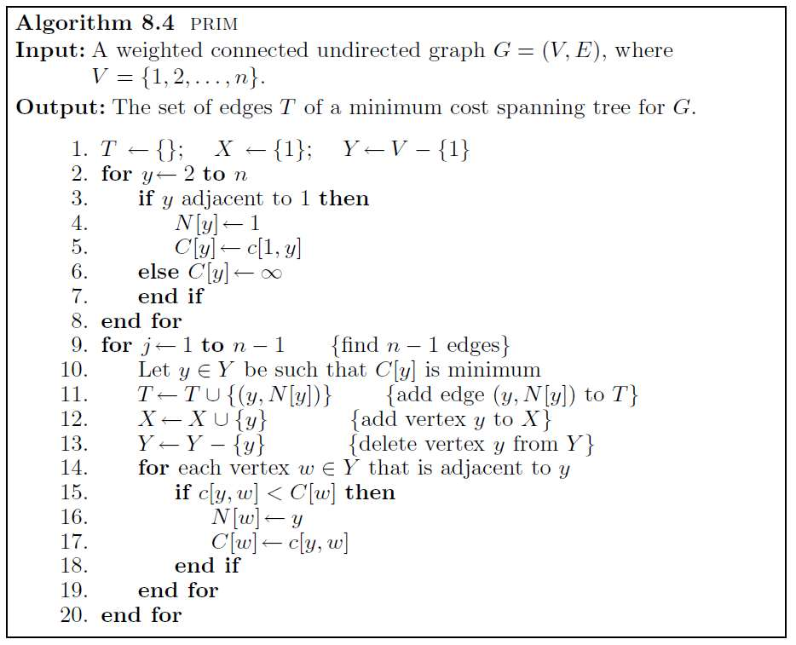
Prim’s Algorithm
Complexity Analysis is O(n2)
If the input graph is represented using adjacency list,
then the time complexity of Prim’s algorithm can be reduced to O(E log V) with the help of binary heap.

Slide 9
MST by Kruskal’s Algorithm

Slide 10
Kruskal’s Algorithm
Work with edges, rather than nodes
Two steps:
– Sort edges by increasing edge weight
– Select the first |V| – 1 edges that do not generate a cycle

Slide 11
4
c
b
4
1
a
2
e
4
d
1
7
j
2
6
f
5
6
3
5
g
4
h
i
2
3

Slide 12
Sort edges by increasing edge weight
cd = 1
aj = 1
ce = 2
ef = 2
ih = 2
fg = 3
gh = 3
ab = 4
bc = 4
bj = 4
fh = 4
dg = 5
ij = 5
hj= 6
df = 6
bh = 7

Slide 13
4
cd = 1
aj = 1
ce = 2
ef = 2
ih = 2
fg = 3
gh = 3
ab = 4
bc = 4
bj = 4
fh = 4
dg = 5
ij = 5
hj= 6
df = 6
bh = 7
c
b
4
1
a
2
e
4
d
1
7
j
2
6
f
5
6
3
5
g
4
h
i
2
3

Slide 14
Time Complexity
Time Complexity Analysis is O(n2)
Time Complexity Analysis is O(E log V) using binary heap.

Slide 15
Dijkstra Algorithm

Slide 16
Single-Source Shortest Path Problem
Single-Source Shortest Path Problem - The problem of finding shortest paths from a source vertex v to all other vertices in the graph.

Slide 17
Dijkstra's algorithm
Dijkstra's algorithm - is a solution to the single-source shortest path problem in graph theory.
Works on both directed and undirected graphs. However, all edges must have nonnegative weights.
Approach: Greedy
Input: Weighted graph G={E,V} and source vertex v∈V, such that all edge weights are nonnegative
Output: Lengths of shortest paths (or the shortest paths themselves) from a given source vertex v∈V to all other vertices

Slide 18
What is Edge Relaxation?
Consider the edge (a,b) in the following graph-
d [a]
d [b]
s
1
a
2
b
∞
Here, d[a] and d[b] denotes the shortest path estimate for vertices a and b respectively from the source vertex ‘S’.
Now,
If d[a] + w < d[b]
then d[b] = d[a] + w
This is called as edge relaxation.

Slide 19
a
8
b
1
1
s
2
7
2
c
5
5
e
d
3

Slide 20


1
♾
a
8
b
1
1
s
2
7
2
c
♾
5
5
e
d
3
♾
5

Slide 21
1
♾
9
a
8
b
1
1
s
2
7
2
c
♾
5
5
e
d
3
♾
5
8
3

Slide 22

1
♾
9
a
8
b
1
1
s
2
7
2
c
♾
5
5
e
d
3
♾
5
8
3
6

Slide 23
1
♾
9
8
a
8
b
1
1
s
2
7
2
c
♾
11
5
5
e
d
3
♾
5
8
3
6

Slide 24

1
♾
9
8
a
8
b
1
1
s
2
7
2
c
♾
11
5
5
9
e
d
3
♾
5
8
3
6

Slide 25
1
♾
9
8
a
8
b
1
1
s
2
7
2
c
♾
11
5
5
9
e
d
3
♾
5
8
3
6

Slide 26
Time Complexity
Time Complexity of Dijkstra's Algorithm is O ( V 2 ) but with min-priority queue it drops down to O ( V + E l o g V ) .

Slide 27
Dijkstra Table
Selected Vertex | a | b | c | d | e
a | 1 | ♾ | ♾ | ♾ | 5
e | 1 | 9 | ♾ | 8 | 3
d | 1 | 9 | ♾ | 6 | 3
b | 1 | 8 | 11 | 6 | 3
c | 1 | 8 | 9 | 6 | 3

