Slide 1
Chapter 14
Wireless LANs
14.<number>

Slide 2
14-1 IEEE 802.11
IEEE has defined the specifications for a wireless LAN, called IEEE 802.11, which covers the physical and data link layers.
Topics discussed in this section:
Architecture
MAC Sublayer
Physical Layer
14.<number>

Slide 3

Note
A BSS without an AP is called an ad hoc network;
a BSS with an AP is called an infrastructure network.
14.<number>

Slide 4
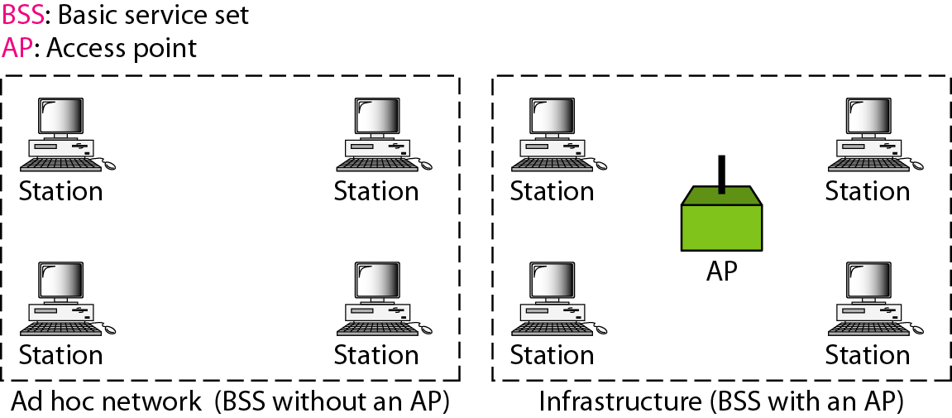
Figure 14.1 Basic service sets (BSSs)
14.<number>

Slide 5
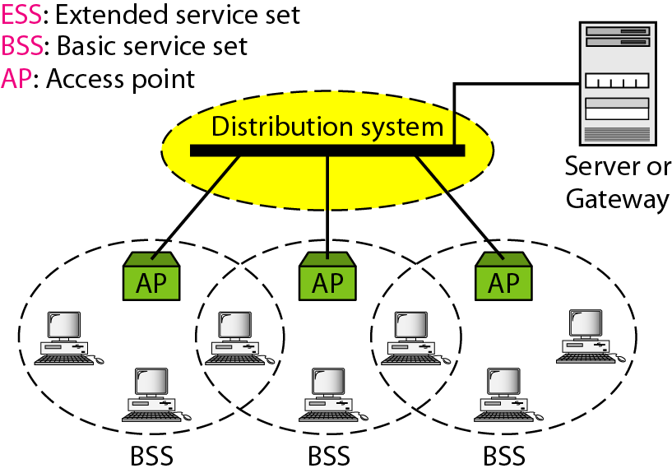
Figure 14.2 Extended service sets (ESSs)
14.<number>

Slide 6
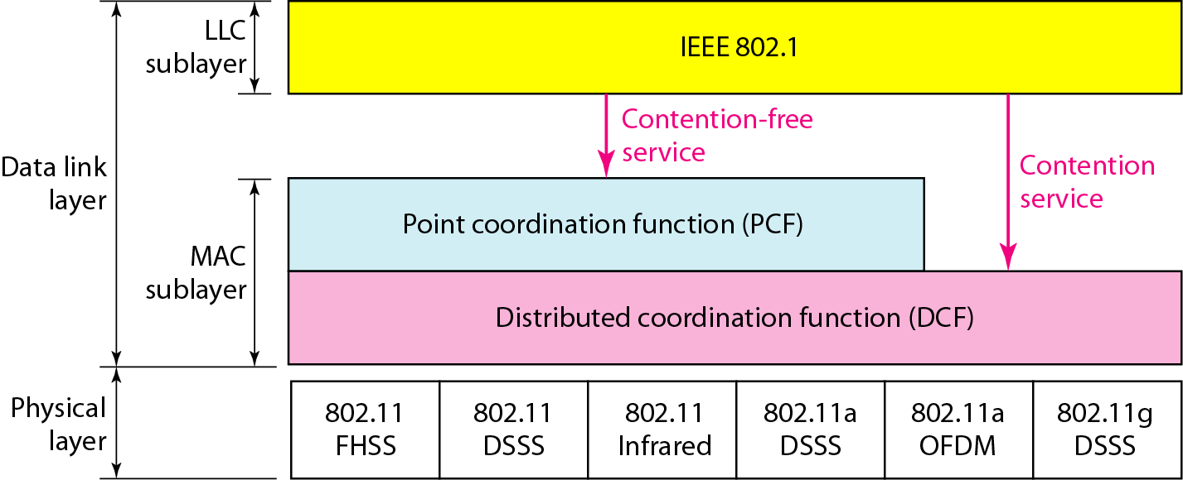
Figure 14.3 MAC layers in IEEE 802.11 standard
14.<number>

Slide 7

Figure 14.4 CSMA/CA flowchart
14.<number>

Slide 8
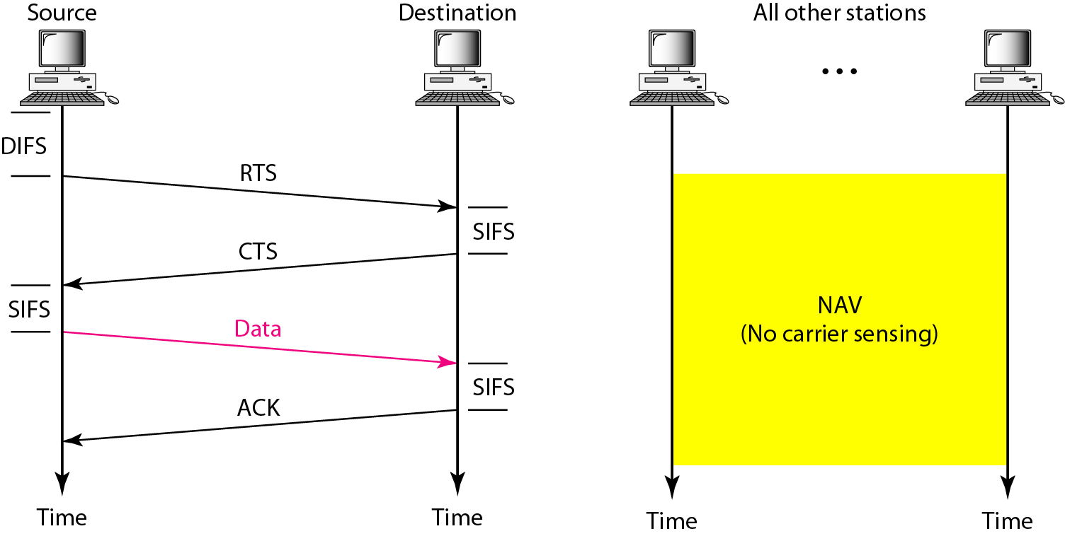
Figure 14.5 CSMA/CA and NAV
14.<number>

Slide 9
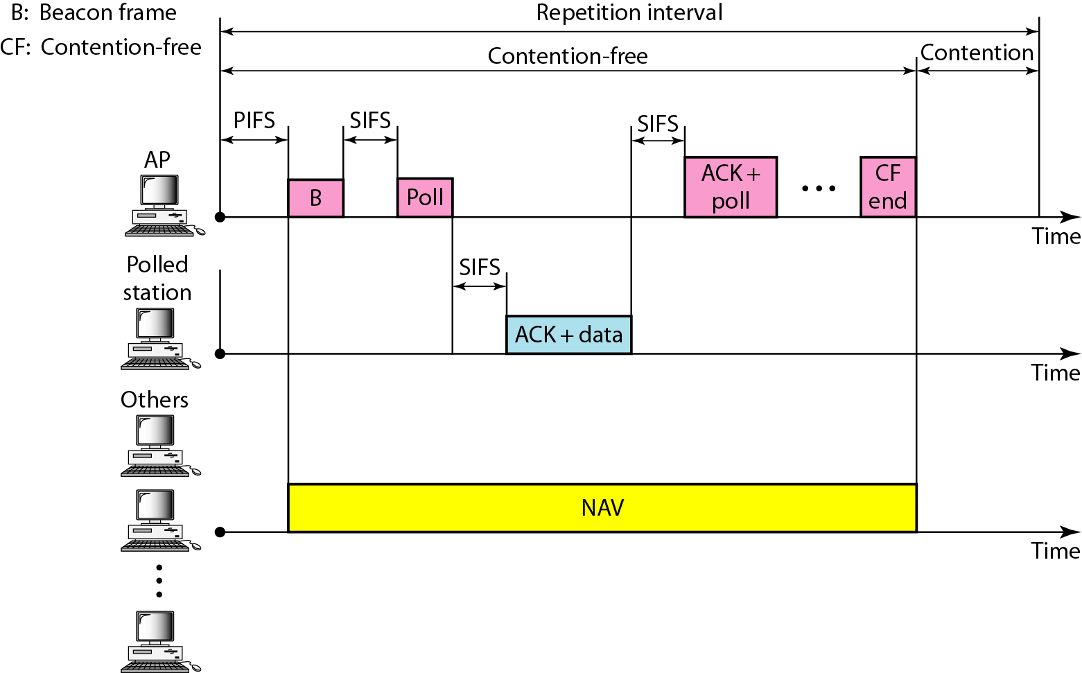
Figure 14.6 Example of repetition interval
14.<number>

Slide 10

Figure 14.7 Frame format
14.<number>

Slide 11
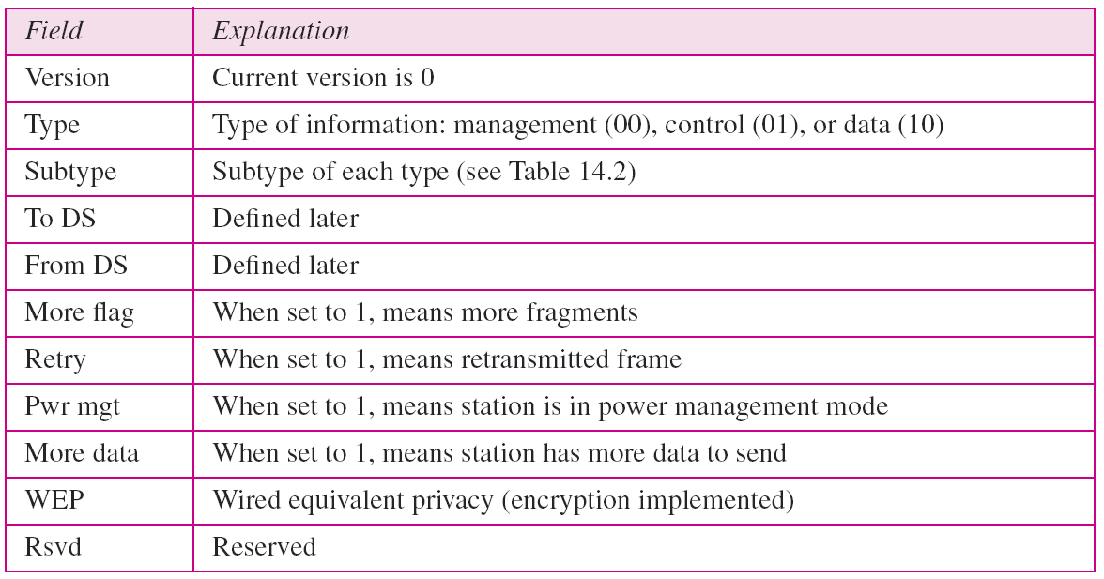
Table 14.1 Subfields in FC field
14.<number>

Slide 12
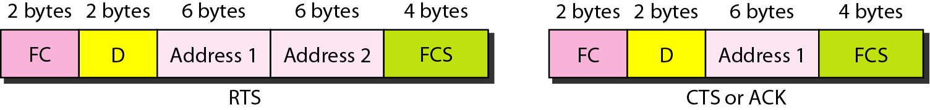
Figure 14.8 Control frames
14.<number>

Slide 13
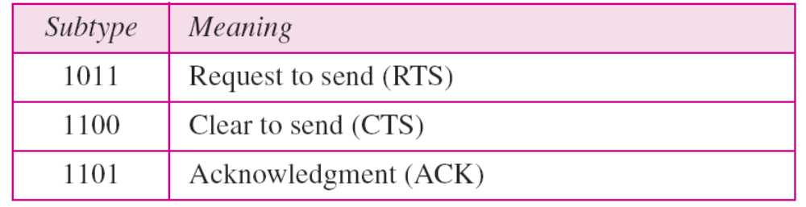
Table 14.2 Values of subfields in control frames
14.<number>

Slide 14
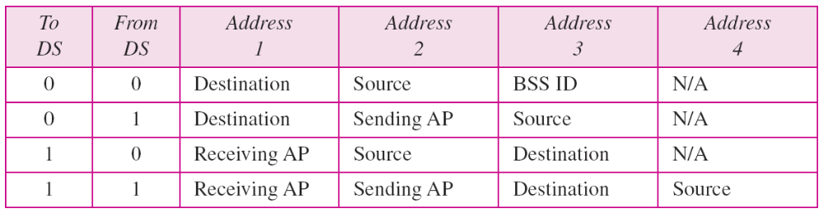
Table 14.3 Addresses
14.<number>

Slide 15
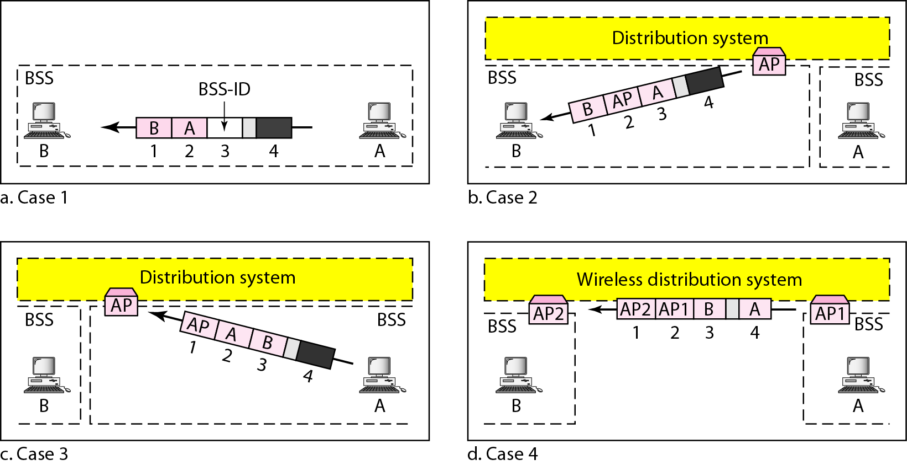
Figure 14.9 Addressing mechanisms
14.<number>

Slide 16
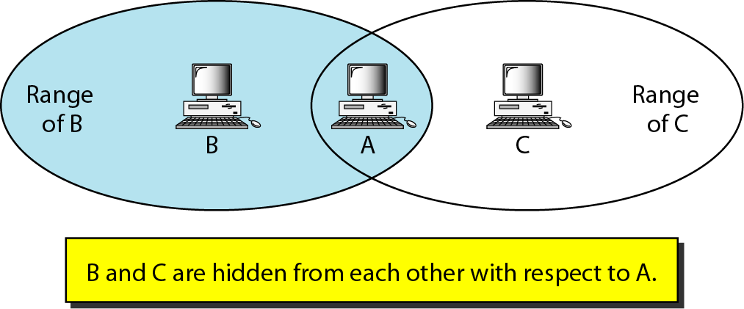
Figure 14.10 Hidden station problem
14.<number>

Slide 17
Note
The CTS frame in CSMA/CA handshake can prevent collision from
a hidden station.
14.<number>

Slide 18
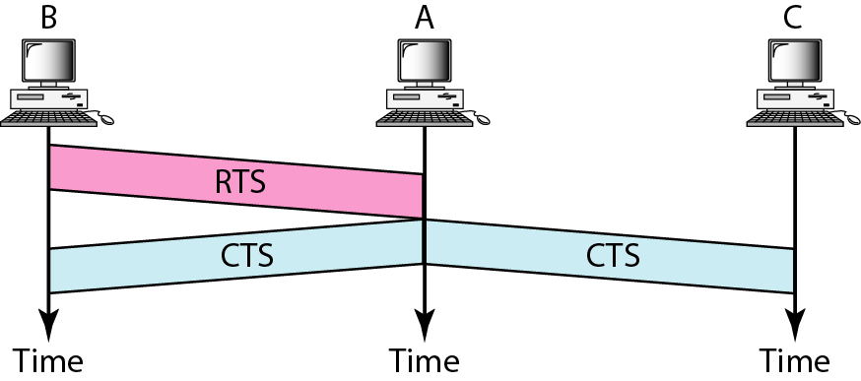
Figure 14.11 Use of handshaking to prevent hidden station problem
14.<number>

Slide 19
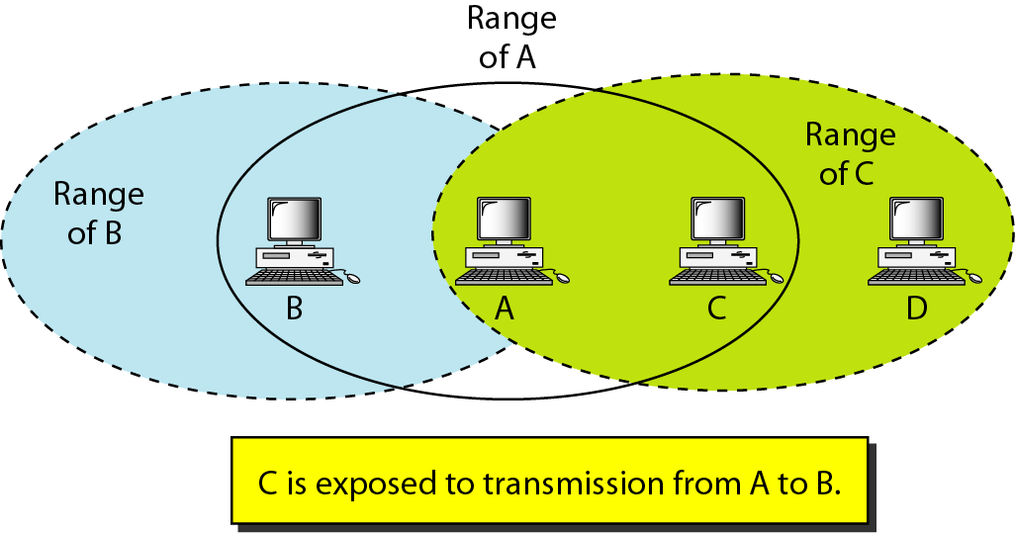
Figure 14.12 Exposed station problem
14.<number>

Slide 20
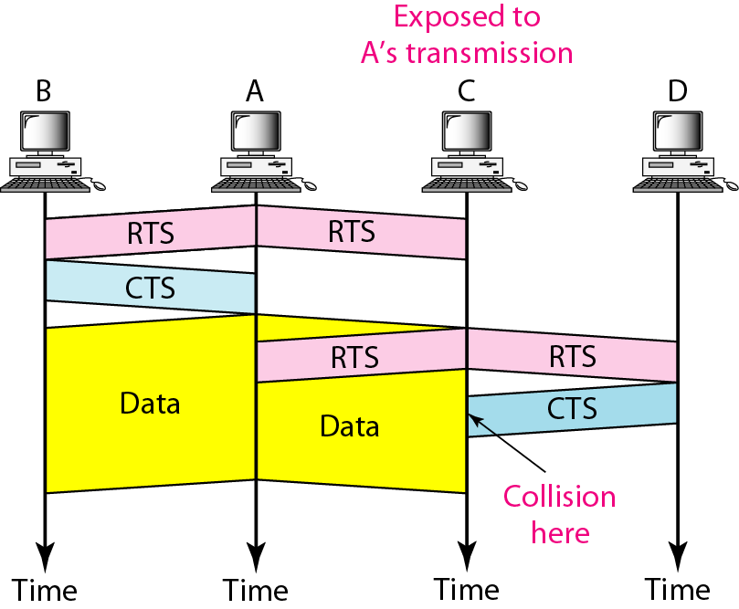
Figure 14.13 Use of handshaking in exposed station problem
14.<number>

Slide 21
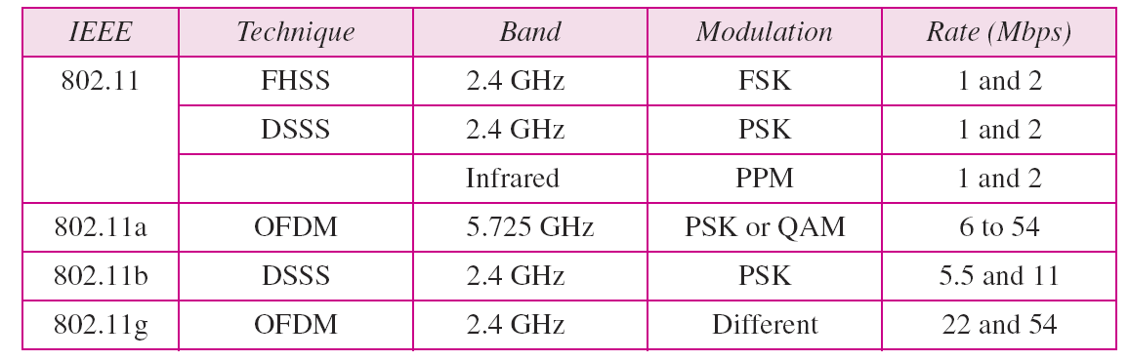
Table 14.4 Physical layers
14.<number>

Slide 22
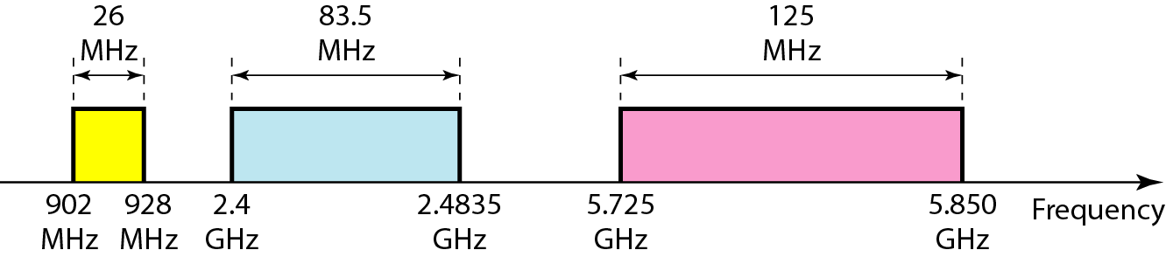
Figure 14.14 Industrial, scientific, and medical (ISM) band
14.<number>

Slide 23
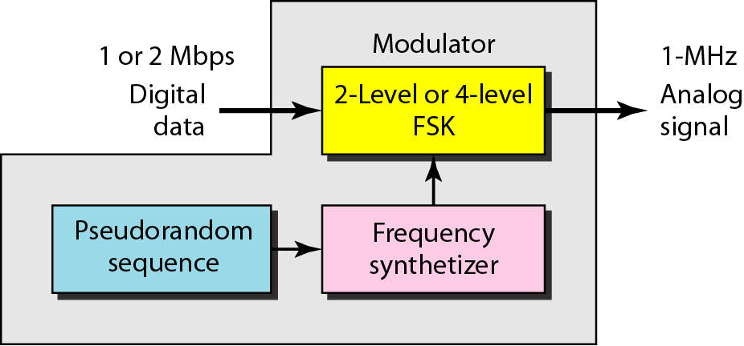
Figure 14.15 Physical layer of IEEE 802.11 FHSS
14.<number>

Slide 24
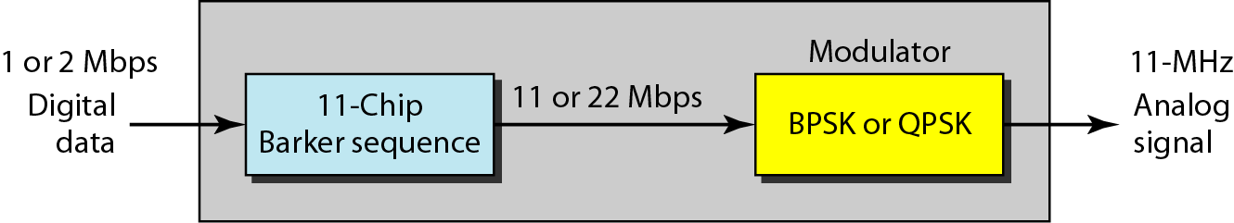
Figure 14.16 Physical layer of IEEE 802.11 DSSS
14.<number>

Slide 25
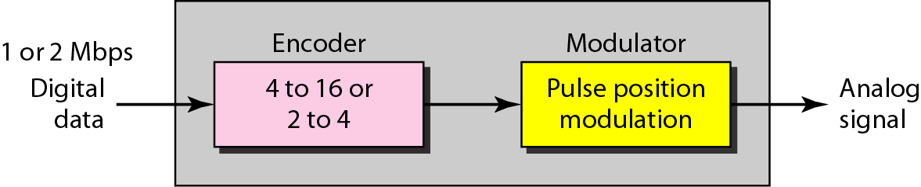
Figure 14.17 Physical layer of IEEE 802.11 infrared
14.<number>

Slide 26
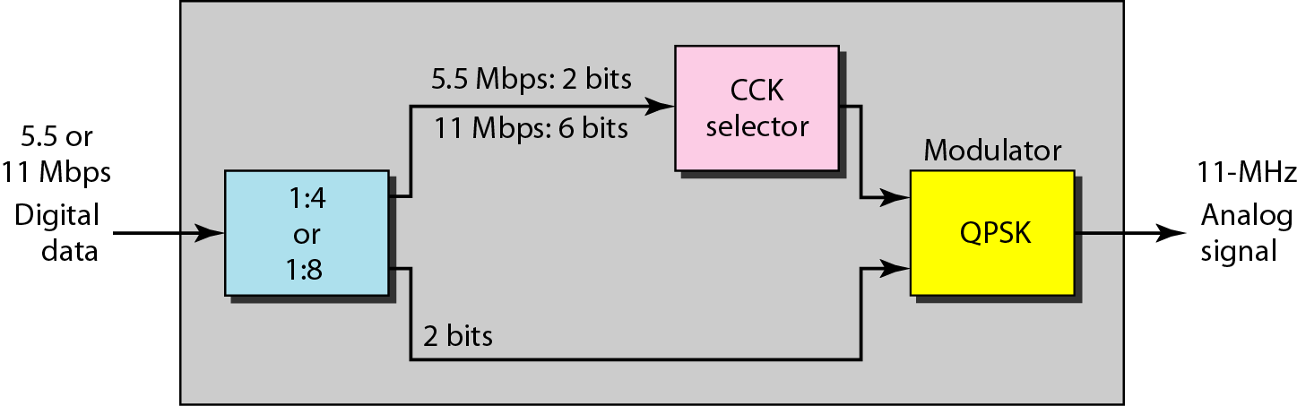
Figure 14.18 Physical layer of IEEE 802.11b
14.<number>

Slide 27
14-2 BLUETOOTH
Bluetooth is a wireless LAN technology designed to connect devices of different functions such as telephones, notebooks, computers, cameras, printers, coffee makers, and so on. A Bluetooth LAN is an ad hoc network, which means that the network is formed spontaneously.
Topics discussed in this section:
Architecture
Bluetooth Layers
Baseband Layer
L2CAP
14.<number>

Slide 28
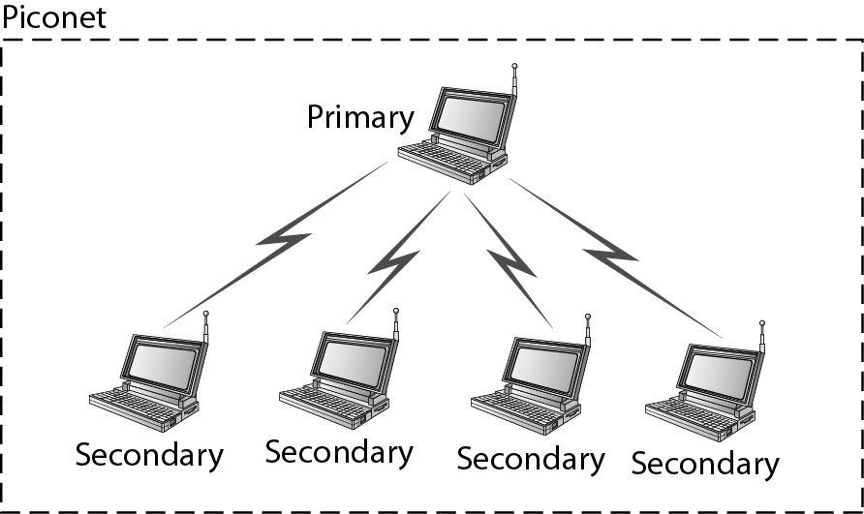
Figure 14.19 Piconet
14.<number>

Slide 29
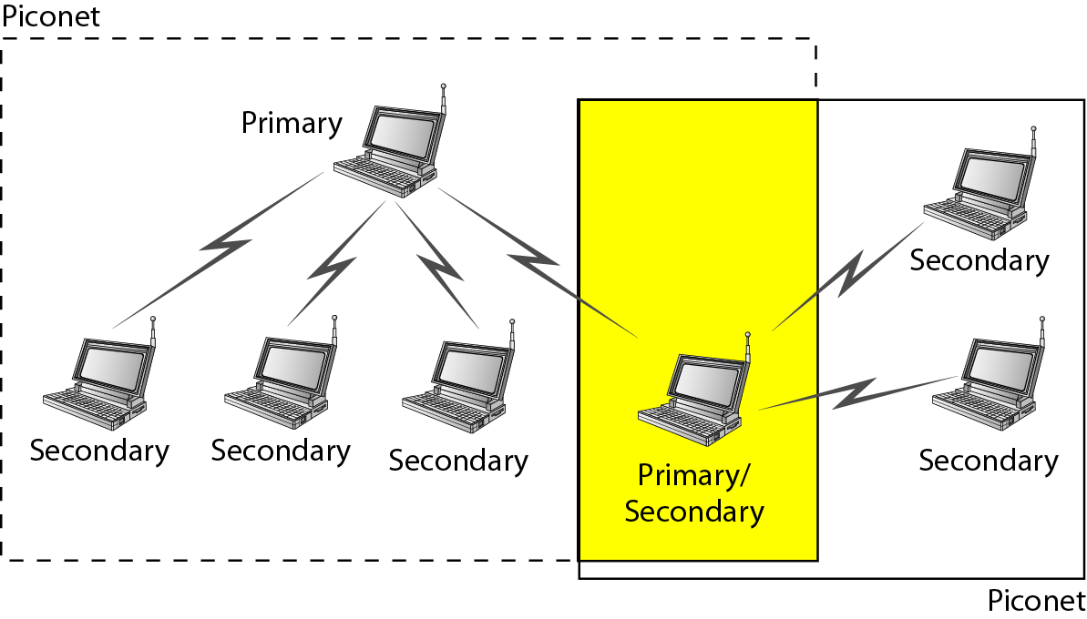
Figure 14.20 Scatternet
14.<number>

Slide 30
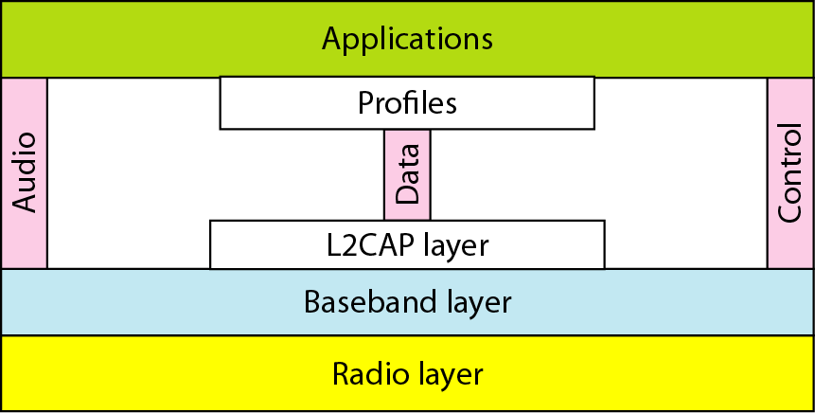
Figure 14.21 Bluetooth layers
14.<number>

Slide 31
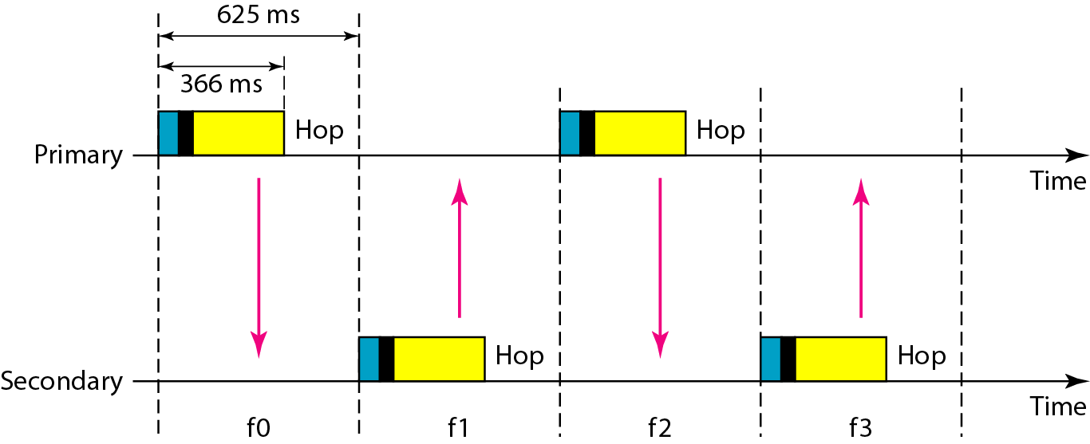
Figure 14.22 Single-secondary communication
14.<number>

Slide 32
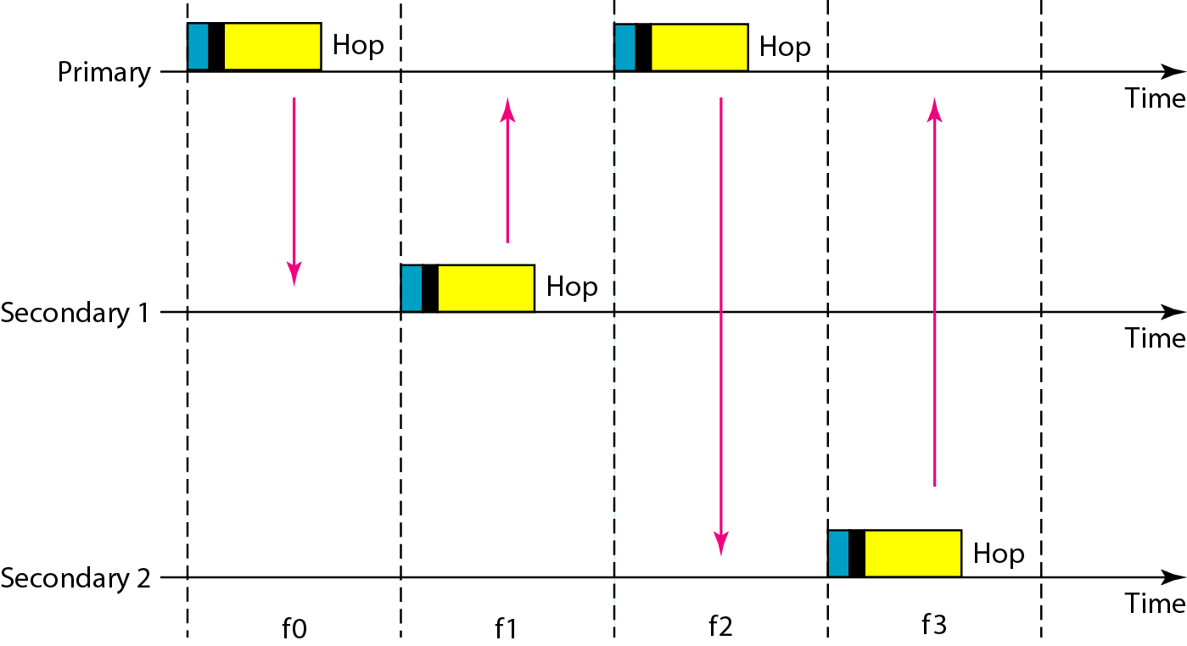
Figure 14.23 Multiple-secondary communication
14.<number>

Slide 33
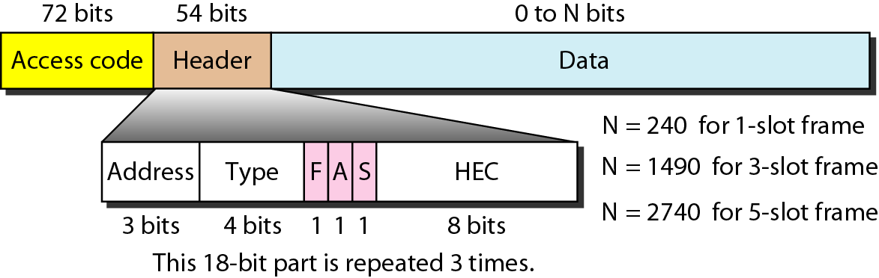
Figure 14.24 Frame format types
14.<number>

Slide 34

Figure 14.25 L2CAP data packet format
14.<number>

