Slide 1
Chapter 16
Wireless WANs:
Cellular Telephone
and Satellite Networks
16.<number>

Slide 2
16-1 CELLULAR TELEPHONY
Cellular telephony is designed to provide communications between two moving units, called mobile stations (MSs), or between one mobile unit and one stationary unit, often called a land unit.
Topics discussed in this section:
Frequency-Reuse Principle
Transmitting
Receiving
Roaming
First Generation
Second Generation
Third Generation
16.<number>

Slide 3
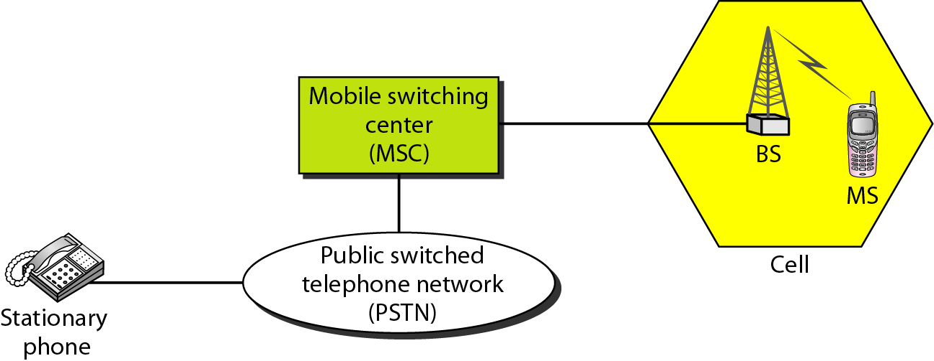
Figure 16.1 Cellular system
16.<number>

Slide 4
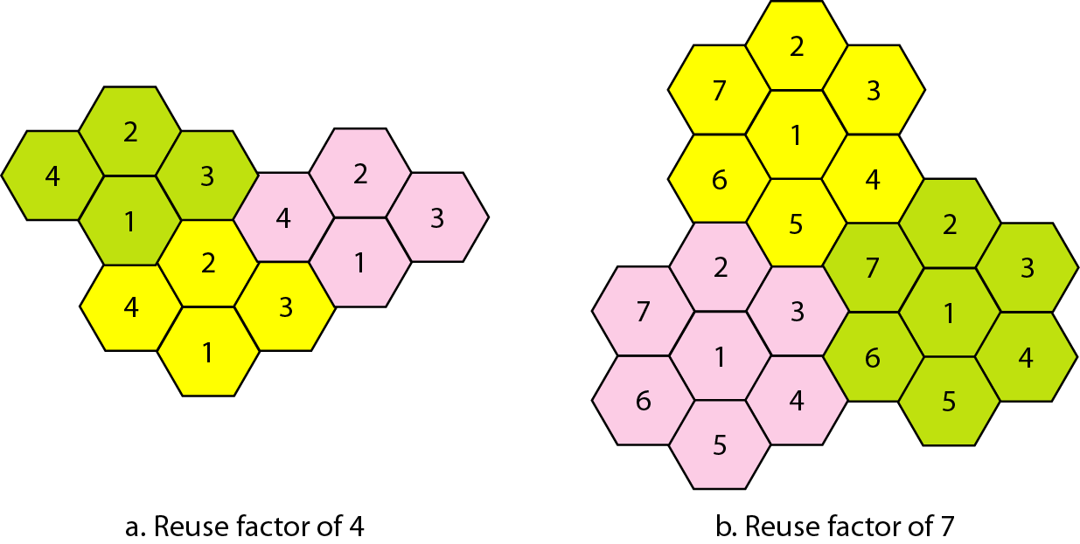
Figure 16.2 Frequency reuse patterns
16.<number>

Slide 5

Note
AMPS is an analog cellular phone system using FDMA.
16.<number>

Slide 6
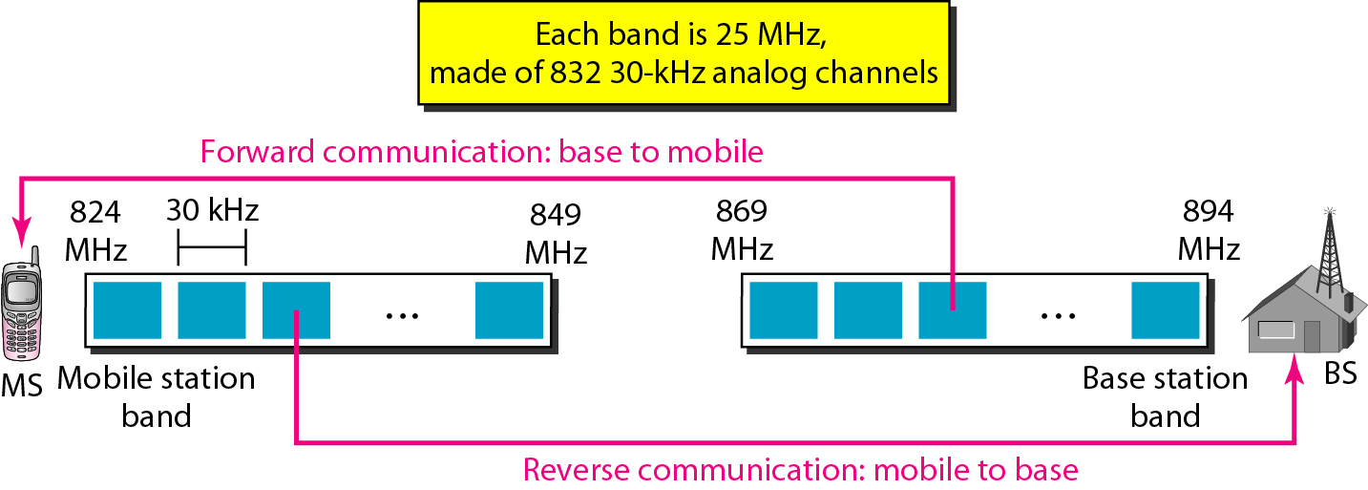
Figure 16.3 Cellular bands for AMPS
16.<number>

Slide 7
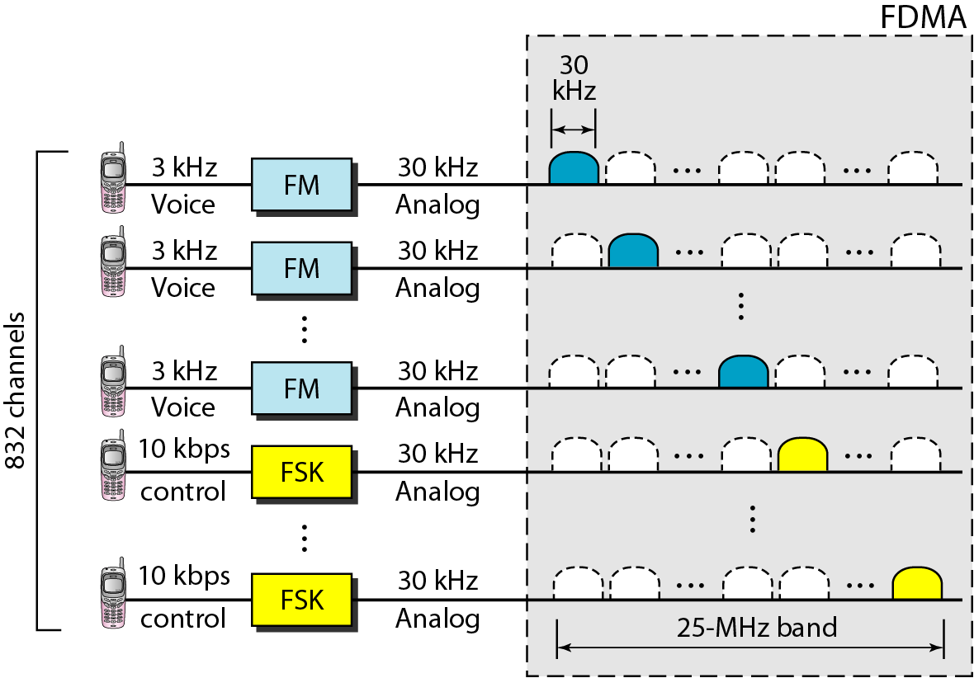
Figure 16.4 AMPS reverse communication band
16.<number>

Slide 8
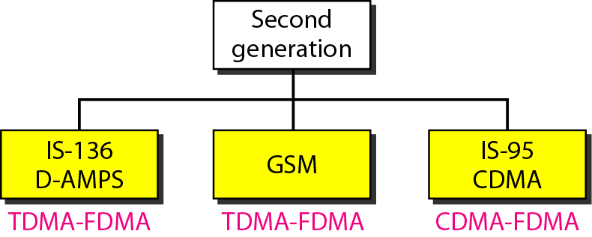
Figure 16.5 Second-generation cellular phone systems
16.<number>

Slide 9
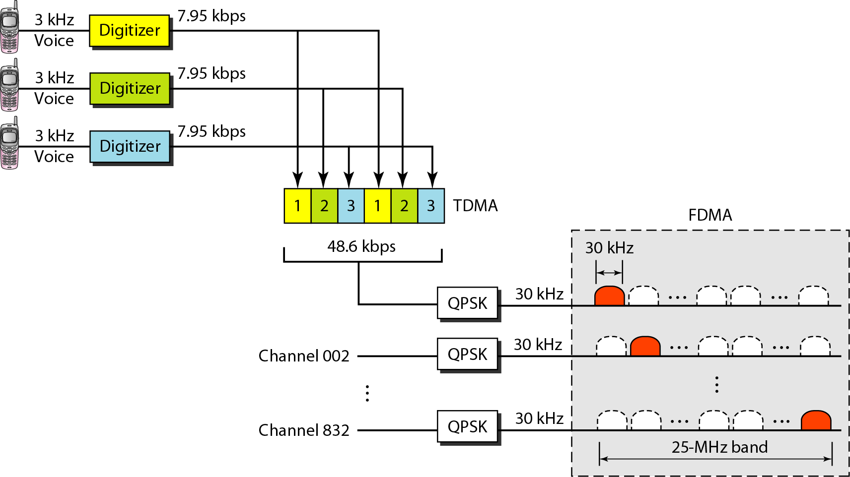
Figure 16.6 D-AMPS
16.<number>

Slide 10
Note
D-AMPS, or IS-136, is a digital cellular phone system using TDMA and FDMA.
16.<number>

Slide 11
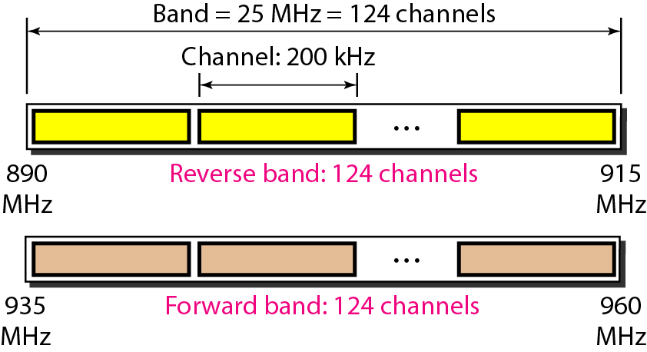
Figure 16.7 GSM bands
16.<number>

Slide 12
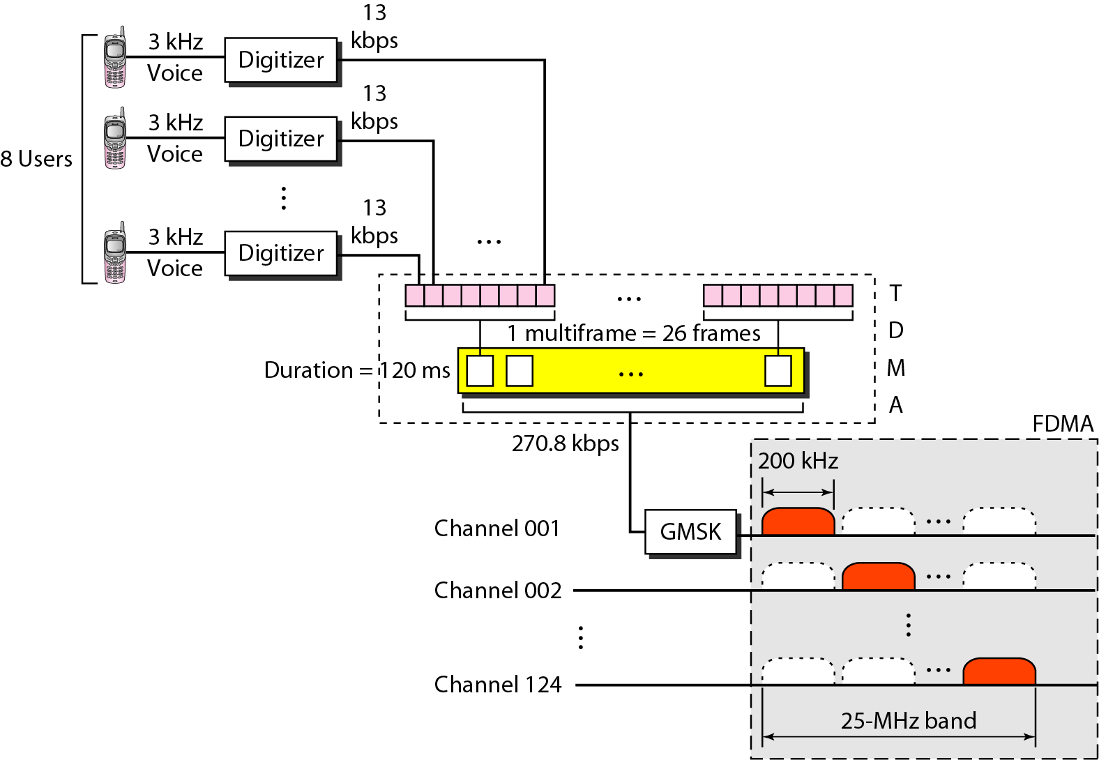
Figure 16.8 GSM
16.<number>

Slide 13
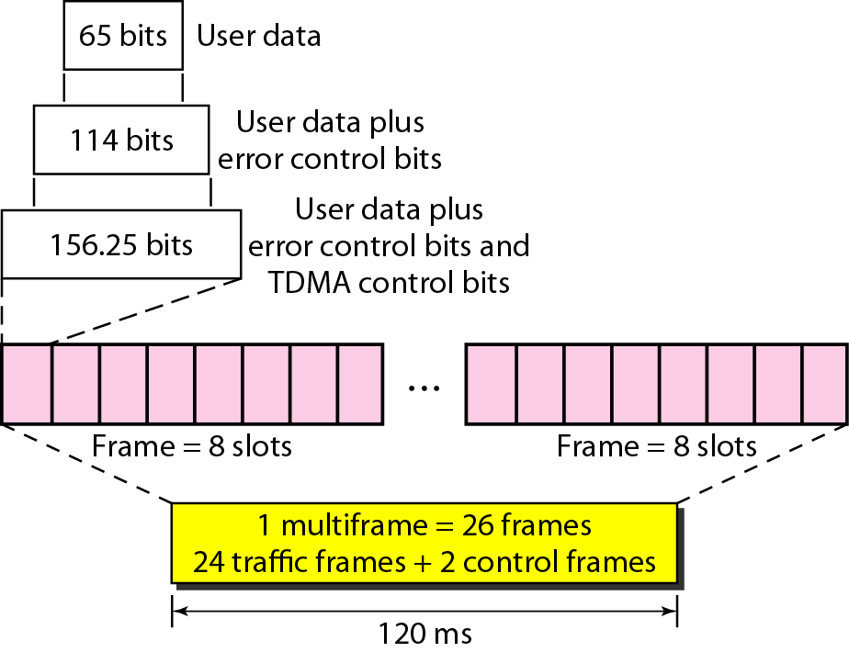
Figure 16.9 Multiframe components
16.<number>

Slide 14
Note
GSM is a digital cellular phone system using TDMA and FDMA.
16.<number>

Slide 15
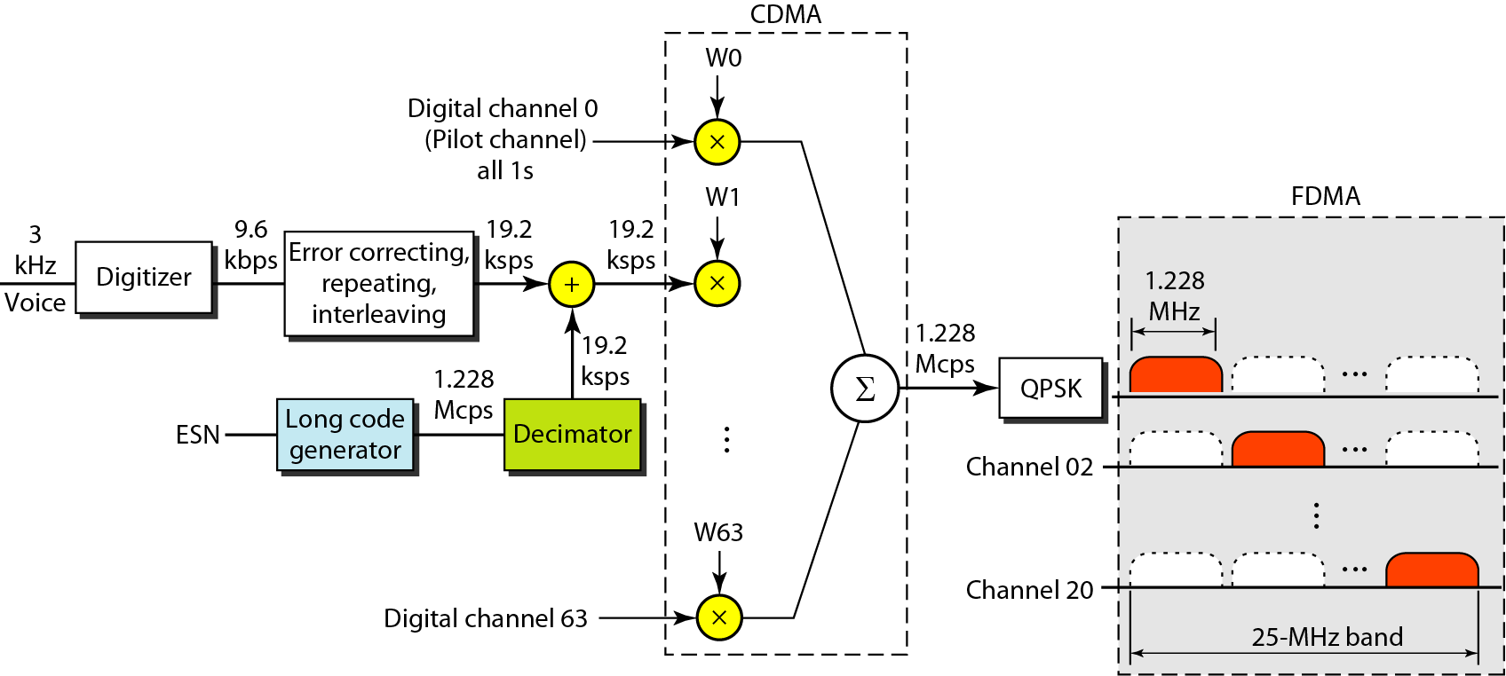
Figure 16.10 IS-95 forward transmission
16.<number>

Slide 16
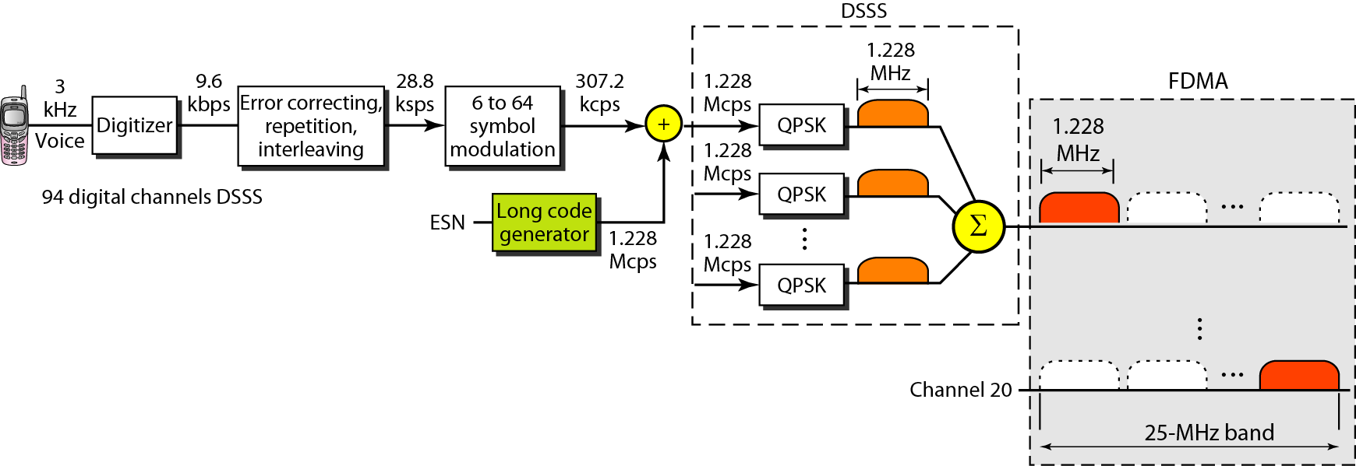
Figure 16.11 IS-95 reverse transmission
16.<number>

Slide 17
Note
IS-95 is a digital cellular phone system using CDMA/DSSS and FDMA.
16.<number>

Slide 18
Note
The main goal of third-generation cellular telephony is to provide
universal personal communication.
16.<number>

Slide 19
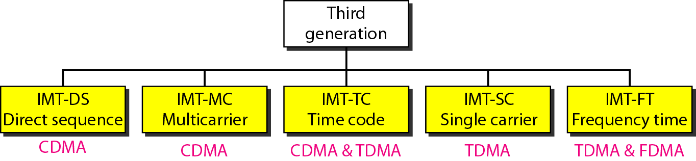
Figure 16.12 IMT-2000 radio interfaces
16.<number>

Slide 20
16-2 SATELLITE NETWORKS
A satellite network is a combination of nodes, some of which are satellites, that provides communication from one point on the Earth to another. A node in the network can be a satellite, an Earth station, or an end-user terminal or telephone.
Topics discussed in this section:
Orbits
Footprint
Three Categories of Satellites
GEO Satellites
MEO Satellites
LEO Satellites
16.<number>

Slide 21
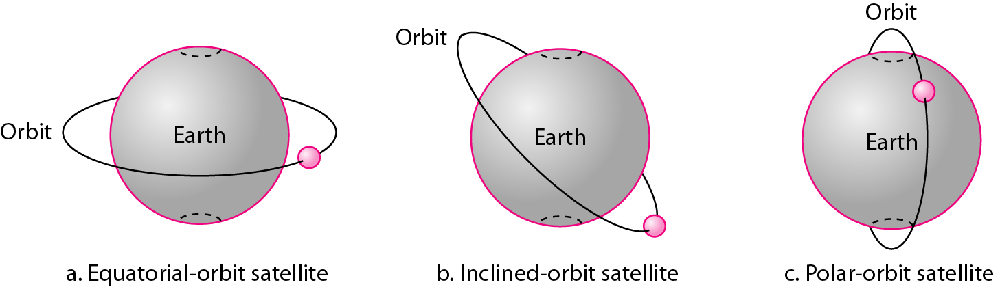
Figure 16.13 Satellite orbits
16.<number>

Slide 22

Example 16.1
What is the period of the Moon, according to Kepler’s law?
Here C is a constant approximately equal to 1/100. The period is in seconds and the distance in kilometers.
16.<number>

Slide 23
Example 16.1 (continued)
Solution
The Moon is located approximately 384,000 km above the Earth. The radius of the Earth is 6378 km. Applying the formula, we get.
16.<number>

Slide 24
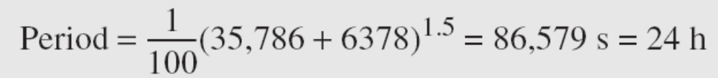
Example 16.2
According to Kepler’s law, what is the period of a satellite that is located at an orbit approximately 35,786 km above the Earth?
Solution
Applying the formula, we get
16.<number>

Slide 25
Example 16.2 (continued)
This means that a satellite located at 35,786 km has a period of 24 h, which is the same as the rotation period of the Earth. A satellite like this is said to be stationary to the Earth. The orbit, as we will see, is called a geosynchronous orbit.
16.<number>

Slide 26
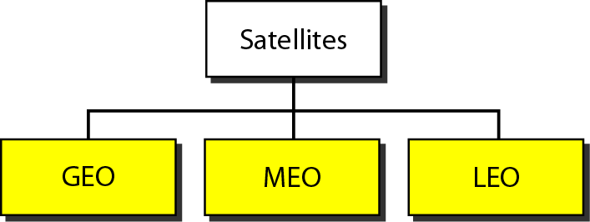
Figure 16.14 Satellite categories
16.<number>

Slide 27
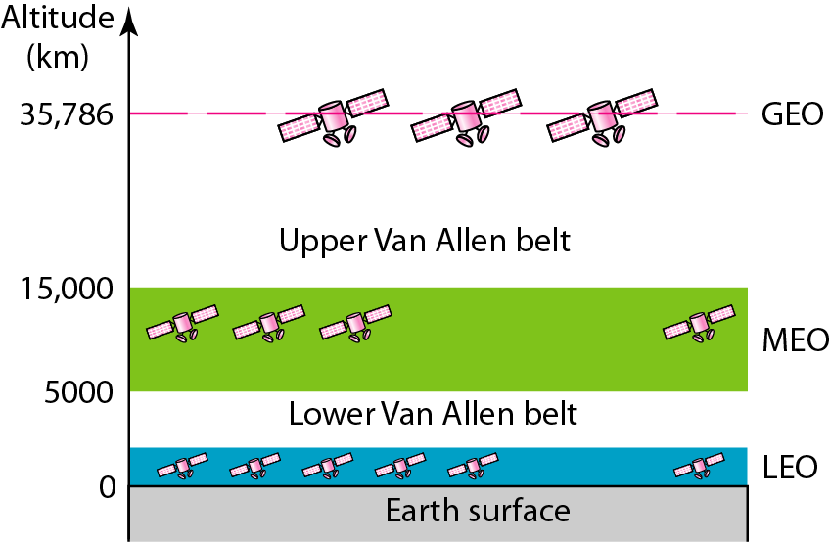
Figure 16.15 Satellite orbit altitudes
16.<number>

Slide 28
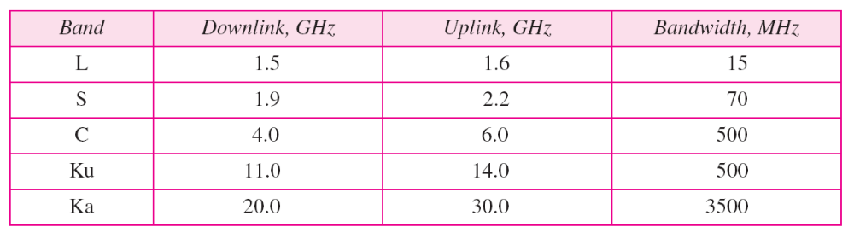
Table 16.1 Satellite frequency bands
16.<number>

Slide 29
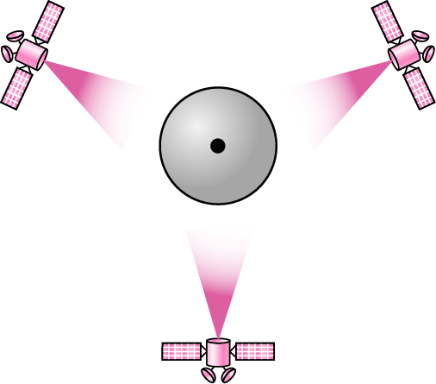
Figure 16.16 Satellites in geostationary orbit
16.<number>

Slide 30
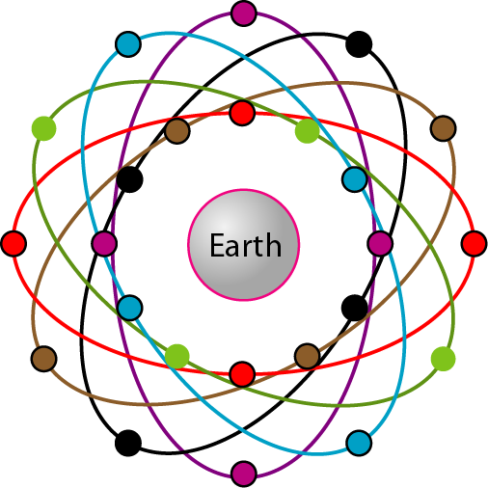
Figure 16.17 Orbits for global positioning system (GPS) satellites
16.<number>

Slide 31
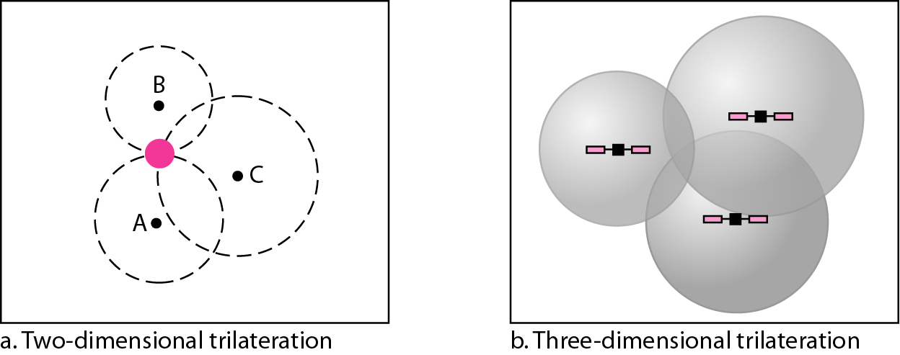
Figure 16.18 Trilateration
16.<number>

Slide 32
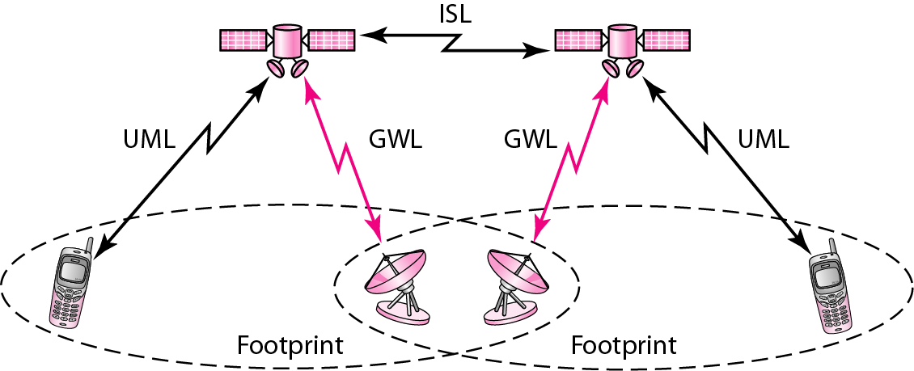
Figure 16.19 LEO satellite system
16.<number>

Slide 33
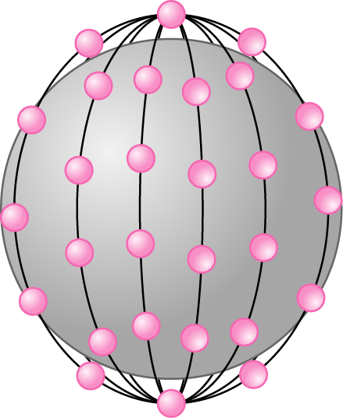
Figure 16.20 Iridium constellation
16.<number>

Slide 34
Note
The Iridium system has 66 satellites in six LEO orbits, each at an
altitude of 750 km.
16.<number>

Slide 35
Note
Iridium is designed to provide direct worldwide voice and data communication using
handheld terminals, a service similar to cellular telephony but on a global scale.
16.<number>

Slide 36
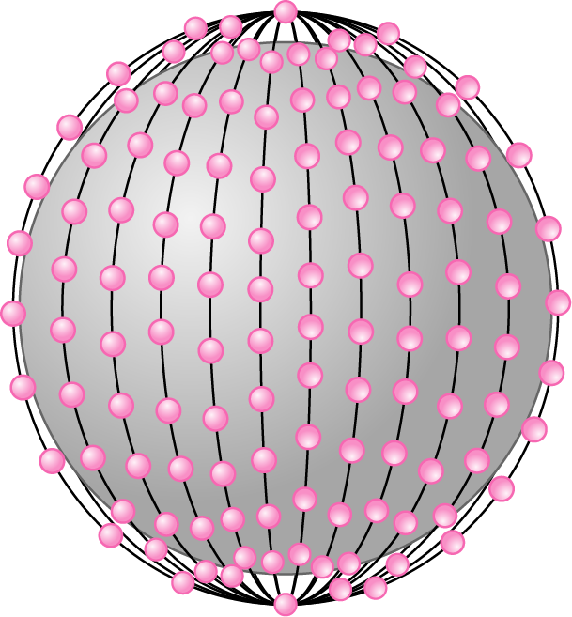
Figure 16.20 Teledesic
16.<number>

Slide 37
Note
Teledesic has 288 satellites in 12 LEO orbits, each at an altitude of 1350 km.
16.<number>

