Slide 2
Regression and Demand Forecasting
Hakim Qahtan
Department of Information and Computing Sciences
Utrecht University

Slide 3
Regression
Demand Forecasting
Evaluation
Today

Slide 4


Supervised Learning
ML algorithms
Data
Training
Computer
Model or Rules
Output
ML model
Prediction
Data
Computer
Output

Slide 5
Supervised Learning
Population Growth Estimation
Risk Assessment
Fraud Detection
Advertising Popularity Prediction
Classification
Supervised Learning
Regression
Image Classification
Spam Email Detection
Predicting a House Price
Energy Price Increase Prediction

Slide 6
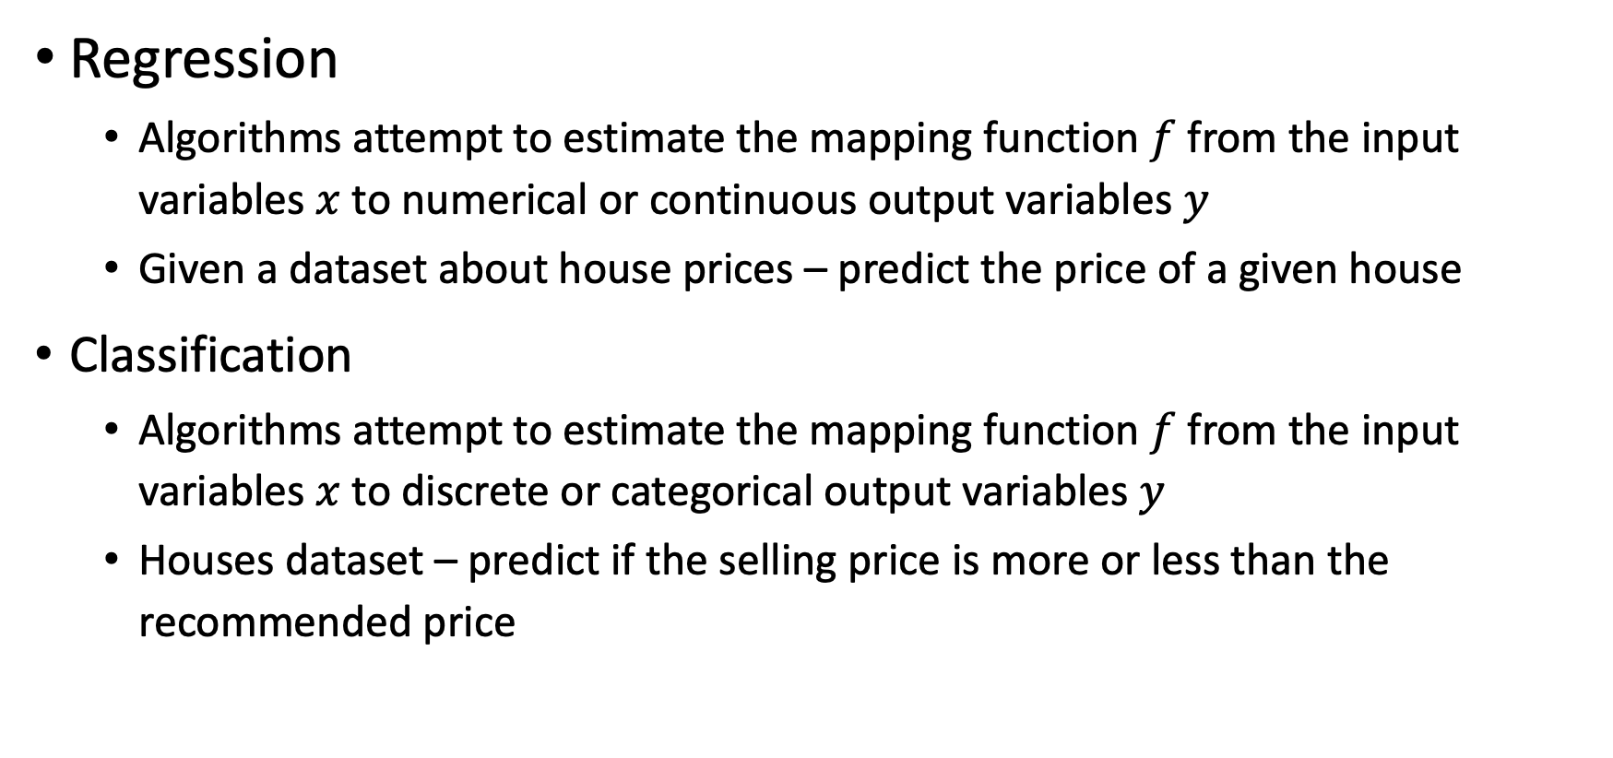
Regression vs. Classification
Regression
Algorithms attempt to estimate the mapping function $f$ from the input variables $x$ to numerical or continuous output variables $y$
Given a dataset about house prices – predict the price of a given house
Classification
Algorithms attempt to estimate the mapping function $f$ from the input variables $x$ to discrete or categorical output variables $y$
Houses dataset – predict if the selling price is more or less than the recommended price

Slide 7
Regression

Slide 8
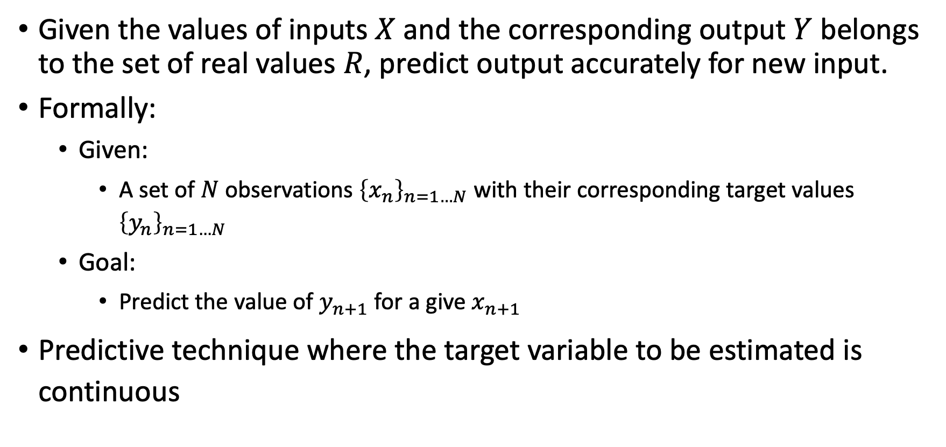
Regression
Given the values of inputs $X$ and the corresponding output $Y$ belongs to the set of real values $R$, predict output accurately for new input.
Formally:
Given:
A set of $N$ observations ${\left\{x_{n}\right\}}_{n=1…N}$ with their corresponding target values ${\left\{y_{n}\right\}}_{n=1…N}$
Goal:
Predict the value of $y_{n+1}$ for a give $x_{n+1}$
Predictive technique where the target variable to be estimated is continuous

Slide 9
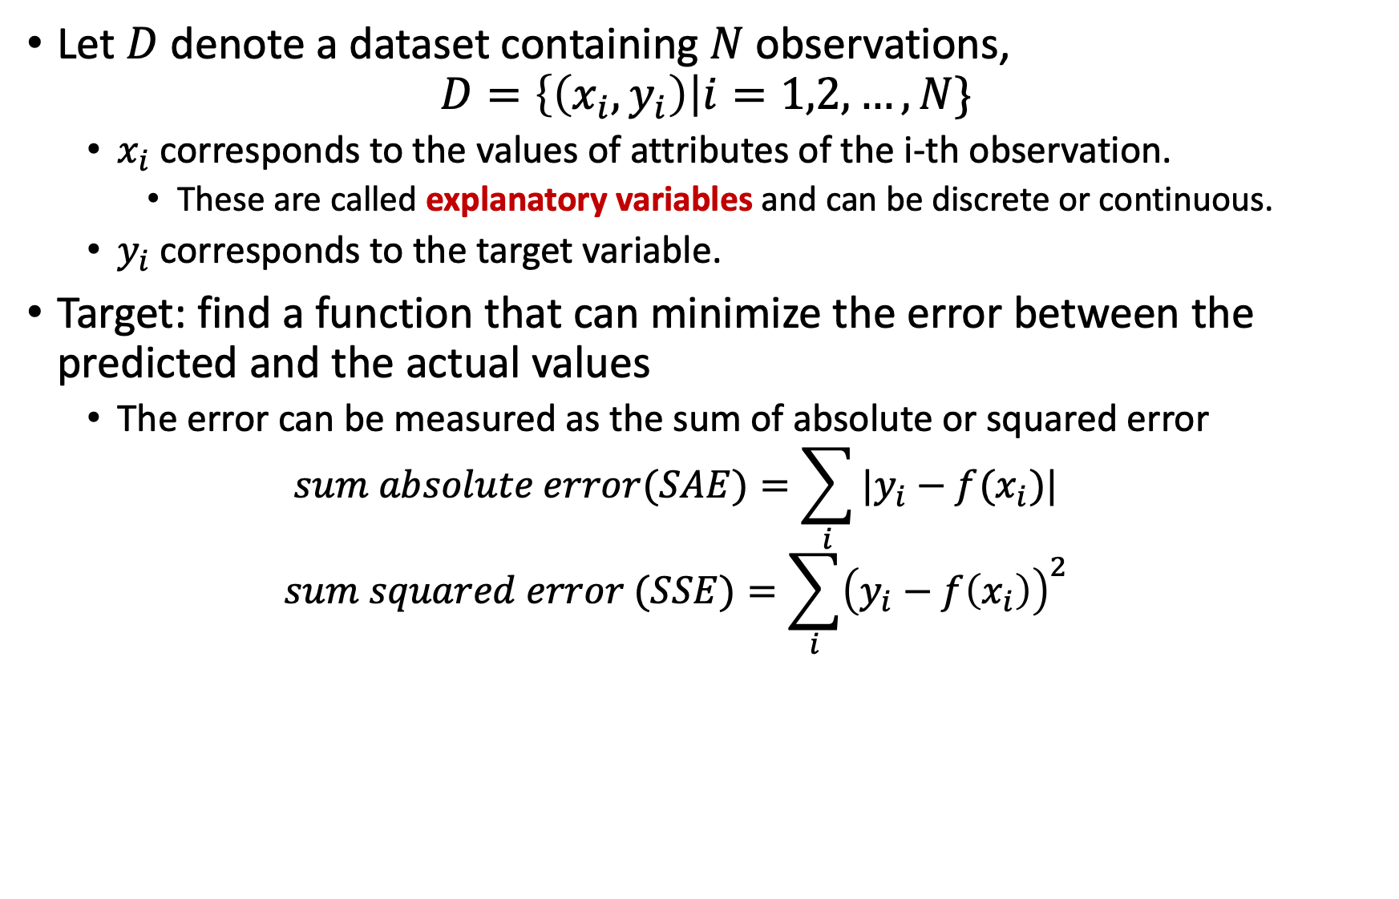
Regression (Cont.)
Let $D$ denote a dataset containing $N$ observations,
$$D=\left\{\left(x_{i}, y_{i}\right)\right|i=1,2,…,N\}$$
$x_{i}$ corresponds to the values of attributes of the i-th observation.
These are called explanatory variables and can be discrete or continuous.
$y_{i}$ corresponds to the target variable.
Target: find a function that can minimize the error between the predicted and the actual values
The error can be measured as the sum of absolute or squared error
$$sum absolute error(SAE)=\sum_{i}{|y_{i}−f(x_{i})|}$$
$$sum squared error (SSE)=\sum_{i}{{\left(y_{i}−f\left(x_{i}\right)\right)}^{2}}$$

Slide 10
What is Regression?
Regression: making predictions about real-world quantities.
What would be the price of a product after producing a new version?
How much the discount will affect the sales volume?
How much the weather will affect the sales of the restaurants?
How many students are expected to show up in a lecture?
…
Remember: regression is a supervised machine learning model

Slide 11
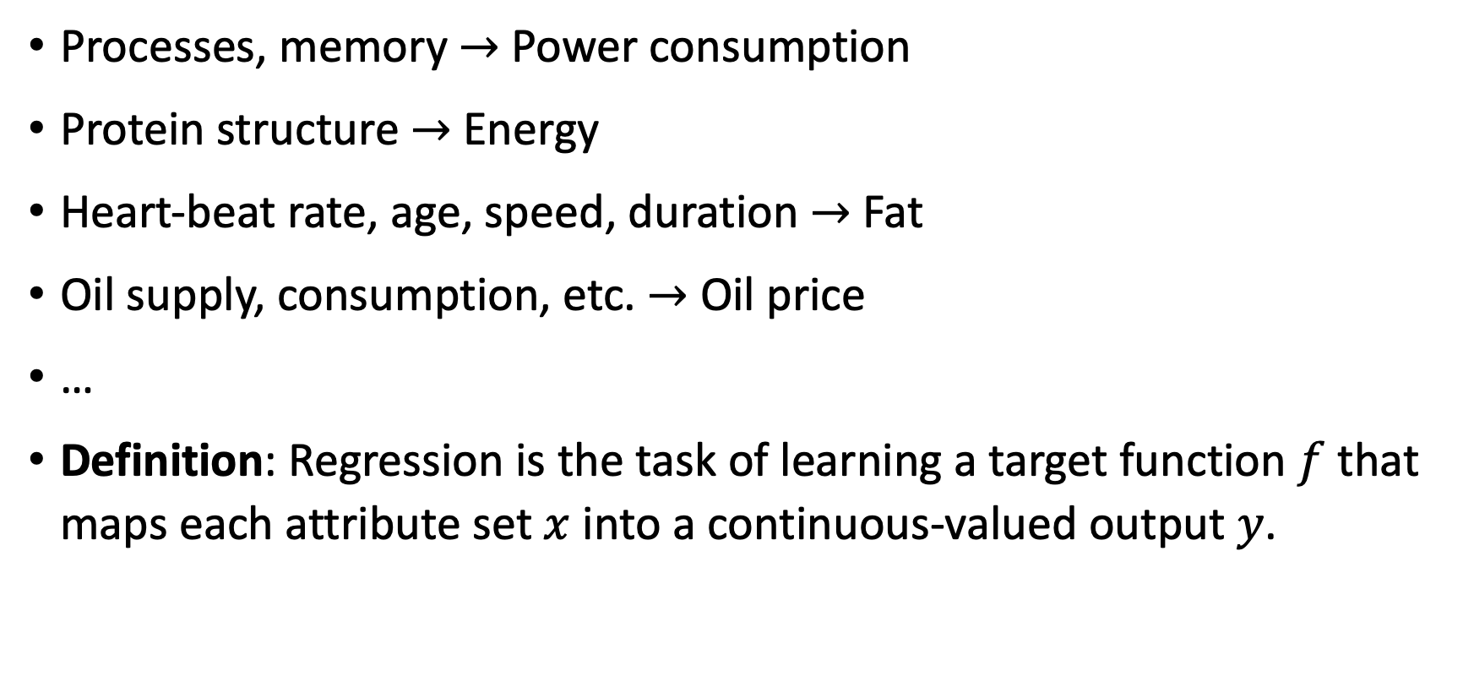
Regression – More Examples
Processes, memory $→$Power consumption
Protein structure $→$ Energy
Heart-beat rate, age, speed, duration $→$ Fat
Oil supply, consumption, etc. $→$ Oil price
…
Definition: Regression is the task of learning a target function $f$ that maps each attribute set $x$ into a continuous-valued output $y$.
Continuous Variables

Slide 12

Regression – Examples
Given ${\left\{x_{n}, y_{n}\right\}}_{n=1…N}$
Predict the value of $y_{n+1}$ for a give $x_{n+1}$

Slide 13
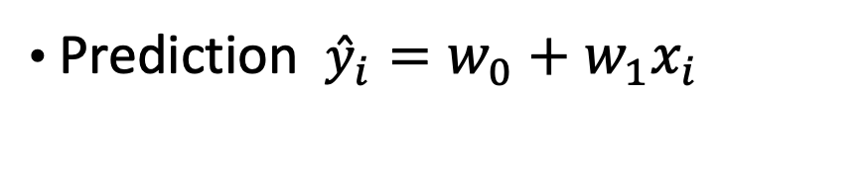
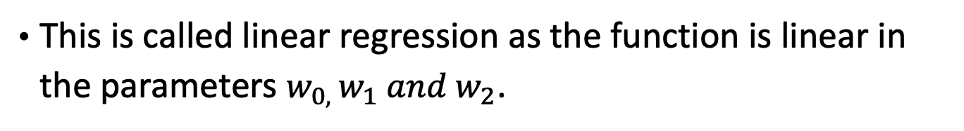
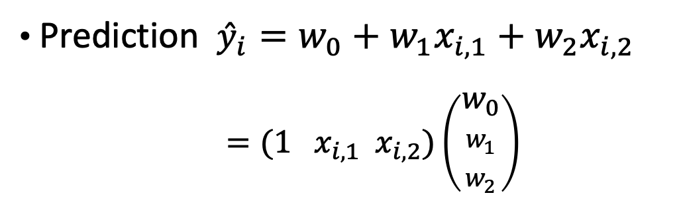
Regression – Examples
Prediction ${\hat{y}}_{i}=w_{0}+w_{1}x_{i,1}+w_{2}x_{i,2}$
$=(1 x_{i,1} x_{i,2})\left(\begin{aligned}w_{0} \\ w_{1} \\ w_{2}\end{aligned}\right)$
Prediction ${\hat{y}}_{i}=w_{0}+w_{1}x_{i}$
This is called linear regression as the function is linear in the parameters $w_{0, }w_{1} and w_{2}$.

Slide 14
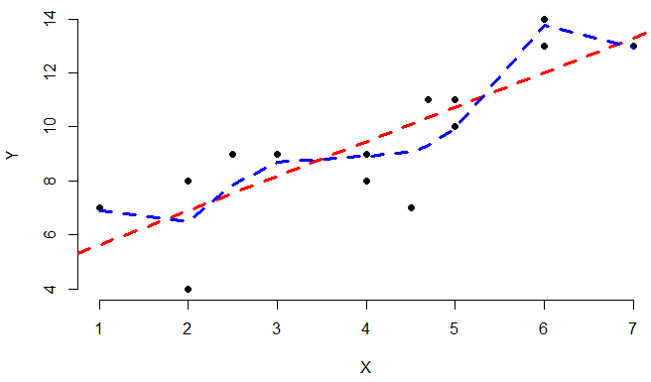
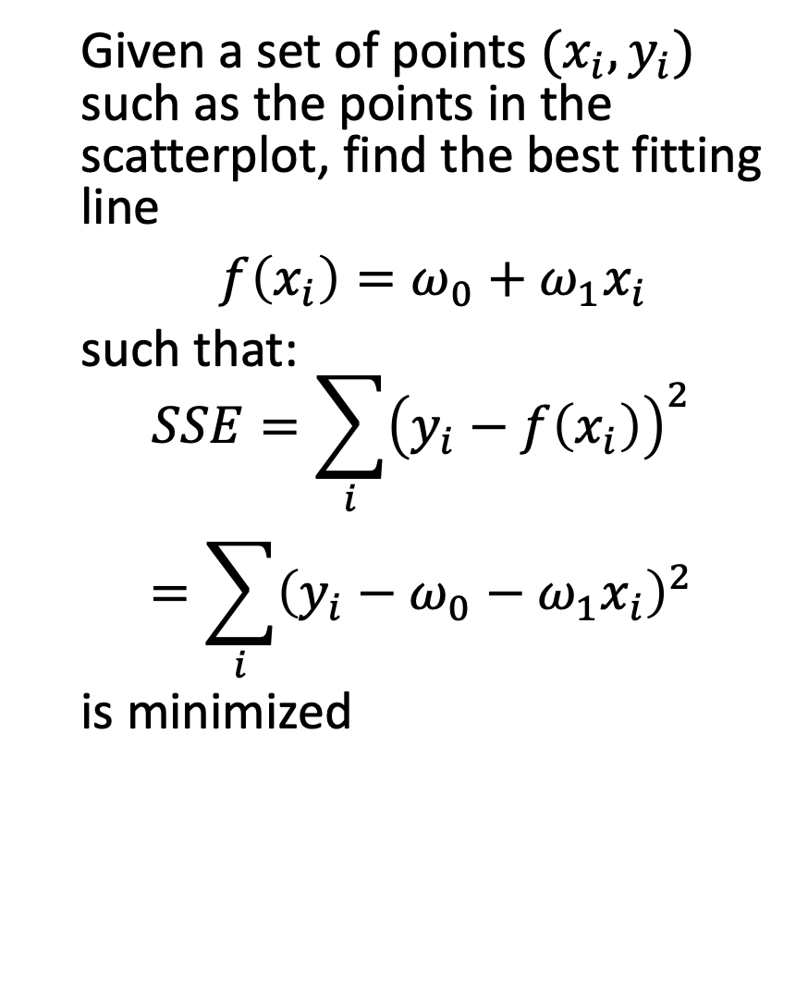
Simple Linear Regression
Given a set of points $(x_{i}, y_{i})$ such as the points in the scatterplot, find the best fitting line
$f\left(x_{i}\right)=ω_{0}+ω_{1}x_{i}$
such that:
$$\begin{matrix}SSE=\sum_{i}{{\left(y_{i}−f\left(x_{i}\right)\right)}^{2}} \\ =\sum_{i}{{\left(y_{i}−ω_{0}−ω_{1}x_{i}\right)}^{2}}\end{matrix}$$
is minimized

Slide 15
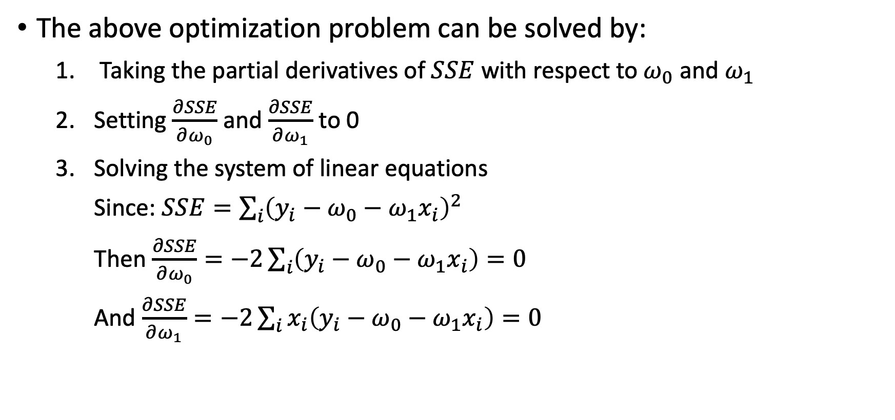
Simple Linear Regression (Cont.)
The above optimization problem can be solved by:
Taking the partial derivatives of $SSE$ with respect to $ω_{0}$ and $ω_{1}$
Setting $\frac{∂SSE}{∂ω_{0}}$ and $\frac{∂SSE}{∂ω_{1}}$ to 0
Solving the system of linear equations
Since: $SSE=\sum_{i}{{\left(y_{i}−ω_{0}−ω_{1}x_{i}\right)}^{2}}$
Then $\frac{∂SSE}{∂ω_{0}}=−2\sum_{i}{\left(y_{i}−ω_{0}−ω_{1}x_{i}\right)}=0$
And $\frac{∂SSE}{∂ω_{1}}=−2\sum_{i}{x_{i}\left(y_{i}−ω_{0}−ω_{1}x_{i}\right)}=0$

Slide 16
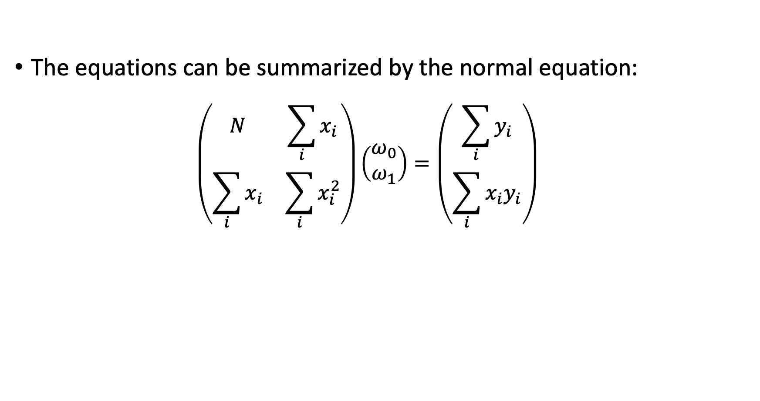
Simple Linear Regression (Cont.)
The equations can be summarized by the normal equation:
$$\left(\begin{matrix}N & \sum_{i}{x_{i}} \\ \sum_{i}{x_{i}} & \sum_{i}{x_{i}^{2}}\end{matrix}\right)\left(\begin{matrix}ω_{0} \\ ω_{1}\end{matrix}\right)=\left(\begin{matrix}\sum_{i}{y_{i}} \\ \sum_{i}{x_{i}y_{i}}\end{matrix}\right)$$

Slide 17
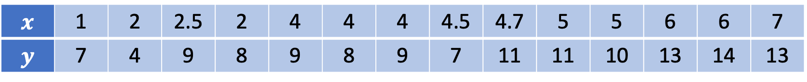
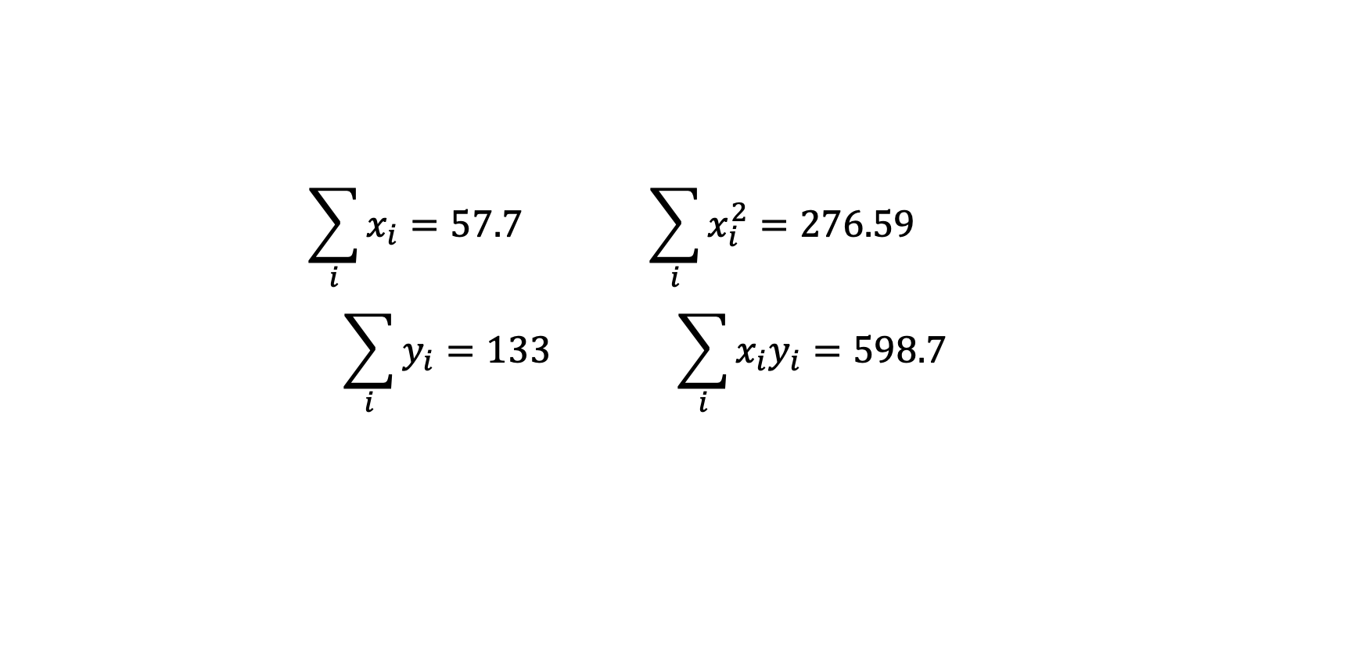
Example
Consider the following dataset
$$x$$ | 1 | 2 | 2.5 | 2 | 4 | 4 | 4 | 4.5 | 4.7 | 5 | 5 | 6 | 6 | 7
$$y$$ | 7 | 4 | 9 | 8 | 9 | 8 | 9 | 7 | 11 | 11 | 10 | 13 | 14 | 13
$$\sum_{i}{x_{i}}=57.7 \sum_{i}{x_{i}^{2}}=276.59$$
$$\sum_{i}{y_{i}}=133 \sum_{i}{x_{i}y_{i}}=598.7$$

Slide 18

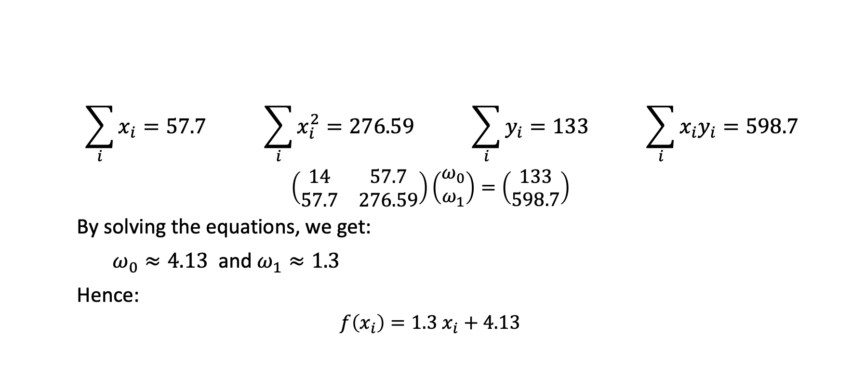
Example (Cont.)
$$x$$ | 1 | 2 | 2.5 | 2 | 4 | 4 | 4 | 4.5 | 4.7 | 5 | 5 | 6 | 6 | 7
$$y$$ | 7 | 4 | 9 | 8 | 9 | 8 | 9 | 7 | 11 | 11 | 10 | 13 | 14 | 13
$$\sum_{i}{x_{i}}=57.7 \sum_{i}{x_{i}^{2}}=276.59 \sum_{i}{y_{i}}=133 \sum_{i}{x_{i}y_{i}}=598.7$$
$$\left(\begin{matrix}14 & 57.7 \\ 57.7 & 276.59\end{matrix}\right)\left(\begin{matrix}ω_{0} \\ ω_{1}\end{matrix}\right)=\left(\begin{matrix}133 \\ 598.7\end{matrix}\right)$$
By solving the equations, we get:
$ω_{0}≈4.13$ and $ω_{1}≈1.3$
Hence:
$$f\left(x_{i}\right)=1.3 x_{i}+4.13$$

Slide 19
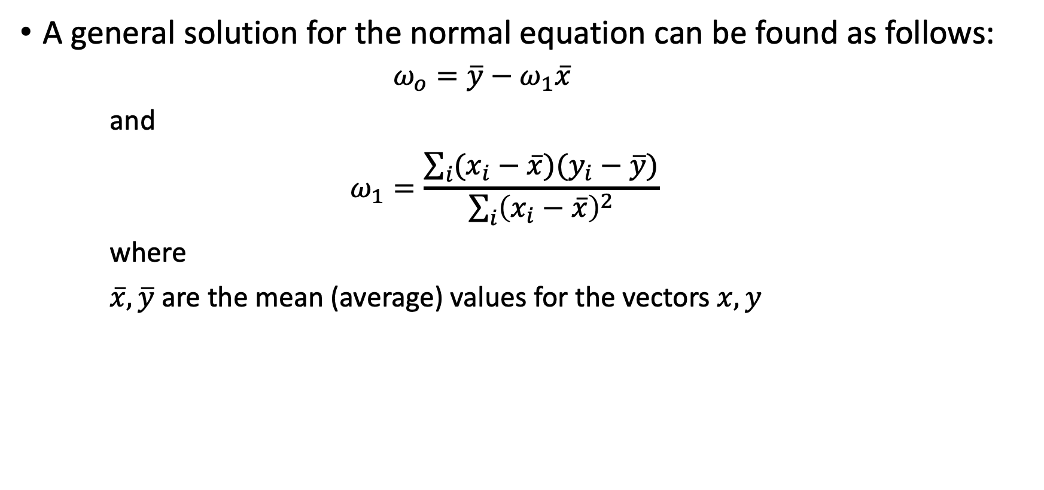
Simple Linear Regression (Cont.)
A general solution for the normal equation can be found as follows:
$$ω_{o}=\overline{y}−ω_{1}\overline{x}$$
and
$$ω_{1}=\frac{\sum_{i}{(x_{i}−\overline{x})(y_{i}−\overline{y})}}{\sum_{i}{{\left(x_{i}−\overline{x}\right)}^{2}}}$$
where
$\overline{x}, \overline{y}$ are the mean (average) values for the vectors $x,y$

Slide 20
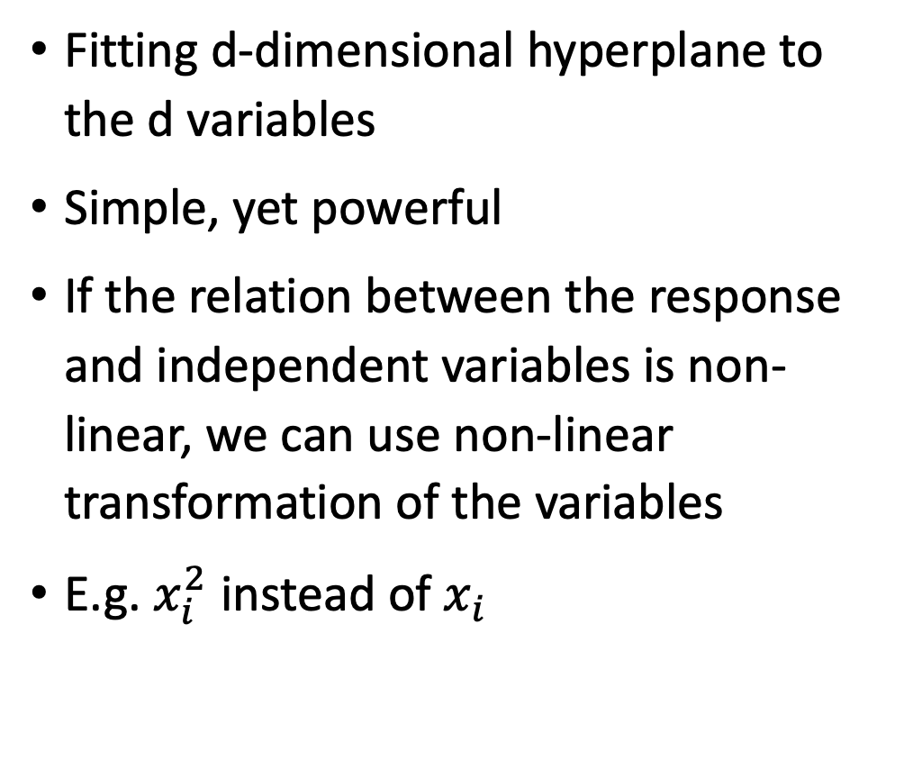
Multiple Linear Regression
Fitting d-dimensional hyperplane to the d variables
Simple, yet powerful
If the relation between the response and independent variables is non-linear, we can use non-linear transformation of the variables
E.g. $x_{i}^{2}$ instead of $x_{i}$

Slide 21
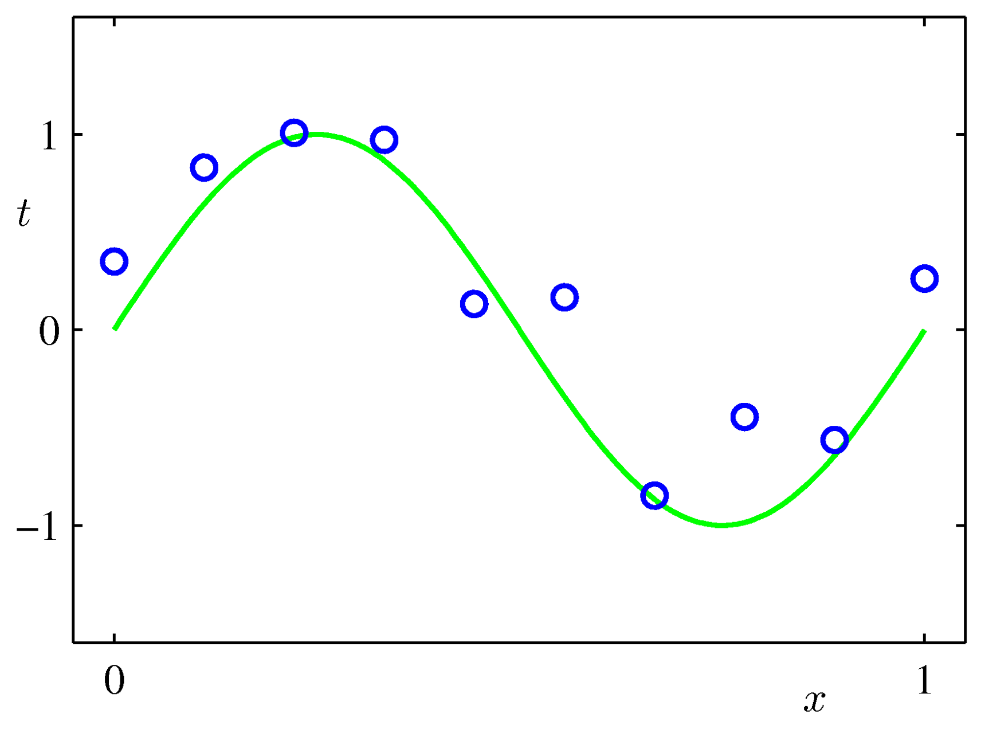
Polynomial Regression
Suitable when the relationship between the response and the independent variables is non-linear
Higher order polynomials complicate the model
May cause model overfitting
Increase the computational complexity
Case Study: Predicting the price of a new housing market – check the provided notebook

Slide 22
Linear Regression in Python
from sklearn.linear_model import LinearRegression
import matplotlib
df = pd.read_csv('sample_data/diabetes_data.csv')
matplotlib.rcParams.update({'font.size': 18})
x = np.array(df["BMXWAIST"]).reshape(-1,1)
y = np.array(df["BMXWT"]).reshape(-1,1)
mdl = LinearRegression()
mdl.fit(x, y)
test = np.arange(min(x),max(x)+4).reshape(-1,1)
test_hat = mdl.predict(test)

Slide 23
Polynomial Regression in Python
x1 = np.array(df["BMXWAIST"])
y1 = np.array(df["BMXWT"])
poly_mdl = numpy.poly1d(numpy.polyfit(x1, y1, 3))
te = np.arange(min(x),max(x))
Test_hat = poly_mdl(test)
Degree 3
Try Larger Degrees

Slide 24

Coffee Break

Slide 25
Demand Forecasting

Slide 26
Decisions that Require Forecasting
What products to produce?
How many people to hire?
How many units to purchase?
How many units to produce?
How many items to order?
And so on……

Slide 27
Common Characteristics of Forecasting
Forecasts are rarely perfect
Forecasts are more accurate for aggregated data than for individual items
Forecast are more accurate for shorter than longer time periods

Slide 28


Why Forecasting is Important?

Slide 29
Methods of Forecasting the Trend
Naïve Forecasting
Simple Mean
Moving Average
Weighted Moving Average
Exponential Smoothing
Regression models

Slide 30
Methods of Forecasting the Trend – Example
Determine forecast for periods 11
Naïve forecast
Simple average
3- and 5-period moving average
3-period weighted moving average with weights 0.5, 0.3, and 0.2
Exponential smoothing with alpha=0.2 and 0.5
Period | Orders
1 | 122
2 | 91
3 | 100
4 | 77
5 | 115
6 | 58
7 | 75
8 | 128
9 | 111
10 | 88

Slide 31
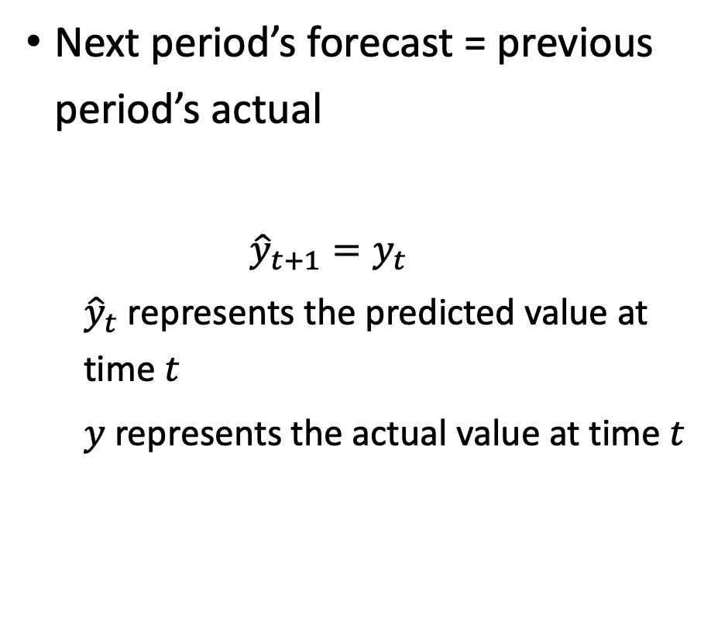
Methods of Forecasting the Trend – Naïve Forecasting
Period | Orders | Naïve Forecast
1 | 122
2 | 91 | 122
3 | 100 | 91
4 | 77 | 100
5 | 115 | 77
6 | 58 | 115
7 | 75 | 58
8 | 128 | 75
9 | 111 | 128
10 | 88 | 111
11 |  | 88
Next period’s forecast = previous period’s actual
$${\hat{y}}_{t+1}=y_{t}$$
${\hat{y}}_{t}$ represents the predicted value at time $t$
$y$ represents the actual value at time $t$

Slide 32
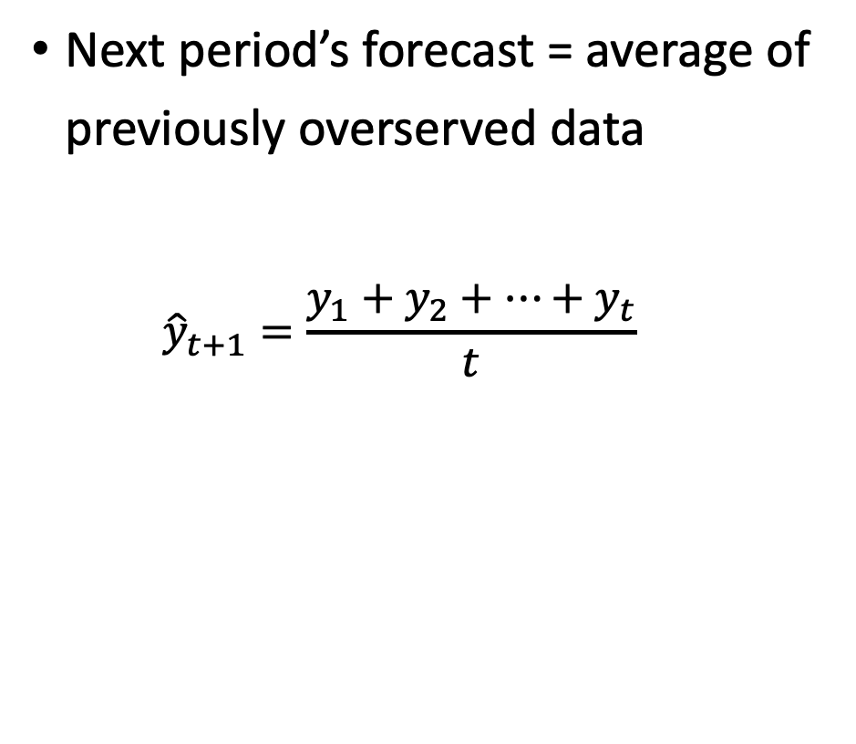
Methods of Forecasting the Trend – Simple Average
Period | Orders | Simple Average
1 | 122
2 | 91 | 122
3 | 100 | 107
4 | 77 | 104
5 | 115 | 98
6 | 58 | 101
7 | 75 | 94
8 | 128 | 91
9 | 111 | 96
10 | 88 | 97
11 |  | 97
Next period’s forecast = average of previously overserved data
$${\hat{y}}_{t+1}=\frac{y_{1}+y_{2}+…+y_{t}}{t}$$

Slide 33
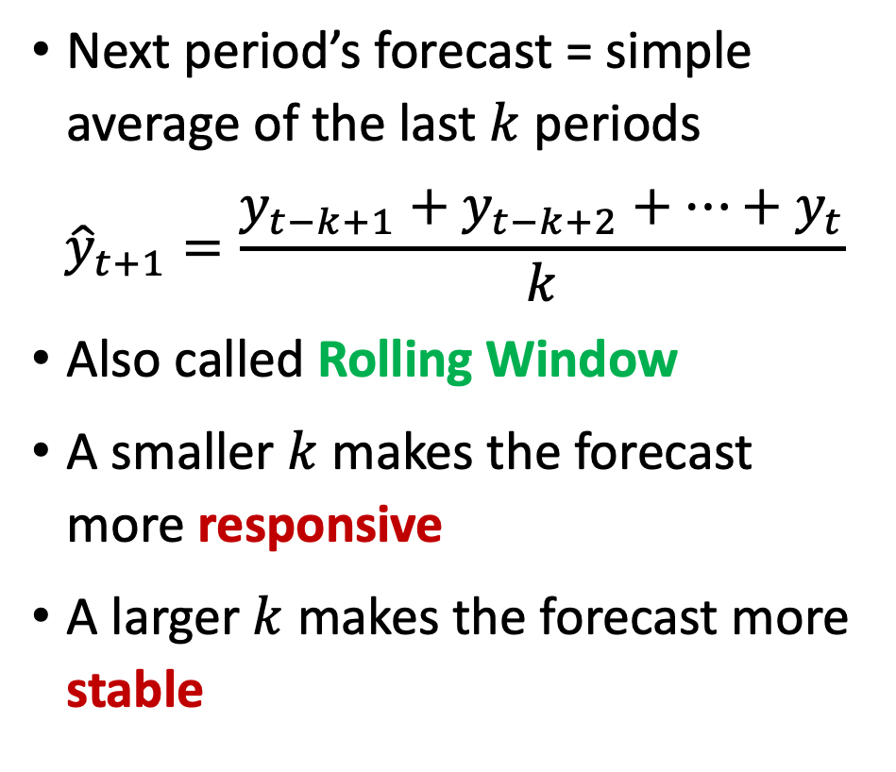
Methods of Forecasting the Trend – Moving Average
Period | Orders | Moving Average (k = 3) | Moving Average (k = 5)
1 | 122
2 | 91
3 | 100
4 | 77 | 104
5 | 115 | 89
6 | 58 | 97 | 101
7 | 75 | 83 | 88
8 | 128 | 83 | 85
9 | 111 | 87 | 91
10 | 88 | 105 | 97
11 |  | 109 | 92
Next period’s forecast = simple average of the last $k$ periods
$${\hat{y}}_{t+1}=\frac{y_{t−k+1}+y_{t−k+2}+…+y_{t}}{k}$$
Also called Rolling Window
A smaller $k$ makes the forecast more responsive
A larger $k$ makes the forecast more stable

Slide 34
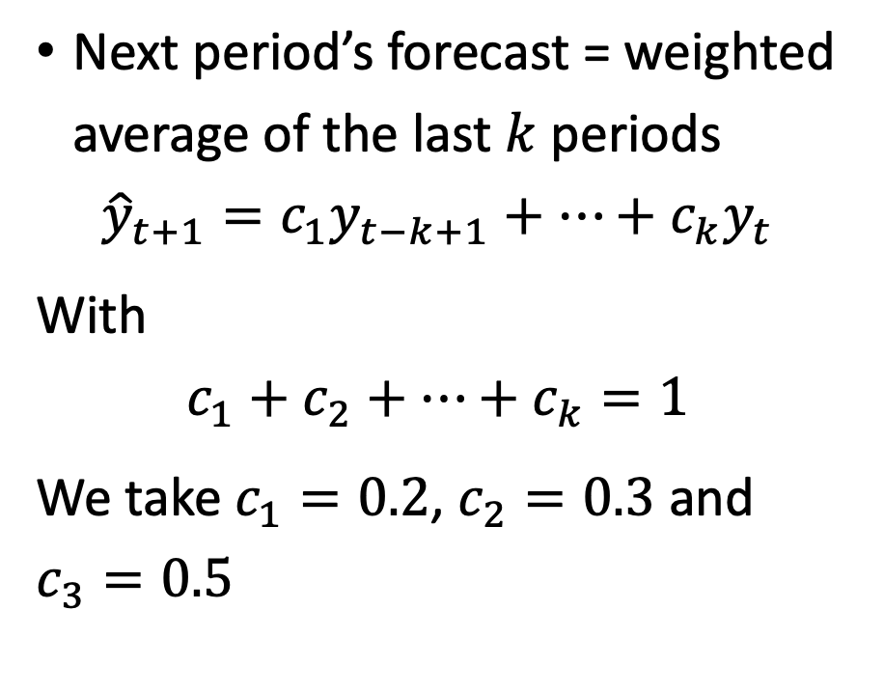
Methods of Forecasting the Trend –
Weighted Moving Average
Period | Orders | Weighted Moving Average (k = 3)
1 | 122
2 | 91
3 | 100
4 | 77 | 102
5 | 115 | 87
6 | 58 | 101
7 | 75 | 79
8 | 128 | 78
9 | 111 | 98
10 | 88 | 109
11 |  | 103
Next period’s forecast = weighted average of the last $k$ periods
$${\hat{y}}_{t+1}={c_{1}y}_{t−k+1}+…+{c_{k}y}_{t}$$
With
$$c_{1}+c_{2}+…+c_{k}=1$$
We take $c_{1}=0.2$, $c_{2}=0.3$ and $c_{3}=0.5$

Slide 35
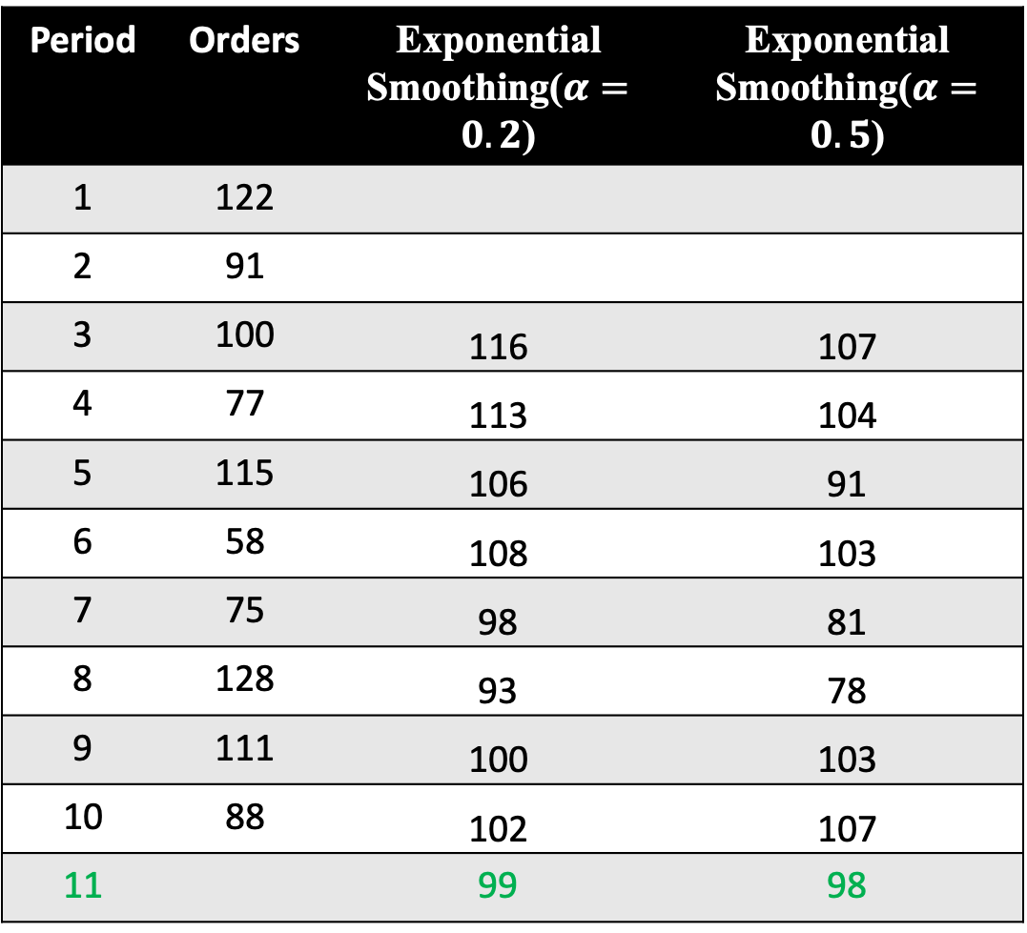
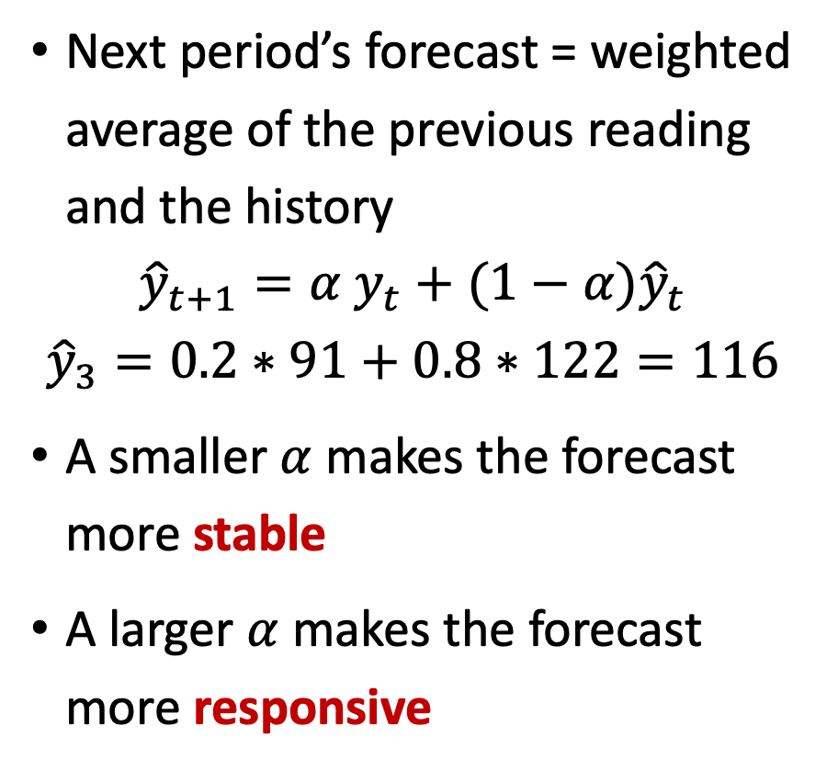
Methods of Forecasting the Trend –
Exponential Smoothing
Period | Orders | Exponential Smoothing($α=0.2$) | Exponential Smoothing($α=0.5$)
1 | 122
2 | 91
3 | 100 | 116 | 107
4 | 77 | 113 | 104
5 | 115 | 106 | 91
6 | 58 | 108 | 103
7 | 75 | 98 | 81
8 | 128 | 93 | 78
9 | 111 | 100 | 103
10 | 88 | 102 | 107
11 |  | 99 | 98
Next period’s forecast = weighted average of the previous reading and the history
$${\hat{y}}_{t+1}={α y}_{t}+(1−α){\hat{y}}_{t}$$
$${\hat{y}}_{3}=0.2∗91+0.8∗122=116$$
A smaller $α$ makes the forecast more stable
A larger $α$ makes the forecast more responsive

Slide 36
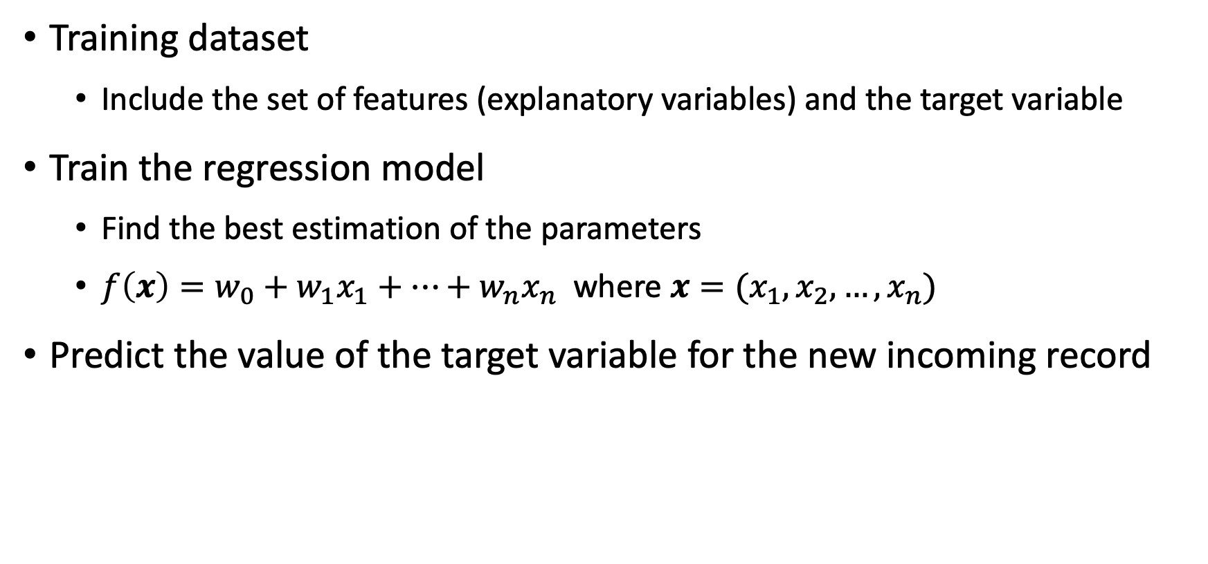
Methods of Forecasting the Trend –
Regression Models
Training dataset
Include the set of features (explanatory variables) and the target variable
Train the regression model
Find the best estimation of the parameters
$f\left(x\right)=w_{0}+w_{1}x_{1}+…+w_{n}x_{n}$ where $x=(x_{1}, x_{2}, …, x_{n})$
Predict the value of the target variable for the new incoming record

Slide 37
Methods of Forecasting the Trend –
Regression Models
from sklearn.linear_model import LinearRegression
import matplotlib
df = pd.read_csv('sample_data/diabetes_data.csv')
matplotlib.rcParams.update({'font.size': 18})
x = np.array(df["BMXWAIST"]).reshape(-1,1)
y = np.array(df["BMXWT"]).reshape(-1,1)
mdl = LinearRegression()
mdl.fit(x, y)
test = np.arange(min(x),max(x)+4).reshape(-1,1)
test_hat = mdl.predict(test)

Slide 38
Coffee Break

Slide 39
Evaluation

Slide 40
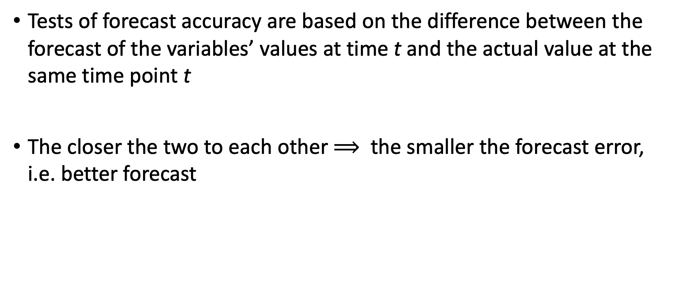
Forecast Accuracy
Tests of forecast accuracy are based on the difference between the forecast of the variables’ values at time t and the actual value at the same time point t
The closer the two to each other $⟹$ the smaller the forecast error, i.e. better forecast

Slide 41
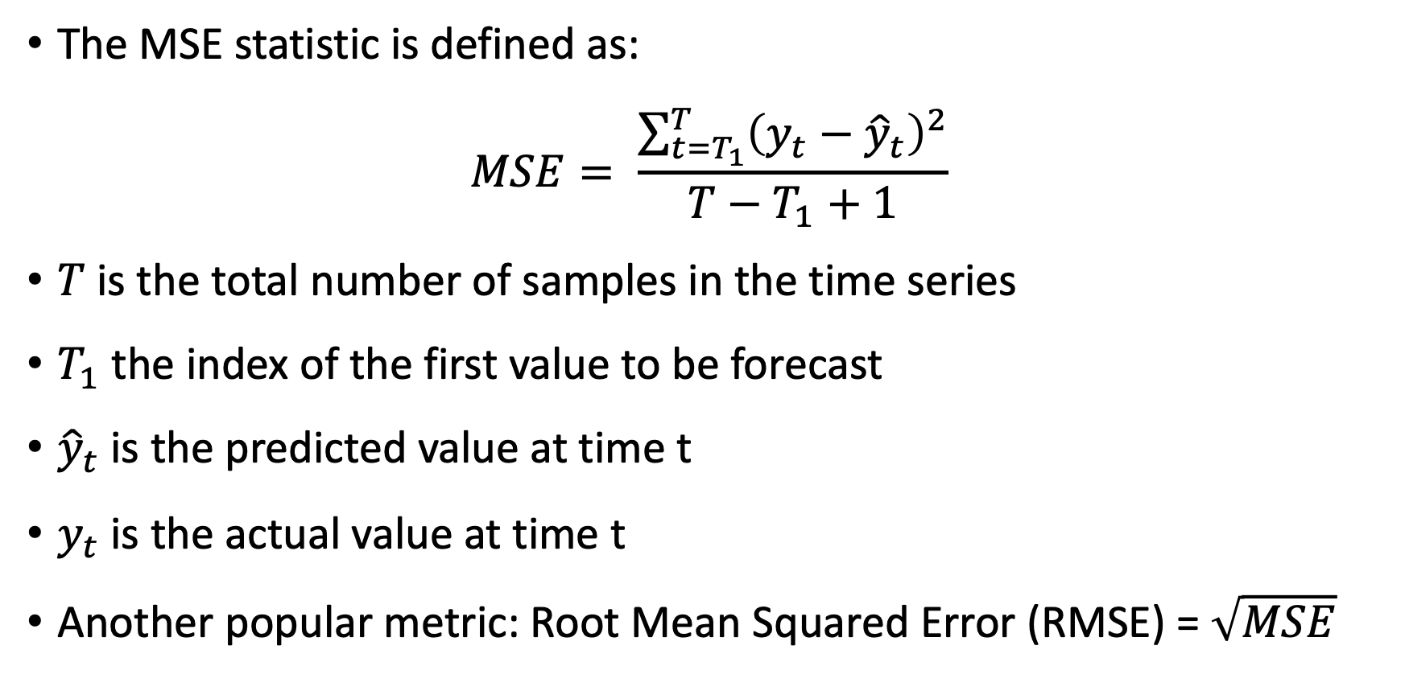
Forecast Accuracy – Mean Squared Error (MSE)
The MSE statistic is defined as:
$$MSE= \frac{\sum_{t=T_{1}}^{T}{{\left(y_{t}−{\hat{y}}_{t}\right)}^{2}}}{T−T_{1}+1}$$
$T$ is the total number of samples in the time series
$T_{1}$ the index of the first value to be forecast
${\hat{y}}_{t}$ is the predicted value at time t
$y_{t}$ is the actual value at time t
Another popular metric: Root Mean Squared Error (RMSE) = $\sqrt{MSE}$

Slide 42
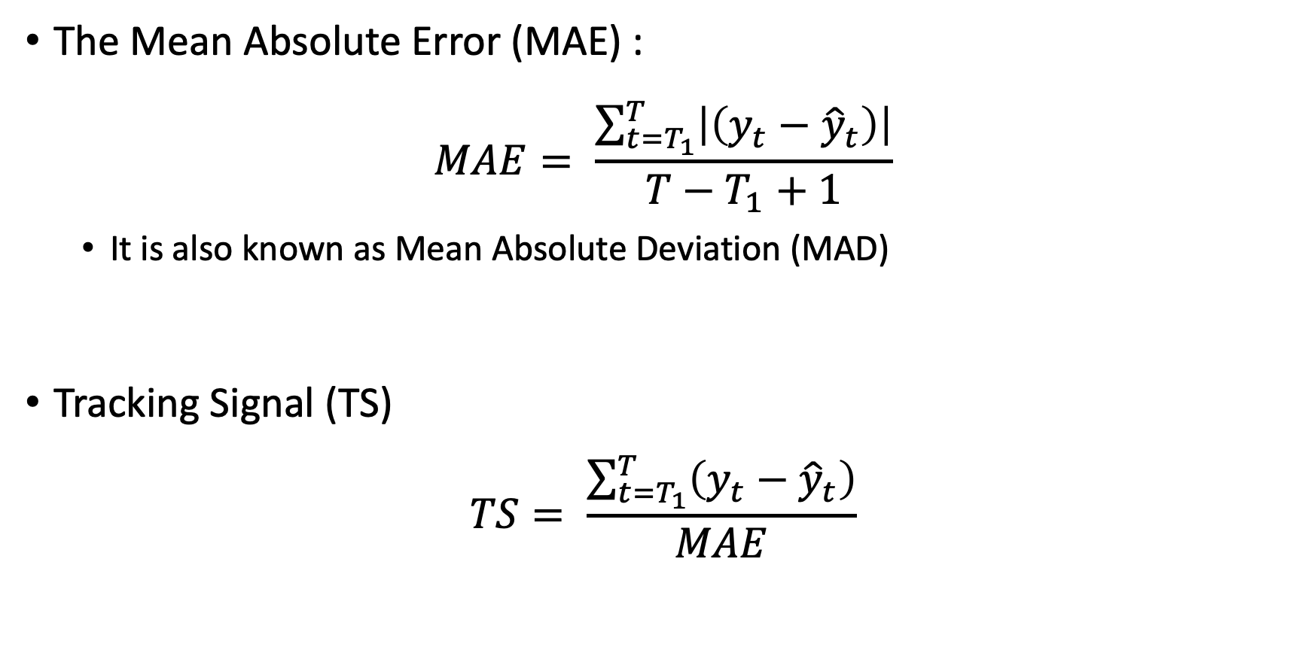
Forecast Accuracy – More Metrics
The Mean Absolute Error (MAE) :
$$MAE= \frac{\sum_{t=T_{1}}^{T}{\left|\left(y_{t}−{\hat{y}}_{t}\right)\right|}}{T−T_{1}+1}$$
It is also known as Mean Absolute Deviation (MAD)
Tracking Signal (TS)
$$TS= \frac{\sum_{t=T_{1}}^{T}{\left(y_{t}−{\hat{y}}_{t}\right)}}{MAE}$$

Slide 43
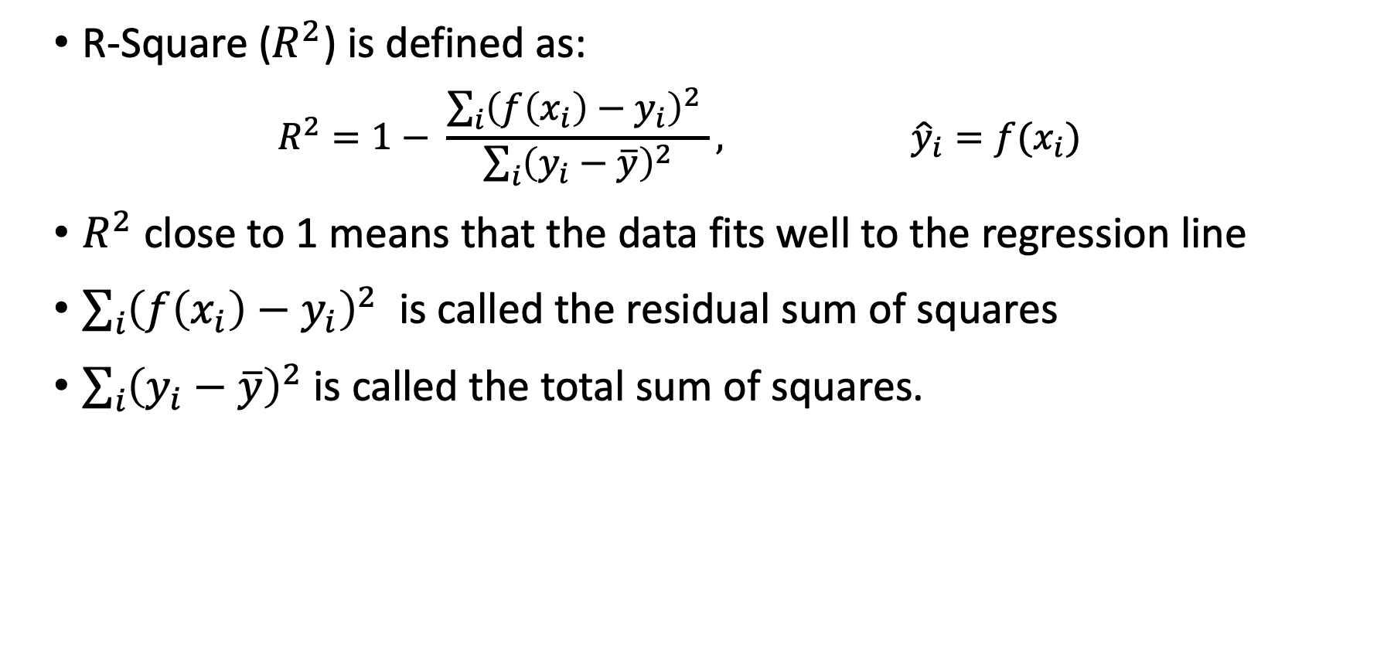
R-Square
R-Square ($R^{2}$) is defined as:
$$R^{2}=1− \frac{\sum_{i}{{\left(f\left(x_{i}\right)−y_{i}\right)}^{2} }}{\sum_{i}{{\left(y_{i}−\overline{y}\right)}^{2}}}, {\hat{y}}_{i}=f(x_{i})$$
$R^{2}$ close to 1 means that the data fits well to the regression line
$\sum_{i}{{\left(f\left(x_{i}\right)−y_{i}\right)}^{2} }$ is called the residual sum of squares
$\sum_{i}{{\left(y_{i}−\overline{y}\right)}^{2}}$ is called the total sum of squares.

Slide 44
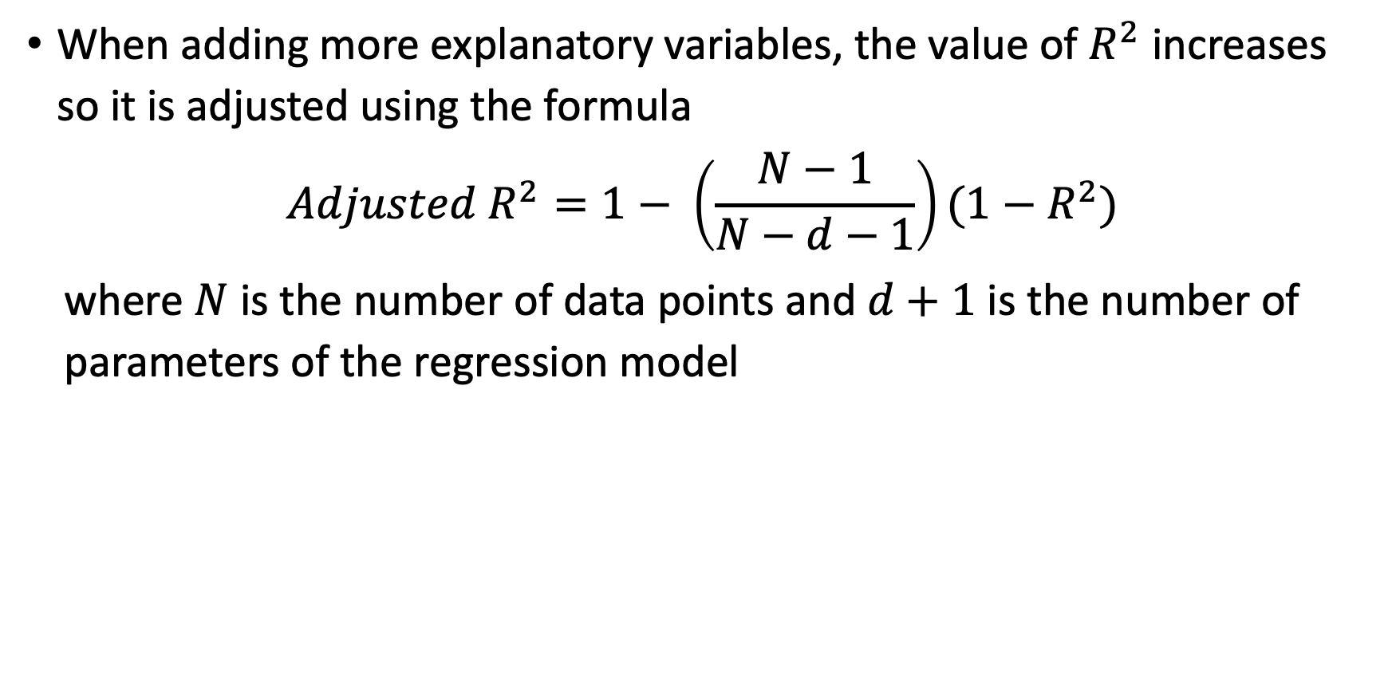
R-Square
When adding more explanatory variables, the value of $R^{2}$ increases so it is adjusted using the formula
$${Adjusted R}^{2}=1− \left(\frac{N−1}{N−d−1}\right)(1−R^{2})$$
where $N$ is the number of data points and $d+1$ is the number of parameters of the regression model

Slide 45

Wrap-Up
Summerize what you learned today in 2-minutes

