Slide 2
Machine Learning for Beginners
Hakim Qahtan
Department of Information and Computing Sciences
Utrecht University

Slide 3
Course Overview

Slide 4
Traditional programming
Rules
Data
Computer
Output

Slide 5


Supervised Learning
ML algorithms
Data
Training
Computer
Model or Rules
Output
ML model
Prediction
Data
Computer
Output

Slide 6
Unsupervised Learning
Pattern Discovery
Data
Computer
Model

Slide 7



Reinforcement Learning
Interpreter
Rewards +/-
State
Action
Environment
Agent

Slide 8

Machine Learning
Classification
Clustering
Machine Learning
Unsupervised Learning
Supervised Learning
Dimensionality Reduction
Regression
Reinforcement Learning

Slide 9
ML For Beginners
The Basics of Python (Day 1)
Supervised Learning
Regression and Demand Forecasting (Day 2)
Classification and Fairness (Day 3)
Unsupervised Learning
Clustering (Day 4)
Text Mining (Day 5)

Slide 10
Wooclap
Google Colab
Introduction to Python
Today

Slide 11
Introduction to Python
Part I : The Basics

Slide 12
Python – The Basics
x = 34 - 23 # A comment.
y = "Hello" # Another one.
z = 3.45
if z == 3.45 or y == "Hello":
x = x + 1
y = y + " World" # String concat.
print (x)
print (y)

Slide 13
Python – The Basics
Indentation matters to code meaning
First assignment to a variable creates it
Assignment is = and comparison is ==
For numbers + - * / % are as expected
Logical operators are words (and, or, not) not symbols
The basic printing command is print

Slide 14
Python – Data Types
Integers (default for numbers)
x = 3
Floats
x = 3.456
Strings
Can use “” (double quotation) or ‘’ (single quotation) to specify strings
“abc” == ‘abc’
Unmatched can occur within the string: “matt’s”

Slide 15
Python – The Basics
Use a newline to end a line of code
Use \ when must go to next line prematurely
indentations mark blocks of code
Colons start of a new block in many constructs, e.g. function definitions, conditional clauses, loops
Start comments with #, rest of line is ignored
Use triple double quotation for comments over multiple lines
''' This comment goes
over two lines '''

Slide 16
Python – The Basics
You can assign to multiple names at the same time
x, y = 2, 3
This makes it easy to swap values
x, y = y, x
Assignments can be chained
a = b = x = 2

Slide 17
Python – The Basics
Accessing a variable before it’s been properly created raises an error
print(w)
---------------------------------------------------------------------------
NameError Traceback (most recent call last) <ipython-input-35-ad11782dc618> in <module> ----> 1 print (w) NameError: name 'w' is not defined
Instead
w = 3
print(w)

Slide 18
Python – Tuples, Lists, Strings, and Arrays
Tuple: t = (‘john’, 32, [CMSC])
Strings: s = “John Smith” or s = ‘John Smith’
List: l = [1, 2, ‘john’, (‘up’, ‘down’)]
Arrays: requires importing the numpy library
import numpy as np
_1d = np.array([1, 2, 3])
_2d = np.array ([[1, 2, 3], [4, 5, 6]])

Slide 19
Python – Matrices and Sets
A matrix is 2-dimensional array
import numpy as np
mat1 = np.matrix ([[1, 2, 3], [4, 5, 6]])
mat2 = np.matrix (‘1, 2, 3; 4, 5, 6’)
A set is list with no repetitions of the elements
set1 = set([1, 1, 2, 3, 3, 4])
The contents of set1 will be {1, 2, 3, 4}

Slide 20
Python – Computing Statistical Quantities
Mean value
import numpy as np
np.mean([1, 2, 3, 4, 5, 6]) # OR
np.array([1, 2, 3, 4, 5, 6]).mean()
Standard deviation
np.std([1, 2, 3, 4, 5, 6]) # OR
np.array([1, 2, 3, 4, 5, 6]).std()

Slide 21

Coffee Break

Slide 22
Introduction to Python
Part II: Pandas DataFrames

Slide 23
Pandas Dataframes
The most popular way to handle data tables in Python is using Pandas dataframes
DataFrame: a rectangular table of data and contains an ordered collection of columns, each of which can be a different value type (numeric, string, boolean, etc.)
Has columns and rows indexes
Columns are made up of pandas series
Column index (df.columns)
Row index
(df.index)
Series of data
Series of data
Series of data
…
Series of data

Slide 24
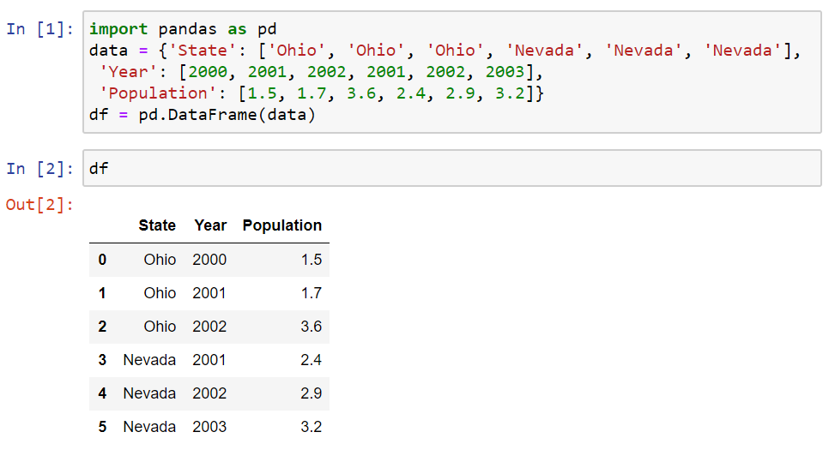
Creating DataFrame
Similarly: you can use the following code
import pandas as pd
data = [['Ohio', 2000, 1.5], ['Ohio', 2001, 1.7],
['Ohio', 2002, 3.6], ['Nevada', 2001, 2.4],
['Nevada', 2002, 2.9], ['Nevada', 2003, 3.2]]
cols = ['State', 'Year', 'Population']
df = pd.DataFrame(data, columns = cols)

Slide 25
Load DataFrame from CSV Files
The simplest way is:
More options can be added when loading a csv file into a dataframe
More options can be found in Pandas documentation
Remeber to import the pandas library as pd
df = pd.read_csv('file.csv’) # often works
df = pd.read_csv('movies.csv', header=0,
index_col=0, quotechar='"',sep=",",
na_values = ['na', '-', '.', ‘’])

Slide 26
Load DataFrame from EXCEL Files
Each Excel sheet in a Pandas dataframe
The parse() method takes many arguments like read_csv().
Refer to the pandas documentation
workbook = pd.ExcelFile('movies.xlsx’)
df = workbook.parse(workbook.sheet_names[0])

Slide 27
Working with Dataframes
Consider the movies dataset extracted from imdb dataset
Start by reading the csv file
Extract sub-table of the dataframe
df = pd.read_csv(filepath_or_buffer = 'movies.csv', delimiter=',',
doublequote=True, quotechar='"',na_values = ['na', '-', '.', ''],
quoting=csv.QUOTE_ALL, encoding = "ISO-8859-1")
df.info() # index & data types
n = 4
dfh = df.head(n) # get first n rows
dft = df.tail(n) # get last n rows
dfs = df.describe() # summary stats cols
top_left_corner_df = df.iloc[:5, :5]

Slide 28
Extracting Data from Dataframes
Extarct row number 0
Extract the column with the names of directors
row1 = df.iloc[0,:] #You may ignore adding the :
row1 = df.iloc[0]
df.director_name # OR
df["director_name"]

Slide 29
Extracting Data from Dataframes (Cont.)
Extract set of rows
Extract set of columns
Note that: df.columns is a vector that contains the attributes’ names
Rows_set1 = df.iloc[5:10, ] # Extracts rows 5,6,7,8, and 9
Rows_set2 = df.iloc[[5,6,8,10], ] # Extracts rows 5,6,8, and 10
cols_set1 = df[df.columns[5:10]][:] # Extracts columns 5,6,7,8, and 9
cols_set2 = df[df.columns[[5,7,9]]][:] # Extracts columns 5,7, and 9
col_set3 = df[['actor_3_facebook_likes', 'actor_1_facebook_likes', 'content_rating']]

Slide 30
Extracting Data from Dataframes (Cont.)
Extract set of rows with a condition
You can do the same thing using iloc
Note that: iloc requires numerical values for the indexes
df.loc[df['content_rating'] == 'PG-13', ['actor_1_facebook_likes',
'actor_3_facebook_likes', 'budget']]
df.iloc[(df['content_rating'] == 'PG-13').values, [1, 3]]

Slide 31
Profiling the Dataframes
Display number of columns
Display number of rows
Find the number of non-null values in each column (attribute)
print(len(df.columns))
print(len(df)) # OR print(len(df[df.columns[0]])
df.count()

Slide 32
Profiling the Dataframes
Display number of distinct values in an attribute
Display the data type of each attribute
for col in df.columns:
print(col, ' has (', len(df[col].unique()), ') unique values')
dataTypeSeries = df.dtypes
for col_idx in range(len(df.columns)):
print(df.columns[col_idx], 'has type (', dataTypeSeries[col_idx], ')')

Slide 33
Profiling the Dataframes –
Computing Statistical Quantities
Find max, min, and average of numerical attributes
If the number of digits after the decimal point is large, use ‘round(n)’
for col in df.columns:
if (not (df.dtype[col] == 'object')):
print(col, 'has Min = ', df[col].min(),
'Max = ', df[col].max(),
'Average = ', df[col].mean())

Slide 34
Coffee Break

Slide 35
Introduction to Python
Part III: Visualization

Slide 36
Python – Matplotlib – Scatter Plot
Emulates MATLAB
import matplotlib.pyplot as plt
xs = df.num_voted_users
ys = df.cast_total_facebook_likes
plt.scatter(xs, ys)
plt.show()
Need to install matplotlib
Scatter plot

Slide 37
Python – Matplotlib – Line Plot
import matplotlib.pyplot as plt
xs = [1,2,3,4,5]
ys = [x**2 for x in xs]
plt.plot(xs, ys) # OR
plt.plot(xs, ys, linewidth = 5, color = 'r’)
plt.show()

Slide 38
Python – Matplotlib – Bar Plot
import matplotlib.pyplot as plt
xs = [1, 2, 3, 4, 5]
ys = [3, 2, 4, 2, 8]
colors = ['b', 'k', 'r', 'g', 'c']
plt.bar(xs, ys, color = colors, edgecolor = ”black")
plt.savefig('barPlot.pdf', bbox_inches = 'tight’)
plt.show()

Slide 39
Python – Matplotlib – Pie Chart
import matplotlib.pyplot as plt
xs = ['AMCS', 'CS', 'EE', 'B', 'CBRC']
ys = [10, 20, 50, 15, 5]
plt.pie(ys, labels = xs, autopct='%1.1f%%')
plt.savefig('pieChart.pdf', bbox_inches = 'tight')
plt.show()

Slide 40
Python – Exercise
Consider the following data for the number of students in different programs
Draw the data as bar plot and pie chart
program | AMCS | CS | ECE | STAT
Master | 45 | 75 | 34 | 22
PhD | 25 | 33 | 72 | 10

Slide 41
Python – Exercise – Examples of Figures

Slide 42

Wrap-Up
Summerize what you learned today in 2-minutes

Slide 44
Extra
For interested students

Slide 45
Set Operations on Dataframes
Assume the following dataframes
The concat function concatenates the dataframes allowing repetition
dd1 = pd.DataFrame( { 'id': ['1', '2', '3', '4', '5'], 'Feature1': ['A', 'C', 'E', 'G', 'I’],
'Feature2': ['B', 'D', 'F', 'H', 'J’]})
dd2 = pd.DataFrame( { 'id': ['1', '2', '6', '7', '8'], 'Feature1': [‘A', ‘C', 'O', 'Q', 'S’],
'Feature2': [‘B', ‘D', 'P', 'R', 'T’]})
union_df = pd.concat([dd1, dd2]) # concatenate row-wise (default)
union_df = pd.concat([dd1, dd2], axis = 1) # concatenate column-wise

Slide 46
Join Operation on Dataframes
The merge function joins dataframes on selected attribute
If the joining attribute has different names in both dataframes
df_merge_col = pd.merge(dd1, dd2, on='id')
df_merge_col = pd.merge(dd1, dd2, left_on='att_dd1’, right_on = 'att_dd2')

