Slide 1
Internal Revenue Service
Wage and Investment
Stakeholder Partnerships, Education and Communication
Spring 2011

Slide 2
Income Tax Workshop for “Nonresident Aliens”

Slide 3
Please Note
This workshop is for students on
F-1 or J-1 visas who have been in the U.S. for 5 years or less.
It is also for scholars on
J-1 visas who have been in the U.S. for 2 years or less

Slide 4
Please Note
E-filing is not available for:
  F-1 and J-1 students who have been in the U.S. for 5 years or less
  J-1 scholars who have been in the U.S. for 2 years or less.
If you e-file, you will misrepresent your tax filing status. (This is tax fraud.)

Slide 5
Please Note
This PowerPoint presentation, handout and a webcast of this presentation
are available at: www.buffalo.edu/intlservices/
tax1.html

Slide 6
Internal Revenue Service
The taxation agency of the U.S. Government to which you
  Report your immigration status
  File your personal Income Tax Return

Slide 7
State Tax Departments
The taxation agency of the State Government to which you may need to
  File your personal Income Tax Return
If you resided in New York State in 2010, you may need to file a NYS Income Tax Return.
If you lived in another state, you may need to file that State’s Income Tax Return.
If you lived in two states, you may need to file two State Income Tax Returns.

Slide 8
Basic Tax Vocabulary
Alien: generally, any person who is not a U.S. citizen
Student: person temporarily in the U.S. on an F, J, Q or M visa
Teacher or Trainee: person who is not a student & who is temporarily in the U.S. on a J or Q visa

Slide 9
Basic Tax Vocabulary (cont.)
Compensation/Earnings: wages, salaries, tips
Income: wages, salaries, tips, interest, dividends, some scholarship/fellowship grants
IRS: Internal Revenue Service
Income Tax Return: statement filed (submitted) by individual taxpayer to the IRS

Slide 10
Who Must File
(a) 2010 Form(s) with the
Internal Revenue Service?

Slide 11
All individuals temporarily in the U.S. on a(n) F-1 or J-1 visa must file (a) form(s) with the
Internal Revenue Service.

Slide 12
Which form(s) must they file?

Slide 13
All individuals in the U.S. on
F-1 or J-1 Student visas for 5 years or less or
J-1 Scholar visas for 2 years or less
MUST file
Form 8843
”Statement for Exempt Individuals and Individuals with a Medical Condition”

Slide 14
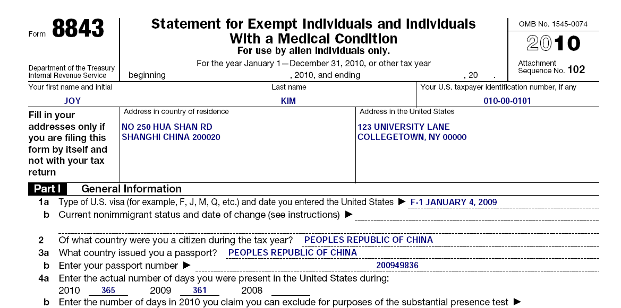
Form 8843

Slide 15
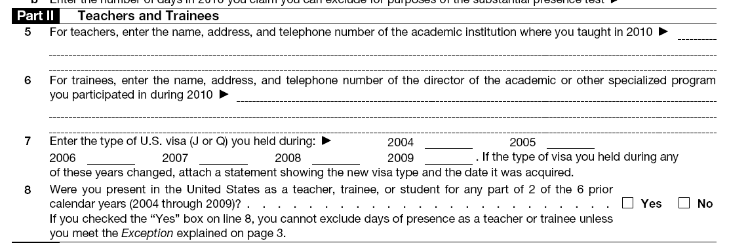
Form 8843 (cont.)

Slide 16
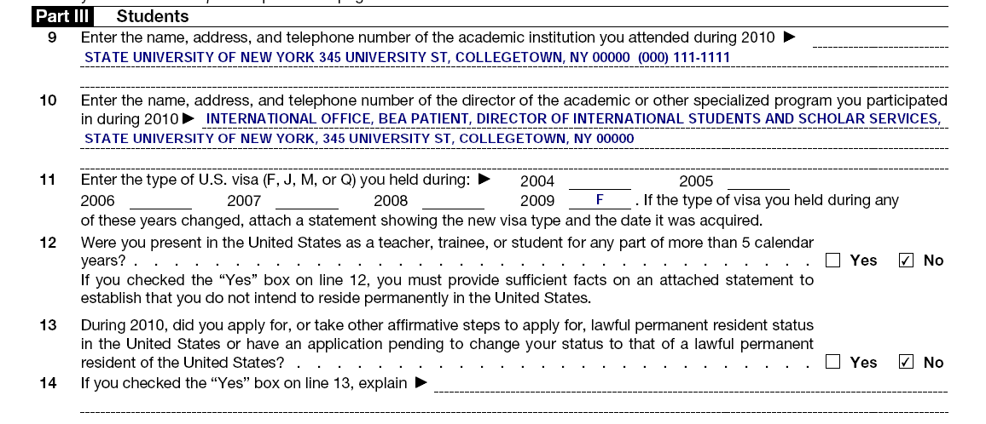
Form 8843 (cont.)
F

Slide 17
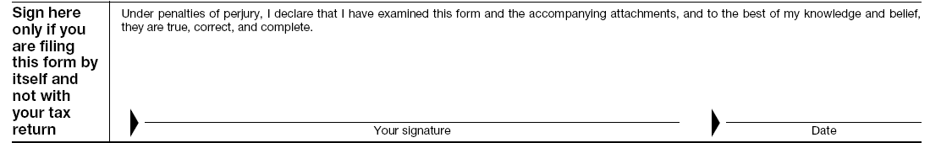
Form 8843 (cont.)
Do not complete the entity-? information and sign Form 8843 if you will attach it to the Form 1040NR(EZ) (discussed later in the presentation).

Slide 18

What about F-1/J-1 students & J-1 scholars who did not earn any U.S. income in 2010?
They do not have to pay taxes, but they must send a form to the IRS.

Slide 19

F-1/J-1 Students & J-1 Scholars: No U.S. Income
File Form 8843: “Statement for Exempt Individuals & Individuals with a Medical Condition”

Slide 20

What about F-1/J-1 students who received only a scholarship or fellowship grant in 2010?

Slide 21
F-1/J-1 Students: Scholarship or Fellowship Grant Only
Scholarship and fellowship grants are not included in taxable income if used for tuition, fees, books, supplies and equipment required for courses AND if the student is pursuing a degree.
Any portion of scholarship or fellowship received for room & board or in exchange for teaching or research is included in taxable income. (Unless exempt by treaty)

Slide 22
What is a Scholarship or Fellowship?
You call it:
Internal Revenue calls it:
Tuition Waiver
Non-taxable Scholarship
(No work required)

Slide 23
What is a Scholarship or Fellowship?
You call it:
Internal Revenue calls it:
Room and Board
Waiver
Taxable Scholarship

Slide 24
What is a Scholarship or Fellowship?
You call it:
Internal Revenue calls it:
Teaching or Research Assistantship Stipend
(recipient performs work)
Taxable Wages

Slide 25
What do I file if I have a scholarship, but I don’t have to pay taxes on it?
File Form 8843

Slide 26
What do I file if I have a scholarship I must pay tax on?
File Form 8843
AND
Form 1040NR OR 1040NR-EZ

Slide 27
What do I file if I have a scholarship I must pay tax on and can also claim a tax treaty benefit on that scholarship?
File Form 8843 and
Form 1040NR OR 1040NR-EZ

Slide 28
What do I file if I have an assistantship stipend?
File Form 8843
AND maybe
Form 1040NR OR 1040NR-EZ

Slide 29
What about F-1/J-1 students and J-1 scholars who earned income in 2010?
They must file Form 8843
AND maybe
Form 1040NR OR 1040NR-EZ

Slide 30
More Tax Forms
W-2: Wage and Tax Statement
1042-S: “Foreign Persons U.S. Source Income Subject to Withholding” form
  Normally used to report income covered by a tax treaty
1040NR: U.S. Non-resident Alien Income Tax Return
1040NR-EZ: U.S. Income Tax Return for certain non-resident aliens who have no dependents

Slide 31
More Tax Vocabulary
Withholding:
  U.S. income tax automatically taken from your paycheck
U.S. Source Income:
  All income, gain or loss from U.S. sources

Slide 32
Forms W-2 & 1042-S
You could have a W-2 or 1042-S or both of these forms.
The form was prepared by your employer and mailed to you.
You do not write anything on this form.
You use this form as a reference when you prepare your income tax return.
When finished, you attach this form to your income tax return.

Slide 33
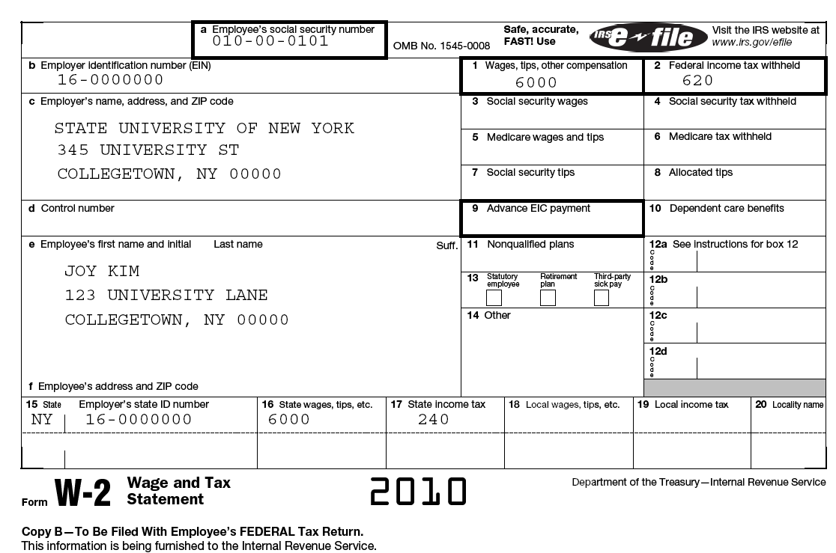
SAMPLE W-2 FORM
2008

Slide 34
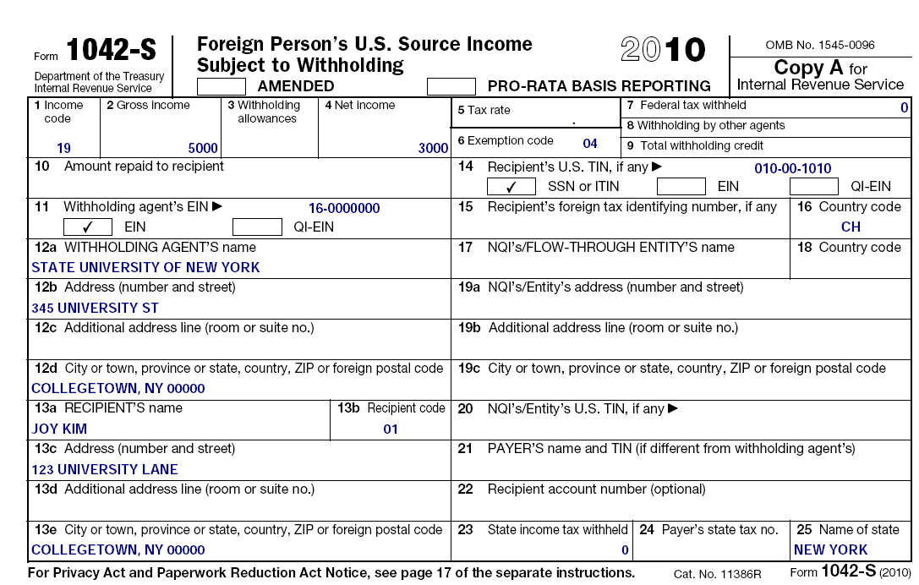
SAMPLE 1042-S
01
Notes:
Amounts reported on the 1040-S Treas. Reg. 1.1461-1©(2)
Amounts subject to withholding
Amounts subject to withholding even if no amount is deducted and withheld because of treaty
Amounts subject to withholding even if no amount is deducted and withheld because of an IRC exeception
New definition of income subject to withholding for Foreign Persons (Reg. 1.1441-2(a))
FDAP Income = Fixed Determinable, Annual or Periodical
Now includes all income includible in gross income under IRC 61 LESS item of income specifically excluded by other code section exclusion of Qualified Scholarship Income under IRC 117.

Slide 35
Filing Requirement
You do not need to file Form 1040-NR or 1040NR-EZ for 2010 if:
  You have only taxable U.S. Source Wages that were less than $3,650 AND
  You don’t need to claim a refund of over-withheld taxes.

Slide 36

How do I file a non-resident income tax return
(Form 1040NR or 1040NR-EZ)?
First, learn the following tax vocabulary . . .

Slide 37
More Tax Vocabulary
Standard Deduction: standard amount that individuals may subtract from income before calculating taxes owed
Itemized Deductions: allowable amounts that individuals may subtract from income before calculating taxes owed
  Examples: charitable contributions, state & local taxes withheld, etc.
Note: No one can have both a standard deduction and itemized deductions. You have to choose one.

Slide 38
PLEASE NOTE
Unless you are an Indian student, you are only eligible for some Itemized Deductions and a Personal Exemption.
Only Indian students are eligible for a Standard Deduction and a Personal Exemption.

Slide 39
More Tax Vocabulary (cont.)
Personal Exemption: amount deducted from income for yourself and/or your dependents
  For 2010, the amount is $3,650

Slide 40
Are there any exemptions for spouses and children?

Slide 41
Spousal Exemptions available for some Non-Residents
Married individuals from Canada, Mexico or South Korea
Married individuals who are students and are from India

Slide 42
Dependent Exemptions for some Non-Residents
Only individuals from Canada, Mexico or South Korea can claim children who live with them as dependents.
Individuals from Canada and Mexico can also claim children who don’t live with them as dependents.
Students from India may be able to claim exemptions for children born in the U.S.

Slide 43
Is any non-resident income exempt from taxes?
Yes, but only some categories of income . . .

Slide 44
Non-Resident Income Exempt from Taxes
(Not connected with a trade or business)
Interest:
  Bank Deposits (including Certificates of Deposit)

Slide 45
Tax Treaties
Many countries have Tax Treaties with the U.S. that allow their residents to earn some money while temporarily in the U.S. without being subject to
income tax on those earnings.
See IRS Publication 901 for details.

Slide 46
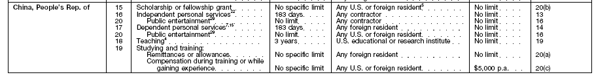
Tax Treaty
People’s Republic of China

Slide 47
Tax Treaty
India
India

Slide 48
Which non-residents can use Form 1040NR-EZ?
Individuals who do not claim any dependents
Individuals whose taxable income is less than $100,000
Individuals who do not claim any itemized deductions (except state and local income tax)
Individuals who received only wages, tips and scholarship or fellowship grants
Miscellaneous other reasons (see Publication 519)

Slide 49
Let’s look at the steps for completing
Form 1040NR-EZ
(Example of Chinese student’s Form 1040NR-EZ)

Slide 50
FORM W-2
Used for 1040NR-EZ Example

Slide 51
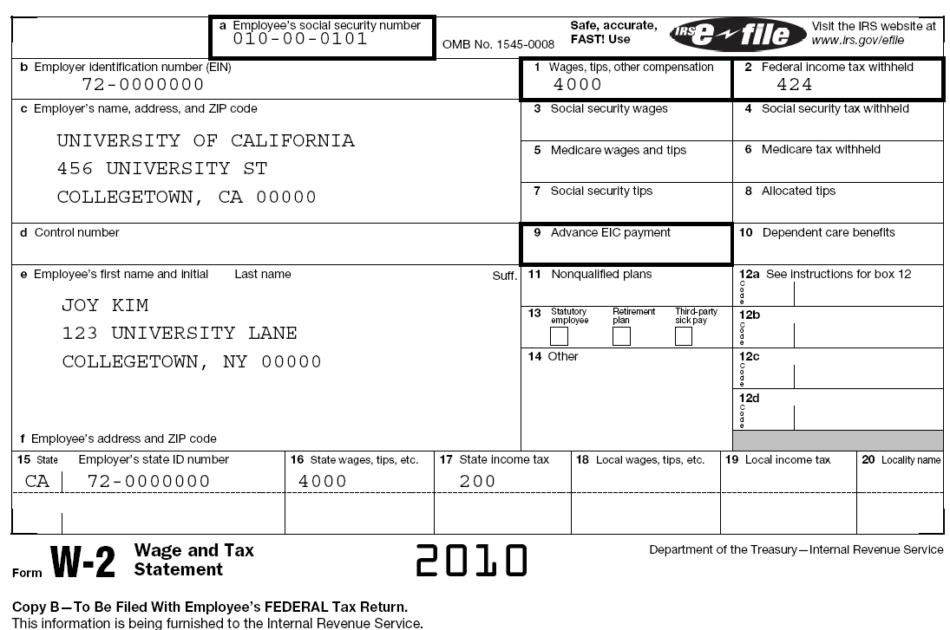
FORM W-2
Used for 1040NR-EZ Example

Slide 52
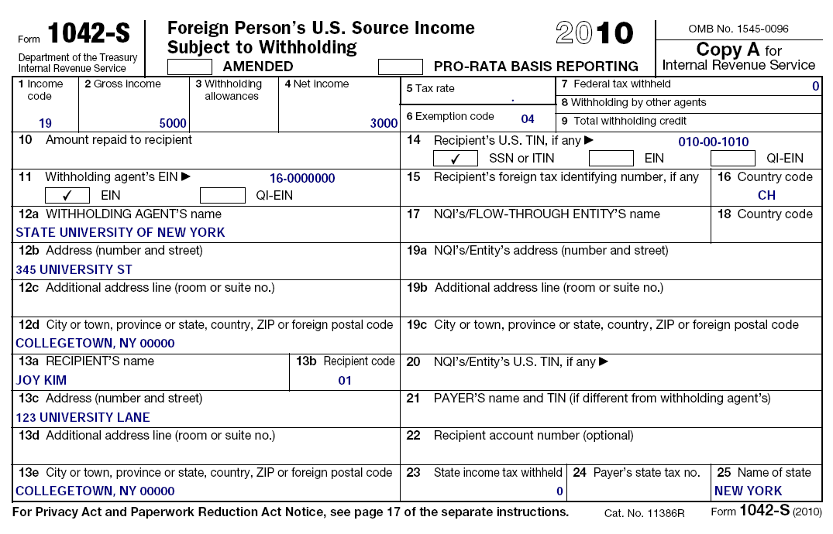
Form 1042-S: Compensation
Used for 1040NR-EZ Example

Slide 53
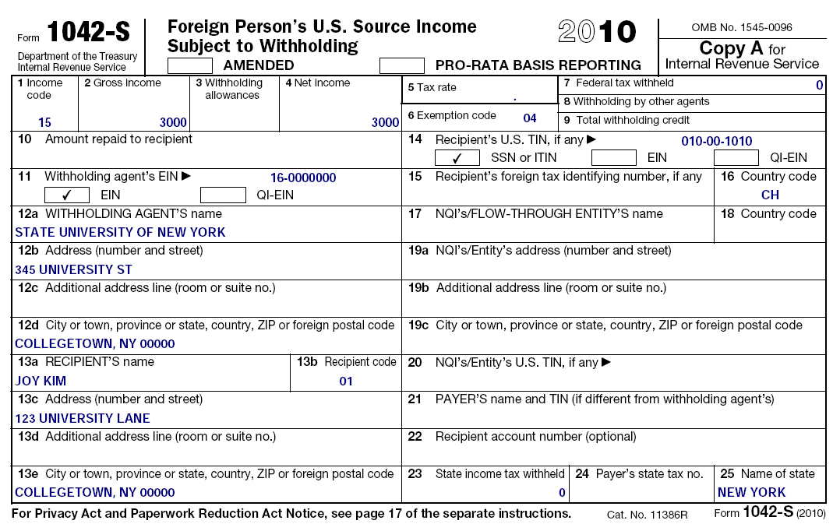
Form 1042-S: Scholarship
Used for 1040NR-EZ Example

Slide 54
1099-G
Prior Year State Refund
New York State is not issuing paper 1099-G for your 2010 refunds this year.
You will need to speak with a New York State Department Representative to get that information unless you have your tax return from 2010 which will show the amount of overpayment of income taxes.

Slide 55

Tax Treaty
People’s Republic of China

Slide 56
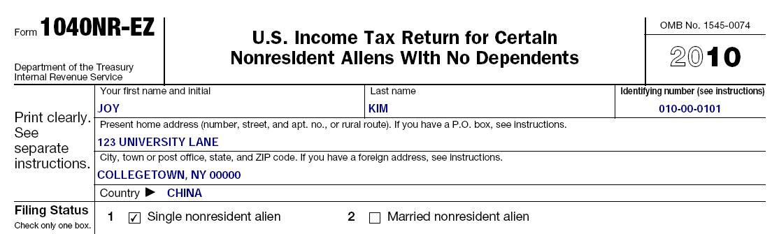
Form 1040NR-EZ
Notes:
No longer have to input foreign address. More simple format now

Slide 57
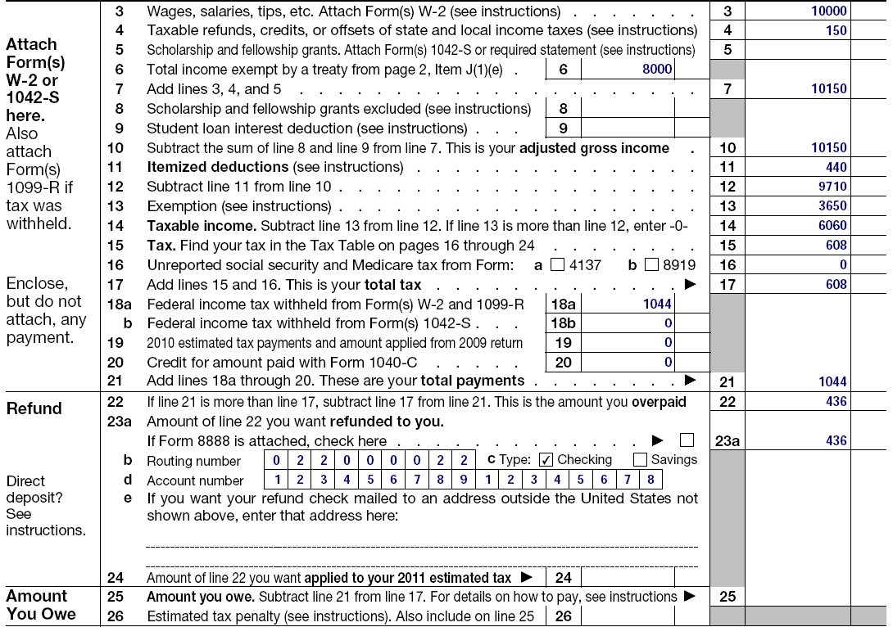
Form 1040NR-EZ
From Forms W-2 Box 1 Wages, etc.
From Form 1042-S ($5,000 Wages & $3,000 Scholarship)
From your 2010 NYS Income Tax Return since NYS no longer issues Form 1099-G
Personal Exemption amount of $3,650
From Forms W-2 Box 17 State Tax Withheld
Students from India put Standard Deduction amount of $5,700 and write on dotted line “Standard Deduction Allowed by Treaty”
Notes:
Line 5 is for taxable scholarships not exempt by a treaty
If scholarship or wages are exempt because of a treaty use line 6 to report it and complete Item J on page 2 of this form.

Slide 58
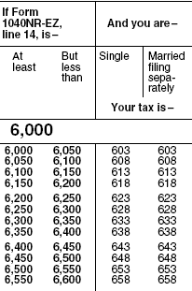
1040NR-EZ 2010 Tax Table

Slide 59
Tax Tables for
Form 1040-NR EZ can be found on page 12 in
Form 1040-NR EZ Instructions booklet www.irs.gov/pub/irs-pdf/i1040nre.pdf

Slide 60
Form 1040NR-EZ
Tax From Tax Table
Add all Box 2 amounts from Forms W-2 and/or Forms 1042-S Box 7
Notes:
Line 5 is for taxable scholarships not exempt by a treaty
If scholarship or wages are exempt because of a treaty use line 6 to report it and complete Item J on page 2 of this form.

Slide 61
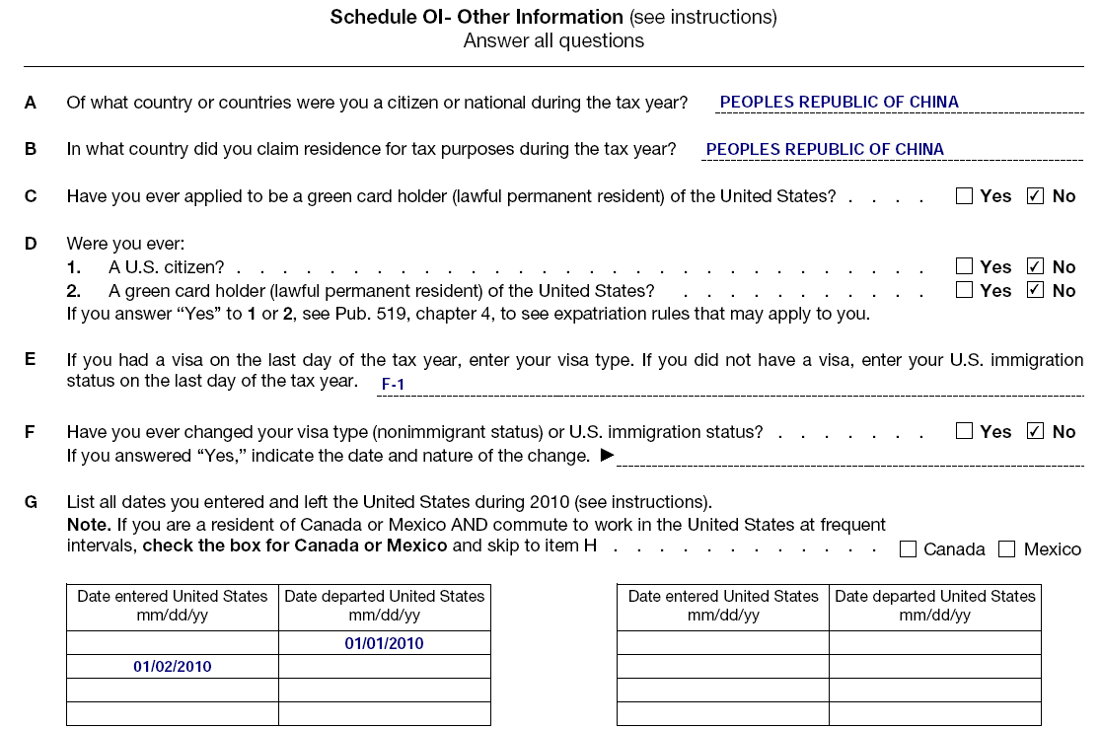
Form 1040NR-EZ (cont.)

Slide 62
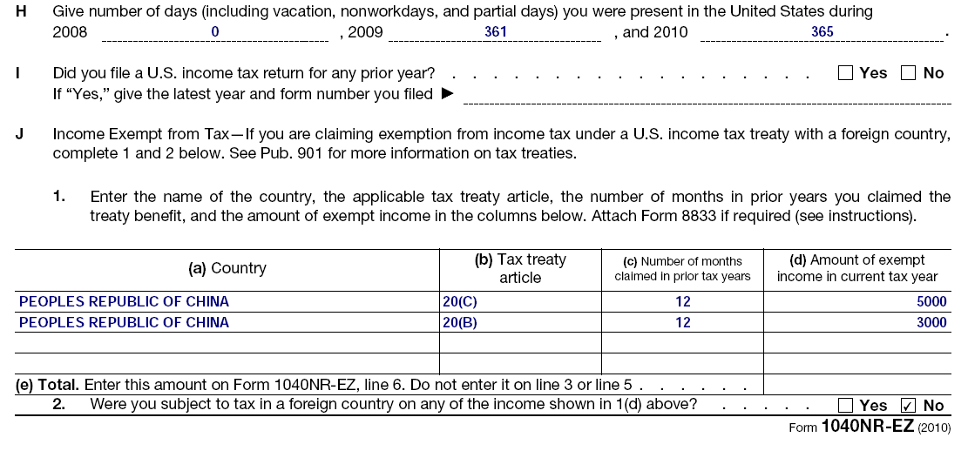
Form 1040NR-EZ (cont.)
Students from India would complete this section for the Standard Deduction using Treaty Article 21(2)

Slide 63
When do I file a non-resident income tax return?

Slide 64
The Filing Deadline is
April 18, 2011
If you are filing
Forms 8843 AND 1040NR/1040NR-EZ
June 15, 2011
If you are required
to file ONLY Form 8843 or Form 1040NR / 1040NR-EZ with no wages subject to withholding

Slide 65
Where do I file non-resident income tax returns?
Remember!
Internal Revenue Service
Austin, Texas 73301-0215

Slide 66
Additional Issue for
Discussion

Slide 67
Social Security and Medicare Taxes were incorrectly withheld from my wages.
What can I do?

Slide 68
FIRST,
Contact your Employer.
Ask for a Refund.
If they refuse, then file a claim for a refund with the IRS. Use Form 843 to do this.

Slide 69
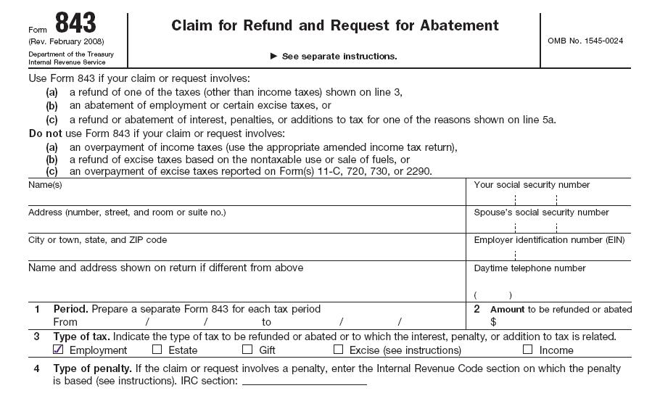
Claiming a Refund of Social Security and Medicare Tax from IRS

Slide 70
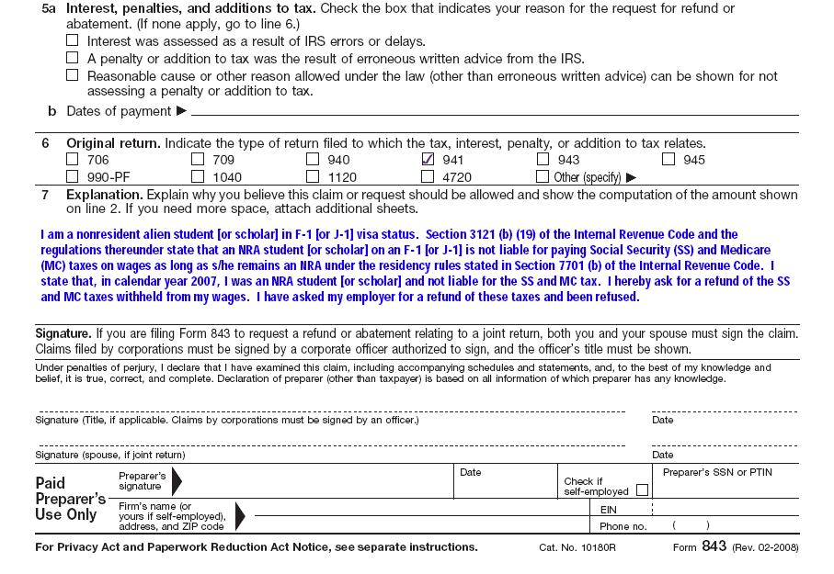
Suggested Explanation
Notes:
If possible attach letter from employer stating they will not refund withheld Social SecurityIRS found that some people were requesting the money through the 843 and had received monies from the employer

Slide 71
Additional Statement
Attach statement to Form 843
If you cannot obtain reimbursement from the employer, you will need a signed statement from the employer. It should indicate you have not authorized them to file a claim, nor have you been reimbursed by the employer for the amount over-withheld.

Slide 72
Attachments to Form 843
F-1 Students
Copy of W-2
Copy of Form I-94
Copy of your valid entry visa
Copy of Form I-20
If on OPT, copy of your EAD Card
Form 8316
Copy of 1040NR-EZ
If you changed your visa category, copy of Form I-797
J-1 Exchange Visitors
Same as student except
Copy of DS-2019 (instead of Form I-20)

Slide 73
Where do I mail Form 843 to?
File the claim, with attachments, to the IRS Center where the employer’s returns were filed.
For New York State:
Internal Revenue Service
Cincinnati, OH 45999-0005

Slide 74
Forms and Publications
ON THE WEB
www.irs.gov
www.buffalo.edu/intlservices
PHONE ORDERS
1-800-829-3676

Slide 75
IRS Resources
IRS International Customer Service:
(267) 941–1000 (new number)
IRS Toll Free Number – 1-800-829-1040
(The IRS International Customer Service number is much better than this number.)

Slide 76
Thank You For Coming!

