Slide 1
New York State Department of Taxation and Finance
International Students and Scholars
Spring 2011 Workshop

Slide 2
Please Note:
The PowerPoint presentation, handout and a webcast of this presentation
are available at
www.buffalo.edu/intlservices/tax2.html

Slide 3
New York State (NYS) Income Taxes
If you did not have income and only need to send Form 8843 to the IRS ……
then, you do not need to file a New York State income tax return.

Slide 4
Filing a NYS Income Tax Return
You must first determine if you are considered a NYS resident or a NYS nonresident for income tax purposes.
New York State residency rules differ from those of the Internal Revenue Service.
Once you determine residency status for NYS income tax purposes, then you must determine if you are required to file a NYS income tax return.

Slide 5
Undergraduate Student Rules
Undergraduate full-time students, whose permanent home is not New York, would be considered NYS nonresidents for income tax purposes.
Note: If you were a graduate student, the rules for determining NYS residency status are different than those for undergraduate students.

Slide 6
If you are NOT a full-time undergraduate student and your domicile (permanent home) is NOT New York State, but you maintained a permanent place of abode (on-campus or off-campus apartment/house) for more than eleven months during the calendar year 2010 AND spent more than 183 days in New York, you are a New York State resident for personal income tax purposes.

Slide 7
If you are NOT a full-time undergraduate student, answering these questions will help determine whether or not you are a NYS resident for NYS income tax purposes.
 | Yes | No
Did you live in an on-campus apartment or an apartment or house off campus in NYS during the calendar year 2010?
If yes, did you maintain it (rent) for more than 11 months in the calendar year 2010?
Did you spend more than 183 days in New York State during the calendar year 2010?
ONLY if you answered YES to ALL of the above, you are considered a resident for NYS income tax purposes.

Slide 8
Did you receive a NYS refund during in the calendar year 2010?
The New York State Department of Taxation and Finance does not mail Form 1099-G, which reports to you the amount of the New York State tax refund you may have received in 2010. You may obtain that information by calling the 1099-G Hotline at (518) 457-5181 and speaking with a department representative.
Note: If you took an itemized deduction on your federal income tax return for state and local income taxes and received an income tax refund from the state, the Internal Revenue Service will require you to include the refund amount as income on your federal (IRS) income tax return.

Slide 9
Which Tax Forms Should I Complete?
Note:
Forms requirements differ for
NYS residents and nonresidents

Slide 10
Which NYS tax forms should I file?
If you are a nonresident for NYS income tax purposes and are required to file an income tax return, you will need to file:
Form IT-203, “Nonresident and Part-year Resident Income Tax Return”
Form IT-203-B to report where you live in NYS, and
Form IT-2 for wages (if W-2 received)
If you are a resident for NYS income tax purposes and are required to file an income tax return, you will need to file:
Form IT-150 “Resident Income Tax Return (short form)” or IT-201 (in limited cases) and
Form IT-2 for wages (if W-2 received)

Slide 11
Who Must File a NYS Income Tax Return?
Note:
Filing requirements differ for
NYS residents and nonresidents

Slide 12
If I am a nonresident , do I need to file a NYS income tax return?
Yes, if you meet any of the following conditions::
You had New York-source income and your New York adjusted gross income (Federal amount column line 31 on Form IT-203) is more than:
$7,500 for single individuals
$3,000 if single & can be claimed on another taxpayer’s federal (IRS) income tax return
$7,500 if married & filing separate tax returns
You want to claim a refund.

Slide 13
If I am a resident, do I need to file a NYS income tax return?
Yes, if you meet any of the following conditions::
If your federal income is more than: $4,000 for single and married
$3,000 if single & can be claimed on another taxpayer’s federal (IRS) income tax return
You want to claim a refund or credit

Slide 14
General NYS Income Tax Filing Guidelines

Slide 15
NYS Conforms with Internal Revenue Service
New York State (NYS) complies with ALL tax treaties that the Internal Revenue Service uses.
Your Federal (IRS) Adjusted Gross Income is the starting point in computing your New York State income tax. The amount you include as income on the federal return is transferred to the NYS income tax return.
New York State-source income for nonresidents is your Federal (IRS) Income that you earned in New York State.
New York State income for residents is the TOTAL Federal Income that you earned.
Note: If you earned income in any other state in the U.S., please consult that state for income tax filing requirements

Slide 16
General Guidelines
If any part of your New York scholarship or New York fellowship was included as INCOME on your federal (IRS) income tax return, then enter it on the line for OTHER INCOME on your NYS personal income tax return.
If you included the 2009 State income tax refund you received in 2010 as income on your federal (IRS) income tax return, you can subtract this amount on your New York State Income Tax return before you begin computing your New York State Income taxes.

Slide 17
Filing Status Guidelines
If you checked “single” on your federal (IRS) income tax return and are required to file a NYS income tax return, you MUST check “single” as your filing status on your NYS income tax return.
If you checked “married” on your federal (IRS) income tax return, you must check “married” on your NYS income tax return.
If you are married and filing federal Forms 1040-NR or 1040-NR-EZ, you must check “married filing separate” as your filing status on your NYS income tax return.

Slide 18
General Guidelines
Unlike the federal (IRS) income tax return, NO PERSONAL EXEMPTION is allowed for you or your spouse on the NYS income tax return.
You are allowed the SAME number of DEPENDENT EXEMPTIONS as claimed on your federal (IRS) income tax return. The New York Dependent Exemption is $1000.
Unlike the federal (IRS) income tax return, EVERYONE filing a NYS income tax return may claim a New York STANDARD DEDUCTION.

Slide 19
NYS 2010 Standard Deduction Amount
Filing Status
Standard Deduction
Single
can be claimed on another’s income tax return
$3,000
Single
cannot be claimed on another ‘s income tax return
$7,500
Married Filing Jointly
$15,000
Married Filing Separately
$7,500
Head of Household
with qualifying person
$10,500
Qualifying Widow(er)
with dependent child
$15,000

Slide 20
New York State and Local Sales and Use Tax
You owe a sales and use tax if:
You purchase property or a service delivered to YOU in New York State without payment of sales and use tax (Ex. Internet, catalog purchases).
Most tangible personal property such as clothing, jewelry, furniture, computers, videos, etc. is subject to New York and Local Sales tax.
IF YOU DO NOT OWE NYS SALES TAX, ENTER A ZERO IN THE SALES TAX LINE. DO NOT LEAVE THE LINE BLANK.

Slide 21
Who is entitled to a NYS household credit?
Individuals who:
Cannot be claimed on another person’s federal income tax return AND
Whose tax filing status and income on the NYS income tax return (either as a New York resident or nonresident) is:
Single and federal adjusted gross income is $28,000 or less
Married and federal adjusted gross income is $32,000 or less
The household credit is NOT refundable and will only reduce your NYS tax.
See instructions booklet for household credit chart.

Slide 22
How do I Prepare a NYS Nonresident Income Tax Return?

Slide 23
You must complete your Federal (IRS) Income Tax Return before completing your NYS Income Tax Return. Do NOT include on your NYS Income Tax Return any income that is exempt because of your country’s treaty with the U.S.

Slide 24
Joy Kim is attending the State University of New York Graduate School. She received her undergraduate degree from the University of California. She moved to New York State from California on June 30, 2010 and, since then, has been living in an apartment in NYS. She has been in the U.S. for five years or less and filed a nonresident (1040NR-EZ) federal income tax return. Note: Scholars follow the same rules as graduate students.

Slide 25
Joy Kim is a full-time graduate student. Answering these questions will help her determine whether she should file her NYS income tax return as a NYS resident or nonresident.
 | Yes | No
Did you live in an on-campus apartment or an apartment or house off campus in NYS during the calendar year 2010? | X
If yes, did you maintain it (rent) for more than 11 months in the calendar year 2010? Joy moved June 30, 2010 |  | X
Did you spend more than 183 days in New York State during the calendar year 2010? June 30- December 31 = 185 days | X
ONLY if you answered YES to ALL of the above are you considered a resident for NYS income tax purposes. Because Joy answered NO to maintaining a place for more than 11 months, she files as a NYS nonresident.

Slide 26
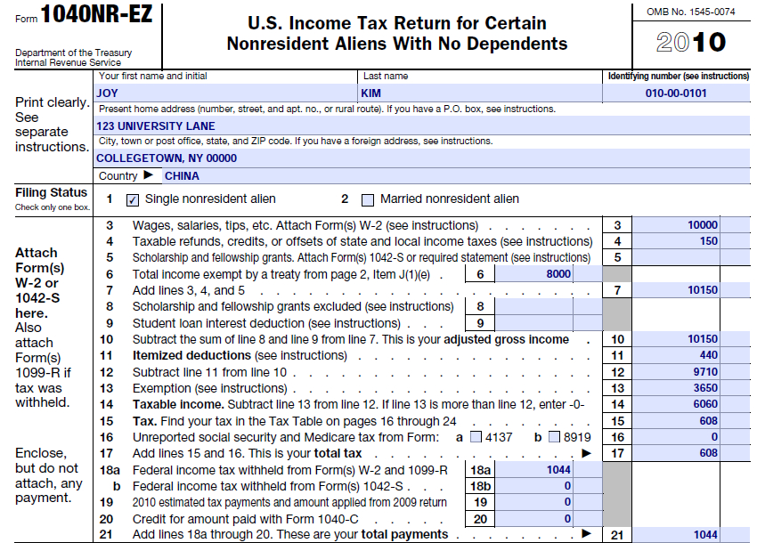
When completing a New York State personal income tax return, you will transfer to the NYS return only the amounts included in federal adjusted gross income.

Slide 27
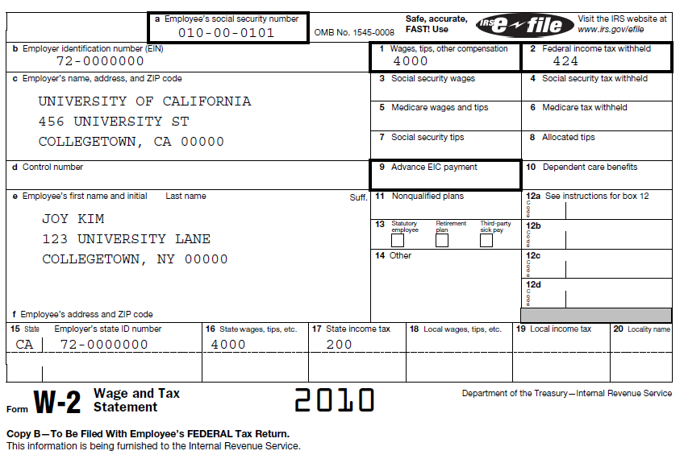
W-2 from California

Slide 28
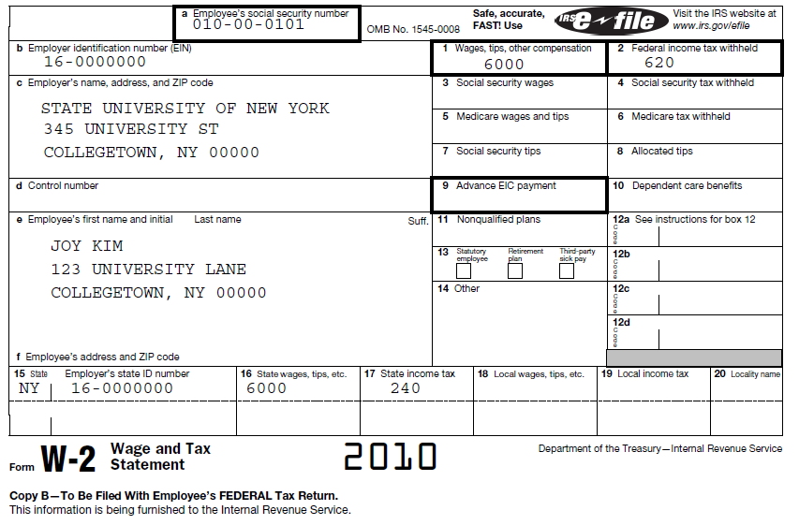
W-2 from New York

Slide 29
What do I do with the state copy of the W-2?
If you are filing a NYS income tax return and have a W-2, transfer your W-2 information onto NYS Form IT-2.
DO NOT forget to complete the NYS withholding information on Form IT-2.
Attach Form IT-2 to your NYS income tax return
DO NOT attach a W-2 to your NYS income tax return. Keep the state copy for your records.
Note: Obtain Form IT-2 from www.tax.ny.gov

Slide 30

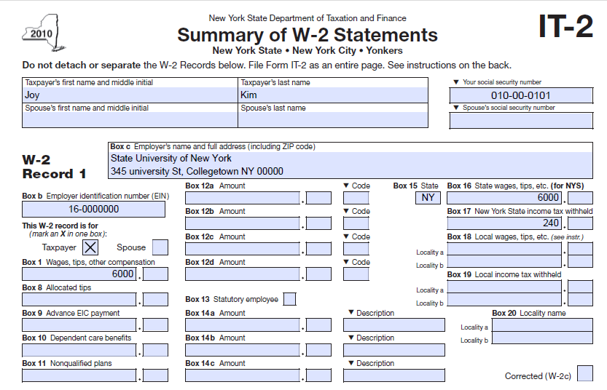
Transfer ALL W-2 Information to Form IT-2

Slide 31
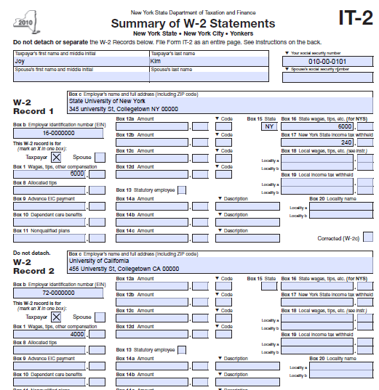
The information from all of your Forms W-2 must be transferred to Form IT-2 even if the amount is NOT taxable income in New York State. You should only complete Boxes 15-20 if you have a Form W-2 because of wages earned in New York.

Slide 32
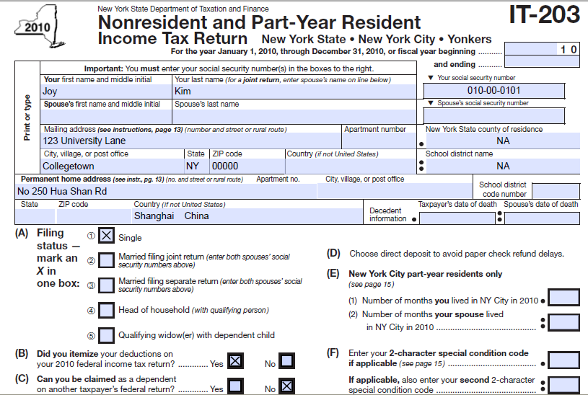
Completing IT-203

Slide 33
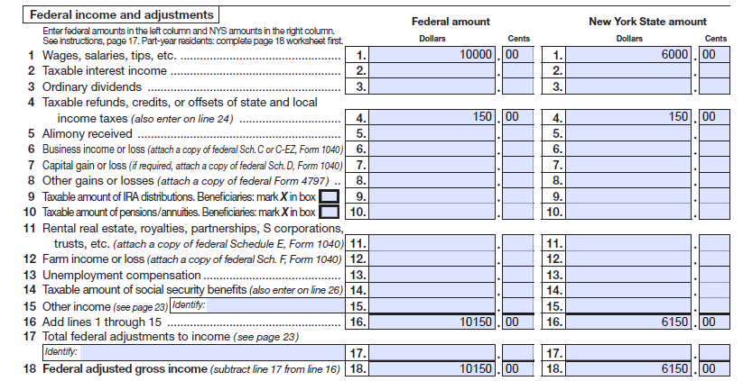
Complete Lines 1 through 18. Transfer the amounts from your federal income tax return to the Federal Amount column and income you earned in New York State (New York-source income) to the NYS amount column.

Slide 34
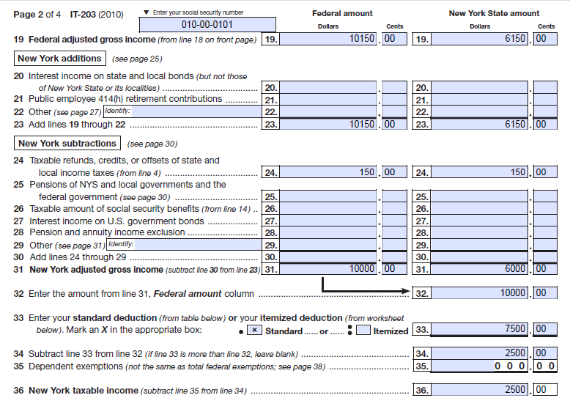
Start with your Federal Adjusted Gross Income. Then determine your NYS Adjusted Gross Income. If you included the state refund that you received in 2010 as income on your federal income tax return, subtract it on line 24 to arrive at your NYS Adjusted Gross Income. __________________________________________________________________________

Slide 35
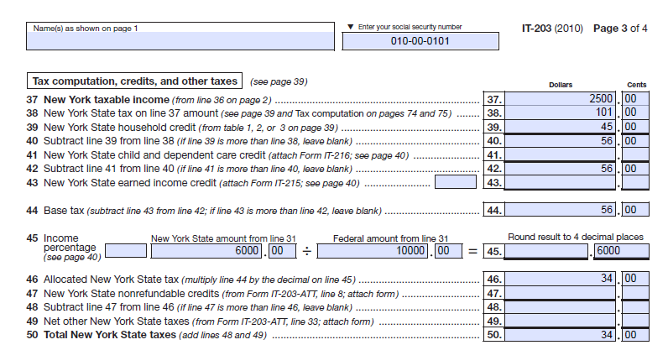
Line 38 NYS taxes – See next slide for Tax Chart

Slide 36
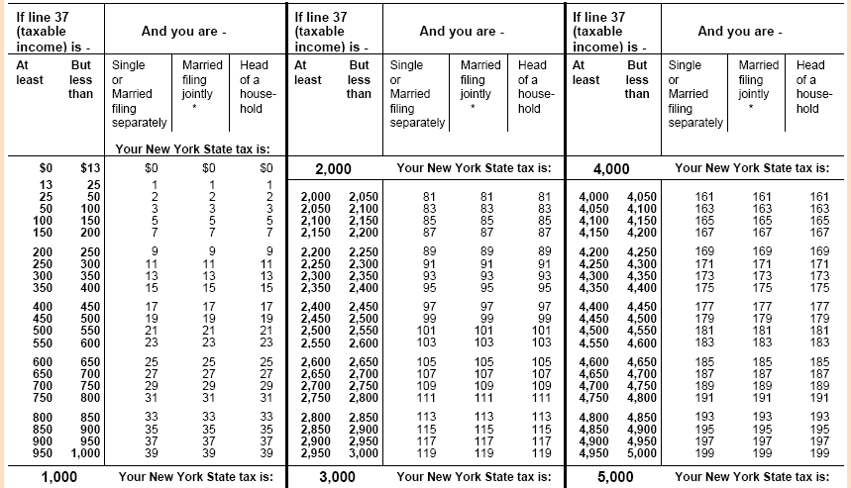
If you have a dollar amount on line 37 (NYS taxable income), find your income tax in the tables beginning on page 65 of the IT-203 Instructions Booklet

Slide 37
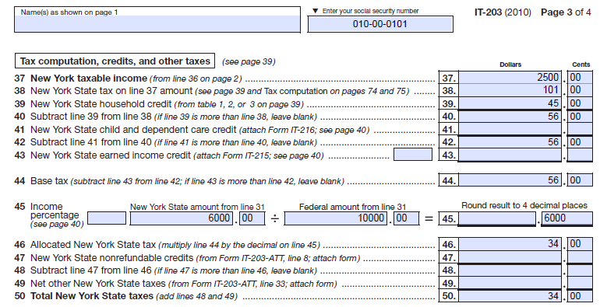
Line 38 NYS taxes – see next slide for Household Credit Chart

Slide 38
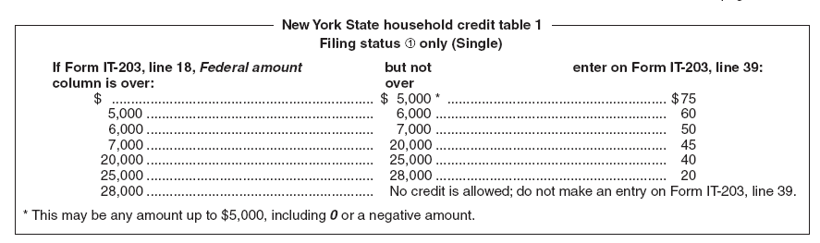
NYS Household Credit Chart for a single person who CANNOT be claimed on another taxpayer’s federal income tax return

Slide 39
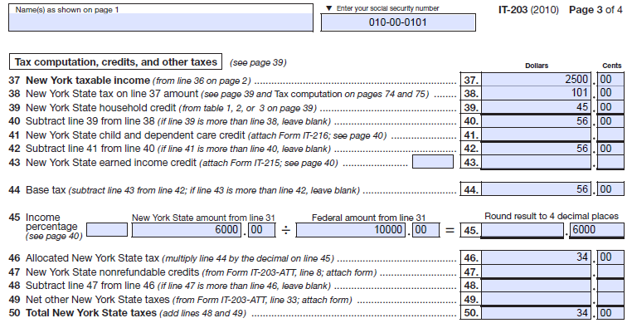
Line 46 NYS taxes – amount of taxes allocated to New York Income

Slide 40
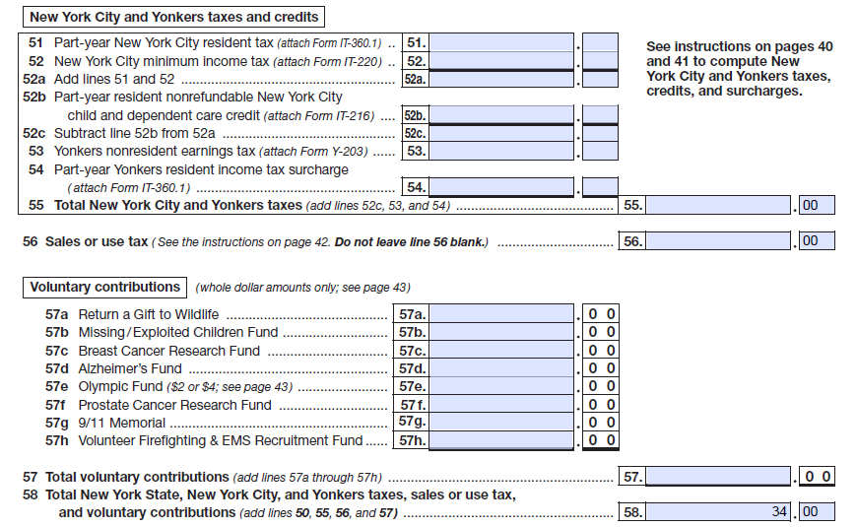
Line 56 (IT-203) is used to report the amount of sales tax you owe. If you do not owe sales tax, enter “0” on Line 56. On page 42 of the IT-203 Instructions Booklet, there are instructions for computing the amount of tax due if you owe. If you DO NOT owe Sales and Use tax, enter a ZERO on Line 56. Do NOT leave line 56 blank.

Slide 41
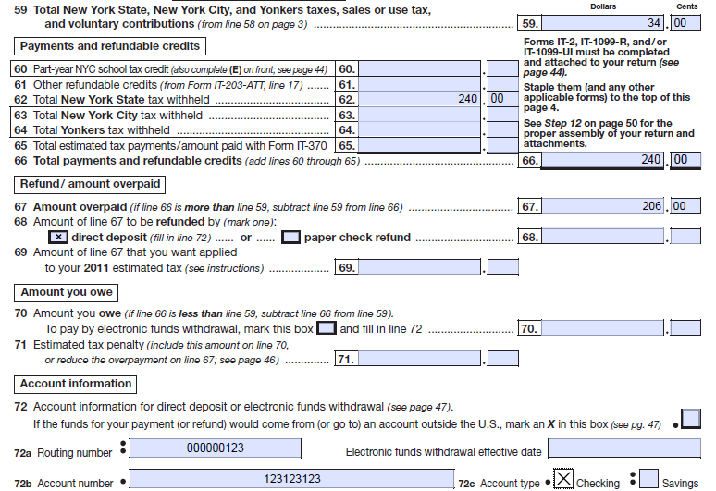
Page 4 of IT-203 – Line 62 is from IT-2

Slide 42
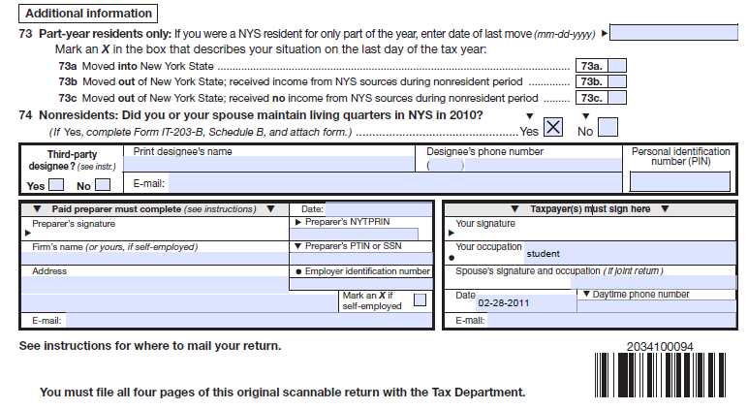
Sign and Date NYS Income Tax Return. Note: You may need to complete Form IT-203B
Joy Kim

Slide 43
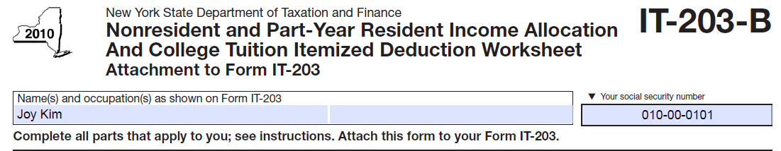
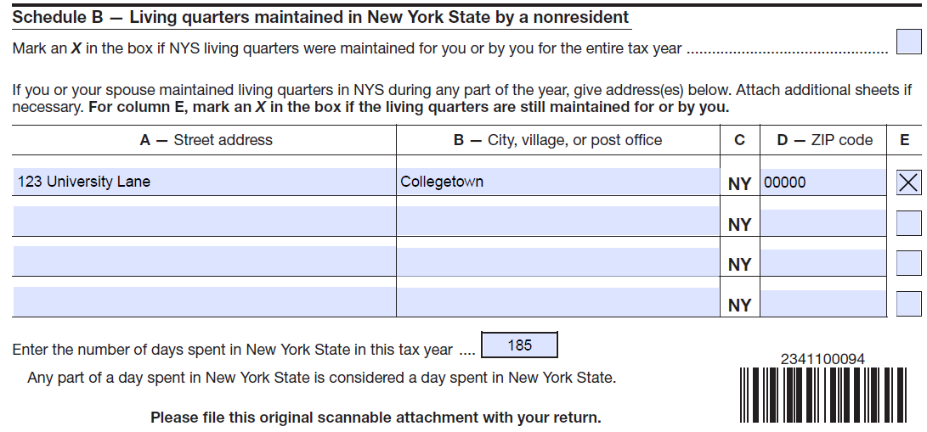
If you maintain living quarters in NYS, and are completing an IT-203, Nonresident Income Tax Return, complete Section B on Form IT-203-B and attach it to Form IT-203.

Slide 44
Filing a resident NYS income tax return
Kumar Dali is a graduate student and has been in the U.S. for less than five years and filed as a nonresident alien for federal (IRS) purposes. Kumar Dali moved to New York State in August 2009. For the calendar year 2010 (tax year 2010) Kumar rented an apartment in NYS for the entire year. He went home to his country on May 15, 2010 and returned to NYS on August 22, 2010. While he was away from NYS, he continued to maintain his apartment.
Note: Scholars file the same rules as graduate students.

Slide 45
Kumar is NOT a full-time undergraduate student. Answering these questions will help him determine whether or not he is a NYS resident for NYS income tax purposes.
 | Yes | No
Did you live in an on-campus apartment or an apartment or house off campus in NYS during the calendar year 2010? | X
If yes, did you maintain it (rent) for more than 11 months in the calendar year 2010? | X
Did you spend more than 183 days in New York State during the calendar year 2010? | X
ONLY if you answered YES to ALL of the above, you are considered a resident for NYS income tax purposes. Because he answered YES to all three questions, he is a resident for NYS income tax purposes.

Slide 46
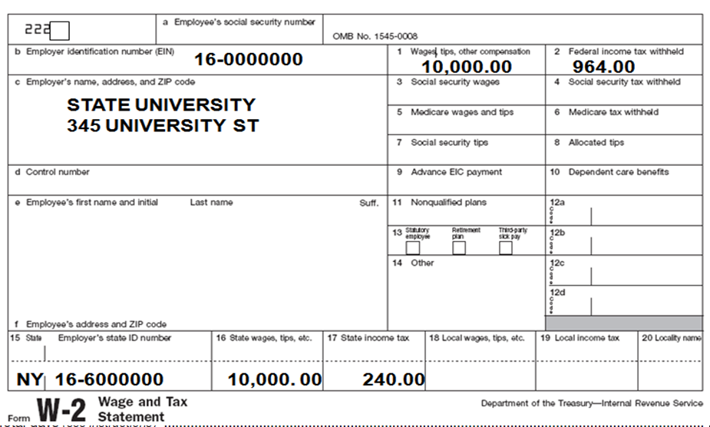
W-2 from the State of New York
101-00-0000
Collegetown NY 00000
Kumar Dali
3636 Main St
Buffalo NY 14214
Collegetown NY 00000
2010
2010

Slide 47
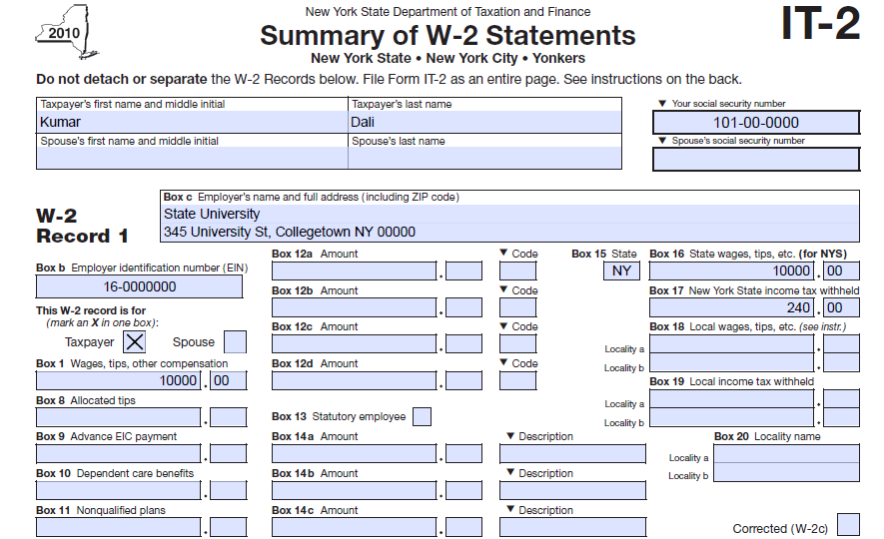
Transfer ALL W-2 Information to Form IT-2

Slide 48
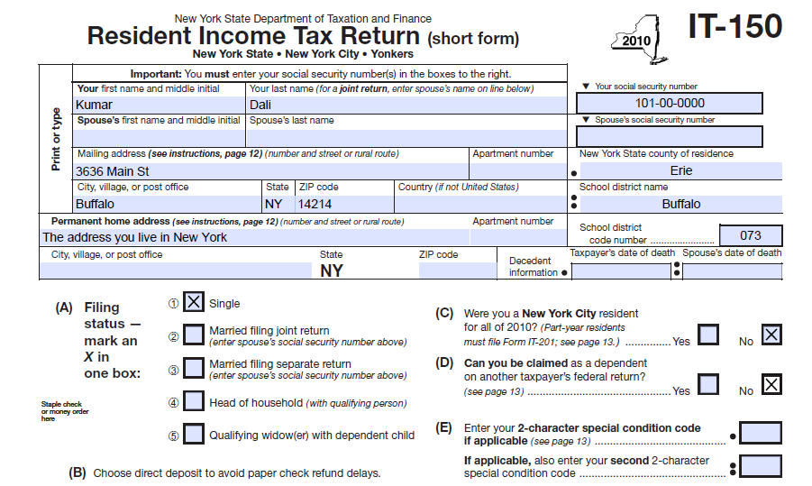
Completing IT-150 – School District NAME and CODES can be found on page 37 of the Form IT-150/201 Instructions Booklet.

Slide 49
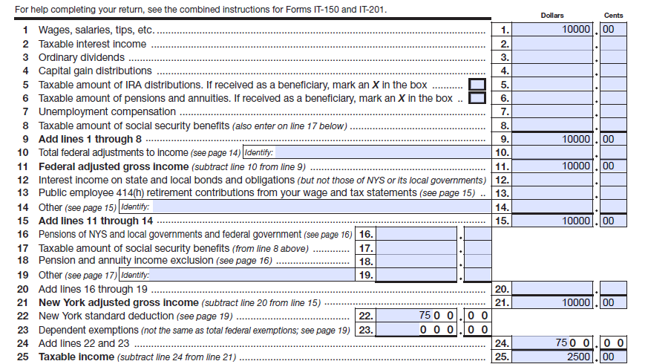
Transfer the amounts from Form 1040-NR EZ

Slide 50
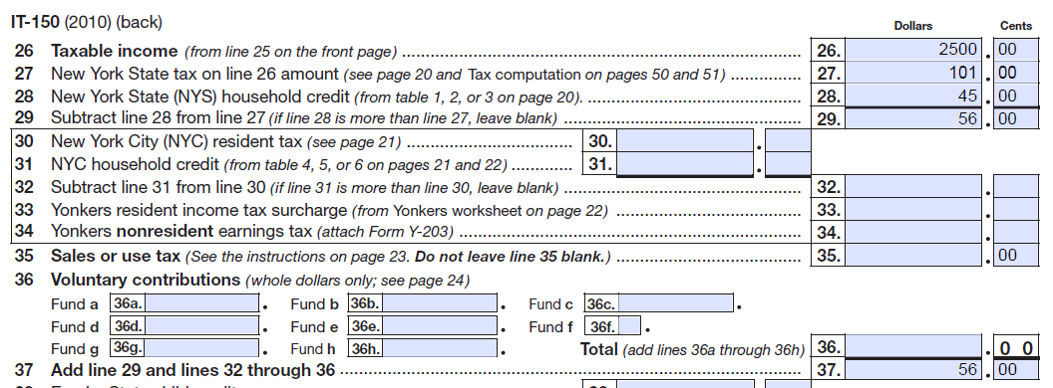
Line 26 amount for NYS taxes – see next slide for Tax Chart

Slide 51
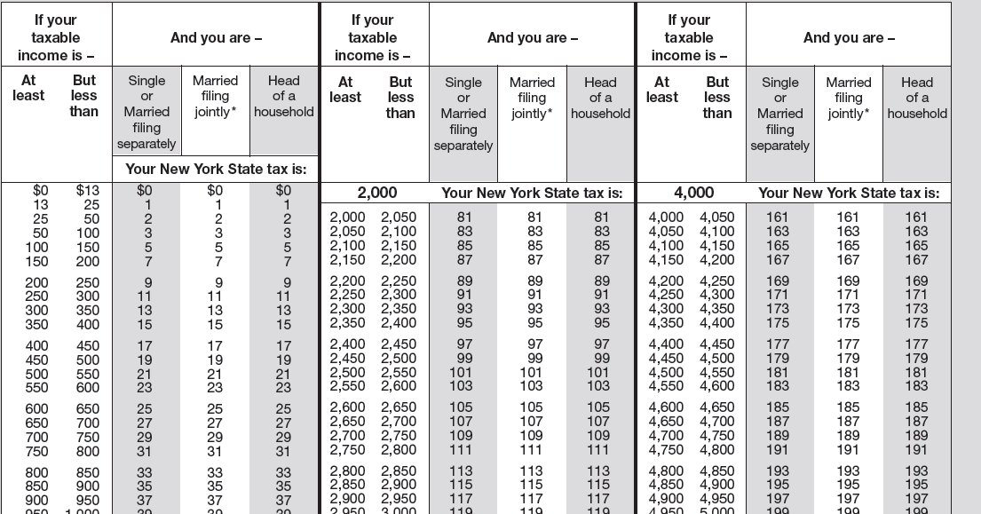
If you have NYS taxable income, find your income tax in the tables in the Form IT-150/201 Instructions Booklet beginning on page 41.

Slide 52
Household Credit

Slide 53
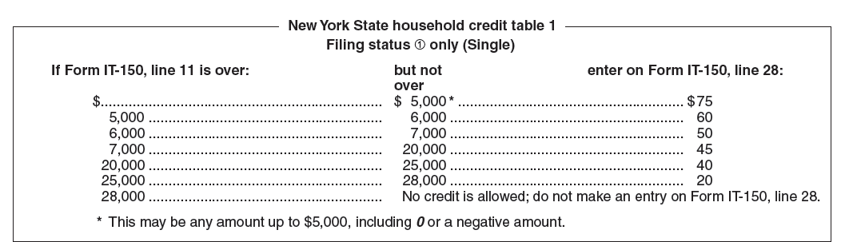
NYS Household Credit chart for a single person who CANNOT be claimed on another taxpayer’s federal (IRS) income tax return

Slide 54
Sales and use tax – Do not leave blank

Slide 55
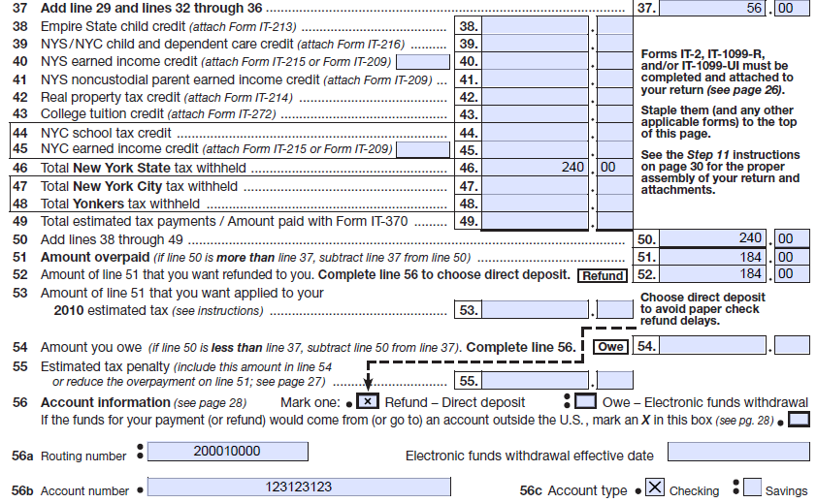
Note: Line 46 - Enter New York tax Withholding Tax
Line 46 - Enter New York Tax Withheld

Slide 56
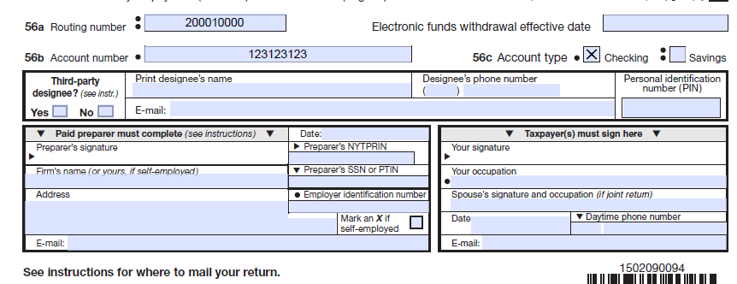
Sign and Date NYS Income Tax Return
Kumar Dali
graduate student
2/28/11

Slide 57
Where to File NYS Income Tax Returns
If enclosing a payment (check or money order), mail your NYS income tax return to:
STATE PROCESSING CENTER
PO BOX 15555
ALBANY, NY 12212-5555
If not enclosing a payment, mail your NYS income tax return to:
STATE PROCESSING CENTER
PO BOX 61000
ALBANY, NY 12261-0001

Slide 58
NYS residents who earned income in other states
If you are a New York State resident for income tax purposes, your total income, as reported to the IRS on your federal income tax return, is reported on your NYS resident income tax return.
However, if you are required to pay taxes to other states, you may be entitled to claim a resident tax credit by completing the other state’s income tax return first and then completing Form IT-112R, NYS Resident Tax Credit.
You cannot use the short form (Form IT-150) if you are claiming the resident tax credit. The credit you calculate is entered on line 41 of Form IT-201. You must attach Form IT-112R to Form IT-201 and Form IT-201-ATT.

Slide 59
General Guidelines
DO NOT attach ANY of the federal (IRS) tax forms unless you carried on a trade or business in New York State for which special rules may apply.
DO NOT Send any Federal income tax returns to New York State.
Do NOT send any copies of Forms W-2 or 1042-S to New York State.
DO NOT send any other federal forms to New York State.

Slide 60
Due Date of NYS Income Tax Return
Filing due dates for your 2010 NYS Income Tax Return
Income tax return: April 18, 2011
Request for extension of time to file: April 18, 2011
Note: There are limited circumstances under which nonresident aliens filing as a NYS nonresident can file on June 15, 2011 and enter code E-4 on Form IT-203. This is only possible if the IRS (federal government) allows you to file your 1040NR or 1040NR-EZ on June 15, 2011.

Slide 61
Extensions
Form IT-370 will extend the due date for 6 months
You can file Form IT-370 on-line on @ www.tax.ny.gov.
Your NYS Income Tax Return must be filed by April 18,2011.
If you owe income tax to New York, your tax payment is also due by April 18, 2011.

Slide 62
Income Tax Filing Tips
Remember to:
Sign your income tax return.
Enter your Social Security Number on your income tax return.
Complete Form IT-2 using your Form W-2 information and attach Form IT-2.

Slide 63
Free Tax Information 518-457-5181 (foreign language assistance is available)
VISIT OUR WEB SITE www.tax.ny.gov

Slide 64
The material included in this slide show is intended only to highlight NYS tax issues as of the date presented. For more comprehensive information, please refer to our TSB-M’s, forms, instructions and publications.
QUESTIONS?
THANK YOU

